Slide 1
FPGA

Slide 2
Definition
A field-programmable gate array (FPGA) is an integrated circuit designed to be configured by a customer after manufacturing (still can change after manufactured!)

Slide 3
SOC
An integrated circuit that integrates all components of a computer into a single chip

Slide 4
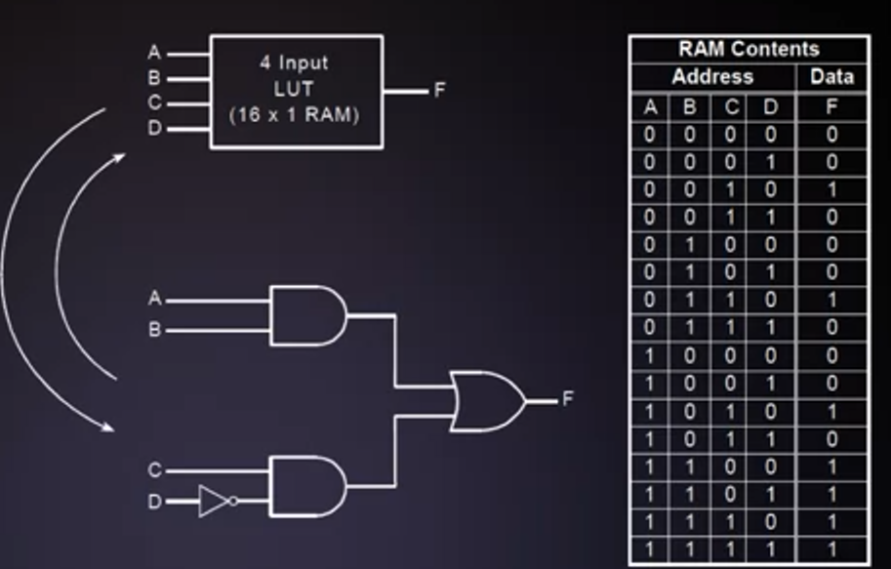
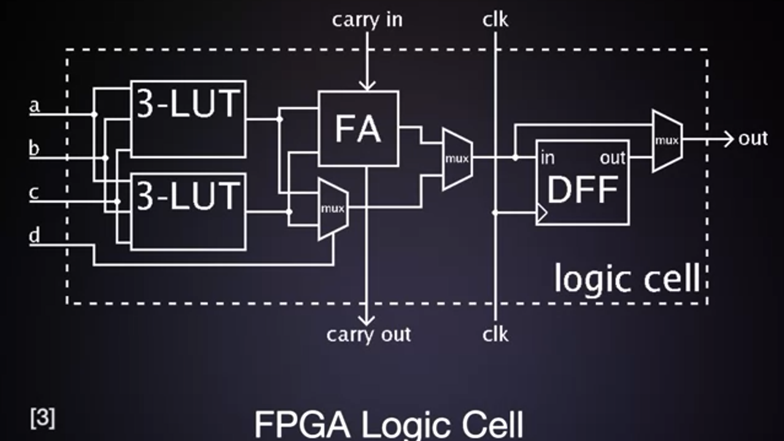
Look up tables (LUTS)
FPGAs use Look up Tables as the base logic element
LUTS can be used to implement any 4-input logic (4 input needs 16 memory locations)
FPGA logic cell:
4 input LUT (can be constructed with double 3 –input LUT
Full adder
D flip-flop

Slide 5
Half/full adder
The heart of computer is CPU
The heart of CPU is Arithmetic Logic unit (ALU)
The heart of ALU is adder circuit
Adder : half adder, full adder and ripple carry adder

Slide 6
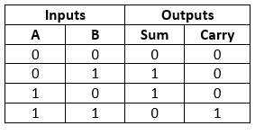
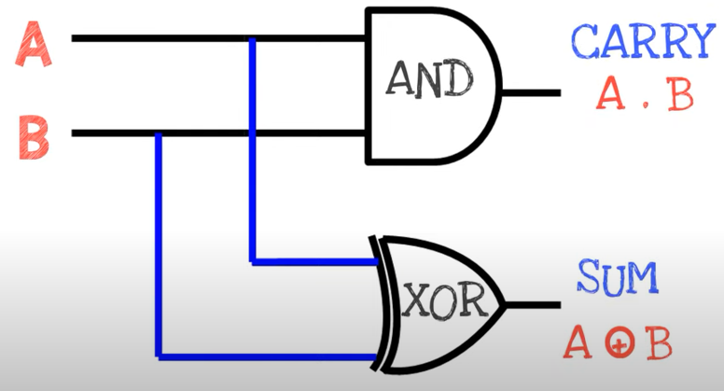
Half adder
Is useful when we want to add 1 bit of number :

Slide 7
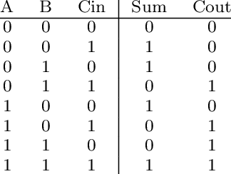
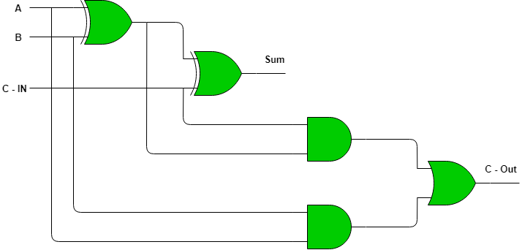
Full adder
The drawback of half adder is the carry from previous half adder can’t propagate to the next half adder (half adder only has 2 inputs A,B and can't’ include a carry). It can be solved by full adder which has 3 inputs (A,B and carry from previous adder)

Slide 8
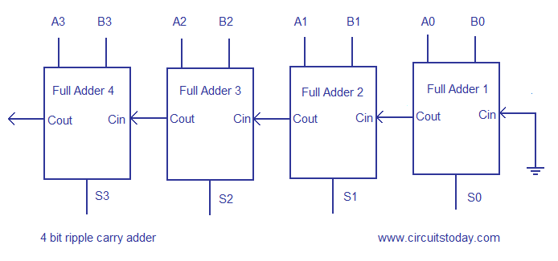
Ripple carry adder or parallel adder
Full adders' cascade
It has propagation
delay problem which can be addressed by carry look ahead adder
Carry look ahead adder calculate 1 or more carry bits before the sum which reduces the wait time

Slide 9
Design adders in FPGA

