Slide 2
Reference link
https://semiengineering.com/the-benefits-of-antifuse-otp/
Defense-in-Depth: A Recipe for Logic Locking to Prevail
Electrically Programmable Fuse (eFUSE) Using Electromigration in Silicides

Slide 3
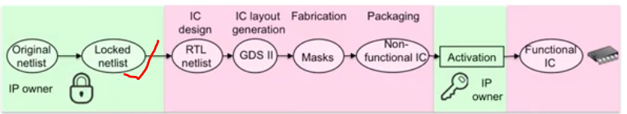
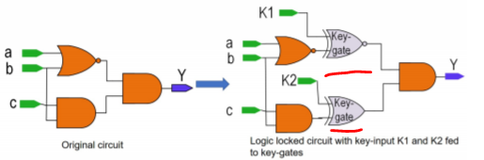
Overview (logic locking)
IP designer encrypts the netlist and generate locked netlist (additional hardware called “key-gate”)
Key gate are controlled by 0,1..(IP designer knows exactly what is the value, that’s where fusing comes into picture, fusing helps to permanently put all the information into fuse box and when the chip boot up, this information will be transfer to RAM so that individual IP can go and grab)
In order to have a functional IC, correct key-gates information needs to pass to the logical gates
Locked netlist sent to fab to generate layout and future semiconductor manufacturing

Slide 4
Purpose of logic locking
Prevent fab secretly fabricate chip (chips are useless until been activated by the key, that’s where fusing comes into picture)
Even someone reverse engineering and saw the locked netlist, they won’t understand exactly what does the circuit do!

Slide 5
Why need fuse?
Fuse (permanently store) key information for each of the IP
eFuse is a technology which helps to permanently store information in the chip (similar to ROM)
When device boot up, this information will be tranfer to RAM and indivial IP will go and grab the assigned information (0,1) base on IP address

Slide 6
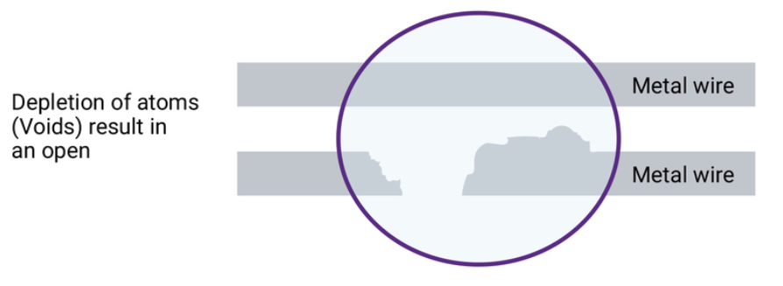
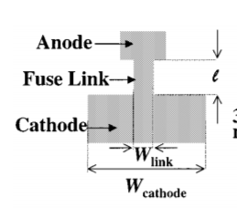

Types of fuse (effuse vs anti-fuse)
Efuse
  Fuse link(metal) can be broken via high voltage/current
  Electromigration (high current flow through thin metal cause the metal to move and break the connection)

Slide 7
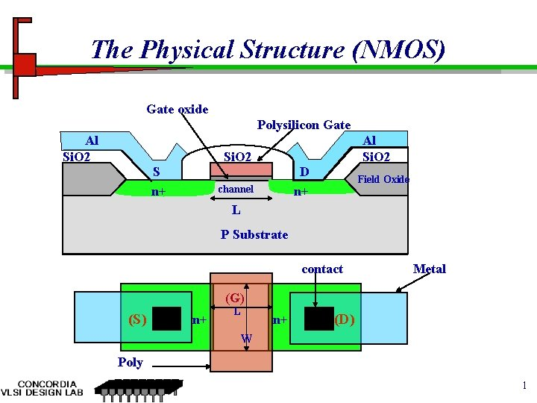
Anti-fuse
Why we need a dielectric layer(sio2)?
  -The gate oxide serves as the dielectric layer so that the gate can sustain as high as 1 to 5 MV/cm transverse electric field in order to strongly modulate the conductance of the channel.
Anti-fuse: High voltage causes break down of oxide(form a permanent electrically conductive path)

