Slide 1
Jtag

Slide 2
What is Jtag
Joint Test Action Group (IEEE standard. Design rules which helps chip, chip interconnects, board level testing) also called boundary scan test
“Bed-of-nails” method to test chip outdated (pins getting smaller)
Simple Jtag(with simple 4 pins TDI,TDO,TCK,TMS) can complete complex testing task which traditionally needs “bed-of-nail” technique.

Slide 3
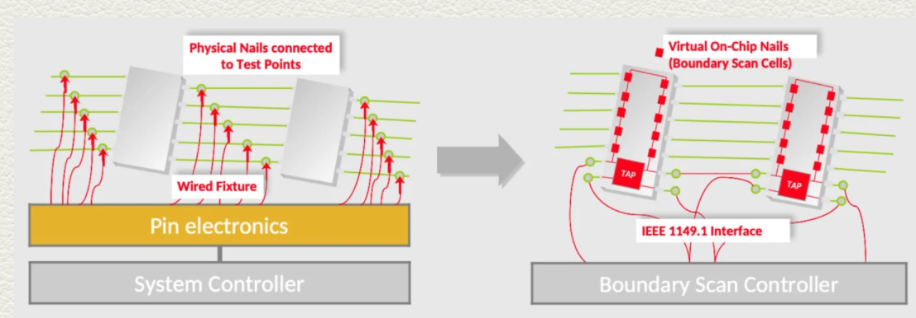
Cont’

Slide 4
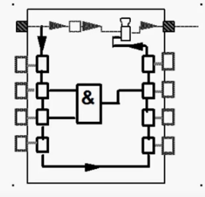
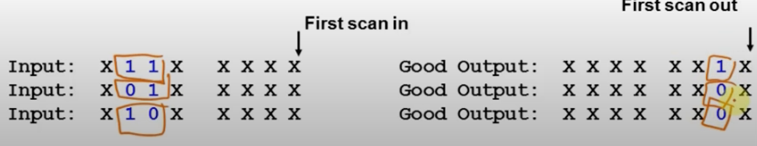
Chip level testing
Shift in data to the core logic and observer output

Slide 5
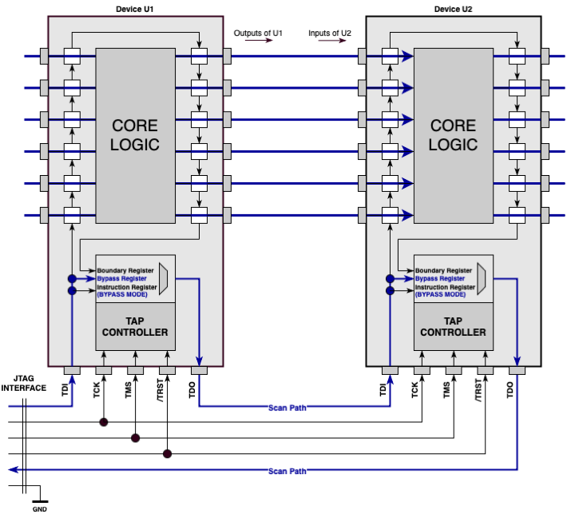
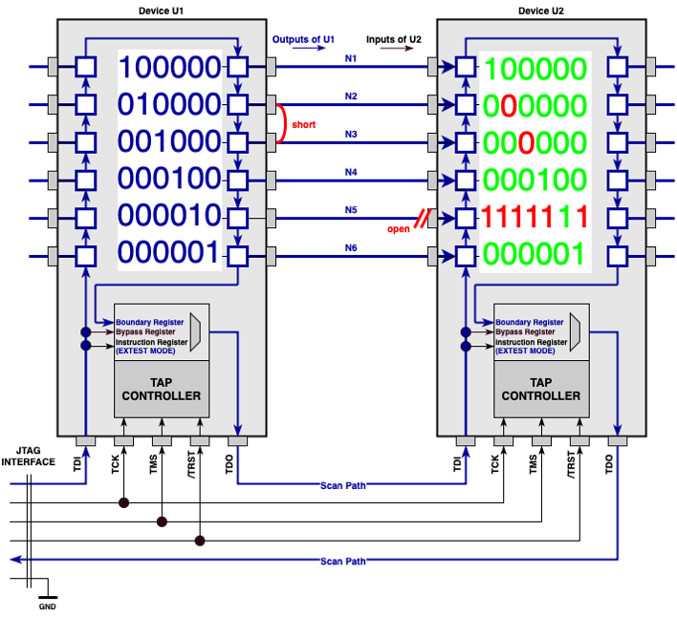
Chip to chip interconnect testing (online reference)
BYPASS MODE
EXTEST MODE
Notes:
Unit 1 (output) connects to Unit 2 (input)
“BYPASS MODE”: bypass register is activated, and boundary scan register is transparent
“EXTEST MODE” : Boundary register is activated. Check which input pins (open,short..) have problem via inputting different bits

Slide 6
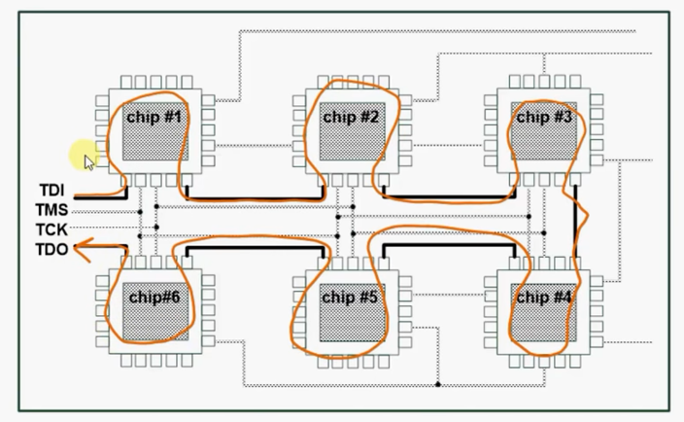
Board level testing

Slide 7
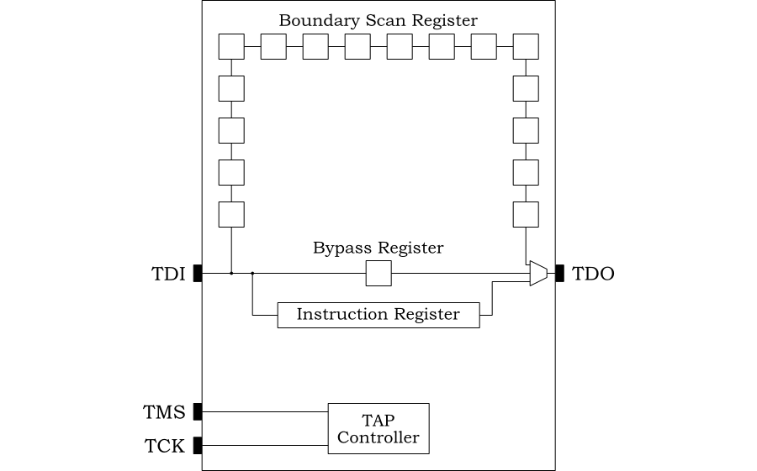
Jtag Architecture
Test Access Port: TDI,TDO,TMS,TCK
TAP controller: sixteen-state machine
Register: Bypass register, Boundary scan register ,instruction register
Instruction decoder
Notes:
TDI: Shift in bits (positive TCK edge) when the state is shift IR
TDO: Shift out bits via TDO (negative TCK edge) when the state is shift IR
TMS; Change state (positive TCK edge)

Slide 8
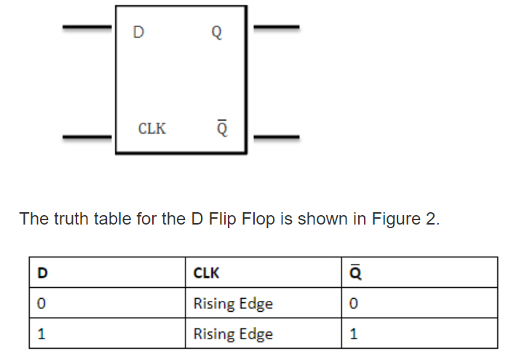
Register (online reference)
Flip-flop is a 1 bit memory cell which can be used for storing the digital data. A group of flip-flop is known as a Register
The binary data in a register can be moved within the register from one flip-flop to another. The registers that allow such data transfers are called as shift registers.
Notes:
Reference link :https://www.tutorialspoint.com/computer_logical_organization/digital_registers.htm

Slide 9
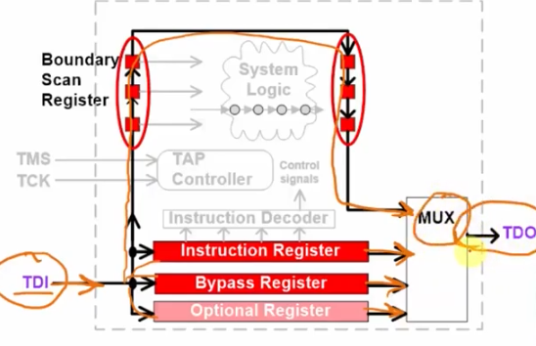
Cont’
Data register:
- Bypass register ( when ShiftDR=1, shift data from TDI to TDO)
- Boundary scan register
Instruction Register
Boundary scan register
-

Slide 10
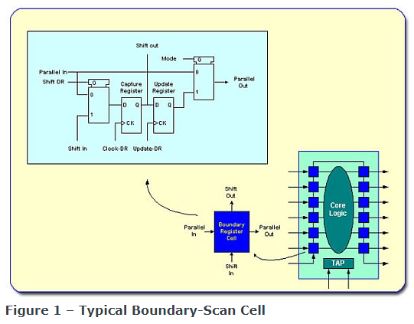
Boundary scan register

Slide 11
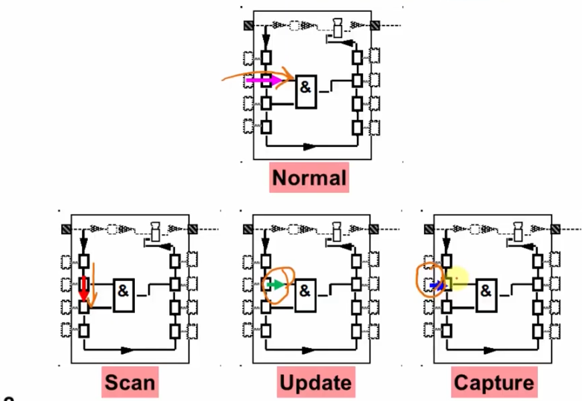
Notes:
Scan : load pattern
Update: Apply pattern
Capture: Capture results

Slide 12
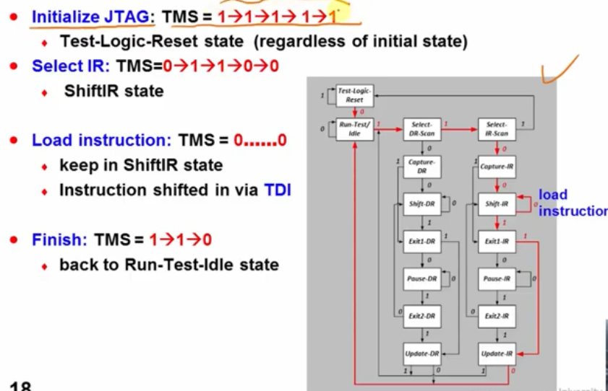
Instruction register
Help to shift in the instruction (EYTEST,BYPASS) via TDI
In “shift IR” state, shift in instruction
These instruction will be translated by instruction decoder
Load instruction via TDI(need to tell what kind of test I want to do first)
EXTEST:000….
BYPASS:111….

Slide 13
EXTEST

Slide 14
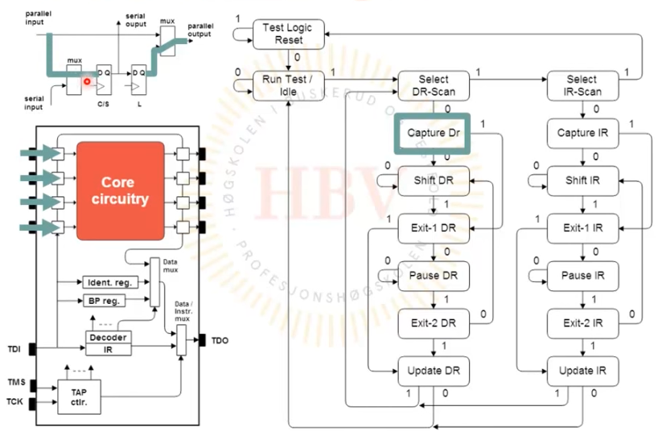
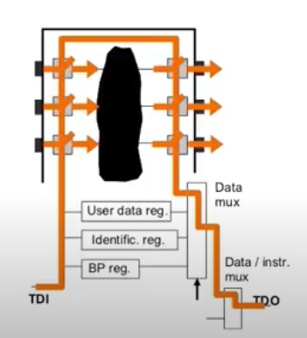
Cont’..
Notes:
Reference https://www.youtube.com/watch?v=PqGhRrgLyaU

Slide 15
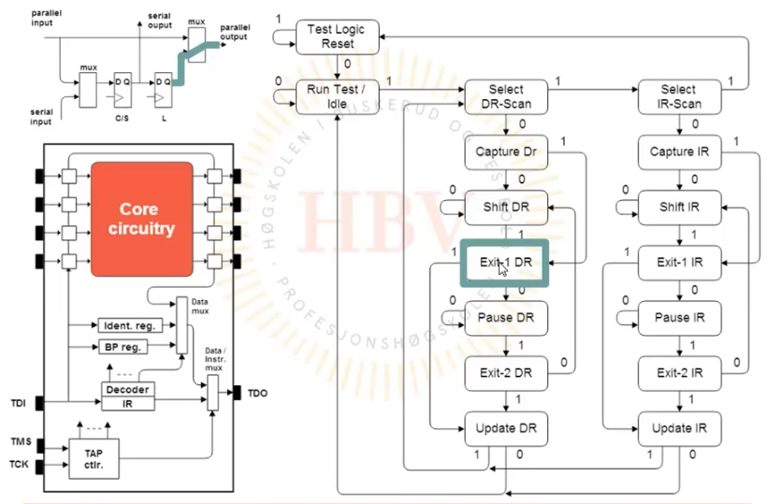
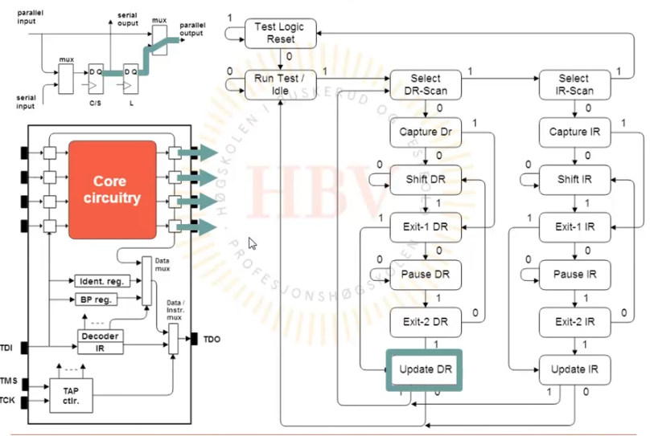
Con’t..

Slide 16
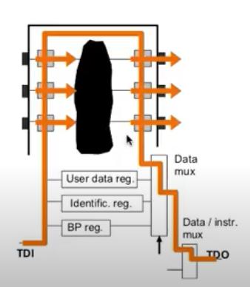
Sample/preload
The SAMPLE/PRELOAD instruction is used to take a snapshot of the device as it is in normal functional operation
This instruction does not interfere with the normal operation of the device. The SAMPLE part of this instruction occurs during Capture-DR. The DRs are loaded with the state of the pins on the rising edge of TCK while in Capture-DR. The DR can then be shifted out TDO for examination. The PRELOAD part of this instruction is simply loading the DRs during Shift-DR. It is typically used before the EXTEST instruction to define the initial state of the pins.

