Slide 2
Applications (microprocessor)
Gaming
Web bowsing
Programming…
Task was not predefined, it depends on the user

Slide 3
Microcontroller
Microwave oven, washing machines…
Predefined task

Slide 4
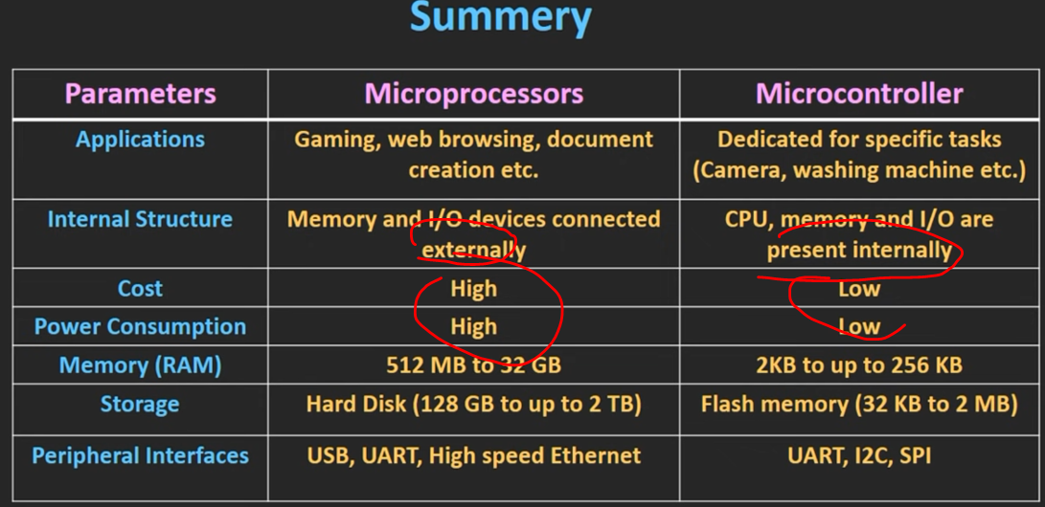
Summary

