Slide 1

INFO 6350 --- Final Presentation
Movie World Application
By Xuhang Liu

Slide 2
1
Problem Statement

Slide 3

Problem description
This final project (Movie World App) is to build an iOS application for movie reviews and personal collections. By using Core Data as the database with Swift4, MapKit, and TheMovieDB API.

Slide 4
Problem Statements
Solutions
Now days, more and more movies come out on the market which makes us hard to select the right movie to watch without wasting time in the theater for more than 2 hours.
Also, people like to discuss all the movies they watched and liked, but sometimes they need something to remind them of the movies they liked or watched before.
Therefore, I build an iOS application which allows every user to check the reviews of the movies.
Also, customers will be able to create their own movie collections.

Slide 5
2
Tech & Tools

Slide 6
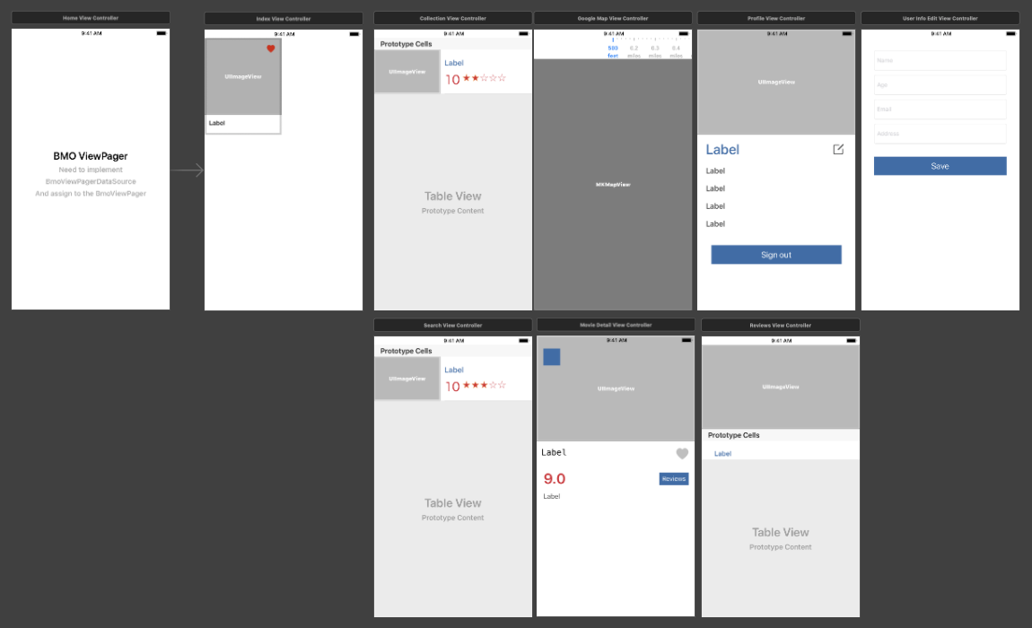
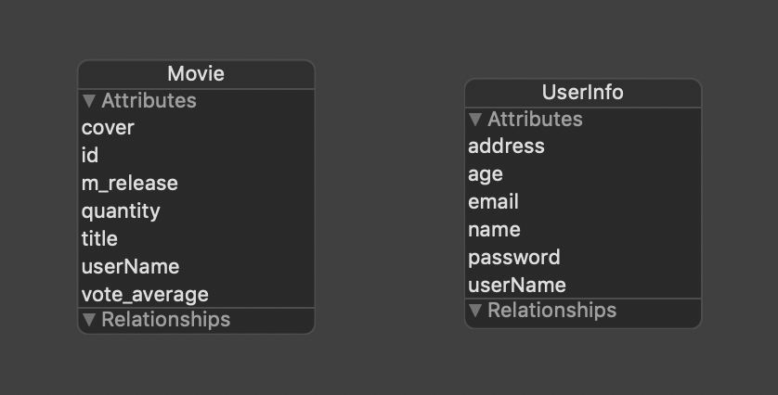
Swift 4
Collection View Controller
Table View Controller
Search View Controller
MK Map View
With
Core Data
MapKit

Slide 7
3
Use cases

Slide 8

Use Cases
Login
Personal Info
Current User
Search Movie
Collections
Movie Info
Map View
Movie Review
Register
New User

Slide 9
THANKS

