Slide 1

Analysis of SPD Response Time to Call for Service
Data 512
Yiming Liu

Slide 2
Motivation and Goal
Motivation
According to this article, most cities aim for an average response time of 5 – 6 minutes for high priority calls
Every minute counts when emergencies come up
Goal
Find out how SPD’s response time varies by call priority, call type, event type, and region
Predict response time
Notes:
When emergencies come up, it is comforting to know that first responders are typically just a few minutes away. According to one of the articles I read, most cities aim for an average response time of 5 to 6 minutes for emergency calls. So I was wondering how do the numbers look like in Seattle, and that’s basically my motivation of the project.

Slide 3
Data and Approach
Data
Seattle.gov, Public Domain
Call data (4M x 11, 2008 - 2019): each row is a record of Call for Service
Crime data (500K x 12, 2008 - 2019): each row is is a record of event
Approach
Visualization with matplotlib and seaborn
Tableau
Decision Tree
Notes:
The data I used come from seattle.gov and they are all in public domain. The call data contains 4M rows where each row is a record of call for service. And I also used crime data for comparison purpose. So for the approaches, I mainly used matplotlib and seaborn for visualization, I built a simple Tableau dashboard to compare crime counts and response time. And I used decision tree for modeling because all the features in the data are binary and I also wanted to see feature importance.

Slide 4
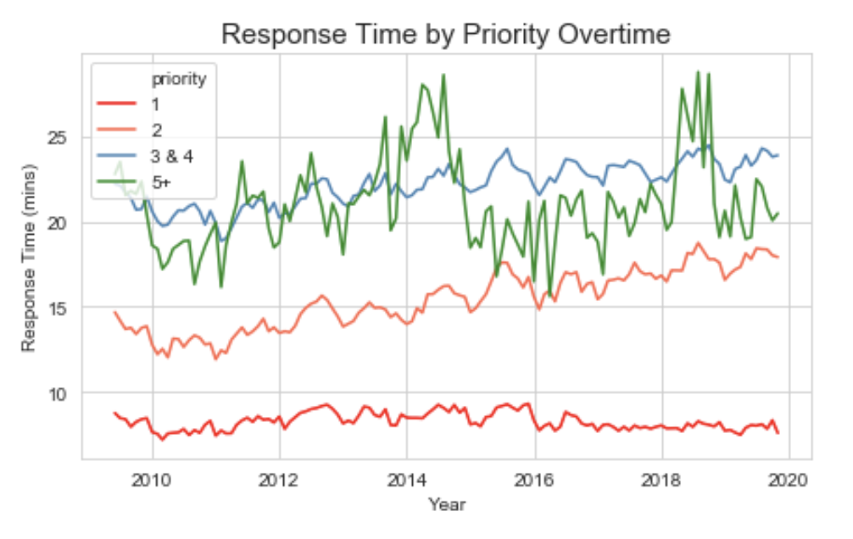
Priority
Response time to top priority calls is consistent overtime
Response to priority 2 calls becomes slower
For certain period, response time to priority 3 & 4 is shorter than priority 5+
Notes:
First of all, I plotted the response time by each priority overtime. Priority 1 are events like active shooting, priority 2 are slightly less urgent events but also need immediate actions. Priority 3 and 4 are less moderate events like traffic issues, and starting at priority 5, the events are actually handled directly by the communication center. The time is pretty constant for top priority calls, and it increases overtime for priority 2 calls. And from 2015 to 2018, the time is shorter for priority 3&4 than priority 5+.

Slide 5
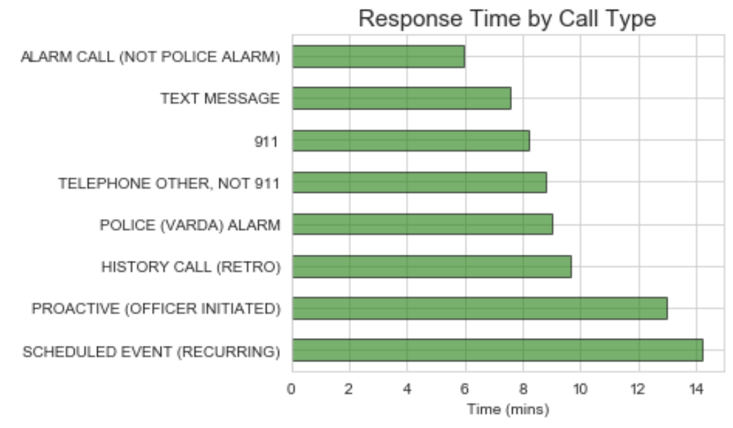
Call Type
Alarm Call: bank, school, residential, bus, taxi
Response to text message faster, but not statistically significant
Response to 911 calls faster than non 911 calls?
Notes:
Seattle police responds to alarm calls really fast. Interestingly, response to text messages is slightly faster than 911 calls, but the difference is not statistically significant. While I was doing this part, I was wondering if response to 911 calls is faster than non 911 calls. And the answer is yes

Slide 6
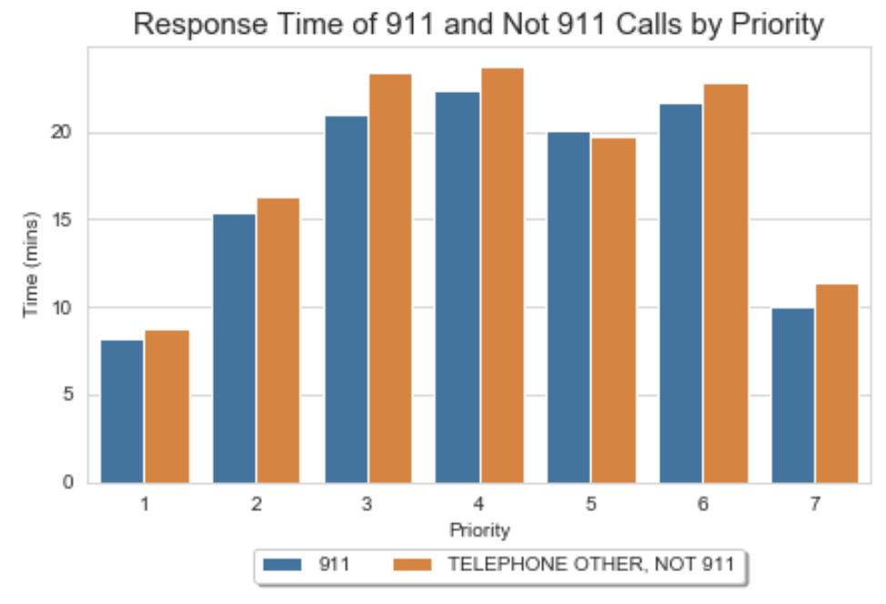
Call Type
Responses to 911 calls are generally faster than non 911 calls even for priority 6, 7 events
Always call 911
Notes:
911 calls generally receive faster responses than non 911 calls even for low priority events. So always call 911

Slide 7
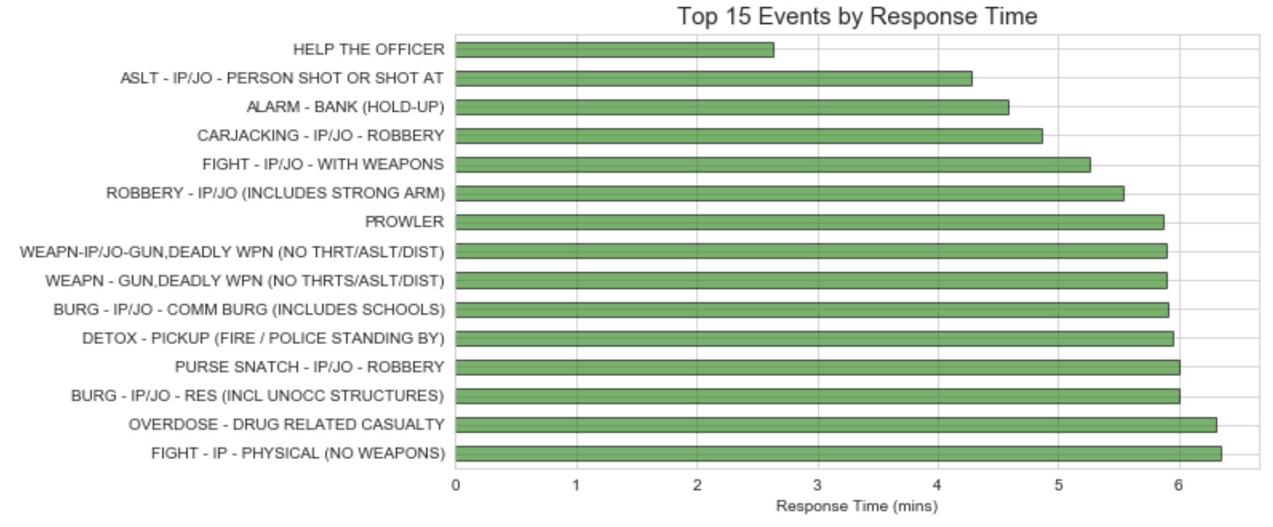
Event Type
Notes:
Top 15 events. Calls that request backups or report active shootings receive fastest responses. It is good to see that most of the times are less than 6 minutes which is the goal they aim for.

Slide 8
Region
Side by side comparison of crime counts and response time
Beat: most granular unit of management used for patrol deployment
Demo
Notes:
I plotted crime counts and response time in two different maps to make side by side comparisons. The regions are divided into beats which are the most granular unit used by SPD.

Slide 9
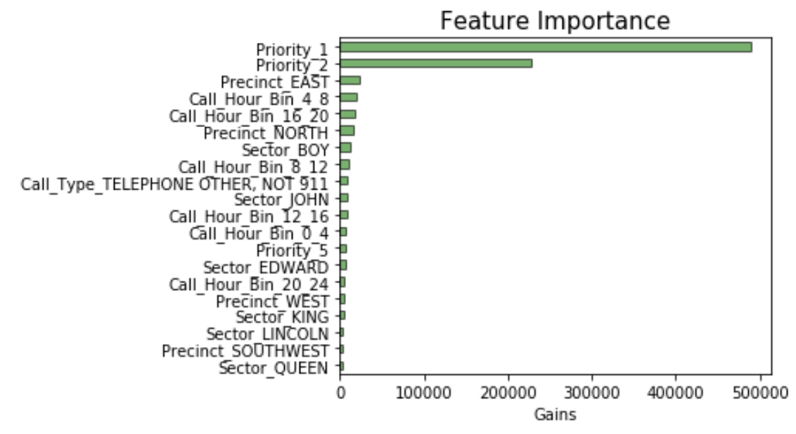
Predict Response Time
Decision Tree
RMSE: 13.8
Priority is much more crucial than call time in determining response time
Notes:
As mentioned, decision tree was used and the final root mean square error is 13.8. According to the feature importance, priority is much more crucial than call time determined by the model. And one future work I wanna do is to add traffic data and see if that would replace priority in the feature importance.

Slide 10
Thank you!

