Slide 1
CMPT 459 - Course Project
A Data Mining Study on
COVID-19 Pandemic Growth & Related Social Media Dynamics
Notes:
Hello, this is the presentation for CMPT 459 Data mining project
A Data Mining Study on COVID-19 Pandemic Growth & Related Social Media Dynamics
The goal of this project was to develop an end-to-end data mining application on COVID-19 related datasets

Slide 2
Overview
Background & Motivation
Datasets
Methodology
Architecture/Pipeline
Results
Conclusion
Notes:
In this presentation we will go over:
Background and motivation of this project
Talk about The datasets used and the Methodology behind the implementation
The overall architecture and pipeline of the data mining process
Showcase the final results
And provide some future improvements for the process

Slide 3
Background & Motivation
Perform COVID-19 related Data Mining Study
Determine relationship between:
Daily COVID-19 related trending topics and sentiments on Twitter
Number of reported confirmed cases within the United States
Potentially help government bodies prepare for future pandemic
Notes:
Amidst the COVID-19 pandemic, social media usage has surged significantly
As the general population relies heavily on social media platforms to gather the latest information in regards to the pandemic, resulting in an unprecedented amount of content and information.
An data mining analysis of social media dynamics was conducted on COVID-19 related tweets in relation to daily confirmed cases trend within the US
over a given period of time to measure the changes in overall tweet sentiments, and trending topics.
This data mining study could potentially help government bodies to proper issue emergency procedures and restrictions
with appropriate messaging and policy decisions in times of crisis for future global events and pandemics.

Slide 4
Datasets
COVID-19 Daily Confirmed Cases Dataset
By Center for Systems Science and Engineering (CSSE) at Johns Hopkins University
Set of aggregated data source containing daily confirmed cases for all countries
COVID-19 Related Tweet ID Dataset
By Ph.D. Student Emily Chen from University of Southern California
Tweet IDs are collected using a selection of keywords related to COVID-19
Collected from January, 2020
Notes:
Two datasets were used for this data mining task
The first dataset is the COVID-19 Data Repository by the Center for Systems Science and Engineering (CSSE) at Johns Hopkins University.
It contains daily confirmed COVID-19 cases from all countries and is an excellent aggregated data source.
The second dataset is the COVID -19 Tweet ID dataset gathered by University of Southern California Ph.D. student Emily Chen.
This dataset contains COVID-19 related tweet IDs collected starting from January, 2020.

Slide 5

Methodology
CSSE Confirmed Cases Dataset
Data Cleaning
Data Aggregation
COVID-19 Related Tweet ID Dataset
3-way Polarity Sentiment Classifier Training
NLTK Topic Modeling with Latent Dirichlet Allocation (LDA)
Notes:
The two datasets will follow a simplified KDDM process.
Daily confirmed cases will undergo simple data cleaning and aggregation to extracted daily case growth for the United States.
For tweets data, sampling and hydration methods were performed on the IDs to extract a limited number of the original tweet text for topic modeling and sentiment analysis
In order to perform sentiment classification, a Naïve Bayes model was trained with a Twitter for Sentiment Analysis dataset
that contianed 371k positive tweets, 629k neutral tweets, and 179k negative tweets
Daily trending topic was also evaluated using NLTK’s topic modeling with LDA

Slide 6
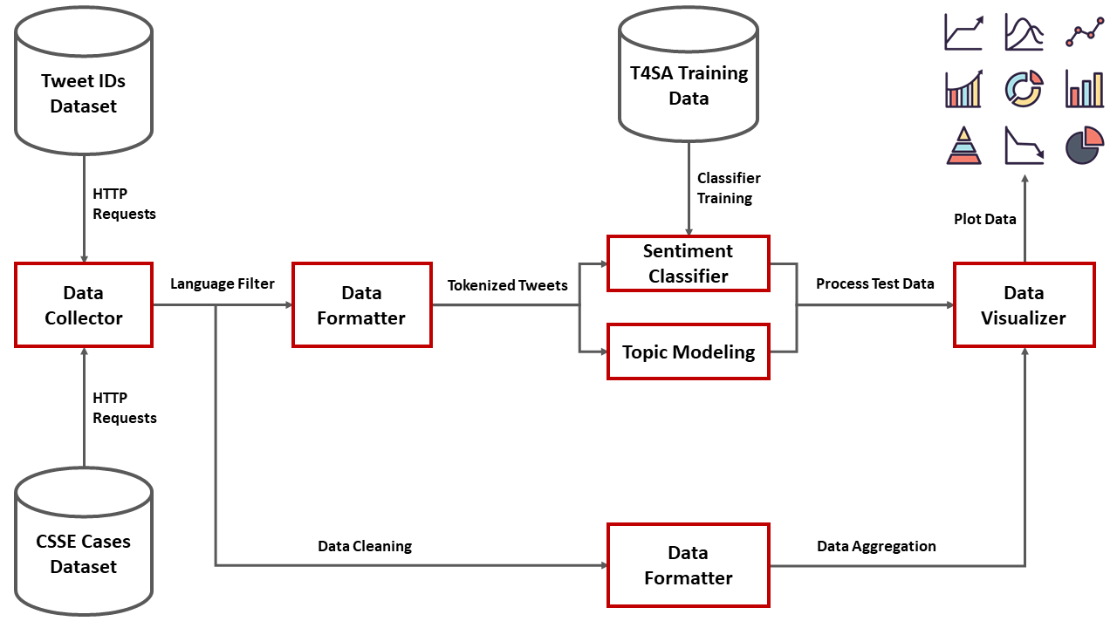
Architecture/Pipeline
Notes:
A detailed diagram of the data mining architrave and pipeline is shown here.
Raw Data is first collected from their respective GitHub repository using HTTP requests.
The Daily confirmed cases dataset is cleaned up by filtering out non-US related entries
and is then aggregated using the SUM function on the number of confirmed cases, and grouped by the reported date
For the Tweet ID data set, 1000 twitter IDs were sampled for each date and hydrated, then a language filter is used to remove non-English tweets
The tweets are then tokenized before inputting through the trained sentiment classifier and topic modeling.
Lastly, the two datasets are integrated together for data visualization

Slide 7
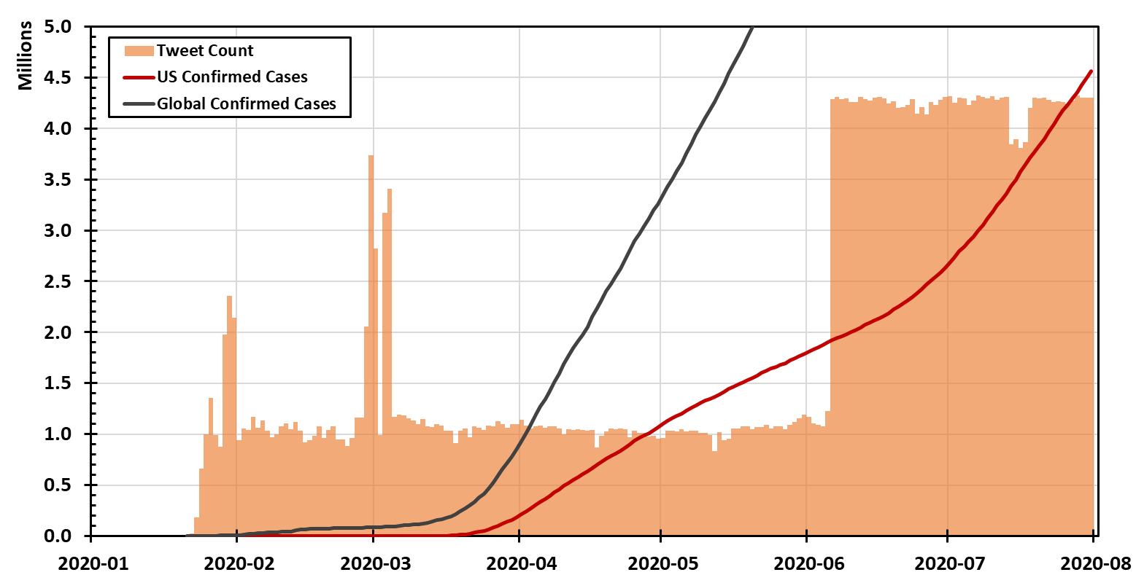
Results - Confirmed Cases & Tweets
Notes:
After simple data processing of the CSSE dataset, rapid exponential growth for number of confirmed cases for the United states and globally
was visualized with the daily number of tweets related to COVID-19 over the last couple of months
This provides a clear picture for the severity and contagious effect of the COVID-19 pandemic in relation to the growing number of daily tweets.

Slide 8
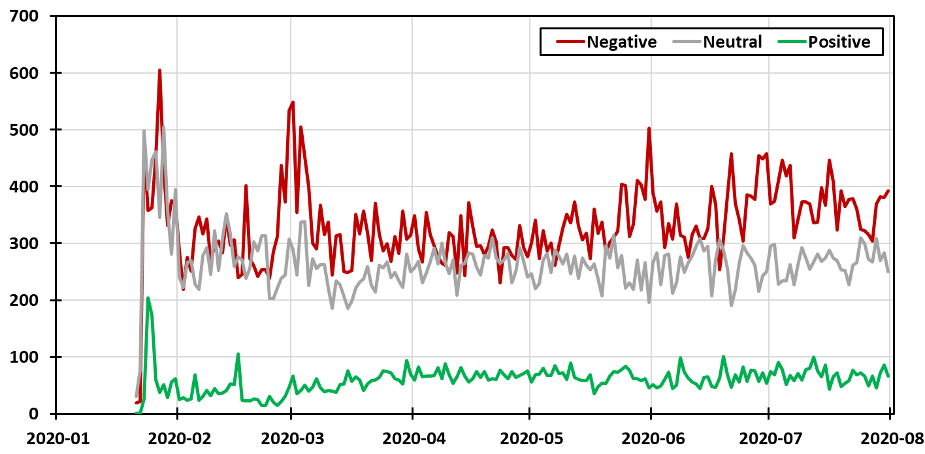
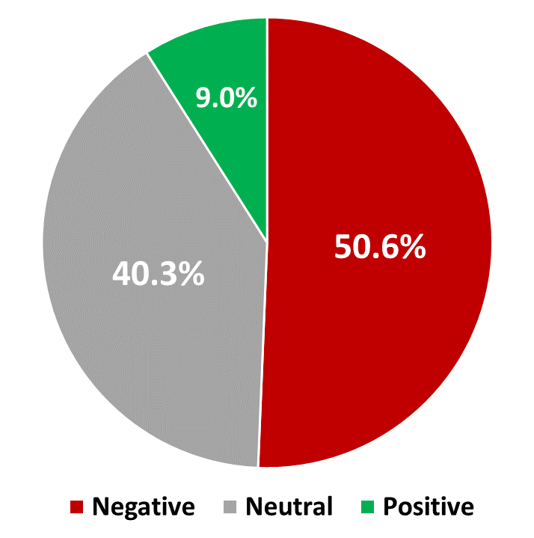
Results - Sentiment Analysis
Notes:
In total, over 193 days, 126k Tweets were sampled, collected, and analyzed.
As expected, the majority around 50% of the tweets were classified as Negative
40% as classified as neutral and only 9% was classified as positive
Trend for the positive and neutral tweets has stayed relatively the same throughout,
but trend for the negative tweets were shown to spiked during specific periods in time

Slide 9
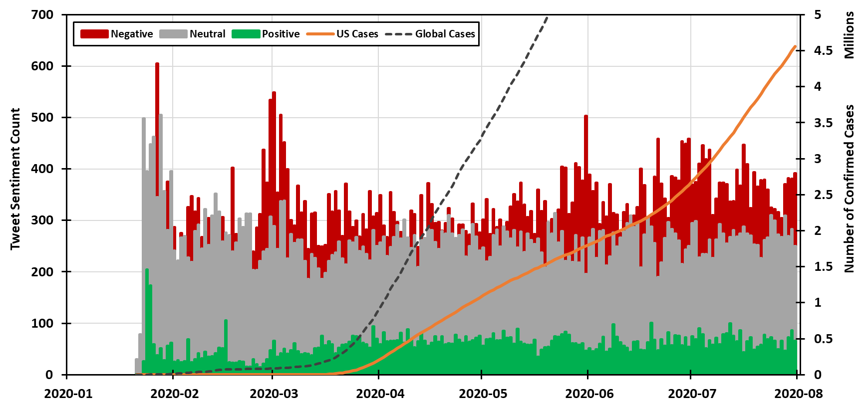
Results - Growth & Sentiment Frequency
Notes:
As COVID-19 progressed and its seriousness became evident, the growth of negative sentiment tweets was also apparent.
This relationship could be observed during 2 different time frames:
the first spike in negative sentiment tweets was near the end of February and early march where COVID-19 growth starts to manifest rapidly in areas outside of China.
The second increase in negative sentiment tweets occurs from mid-May onwards, which can be correlated to the explosive growth within the United States.

Slide 10
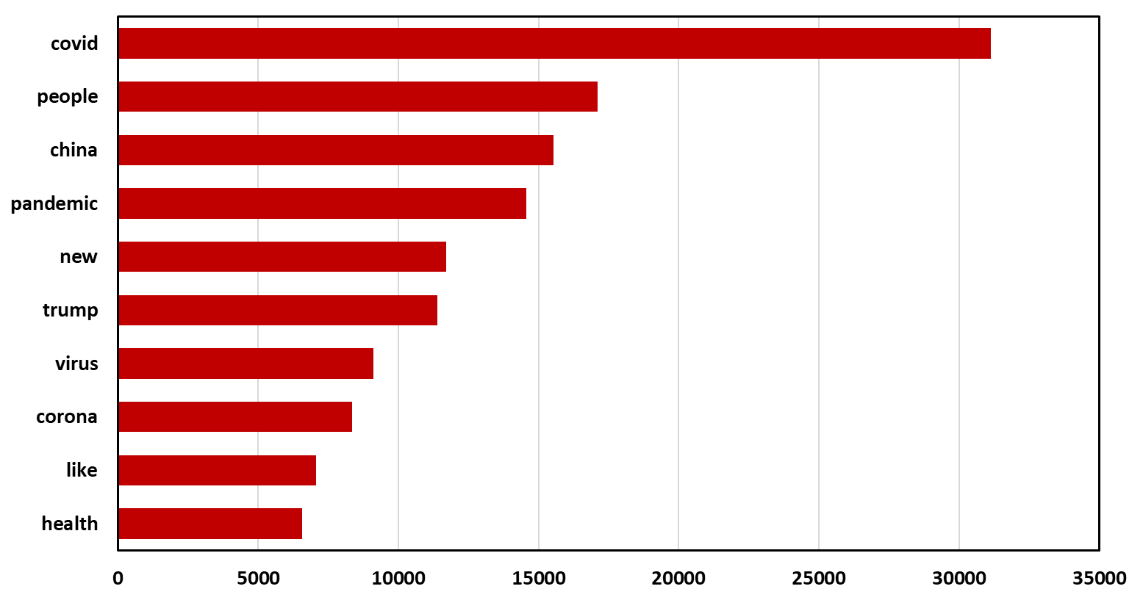
Results - Term Distributions
Notes:
The top 10 most common words from the daily tweet dataset is visualized in the following figure
This could be interpreted as a summery of the general topic for collected COVID-19 related tweets.
Words with higher frequency of occurrence have higher weight in the overall topic model.

Slide 11
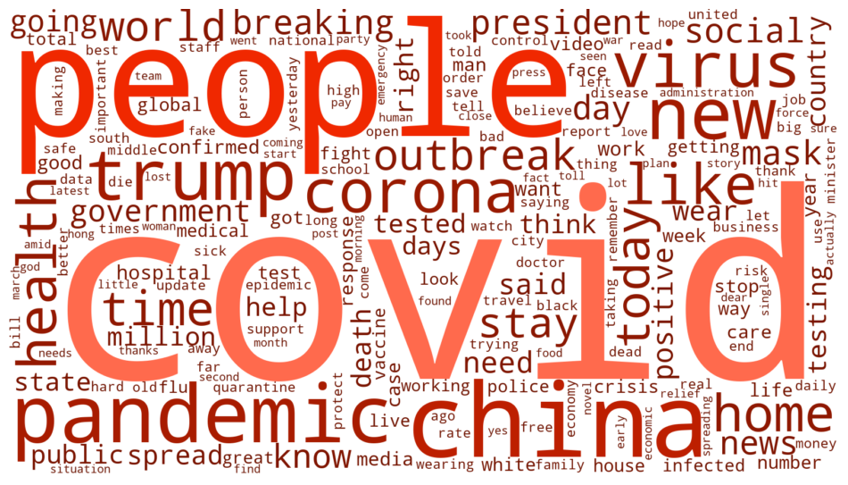
Results - Word Cloud
Notes:
A word cloud was also generated to further visualize the frequency of occurrence of the top most common words
Words with high frequency are shown to be brighter and larger while words with lower frequencies are shown to be darker and smaller.
From the word cloud, the words covid, people, china, pandemic, and trump were shown to have the highest frequency of occurrence from the collected tweets.

Slide 12
Results - Topic Modeling
Topic # | Topic Model 2020-01-25
0 | 0.118*health + 0.073*virus + 0.044*ministry + 0.034*china + 0.030*linked
1 | 0.051*doctor + 0.046*hospital + 0.032*video + 0.030*government + 0.030*days
2 | 0.136*china + 0.130*death + 0.129*toll + 0.084*people + 0.073*breaking
Topic # | Topic Model 2020-07-15
0 | 0.084*covid + 0.031*got + 0.029*school + 0.028*data + 0.024*testing
1 | 0.107*mask + 0.062*covid + 0.057*wear 0.018*social + 0.015*nail + 0.015*salon +
2 | 0.062*vaccine + 0.055*covid + 0.054*today + 0.036*new + 0.033*time
Notes:
LDA daily topic models were constructed as shown in these 2 tables,
the top 3 models for Jan 25th and July 15th shows the difference in topic key words
During the initial couple of months, the topics mainly focused on the Chinese coverage of the outbreak
Words such as China, virus, spread, and outbreak can be seen to have a high occurrence within each topic.
However, as COVID-19 progressed and the explosive spread was observed within the United states,
the focus of the topics can be seen to shift to relate more to the US coverage of the COVID-19 pandemic
Keywords such as mask, president, covid, and trump could be seen to have a higher occurrence within each topic.

Slide 13
Conclusion
Low classification accuracy
Positive 60.9%
Negative 45.3%
Improvements:
Use larger Tweet Dataset
Better Classification Model
Better Set of Training Data
Notes:
Overall, the data mining results are promising, and answered the question of the relationship between tweets and covid growth
However, the classification accuracy of the trained model was quite low when classifying a set of control data.
positive tweet detection accuracy was around 60.9%, and negative tweet detection accuracy was around 45.24%
Some possible improvement to the data mining process for the future could be to increase tweet sample size
Use different classification models or APIs for higher accuracy, and even consider building a better set of training data

Slide 14
Thank you!
Notes:
Thank you for watching
The project repository can be found in the description box below

