Slide 1
Deep Reinforcement Learning
表格法（准确）
Model-free
Q-learning(off-policy)
Monte Carlo(on-policy)
SARSA(on-policy)
近似估计方法
Q-value
Experience replay
Fixed target
Double DQN
Dueling DQN
DRQN(RNN)
Rainbow
Policy
Gradient
SPG
DDPG
AC
A3C
PPO
Model
Dynamic Programming(MDP)
Value iteration
Policy iteration
综述：
Mnih V, Kavukcuoglu K, Silver D, et al. Human-level control through deep reinforcement learning[J]. Nature, 2015, 518(7540): 529.
Justesen N, Bontrager P, Togelius J, et al. Deep learning for video game playing[J]. IEEE Transactions on Games, 2019.
结构优化：
Van Hasselt H, Guez A, Silver D. Deep reinforcement learning with double q-learning[C]//Thirtieth AAAI conference on artificial intelligence. 2016.
Wang Z, Schaul T, Hessel M, et al. Dueling network architectures for deep reinforcement learning[J]. arXiv preprint arXiv:1511.06581, 2015.
Wang Z, Bapst V, Heess N, et al. Sample efficient actor-critic with experience replay[J]. arXiv preprint arXiv:1611.01224, 2016.
Kulkarni T D, Narasimhan K, Saeedi A, et al. Hierarchical deep reinforcement learning: Integrating temporal abstraction and intrinsic motivation[C]//Advances in neural information processing systems. 2016: 3675-3683.
架构：
Kulkarni T D, Narasimhan K, Saeedi A, et al. Hierarchical deep reinforcement learning: Integrating temporal abstraction and intrinsic motivation[C]//Advances in neural information processing systems. 2016: 3675-3683.
Haarnoja T, Pong V, Zhou A, et al. Composable deep reinforcement learning for robotic manipulation[C]//2018 IEEE International Conference on Robotics and Automation (ICRA). IEEE, 2018: 6244-6251.
Github 上关于DRL的paper list：https://github.com/junhyukoh/deep-reinforcement-learning-papers

Slide 2

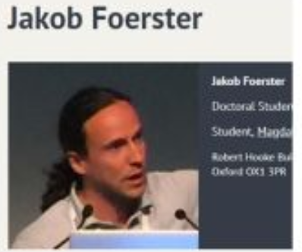

Multi Agent Reinforcement Learning
综述：
梁星星,冯旸赫,马扬,程光权,黄金才,王琦,周玉珍,刘忠.多Agent深度强化学习综述[J/OL].自动化学报:1-21[2019-12-26].https://doi.org/10.16383/j.aas.c180372.
Bu L, Babu R, De Schutter B. A comprehensive survey of multiagent reinforcement learning[J]. IEEE Transactions on Systems, Man, and Cybernetics, Part C (Applications and Reviews), 2008, 38(2): 156-172.
架构：
Sunehag P, Lever G, Gruslys A, et al. Value-decomposition networks for cooperative multi-agent learning based on team reward[C]//Proceedings of the 17th International Conference on Autonomous Agents and MultiAgent Systems. International Foundation for Autonomous Agents and Multiagent Systems, 2018: 2085-2087.
Rashid T, Samvelyan M, De Witt C S, et al. QMIX: monotonic value function factorisation for deep multi-agent reinforcement learning[J]. arXiv preprint arXiv:1803.11485, 2018.
Foerster J N, Farquhar G, Afouras T, et al. Counterfactual multi-agent policy gradients[C]//Thirty-Second AAAI Conference on Artificial Intelligence. 2018.
Peng P, Yuan Q, Wen Y, et al. Multiagent bidirectionally-coordinated nets for learning to play starcraft combat games[J]. arXiv preprint arXiv:1703.10069, 2017, 2.
Github 上关于MARL的paper list：https://github.com/LantaoYu/MARL-Papers

