Slide 1
Topic：Deep reinforcement learning
Problem 1: TSP + path planning（obstacles）
问题难度（有待进一步论证）：多任务调度（NP）、局部最优化（避障）、全局最优化……
两个问题结合到一起产生了什么新的挑战。
Related works:
Work[1]: solving the appropriate travelling salesperson problem (Heuristic) & a roadmap of free-space（启发+经典路径规划）
Work[2]: Genetic Algorithm (GA) and A* to solve Traveling Salesman Problem (TSP) （启发+经典路径规划）
Work[3]: soft q-learning multimodal exploration strategies（RL做抓取任务）
Idea:
Multimodal deep reinforcement learning (如何设计网络架构)
Concrete works: theoretical analysis & Experimental verification
[1]Spitz S N, Requicha A A G. Multiple-goals path planning for coordinate measuring machines[C]//Proceedings 2000 ICRA. Millennium Conference. IEEE International Conference on Robotics and Automation. Symposia Proceedings (Cat. No. 00CH37065). IEEE, 2000, 3: 2322-2327.
[2] Bolourian N, Hammad A. Path Planning of LiDAR-Equipped UAV for Bridge Inspection Considering Potential Locations of Defects[M]//Advances in Informatics and Computing in Civil and Construction Engineering. Springer, Cham, 2019: 545-552.
[3]Haarnoja T, Pong V, Zhou A, et al. Composable deep reinforcement learning for robotic manipulation[C]//2018 IEEE International Conference on Robotics and Automation (ICRA). IEEE, 2018: 6244-6251.

Slide 2
Problem 2: Problem 1 + Dynamic
在Agent移动过程中，有新的目标节点加入或已规划的节点消失。
环境是动态的（障碍物的消失或出现）
某条线路处有拥堵（随机延时）
Related works:
Work[1]: the genetic algorithm (GA) and applied to the path planning problem of mobile robots in dynamic environments(启发式)
Work[2]: The proposed path planning method determines not only an optimal path, but also the appropriate acceleration and speed for a vehicle
Work[3]: Socially Adaptive Path Planning in Human Environments Using Inverse Reinforcement Learning强化（逆学习）
[1]Tuncer A, Yildirim M. Dynamic path planning of mobile robots with improved genetic algorithm[J]. Computers & Electrical Engineering, 2012, 38(6): 1564-1572.
[2]Hu X, Chen L, Tang B, et al. Dynamic path planning for autonomous driving on various roads with avoidance of static and moving obstacles[J]. Mechanical Systems and Signal Processing, 2018, 100: 482-500.
[3] Kim B, Pineau J. Socially adaptive path planning in human environments using inverse reinforcement learning[J]. International Journal of Social Robotics, 2016, 8(1): 51-66.

Slide 3
Problem 2: Problem 2 + Multi-objective
距离，时间，耗电量（货物）
Related works:
Work[1]:A simulation-based approach by means of particle swarm optimization (PSO)（粒子群优化）
Work[2]:a Multi-Objective Grey Wolf Optimizer (MOGWO) 优化求解器
Work[3]:Deep Optimistic Linear Support Learning (DOL) to solve high-dimensional multi-objective decision problems（DRL）
Idea:
tasks
NN
optimal
NN
path
NN
multimodal exploration
[1] Delgarm N, Sajadi B, Kowsary F, et al. Multi-objective optimization of the building energy performance: A simulation-based approach by means of particle swarm optimization (PSO)[J]. Applied energy, 2016, 170: 293-303.
[2] Mirjalili S, Saremi S, Mirjalili S M, et al. Multi-objective grey wolf optimizer: a novel algorithm for multi-criterion optimization[J]. Expert Systems with Applications, 2016, 47: 106-119.
[3] Mossalam H, Assael Y M, Roijers D M, et al. Multi-objective deep reinforcement learning[J]. arXiv preprint arXiv:1610.02707, 2016.

Slide 4
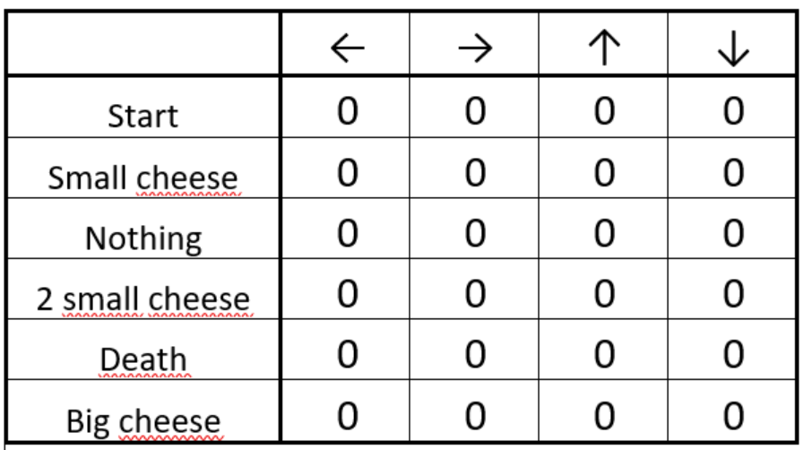
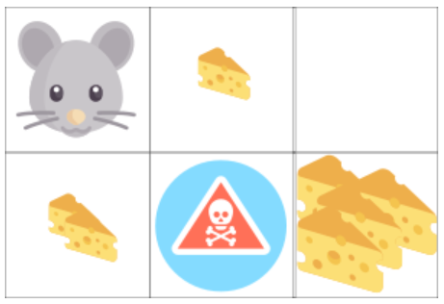
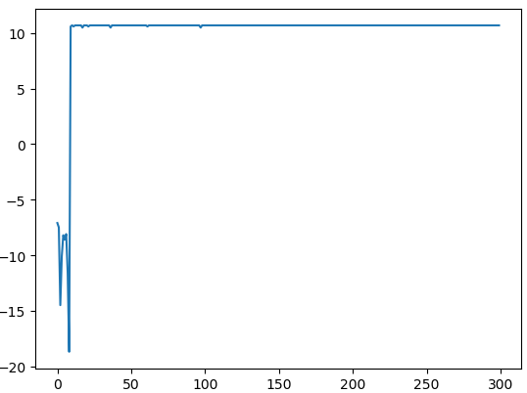
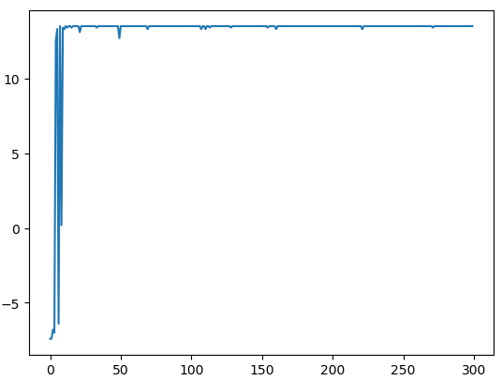
问题背景：DQN迷宫多目标最短路径，在reward值收敛后，有震荡，寻找震荡原因。
理论：q_learning算法一定收敛于最优解处。
Watkins C J C H, Dayan P. Q-learning[J]. Machine learning, 1992, 8(3-4): 279-292.
实际：q_learning算法epsilon-greed探索，不可靠收敛，epsilon、学习率参数有关
https://stats.stackexchange.com/questions/206944/how-do-i-know-when-a-q-learning-algorithm-converges
Q-learning实例（rat-maze）：
状态信息不全（6*8(cheese or not)）
环境
状态、动作
Reward
One cheese： +1
Two cheese: +3
Big pile of cheese: +10
(end of the episode)
Trap：-10
(end of the episode)
Moving: -0.1
one | two | big
False | False | False
False | False | True
False | True | False
False | True | True
True | False | False
True | False | True
True | True | False
True | True | True
结果（episode-reward 收敛图）：
结果
（episode-reward 收敛图）：
Best reward: 10.7,
action: ['right', 'right', 'down']
Best reward: 13.5,
action: ['down', 'up', 'right', 'right', 'down']
问题：
reward值并没有收敛于最优解处。
问题：
DQN收敛吗？
收敛后震荡的原因……

Slide 5
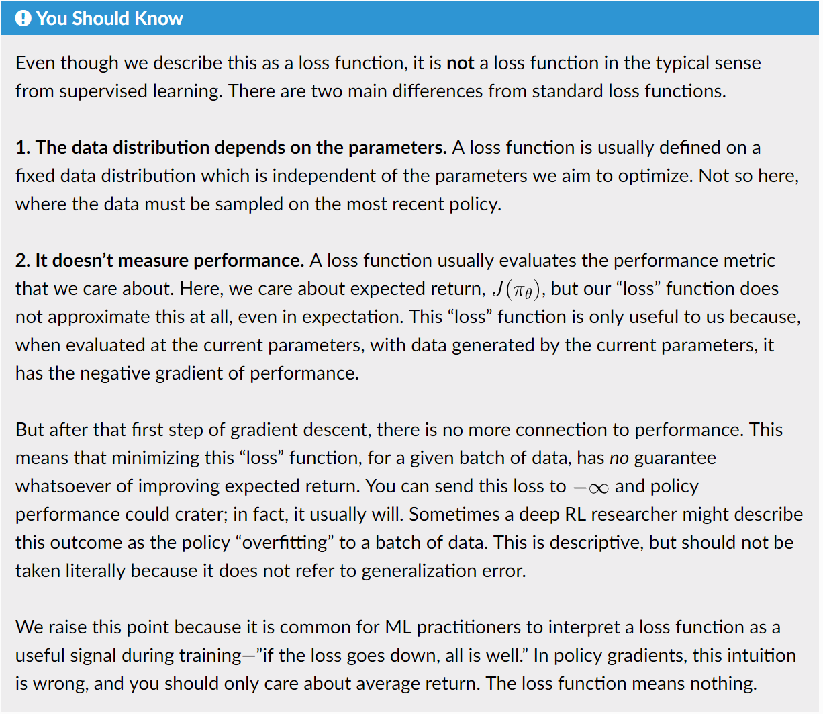
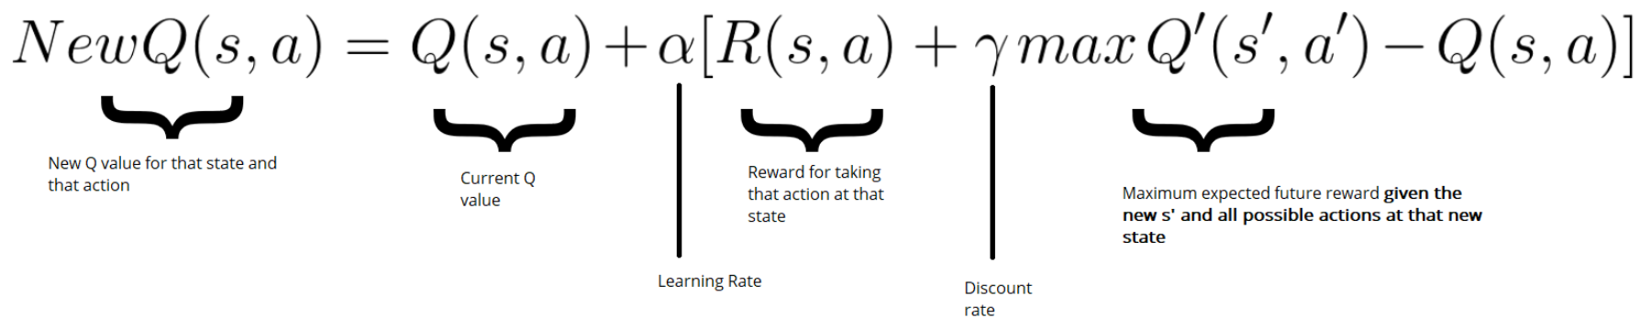
DQN收敛吗？
Q-loss, reward
States
Neural Network
LOSS
Q-value
(action-distribution)
Supervise learning: a fixed data distribution
Target label
DQN: the data must be sampled on the most recent policy
Experience Replay
https://medium.com/free-code-camp/an-introduction-to-deep-q-learning-lets-play-doom-54d02d8017d8
降低动作的相关性，避免动作灾难性的震荡和不收敛……
策略梯度……（非DQN）
OpenAI: https://spinningup.openai.com/en/latest/spinningup/rl_intro3.html

Slide 6
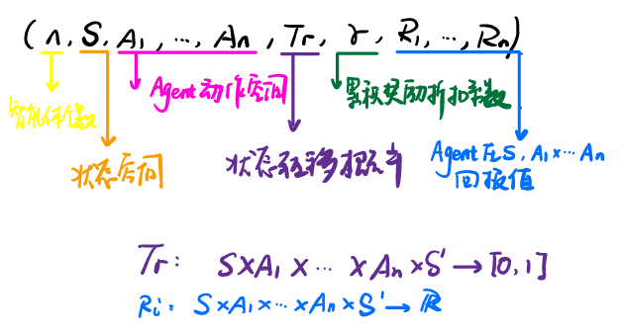
Topic：从单体到多智能体
获利（分布式架构）：
加快学习速度，经验分享（示教，模拟）；
系统更稳定（鲁棒性），个别agent任务失败（接管）；
挑战：
维度爆炸，联合动作空间随agent个数指数增长；
Reward难以设计，agent的任务不同，且相互影响；
协同，agent个体动作对环境的改变，依赖于其他agents；
探索/利用策略，不仅针对环境，还针对其他agent；
几个博弈的概念和随机博弈（stochastic game）
静态博弈（static game），不存在状态转移，回报值只由agent动作决定；
阶段博弈（stage game），是随机博弈的组成成分，状态s是固定的，相当于一个状态固定的静态博弈，随机博弈中的Q值函数就是该阶段博弈的奖励函数。若干状态的阶段博弈组成一个随机博弈。
重复博弈（repeat game），智能体重复访问同一个状态的阶段博弈，并且在访问同一个状态的阶段博弈的过程中收集其他智能体的信息与奖励值，并学习更好的Q值函数与策略。
随机博弈(stochastic game / Markov game)是马尔可夫决策过程与矩阵博弈（只有一个状态，静态博弈）的结合，具有多个智能体与多个状态，即多智能体强化学习。
MARL随机博弈过程描述
将随机博弈过程分解为多个阶段博弈。
与环境交互更新每一个状态阶段博弈中的Q值。
马尔可夫决策过程

Slide 7
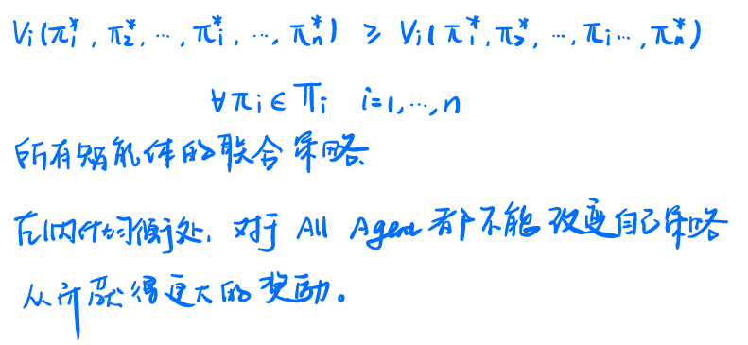
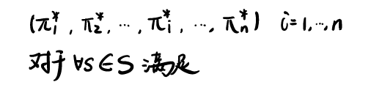
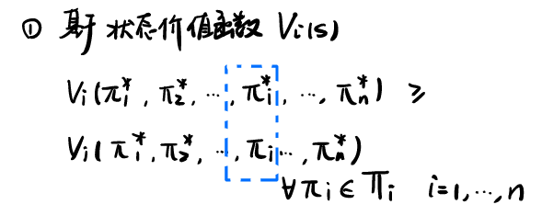
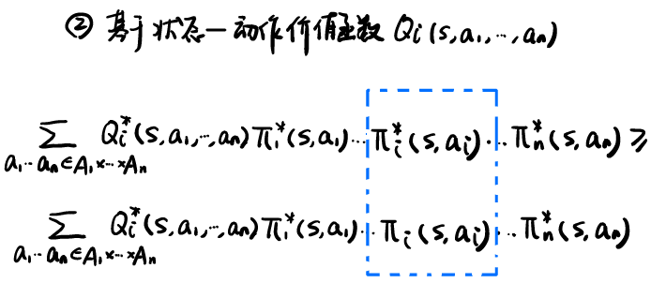
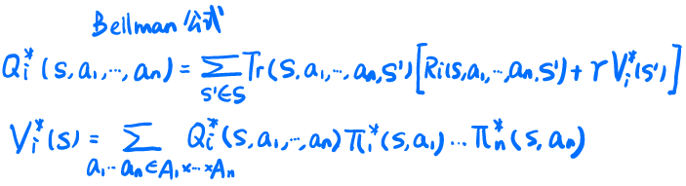
MARL 目标
每个状态下的纳什均衡策略（最优策略）
MARL最优策略数学描述
状态价值函数—动作状态价值函数
如何得到最优策略呢？

Slide 8
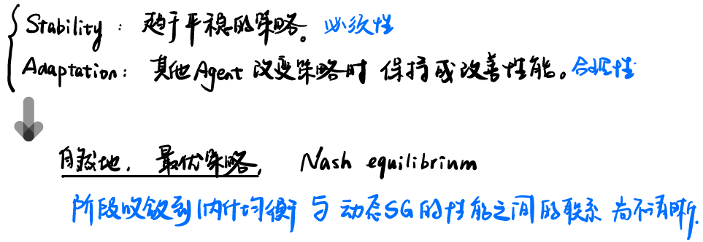
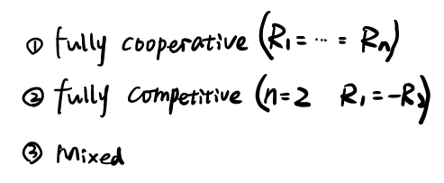
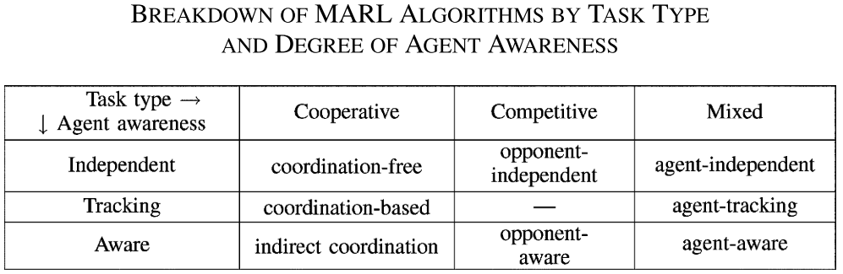
MARL 算法
从Task类型和 agent awareness 两个维度分析
对稳定和适应的理解
Independent（聚焦稳定性的算法）
Aware（对其他代理的适应能力）
Tracking（只考虑稳定性，不考虑收敛）
算法分类
Team Q-learning | Minimax-Q | CE-Q
Coordination graph |  | Hyper-Q
FMQ |  | IGA

Slide 9
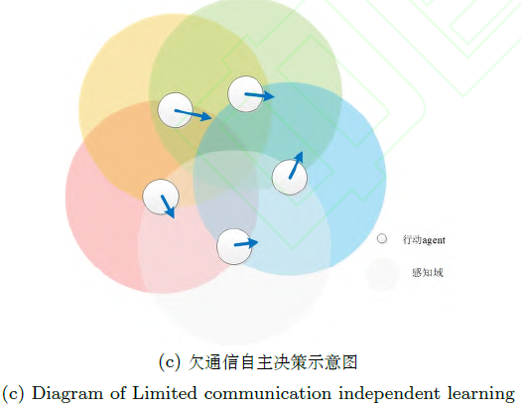
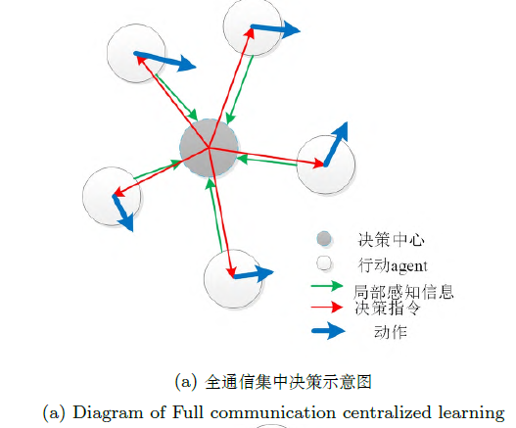
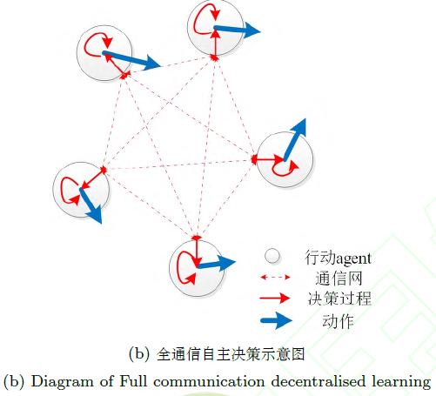
Multi-agent Reinforcement Learning
好处：
天生并发，大量样本；
并行计算，提高学习效率；
神经网络，内部通信；
坏处：
动作空间指数上升；
难以指定学习目标；
多agent学习，打破环境平稳性；
从深度强化学习到多智能体
MARF算法分类
全通信集中决策
全通信自主决策
欠通信自主决策
基于隐藏层信息池化共享的集中决策架构[1]
自适应端到端的通信协议算法[4]
一般性协作actor-critic网络[5]
平均强化学习分析[6]
基于AC （actor-critic）的多agent 双向协作网络
（Bidirectionally-Coordinated Network, BiCNet）[2]
全局奖赏，2个独立DQN网络[7]
采用分散滞后深度RNN 的Q 网络（Dec-HDRQNs）架构[8]
随访问次数的增加而增大接受负TD error 的概率[9]
全局奖赏下的值分解网络[3]
[1] Sukhbaatar S, Fergus R. Learning multiagent communication with backpropagation[C]//Advances in Neural Information Processing Systems. 2016: 2244-2252.
[2] Peng P, Yuan Q, Wen Y, et al. Multiagent bidirectionally-coordinated nets for learning to play starcraft combat games[J]. arXiv preprint arXiv:1703.10069, 2017, 2.
[3] Sunehag P, Lever G, Gruslys A, et al. Value-decomposition networks for cooperative multi-agent learning[J]. arXiv preprint arXiv:1706.05296, 2017.
[4] Foerster J, Assael I A, de Freitas N, et al. Learning to communicate with deep multi-agent reinforcement learning[C]//Advances in Neural Information Processing Systems. 2016: 2137-2145.
[5] Mao H, Gong Z, Ni Y, et al. ACCNet: Actor-Coordinator-Critic Net for" Learning-to-Communicate" with Deep Multi-agent Reinforcement Learning[J]. arXiv preprint arXiv:1706.03235, 2017.
[6] Yang Y, Luo R, Li M, et al. Mean field multi-agent reinforcement learning[J]. arXiv preprint arXiv:1802.05438, 2018.
[7] Tampuu A, Matiisen T, Kodelja D, et al. Multiagent cooperation and competition with deep reinforcement learning[J]. PloS one, 2017, 12(4): e0172395.
[8] Omidshafiei S, Pazis J, Amato C, et al. Deep decentralized multi-task multi-agent reinforcement learning under partial observability[C]//Proceedings of the 34th International Conference on Machine Learning-Volume 70. JMLR. org, 2017: 2681-2690.
[9] Palmer G, Tuyls K, Bloembergen D, et al. Lenient multi-agent deep reinforcement learning[C]//Proceedings of the 17th International Conference on Autonomous Agents and MultiAgent Systems. International Foundation for Autonomous Agents and Multiagent Systems, 2018: 443-451.

