Slide 1
Digital Signature Algorithm
Reporter：Yang Liu
Instructor：Wolfgang Härdle

Slide 2
Digital Signature
A digital signature is a mathematical scheme for demonstrating the authenticity of digital messages or documents. A valid digital signature gives a recipient reason to believe that the message was created by a known sender (authentication), that the sender cannot deny having sent the message (non-repudiation), and that the message was not altered in transit (integrity).[1]
Digital signatures are a standard element of most cryptographic protocol suites, and are commonly used for software distribution, financial transactions, contract management software, and in other cases where it is important to detect forgery or tampering.

Slide 3
Applications of digital signatures
Authentication
Digital signatures can be used to authenticate the source of messages. When ownership of a digital signature secret key is bound to a specific user, a valid signature shows that the message was sent by that user.
Integrity
if a message is digitally signed, any change in the message after signature invalidates the signature.
Non-repudiation
An entity that has signed some information cannot at a later time deny having signed it. Similarly, access to the public key only does not enable a fraudulent party to fake a valid signature.

Slide 4
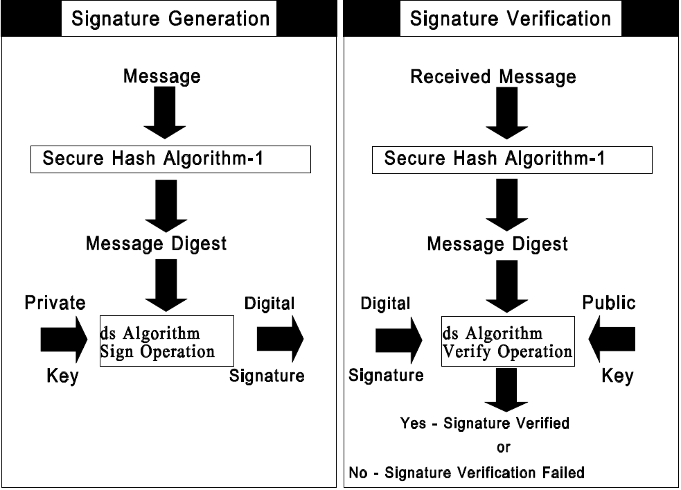

Slide 5
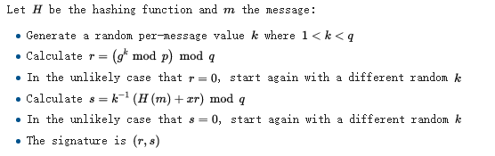
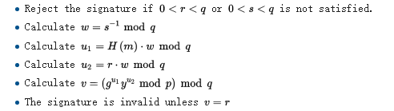
Signing and Verifying

