Slide 1
介绍 C++ coroutine 在数据库算子优化中的应用 Interleaving with Coroutines: A Practical Approach for Robust Index Joins Exploiting Coroutines to Attack the “Killer Nanoseconds”
方祝和
2023/6/20

Slide 2
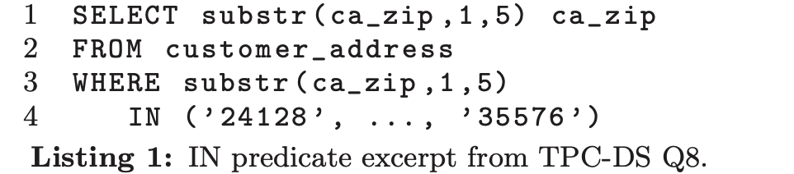
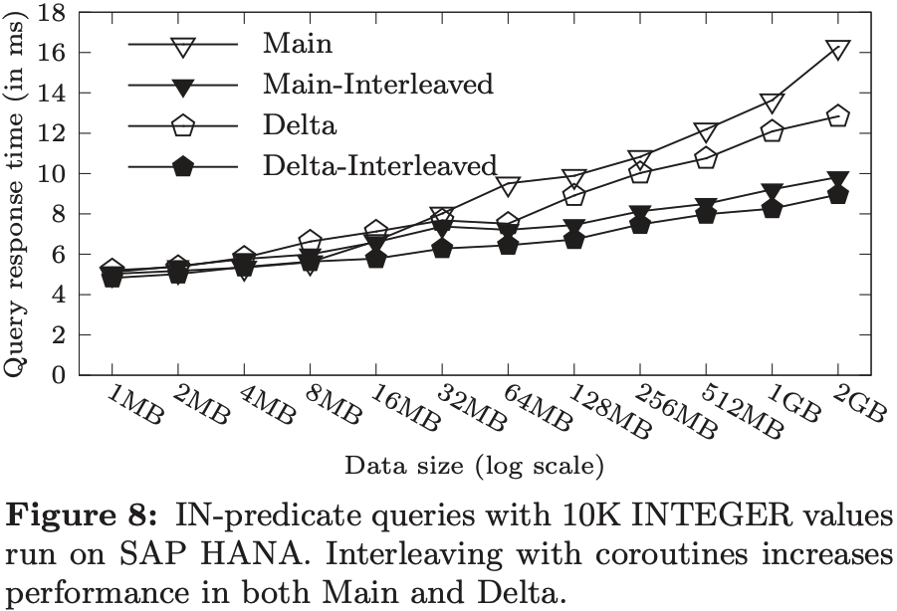
why coroutine?
Heavy data cache misses due to pointer-chasing and irregular access patterns
tree traversal
hash table lookups
binary search
...
An Example: in predicte on columnar store
main part: sorted array
delta part: CSB+-tree

Slide 3
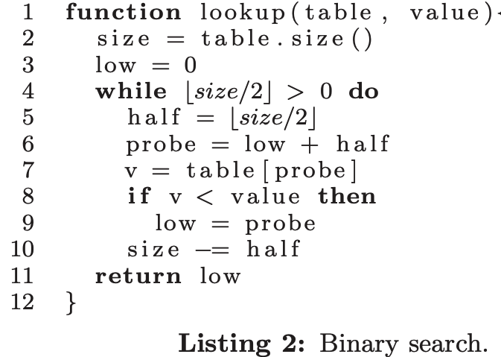
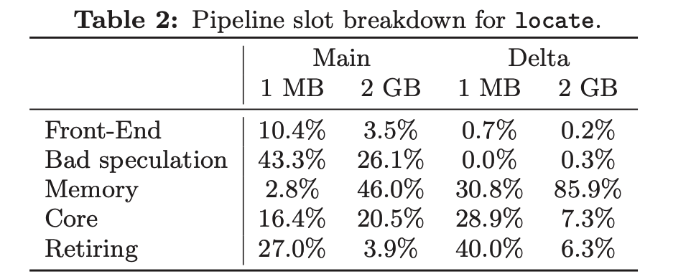
why coroutine?

Slide 4
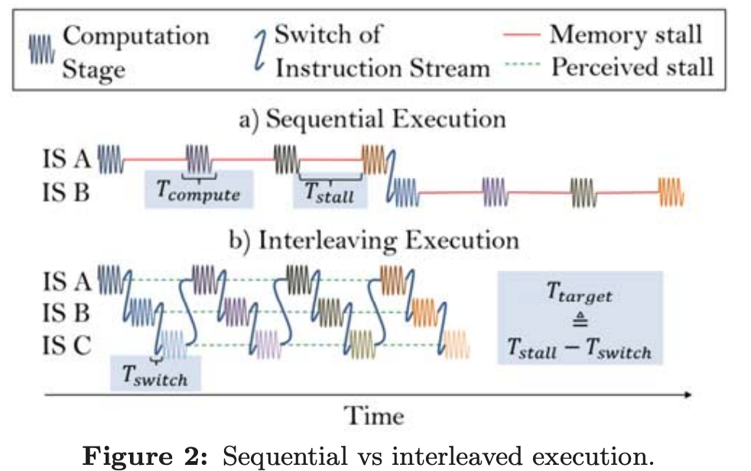
why coroutine?
How to reduce cache misses?
improve data locality
reduce miss penalty
Hide the cache miss penalty by overlapping with compution
need interleaving to hide cache misses

Slide 5
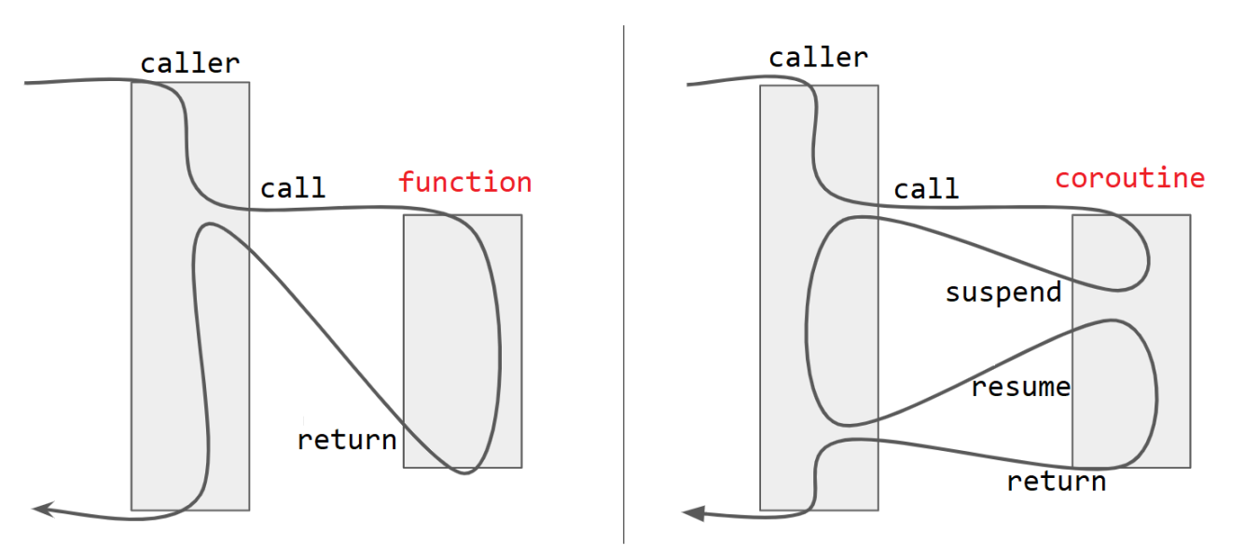
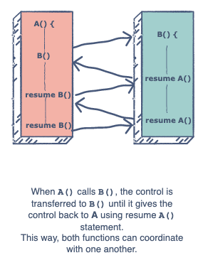
what’s C++ coroutine
advantages：
1. easily use suspend-resume to switch states of FSMs
2. no need to care the states of each flow
3. slightly change original code
4. easy to understand and implement

Slide 6
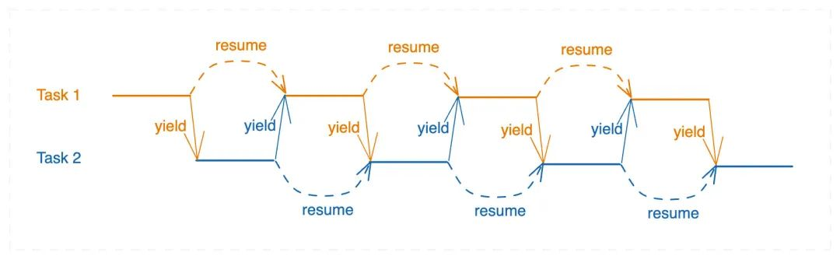
what’s C++ coroutine

Slide 7
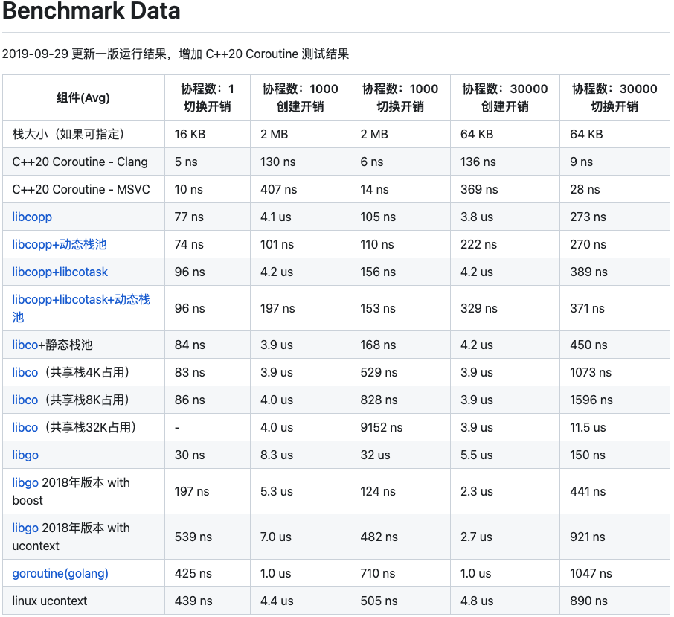
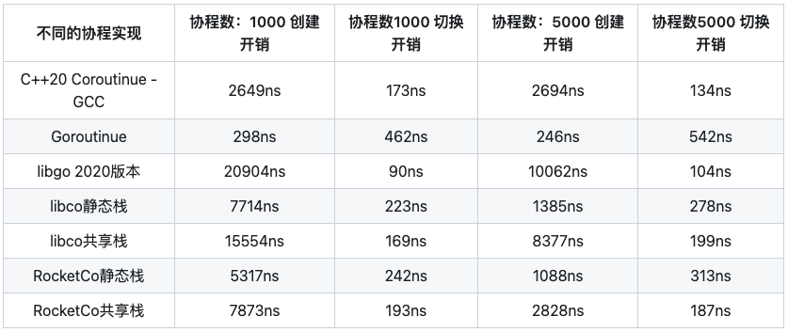
what’s C++ coroutine

Slide 8
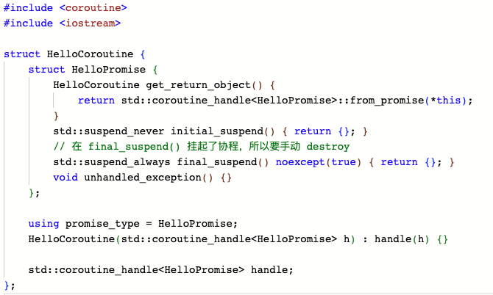
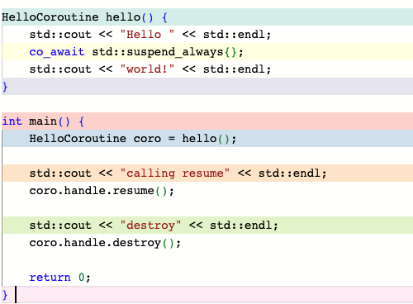
what’s C++ coroutine
Hello wrold!

Slide 9
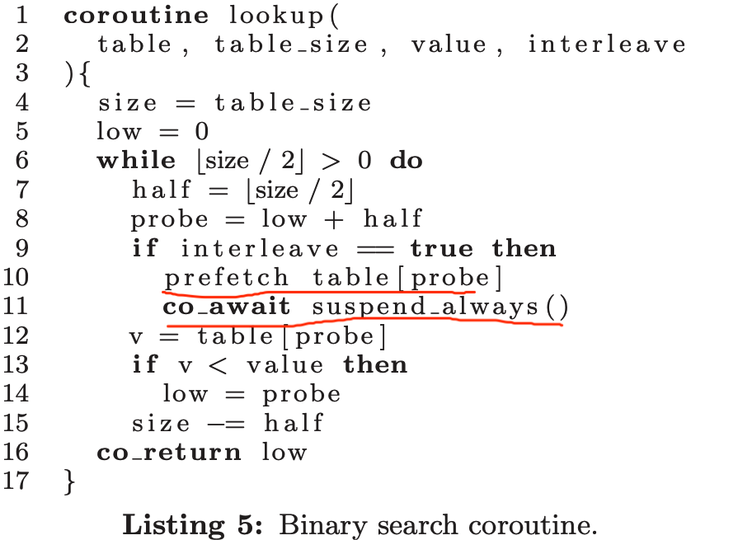
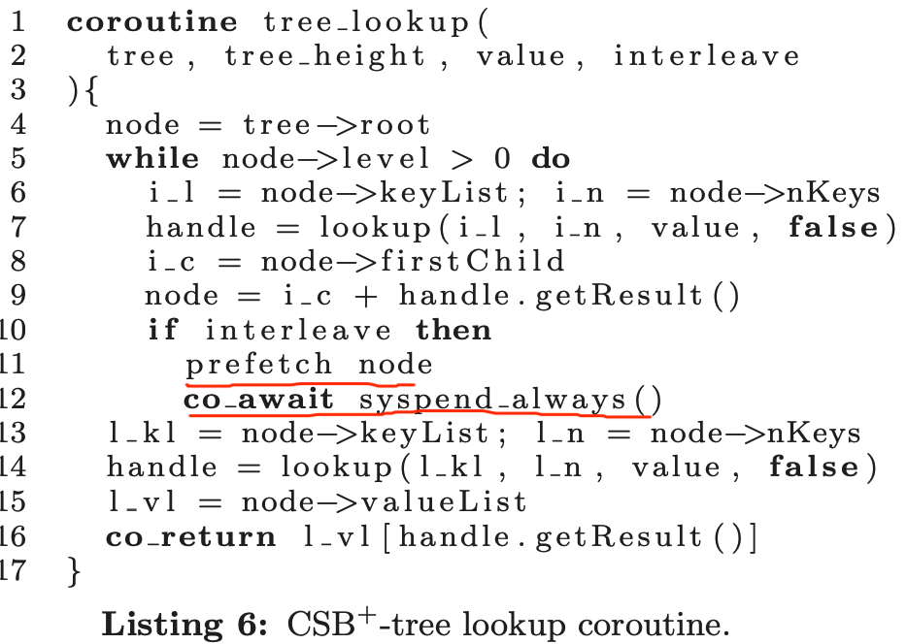
How to use coroutine

Slide 10
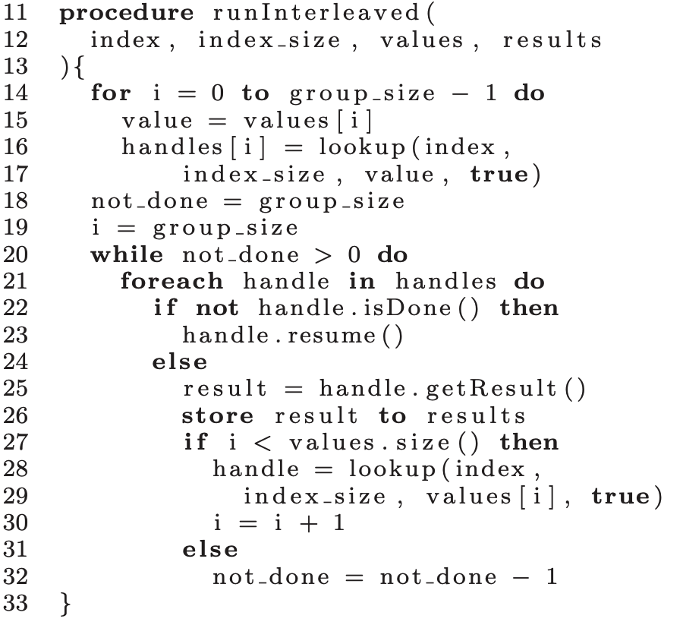
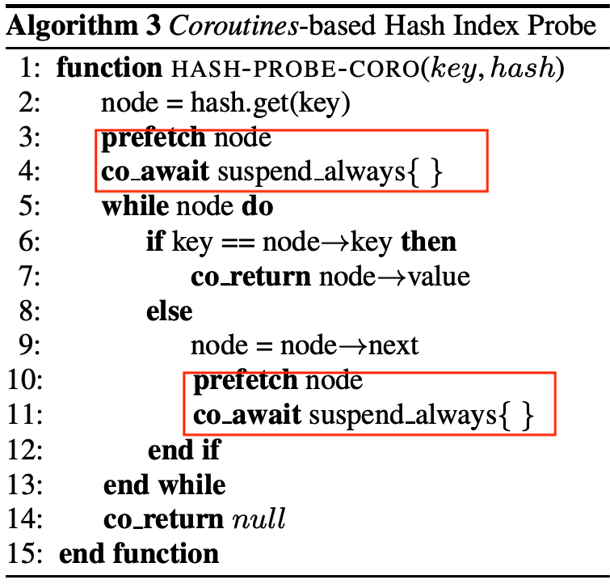
How to use coroutine
control handles, group size is around 10

Slide 11
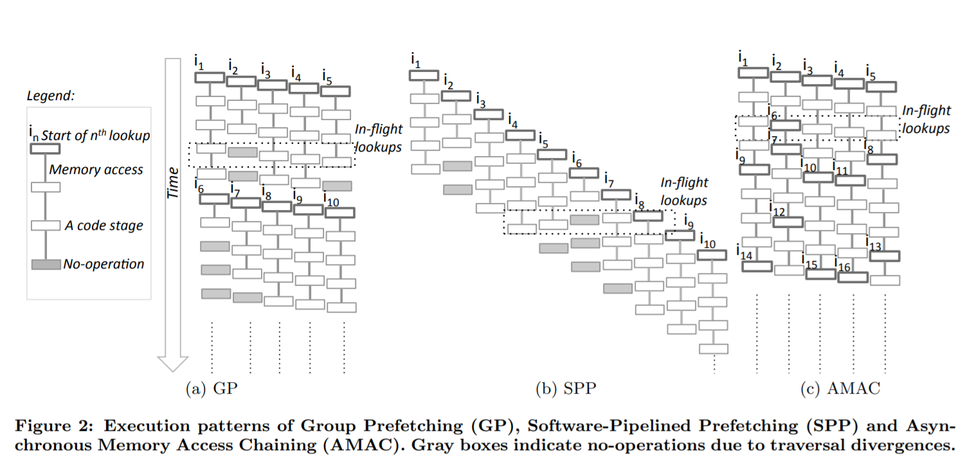
How to use coroutine

Slide 12
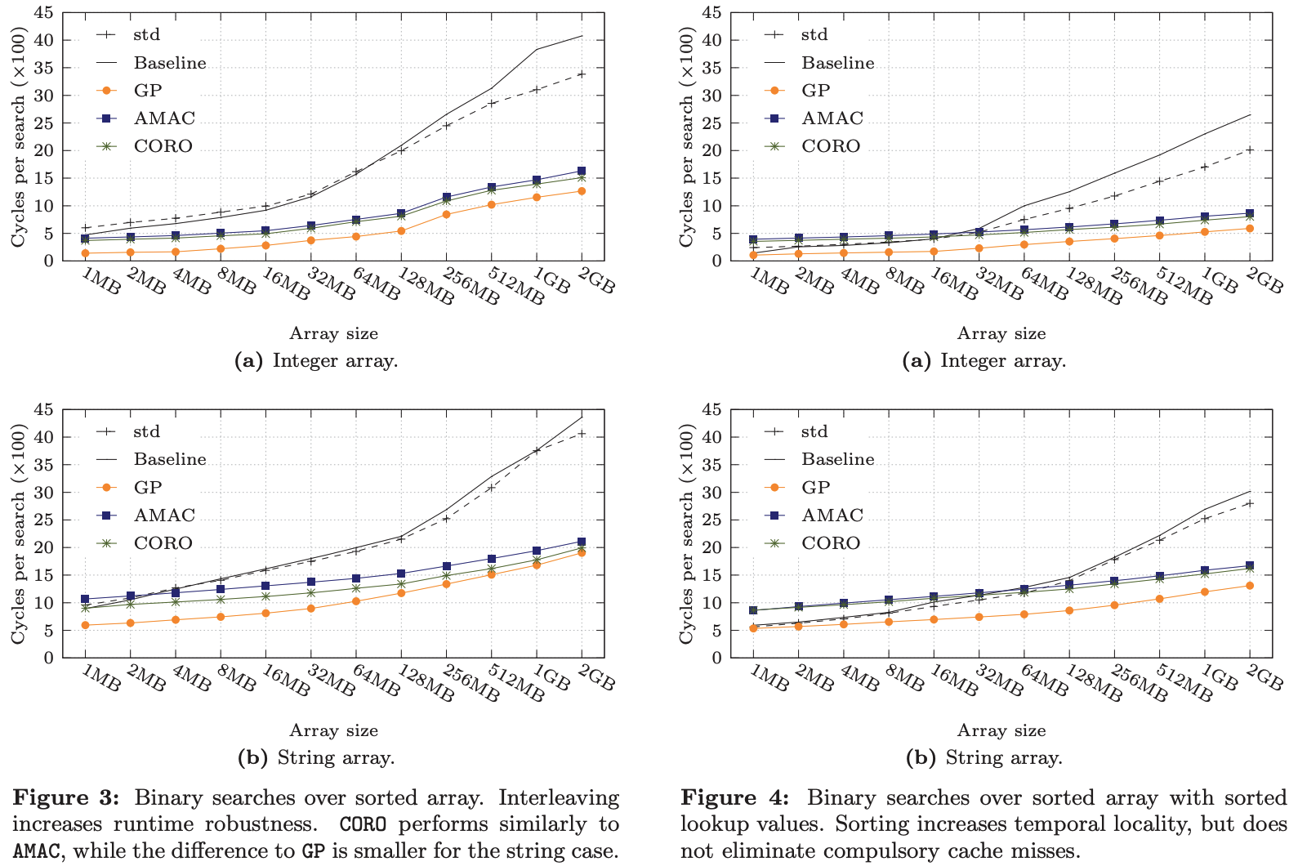
Performance

Slide 13
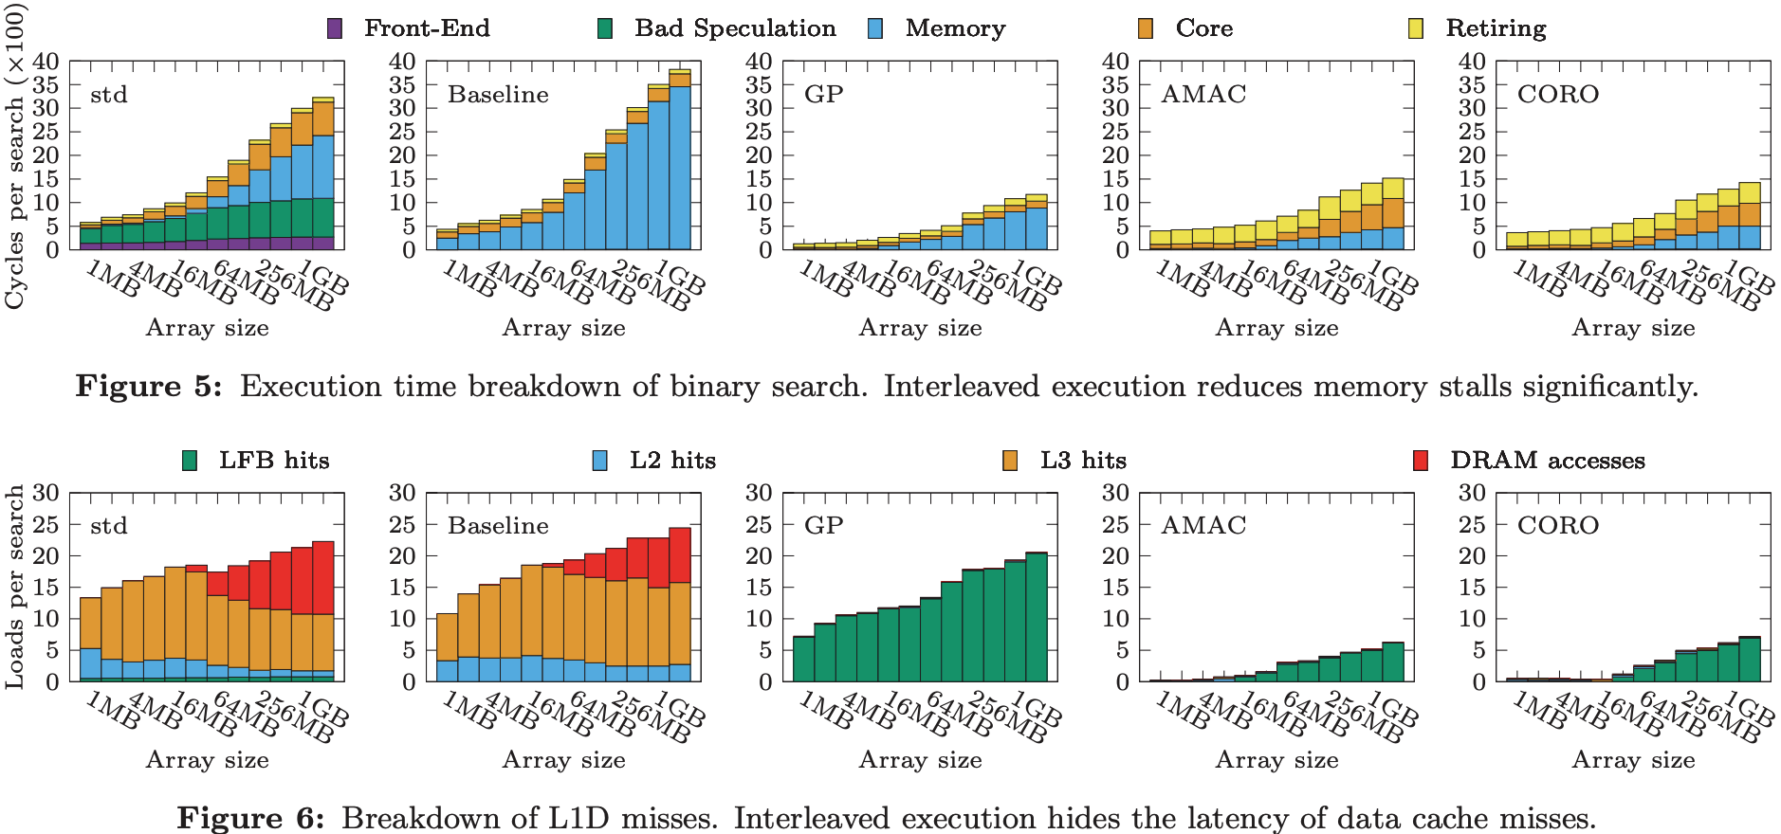
Performance

Slide 14
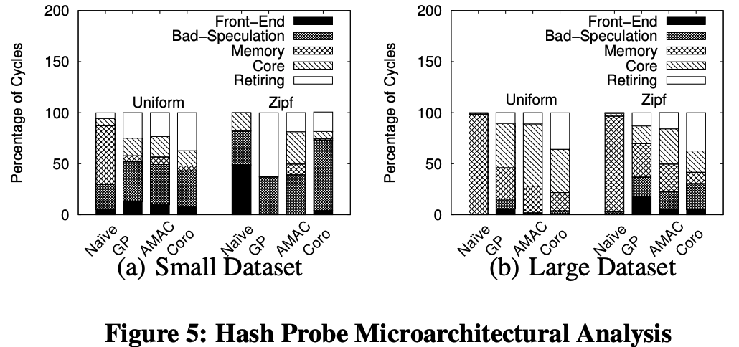
Performance

Slide 15
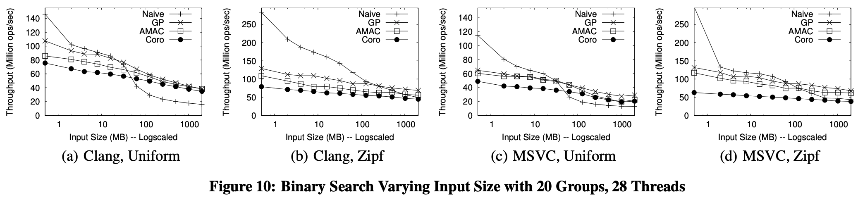
Performance

Slide 16
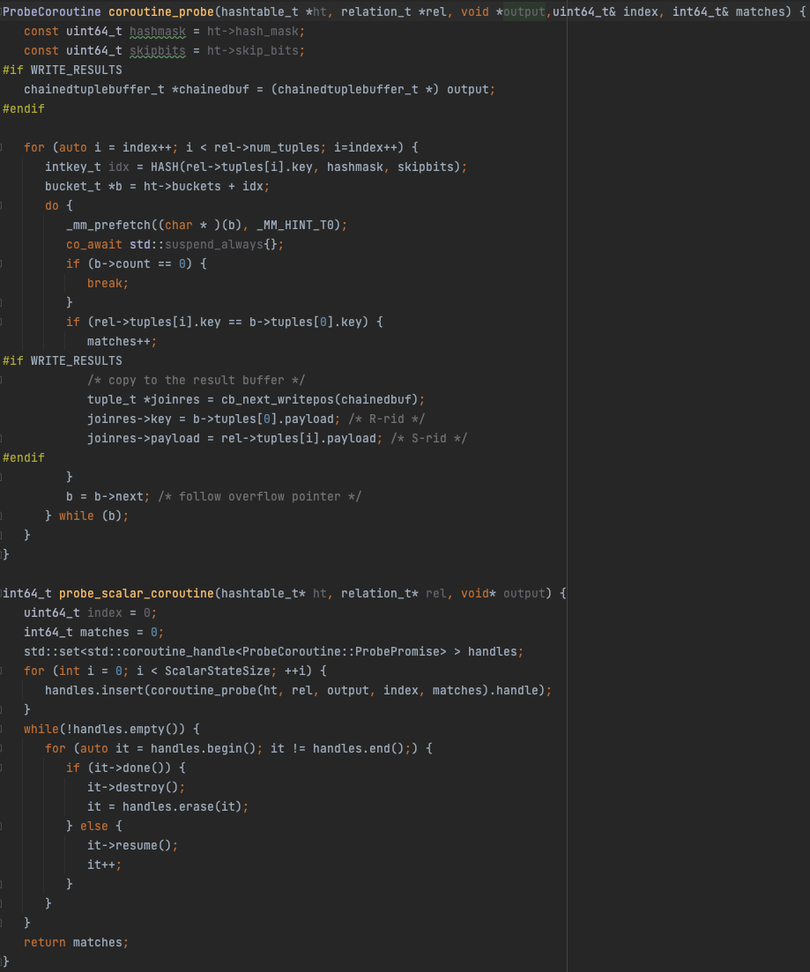
verification
code source

Slide 17
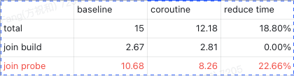
Verification in StarRocks
heavy inner hash join reduce ~20% time
select count(*) from lineitem t join lineitem s on s.l_partkey = t.l_orderkey;
1 FE + 1 BE(16 threads) elastic cluster, pipeline_dop = 16;

Slide 18
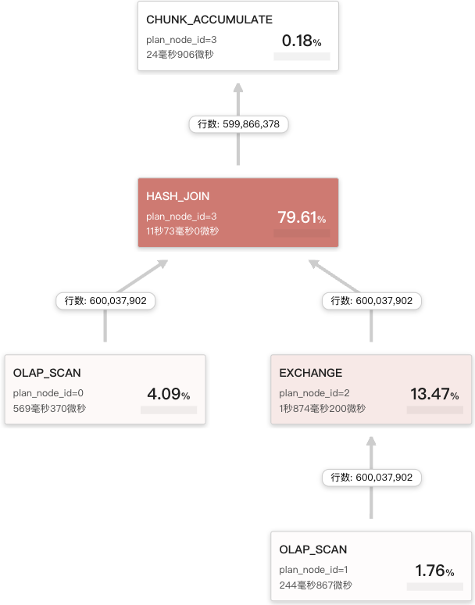
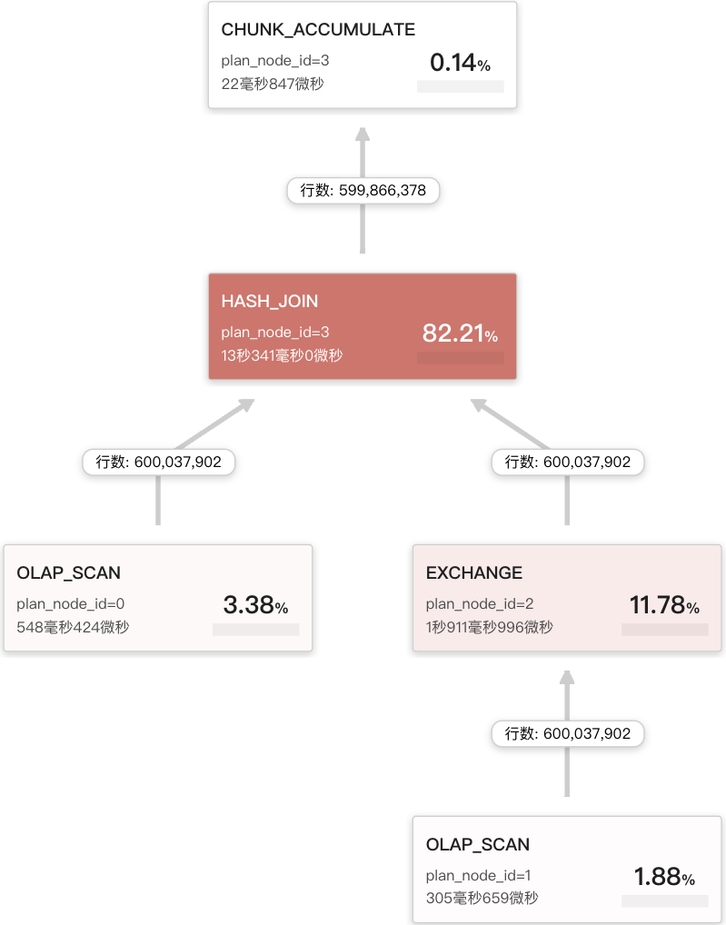
Verification in StarRocks

Slide 19
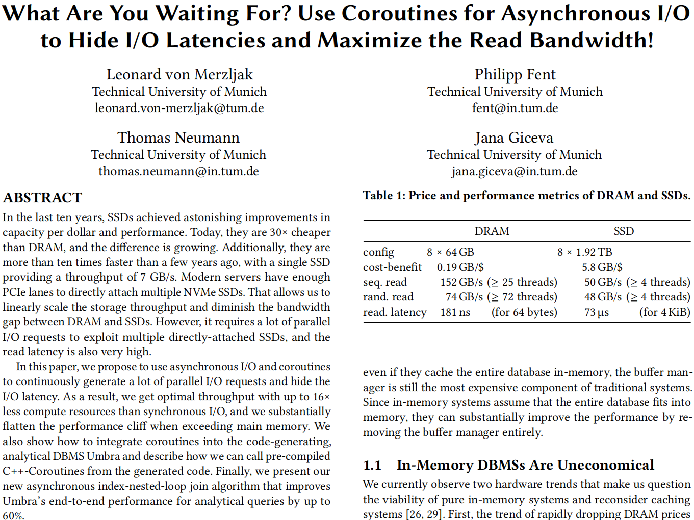
TODO
compile with clang
try more operators, include scan, hash build
do more exprements, including on TPC-H, TPC-DS

Slide 20
THANKS

