Slide 1




Mobile-Efficient Image Super-Resolution with Plain-Endpoint ECB Networks Yuebo Hu
SR
SR
LR
HR
LR
HR

Slide 2
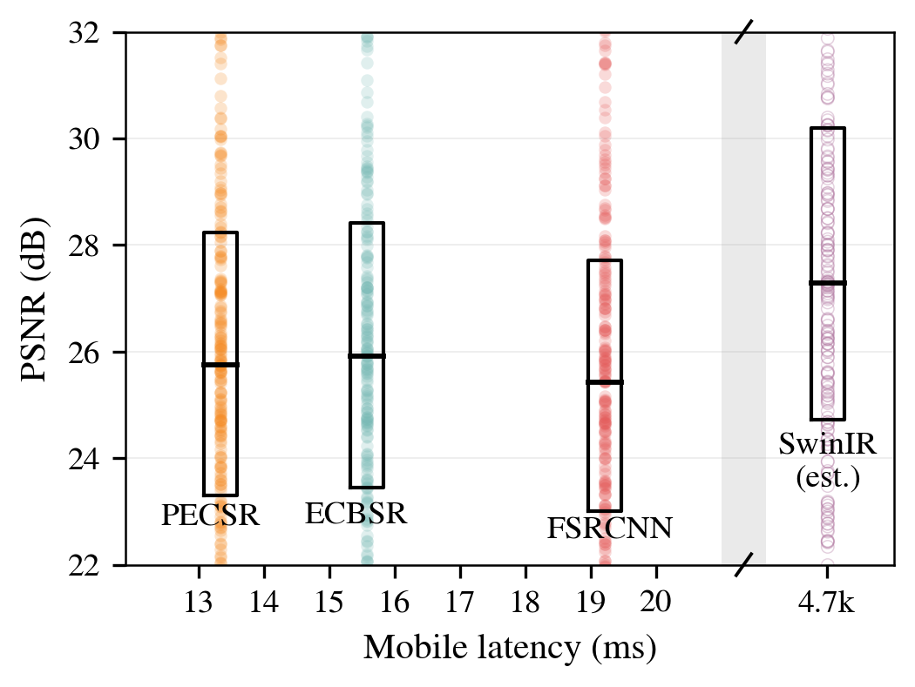
Motivation
SOTA models like SwinIR cannot balance quality and on-device latency, since Transformer blocks blow up size and computation.
Instead, many mobile-efficient CNN models:
1. operate at LR and then PixelShuffle
2. use Edge-oriented Convolution Blocks (ECB)
We further remove residuals for smaller latency. PECSR (ours) is 14% faster, at a 0.51% PSNR cost relative to standard ECBSR (reproduced baseline).

Slide 3
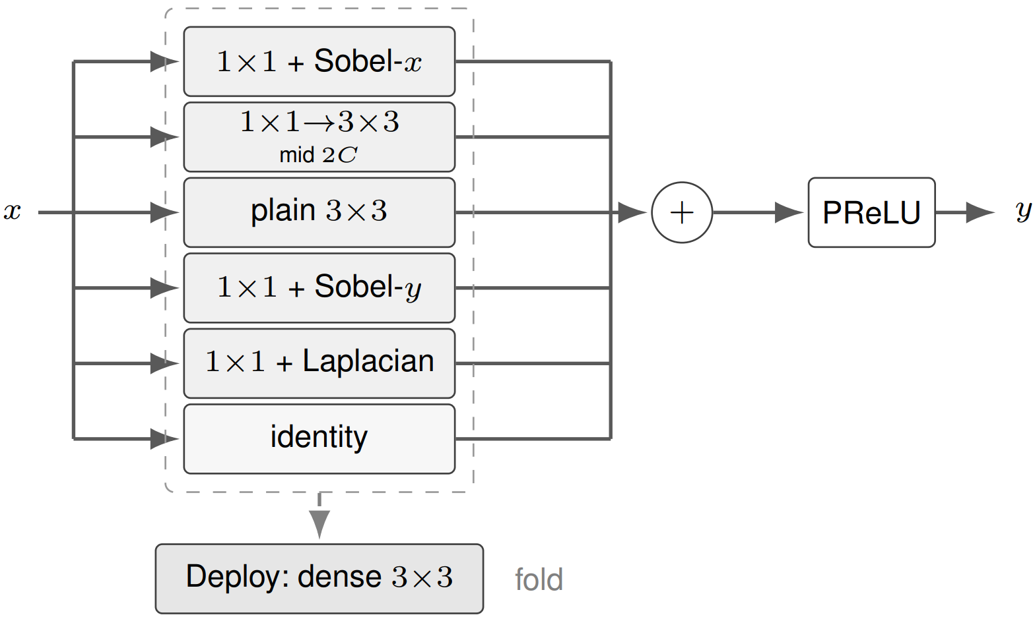
Network Design
Why use Edge-oriented Convolution Blocks (ECB):
1. Train: multi-branch block → more capacity / better edges
2. Deploy: fold to one dense 3×3 → same cost as a plain CNN
Edge operators matter for SR quality:
1. Sobel: first-order gradients → horizontal / vertical edges
2. Laplacian: second-order → ridges, corners, texture

Slide 4
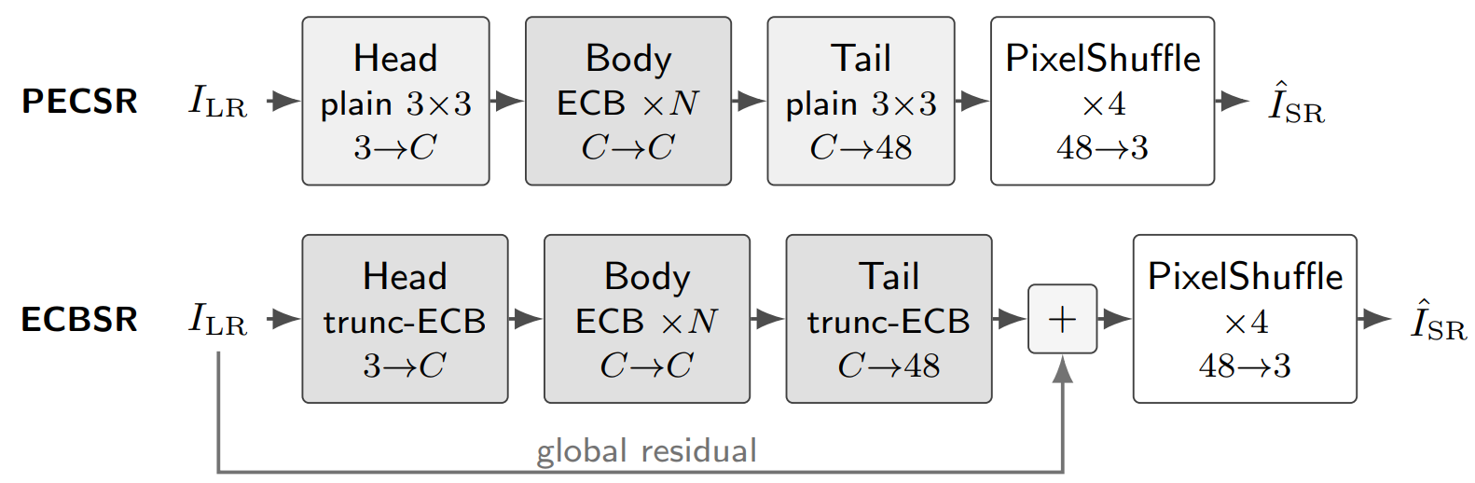
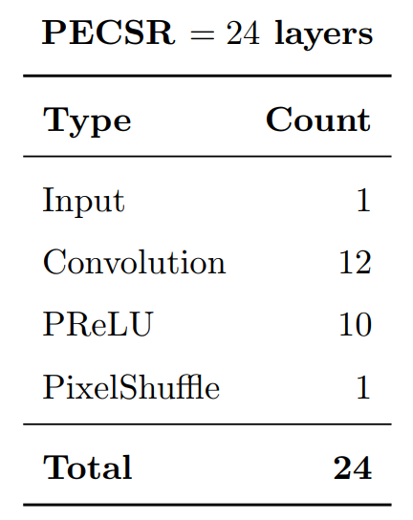
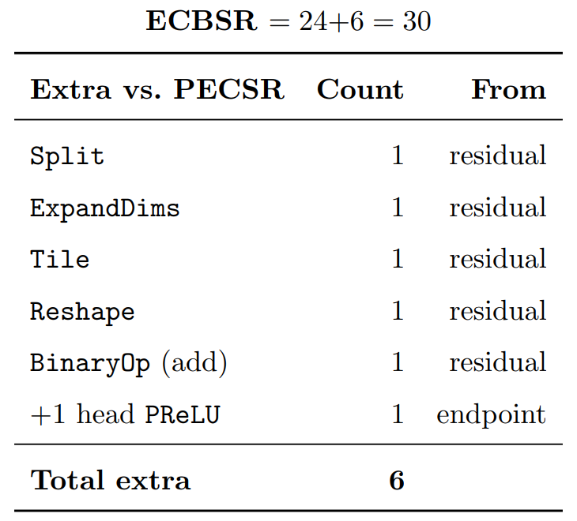
Network Design
PECSR: Plain-Endpoint ECB Super-Resolution
(ours)
ECBSR: Edge-oriented Convolution Blocks SR
(reproduced baseline)
Our design:
Use plain head and tail
Apply ECB only to equal-channel (C →C) body
Drop residual
Ours has 6 (20%) less NCNN graph layers

Slide 5
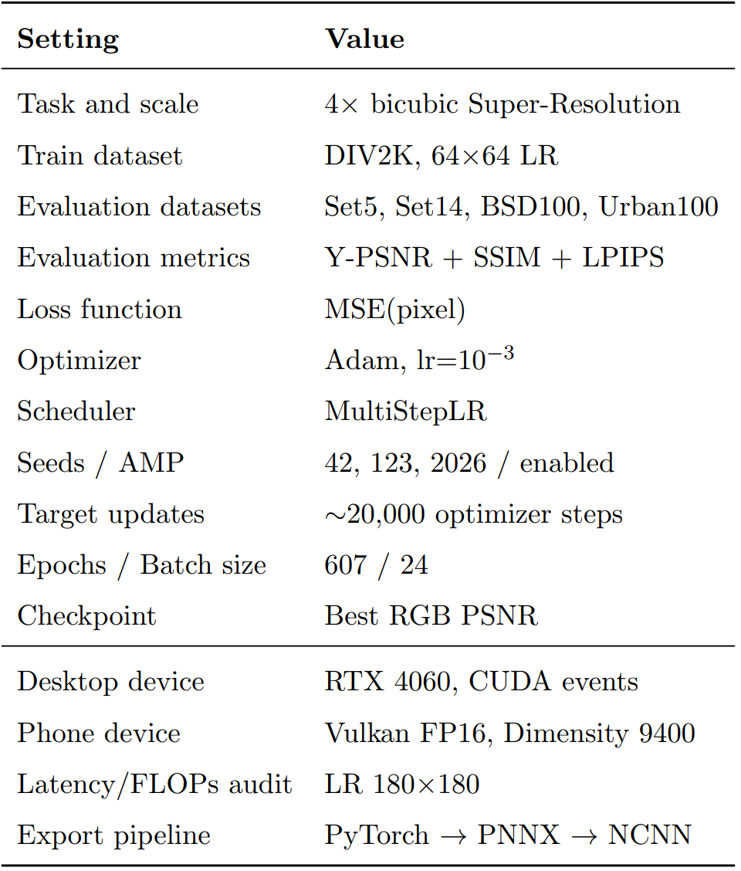
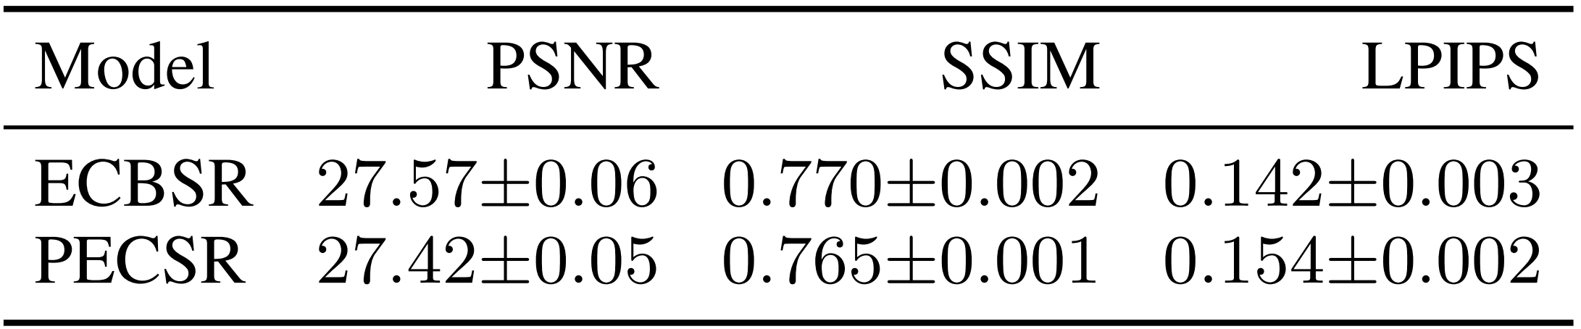
Experiment Setup
The fair budget controls optimizer updates.
Training image sizes vary;
Evaluation image size is fixed at 180×180.
Training results across random seeds are stable.

Slide 6
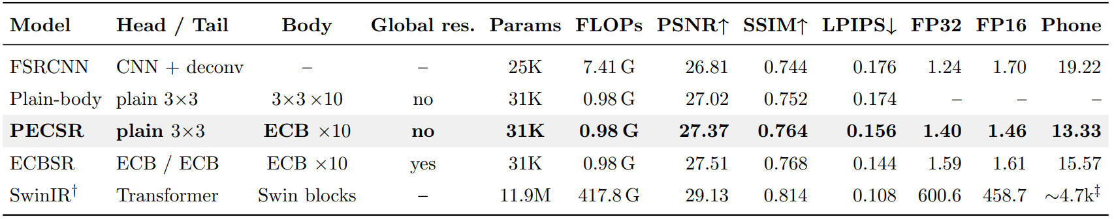
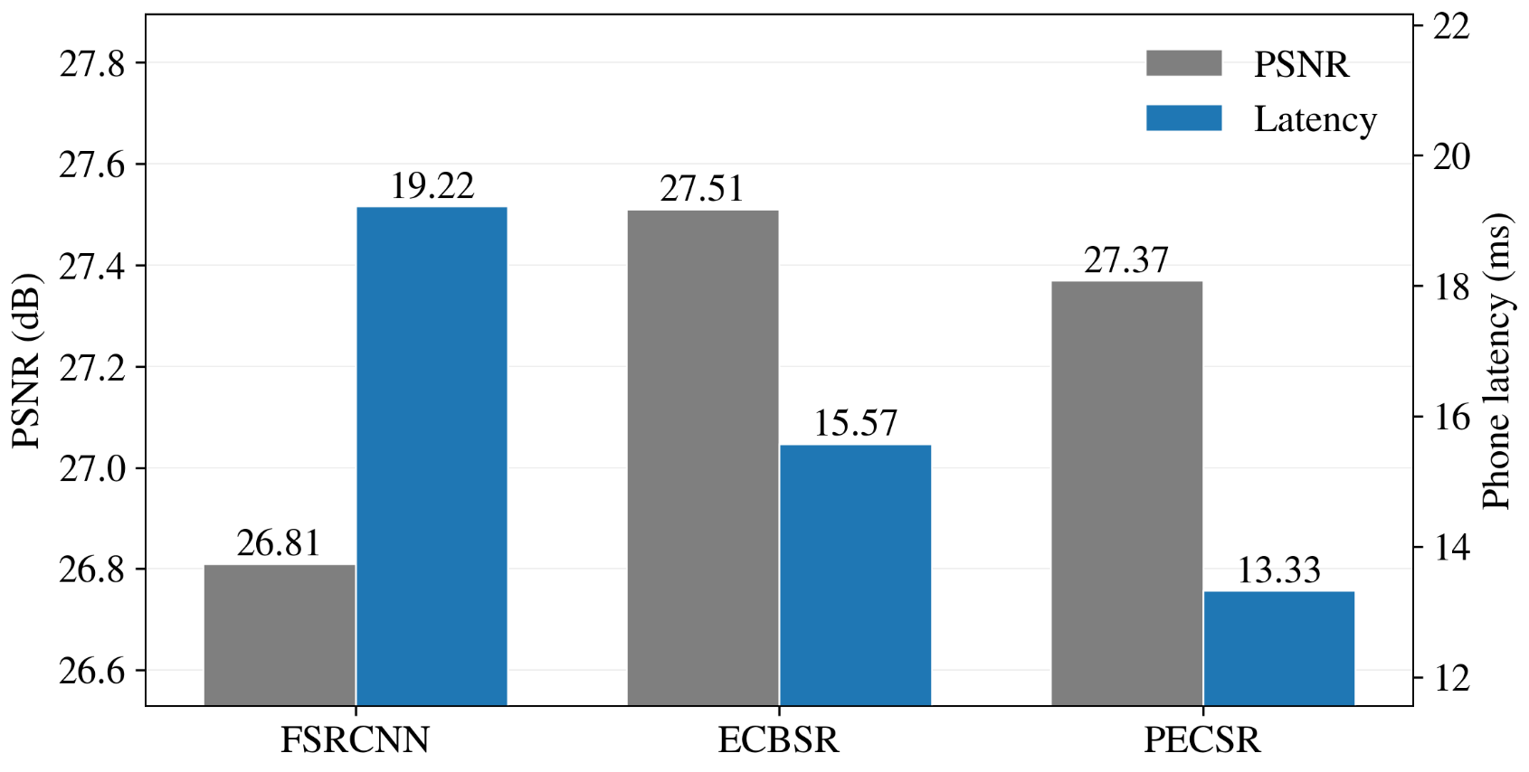
Results
Mobile latency: PECSR at 13.33 ms, 14% faster than ECBSR.
PSNR: PECSR at 27.37 dB, 0.51% weaker than ECBSR.
Both metrics clearly outperform FSRCNN.
The trade-off is consistent across multiple evaluation metrics.
Ablation model “Plain-body” shows ECBs are necessary.
SwinIR has latencies at several magnitudes above.

Slide 7
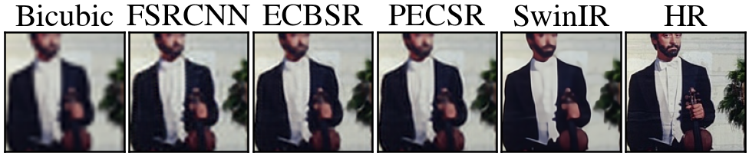
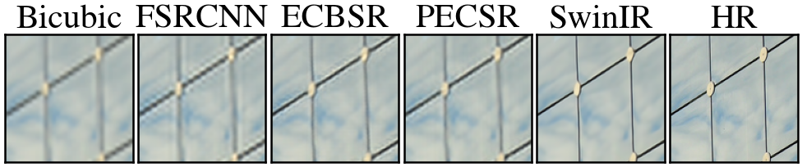
Qualitative Observation

Slide 8
Qualitative Observation
Distinguish better between nose, beard, and face.
Less sawtooth halo (unwanted white line).
ECBSR
PECSR
ECBSR
PECSR

Slide 9
Conclusion
Efficient SR needs both quality and latency.
We do this by reducing NCNN graph layers in mobile deployment.
Using ECB (Edge-oriented Convolution Blocks), we design PECSR (Plain-Endpoint ECB SR).
Ablation proves ECB trunk is indispensable.
We achieve 14% lower phone latency at the cost of a small 0.51% PSNR gap.

Slide 10
References
[1] C. Dong et al., “Accelerating the Super-Resolution Convolutional Neural Network,” ECCV, 2016.
[2] W. Shi et al., “Real-Time Single Image and Video Super-Resolution Using an Efficient Sub-Pixel Convolutional Neural Network,” CVPR, 2016.
[3] X. Ding et al., “RepVGG: Making VGG-style ConvNets Great Again,” CVPR, 2021.
[4] X. Zhang et al., “Edge-oriented Convolution Block for Real-time Super Resolution on Mobile Devices,” ACM MM, 2021.
[5]J. Liang et al., “SwinIR: Image Restoration Using Swin Transformer,” ICCV Workshops, 2021.
Full bibliography in report paper.

