Slide 1
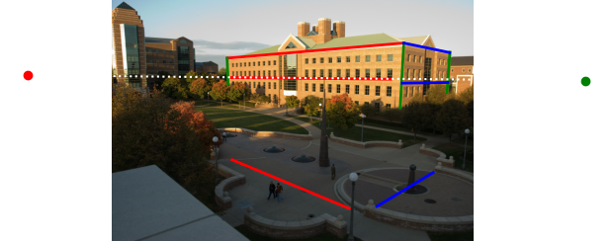
v
t0
t
r
b0
b

