Slide 1
Introducing Git/Gerrit

Slide 2
Topics:
Git
Gerrit
Workflow using Git/Gerrit

Slide 3
Introducing Git
Git is a free & open source, distributed version control system designed to handle everything from small to very large projects with speed and efficiency
There are two ways to get a Git repository, one is through the “Git clone” command, this will copy an full-fledged repository that already exist with complete history info to your local working directory, and the other is through “Git init”, this will create a new git repository.

Slide 4
commonly used Git commands
Git clone: copy a git repository so you can add to it
For example: git clone git://review.sonyericsson.net/semctools/gpvlab/workspace, this will clone the whole git repository to your local machine.
By default, Git will create a directory that is the same name as the project in the URL you give it, in this case, the directory is ‘workspace’
Git add: adds file contents to the staging area
Git status: view the status of your files in the working directory and staging area
Git diff: shows diff of what is staged and what is modified but unstaged
Git Commit: records a snapshot of the staging area and commit your changes to your local repository

Slide 5
Git branch: list, create and manager working contexts
Git branch
Without arguments, git branch will list out the local branches that you have. The branch that you are currently working on will have a star next to it
Git branch branch-name
This will create a new branch with the name you gave. You can think of branch like a bookmark from where you currently are.
Git checkout: switch you between your branches
Git checkout -b branch-name
This will create a new branch and immediately switch to the new branch
Git merge: merge a branch content to your current one
Git pull: fetch from a remote repo and try to merge into the current branch
Git push: push your new branches and data to a remote repository
Git remote: list your remote aliases, you can use “git remote –v” to look your remote repository’s address when you forget it

Slide 6
Gerrit
Gerrit is a web based code review system, facilitating online code reviews for projects using the Git version control system.
Gerrit makes reviews easier by showing changes in a side-by-side display, and allowing inline comments to be added by any reviewer.
Gerrit simplifies Git based project maintainership by permitting any authorized user to submit changes to the master Git repository, rather than requiring all approved changes to be merged in by hand by the project maintainer. This functionality enables a more centralized usage of Git.

Slide 7
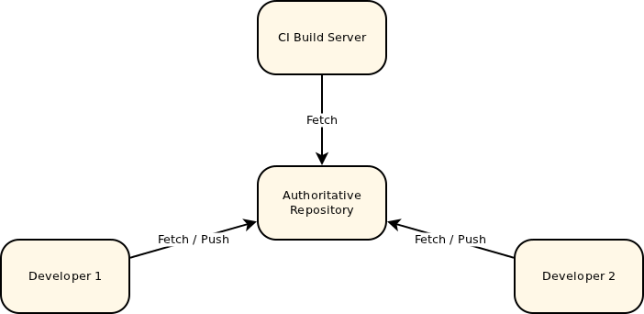
Central Repository without Gerrit

Slide 8
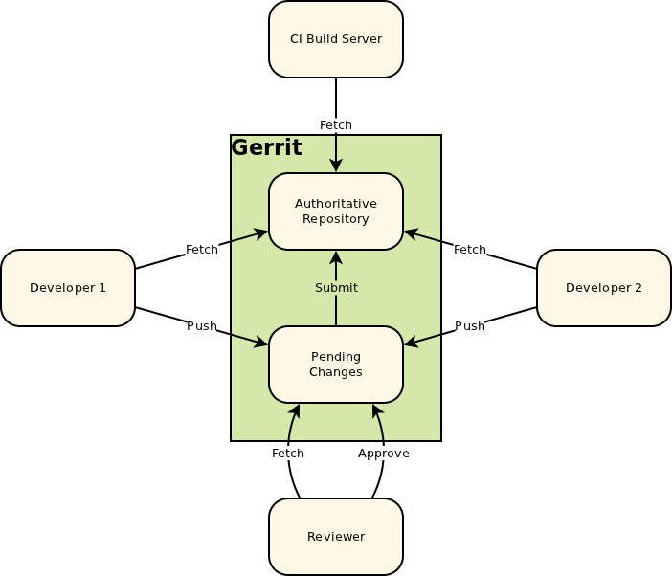
Gerrit in Central Repository

Slide 9
Workflow with Git and Gerrit
Assume that you already have a copy of remote repository.
Git pull: get the latest updates from the remote repository. E.g. Git pull ssh://firstnam.lastname@review.sonyericsson.net/semctools/gpvlab/testcases
Git branch: list the branch you current on
Git checkout master: switch to master branch
Git checkout –b your_temp_branch: create and switch to the branch, to add your changes
Create or edit the file
Git add: add your changes into the stage area to prepare a commit
Git commit –m “comments”: commit your change to your local repository

Slide 10
Git push: push your change to Gerrit server for review. E.g. git push ssh://firstname.lastname@sonyericsson.net/semctools/gpvlab/testcases HEAD:refs/for/master. In the push log, there have a link of the review page, you can click the link to visit the review page.
If the changes get approved from the Code Reviewer and the Verifier, your changes will automatically merged into the master branch of the remote repository.

Slide 11
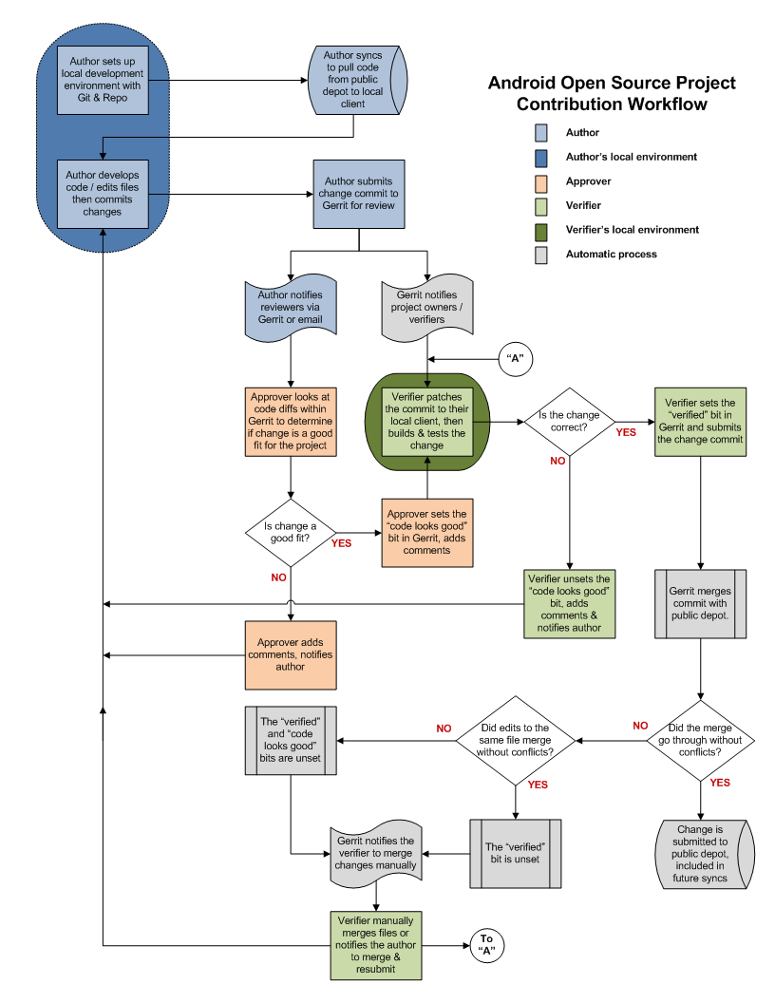
Default workflow

Slide 12
Useful Links
You can get more information from the following links
Git Reference: http://gitref.org/
Gerrit:gerrit-documentation

Slide 13
Q&A
thanks

