Slide 1
PhysLiteBench
Yue Pan and Andrew Liu
Notes:
Target time: 10 seconds.
We study how well coding agents can turn a physical setup and limited measurements into predictions.
Sources:

Slide 2
Physics beyond a good fit
Can agents identify the physics behind a scenario and predict beyond the observed data?
Available to the agent | What the evaluator checks
Physical description and starter code | Fit to observed data and model parameters
Calibration data and public tests | Predictions beyond the observed settings
Documented Python functions and I/O format | Completion within the time budget
13
physics tasks require predictions beyond the supplied observations.
General and physics hints test what guidance helps agents succeed.
2
Notes:
Target time: 45 seconds.
Our key question is whether an agent can identify the physics behind a scenario and predict beyond what it observes. A good fit to the supplied data is not enough. We use thirteen tasks with hidden predictions, then test whether general checking instructions and task-specific physics guidance improve performance. The hints probe what the agent misses without guidance.
The suite was selected using GPT-5.6 Luna. The original ten tasks had zero of three Luna High passes during initial selection. All thirteen are implemented with Harbor. Selection outcomes differ from independent evaluation. Historical controls, runtime differences and unmatched hint length limit causal interpretation. General-hint gains alone cannot identify a specifically physical reasoning defect. The task-specific hints and reviewed failures provide further evidence.
Sources:
/Users/yp9846/Desktop/PhysLiteBench/results/task-roster.json
/Users/yp9846/Desktop/PhysLiteBench/output/presentation-20261014/PhysLiteBench-focused-study-figures-20261015/sources/hint-matrix-summary.md
/Users/yp9846/Desktop/PhysLiteBench/output/presentation-20261014/PhysLiteBench-focused-study-figures-20261015/summary.json

Slide 3
Example Task: tracking one bead in a narrow tube
The beads move randomly and bump into each other, but cannot pass one another.
Start every run with the same spacing
What the agent gets
A setup description, starter code, and data
on how far the bead typically moves
at several observation times.
Observe the orange bead early in the run
What the agent must predict
Fit the spread of random motion (variance).
Then predict how the bead’s early and later
positions correlate across many runs (covariance).
Observe that same bead later in the run
Physics it must account for
The initial bead spacing can affect the correlation
between early and later motion.
The agent overestimates covariance between early and later bead positions.
3
Notes:
Target time: 85 seconds.
Imagine a long tube containing a row of beads. Random motion makes them bump around, but the tube is too narrow for one bead to pass another. We mark one bead orange and observe it. Every repeat starts with all the beads in exactly the same evenly spaced positions. We release them, then record the orange bead's position early and later in the same run. The next run starts from the original row but has different random motion. The pictures illustrate one possible run, not measured data. What does the agent know? It has this description, starter code, and measurements of how far the orange bead typically moves at several chosen times. These data let it estimate how strong the random motion is. What must it predict? Across many repeats, how strongly are the orange bead's early and later positions connected? For example, in runs where it is farther right early, does it also tend to be farther right later, and how strong is that relationship? The agent must write a numerical prediction for this relationship. The important physical detail is how we start the experiment. The beads begin in a regular row and cannot pass one another. That arrangement can still influence how motion at one time relates to motion later. Fitting the movement strength alone does not settle that question.
Sources:
/Users/yp9846/Desktop/PhysLiteBench/tasks/single-file-memory/environment/README.md
/Users/yp9846/Desktop/PhysLiteBench/tasks/single-file-memory/instruction.md
/Users/yp9846/Desktop/PhysLiteBench/tasks/single-file-memory/environment/model.py
/Users/yp9846/Desktop/PhysLiteBench/tasks/single-file-memory/solution/model.py
/Users/yp9846/Desktop/PhysLiteBench/tasks/single-file-memory/AUTHOR.md
One run shown. Each repeat resets the starting row.
Illustrative setup. The benchmark asks for the statistical trend after long observation times, rather than one bead’s exact path.

Slide 4
Three prompt conditions
The task stays the same. Hints probe why the agent fails.
Condition | Instruction or added guidance
No hint | Use the setup and supplied data to implement the model.
General hint | “Check your implementation carefully and test its correctness before finishing.”
Physics hint | The starting arrangement affects how early and later motion are correlated. Account for that shared history.
For the bead example
The general hint asks the agent to check its work.
The physics hint points to something its formula may be missing.
4
Notes:
Target time: 60 seconds.
There are three prompt conditions. The baseline gives the original task and public files. The general hint asks the agent to check its implementation and test correctness. It does not identify which assumption might need attention. The physics hint points to a specific feature of the experiment. For the beads, it emphasizes that the same starting arrangement can affect the relationship between positions measured at two times. The full hint also suggests how to calculate this relationship. The slide summarizes its physical idea in everyday language. The hint supplies a direction for thinking, not the final formula. We keep the task files and grading the same across these conditions.
Sources:
/Users/yp9846/Desktop/PhysLiteBench/results/hint-comparison-20261014/plan.json
/Users/yp9846/Desktop/PhysLiteBench/tasks/single-file-memory/hint.md
No-hint instruction shortened. General hint quoted exactly. Physics hint summarized in plain language from the actual task hint.

Slide 5
Experiment and evaluation
13 frozen tasks. A pass requires completion within the time limit and all graded checks. 3 repeat for each config.
Model | No-hint efforts | Hinted efforts | Tasks | Attempts
GPT-5.6 Luna | None to Max (6 levels) | None to Max (6 levels) | 13 | 781
GPT-5.6 Terra | Low, Medium, High, Extra High | Low, Medium, High | 13 | 468
GPT-5.6 Sol | Low, Medium | Low, Medium | 13 | 234
GPT-6 Luna | Low, High, Extra High | — | 13 | 117
GPT-6 Sol | Low, High, Extra High | — | 13 | 117
GPT-6 Astra | Low, High, Extra High | — | 13 | 117
DeepSeek V4.1 Flash | Low, High, Max | High | 13 | 234
2,068 attempts across 48 model, effort and hint settings.
Harbor with Codex agents. Time limits: 600 s for solving and 60 s for grading.
5
Notes:
Target time: 55 seconds.
This is one study across seven model versions. Each listed setting covers all thirteen tasks. A batch usually samples three independent attempts per task, without stopping after a pass. We combine independent repetitions of the same model, effort and condition, and count each reused baseline only once. The table shows total attempts over the listed conditions, including exceptions. The exact breakdown is in the backup tables and CSV. No-hint totals are 1,054; general and physics hints each have 507. An incomplete three-attempt DeepSeek None pilot remains outside these totals.
Results are grouped by exact model version, effort and reported prompt condition. Thirty-eight duplicate baseline records were removed by trial identity. Rates are total completed passes divided by all recorded attempts, including execution errors. Most settings have 39 attempts, repeated settings have 78. Luna High no-hint has 40: four attempts on entropy-anomaly and three on each other task. The three-attempt DeepSeek None pilot is retained outside the primary summary. Five earlier setup records were replaced before the reported 780 model-attempt matrix; the later setup failure and administrative interruptions remain in their original denominators. No outcomes have been rerun or changed.
The task content and grading match the frozen 13-task suite according to saved hashes and published verification metadata. Runtime varies across batches: Codex CLI 0.154.0 or 0.160.0; concurrency four or up to eight under CPU quotas in earlier batches; later concurrency up to three, then six sharing eight Docker CPUs. Agent and verifier limits remain 600 and 60 seconds. Baselines can predate hint runs, and hint length is not matched. These pooled comparisons are descriptive, not randomized causal estimates. Published aggregate data is included, but the 780 hinted raw transcripts were not independently reviewed on this machine. Their published model/session and source checks are preserved in the source archive.
Costs use saved Standard API-equivalent token rates, including caching and per-request long-context factors. They are not subscription charges and exclude local compute. Incomplete costs are never imputed as zero. Unknown provider charges retain bounds, whose upper reserves are not confirmed spending.
Sources:
/Users/yp9846/Desktop/PhysLiteBench/output/presentation-20261014/PhysLiteBench-study-figures-20261015/summary.csv
/Users/yp9846/Desktop/PhysLiteBench/output/presentation-20261014/PhysLiteBench-study-figures-20261015/source-manifest.json
/Users/yp9846/Desktop/PhysLiteBench/output/presentation-20261014/PhysLiteBench-study-figures-20261015/aggregate_results.py
/Users/yp9846/Desktop/PhysLiteBench/output/presentation-20261014/PhysLiteBench-study-figures-20261015/plot_results.py

Slide 6
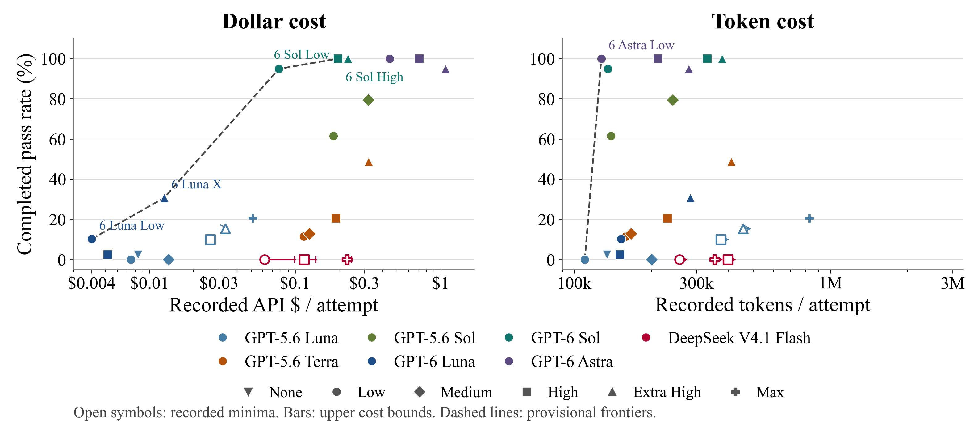
Cost and success without hints
All 24 benchmark settings. Both cost axes use log scales.
6
Notes:
Target time: 75 seconds.
These two panels use the same no-hint outcomes. Dollar cost is on the left and processed tokens on the right, both on log scales. Every benchmark setting is now visible, including the five settings with incomplete usage. Open points are recorded minima, and the horizontal bars show conservative provider reserve ceilings. The low-cost GPT-6 Luna and high-success GPT-6 Sol settings still stand out in dollars. GPT-6 Astra Low uses relatively few processed tokens at high success, but its higher token price makes it more expensive. Token count and dollar cost therefore tell different stories.
All 48 primary model/effort/condition settings appear across slides 6 and 7. Slide 6 has all 24 no-hint settings representing 1,054 attempts. Slide 7 has all 36 settings for the 12 model/effort combinations measured under all three hint conditions, representing 1,600 distinct attempts within that comparison. Twelve baseline settings appear in both views for comparison, but their observations are not added again to the 2,068 study total. The three-attempt DeepSeek None pilot covers only one task. It is excluded from the figures, benchmark totals and frontier; its source records are preserved. No new attempts or changed grades were introduced.
Dollar coordinates are the saved complete API-equivalent estimate where available, otherwise the recorded minimum divided by every attempt in the cell. The previous plots omitted five incomplete no-hint settings and fourteen incomplete matched-hint settings. This version draws every one. Open markers show incomplete usage. Arrows point toward unrecorded additional usage and do not encode a finite interval. DeepSeek dollar bars end at the preserved conservative reserve ceilings; those ceilings are not confirmed spending. No model-based imputation fills missing requests. Dashed lines show provisional Pareto envelopes at the displayed costs, using all primary points, including the lower bounds. If unrecorded usage moves an open point rightward, the true frontier may change. The lines connect observed settings and do not imply intermediate model configurations.
Token coordinates are the sum of request input plus output tokens divided by all attempts, including errors. Cached input is already part of input, and reasoning is already part of output, so neither is added twice. For DeepSeek, saved provider ledgers supersede incomplete client-observed totals. This includes retries and streams finishing after agent timeout; 157 archived provider batches have 3,341 unique request IDs including the pilot. Unknown stream usage remains a lower bound. One published Terra Medium/general aggregate reports only total recorded tokens, so its input/output split remains unavailable. Tokens measure processed token volume, not latency, FLOPs, uncached tokens or subscription usage. Different model prices and caching account for differences between dollar and token plots.
Rates and unique trial identities are unchanged. Raw published hinted trials are aggregate evidence, not independently reviewed here. Runtime differences and historical controls remain, so this is a descriptive comparison. All five pre-agent setup records remain outside their original matrix denominator and all retained execution exceptions remain in their original counts.
Sources:
/Users/yp9846/Desktop/PhysLiteBench/output/presentation-20261014/PhysLiteBench-no-pilot-figures-20261016/resource-summary.csv
/Users/yp9846/Desktop/PhysLiteBench/output/presentation-20261014/PhysLiteBench-no-pilot-figures-20261016/resource-summary.json
/Users/yp9846/Desktop/PhysLiteBench/output/presentation-20261014/PhysLiteBench-no-pilot-figures-20261016/aggregate_resources.py
/Users/yp9846/Desktop/PhysLiteBench/output/presentation-20261014/PhysLiteBench-no-pilot-figures-20261016/plot_resources.py
/Users/yp9846/Desktop/PhysLiteBench/output/presentation-20261014/PhysLiteBench-no-pilot-figures-20261016/source-manifest.json
/Users/yp9846/Desktop/PhysLiteBench/output/presentation-20261014/PhysLiteBench-no-pilot-figures-20261016/sources/provider-resource-records.json

Slide 7
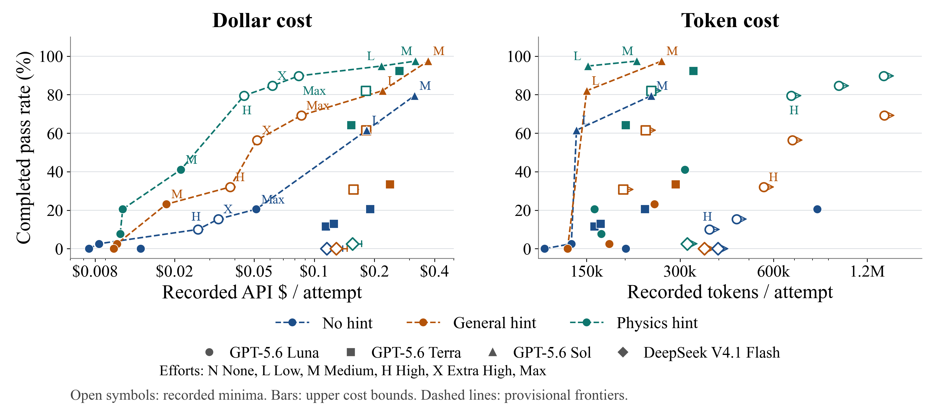
Cost and success with hints
All 36 settings across the same 12 model–effort combinations. Both cost axes use log scales.
7
Notes:
Target time: 50 seconds.
The three prompt conditions use the same twelve model and effort combinations. All thirty-six settings appear in both panels. In particular, the previously missing Luna High, Extra High and Max hinted settings are now visible as open circles. Physics hints generally improve observed success, although they can also change the amount of work. The dollar and token frontiers differ because model prices and caching differ. The dashed frontiers use recorded minima, so incomplete usage can move points to the right. We preserve every attempt and keep failures and execution errors in the pass-rate denominator.
All 48 primary model/effort/condition settings appear across slides 6 and 7. Slide 6 has all 24 no-hint settings representing 1,054 attempts. Slide 7 has all 36 settings for the 12 model/effort combinations measured under all three hint conditions, representing 1,600 distinct attempts within that comparison. Twelve baseline settings appear in both views for comparison, but their observations are not added again to the 2,068 study total. The three-attempt DeepSeek None pilot covers only one task. It is excluded from the figures, benchmark totals and frontier; its source records are preserved. No new attempts or changed grades were introduced.
Dollar coordinates are the saved complete API-equivalent estimate where available, otherwise the recorded minimum divided by every attempt in the cell. The previous plots omitted five incomplete no-hint settings and fourteen incomplete matched-hint settings. This version draws every one. Open markers show incomplete usage. Arrows point toward unrecorded additional usage and do not encode a finite interval. DeepSeek dollar bars end at the preserved conservative reserve ceilings; those ceilings are not confirmed spending. No model-based imputation fills missing requests. Dashed lines show provisional Pareto envelopes at the displayed costs, using all primary points, including the lower bounds. If unrecorded usage moves an open point rightward, the true frontier may change. The lines connect observed settings and do not imply intermediate model configurations.
Token coordinates are the sum of request input plus output tokens divided by all attempts, including errors. Cached input is already part of input, and reasoning is already part of output, so neither is added twice. For DeepSeek, saved provider ledgers supersede incomplete client-observed totals. This includes retries and streams finishing after agent timeout; 157 archived provider batches have 3,341 unique request IDs including the pilot. Unknown stream usage remains a lower bound. One published Terra Medium/general aggregate reports only total recorded tokens, so its input/output split remains unavailable. Tokens measure processed token volume, not latency, FLOPs, uncached tokens or subscription usage. Different model prices and caching account for differences between dollar and token plots.
Rates and unique trial identities are unchanged. Raw published hinted trials are aggregate evidence, not independently reviewed here. Runtime differences and historical controls remain, so this is a descriptive comparison. All five pre-agent setup records remain outside their original matrix denominator and all retained execution exceptions remain in their original counts.
Sources:
/Users/yp9846/Desktop/PhysLiteBench/output/presentation-20261014/PhysLiteBench-no-pilot-figures-20261016/resource-summary.csv
/Users/yp9846/Desktop/PhysLiteBench/output/presentation-20261014/PhysLiteBench-no-pilot-figures-20261016/resource-summary.json
/Users/yp9846/Desktop/PhysLiteBench/output/presentation-20261014/PhysLiteBench-no-pilot-figures-20261016/aggregate_resources.py
/Users/yp9846/Desktop/PhysLiteBench/output/presentation-20261014/PhysLiteBench-no-pilot-figures-20261016/plot_resources.py
/Users/yp9846/Desktop/PhysLiteBench/output/presentation-20261014/PhysLiteBench-no-pilot-figures-20261016/source-manifest.json
/Users/yp9846/Desktop/PhysLiteBench/output/presentation-20261014/PhysLiteBench-no-pilot-figures-20261016/sources/provider-resource-records.json

Slide 8
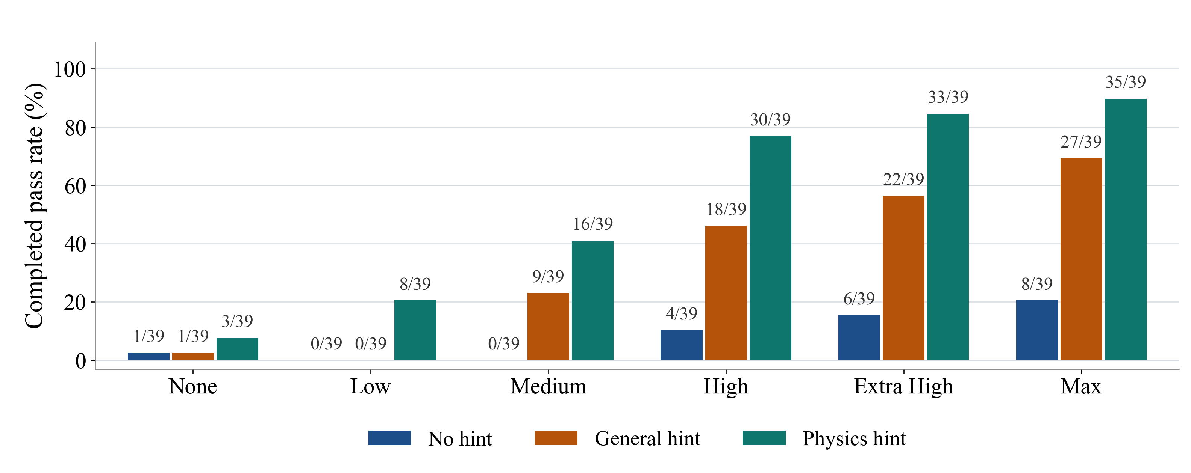
Luna: reasoning effort and hints
GPT-5.6 Luna. 13 tasks × 3 attempts for each effort and hint condition.
General hints help at higher efforts. Physics hints help at every effort.
8
Notes:
Target time: 55 seconds.
The model is GPT-5.6 Luna throughout. Every bar uses thirteen tasks with three attempts each, giving thirty-nine attempts. At High effort, the completed passes are four without a hint, eighteen with a general hint, and thirty with a physics hint. General hints increase the observed pass rate from Medium effort upward. Physics hints have the highest observed rate at all six efforts. These results suggest that relevant physics is often available to the agent but is not identified or applied without guidance.
This figure selects the complete six-effort matrix and its historical no-hint controls. It does not add the later independent High-effort replication or the one fresh baseline. The prior 78-attempt bars pooled independent trials, rather than duplicate trial identities, but this view deliberately keeps one three-repeat panel per cell. Full-study plots and backup tables still preserve the independent replication. Execution errors remain in each denominator. No trial outcomes were changed.
The hint comparison remains descriptive. Earlier controls differ in runtime, concurrency and CPU quotas. Hint lengths are not matched. A general hint may improve checking, implementation or attention, and alone does not isolate a physics deficit. Task-specific hint gains together with submitted-code failure evidence support the proposed interpretation. Published hinted evidence is aggregate only; raw transcripts were not independently inspected here.
Sources:
/Users/yp9846/Desktop/PhysLiteBench/output/presentation-20261014/PhysLiteBench-focused-study-figures-20261015/luna-effort-panel.json
/Users/yp9846/Desktop/PhysLiteBench/output/presentation-20261014/PhysLiteBench-focused-study-figures-20261015/sources/baseline-luna-trials.csv
/Users/yp9846/Desktop/PhysLiteBench/output/presentation-20261014/PhysLiteBench-focused-study-figures-20261015/sources/hint-matrix-summary.csv
/Users/yp9846/Desktop/PhysLiteBench/output/presentation-20261014/PhysLiteBench-focused-study-figures-20261015/plot_results.py

Slide 9
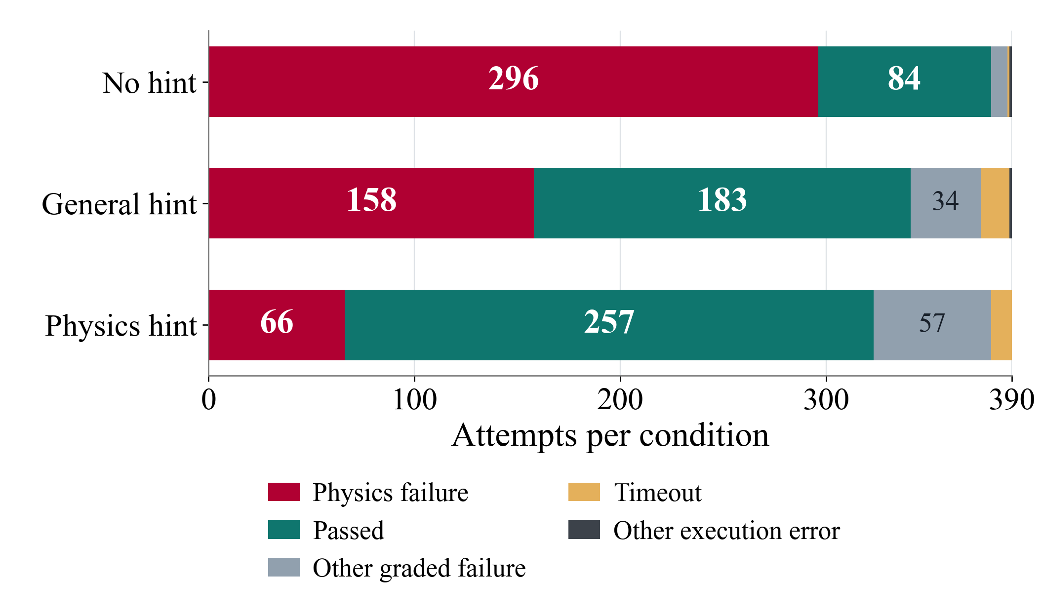
Fewer physics failures with hints
Physics failure: fits the supplied data, but uses the wrong model for new predictions.
GPT-5.6 Luna, Terra and Sol. 390 attempts per condition across 10 model–effort settings.
33 to 2
Luna High physics failures:
no hint versus physics hint,
each out of 39 attempts.
56 / 66
Remaining physics failures
with physics hints are in Luna
at None, Low or Medium effort.
9
Notes:
Target time: 55 seconds.
Here a physics failure means the agent fits the supplied data, but the reviewed code uses the wrong physical model for a new prediction. Across the same ten model and effort settings, we see 296 such failures without hints, 158 with a general hint and 66 with a physics hint, out of 390 attempts per condition. At Luna High, the counts are 33, 12 and 2 out of 39. Hints help, but lower reasoning effort still leaves a problem: 56 of the 66 physics failures with physics hints are Luna at None, Low or Medium effort. The other colors keep mathematical or coding failures and execution errors separate. Now the bead example shows what this kind of physics error looks like in code.
This classification covers 1,170 existing matrix attempts, not additional observations: 390 no-hint, 390 general-hint and 390 physics-hint. It uses GPT-5.6 Luna at None, Low, Medium, High, Extra High and Max; GPT-5.6 Terra at Low and Medium; and GPT-5.6 Sol at Low and Medium. Each of the 30 cells has thirteen tasks with three attempts, so n=39. The full study remains 2,068 unique attempts. The additional independent High-effort study and other models are outside this strict classification. No classifications were imputed for them. Luna High here is the same single 39-attempt matrix used on slide 8.
A physics failure is a normally completed reward-0 attempt that passes calibration, parameter recovery and the public checks, fails at least one hidden prediction, and has a reviewed primary physical-model error. Mathematical, numerical or coding primaries remain Other graded failure, even if a secondary physics issue appears. Execution exceptions take precedence over saved grades. Timeout and other execution errors never establish a physics mistake.
The published report reuses full observable-trajectory and final-code reviews for 315 hinted graded failures and targeted reviews of 304 historical no-hint graded failures. We verified aggregate counts and overlap with archived results; we did not independently review the underlying raw trajectories or unpublished classification ledger. The report states 4,686 original artifact hashes were checked. The report ledger SHA-256 is b9faeffe2d4db9c983eab440f52b0eb19cf9222ead0e142fd0c9dfb2a2e5faca. No new model runs, numerical diagnostic reruns or grades were introduced.
Historical controls used four workers without the newer per-container CPU quotas. Hint runs used up to eight workers capped at 8.8 CPU cores including proxies. Hint lengths also differ. Comparisons describe observed outcomes and do not isolate a causal hint effect. Aggregate changes do not show that particular failed attempts became passes. Five replaced pre-agent DNS failures remain outside this matrix, preventing double counting of their replacements. All other retained exceptions remain in the 39-attempt denominators.
Sources:
https://github.com/liuyiqiandrew/PhysLiteBench/blob/f1164fe2b2bc8d312733bedbfc633b48e3b3cb36/results/hint-comparison-20261015-005800/outcome-breakdown.md
/Users/yp9846/Desktop/PhysLiteBench/output/presentation-20261014/PhysLiteBench-physics-failure-figures-20261015/failure-breakdown.json
/Users/yp9846/Desktop/PhysLiteBench/output/presentation-20261014/PhysLiteBench-physics-failure-figures-20261015/analyze_failures.py
/Users/yp9846/Desktop/PhysLiteBench/output/presentation-20261014/PhysLiteBench-physics-failure-figures-20261015/plot_failures.py
/Users/yp9846/Desktop/PhysLiteBench/output/presentation-20261014/PhysLiteBench-physics-failure-figures-20261015/outcome-source-manifest.json

Slide 10
Why the agent failed on the bead task
GPT-5.6 Terra High, no hint
Same evenly spaced start
Fits the measured motion
Adjusts how far the bead wanders
at each observation time.
Early position
Later position
Overestimates early–late covariance
Keeps the starter’s covariance formula.
Assumes equal-duration intervals have the same motion statistics, regardless of when they start.
Same bead in one run
The agent overestimates the covariance
Fits the supplied data. Covariance errors reach 136% (allowed tolerance: 4%).
10
Notes:
Target time: 80 seconds.
Here is the same bead example, now using a saved Terra run. Every repeat starts with the neighbors evenly spaced. We record the orange bead early and again later. The red arrow means a statistical link across repeats, not a force between two beads.
The agent adjusted one number controlling the amount of random motion. Its code matched the supplied measurements of how far the bead wanders at each time, and the public test passed.
But it kept the starter's rule for connecting the two observations. In plain terms, that rule made an early displacement count too much when predicting the later motion. The evenly spaced starting row affects this connection, and its formula did not account for that effect correctly. Matching the spread at each time could not reveal this mistake.
The hidden predictions were wrong by as much as 136%, against a 4% allowance. We checked the diagnosis by keeping its fitted motion strength and replacing only the rule connecting two times. The largest error fell to about 0.003%. That is our diagnostic correction, not a new agent pass or a hint result. The conclusion comes from the saved code, tool actions and tests.
Sources:
/Users/yp9846/Desktop/PhysLiteBench/tasks/single-file-memory/environment/README.md
/Users/yp9846/Desktop/PhysLiteBench/tasks/single-file-memory/environment/model.py
/Users/yp9846/Desktop/PhysLiteBench/tasks/single-file-memory/solution/model.py
/Users/yp9846/Desktop/PhysLiteBench/results/trajectory-analysis-20261014/cases/single-file-memory__PC6LumP/review.json
/Users/yp9846/Desktop/PhysLiteBench/results/trajectory-analysis-20261014/cases/single-file-memory__PC6LumP/model.diff
/Users/yp9846/Desktop/PhysLiteBench/results/trajectory-analysis-20261014/cases/single-file-memory__PC6LumP/metrics.json
/Users/yp9846/Desktop/PhysLiteBench/results/trajectory-analysis-20261014/diagnostic-repairs.json
Technical clarification for questions: both formulas have correlated motion and agree at equal times. The saved formula overestimates the two-time covariance. It incorrectly treats increments as depending only on the time gap. The benchmark uses a joint long-time coefficient, not the finite-time positions drawn in this schematic. Equations and exact metrics remain in backup slide 16.
Allowed tolerance: 4%. The covariance describes averages across repeated runs. Bead positions are schematic.

Slide 11
Conclusions
Agents can fit observations and still miss the physics
The bead example fits the data but predicts the covariance incorrectly.
Hints reduce observed physics failures
Luna High: 33/39 without hints, 12/39 with a general hint, and 2/39 with a physics hint.
The gains suggest a gap in physical reasoning
Agents often need guidance to identify and use relevant physics.
11
Notes:
Target time: 30 seconds.
Agents can fit observations and still miss the physics. The bead example shows how the wrong covariance formula fails beyond the supplied data. Both general and physics hints improve prediction performance. The new reviewed breakdown also shows fewer primary physics failures, with Luna High falling from 33 to 12 to 2 out of 39. Together, these results suggest that agents often need guidance to identify and use relevant physics.
The hint result is descriptive. General hints can improve checking or implementation as well as physical reasoning. Historical controls and runtime differences remain, and this selected suite does not establish a universal capability limit. The 33, 12 and 2 refer to failures, whereas slide 8 uses completed passes of 4, 18 and 30 in those same cells. They are not complements because other graded failures and execution errors remain separate.
This classification covers 1,170 existing matrix attempts, not additional observations: 390 no-hint, 390 general-hint and 390 physics-hint. It uses GPT-5.6 Luna at None, Low, Medium, High, Extra High and Max; GPT-5.6 Terra at Low and Medium; and GPT-5.6 Sol at Low and Medium. Each of the 30 cells has thirteen tasks with three attempts, so n=39. The full study remains 2,068 unique attempts. The additional independent High-effort study and other models are outside this strict classification. No classifications were imputed for them. Luna High here is the same single 39-attempt matrix used on slide 8.
A physics failure is a normally completed reward-0 attempt that passes calibration, parameter recovery and the public checks, fails at least one hidden prediction, and has a reviewed primary physical-model error. Mathematical, numerical or coding primaries remain Other graded failure, even if a secondary physics issue appears. Execution exceptions take precedence over saved grades. Timeout and other execution errors never establish a physics mistake.
The published report reuses full observable-trajectory and final-code reviews for 315 hinted graded failures and targeted reviews of 304 historical no-hint graded failures. We verified aggregate counts and overlap with archived results; we did not independently review the underlying raw trajectories or unpublished classification ledger. The report states 4,686 original artifact hashes were checked. The report ledger SHA-256 is b9faeffe2d4db9c983eab440f52b0eb19cf9222ead0e142fd0c9dfb2a2e5faca. No new model runs, numerical diagnostic reruns or grades were introduced.
Historical controls used four workers without the newer per-container CPU quotas. Hint runs used up to eight workers capped at 8.8 CPU cores including proxies. Hint lengths also differ. Comparisons describe observed outcomes and do not isolate a causal hint effect. Aggregate changes do not show that particular failed attempts became passes. Five replaced pre-agent DNS failures remain outside this matrix, preventing double counting of their replacements. All other retained exceptions remain in the 39-attempt denominators.
Sources:
https://github.com/liuyiqiandrew/PhysLiteBench/blob/f1164fe2b2bc8d312733bedbfc633b48e3b3cb36/results/hint-comparison-20261015-005800/outcome-breakdown.md
/Users/yp9846/Desktop/PhysLiteBench/output/presentation-20261014/PhysLiteBench-physics-failure-figures-20261015/failure-breakdown.json
/Users/yp9846/Desktop/PhysLiteBench/output/presentation-20261014/PhysLiteBench-physics-failure-figures-20261015/analyze_failures.py
/Users/yp9846/Desktop/PhysLiteBench/output/presentation-20261014/PhysLiteBench-physics-failure-figures-20261015/plot_failures.py
/Users/yp9846/Desktop/PhysLiteBench/output/presentation-20261014/PhysLiteBench-physics-failure-figures-20261015/outcome-source-manifest.json

Slide 12
Questions
3 minutes
Notes:
Target time: 180 seconds.
Questions. Useful scope distinctions are task selection versus evaluation, completed passes versus timeout checkpoints, and descriptive hint comparisons versus causal estimates. Backup slides provide the full model/effort tables, task roster and bead covariance formulas. The plotting bundle contains the archived sources, hash manifest, aggregation script and Python plotting script.
Sources:
/Users/yp9846/Desktop/PhysLiteBench/output/presentation-20261014/PhysLiteBench-study-figures-20261015/summary.csv
/Users/yp9846/Desktop/PhysLiteBench/output/presentation-20261014/PhysLiteBench-study-figures-20261015/source-manifest.json
/Users/yp9846/Desktop/PhysLiteBench/output/presentation-20261014/PhysLiteBench-study-figures-20261015/aggregate_results.py
/Users/yp9846/Desktop/PhysLiteBench/output/presentation-20261014/PhysLiteBench-study-figures-20261015/plot_results.py
Additional backup slides 18 and 19 give the reviewed physics failures by model/effort/hint and the mutually exclusive outcome definitions. They classify existing observations, with no added trials.

Slide 13
Backup: no-hint results by model and effort
Completed passes / attempts. Errors are retained. Mean cost is shown only when complete.
Model and effort | Passes / n | Errors | Mean cost
5.6 Luna None | 1/39 | 0 | $0.0084
5.6 Luna Low | 0/39 | 0 | $0.0074
5.6 Luna Medium | 0/39 | 0 | $0.0135
5.6 Luna High | 4/40 | 1 | Incomplete
5.6 Luna Extra High | 6/39 | 1 | Incomplete
5.6 Luna Max | 8/39 | 0 | $0.0513
5.6 Terra Low | 9/78 | 0 | $0.1145
5.6 Terra Medium | 5/39 | 0 | $0.1254
5.6 Terra High | 16/78 | 1 | $0.1905
5.6 Terra Extra High | 19/39 | 4 | $0.3196
5.6 Sol Low | 24/39 | 0 | $0.1832
5.6 Sol Medium | 31/39 | 0 | $0.3178
Model and effort | Passes / n | Errors | Mean cost
6 Luna Low | 4/39 | 0 | $0.0040
6 Luna High | 1/39 | 0 | $0.0052
6 Luna Extra High | 12/39 | 4 | $0.0126
6 Sol Low | 37/39 | 0 | $0.0773
6 Sol High | 39/39 | 0 | $0.1975
6 Sol Extra High | 39/39 | 0 | $0.2306
6 Astra Low | 39/39 | 0 | $0.4450
6 Astra High | 39/39 | 0 | $0.7132
6 Astra Extra High | 37/39 | 2 | $1.0801
DeepSeek Low | 0/39 | 33 | Incomplete
DeepSeek High | 0/78 | 71 | Incomplete
DeepSeek Max | 0/39 | 38 | Incomplete
All 24 settings cover 13 tasks. DeepSeek None has only 3 attempts and is excluded. Costs are API-equivalent estimates.
13
Notes:
Backup.
All complete no-hint settings, aggregated by exact model version and effort. This table retains results with missing cost, even though those settings are absent from the exact frontier. Terra Low and High, and DeepSeek High, each have 78 distinct attempts. Luna High has 40 because one fresh baseline was already started before historical baseline reuse. Other settings have 39. Cost bounds and original records are in the plotting bundle.
Results are grouped by exact model version, effort and reported prompt condition. Thirty-eight duplicate baseline records were removed by trial identity. Rates are total completed passes divided by all recorded attempts, including execution errors. Most settings have 39 attempts, repeated settings have 78. Luna High no-hint has 40: four attempts on entropy-anomaly and three on each other task. The three-attempt DeepSeek None pilot is retained outside the primary summary. Five earlier setup records were replaced before the reported 780 model-attempt matrix; the later setup failure and administrative interruptions remain in their original denominators. No outcomes have been rerun or changed.
The task content and grading match the frozen 13-task suite according to saved hashes and published verification metadata. Runtime varies across batches: Codex CLI 0.154.0 or 0.160.0; concurrency four or up to eight under CPU quotas in earlier batches; later concurrency up to three, then six sharing eight Docker CPUs. Agent and verifier limits remain 600 and 60 seconds. Baselines can predate hint runs, and hint length is not matched. These pooled comparisons are descriptive, not randomized causal estimates. Published aggregate data is included, but the 780 hinted raw transcripts were not independently reviewed on this machine. Their published model/session and source checks are preserved in the source archive.
Costs use saved Standard API-equivalent token rates, including caching and per-request long-context factors. They are not subscription charges and exclude local compute. Incomplete costs are never imputed as zero. Unknown provider charges retain bounds, whose upper reserves are not confirmed spending.
Sources:
/Users/yp9846/Desktop/PhysLiteBench/output/presentation-20261014/PhysLiteBench-study-figures-20261015/summary.csv
/Users/yp9846/Desktop/PhysLiteBench/output/presentation-20261014/PhysLiteBench-study-figures-20261015/source-manifest.json
/Users/yp9846/Desktop/PhysLiteBench/output/presentation-20261014/PhysLiteBench-study-figures-20261015/aggregate_results.py
/Users/yp9846/Desktop/PhysLiteBench/output/presentation-20261014/PhysLiteBench-study-figures-20261015/plot_results.py
Slides 6 and 7 now show incomplete costs at recorded lower bounds. This table retains its conservative complete-cost entries. Every numeric lower bound, provider reserve ceiling and token total is in /Users/yp9846/Desktop/PhysLiteBench/output/presentation-20261014/PhysLiteBench-all-cost-figures-20261015/resource-summary.csv. No incomplete value is treated as zero.

Slide 14
Backup: results under all three prompt conditions
Each cell shows completed passes / attempts, followed by execution errors in parentheses.
Model and effort | No hint | General hint | Physics hint
GPT-5.6 Luna None | 1/39 (0) | 1/39 (0) | 3/39 (2)
GPT-5.6 Luna Low | 0/39 (0) | 0/39 (0) | 8/39 (0)
GPT-5.6 Luna Medium | 0/39 (0) | 9/39 (0) | 16/39 (1)
GPT-5.6 Luna High | 4/40 (1) | 25/78 (3) | 62/78 (1)
GPT-5.6 Luna Extra High | 6/39 (1) | 22/39 (3) | 33/39 (1)
GPT-5.6 Luna Max | 8/39 (0) | 27/39 (5) | 35/39 (3)
GPT-5.6 Terra Low | 9/78 (0) | 12/39 (1) | 25/39 (2)
GPT-5.6 Terra Medium | 5/39 (0) | 24/39 (3) | 32/39 (1)
GPT-5.6 Terra High | 16/78 (1) | 13/39 (6) | 36/39 (1)
GPT-5.6 Sol Low | 24/39 (0) | 32/39 (0) | 37/39 (0)
GPT-5.6 Sol Medium | 31/39 (0) | 38/39 (0) | 38/39 (0)
DeepSeek V4.1 Flash High | 0/78 (71) | 0/39 (39) | 1/39 (38)
13 tasks per setting. Counts combine distinct attempts; repeated baseline records count once.
14
Notes:
Backup.
These twelve model-effort combinations have all three prompt conditions. The full experiment also includes models and effort settings tested without hints only. Every result in this table belongs to the same frozen thirteen-task benchmark. Parenthesized values are execution errors, not additional passes or independently diagnosed physics failures. The setup replacement policy differs across the archived schedules and remains documented, rather than being changed after the fact.
Results are grouped by exact model version, effort and reported prompt condition. Thirty-eight duplicate baseline records were removed by trial identity. Rates are total completed passes divided by all recorded attempts, including execution errors. Most settings have 39 attempts, repeated settings have 78. Luna High no-hint has 40: four attempts on entropy-anomaly and three on each other task. The three-attempt DeepSeek None pilot is retained outside the primary summary. Five earlier setup records were replaced before the reported 780 model-attempt matrix; the later setup failure and administrative interruptions remain in their original denominators. No outcomes have been rerun or changed.
The task content and grading match the frozen 13-task suite according to saved hashes and published verification metadata. Runtime varies across batches: Codex CLI 0.154.0 or 0.160.0; concurrency four or up to eight under CPU quotas in earlier batches; later concurrency up to three, then six sharing eight Docker CPUs. Agent and verifier limits remain 600 and 60 seconds. Baselines can predate hint runs, and hint length is not matched. These pooled comparisons are descriptive, not randomized causal estimates. Published aggregate data is included, but the 780 hinted raw transcripts were not independently reviewed on this machine. Their published model/session and source checks are preserved in the source archive.
Costs use saved Standard API-equivalent token rates, including caching and per-request long-context factors. They are not subscription charges and exclude local compute. Incomplete costs are never imputed as zero. Unknown provider charges retain bounds, whose upper reserves are not confirmed spending.
Sources:
/Users/yp9846/Desktop/PhysLiteBench/output/presentation-20261014/PhysLiteBench-study-figures-20261015/summary.csv
/Users/yp9846/Desktop/PhysLiteBench/output/presentation-20261014/PhysLiteBench-study-figures-20261015/source-manifest.json
/Users/yp9846/Desktop/PhysLiteBench/output/presentation-20261014/PhysLiteBench-study-figures-20261015/aggregate_results.py
/Users/yp9846/Desktop/PhysLiteBench/output/presentation-20261014/PhysLiteBench-study-figures-20261015/plot_results.py
Slide 8 now shows one six-effort Luna matrix with 39 attempts per cell. This backup table continues to show all unique attempts, including the independent later High repetition. These are different declared summaries, not duplicated trial identities.

Slide 15
Backup: the frozen 13-task roster
entropy-anomaly
rotating-reservoir
finite-layer-phoresis
single-file-memory
hierarchical-glass-overlaps
superconducting-heat
insulating-mhd-duct
swirling-heat-tails
magnetic-tracer
hard-rod-current
reaction-diffusion
finite-ion-cloud
ring-current-fluctuations
Frozen snapshot: 34dedfbbd8ff. Task selection against GPT-5.6 Luna limits generalization to a broader physics population.
15
Notes:
Backup.
The same thirteen task families are used throughout the study. Content and grading match the frozen source snapshot. The original ten have a preserved zero-of-three Luna High qualification record; the three later tasks have separate selection and confirmation evidence. Subsequent independent evaluations can pass.
Sources:
/Users/yp9846/Desktop/PhysLiteBench/results/task-roster.json

Slide 16
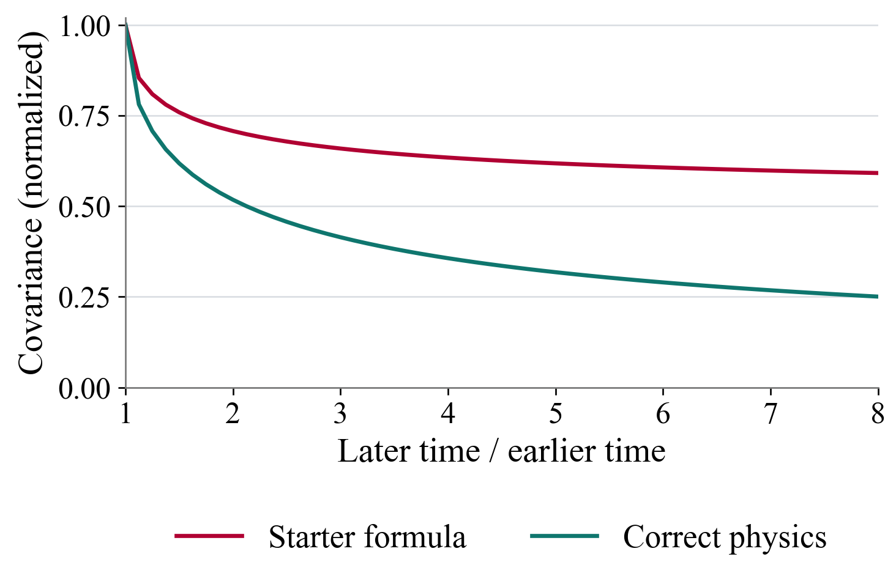
Backup: comparing the two prediction formulas
A narrow channel preserves particle order. Every experiment starts from the same positions.
Physical setup
Why fitting alone is insufficient
Reset to evenly spaced positions
●
Let the particles move randomly
●
Track the orange particle in each repeat.
Particles collide but never overtake.
Agent task: fit the movement scale, then
predict how two measurement times are related.
Same time: both fit.
Different times: memory changes the prediction.
Analytic covariance curves and schematic positions, not measured trajectories. The task asks for the long-time scaling coefficient.
16
Notes:
Target time: skip in current talk.
Technical detail for questions. The channel represents an infinite line of identical Brownian point particles with reflecting collisions and fixed initial positions j/rho in each independent repeat. The task predicts the joint long-time covariance coefficient, not finite-time trajectories or the exact position in one realization. With A = sqrt(D/pi)/rho, the correct coefficient is A[sqrt(t+s)-sqrt(abs(t-s))]. The starter uses A/sqrt(2)[sqrt(t)+sqrt(s)-sqrt(abs(t-s))]. Both agree on every equal-time setting. The plotted curves use the same D and density, normalized to the equal-time value, with earlier time multiplier 0.5 and later multiplier from 0.5 to 4. They therefore isolate the time-dependence difference. This plot is analytic, not a measured trial result. The apparent memory comes from the fixed preparation and no-passing constraint, even though the random forcing on different particles is independent. The saved Terra fit is 0.949947415037877. Its parameter error is 0.005535%, and its prediction-group errors at later/earlier ratios 2, 4 and 8 are 36.60%, 77.88% and 136.06%. Replacing only the covariance expression at the fixed fitted D reduces all tested group errors to 0.002768%.
Sources:
/Users/yp9846/Desktop/PhysLiteBench/tasks/single-file-memory/environment/README.md
/Users/yp9846/Desktop/PhysLiteBench/tasks/single-file-memory/instruction.md
/Users/yp9846/Desktop/PhysLiteBench/tasks/single-file-memory/environment/model.py
/Users/yp9846/Desktop/PhysLiteBench/tasks/single-file-memory/solution/model.py
/Users/yp9846/Desktop/PhysLiteBench/tasks/single-file-memory/AUTHOR.md
/Users/yp9846/Desktop/PhysLiteBench/results/trajectory-analysis-20261014/cases/single-file-memory__PC6LumP/metrics.json
/Users/yp9846/Desktop/PhysLiteBench/results/trajectory-analysis-20261014/diagnostic-repairs.json
The Python plot uses the exact 57 coordinate pairs per series from the user-edited source chart. No spline or smoothing is applied. The source series and plotting script are archived in /Users/yp9846/Desktop/PhysLiteBench/output/presentation-20261014/PhysLiteBench-study-figures-20261015.

Slide 17
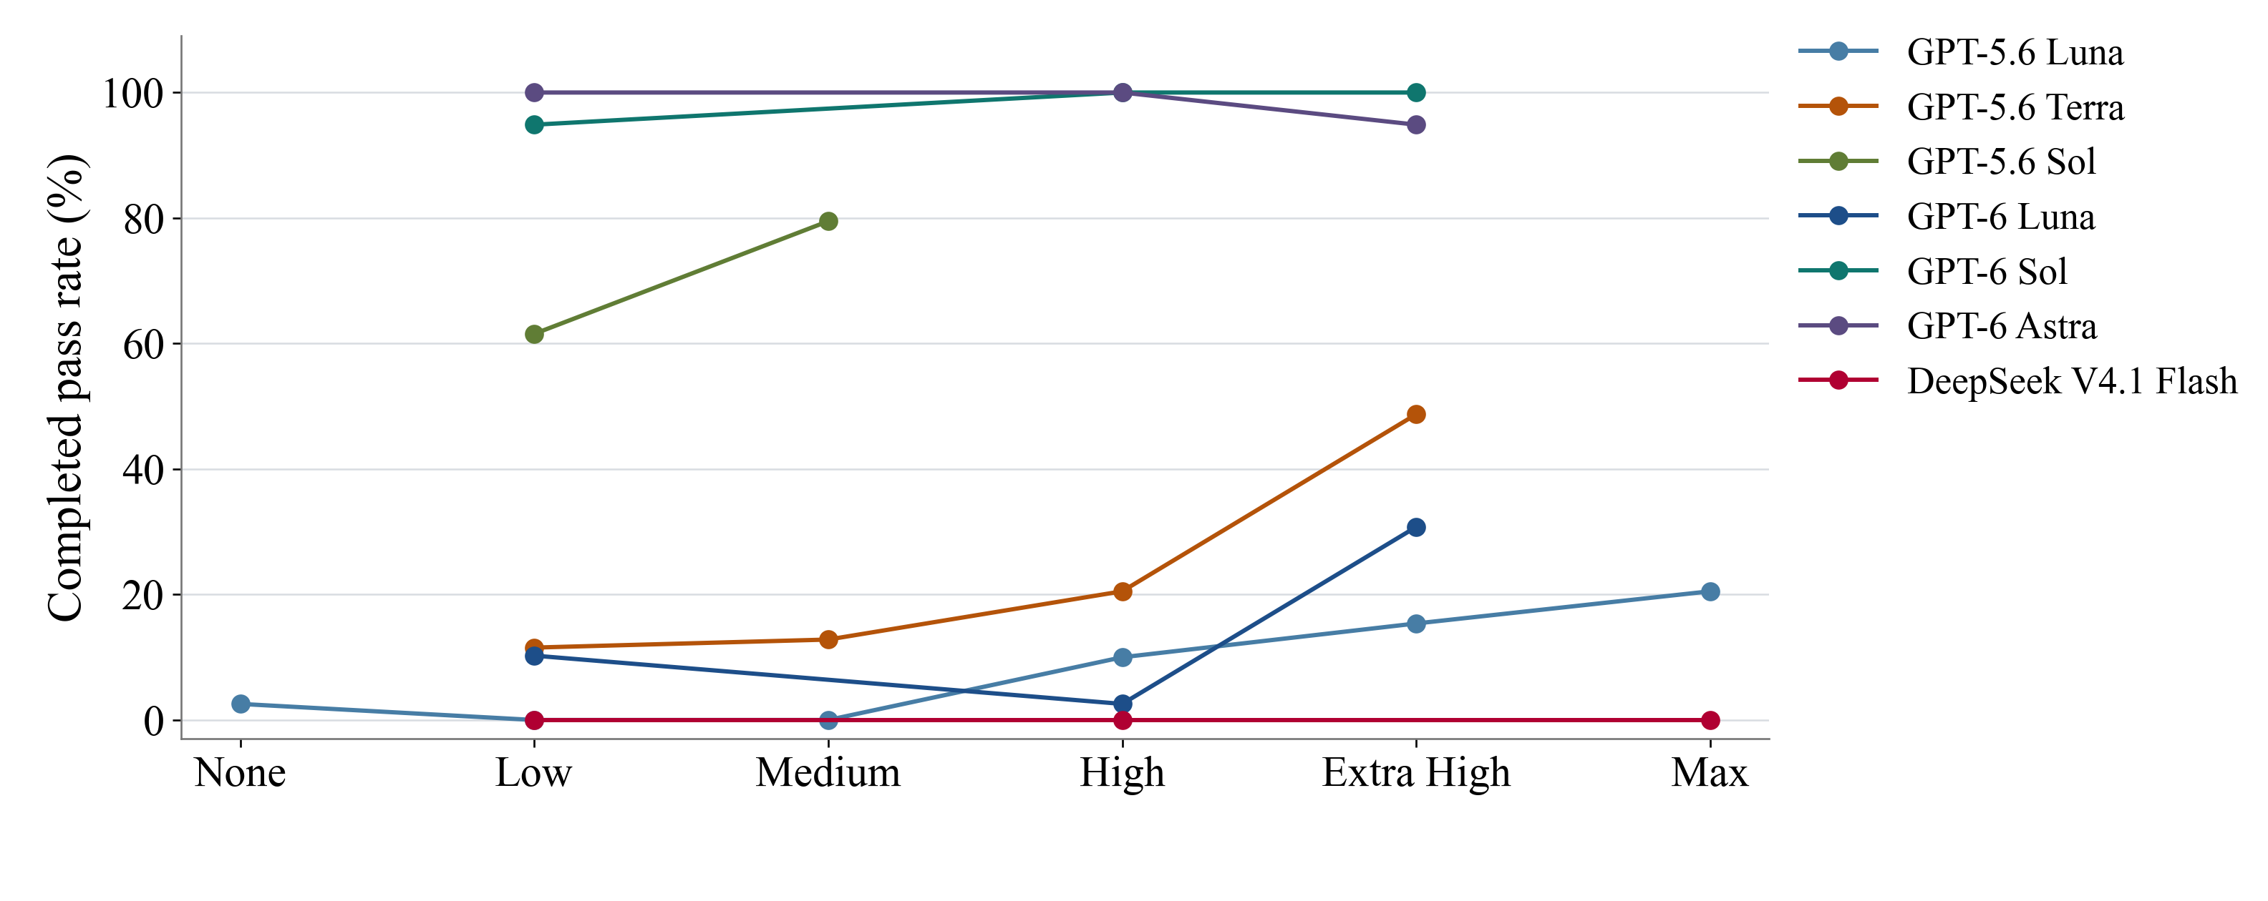
Backup: reasoning effort without hints
Each line holds the model fixed. Only the observed effort settings are connected.
Rates use each setting’s actual denominator. Model generations remain distinct. Historical and runtime differences apply.
17
Notes:
Backup.
All available model versions and no-hint effort settings appear in one chart. Rates use the pooled distinct-attempt denominators in the preceding table. Points are connected by straight segments only for visual guidance. Untested effort settings are not inferred. More reasoning does not monotonically increase the observed completion rate under the fixed time limit.
Results are grouped by exact model version, effort and reported prompt condition. Thirty-eight duplicate baseline records were removed by trial identity. Rates are total completed passes divided by all recorded attempts, including execution errors. Most settings have 39 attempts, repeated settings have 78. Luna High no-hint has 40: four attempts on entropy-anomaly and three on each other task. The three-attempt DeepSeek None pilot is retained outside the primary summary. Five earlier setup records were replaced before the reported 780 model-attempt matrix; the later setup failure and administrative interruptions remain in their original denominators. No outcomes have been rerun or changed.
The task content and grading match the frozen 13-task suite according to saved hashes and published verification metadata. Runtime varies across batches: Codex CLI 0.154.0 or 0.160.0; concurrency four or up to eight under CPU quotas in earlier batches; later concurrency up to three, then six sharing eight Docker CPUs. Agent and verifier limits remain 600 and 60 seconds. Baselines can predate hint runs, and hint length is not matched. These pooled comparisons are descriptive, not randomized causal estimates. Published aggregate data is included, but the 780 hinted raw transcripts were not independently reviewed on this machine. Their published model/session and source checks are preserved in the source archive.
Costs use saved Standard API-equivalent token rates, including caching and per-request long-context factors. They are not subscription charges and exclude local compute. Incomplete costs are never imputed as zero. Unknown provider charges retain bounds, whose upper reserves are not confirmed spending.
Sources:
/Users/yp9846/Desktop/PhysLiteBench/output/presentation-20261014/PhysLiteBench-study-figures-20261015/summary.csv
/Users/yp9846/Desktop/PhysLiteBench/output/presentation-20261014/PhysLiteBench-study-figures-20261015/source-manifest.json
/Users/yp9846/Desktop/PhysLiteBench/output/presentation-20261014/PhysLiteBench-study-figures-20261015/aggregate_results.py
/Users/yp9846/Desktop/PhysLiteBench/output/presentation-20261014/PhysLiteBench-study-figures-20261015/plot_results.py

Slide 18
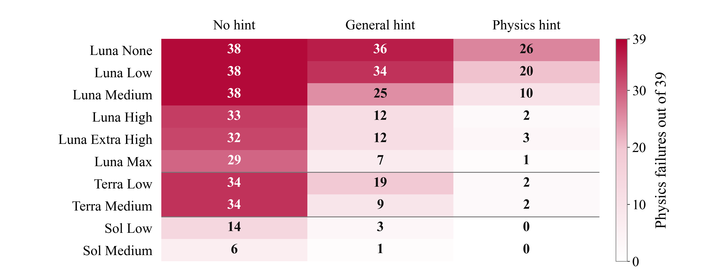
Backup: physics failures by model and effort
GPT-5.6 models. Each cell counts physics failures among 39 attempts.
18
Notes:
Backup.
The full breakdown separates model, effort and prompt condition. Each cell contains three repeats on all thirteen tasks. At each Luna effort the physics hint has fewer physics failures than the other conditions. With a physics hint, Luna None, Low and Medium account for 26 + 20 + 10 = 56 of the 66 remaining physics failures. The higher Luna efforts contribute six, Terra contributes four and Sol contributes zero. Zero physics failures is not perfect task success: Sol Low and Medium still have two and one other graded failures, respectively. Counts concern primary causes, so a numerical or coding primary with a secondary physics issue remains Other.
This classification covers 1,170 existing matrix attempts, not additional observations: 390 no-hint, 390 general-hint and 390 physics-hint. It uses GPT-5.6 Luna at None, Low, Medium, High, Extra High and Max; GPT-5.6 Terra at Low and Medium; and GPT-5.6 Sol at Low and Medium. Each of the 30 cells has thirteen tasks with three attempts, so n=39. The full study remains 2,068 unique attempts. The additional independent High-effort study and other models are outside this strict classification. No classifications were imputed for them. Luna High here is the same single 39-attempt matrix used on slide 8.
A physics failure is a normally completed reward-0 attempt that passes calibration, parameter recovery and the public checks, fails at least one hidden prediction, and has a reviewed primary physical-model error. Mathematical, numerical or coding primaries remain Other graded failure, even if a secondary physics issue appears. Execution exceptions take precedence over saved grades. Timeout and other execution errors never establish a physics mistake.
The published report reuses full observable-trajectory and final-code reviews for 315 hinted graded failures and targeted reviews of 304 historical no-hint graded failures. We verified aggregate counts and overlap with archived results; we did not independently review the underlying raw trajectories or unpublished classification ledger. The report states 4,686 original artifact hashes were checked. The report ledger SHA-256 is b9faeffe2d4db9c983eab440f52b0eb19cf9222ead0e142fd0c9dfb2a2e5faca. No new model runs, numerical diagnostic reruns or grades were introduced.
Historical controls used four workers without the newer per-container CPU quotas. Hint runs used up to eight workers capped at 8.8 CPU cores including proxies. Hint lengths also differ. Comparisons describe observed outcomes and do not isolate a causal hint effect. Aggregate changes do not show that particular failed attempts became passes. Five replaced pre-agent DNS failures remain outside this matrix, preventing double counting of their replacements. All other retained exceptions remain in the 39-attempt denominators.
Sources:
https://github.com/liuyiqiandrew/PhysLiteBench/blob/f1164fe2b2bc8d312733bedbfc633b48e3b3cb36/results/hint-comparison-20261015-005800/outcome-breakdown.md
/Users/yp9846/Desktop/PhysLiteBench/output/presentation-20261014/PhysLiteBench-physics-failure-figures-20261015/failure-breakdown.json
/Users/yp9846/Desktop/PhysLiteBench/output/presentation-20261014/PhysLiteBench-physics-failure-figures-20261015/analyze_failures.py
/Users/yp9846/Desktop/PhysLiteBench/output/presentation-20261014/PhysLiteBench-physics-failure-figures-20261015/plot_failures.py
/Users/yp9846/Desktop/PhysLiteBench/output/presentation-20261014/PhysLiteBench-physics-failure-figures-20261015/outcome-source-manifest.json

Slide 19
Backup: outcome definitions and counts
Each attempt gets one outcome. Execution exceptions take priority over grades.
Hint | Passed | Physics failure | Other graded failure | Timeout | Other execution error | Total
No hint | 84 | 296 | 8 | 1 | 1 | 390
General | 183 | 158 | 34 | 14 | 1 | 390
Physics | 257 | 66 | 57 | 10 | 0 | 390
All | 524 | 520 | 99 | 25 | 2 | 1,170
A physics failure fits the supplied data and has a reviewed physical-model error
that causes a wrong prediction under new conditions.
84 of 604 failures that fit the supplied data had a mathematical or coding primary cause.
Those attempts count as other graded failures.
19
Notes:
Backup.
The table has five mutually exclusive outcomes and sums to 1,170. Of the 619 normally completed graded failures, 520 meet the strict physics-failure definition and 99 count as Other graded failure. Calibration and parameter success plus a hidden-prediction failure alone would identify 604 attempts. Review places 84 of them in Other because a mathematical, numerical or coding error was the primary cause. Examples in the report include detector-coordinate conversion, an anion charge sign, incorrect operator derivatives and a phase-wrap implementation error. A fit plus a failed new prediction is therefore insufficient to diagnose a physics failure. Three saved verifier-passing checkpoints in the hinted batch still count as timeouts because the agent exceeded its time limit.
This classification covers 1,170 existing matrix attempts, not additional observations: 390 no-hint, 390 general-hint and 390 physics-hint. It uses GPT-5.6 Luna at None, Low, Medium, High, Extra High and Max; GPT-5.6 Terra at Low and Medium; and GPT-5.6 Sol at Low and Medium. Each of the 30 cells has thirteen tasks with three attempts, so n=39. The full study remains 2,068 unique attempts. The additional independent High-effort study and other models are outside this strict classification. No classifications were imputed for them. Luna High here is the same single 39-attempt matrix used on slide 8.
A physics failure is a normally completed reward-0 attempt that passes calibration, parameter recovery and the public checks, fails at least one hidden prediction, and has a reviewed primary physical-model error. Mathematical, numerical or coding primaries remain Other graded failure, even if a secondary physics issue appears. Execution exceptions take precedence over saved grades. Timeout and other execution errors never establish a physics mistake.
The published report reuses full observable-trajectory and final-code reviews for 315 hinted graded failures and targeted reviews of 304 historical no-hint graded failures. We verified aggregate counts and overlap with archived results; we did not independently review the underlying raw trajectories or unpublished classification ledger. The report states 4,686 original artifact hashes were checked. The report ledger SHA-256 is b9faeffe2d4db9c983eab440f52b0eb19cf9222ead0e142fd0c9dfb2a2e5faca. No new model runs, numerical diagnostic reruns or grades were introduced.
Historical controls used four workers without the newer per-container CPU quotas. Hint runs used up to eight workers capped at 8.8 CPU cores including proxies. Hint lengths also differ. Comparisons describe observed outcomes and do not isolate a causal hint effect. Aggregate changes do not show that particular failed attempts became passes. Five replaced pre-agent DNS failures remain outside this matrix, preventing double counting of their replacements. All other retained exceptions remain in the 39-attempt denominators.
Sources:
https://github.com/liuyiqiandrew/PhysLiteBench/blob/f1164fe2b2bc8d312733bedbfc633b48e3b3cb36/results/hint-comparison-20261015-005800/outcome-breakdown.md
/Users/yp9846/Desktop/PhysLiteBench/output/presentation-20261014/PhysLiteBench-physics-failure-figures-20261015/failure-breakdown.json
/Users/yp9846/Desktop/PhysLiteBench/output/presentation-20261014/PhysLiteBench-physics-failure-figures-20261015/analyze_failures.py
/Users/yp9846/Desktop/PhysLiteBench/output/presentation-20261014/PhysLiteBench-physics-failure-figures-20261015/plot_failures.py
/Users/yp9846/Desktop/PhysLiteBench/output/presentation-20261014/PhysLiteBench-physics-failure-figures-20261015/outcome-source-manifest.json

