Slide 1
PhysLiteBench
Yue Pan and Andrew Liu
Notes:
Target time: 10 seconds.
We study how well coding agents can turn a physical setup and limited measurements into predictions.
Sources:

Slide 2
Physics beyond a good fit
Can a coding agent infer the right physical model from a description and limited observations?
Available to the agent | What the evaluator checks
Physical description and starter code | Fit to observed data and model parameters
Calibration data and public tests | Predictions beyond the observed settings
A fixed software interface | Completion within the time budget
13
physics tasks that test agent need to predict beyond calibration observation.
Ten had 0/3 Luna High passes during initial selection.
Implemented with the Harbor framework.
Tasks were selected using GPT-5.6 Luna, so this is a deliberately challenging suite.
2
Notes:
Target time: 45 seconds.
Our benchmark asks a coding agent to infer a physical model from a description and limited observations, then predict new conditions. It receives starter code, calibration data and public tests. The hidden evaluator tests predictions that a good calibration fit does not guarantee. The thirteen tasks cover several physics families. The original ten had zero of three GPT-5.6 Luna High passes during selection. The roster does not support claiming the same current qualification result for all thirteen. Selection outcomes and independent evaluation results answer different questions.
Sources:
/Users/yp9846/Desktop/PhysLiteBench/results/task-roster.json
/Users/yp9846/Desktop/PhysLiteBench/results/qualified-tasks.json

Slide 3
Example Task: tracking one bead in a narrow tube
The beads move randomly and bump into each other, but cannot pass one another.
Start every run with the same spacing
What the agent gets
A setup description, starter code, and data
on how far the bead typically moves
at several observation times.
Observe the orange bead early in the run
What the agent must predict
Fit the strength of random motion.
Then predict how the bead’s early and later
positions correlate across many runs.
Observe that same bead later in the run
Physics it must account for
The initial bead spacing can affect the correlation
between early and later motion.
One run shown. Each repeat resets the starting row.
Illustrative setup. The benchmark asks for the statistical trend after long observation times, rather than one bead’s exact path.
3
Notes:
Target time: 85 seconds.
Imagine a long tube containing a row of beads. Random motion makes them bump around, but the tube is too narrow for one bead to pass another. We mark one bead orange and observe it. Every repeat starts with all the beads in exactly the same evenly spaced positions. We release them, then record the orange bead's position early and later in the same run. The next run starts from the original row but has different random motion. The pictures illustrate one possible run, not measured data. What does the agent know? It has this description, starter code, and measurements of how far the orange bead typically moves at several chosen times. These data let it estimate how strong the random motion is. What must it predict? Across many repeats, how strongly are the orange bead's early and later positions connected? For example, in runs where it is farther right early, does it also tend to be farther right later, and how strong is that relationship? The agent must write a numerical prediction for this relationship. The important physical detail is how we start the experiment. The beads begin in a regular row and cannot pass one another. That arrangement can still influence how motion at one time relates to motion later. Fitting the movement strength alone does not settle that question.
Sources:
/Users/yp9846/Desktop/PhysLiteBench/tasks/single-file-memory/environment/README.md
/Users/yp9846/Desktop/PhysLiteBench/tasks/single-file-memory/instruction.md
/Users/yp9846/Desktop/PhysLiteBench/tasks/single-file-memory/environment/model.py
/Users/yp9846/Desktop/PhysLiteBench/tasks/single-file-memory/solution/model.py
/Users/yp9846/Desktop/PhysLiteBench/tasks/single-file-memory/AUTHOR.md

Slide 4
Three prompt conditions
The task stays the same. Hints probe why the agent fails.
Condition | Instruction or added guidance
No hint | Use the setup and supplied data to implement the model.
General hint | “Check your implementation carefully and test its correctness before finishing.”
Physics hint | The starting arrangement affects how early and later motion are correlated. Account for that shared history.
For the bead example
The general hint asks the agent to check its work.
The physics hint points to something its formula may be missing.
No-hint instruction shortened. General hint quoted exactly. Physics hint summarized in plain language from the actual task hint.
4
Notes:
Target time: 60 seconds.
There are three prompt conditions. The baseline gives the original task and public files. The general hint asks the agent to check its implementation and test correctness. It does not identify which assumption might need attention. The physics hint points to a specific feature of the experiment. For the beads, it emphasizes that the same starting arrangement can affect the relationship between positions measured at two times. The full hint also suggests how to calculate this relationship. The slide summarizes its physical idea in everyday language. The hint supplies a direction for thinking, not the final formula. We keep the task files and grading the same across these conditions.
Sources:
/Users/yp9846/Desktop/PhysLiteBench/results/hint-comparison-20261014/plan.json
/Users/yp9846/Desktop/PhysLiteBench/tasks/single-file-memory/hint.md

Slide 5
Experiment and evaluation
13 frozen tasks. A pass requires completion within the time limit and all grading checks.
Model | No-hint efforts | Hinted efforts | Tasks | Attempts
GPT-5.6 Luna | None to Max (6 levels) | None to Max (6 levels) | 13 | 781
GPT-5.6 Terra | Low, Medium, High, Extra High | Low, Medium, High | 13 | 468
GPT-5.6 Sol | Low, Medium | Low, Medium | 13 | 234
GPT-6 Luna | Low, High, Extra High | — | 13 | 117
GPT-6 Sol | Low, High, Extra High | — | 13 | 117
GPT-6 Astra | Low, High, Extra High | — | 13 | 117
DeepSeek V4.1 Flash | Low, High, Max | High | 13 | 234
2,068 attempts across 48 settings. Reused baseline trials count once.
Harbor 0.21.0 and Codex agent. Limits: 600 s for the agent, 60 s for grading.
5
Notes:
Target time: 55 seconds.
This is one study across seven model versions. Each listed setting covers all thirteen tasks. A batch usually samples three independent attempts per task, without stopping after a pass. We combine independent repetitions of the same model, effort and condition, and count each reused baseline only once. The table shows total attempts over the listed conditions, including exceptions. The exact breakdown is in the backup tables and CSV. No-hint totals are 1,054; general and physics hints each have 507. An incomplete three-attempt DeepSeek None pilot remains outside these totals.
Results are grouped by exact model version, effort and reported prompt condition. Thirty-eight duplicate baseline records were removed by trial identity. Rates are total completed passes divided by all recorded attempts, including execution errors. Most settings have 39 attempts, repeated settings have 78. Luna High no-hint has 40: four attempts on entropy-anomaly and three on each other task. The three-attempt DeepSeek None pilot is retained outside the primary summary. Five earlier setup records were replaced before the reported 780 model-attempt matrix; the later setup failure and administrative interruptions remain in their original denominators. No outcomes have been rerun or changed.
The task content and grading match the frozen 13-task suite according to saved hashes and published verification metadata. Runtime varies across batches: Codex CLI 0.154.0 or 0.160.0; concurrency four or up to eight under CPU quotas in earlier batches; later concurrency up to three, then six sharing eight Docker CPUs. Agent and verifier limits remain 600 and 60 seconds. Baselines can predate hint runs, and hint length is not matched. These pooled comparisons are descriptive, not randomized causal estimates. Published aggregate data is included, but the 780 hinted raw transcripts were not independently reviewed on this machine. Their published model/session and source checks are preserved in the source archive.
Costs use saved Standard API-equivalent token rates, including caching and per-request long-context factors. They are not subscription charges and exclude local compute. Incomplete costs are never imputed as zero. Unknown provider charges retain bounds, whose upper reserves are not confirmed spending.
Sources:
/Users/yp9846/Desktop/PhysLiteBench/output/presentation-20261014/PhysLiteBench-study-figures-20261015/summary.csv
/Users/yp9846/Desktop/PhysLiteBench/output/presentation-20261014/PhysLiteBench-study-figures-20261015/source-manifest.json
/Users/yp9846/Desktop/PhysLiteBench/output/presentation-20261014/PhysLiteBench-study-figures-20261015/aggregate_results.py
/Users/yp9846/Desktop/PhysLiteBench/output/presentation-20261014/PhysLiteBench-study-figures-20261015/plot_results.py

Slide 6
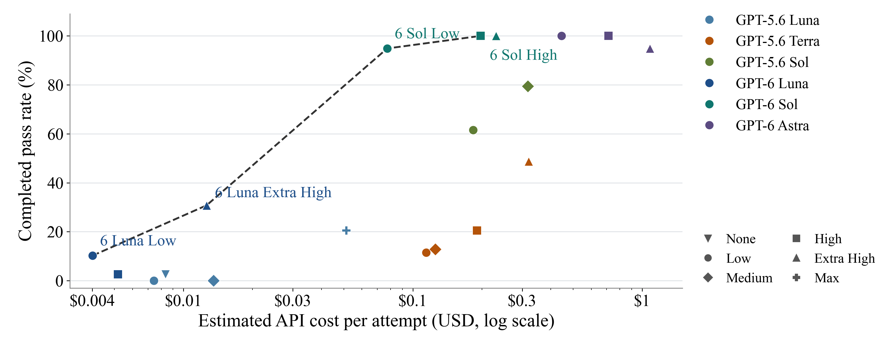
Cost and success without hints
All model versions on one cost axis. Each point is one model and reasoning effort.
19 of 24 settings have complete costs. Dashed line: observed frontier. Five incomplete-cost settings are omitted.
6
Notes:
Target time: 75 seconds.
The horizontal axis uses a logarithmic scale because costs span more than two orders of magnitude. Moving left means lower cost and moving up means more completed passes. Colors identify exact model versions; marker shapes identify reasoning effort. The dashed line joins observed nondominated settings with straight segments, without smoothing or interpolation of new observations. GPT-6 Luna Low and Extra High anchor the inexpensive end. GPT-6 Sol Low and High reach about 95% and 100% completion. The remaining complete-cost settings are shown even when dominated. Five settings have incomplete costs: Luna 5.6 High and Extra High plus DeepSeek Low, High and Max. Their outcomes stay in the backup and data, but their uncertain cost does not enter an exact frontier.
Results are grouped by exact model version, effort and reported prompt condition. Thirty-eight duplicate baseline records were removed by trial identity. Rates are total completed passes divided by all recorded attempts, including execution errors. Most settings have 39 attempts, repeated settings have 78. Luna High no-hint has 40: four attempts on entropy-anomaly and three on each other task. The three-attempt DeepSeek None pilot is retained outside the primary summary. Five earlier setup records were replaced before the reported 780 model-attempt matrix; the later setup failure and administrative interruptions remain in their original denominators. No outcomes have been rerun or changed.
The task content and grading match the frozen 13-task suite according to saved hashes and published verification metadata. Runtime varies across batches: Codex CLI 0.154.0 or 0.160.0; concurrency four or up to eight under CPU quotas in earlier batches; later concurrency up to three, then six sharing eight Docker CPUs. Agent and verifier limits remain 600 and 60 seconds. Baselines can predate hint runs, and hint length is not matched. These pooled comparisons are descriptive, not randomized causal estimates. Published aggregate data is included, but the 780 hinted raw transcripts were not independently reviewed on this machine. Their published model/session and source checks are preserved in the source archive.
Costs use saved Standard API-equivalent token rates, including caching and per-request long-context factors. They are not subscription charges and exclude local compute. Incomplete costs are never imputed as zero. Unknown provider charges retain bounds, whose upper reserves are not confirmed spending.
Sources:
/Users/yp9846/Desktop/PhysLiteBench/output/presentation-20261014/PhysLiteBench-study-figures-20261015/summary.csv
/Users/yp9846/Desktop/PhysLiteBench/output/presentation-20261014/PhysLiteBench-study-figures-20261015/source-manifest.json
/Users/yp9846/Desktop/PhysLiteBench/output/presentation-20261014/PhysLiteBench-study-figures-20261015/aggregate_results.py
/Users/yp9846/Desktop/PhysLiteBench/output/presentation-20261014/PhysLiteBench-study-figures-20261015/plot_results.py

Slide 7
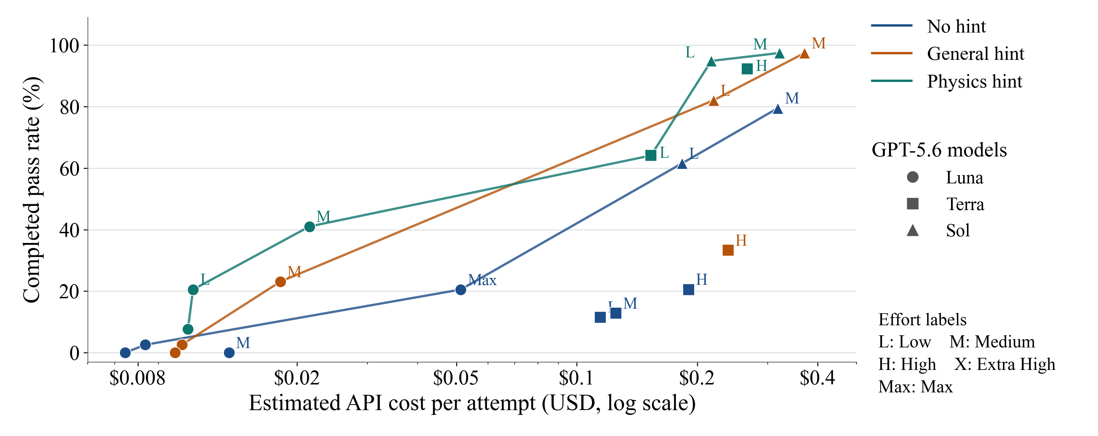
Cost and success with hints
Three prompt conditions for the 12 model–effort combinations tested under every condition.
22 of 36 settings have complete costs. Lines join observed frontiers. Historical controls and runtime differences remain.
7
Notes:
Target time: 50 seconds.
This view holds the set of model and effort combinations fixed across the three prompt conditions. It includes GPT-5.6 Luna at six efforts, Terra at Low, Medium and High, Sol at Low and Medium, and DeepSeek at High. Color shows the hint condition. Shape shows the model and nearby letters show selected effort labels. We combine the available independent attempts within each model, effort and condition. The log-scaled cost axis exposes the low-cost Luna settings and the more expensive Terra and Sol settings. Physics hints generally reach higher observed success, but fourteen settings have incomplete costs, including all three Luna High cost estimates after pooling, so they are omitted from exact cost frontiers. All outcomes remain in the next slide and backup table. The curves join observed points with straight segments. They do not imply interpolated model configurations or a causal effect.
Results are grouped by exact model version, effort and reported prompt condition. Thirty-eight duplicate baseline records were removed by trial identity. Rates are total completed passes divided by all recorded attempts, including execution errors. Most settings have 39 attempts, repeated settings have 78. Luna High no-hint has 40: four attempts on entropy-anomaly and three on each other task. The three-attempt DeepSeek None pilot is retained outside the primary summary. Five earlier setup records were replaced before the reported 780 model-attempt matrix; the later setup failure and administrative interruptions remain in their original denominators. No outcomes have been rerun or changed.
The task content and grading match the frozen 13-task suite according to saved hashes and published verification metadata. Runtime varies across batches: Codex CLI 0.154.0 or 0.160.0; concurrency four or up to eight under CPU quotas in earlier batches; later concurrency up to three, then six sharing eight Docker CPUs. Agent and verifier limits remain 600 and 60 seconds. Baselines can predate hint runs, and hint length is not matched. These pooled comparisons are descriptive, not randomized causal estimates. Published aggregate data is included, but the 780 hinted raw transcripts were not independently reviewed on this machine. Their published model/session and source checks are preserved in the source archive.
Costs use saved Standard API-equivalent token rates, including caching and per-request long-context factors. They are not subscription charges and exclude local compute. Incomplete costs are never imputed as zero. Unknown provider charges retain bounds, whose upper reserves are not confirmed spending.
Sources:
/Users/yp9846/Desktop/PhysLiteBench/output/presentation-20261014/PhysLiteBench-study-figures-20261015/summary.csv
/Users/yp9846/Desktop/PhysLiteBench/output/presentation-20261014/PhysLiteBench-study-figures-20261015/source-manifest.json
/Users/yp9846/Desktop/PhysLiteBench/output/presentation-20261014/PhysLiteBench-study-figures-20261015/aggregate_results.py
/Users/yp9846/Desktop/PhysLiteBench/output/presentation-20261014/PhysLiteBench-study-figures-20261015/plot_results.py

Slide 8
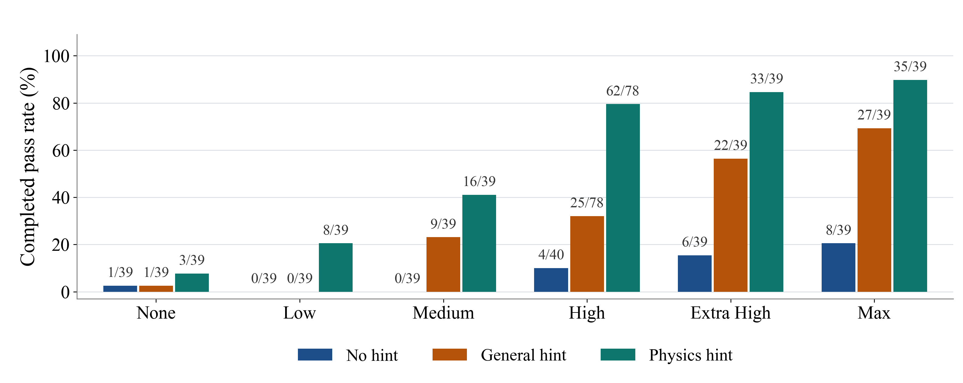
Luna: reasoning effort and hints
GPT-5.6 Luna. Bar height is the pass rate; labels show completed passes / attempts.
Physics hints have the highest observed pass rate at every effort setting.
8
Notes:
Target time: 55 seconds.
Here we keep the model fixed and compare effort and guidance. The height of each bar is a rate, so the additional High-effort attempts do not create an artificial height advantage. At High, the combined results are four of forty without a hint, twenty-five of seventy-eight with a general hint, and sixty-two of seventy-eight with a physics hint. Other cells have thirty-nine attempts. Physics hints have the highest observed rate at each effort setting. Extra High and Max still differ, and the small number of repeats limits precision.
Results are grouped by exact model version, effort and reported prompt condition. Thirty-eight duplicate baseline records were removed by trial identity. Rates are total completed passes divided by all recorded attempts, including execution errors. Most settings have 39 attempts, repeated settings have 78. Luna High no-hint has 40: four attempts on entropy-anomaly and three on each other task. The three-attempt DeepSeek None pilot is retained outside the primary summary. Five earlier setup records were replaced before the reported 780 model-attempt matrix; the later setup failure and administrative interruptions remain in their original denominators. No outcomes have been rerun or changed.
The task content and grading match the frozen 13-task suite according to saved hashes and published verification metadata. Runtime varies across batches: Codex CLI 0.154.0 or 0.160.0; concurrency four or up to eight under CPU quotas in earlier batches; later concurrency up to three, then six sharing eight Docker CPUs. Agent and verifier limits remain 600 and 60 seconds. Baselines can predate hint runs, and hint length is not matched. These pooled comparisons are descriptive, not randomized causal estimates. Published aggregate data is included, but the 780 hinted raw transcripts were not independently reviewed on this machine. Their published model/session and source checks are preserved in the source archive.
Costs use saved Standard API-equivalent token rates, including caching and per-request long-context factors. They are not subscription charges and exclude local compute. Incomplete costs are never imputed as zero. Unknown provider charges retain bounds, whose upper reserves are not confirmed spending.
Sources:
/Users/yp9846/Desktop/PhysLiteBench/output/presentation-20261014/PhysLiteBench-study-figures-20261015/summary.csv
/Users/yp9846/Desktop/PhysLiteBench/output/presentation-20261014/PhysLiteBench-study-figures-20261015/source-manifest.json
/Users/yp9846/Desktop/PhysLiteBench/output/presentation-20261014/PhysLiteBench-study-figures-20261015/aggregate_results.py
/Users/yp9846/Desktop/PhysLiteBench/output/presentation-20261014/PhysLiteBench-study-figures-20261015/plot_results.py

Slide 9
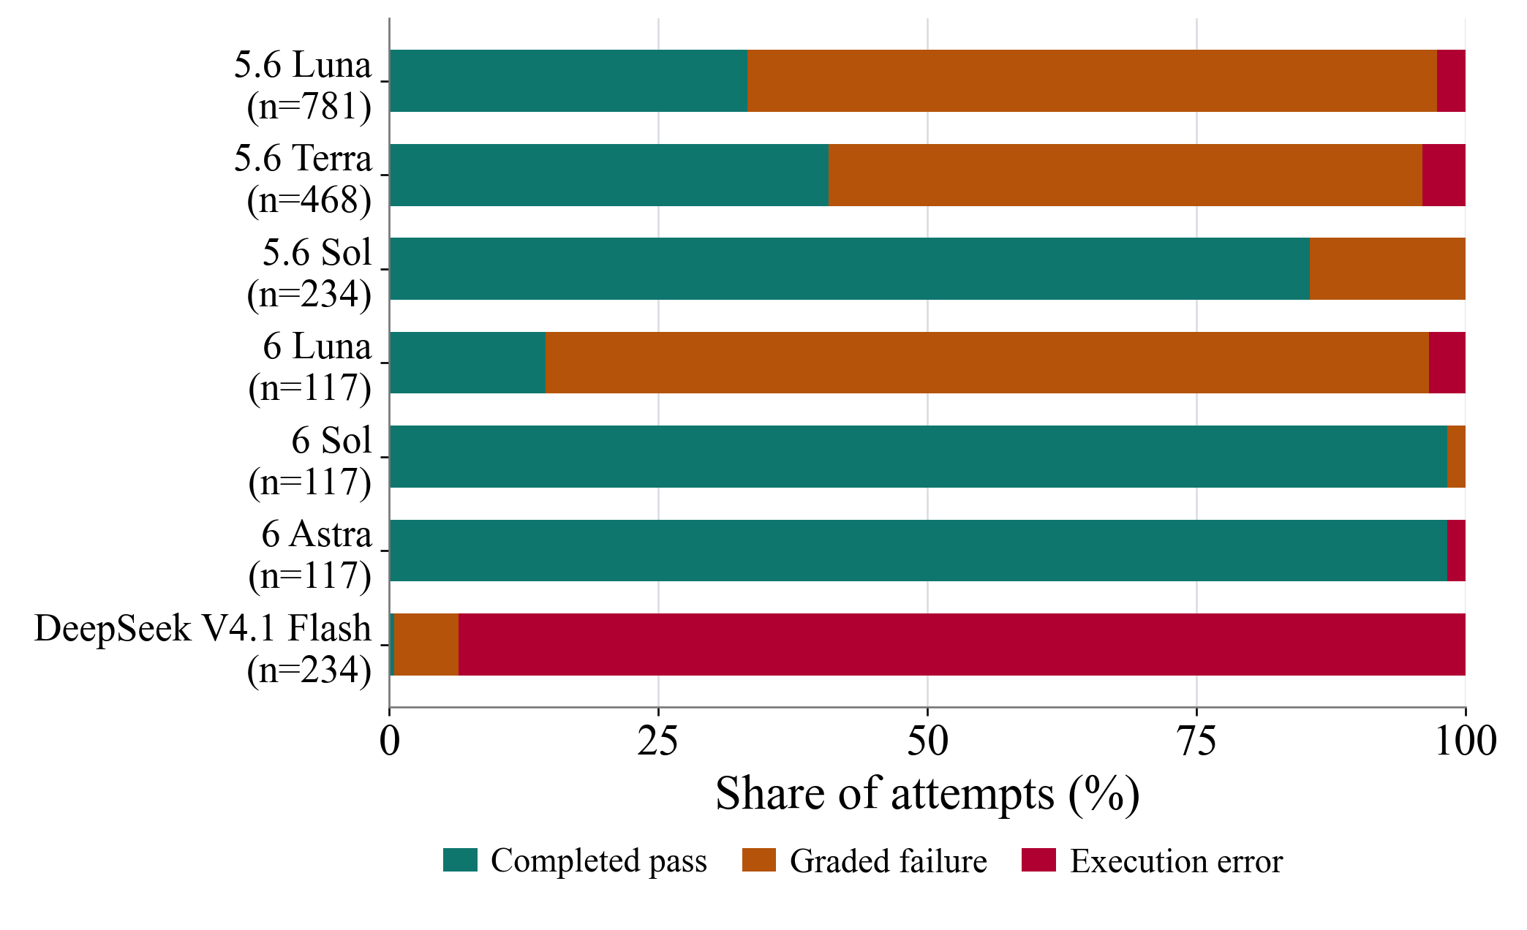
Where the agents fail
Outcome totals combine all tested efforts and hints. Failure diagnoses use reviewed subsets.
186 / 191
Reviewed no-hint failures
fit calibration but failed
on new predictions.
229 / 315
Reviewed hinted failures
involved physics or modeling.
Review subsets use different diagnostic categories. Execution errors alone do not establish a physics mistake.
9
Notes:
Target time: 55 seconds.
The outcome chart combines all recorded attempts by model. Its different sample sizes are printed beside the names. The study has 899 completed passes, 904 graded failures and 265 execution errors. These model totals combine different effort and hint settings, so this chart describes outcome composition rather than a controlled ranking.
The failure diagnoses on the right refer to explicitly reviewed subsets. Among 191 normally completed failures in a 585-attempt no-hint subset, 186 passed calibration and parameter checks but failed new predictions. At least 141 of these 186 also show public-test passes. The published hinted failure review classified 229 of 315 graded failures as physics/modeling, 54 as mathematical/numerical and 32 as implementation. These are different review taxonomies and should not be subtracted as a hint-effect estimate. The no-hint analysis used saved tool actions, submitted code and verifier evidence. The hinted diagnoses are published review results; their raw trajectories were not independently reviewed here. None of these counts infer physics failure from a timeout.
Sources:
/Users/yp9846/Desktop/PhysLiteBench/output/presentation-20261014/PhysLiteBench-study-figures-20261015/sources/trajectory-analysis.json
/Users/yp9846/Desktop/PhysLiteBench/output/presentation-20261014/PhysLiteBench-study-figures-20261015/sources/hint-matrix-summary.md
Sources:
/Users/yp9846/Desktop/PhysLiteBench/output/presentation-20261014/PhysLiteBench-study-figures-20261015/summary.csv
/Users/yp9846/Desktop/PhysLiteBench/output/presentation-20261014/PhysLiteBench-study-figures-20261015/source-manifest.json
/Users/yp9846/Desktop/PhysLiteBench/output/presentation-20261014/PhysLiteBench-study-figures-20261015/aggregate_results.py
/Users/yp9846/Desktop/PhysLiteBench/output/presentation-20261014/PhysLiteBench-study-figures-20261015/plot_results.py

Slide 10
Why the agent failed on the bead task
GPT-5.6 Terra High, no hint
Same evenly spaced start
Fits the measured motion
Adjusts how far the bead wanders
at each observation time.
Early position
Later position
Misses the effect of the starting row
Keeps the starter’s correlation formula.
It misses the effect of the initial spacing,
so the covariance is too large.
Same bead in one run
The agent overestimates the covariance
Fits the supplied data. New predictions are wrong by up to 136%.
Allowed tolerance: 4%. The covariance describes averages across repeated runs. Bead positions are schematic.
10
Notes:
Target time: 80 seconds.
Here is the same bead example, now using a saved Terra run. Every repeat starts with the neighbors evenly spaced. We record the orange bead early and again later. The red arrow means a statistical link across repeats, not a force between two beads.
The agent adjusted one number controlling the amount of random motion. Its code matched the supplied measurements of how far the bead wanders at each time, and the public test passed.
But it kept the starter's rule for connecting the two observations. In plain terms, that rule made an early displacement count too much when predicting the later motion. The evenly spaced starting row affects this connection, and its formula did not account for that effect correctly. Matching the spread at each time could not reveal this mistake.
The hidden predictions were wrong by as much as 136%, against a 4% allowance. We checked the diagnosis by keeping its fitted motion strength and replacing only the rule connecting two times. The largest error fell to about 0.003%. That is our diagnostic correction, not a new agent pass or a hint result. The conclusion comes from the saved code, tool actions and tests.
Sources:
/Users/yp9846/Desktop/PhysLiteBench/tasks/single-file-memory/environment/README.md
/Users/yp9846/Desktop/PhysLiteBench/tasks/single-file-memory/environment/model.py
/Users/yp9846/Desktop/PhysLiteBench/tasks/single-file-memory/solution/model.py
/Users/yp9846/Desktop/PhysLiteBench/results/trajectory-analysis-20261014/cases/single-file-memory__PC6LumP/review.json
/Users/yp9846/Desktop/PhysLiteBench/results/trajectory-analysis-20261014/cases/single-file-memory__PC6LumP/model.diff
/Users/yp9846/Desktop/PhysLiteBench/results/trajectory-analysis-20261014/cases/single-file-memory__PC6LumP/metrics.json
/Users/yp9846/Desktop/PhysLiteBench/results/trajectory-analysis-20261014/diagnostic-repairs.json
Technical clarification for questions: both formulas have correlated motion and agree at equal times. The saved formula overestimates the two-time covariance. It incorrectly treats increments as depending only on the time gap. The benchmark uses a joint long-time coefficient, not the finite-time positions drawn in this schematic. Equations and exact metrics remain in backup slide 16.

Slide 11
Conclusions
A good fit can hide the wrong physical model
The bead example fits the data but predicts the covariance incorrectly.
Cost, reasoning effort, and completion all matter
GPT-6 Sol Low and High reach the high-success end of the no-hint frontier.
Physics hints show the highest observed success
At High effort: Luna 62/78 and Terra 36/39 passes with physics hints.
Historical controls and runtime differences limit causal claims. DeepSeek has many execution errors.
11
Notes:
Target time: 30 seconds.
A good calibration fit can hide the wrong physical model, as the bead covariance example shows. Model choice and reasoning effort trade off cost against success. Across the combined evidence, physics hints have the highest observed success at every tested Luna effort. At High, Luna passes sixty-two of seventy-eight attempts and Terra thirty-six of thirty-nine with physics hints. Historical controls and runtime differences qualify causal claims, and execution errors remain separate from physics failure.
Sources:
/Users/yp9846/Desktop/PhysLiteBench/output/presentation-20261014/PhysLiteBench-study-figures-20261015/summary.csv
/Users/yp9846/Desktop/PhysLiteBench/output/presentation-20261014/PhysLiteBench-study-figures-20261015/source-manifest.json
/Users/yp9846/Desktop/PhysLiteBench/output/presentation-20261014/PhysLiteBench-study-figures-20261015/aggregate_results.py
/Users/yp9846/Desktop/PhysLiteBench/output/presentation-20261014/PhysLiteBench-study-figures-20261015/plot_results.py

Slide 12
Questions
3 minutes
Notes:
Target time: 180 seconds.
Questions. Useful scope distinctions are task selection versus evaluation, completed passes versus timeout checkpoints, and descriptive hint comparisons versus causal estimates. Backup slides provide the full model/effort tables, task roster and bead covariance formulas. The plotting bundle contains the archived sources, hash manifest, aggregation script and Python plotting script.
Sources:
/Users/yp9846/Desktop/PhysLiteBench/output/presentation-20261014/PhysLiteBench-study-figures-20261015/summary.csv
/Users/yp9846/Desktop/PhysLiteBench/output/presentation-20261014/PhysLiteBench-study-figures-20261015/source-manifest.json
/Users/yp9846/Desktop/PhysLiteBench/output/presentation-20261014/PhysLiteBench-study-figures-20261015/aggregate_results.py
/Users/yp9846/Desktop/PhysLiteBench/output/presentation-20261014/PhysLiteBench-study-figures-20261015/plot_results.py

Slide 13
Backup: no-hint results by model and effort
Completed passes / attempts. Errors are retained. Mean cost is shown only when complete.
Model and effort | Passes / n | Errors | Mean cost
5.6 Luna None | 1/39 | 0 | $0.0084
5.6 Luna Low | 0/39 | 0 | $0.0074
5.6 Luna Medium | 0/39 | 0 | $0.0135
5.6 Luna High | 4/40 | 1 | Incomplete
5.6 Luna Extra High | 6/39 | 1 | Incomplete
5.6 Luna Max | 8/39 | 0 | $0.0513
5.6 Terra Low | 9/78 | 0 | $0.1145
5.6 Terra Medium | 5/39 | 0 | $0.1254
5.6 Terra High | 16/78 | 1 | $0.1905
5.6 Terra Extra High | 19/39 | 4 | $0.3196
5.6 Sol Low | 24/39 | 0 | $0.1832
5.6 Sol Medium | 31/39 | 0 | $0.3178
Model and effort | Passes / n | Errors | Mean cost
6 Luna Low | 4/39 | 0 | $0.0040
6 Luna High | 1/39 | 0 | $0.0052
6 Luna Extra High | 12/39 | 4 | $0.0126
6 Sol Low | 37/39 | 0 | $0.0773
6 Sol High | 39/39 | 0 | $0.1975
6 Sol Extra High | 39/39 | 0 | $0.2306
6 Astra Low | 39/39 | 0 | $0.4450
6 Astra High | 39/39 | 0 | $0.7132
6 Astra Extra High | 37/39 | 2 | $1.0801
DeepSeek Low | 0/39 | 33 | Incomplete
DeepSeek High | 0/78 | 71 | Incomplete
DeepSeek Max | 0/39 | 38 | Incomplete
All 24 settings cover 13 tasks. DeepSeek None has only 3 attempts and is excluded. Costs are API-equivalent estimates.
13
Notes:
Backup.
All complete no-hint settings, aggregated by exact model version and effort. This table retains results with missing cost, even though those settings are absent from the exact frontier. Terra Low and High, and DeepSeek High, each have 78 distinct attempts. Luna High has 40 because one fresh baseline was already started before historical baseline reuse. Other settings have 39. Cost bounds and original records are in the plotting bundle.
Results are grouped by exact model version, effort and reported prompt condition. Thirty-eight duplicate baseline records were removed by trial identity. Rates are total completed passes divided by all recorded attempts, including execution errors. Most settings have 39 attempts, repeated settings have 78. Luna High no-hint has 40: four attempts on entropy-anomaly and three on each other task. The three-attempt DeepSeek None pilot is retained outside the primary summary. Five earlier setup records were replaced before the reported 780 model-attempt matrix; the later setup failure and administrative interruptions remain in their original denominators. No outcomes have been rerun or changed.
The task content and grading match the frozen 13-task suite according to saved hashes and published verification metadata. Runtime varies across batches: Codex CLI 0.154.0 or 0.160.0; concurrency four or up to eight under CPU quotas in earlier batches; later concurrency up to three, then six sharing eight Docker CPUs. Agent and verifier limits remain 600 and 60 seconds. Baselines can predate hint runs, and hint length is not matched. These pooled comparisons are descriptive, not randomized causal estimates. Published aggregate data is included, but the 780 hinted raw transcripts were not independently reviewed on this machine. Their published model/session and source checks are preserved in the source archive.
Costs use saved Standard API-equivalent token rates, including caching and per-request long-context factors. They are not subscription charges and exclude local compute. Incomplete costs are never imputed as zero. Unknown provider charges retain bounds, whose upper reserves are not confirmed spending.
Sources:
/Users/yp9846/Desktop/PhysLiteBench/output/presentation-20261014/PhysLiteBench-study-figures-20261015/summary.csv
/Users/yp9846/Desktop/PhysLiteBench/output/presentation-20261014/PhysLiteBench-study-figures-20261015/source-manifest.json
/Users/yp9846/Desktop/PhysLiteBench/output/presentation-20261014/PhysLiteBench-study-figures-20261015/aggregate_results.py
/Users/yp9846/Desktop/PhysLiteBench/output/presentation-20261014/PhysLiteBench-study-figures-20261015/plot_results.py

Slide 14
Backup: results under all three prompt conditions
Each cell shows completed passes / attempts, followed by execution errors in parentheses.
Model and effort | No hint | General hint | Physics hint
GPT-5.6 Luna None | 1/39 (0) | 1/39 (0) | 3/39 (2)
GPT-5.6 Luna Low | 0/39 (0) | 0/39 (0) | 8/39 (0)
GPT-5.6 Luna Medium | 0/39 (0) | 9/39 (0) | 16/39 (1)
GPT-5.6 Luna High | 4/40 (1) | 25/78 (3) | 62/78 (1)
GPT-5.6 Luna Extra High | 6/39 (1) | 22/39 (3) | 33/39 (1)
GPT-5.6 Luna Max | 8/39 (0) | 27/39 (5) | 35/39 (3)
GPT-5.6 Terra Low | 9/78 (0) | 12/39 (1) | 25/39 (2)
GPT-5.6 Terra Medium | 5/39 (0) | 24/39 (3) | 32/39 (1)
GPT-5.6 Terra High | 16/78 (1) | 13/39 (6) | 36/39 (1)
GPT-5.6 Sol Low | 24/39 (0) | 32/39 (0) | 37/39 (0)
GPT-5.6 Sol Medium | 31/39 (0) | 38/39 (0) | 38/39 (0)
DeepSeek V4.1 Flash High | 0/78 (71) | 0/39 (39) | 1/39 (38)
13 tasks per setting. Counts combine distinct attempts; repeated baseline records count once.
14
Notes:
Backup.
These twelve model-effort combinations have all three prompt conditions. The full experiment also includes models and effort settings tested without hints only. Every result in this table belongs to the same frozen thirteen-task benchmark. Parenthesized values are execution errors, not additional passes or independently diagnosed physics failures. The setup replacement policy differs across the archived schedules and remains documented, rather than being changed after the fact.
Results are grouped by exact model version, effort and reported prompt condition. Thirty-eight duplicate baseline records were removed by trial identity. Rates are total completed passes divided by all recorded attempts, including execution errors. Most settings have 39 attempts, repeated settings have 78. Luna High no-hint has 40: four attempts on entropy-anomaly and three on each other task. The three-attempt DeepSeek None pilot is retained outside the primary summary. Five earlier setup records were replaced before the reported 780 model-attempt matrix; the later setup failure and administrative interruptions remain in their original denominators. No outcomes have been rerun or changed.
The task content and grading match the frozen 13-task suite according to saved hashes and published verification metadata. Runtime varies across batches: Codex CLI 0.154.0 or 0.160.0; concurrency four or up to eight under CPU quotas in earlier batches; later concurrency up to three, then six sharing eight Docker CPUs. Agent and verifier limits remain 600 and 60 seconds. Baselines can predate hint runs, and hint length is not matched. These pooled comparisons are descriptive, not randomized causal estimates. Published aggregate data is included, but the 780 hinted raw transcripts were not independently reviewed on this machine. Their published model/session and source checks are preserved in the source archive.
Costs use saved Standard API-equivalent token rates, including caching and per-request long-context factors. They are not subscription charges and exclude local compute. Incomplete costs are never imputed as zero. Unknown provider charges retain bounds, whose upper reserves are not confirmed spending.
Sources:
/Users/yp9846/Desktop/PhysLiteBench/output/presentation-20261014/PhysLiteBench-study-figures-20261015/summary.csv
/Users/yp9846/Desktop/PhysLiteBench/output/presentation-20261014/PhysLiteBench-study-figures-20261015/source-manifest.json
/Users/yp9846/Desktop/PhysLiteBench/output/presentation-20261014/PhysLiteBench-study-figures-20261015/aggregate_results.py
/Users/yp9846/Desktop/PhysLiteBench/output/presentation-20261014/PhysLiteBench-study-figures-20261015/plot_results.py

Slide 15
Backup: the frozen 13-task roster
entropy-anomaly
rotating-reservoir
finite-layer-phoresis
single-file-memory
hierarchical-glass-overlaps
superconducting-heat
insulating-mhd-duct
swirling-heat-tails
magnetic-tracer
hard-rod-current
reaction-diffusion
finite-ion-cloud
ring-current-fluctuations
Frozen snapshot: 34dedfbbd8ff. Task selection against GPT-5.6 Luna limits generalization to a broader physics population.
15
Notes:
Backup.
The same thirteen task families are used throughout the study. Content and grading match the frozen source snapshot. The original ten have a preserved zero-of-three Luna High qualification record; the three later tasks have separate selection and confirmation evidence. Subsequent independent evaluations can pass.
Sources:
/Users/yp9846/Desktop/PhysLiteBench/results/task-roster.json

Slide 16
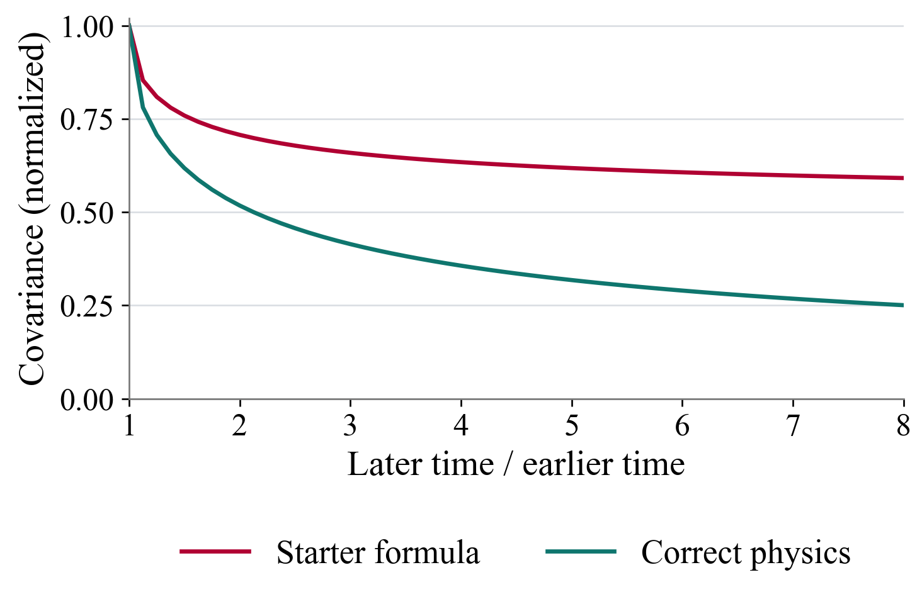
Backup: comparing the two prediction formulas
A narrow channel preserves particle order. Every experiment starts from the same positions.
Physical setup
Why fitting alone is insufficient
Reset to evenly spaced positions
●
Let the particles move randomly
●
Track the orange particle in each repeat.
Particles collide but never overtake.
Agent task: fit the movement scale, then
predict how two measurement times are related.
Same time: both fit.
Different times: memory changes the prediction.
Analytic covariance curves and schematic positions, not measured trajectories. The task asks for the long-time scaling coefficient.
16
Notes:
Target time: skip in current talk.
Technical detail for questions. The channel represents an infinite line of identical Brownian point particles with reflecting collisions and fixed initial positions j/rho in each independent repeat. The task predicts the joint long-time covariance coefficient, not finite-time trajectories or the exact position in one realization. With A = sqrt(D/pi)/rho, the correct coefficient is A[sqrt(t+s)-sqrt(abs(t-s))]. The starter uses A/sqrt(2)[sqrt(t)+sqrt(s)-sqrt(abs(t-s))]. Both agree on every equal-time setting. The plotted curves use the same D and density, normalized to the equal-time value, with earlier time multiplier 0.5 and later multiplier from 0.5 to 4. They therefore isolate the time-dependence difference. This plot is analytic, not a measured trial result. The apparent memory comes from the fixed preparation and no-passing constraint, even though the random forcing on different particles is independent. The saved Terra fit is 0.949947415037877. Its parameter error is 0.005535%, and its prediction-group errors at later/earlier ratios 2, 4 and 8 are 36.60%, 77.88% and 136.06%. Replacing only the covariance expression at the fixed fitted D reduces all tested group errors to 0.002768%.
Sources:
/Users/yp9846/Desktop/PhysLiteBench/tasks/single-file-memory/environment/README.md
/Users/yp9846/Desktop/PhysLiteBench/tasks/single-file-memory/instruction.md
/Users/yp9846/Desktop/PhysLiteBench/tasks/single-file-memory/environment/model.py
/Users/yp9846/Desktop/PhysLiteBench/tasks/single-file-memory/solution/model.py
/Users/yp9846/Desktop/PhysLiteBench/tasks/single-file-memory/AUTHOR.md
/Users/yp9846/Desktop/PhysLiteBench/results/trajectory-analysis-20261014/cases/single-file-memory__PC6LumP/metrics.json
/Users/yp9846/Desktop/PhysLiteBench/results/trajectory-analysis-20261014/diagnostic-repairs.json
The Python plot uses the exact 57 coordinate pairs per series from the user-edited source chart. No spline or smoothing is applied. The source series and plotting script are archived in /Users/yp9846/Desktop/PhysLiteBench/output/presentation-20261014/PhysLiteBench-study-figures-20261015.

Slide 17
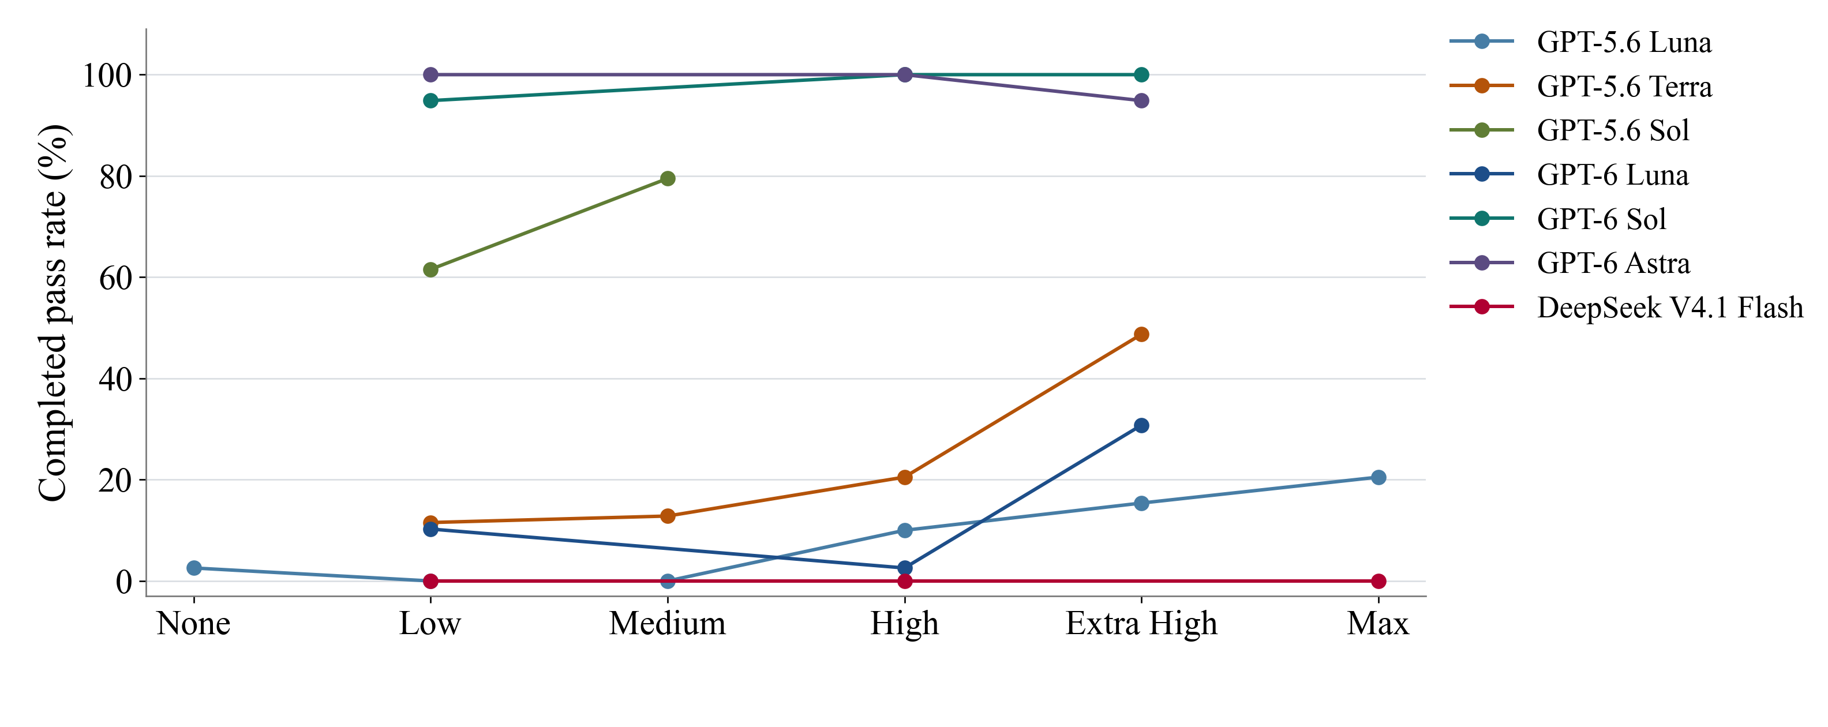
Backup: reasoning effort without hints
Each line holds the model fixed. Only the observed effort settings are connected.
Rates use each setting’s actual denominator. Model generations remain distinct. Historical and runtime differences apply.
17
Notes:
Backup.
All available model versions and no-hint effort settings appear in one chart. Rates use the pooled distinct-attempt denominators in the preceding table. Points are connected by straight segments only for visual guidance. Untested effort settings are not inferred. More reasoning does not monotonically increase the observed completion rate under the fixed time limit.
Results are grouped by exact model version, effort and reported prompt condition. Thirty-eight duplicate baseline records were removed by trial identity. Rates are total completed passes divided by all recorded attempts, including execution errors. Most settings have 39 attempts, repeated settings have 78. Luna High no-hint has 40: four attempts on entropy-anomaly and three on each other task. The three-attempt DeepSeek None pilot is retained outside the primary summary. Five earlier setup records were replaced before the reported 780 model-attempt matrix; the later setup failure and administrative interruptions remain in their original denominators. No outcomes have been rerun or changed.
The task content and grading match the frozen 13-task suite according to saved hashes and published verification metadata. Runtime varies across batches: Codex CLI 0.154.0 or 0.160.0; concurrency four or up to eight under CPU quotas in earlier batches; later concurrency up to three, then six sharing eight Docker CPUs. Agent and verifier limits remain 600 and 60 seconds. Baselines can predate hint runs, and hint length is not matched. These pooled comparisons are descriptive, not randomized causal estimates. Published aggregate data is included, but the 780 hinted raw transcripts were not independently reviewed on this machine. Their published model/session and source checks are preserved in the source archive.
Costs use saved Standard API-equivalent token rates, including caching and per-request long-context factors. They are not subscription charges and exclude local compute. Incomplete costs are never imputed as zero. Unknown provider charges retain bounds, whose upper reserves are not confirmed spending.
Sources:
/Users/yp9846/Desktop/PhysLiteBench/output/presentation-20261014/PhysLiteBench-study-figures-20261015/summary.csv
/Users/yp9846/Desktop/PhysLiteBench/output/presentation-20261014/PhysLiteBench-study-figures-20261015/source-manifest.json
/Users/yp9846/Desktop/PhysLiteBench/output/presentation-20261014/PhysLiteBench-study-figures-20261015/aggregate_results.py
/Users/yp9846/Desktop/PhysLiteBench/output/presentation-20261014/PhysLiteBench-study-figures-20261015/plot_results.py

