Slide 1
LECTURE 09
Dimension Reduction Beyond PCA: MDS, t-SNE & UMAP
When linear PCA isn't enough — reducing dimensions that preserve distances or reveal non-linear structure, and how to read (and misread) the pictures.
School of Mathematics & Statistics · The University of Sydney

Slide 2
AGENDA
Today's roadmap
▸ Recap: what PCA does and where it stops
▸ Multidimensional scaling (MDS): preserve distances
▸ t-SNE: reveal non-linear neighbourhoods
▸ UMAP: the modern alternative
▸ Choosing and comparing methods
▸ Practice in R, pitfalls and honest interpretation
STAT3888 · Statistical Machine Learning
L09 · 2

Slide 3
RECAP
PCA in one breath
▸ PCA finds orthogonal directions of maximum variance
▸ It is linear — new axes are straight-line combinations of variables
▸ Great for compression, denoising and visualising linear structure
▸ But real data often bends…
STAT3888 · Statistical Machine Learning
L09 · 3

Slide 4
CHECK YOUR UNDERSTANDING
PCA is fundamentally a … method.
A
Non-linear
B
Supervised
C
Linear ✓
D
Probabilistic
Why: PCA builds components as linear combinations of the original variables — it can only capture linear structure.
STAT3888 · Statistical Machine Learning
L09 · 4

Slide 5
PART 1
Why go beyond PCA?

Slide 6
THE LIMITATION
PCA can only rotate and stretch — it cannot 'unroll' data that lies on a curved surface.
If the interesting structure is non-linear, PCA's flat projection smears it together.

Slide 7
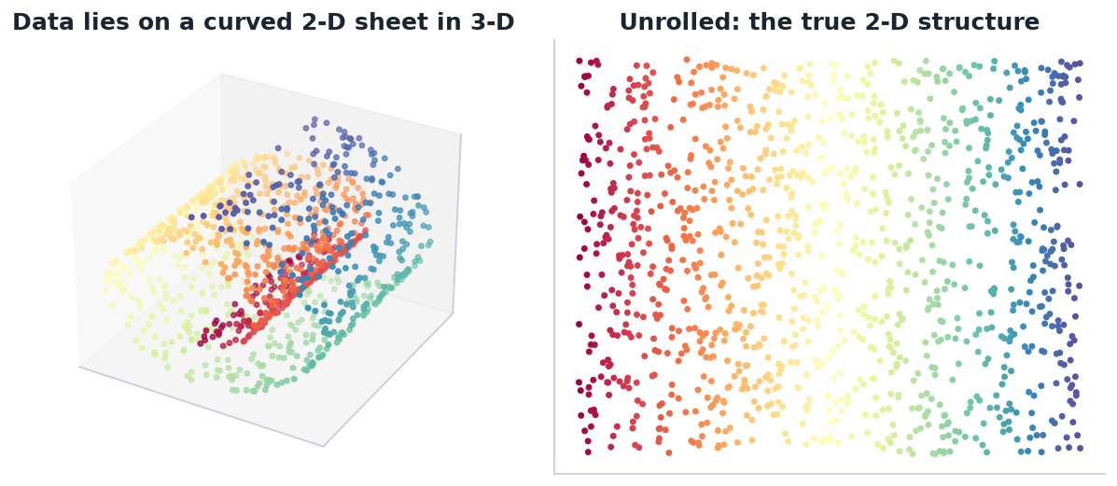
CURVED DATA
Data on a manifold
The 'Swiss roll': points live on a curved 2-D sheet embedded in 3-D. The true structure (right) is only revealed by 'unrolling' it — PCA can't.
STAT3888 · Statistical Machine Learning
L09 · 6

Slide 8
DEFINITION
Manifold
A manifold is a lower-dimensional surface (possibly curved) on which the data approximately lies within a higher-dimensional space.
▸ The 'manifold hypothesis': real data often lies near a low-dim manifold
▸ Non-linear methods try to recover its intrinsic coordinates
▸ PCA sees only the flat, linear shadow
STAT3888 · Statistical Machine Learning
L09 · 7

Slide 9
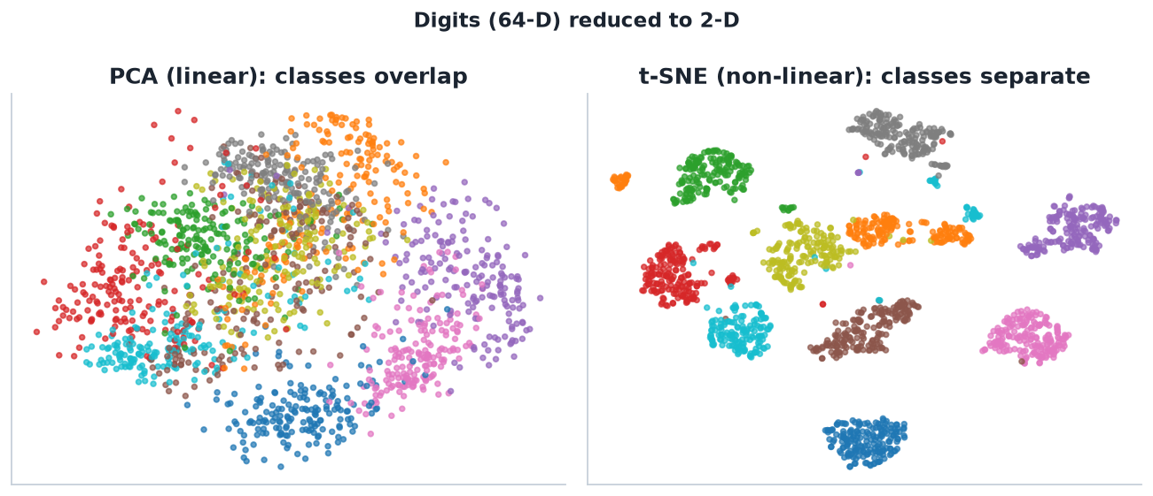
THE PAYOFF
Linear vs non-linear on real data
64-D handwritten digits in 2-D: PCA (left) overlaps the classes; t-SNE (right) pulls them into clear islands.
STAT3888 · Statistical Machine Learning
L09 · 8

Slide 10
TWO GOALS, TWO TOOLS
What are you reducing for?
Faithful geometry
Reveal groupings
• Preserve actual distances
• Good for quantitative structure
• → MDS (and PCA)
• Preserve local neighbourhoods
• Great for spotting clusters
• → t-SNE, UMAP
STAT3888 · Statistical Machine Learning
L09 · 9

Slide 11
PART 2
Multidimensional scaling (MDS)

Slide 12
DEFINITION
Multidimensional scaling
MDS places points in a low-dimensional space so that their pairwise distances match the original distances as closely as possible.
▸ Input: a distance / dissimilarity matrix
▸ Output: coordinates (e.g. 2-D) that reproduce those distances
▸ Classical (metric) MDS on Euclidean distance ≈ PCA
STAT3888 · Statistical Machine Learning
L09 · 10

Slide 13
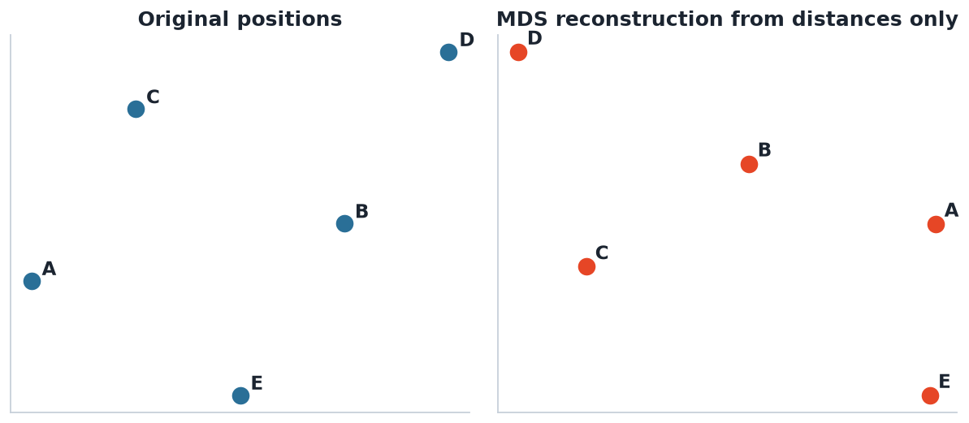
THE IDEA
Reconstruct a map from distances
Given only pairwise distances, MDS recovers a configuration that preserves them — like rebuilding a map from a table of city-to-city distances.
STAT3888 · Statistical Machine Learning
L09 · 11

Slide 14
OBJECTIVE
MDS minimises stress
Stress = Σ_{i<j} ( d_{ij} − ‖zᵢ − zⱼ‖ )²
• d_{ij} — original dissimilarity between i and j
• ‖zᵢ − zⱼ‖ — distance in the low-dim embedding
• Minimising stress = matching the two as well as possible
Low stress = a faithful low-dimensional picture.
STAT3888 · Statistical Machine Learning
L09 · 12

Slide 15
FLAVOURS
Metric vs non-metric MDS
▸ Metric MDS — preserves the actual distance values
▸ Non-metric MDS — preserves only the rank order of distances
▸ Use non-metric when only ordinal dissimilarities are meaningful
▸ Works with any distance — a big advantage over raw PCA
STAT3888 · Statistical Machine Learning
L09 · 13

Slide 16
CHECK YOUR UNDERSTANDING
MDS takes as its input primarily…
A
The raw data matrix only
B
A matrix of pairwise distances/dissimilarities ✓
C
Class labels
D
Principal components
Why: MDS works from a dissimilarity matrix, arranging points to reproduce those dissimilarities in low dimensions.
STAT3888 · Statistical Machine Learning
L09 · 14

Slide 17
PART 3
t-SNE

Slide 18
DEFINITION
t-SNE
t-distributed Stochastic Neighbour Embedding places points so that near neighbours stay near, emphasising local structure for visualisation.
▸ Converts distances into neighbour probabilities
▸ Matches those probabilities in 2-D using a heavy-tailed (t) distribution
▸ Superb at revealing clusters; a visualisation tool, not a general reducer
STAT3888 · Statistical Machine Learning
L09 · 15

Slide 19
HOW IT WORKS
t-SNE in four ideas
1
Neighbours
for each point, define probabilities of picking each other point as a neighbour
2
Low-dim mirror
define similar probabilities in the 2-D map
3
Match
move points to make the two probability sets agree (minimise KL divergence)
4
Heavy tails
the t-distribution stops distant points crowding the centre
STAT3888 · Statistical Machine Learning
L09 · 16

Slide 20
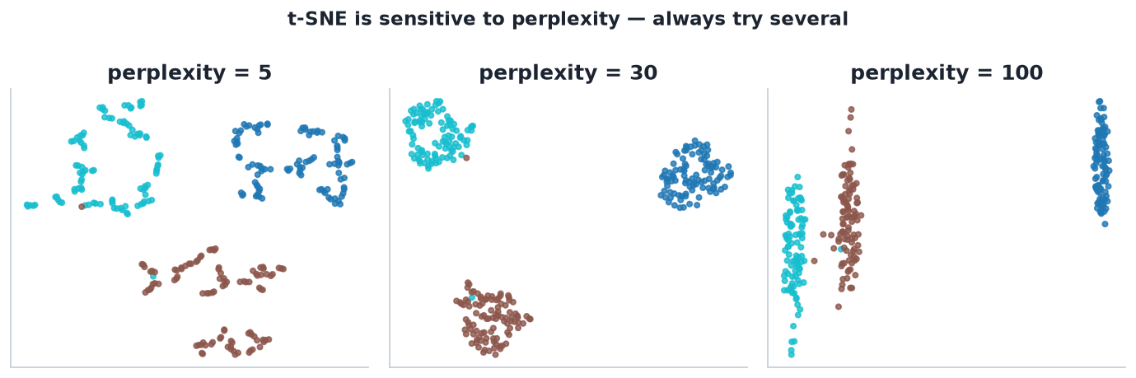
TUNING
Perplexity changes the picture
Perplexity ≈ the effective number of neighbours. Too small fragments clusters; too large merges them. Always try several values.
STAT3888 · Statistical Machine Learning
L09 · 17

Slide 21
READING T-SNE
What you may and may NOT conclude
▸ Do trust: which points form tight local groups
▸ Don't trust: the sizes of clusters — they're distorted
▸ Don't trust: distances between clusters — not meaningful
▸ Don't trust: the global layout — it can be arbitrary
STAT3888 · Statistical Machine Learning
L09 · 18

Slide 22
A FAMOUS WARNING
In t-SNE, cluster sizes and between-cluster distances are essentially meaningless — only local neighbourhoods are reliable.
Beautiful plots invite over-interpretation. Report it as exploratory.

Slide 23
CHECK YOUR UNDERSTANDING
In a t-SNE plot, two clusters are far apart. You may conclude…
A
They are very different
B
Nothing reliable — t-SNE distorts between-cluster distance ✓
C
One is larger
D
They will never merge
Why: t-SNE preserves local neighbourhoods, not global distances, so the gap between two clusters carries little meaning.
STAT3888 · Statistical Machine Learning
L09 · 20

Slide 24
PART 4
UMAP & the modern toolkit

Slide 25
DEFINITION
UMAP
Uniform Manifold Approximation and Projection is a newer non-linear reducer that is faster than t-SNE and better preserves some global structure.
▸ Built on manifold theory and graph layout
▸ Scales to large data; increasingly the default
▸ Still a visualisation tool — read with the same caution
STAT3888 · Statistical Machine Learning
L09 · 21

Slide 26
COMPARE
The dimension-reduction toolkit
Method | Type | Preserves | Main use
PCA | linear | variance / global | compress, preprocess
MDS | linear* | distances | faithful geometry
t-SNE | non-linear | local neighbours | cluster visualisation
UMAP | non-linear | local + some global | fast visualisation
STAT3888 · Statistical Machine Learning
L09 · 22

Slide 27
T-SNE VS UMAP
Choosing between the two
t-SNE
UMAP
• Excellent local structure
• Slower on big data
• Global layout unreliable
• Very widely cited
• Fast, scales well
• Keeps more global structure
• Can embed new points
• Now often preferred
STAT3888 · Statistical Machine Learning
L09 · 23

Slide 28
PART 5
In practice

Slide 29
R
Dimension reduction in a few lines
X <- scale(diet_numeric)
# MDS
mds <- cmdscale(dist(X), k = 2)
# t-SNE
library(Rtsne)
ts <- Rtsne(X, perplexity = 30)$Y
# UMAP
library(umap); um <- umap(X)$layout
STAT3888 · Statistical Machine Learning
L09 · 24

Slide 30
WORKFLOW
A sensible reduction pipeline
1
Clean & standardise
as always for distance-based methods
2
PCA first
reduce noise; often feed ~30 PCs into t-SNE/UMAP
3
Non-linear embed
t-SNE or UMAP for the 2-D picture
4
Colour by metadata
overlay a known group to interpret
5
Cross-check
does clustering on the data agree with the picture?
Running t-SNE/UMAP on PCA scores is standard — faster and less noisy.
STAT3888 · Statistical Machine Learning
L09 · 25

Slide 31
INTERPRETING HONESTLY
Rules for your report
▸ Label the axes as arbitrary for t-SNE/UMAP
▸ State the perplexity / parameters you used
▸ Show that clusters are stable across runs / settings
▸ Back up visual clusters with a quantitative method
STAT3888 · Statistical Machine Learning
L09 · 26

Slide 32
PART 6
Pitfalls, applications & wrap-up

Slide 33
PITFALLS
Where students go wrong
▸ Treating a t-SNE plot as quantitative truth
▸ Forgetting to standardise or to set a seed
▸ Reading meaning into cluster sizes / gaps
▸ Using non-linear embeddings as model features (they don't generalise well)
STAT3888 · Statistical Machine Learning
L09 · 27

Slide 34
WHEN TO USE WHICH
A quick decision guide
Reach for PCA/MDS
Reach for t-SNE/UMAP
• You need faithful distances
• You'll model on the output
• Interpretability matters
• You're exploring for clusters
• Structure looks non-linear
• The output is a picture, not features
STAT3888 · Statistical Machine Learning
L09 · 28

Slide 35
APPLICATIONS
Non-linear reduction in the wild
▸ Single-cell genomics — UMAP of thousands of cell types
▸ Metabolomics — visualising participant subtypes
▸ Image / text embeddings — mapping high-dim features
▸ Relevant to your project's exploratory phase
STAT3888 · Statistical Machine Learning
L09 · 29

Slide 36
DEFINITION
Intrinsic dimension
The intrinsic dimension is the true number of coordinates needed to describe the data, often far smaller than the number of variables.
▸ The manifold hypothesis says this is usually small
▸ Dimension reduction tries to recover it
▸ Estimating it guides how many components to keep
STAT3888 · Statistical Machine Learning
L09 · 30

Slide 37
CHECK YOUR UNDERSTANDING
You need reduced features to feed into a classifier that must work on new data. Best choice?
A
t-SNE
B
UMAP
C
PCA ✓
D
A random projection
Why: PCA gives a fixed, reproducible linear map you can apply to new data. t-SNE has no clean out-of-sample mapping and is meant for visualisation.
STAT3888 · Statistical Machine Learning
L09 · 31

Slide 38
IN-CLASS EXERCISE
Reduce and interpret
1. Standardise the nutrition data and run PCA, t-SNE (perplexity 5, 30, 50) and UMAP.
2. Which methods show clear participant groups? Are they stable across t-SNE settings?
3. Colour the embeddings by a health outcome — do groups align with it?
4. Write one sentence you could defend about the structure, and one you could NOT.
Hint. Defensible: 'points form tight local neighbourhoods'. Not defensible: 'cluster A is twice as big / far from B' in t-SNE.
STAT3888 · Statistical Machine Learning
L09 · 32

Slide 39
KEY IDEAS RECAP
Hold onto these
▸ MDS preserves distances; t-SNE/UMAP preserve local neighbourhoods
▸ Non-linear methods reveal structure PCA can't
▸ Their plots are exploratory — sizes & gaps are unreliable
▸ PCA-then-t-SNE/UMAP, standardise, set seeds, validate
STAT3888 · Statistical Machine Learning
L09 · 33

Slide 40
FURTHER READING
To go deeper
▸ van der Maaten & Hinton (2008) — the t-SNE paper
▸ McInnes et al. (2018) — UMAP
▸ *Distill.pub* — 'How to Use t-SNE Effectively'
STAT3888 · Statistical Machine Learning
L09 · 34

Slide 41
PART 7
More methods & diagnostics

Slide 42
DEFINITION
Isomap
Isomap is MDS on geodesic distances — distances measured *along* the manifold rather than straight through space.
▸ Builds a neighbour graph, then shortest paths approximate geodesics
▸ Unrolls curved manifolds like the Swiss roll
▸ A bridge between MDS and non-linear methods
STAT3888 · Statistical Machine Learning
L09 · 35

Slide 43
THE WIDER FAMILY
Manifold-learning methods
▸ LLE (Locally Linear Embedding) — preserve local linear reconstructions
▸ Kernel PCA — PCA in a transformed feature space
▸ Spectral embedding — eigenvectors of a similarity graph
▸ Autoencoders — neural networks that learn a compressed code (preview of NNs)
STAT3888 · Statistical Machine Learning
L09 · 36

Slide 44
DEFINITION
Shepard diagram
A Shepard diagram plots embedded distances against original distances to judge how faithfully an embedding preserves them.
▸ Points near the diagonal = distances well preserved
▸ Scatter = distortion
▸ A quick honesty check for MDS
STAT3888 · Statistical Machine Learning
L09 · 37

Slide 45
GOODNESS OF FIT
Is the picture trustworthy?
▸ Stress (MDS) — lower is better; report it
▸ Shepard diagram — visual check of distance preservation
▸ Stability — rerun with new seeds; do groups persist?
▸ Agreement — does clustering confirm the visual groups?
STAT3888 · Statistical Machine Learning
L09 · 38

Slide 46
COMPUTATIONAL COST
Practical considerations
▸ Classical MDS & PCA — fast (linear algebra)
▸ t-SNE — O(n²) naively; slow for large n
▸ UMAP — much faster, scales to big data
▸ PCA-first cuts cost and noise for all of them
STAT3888 · Statistical Machine Learning
L09 · 39

Slide 47
CHECK YOUR UNDERSTANDING
Which method is designed to 'unroll' a curved manifold using distances along it?
A
PCA
B
Isomap ✓
C
Classical MDS
D
Random projection
Why: Isomap uses geodesic (along-manifold) distances, letting it unroll curved structures that straight-line methods cannot.
STAT3888 · Statistical Machine Learning
L09 · 40

Slide 48
PART 8
Consolidation & a worked case

Slide 49
THE MENTAL MODEL
PCA asks 'which directions vary most?'; MDS asks 'can I preserve distances?'; t-SNE/UMAP ask 'who are each point's neighbours?'
Three different questions — pick the one your problem is really asking.

Slide 50
DECISION GUIDE
Picking a reducer, expanded
Goal | Data | Use
Compress / preprocess | linear-ish | PCA
Preserve distances | any distance | MDS / Isomap
Explore clusters (viz) | non-linear | t-SNE / UMAP
Features for a model | any | PCA (reproducible map)
STAT3888 · Statistical Machine Learning
L09 · 42

Slide 51
CASE STUDY
Metabolite subtypes, exploratory phase
▸ Standardise 40 metabolites; run PCA → keep 15 PCs (90% variance)
▸ Feed PCs into UMAP; colour by a clinical variable
▸ See 3 apparent groups → confirm with GMM on the PCs
▸ Report UMAP as exploratory, GMM clusters as the quantitative claim
STAT3888 · Statistical Machine Learning
L09 · 43

Slide 52
DO & DON'T
Non-linear reduction hygiene
Do
Don't
• PCA-first, standardise, set seeds
• Try several perplexities
• Validate with clustering
• Report parameters
• Read sizes/gaps as real
• Use t-SNE coords as features
• Trust one run
• Skip the honesty checks
STAT3888 · Statistical Machine Learning
L09 · 44

Slide 53
IN-CLASS EXERCISE
Critique a figure
1. A paper shows a t-SNE plot and claims 'group A is far more diverse than group B'.
2. Why is that claim unsupportable from t-SNE alone?
3. What analysis *would* support a claim about within-group diversity?
4. Rewrite the caption to be defensible.
Hint. t-SNE distorts cluster size/spread; measure diversity with variance/pairwise distances in the original (or PCA) space.
STAT3888 · Statistical Machine Learning
L09 · 45

Slide 54
DEFINITION
Out-of-sample extension
The ability to project new points into an existing embedding without refitting.
▸ PCA & UMAP support it cleanly (a reusable mapping)
▸ Standard t-SNE does not — a key limitation for pipelines
▸ Matters when you'll see new data (almost always)
STAT3888 · Statistical Machine Learning
L09 · 46

Slide 55
CHECK YOUR UNDERSTANDING
You need to embed NEW participants into an existing 2-D map next month. Avoid…
A
PCA
B
UMAP
C
Standard t-SNE ✓
D
Isomap with a mapping
Why: Standard t-SNE has no clean out-of-sample extension; PCA and UMAP provide reusable mappings for new points.
STAT3888 · Statistical Machine Learning
L09 · 47

Slide 56
CHAPTER CHECKLIST
Before moving on, you can…
▸ Explain why PCA fails on curved manifolds
▸ Describe MDS, t-SNE and UMAP and their goals
▸ List what you may NOT read from a t-SNE plot
▸ Give a PCA-first, seed-set, validated workflow
STAT3888 · Statistical Machine Learning
L09 · 48

Slide 57
DEFINITION
Autoencoder (preview)
An autoencoder is a neural network trained to compress data to a small 'code' and reconstruct it — a non-linear generalisation of PCA.
▸ The bottleneck layer is the reduced representation
▸ Linear autoencoder ≈ PCA; non-linear ones capture curved structure
▸ We meet neural networks in Lectures 17–18
STAT3888 · Statistical Machine Learning
L09 · 49

Slide 58
APPLICATIONS RECAP
Where reduction pays off
▸ Visualisation of high-dim participant data
▸ Preprocessing before clustering / classification
▸ Denoising by dropping low-variance directions
▸ Compression for storage and speed
STAT3888 · Statistical Machine Learning
L09 · 50

Slide 59
ONE LINE TO REMEMBER
Reduce dimensions to *see* and to *simplify* — but always check that the reduced picture tells the truth.
A pretty embedding is a hypothesis, not a result.

Slide 60
SUMMARY
Key takeaways
✓ PCA is linear; MDS, t-SNE and UMAP handle distances and non-linear structure.
✓ MDS preserves distances; t-SNE/UMAP preserve local neighbourhoods for visualisation.
✓ t-SNE/UMAP plots are exploratory — cluster sizes and gaps are not trustworthy.
✓ Standardise, often PCA-first, set a seed, and validate visual structure quantitatively.
Next lecture → Lecture 10 — Introduction to supervised learning: prediction, error and validation.
STAT3888 · Statistical Machine Learning
L09 · 52

