Slide 1
LECTURE 10
Introduction to Supervised Learning
The framework behind every prediction method: inputs and targets, loss, training vs generalisation, the bias–variance trade-off, and cross-validation.
School of Mathematics & Statistics · The University of Sydney

Slide 2
AGENDA
Today's roadmap
▸ From unsupervised to supervised learning
▸ The setup: features, target, and the function f
▸ Regression vs classification; loss functions
▸ Training error vs test error
▸ Overfitting and the bias–variance trade-off
▸ Cross-validation and honest model assessment
▸ The tidymodels workflow
STAT3888 · Statistical Machine Learning
L10 · 2

Slide 3
WHERE WE ARE
A turning point in the unit
▸ Weeks 1–3: unsupervised — structure without labels (clustering, PCA)
▸ Weeks 4–7: supervised — predicting a known target Y
▸ Today builds the framework every later method plugs into
▸ Master this and logistic regression, trees, SVMs all make sense
STAT3888 · Statistical Machine Learning
L10 · 3

Slide 4
CHECK YOUR UNDERSTANDING
What defines a supervised learning problem?
A
Many variables
B
A known target/label Y to predict ✓
C
No labels
D
Only numeric data
Why: Supervised learning has a target variable Y; the goal is to learn to predict it from features X.
STAT3888 · Statistical Machine Learning
L10 · 4

Slide 5
PART 1
The supervised setup

Slide 6
DEFINITION
Supervised learning
Learn a function f mapping input features X to a target Y, using labelled examples, so that f predicts Y well on new data.
▸ X — predictors / features (the columns you know)
▸ Y — target / label (what you want to predict)
▸ f — the fitted model; Ŷ = f(X)
STAT3888 · Statistical Machine Learning
L10 · 5

Slide 7
THE MODEL
Signal plus noise
Y = f(X) + ε
• f(X) — the true systematic relationship we try to learn
• ε — irreducible noise (measurement error, randomness)
• We can shrink error toward, but never below, the noise floor
STAT3888 · Statistical Machine Learning
L10 · 6

Slide 8
TWO TASKS
Regression vs classification
Regression
Classification
• Y is numeric
• e.g. predict fasting glucose
• Error: squared / absolute
• Output: a number
• Y is categorical
• e.g. diabetic / not
• Error: misclassification, log-loss
• Output: a class or probability
STAT3888 · Statistical Machine Learning
L10 · 7

Slide 9
EXAMPLES IN NUTRITION
Same framework, many questions
▸ Regression: body-fat % from intake variables
▸ Classification: metabolic-syndrome yes/no
▸ Probability: chance of high cholesterol
▸ Ranking: which foods most raise glucose
STAT3888 · Statistical Machine Learning
L10 · 8

Slide 10
PART 2
Measuring error: loss

Slide 11
DEFINITION
Loss function
A loss function measures how wrong a prediction is; fitting a model means minimising average loss.
▸ Regression: squared error (y − ŷ)²
▸ Classification: 0/1 misclassification, or log-loss
▸ The loss encodes what 'a good prediction' means
STAT3888 · Statistical Machine Learning
L10 · 9

Slide 12
REGRESSION LOSS
Mean squared error
MSE = (1/n) Σᵢ ( yᵢ − ŷᵢ )²
• Averages the squared prediction errors
• Squaring punishes large errors heavily
• Its square root, RMSE, is on the original scale
STAT3888 · Statistical Machine Learning
L10 · 10

Slide 13
CLASSIFICATION LOSS
Ways to be wrong
▸ Misclassification rate — fraction predicted into the wrong class
▸ Log-loss / cross-entropy — punishes confident wrong probabilities
▸ Cost-sensitive — some errors matter more (missing a disease!)
▸ Choose the loss to match the real-world cost
STAT3888 · Statistical Machine Learning
L10 · 11

Slide 14
PART 3
Training vs test error

Slide 15
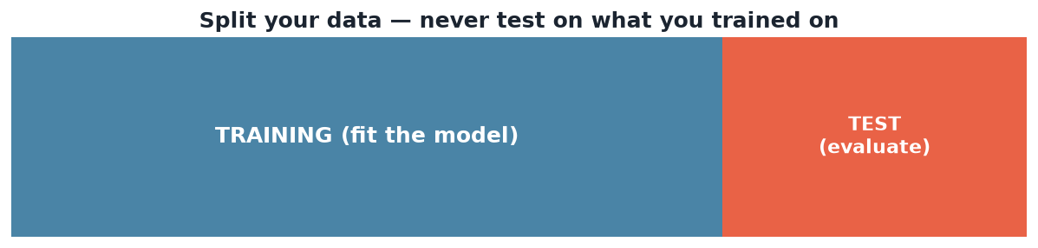
THE SPLIT
Train on some, test on the rest
Fit the model on the training set; estimate real-world performance on a held-out test set it never saw.
STAT3888 · Statistical Machine Learning
L10 · 12

Slide 16
DEFINITION
Generalisation
Generalisation is a model's performance on new, unseen data — the only performance that actually matters.
▸ Training error is optimistic — the model has seen that data
▸ Test error estimates generalisation
▸ The gap between them signals overfitting
STAT3888 · Statistical Machine Learning
L10 · 13

Slide 17
THE CARDINAL RULE
Never evaluate a model on data it was trained on — and never let test data influence training.
Break this and every performance number becomes a fantasy.

Slide 18
WHY TRAINING ERROR MISLEADS
The optimism of hindsight
▸ A flexible model can memorise the training data → ~0 training error
▸ That says nothing about new data
▸ Test error can be far worse — the honest number
▸ More flexibility always lowers training error, not always test error
STAT3888 · Statistical Machine Learning
L10 · 15

Slide 19
PART 4
Overfitting & bias–variance

Slide 20
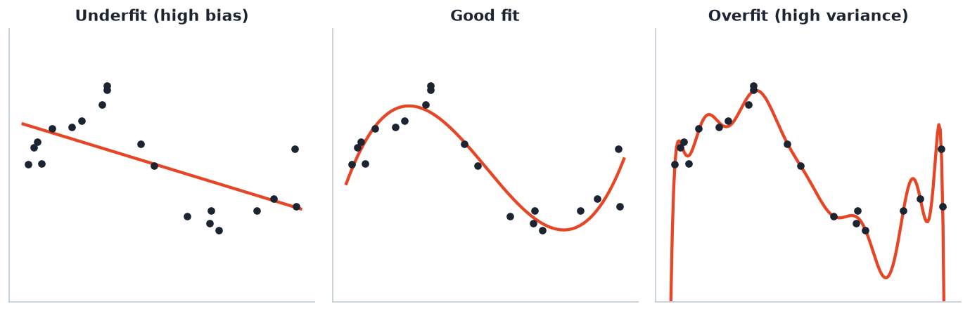
COMPLEXITY
Underfit, good fit, overfit
Too simple misses the pattern (bias); too complex chases noise (variance). The middle generalises best.
STAT3888 · Statistical Machine Learning
L10 · 16

Slide 21
DEFINITION
Bias & variance
Bias is error from wrong assumptions (too simple); variance is error from sensitivity to the particular training sample (too complex).
▸ High bias → underfitting
▸ High variance → overfitting
▸ Total error = bias² + variance + irreducible noise
STAT3888 · Statistical Machine Learning
L10 · 17

Slide 22
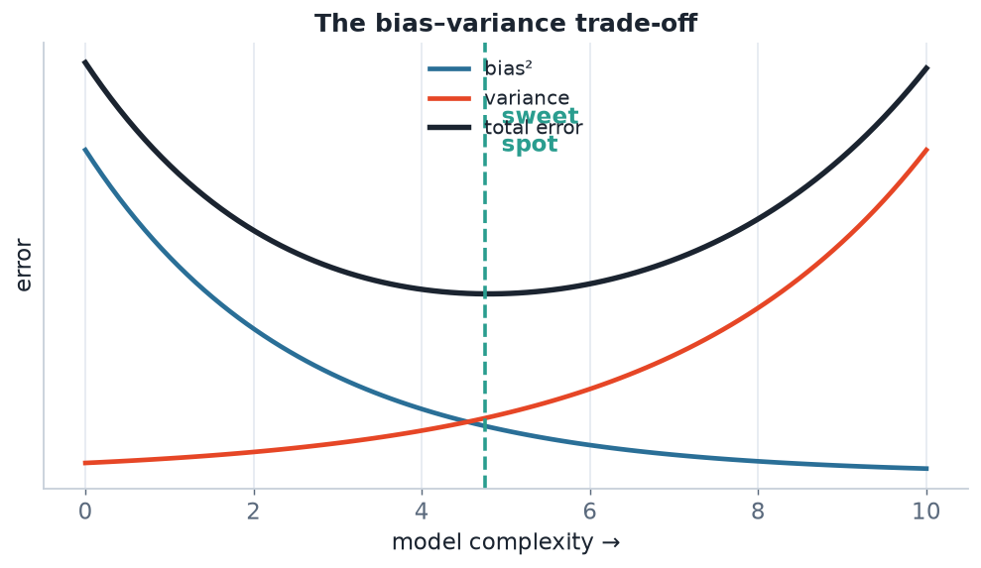
THE TRADE-OFF
Bias–variance decomposition
As complexity grows, bias falls but variance rises. Test error is U-shaped — the minimum is the sweet spot.
STAT3888 · Statistical Machine Learning
L10 · 18

Slide 23
DECOMPOSITION
Expected test error splits three ways
E[error] = bias² + variance + σ²
• bias² — systematic error from an over-simple model
• variance — instability across training samples
• σ² — irreducible noise you can never remove
Model selection is the art of balancing bias against variance.
STAT3888 · Statistical Machine Learning
L10 · 19

Slide 24
CHECK YOUR UNDERSTANDING
A very flexible model has near-zero training error but poor test error. It suffers from…
A
High bias
B
High variance (overfitting) ✓
C
Irreducible noise
D
Underfitting
Why: Low training but high test error = the model fits noise in the training sample: high variance / overfitting.
STAT3888 · Statistical Machine Learning
L10 · 20

Slide 25
PART 5
Cross-validation

Slide 26
DEFINITION
Cross-validation
k-fold cross-validation splits data into k parts, trains on k−1 and validates on the held-out part, rotating through all k.
▸ Every observation is used for both training and validation
▸ Average the k validation scores for a stable estimate
▸ Common choices: k = 5 or 10
STAT3888 · Statistical Machine Learning
L10 · 21

Slide 27
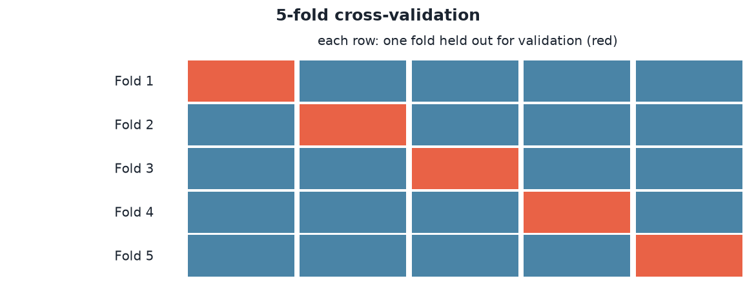
HOW IT WORKS
5-fold cross-validation
Each fold takes a turn as the validation set (red). Averaging the five scores gives a reliable estimate of generalisation.
STAT3888 · Statistical Machine Learning
L10 · 22

Slide 28
WHY CROSS-VALIDATE
Better than a single split
▸ A single train/test split is noisy — depends on luck of the draw
▸ CV reuses data efficiently for a stable estimate
▸ Essential for tuning settings (e.g. how much to regularise — Lecture 12)
▸ Still keep a final untouched test set for the last word
STAT3888 · Statistical Machine Learning
L10 · 23

Slide 29
VARIANTS
Flavours of CV
▸ k-fold — the standard (k = 5 or 10)
▸ Stratified — keep class proportions per fold (imbalanced Y)
▸ Leave-one-out — k = n; low bias, high variance, expensive
▸ Repeated — average over several k-fold runs for stability
STAT3888 · Statistical Machine Learning
L10 · 24

Slide 30
CHECK YOUR UNDERSTANDING
Why use cross-validation instead of a single train/test split?
A
It's faster
B
It gives a more stable, less luck-dependent performance estimate ✓
C
It avoids standardising
D
It removes the need for a test set
Why: Averaging over folds reduces the variance of the estimate compared with one arbitrary split — though a final held-out test set is still wise.
STAT3888 · Statistical Machine Learning
L10 · 25

Slide 31
PART 6
Assessment, workflow & pitfalls

Slide 32
METRICS
How we score models
Task | Metric | Meaning
Regression | RMSE / MAE | typical prediction error
Regression | R² | variance explained
Classification | accuracy | fraction correct
Classification | AUC | ranking quality (Lecture 11)
Classification | precision/recall | for imbalanced classes
STAT3888 · Statistical Machine Learning
L10 · 26

Slide 33
DEFINITION
Model selection vs assessment
Selection chooses among models/settings (use CV); assessment estimates the final model's real-world error (use a held-out test set).
▸ Don't use the test set to choose — that leaks and inflates scores
▸ Train → validate (CV) → test, in that order
▸ The test set is touched once, at the very end
STAT3888 · Statistical Machine Learning
L10 · 27

Slide 34
TIDYMODELS
The supervised workflow in R
library(tidymodels)
split <- initial_split(data, prop = 0.8, strata = outcome)
folds <- vfold_cv(training(split), v = 5)
rec <- recipe(outcome ~ ., training(split)) |> step_normalize(all_numeric_predictors())
spec <- logistic_reg() |> set_engine('glm')
wf <- workflow() |> add_recipe(rec) |> add_model(spec)
fit_resamples(wf, folds) |> collect_metrics() # CV estimate
STAT3888 · Statistical Machine Learning
L10 · 28

Slide 35
THE WORKFLOW IN ONE LINE
Split → preprocess on training → cross-validate to select → evaluate once on test.
This discipline is what separates trustworthy results from wishful ones.

Slide 36
PITFALLS
Classic ways to fool yourself
▸ Leakage — preprocessing before the split
▸ Peeking — tuning on the test set
▸ Ignoring imbalance — 95% accuracy when 95% are one class
▸ No baseline — always compare to a trivial model
STAT3888 · Statistical Machine Learning
L10 · 30

Slide 37
DEFINITION
No free lunch theorem
No single model is best for all problems — performance depends on the data, so we compare candidates empirically.
▸ Justifies trying several methods and cross-validating
▸ Simplicity and interpretability are legitimate tie-breakers
▸ Domain knowledge narrows the search
STAT3888 · Statistical Machine Learning
L10 · 31

Slide 38
CHECK YOUR UNDERSTANDING
You tuned a model's settings using the test set and now report its test accuracy. The number is…
A
Trustworthy
B
Optimistically biased — the test set influenced the model ✓
C
Too low
D
Irrelevant
Why: Using the test set for tuning leaks information; its accuracy no longer reflects genuine generalisation. Tune with CV, test once.
STAT3888 · Statistical Machine Learning
L10 · 32

Slide 39
IN-CLASS EXERCISE
Design an evaluation
1. You must predict metabolic-syndrome (yes/no) from 25 intake variables.
2. Describe the full split → preprocess → CV → test workflow you'd use.
3. Which metric(s) would you report, and why (the classes are imbalanced)?
4. Name two forms of leakage you'll actively guard against.
Hint. For imbalanced classes prefer AUC / precision-recall over raw accuracy; guard against preprocessing-before-split and tuning-on-test leakage.
STAT3888 · Statistical Machine Learning
L10 · 33

Slide 40
KEY IDEAS RECAP
The framework in brief
▸ Supervised learning fits f: X → Y to generalise to new data
▸ Minimise a loss; judge by test, not training, error
▸ Balance bias vs variance; avoid over/under-fitting
▸ Cross-validate to select; hold out to assess
STAT3888 · Statistical Machine Learning
L10 · 34

Slide 41
FURTHER READING
To go deeper
▸ James et al., *An Introduction to Statistical Learning*, Ch. 2 & 5
▸ Hastie et al., *The Elements of Statistical Learning*, Ch. 7
▸ The tidymodels documentation and *Tidy Modeling with R*
STAT3888 · Statistical Machine Learning
L10 · 35

Slide 42
PART 7
Evaluating classifiers properly

Slide 43
DEFINITION
Confusion matrix
A confusion matrix cross-tabulates predicted vs actual classes: true/false positives and negatives.
▸ TP, TN — correct; FP (false alarm), FN (missed case)
▸ Every classification metric is built from these four counts
▸ Always look at it before trusting a single accuracy number
STAT3888 · Statistical Machine Learning
L10 · 36

Slide 44
FROM THE MATRIX
The metrics that matter
Metric | Formula | Answers
Accuracy | (TP+TN)/all | overall correctness
Precision | TP/(TP+FP) | of predicted positives, how many right?
Recall (sens.) | TP/(TP+FN) | of actual positives, how many caught?
Specificity | TN/(TN+FP) | of actual negatives, how many caught?
F1 | harmonic mean P&R | balance of precision & recall
STAT3888 · Statistical Machine Learning
L10 · 37

Slide 45
THE ACCURACY PARADOX
If 95% of people are healthy, a model that predicts 'healthy' for everyone scores 95% accuracy — and is useless.
With imbalanced classes, accuracy lies. Use recall, precision, F1 or AUC.

Slide 46
WORKED EXAMPLE
Reading a confusion matrix
▸ 100 patients: 20 diseased, 80 healthy
▸ Model catches 15 diseased (TP=15, FN=5) and flags 10 healthy wrongly (FP=10, TN=70)
▸ Accuracy = 85/100 = 85%; Recall = 15/20 = 75%; Precision = 15/25 = 60%
▸ Accuracy looks fine, but it misses 1 in 4 diseased patients
STAT3888 · Statistical Machine Learning
L10 · 39

Slide 47
CHECK YOUR UNDERSTANDING
A rare-disease test has 99% accuracy but recall 10%. In practice it…
A
Works well
B
Misses 90% of actual cases — dangerous ✓
C
Has no false positives
D
Is perfectly calibrated
Why: High accuracy with low recall means it rarely predicts the disease and misses most true cases — accuracy is dominated by the healthy majority.
STAT3888 · Statistical Machine Learning
L10 · 40

Slide 48
PART 8
Model families, curves & pitfalls

Slide 49
DEFINITION
Parameters vs hyperparameters
Parameters are learned from data (e.g. regression coefficients); hyperparameters are set before fitting (e.g. penalty strength, k in k-NN).
▸ Parameters: fit by minimising loss
▸ Hyperparameters: chosen by cross-validation
▸ Confusing the two is a common exam slip
STAT3888 · Statistical Machine Learning
L10 · 41

Slide 50
MODEL SPECTRUM
Parametric vs non-parametric
Parametric
Non-parametric
• Fixed form & #parameters
• e.g. linear/logistic regression
• Efficient, interpretable
• Risk: wrong-shape bias
• Flexibility grows with data
• e.g. k-NN, trees, splines
• Adapts to complex shapes
• Risk: overfitting, needs more data
STAT3888 · Statistical Machine Learning
L10 · 42

Slide 51
DEFINITION
Learning curve
A learning curve plots error against training-set size, revealing whether more data would help.
▸ High bias: train & test errors both high and close → more data won't help
▸ High variance: big train–test gap → more data may help
▸ A cheap diagnostic before collecting more data
STAT3888 · Statistical Machine Learning
L10 · 43

Slide 52
BASELINES
Always compare against something trivial
▸ Classification: predict the majority class
▸ Regression: predict the mean
▸ A model that can't beat the baseline is worthless
▸ Baselines keep you honest about 'good' performance
STAT3888 · Statistical Machine Learning
L10 · 44

Slide 53
DEFINITION
Nested cross-validation
Nested CV uses an inner CV loop to tune hyperparameters and an outer loop to assess performance — avoiding optimistic bias from tuning.
▸ Inner loop: select settings
▸ Outer loop: estimate generalisation of the whole procedure
▸ The gold standard when you both tune and report
STAT3888 · Statistical Machine Learning
L10 · 45

Slide 54
ETHICS & FAIRNESS
Responsible supervised learning
▸ A model can be accurate yet unfair across groups
▸ Biased training data → biased, harmful predictions
▸ In health, false negatives can be dangerous — weigh error costs
▸ Interpretability supports accountability
STAT3888 · Statistical Machine Learning
L10 · 46

Slide 55
CHECK YOUR UNDERSTANDING
Which is a hyperparameter, not a parameter?
A
A logistic-regression coefficient
B
The regularisation strength λ ✓
C
A fitted cluster mean
D
A PCA loading
Why: λ is set before fitting and chosen by cross-validation — a hyperparameter. Coefficients, means and loadings are learned from data.
STAT3888 · Statistical Machine Learning
L10 · 47

Slide 56
THE ROAD AHEAD
Every supervised method in Weeks 4–7 — logistic regression, discriminant analysis, trees, forests, SVMs, neural nets — plugs into this framework.
Fit f, control bias vs variance, cross-validate, evaluate honestly.

Slide 57
IN-CLASS EXERCISE
Diagnose from a learning curve
1. Model A: training and test error are both 30% and nearly equal.
2. Model B: training error 3%, test error 25%.
3. Diagnose each (bias vs variance). Would more data help either?
4. Suggest one concrete fix for each model.
Hint. A: high bias (both high, close) → more data won't help; use a richer model. B: high variance (big gap) → more data / regularisation / simpler model.
STAT3888 · Statistical Machine Learning
L10 · 49

Slide 58
KEY IDEAS RECAP
The evaluation toolkit
▸ Read the confusion matrix, not just accuracy
▸ For imbalance use precision, recall, F1, AUC
▸ Tune hyperparameters by CV; assess with a test set
▸ Always beat a baseline; watch fairness
STAT3888 · Statistical Machine Learning
L10 · 50

Slide 59
FURTHER READING
To go deeper
▸ James et al., *ISLR*, Ch. 4 (classification) & Ch. 5 (resampling)
▸ Hastie et al., *ESL*, Ch. 7 (model assessment & selection)
▸ *Tidy Modeling with R* — practical resampling & metrics
STAT3888 · Statistical Machine Learning
L10 · 51

Slide 60
SUMMARY
Key takeaways
✓ Supervised learning fits f: X → Y and is judged by generalisation to new data.
✓ Fitting minimises a loss; training error is optimistic, so we rely on test error.
✓ The bias–variance trade-off explains under- and over-fitting.
✓ Cross-validate to select and tune; keep an untouched test set to assess.
Next lecture → Lecture 11 — Logistic regression: the workhorse classifier.
STAT3888 · Statistical Machine Learning
L10 · 52

