Slide 1
LECTURE 11
Logistic Regression
The workhorse classifier: modelling probabilities with the logit link, interpreting coefficients as odds, fitting by maximum likelihood, and evaluating with the ROC curve.
School of Mathematics & Statistics · The University of Sydney

Slide 2
AGENDA
Today's roadmap
▸ Why not linear regression for classification?
▸ The logistic function and the logit link
▸ Odds, log-odds and coefficient interpretation
▸ Fitting by maximum likelihood
▸ The decision boundary & thresholds
▸ Evaluation: confusion matrix, ROC and AUC
STAT3888 · Statistical Machine Learning
L11 · 2

Slide 3
RECAP
The supervised framework
▸ Last lecture: fit f: X → Y, judge by generalisation, cross-validate
▸ Now our first named method for classification
▸ Y is binary: diseased/healthy, at-risk/not
▸ We predict a probability, then a class
STAT3888 · Statistical Machine Learning
L11 · 3

Slide 4
CHECK YOUR UNDERSTANDING
Logistic regression is used primarily for…
A
Predicting a continuous number
B
Predicting a class / probability ✓
C
Clustering
D
Dimension reduction
Why: Despite its name, logistic regression is a classification method — it models the probability of a categorical outcome.
STAT3888 · Statistical Machine Learning
L11 · 4

Slide 5
PART 1
Why not linear regression?

Slide 6
THE PROBLEM
Fit a straight line to 0/1 outcomes and it predicts probabilities below 0 and above 1 — which are meaningless.
We need a model that always returns a valid probability in (0, 1).

Slide 7
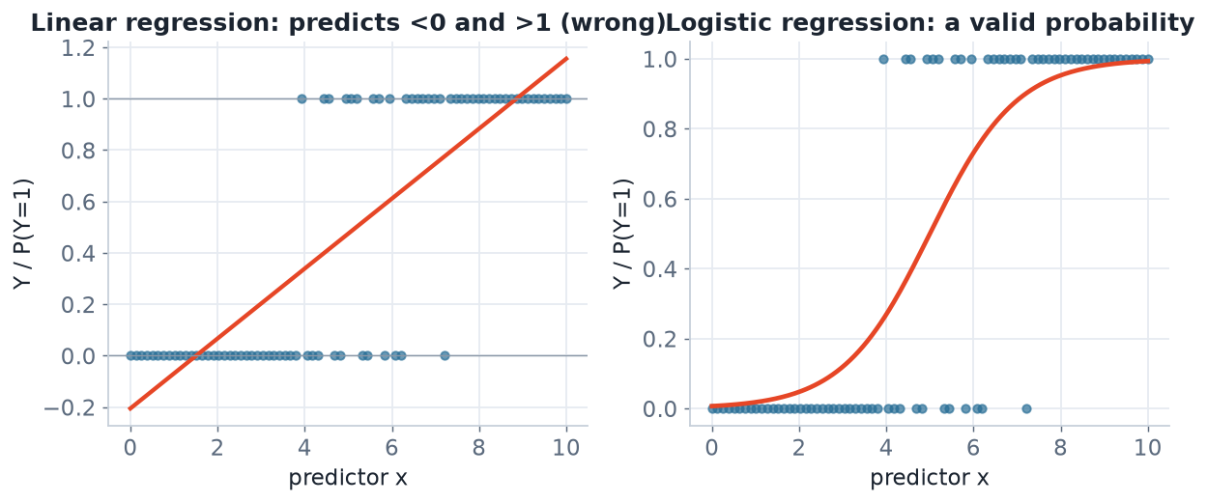
THE FIX
Linear vs logistic on binary data
Linear regression (left) leaves the [0,1] range and extrapolates nonsense. Logistic regression (right) produces a proper S-shaped probability.
STAT3888 · Statistical Machine Learning
L11 · 6

Slide 8
WHAT WE NEED
Requirements for a classifier
▸ Output a probability in (0, 1)
▸ Be monotonic in the predictors (more risk → higher probability)
▸ Keep the interpretability of regression coefficients
▸ Logistic regression delivers all three
STAT3888 · Statistical Machine Learning
L11 · 7

Slide 9
PART 2
The logistic model

Slide 10
DEFINITION
Logistic (sigmoid) function
The logistic function σ(η) = 1/(1 + e⁻η) maps any real number η into the interval (0, 1).
▸ η is the linear predictor β₀ + β₁x₁ + …
▸ σ is S-shaped: flat, steep, flat
▸ σ(0) = 0.5 — the natural decision threshold
STAT3888 · Statistical Machine Learning
L11 · 8

Slide 11
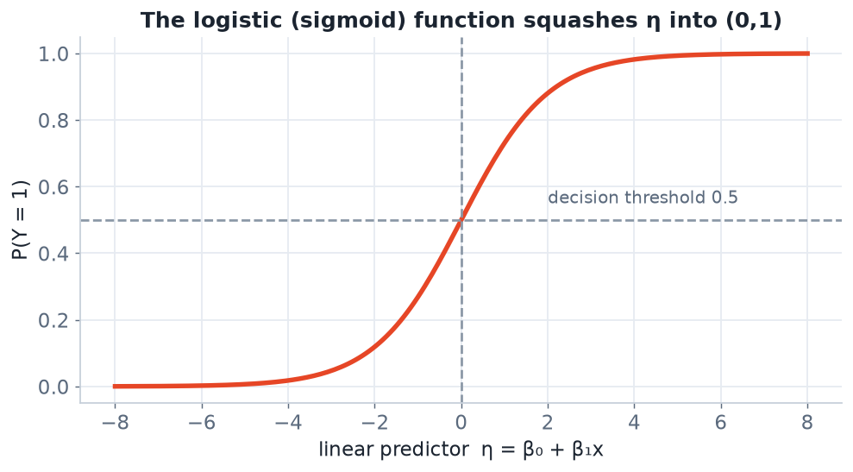
THE CURVE
The sigmoid squashes η into a probability
Large positive η → probability near 1; large negative → near 0; η = 0 → 0.5.
STAT3888 · Statistical Machine Learning
L11 · 9

Slide 12
THE MODEL
Logistic regression
P(Y=1 | x) = 1 / ( 1 + e^−(β₀ + β₁x₁ + … + βₚxₚ) )
• A linear predictor passed through the sigmoid
• Coefficients β act on the log-odds scale (next)
• Fitted by maximum likelihood, not least squares
STAT3888 · Statistical Machine Learning
L11 · 10

Slide 13
DEFINITION
The logit link
The logit is the log-odds, log(p/(1−p)). Logistic regression makes the logit a linear function of the predictors.
▸ logit(p) = β₀ + β₁x₁ + … — linear on this scale
▸ It's the inverse of the sigmoid
▸ This is why logistic regression is a 'generalised linear model'
STAT3888 · Statistical Machine Learning
L11 · 11

Slide 14
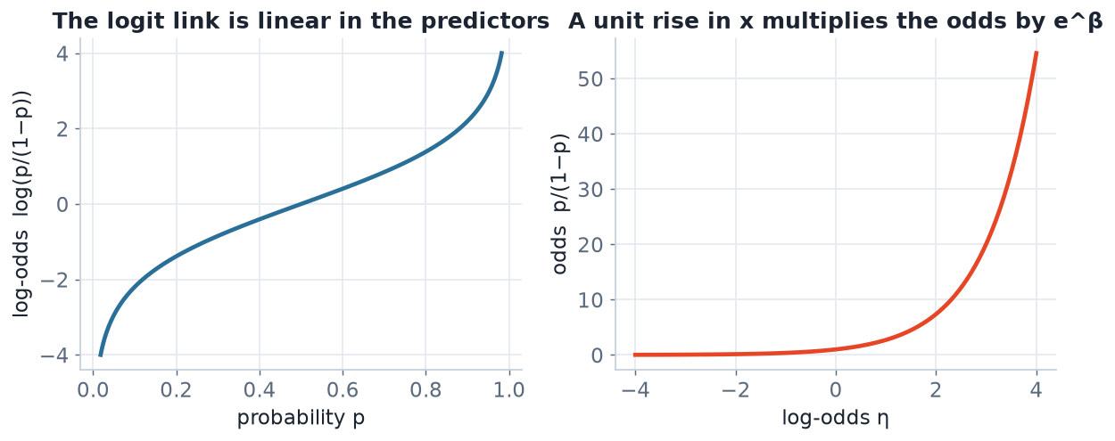
TWO SCALES
Probability, odds and log-odds
The model is linear on the log-odds scale (left); on the odds scale a unit change in x multiplies the odds (right).
STAT3888 · Statistical Machine Learning
L11 · 12

Slide 15
PART 3
Odds & interpreting coefficients

Slide 16
DEFINITION
Odds
The odds of an event is p/(1−p): the probability it happens divided by the probability it doesn't.
▸ p = 0.5 → odds 1 ('even'); p = 0.8 → odds 4 ('4 to 1')
▸ Odds range 0 to ∞; log-odds range −∞ to +∞
▸ Coefficients are naturally read on the odds scale
STAT3888 · Statistical Machine Learning
L11 · 13

Slide 17
INTERPRETATION
Coefficients are log odds-ratios
e^βⱼ = odds ratio for a one-unit increase in xⱼ
• A one-unit rise in xⱼ multiplies the odds by e^βⱼ (others held fixed)
• βⱼ > 0 → e^βⱼ > 1 → the event becomes more likely
• βⱼ = 0 → e^βⱼ = 1 → xⱼ has no effect on the odds
Report odds ratios with confidence intervals — the standard in health research.
STAT3888 · Statistical Machine Learning
L11 · 14

Slide 18
WORKED INTERPRETATION
A nutrition example
▸ Model: P(high cholesterol) from saturated-fat intake
▸ Suppose β = 0.4 for fat (per 10 g/day)
▸ e^0.4 ≈ 1.49 → each extra 10 g/day raises the odds by ~49%
▸ Odds ratios, not probabilities, are what the coefficient gives you directly
STAT3888 · Statistical Machine Learning
L11 · 15

Slide 19
CHECK YOUR UNDERSTANDING
A predictor has coefficient β = 0 in a logistic model. Its odds ratio e^β is…
A
0
B
1 (no effect) ✓
C
Infinite
D
Negative
Why: e^0 = 1, meaning a one-unit change multiplies the odds by 1 — i.e. no effect on the outcome's odds.
STAT3888 · Statistical Machine Learning
L11 · 16

Slide 20
CAREFUL INTERPRETATION
Common traps
▸ Odds ratio ≠ probability ratio (only ≈ for rare events)
▸ Coefficients are conditional — 'holding other variables fixed'
▸ Standardise predictors to compare coefficient magnitudes
▸ Correlation among predictors makes coefficients unstable (→ Lecture 12)
STAT3888 · Statistical Machine Learning
L11 · 17

Slide 21
PART 4
Fitting the model

Slide 22
DEFINITION
Maximum likelihood estimation
MLE chooses the coefficients that make the observed 0/1 outcomes most probable under the model.
▸ No closed-form solution — solved numerically
▸ Iteratively Reweighted Least Squares (IRLS) / Newton's method
▸ Contrast with least squares used in linear regression
STAT3888 · Statistical Machine Learning
L11 · 18

Slide 23
OBJECTIVE
Maximise the log-likelihood
ℓ(β) = Σᵢ [ yᵢ log pᵢ + (1−yᵢ) log(1−pᵢ) ]
• pᵢ = σ(β₀ + βᵀxᵢ) is the model's probability for case i
• Rewards high pᵢ when yᵢ = 1 and low pᵢ when yᵢ = 0
• Equivalent to minimising cross-entropy / log-loss
STAT3888 · Statistical Machine Learning
L11 · 19

Slide 24
HOW IT'S SOLVED
Under the hood (conceptually)
▸ Start with a guess for β
▸ Repeatedly update β to increase the log-likelihood
▸ Converges quickly for well-behaved data
▸ `glm(family = binomial)` does this for you in R
STAT3888 · Statistical Machine Learning
L11 · 20

Slide 25
ASSUMPTIONS
What logistic regression assumes
▸ The logit is linear in the predictors
▸ Observations are independent
▸ Little multicollinearity among predictors
▸ Enough events per predictor (rule of thumb: ≥ 10)
STAT3888 · Statistical Machine Learning
L11 · 21

Slide 26
PART 5
Predictions & the decision boundary

Slide 27
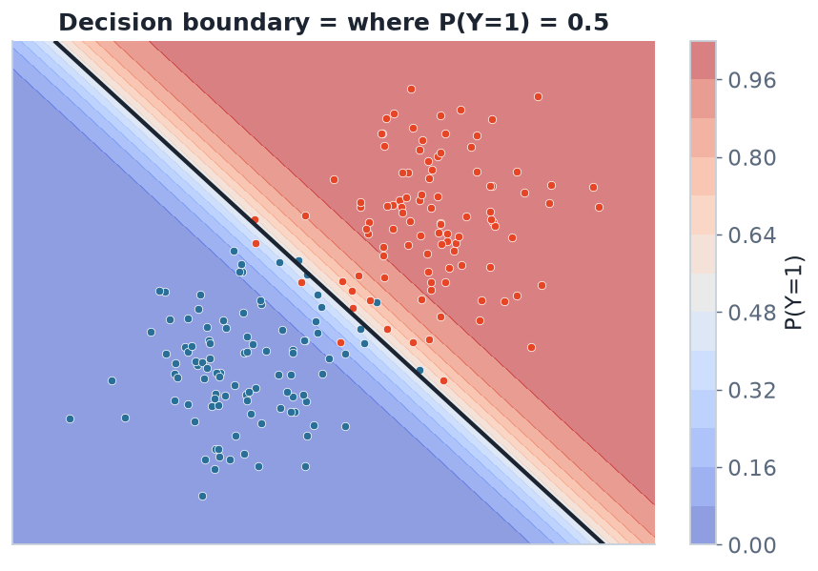
GEOMETRY
Where probability crosses 0.5
Logistic regression draws a **linear** decision boundary — the line where P(Y=1) = 0.5. One side is predicted positive, the other negative.
STAT3888 · Statistical Machine Learning
L11 · 22

Slide 28
DEFINITION
Decision threshold
The threshold converts a predicted probability into a class label — default 0.5, but adjustable to trade off error types.
▸ Lower threshold → catch more positives (higher recall, more false alarms)
▸ Higher threshold → fewer false alarms (higher precision, more misses)
▸ Choose it from the cost of each error type
STAT3888 · Statistical Machine Learning
L11 · 23

Slide 29
CHOOSING A THRESHOLD
It's a decision, not a default
▸ Screening for disease? Lower the threshold — don't miss cases (high recall)
▸ Costly intervention? Raise it — avoid false alarms (high precision)
▸ 0.5 is a starting point, not a law
▸ The ROC curve shows all thresholds at once (next)
STAT3888 · Statistical Machine Learning
L11 · 24

Slide 30
CHECK YOUR UNDERSTANDING
Lowering the classification threshold from 0.5 to 0.3 will generally…
A
Increase recall, increase false positives ✓
B
Increase precision, reduce recall
C
Have no effect
D
Reduce both errors
Why: A lower threshold labels more cases positive, catching more true positives (higher recall) but also producing more false positives.
STAT3888 · Statistical Machine Learning
L11 · 25

Slide 31
PART 6
Evaluation

Slide 32
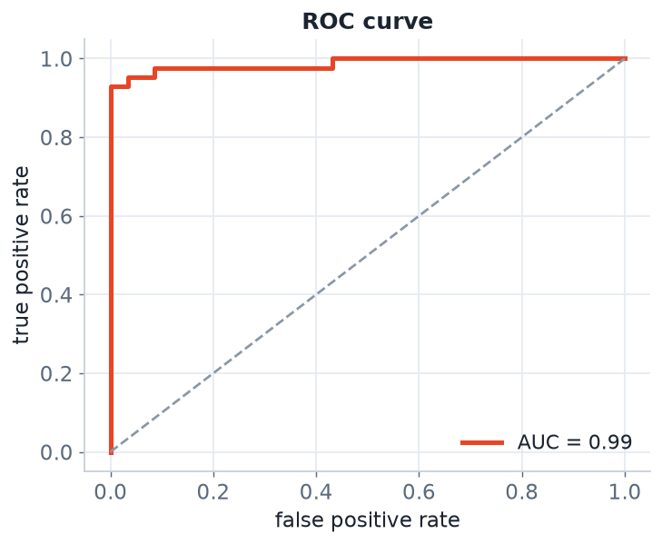
THE ROC CURVE
Performance across all thresholds
The ROC curve plots true-positive vs false-positive rate as the threshold varies. The area under it (AUC) summarises ranking quality.
STAT3888 · Statistical Machine Learning
L11 · 26

Slide 33
DEFINITION
AUC
The area under the ROC curve is the probability the model ranks a random positive above a random negative.
▸ AUC = 0.5 → no better than chance; 1.0 → perfect
▸ Threshold-free — measures ranking, not a single cutoff
▸ Robust to class imbalance
STAT3888 · Statistical Machine Learning
L11 · 27

Slide 34
EVALUATING A CLASSIFIER
The full picture
▸ Confusion matrix — the raw counts at a chosen threshold
▸ Precision / recall / F1 — especially under imbalance
▸ ROC / AUC — threshold-free ranking quality
▸ Calibration — do predicted probabilities match observed rates?
STAT3888 · Statistical Machine Learning
L11 · 28

Slide 35
IN R
Fit and evaluate a logistic model
fit <- glm(highchol ~ sat_fat + fibre + age,
data = training, family = binomial)
summary(fit) # coefficients (log-odds)
exp(coef(fit)) # odds ratios
prob <- predict(fit, test, type = 'response')
pred <- ifelse(prob > 0.5, 1, 0)
library(pROC); roc(test$highchol, prob)$auc # AUC
STAT3888 · Statistical Machine Learning
L11 · 29

Slide 36
WHY IT ENDURES
Logistic regression is fast, interpretable and calibrated — often the first classifier to try and the baseline to beat.
Its coefficients tell a story a clinician can act on — a rare and valuable property.

Slide 37
IN-CLASS EXERCISE
Interpret a model
1. A logistic model gives β = 0.7 for a binary 'processed-food' predictor of obesity.
2. Compute and interpret the odds ratio.
3. The model's AUC is 0.82 — what does that mean in plain words?
4. For a public-health screening tool, would you raise or lower the 0.5 threshold, and why?
Hint. e^0.7 ≈ 2.01 → roughly double the odds; AUC 0.82 = 82% chance a random obese person is ranked above a random non-obese one; screening favours higher recall (lower threshold).
STAT3888 · Statistical Machine Learning
L11 · 31

Slide 38
SUMMARY
Key takeaways
✓ Logistic regression models P(Y=1) via the sigmoid of a linear predictor.
✓ It is linear on the log-odds scale; e^β is an odds ratio.
✓ Fit by maximum likelihood; the decision boundary is linear.
✓ Evaluate with the confusion matrix, precision/recall and ROC/AUC.
Next lecture → Lecture 12 — Penalised logistic regression: ridge, lasso and elastic net.
STAT3888 · Statistical Machine Learning
L11 · 32

Slide 39
PART 7
Extensions, diagnostics & consolidation

Slide 40
DEFINITION
Generalised linear model (GLM)
A GLM links a linear predictor to a response distribution via a link function; logistic regression is the GLM for binary data.
▸ Link: logit; distribution: Bernoulli/binomial
▸ Poisson regression (counts) is another GLM
▸ One unifying framework, many response types
STAT3888 · Statistical Machine Learning
L11 · 33

Slide 41
MULTICLASS
Beyond two classes
▸ Multinomial logistic regression handles >2 unordered classes
▸ Ordinal logistic regression for ordered categories (e.g. BMI band)
▸ One-vs-rest fits a binary model per class
▸ The same logit machinery, generalised
STAT3888 · Statistical Machine Learning
L11 · 34

Slide 42
DIAGNOSTICS
Checking a fitted model
▸ Residual / deviance checks for lack of fit
▸ Influence measures for outlying observations
▸ Multicollinearity via the variance inflation factor (VIF)
▸ Calibration plot — predicted vs observed probabilities
STAT3888 · Statistical Machine Learning
L11 · 35

Slide 43
DEFINITION
Separation
Perfect separation occurs when a predictor perfectly splits the classes; MLE estimates then diverge to ±∞.
▸ Symptom: huge coefficients and standard errors
▸ Common with small samples or strong predictors
▸ Remedy: penalisation (Lecture 12!) or Firth's correction
STAT3888 · Statistical Machine Learning
L11 · 36

Slide 44
STRENGTHS & LIMITS
Logistic regression in balance
Strengths
Limits
• Interpretable odds ratios
• Fast, well-calibrated
• Probabilistic output
• Strong baseline
• Only linear boundaries
• Struggles with many correlated predictors
• Sensitive to separation
• Needs feature engineering for non-linearity
STAT3888 · Statistical Machine Learning
L11 · 37

Slide 45
MAKING IT NON-LINEAR
Extending the reach
▸ Add polynomial or spline terms of predictors
▸ Add interaction terms (effect of one depends on another)
▸ Still a linear model in the transformed features
▸ Or switch to trees / SVMs / neural nets (later lectures)
STAT3888 · Statistical Machine Learning
L11 · 38

Slide 46
CHECK YOUR UNDERSTANDING
Your logistic fit returns a coefficient of 40 with a standard error of 9000. Likely cause?
A
Great fit
B
Perfect (or quasi-) separation ✓
C
Too little regularisation of the mean
D
Wrong link function
Why: Enormous coefficients with huge standard errors are the classic signature of separation — a predictor splits the classes too cleanly for plain MLE.
STAT3888 · Statistical Machine Learning
L11 · 39

Slide 47
CASE STUDY
Predicting metabolic risk
▸ Fit logistic model of metabolic-syndrome on intake + anthropometrics
▸ Report odds ratios with 95% CIs for each predictor
▸ Assess discrimination via AUC on a held-out set
▸ Check calibration; choose a threshold from clinical costs
STAT3888 · Statistical Machine Learning
L11 · 40

Slide 48
IN-CLASS EXERCISE
Plan a classification analysis
1. You must classify participants as insulin-resistant or not from 20 predictors.
2. Write the workflow: split → recipe → glm → threshold → evaluate.
3. Which metric leads your report, and why (classes are imbalanced)?
4. How would you detect and handle separation if it arises?
Hint. Lead with AUC / recall under imbalance; handle separation with penalisation (next lecture) or Firth's method.
STAT3888 · Statistical Machine Learning
L11 · 41

Slide 49
KEY IDEAS RECAP
Hold onto these
▸ Sigmoid + linear predictor = valid probability
▸ e^β = odds ratio; linear on the log-odds scale
▸ Fit by maximum likelihood; boundary is linear
▸ Evaluate with ROC/AUC and the confusion matrix
STAT3888 · Statistical Machine Learning
L11 · 42

Slide 50
FURTHER READING
To go deeper
▸ James et al., *ISLR*, §4.3 (logistic regression)
▸ Hastie et al., *ESL*, §4.4
▸ Harrell, *Regression Modeling Strategies* — clinical practice
STAT3888 · Statistical Machine Learning
L11 · 43

Slide 51
THE TAKEAWAY
When you need a fast, interpretable, probabilistic classifier, logistic regression is almost always the right first move.
Next: how to make it robust when predictors are many and correlated.

Slide 52
PART 8
Probabilities, inference & context

Slide 53
DEFINITION
Calibration
A classifier is well-calibrated if, among cases it gives probability p, about a fraction p are truly positive.
▸ Logistic regression is usually well-calibrated by construction
▸ Check with a calibration (reliability) plot
▸ Matters when the probability itself is used for decisions
STAT3888 · Statistical Machine Learning
L11 · 45

Slide 54
STATISTICAL INFERENCE
Beyond prediction
▸ Each coefficient has a standard error, z-test and p-value
▸ Report odds ratios with 95% confidence intervals
▸ The Wald and likelihood-ratio tests assess predictors
▸ Deviance compares nested models
STAT3888 · Statistical Machine Learning
L11 · 46

Slide 55
CONFIDENCE INTERVALS
On the odds-ratio scale
95% CI for OR = exp( β̂ ± 1.96 · SE(β̂) )
• Compute the interval on the log-odds scale, then exponentiate
• If the CI for the OR excludes 1, the effect is significant
• The standard way clinical results are reported
STAT3888 · Statistical Machine Learning
L11 · 47

Slide 56
SAMPLE-SIZE RULES
Enough data to trust the fit
▸ Rule of thumb: ≥ 10 events per predictor (EPV)
▸ Too few events → unstable, over-optimistic coefficients
▸ Rare outcomes need large samples or penalisation
▸ Report EPV so readers can judge reliability
STAT3888 · Statistical Machine Learning
L11 · 48

Slide 57
LOGISTIC VS THE ALTERNATIVES
Placing it among classifiers
Logistic regression
Coming up
• Linear boundary
• Interpretable, calibrated
• Great baseline
• LDA/QDA — generative, Gaussian (L13)
• Trees/forests — non-linear (L15–16)
• SVM — margins & kernels (L19–20)
STAT3888 · Statistical Machine Learning
L11 · 49

Slide 58
CHECK YOUR UNDERSTANDING
To report a nutrition finding to clinicians, which output of a logistic model is most useful?
A
The raw log-odds
B
Odds ratios with confidence intervals ✓
C
The number of iterations
D
The training accuracy
Why: Clinicians interpret odds ratios (with CIs) directly — they quantify how a predictor changes the odds of the outcome.
STAT3888 · Statistical Machine Learning
L11 · 50

Slide 59
CHAPTER CHECKLIST
You should be able to…
▸ Explain why linear regression fails for classification
▸ Interpret a coefficient as an odds ratio
▸ Describe MLE fitting and the linear boundary
▸ Evaluate with ROC/AUC and pick a threshold from costs
STAT3888 · Statistical Machine Learning
L11 · 51

Slide 60
BRIDGE TO NEXT LECTURE
Plain logistic regression falters when predictors are many and correlated — so we penalise it.
Ridge, lasso and elastic net make it robust and even self-selecting.

