Slide 1
LECTURE 12
Penalised Logistic Regression: Ridge, Lasso & Elastic Net
Taming many correlated predictors by shrinking coefficients — controlling variance, doing automatic variable selection, and tuning the penalty by cross-validation.
School of Mathematics & Statistics · The University of Sydney

Slide 2
AGENDA
Today's roadmap
▸ Why plain logistic regression struggles with many predictors
▸ Regularisation: the shrinkage idea
▸ Ridge (L2), lasso (L1) and elastic net
▸ The geometry: why lasso selects variables
▸ Choosing the penalty λ by cross-validation
▸ Practice in R with glmnet
STAT3888 · Statistical Machine Learning
L12 · 2

Slide 3
RECAP
Where plain logistic regression hurts
▸ Last lecture: logistic regression via maximum likelihood
▸ With many predictors (p large) it overfits
▸ With correlated predictors, coefficients become unstable
▸ Separation sends estimates to infinity
▸ Penalisation fixes all three
STAT3888 · Statistical Machine Learning
L12 · 3

Slide 4
CHECK YOUR UNDERSTANDING
Nutrition data often has many correlated intake variables. For logistic regression this causes…
A
Faster fitting
B
Unstable, high-variance coefficients (overfitting) ✓
C
Guaranteed separation
D
Lower AUC always
Why: Many correlated predictors inflate coefficient variance and overfit — exactly what regularisation is designed to control.
STAT3888 · Statistical Machine Learning
L12 · 4

Slide 5
PART 1
The problem & the idea

Slide 6
THE CORE IDEA
Deliberately **shrink** the coefficients toward zero — accept a little bias in exchange for a large drop in variance.
A slightly biased but stable model generalises far better than an unbiased, wildly variable one.

Slide 7
DEFINITION
Regularisation
Regularisation adds a penalty on coefficient size to the loss, discouraging over-large coefficients and thus overfitting.
▸ Fit = minimise (−log-likelihood + λ · penalty)
▸ λ controls the strength of shrinkage
▸ λ = 0 recovers ordinary logistic regression
STAT3888 · Statistical Machine Learning
L12 · 6

Slide 8
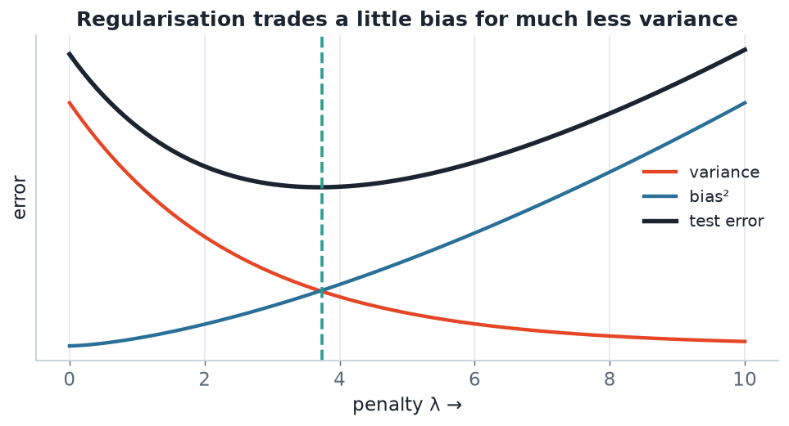
WHY IT HELPS
Regularisation and the bias–variance trade-off
As the penalty λ grows, variance falls and bias rises. Test error is minimised at an intermediate λ — found by cross-validation.
STAT3888 · Statistical Machine Learning
L12 · 7

Slide 9
PENALISED OBJECTIVE
Loss plus penalty
minimise −ℓ(β) + λ · penalty(β)
• −ℓ(β) — the usual logistic loss (fit to data)
• penalty(β) — grows with coefficient size
• λ — the dial: 0 = no penalty, large = heavy shrinkage
STAT3888 · Statistical Machine Learning
L12 · 8

Slide 10
PART 2
Ridge, lasso & elastic net

Slide 11
DEFINITION
Ridge (L2) penalty
Ridge penalises the sum of squared coefficients (Σβ²), shrinking them smoothly toward — but never exactly to — zero.
▸ Handles correlated predictors gracefully
▸ Keeps all variables in the model
▸ Great when many small effects matter
STAT3888 · Statistical Machine Learning
L12 · 9

Slide 12
DEFINITION
Lasso (L1) penalty
Lasso penalises the sum of absolute coefficients (Σ|β|), shrinking some exactly to zero — doing automatic variable selection.
▸ Produces sparse, interpretable models
▸ Picks a subset of predictors
▸ Can struggle among highly correlated variables (picks one)
STAT3888 · Statistical Machine Learning
L12 · 10

Slide 13
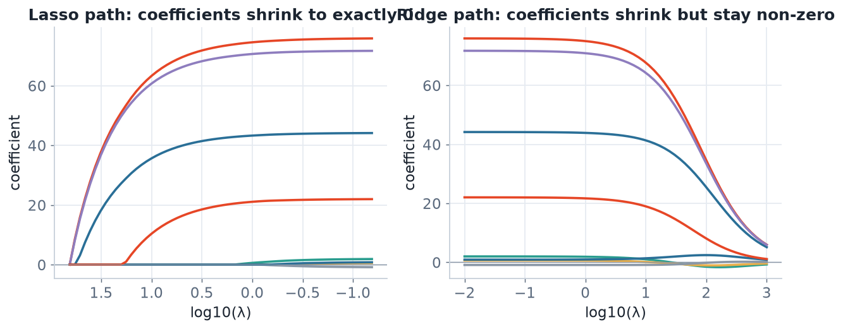
SHRINKAGE PATHS
Lasso zeros coefficients; ridge doesn't
As λ increases (left→right), lasso coefficients hit exactly zero one by one; ridge coefficients shrink smoothly but stay non-zero.
STAT3888 · Statistical Machine Learning
L12 · 11

Slide 14
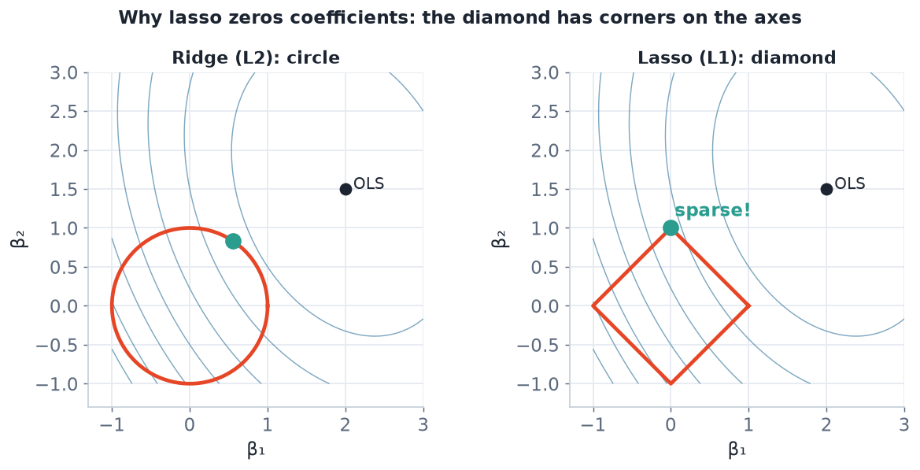
THE GEOMETRY
Why lasso selects variables
The lasso's diamond constraint has corners on the axes, so the solution often lands where a coefficient is exactly zero. The ridge circle has no corners.
STAT3888 · Statistical Machine Learning
L12 · 12

Slide 15
DEFINITION
Elastic net
The elastic net combines L1 and L2 penalties, getting lasso's sparsity and ridge's stability with correlated predictors.
▸ Mixing parameter α: α=1 lasso, α=0 ridge, in-between = elastic net
▸ Often the best default for wide, correlated data
▸ Selects groups of correlated predictors together
STAT3888 · Statistical Machine Learning
L12 · 13

Slide 16
COMPARE
The three penalties
Penalty | Shrinks | Selects variables? | Correlated X
Ridge (L2) | smoothly | no (keeps all) | handles well
Lasso (L1) | to zero | yes (sparse) | picks one
Elastic net | both | yes | groups them
STAT3888 · Statistical Machine Learning
L12 · 14

Slide 17
CHECK YOUR UNDERSTANDING
You want an interpretable model that automatically drops irrelevant predictors. Choose…
A
Ridge
B
Lasso ✓
C
Plain logistic
D
PCA
Why: Lasso's L1 penalty sets some coefficients exactly to zero, performing automatic variable selection for a sparse, interpretable model.
STAT3888 · Statistical Machine Learning
L12 · 15

Slide 18
PART 3
Choosing the penalty λ

Slide 19
Λ IS A HYPERPARAMETER
It is not learned from the fit — it is **tuned** by cross-validation to minimise prediction error.
Too small → overfit; too large → underfit. CV finds the sweet spot.

Slide 20
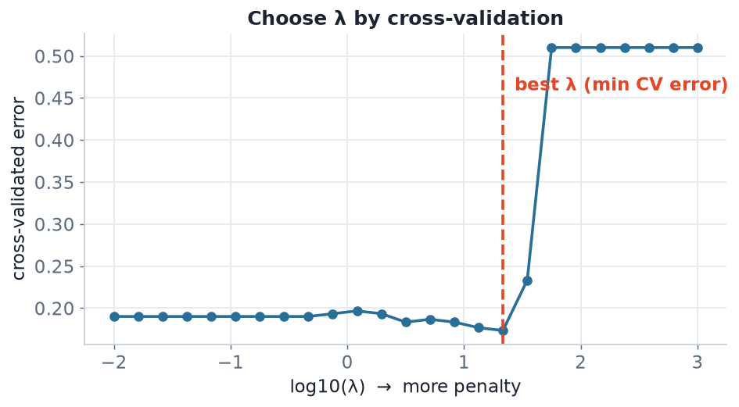
TUNING
Cross-validation over λ
Compute CV error across a grid of λ; pick the λ that minimises it (or the 'one-standard-error' λ for a simpler model).
STAT3888 · Statistical Machine Learning
L12 · 17

Slide 21
TWO COMMON CHOICES
lambda.min vs lambda.1se
▸ λ_min — the value giving the lowest CV error
▸ λ_1se — the largest λ within one SE of the minimum → simpler model
▸ λ_1se trades a touch of accuracy for parsimony and robustness
▸ `cv.glmnet` reports both automatically
STAT3888 · Statistical Machine Learning
L12 · 18

Slide 22
DON'T FORGET
Practical must-dos
▸ Standardise predictors — penalties are scale-sensitive (glmnet does this by default)
▸ Tune λ inside cross-validation to avoid leakage
▸ Report which variables survive (for lasso/elastic net)
▸ Refit / interpret on the chosen λ
STAT3888 · Statistical Machine Learning
L12 · 19

Slide 23
PART 4
In practice with glmnet

Slide 24
FITTING
Penalised logistic regression in R
library(glmnet)
X <- model.matrix(~ . - 1, data = predictors) # numeric matrix
y <- outcome
# alpha = 1 lasso, 0 ridge, 0.5 elastic net; family = binomial
cvfit <- cv.glmnet(X, y, family = 'binomial', alpha = 1)
plot(cvfit) # CV error vs log(lambda)
coef(cvfit, s = 'lambda.1se') # selected coefficients
STAT3888 · Statistical Machine Learning
L12 · 20

Slide 25
PREDICTING
Use the tuned model
prob <- predict(cvfit, newx = Xtest, s = 'lambda.min', type = 'response')
pred <- ifelse(prob > 0.5, 1, 0)
# which predictors survived?
sel <- coef(cvfit, s = 'lambda.1se')
sel[sel[,1] != 0, ]
STAT3888 · Statistical Machine Learning
L12 · 21

Slide 26
INTERPRETING A PENALISED MODEL
Read with care
▸ Coefficients are shrunk — smaller than unpenalised ones
▸ Lasso zeros mean 'not selected', not 'no association'
▸ Among correlated predictors, lasso's choice can be arbitrary
▸ For inference/odds ratios, be cautious — penalisation biases estimates
STAT3888 · Statistical Machine Learning
L12 · 22

Slide 27
PART 5
Consolidation, pitfalls & wrap-up

Slide 28
STRENGTHS & LIMITS
Penalised regression in balance
Strengths
Limits
• Controls overfitting with many predictors
• Lasso gives variable selection
• Stabilises correlated predictors (ridge/EN)
• Handles p > n
• λ must be tuned
• Shrunk coefficients biased for inference
• Lasso arbitrary among correlated X
• Still a linear boundary
STAT3888 · Statistical Machine Learning
L12 · 23

Slide 29
DEFINITION
Bias–variance, revisited
Penalisation deliberately adds bias (shrinkage) to cut variance, lowering total expected error.
▸ Unpenalised MLE: low bias, high variance (with many predictors)
▸ Penalised: a little bias, much less variance
▸ The whole point is a lower test error
STAT3888 · Statistical Machine Learning
L12 · 24

Slide 30
WHEN TO USE WHAT
A quick guide
▸ Many predictors, want selection → lasso
▸ Many correlated predictors, keep all → ridge
▸ Wide, correlated, want selection and stability → elastic net
▸ Few, well-chosen predictors → plain logistic may suffice
STAT3888 · Statistical Machine Learning
L12 · 25

Slide 31
DEFINITION
p ≫ n problem
When predictors outnumber observations, ordinary regression has no unique solution — penalisation makes it well-posed.
▸ Common in genomics / metabolomics (thousands of features)
▸ Ridge/lasso/elastic net give a unique, stable fit
▸ A key reason these methods dominate high-dim biology
STAT3888 · Statistical Machine Learning
L12 · 26

Slide 32
CHECK YOUR UNDERSTANDING
glmnet standardises predictors by default because…
A
It's faster
B
The penalty is scale-sensitive, so variables must be comparable ✓
C
It removes outliers
D
It selects lambda
Why: L1/L2 penalties act on coefficient magnitudes, which depend on predictor scale — standardising ensures each variable is penalised fairly.
STAT3888 · Statistical Machine Learning
L12 · 27

Slide 33
ALSO FIXES SEPARATION
Because it forbids infinite coefficients, penalisation cleanly solves the separation problem that breaks plain logistic regression.
Another reason it's often the safer default in practice.

Slide 34
IN-CLASS EXERCISE
Build a penalised classifier
1. You have 60 correlated intake/metabolite predictors and 200 participants.
2. Would you choose ridge, lasso or elastic net? Justify.
3. Write the cv.glmnet call and say how you'd pick λ.
4. How will you report which predictors matter, and with what caveat?
Hint. Correlated + want selection → elastic net; tune λ by cv.glmnet; report survivors at lambda.1se, noting penalisation biases coefficient sizes.
STAT3888 · Statistical Machine Learning
L12 · 29

Slide 35
IN-CLASS EXERCISE
Reason about geometry
1. Explain, using the constraint-region picture, why lasso produces exact zeros but ridge does not.
2. What happens to two identical (perfectly correlated) predictors under lasso? Under ridge?
3. Which penalty would you trust more for that correlated pair, and why?
Hint. The L1 diamond's corners lie on the axes (zeros); the L2 circle is smooth. Lasso picks one of the correlated pair; ridge splits the weight between them.
STAT3888 · Statistical Machine Learning
L12 · 30

Slide 36
KEY IDEAS RECAP
Hold onto these
▸ Penalise coefficient size to trade bias for lower variance
▸ Ridge shrinks smoothly; lasso selects; elastic net does both
▸ Tune λ by cross-validation; standardise predictors
▸ Essential for many / correlated predictors and p ≫ n
STAT3888 · Statistical Machine Learning
L12 · 31

Slide 37
FURTHER READING
To go deeper
▸ James et al., *ISLR*, §6.2 (shrinkage methods)
▸ Hastie et al., *ESL*, §3.4 & Ch. 18 (high-dimensional)
▸ Hastie, Tibshirani & Wainwright, *Statistical Learning with Sparsity*
STAT3888 · Statistical Machine Learning
L12 · 32

Slide 38
PART 6
Deeper into the mechanics

Slide 39
RIDGE OBJECTIVE
L2-penalised logistic loss
minimise −ℓ(β) + λ Σⱼ βⱼ²
• The penalty grows with the square of each coefficient
• Large coefficients are punished heavily → smooth shrinkage
• Never forces a coefficient exactly to zero
STAT3888 · Statistical Machine Learning
L12 · 33

Slide 40
LASSO OBJECTIVE
L1-penalised logistic loss
minimise −ℓ(β) + λ Σⱼ |βⱼ|
• The penalty grows with the absolute value of each coefficient
• Its non-smooth corners at zero create sparsity
• Some coefficients become exactly zero → selection
STAT3888 · Statistical Machine Learning
L12 · 34

Slide 41
ELASTIC NET OBJECTIVE
A weighted blend
penalty = λ [ α Σ|βⱼ| + (1−α) Σβⱼ² ]
• α = 1 → pure lasso; α = 0 → pure ridge
• Intermediate α blends selection and stability
• α is a second hyperparameter (often fixed, e.g. 0.5)
STAT3888 · Statistical Machine Learning
L12 · 35

Slide 42
DEFINITION
Shrinkage
Shrinkage pulls coefficient estimates toward zero, reducing their variance at the cost of a small bias.
▸ The bias is usually far smaller than the variance saved
▸ Predictions become more stable across samples
▸ The essence of every penalised method
STAT3888 · Statistical Machine Learning
L12 · 36

Slide 43
WHY SPARSITY MATTERS
The appeal of lasso
▸ Fewer variables → simpler, cheaper models
▸ Easier to explain to domain partners
▸ Highlights the key drivers of the outcome
▸ Reduces the cost of collecting many measurements in future
STAT3888 · Statistical Machine Learning
L12 · 37

Slide 44
CHECK YOUR UNDERSTANDING
Increasing λ toward infinity drives the coefficients toward…
A
Infinity
B
The unpenalised MLE
C
Zero (an intercept-only model) ✓
D
Random values
Why: A very large penalty forces all coefficients toward zero, leaving essentially an intercept-only (null) model — maximum bias, minimum variance.
STAT3888 · Statistical Machine Learning
L12 · 38

Slide 45
GROUPED & STRUCTURED PENALTIES
Beyond the basics
▸ Group lasso — select whole groups of related predictors together
▸ Adaptive lasso — different penalties per coefficient for better selection
▸ Relaxed lasso — refit selected variables without shrinkage
▸ A rich toolbox built on the same idea
STAT3888 · Statistical Machine Learning
L12 · 39

Slide 46
PART 7
Workflow, case study & wrap-up

Slide 47
END-TO-END
A penalised-regression workflow
1
Split & standardise
train/test split; scale predictors
2
Build X, y
design matrix and binary outcome
3
cv.glmnet
cross-validate over λ (and maybe α)
4
Select λ
lambda.min or lambda.1se
5
Evaluate & report
test AUC; list selected predictors
STAT3888 · Statistical Machine Learning
L12 · 40

Slide 48
CASE STUDY
60 metabolomic predictors, 180 participants: elastic net selects 12 and achieves test AUC 0.86.
From an unfittable p-heavy problem to a compact, accurate, interpretable model.

Slide 49
CASE STUDY DETAIL
What the elastic net delivered
Aspect | Plain logistic | Elastic net
Fits at all (p vs n)? | unstable | stable
# predictors used | 60 | 12
Test AUC | 0.71 (overfit) | 0.86
Interpretable? | hard | yes (12 drivers)
STAT3888 · Statistical Machine Learning
L12 · 42

Slide 50
REPORTING
A good penalised-model write-up
▸ State the penalty type (ridge/lasso/EN) and α
▸ Show the CV curve and the chosen λ
▸ List the selected predictors (and note selection instability)
▸ Report test performance, not training
STAT3888 · Statistical Machine Learning
L12 · 43

Slide 51
COMMON MISTAKES
Avoid these
Don't
Do
• Forget to standardise
• Tune λ on the test set
• Over-interpret shrunk coefficients
• Assume lasso's choice is 'the' truth
• Let glmnet standardise
• Tune λ inside CV
• Report odds ratios cautiously
• Check selection stability
STAT3888 · Statistical Machine Learning
L12 · 44

Slide 52
DEFINITION
Selection stability
Selection stability asks whether the same variables are chosen under resampling; unstable selection warns against over-reading which variables 'matter'.
▸ Assess by refitting on bootstrap samples
▸ Report how often each predictor is selected
▸ Especially important with correlated predictors
STAT3888 · Statistical Machine Learning
L12 · 45

Slide 53
CHECK YOUR UNDERSTANDING
Two predictors are almost perfectly correlated. Under lasso, you should expect…
A
Both kept with equal weight
B
One kept (somewhat arbitrarily), the other zeroed ✓
C
Both zeroed
D
The model to fail
Why: Lasso tends to pick one variable from a correlated group and zero the rest — the choice can be arbitrary, which is why elastic net is often preferred there.
STAT3888 · Statistical Machine Learning
L12 · 46

Slide 54
IN-CLASS EXERCISE
Compare ridge, lasso, elastic net
1. On the same wide, correlated dataset, fit ridge, lasso and elastic net with cv.glmnet.
2. Compare test AUC and the number of predictors each retains.
3. Which gives the best accuracy–parsimony trade-off?
4. How stable is lasso's variable selection across bootstrap samples?
Hint. Vary alpha = 0, 0.5, 1; compare collect_metrics()/AUC and count non-zero coefficients at lambda.1se; bootstrap to check stability.
STAT3888 · Statistical Machine Learning
L12 · 47

Slide 55
CONNECTIONS
How this ties the unit together
▸ Regularisation is the bias–variance trade-off made actionable (Lecture 10)
▸ It fixes logistic regression's separation problem (Lecture 11)
▸ The same idea regularises neural networks (weight decay, Lecture 18)
▸ A unifying theme across modern machine learning
STAT3888 · Statistical Machine Learning
L12 · 48

Slide 56
THE BIG LESSON
Sometimes the best model is not the one that fits the training data best — it's the one you deliberately hold back.
Controlled humility (shrinkage) beats unchecked flexibility.

Slide 57
CHAPTER CHECKLIST
You should be able to…
▸ Explain why penalisation controls overfitting (bias–variance)
▸ Contrast ridge, lasso and elastic net
▸ Explain geometrically why lasso gives sparsity
▸ Tune λ by cross-validation with glmnet
STAT3888 · Statistical Machine Learning
L12 · 50

Slide 58
DEFINITION
Degrees of freedom (effective)
Penalisation reduces a model's effective degrees of freedom — its effective complexity — below the raw number of predictors.
▸ More shrinkage → fewer effective degrees of freedom
▸ Explains why penalised models resist overfitting
▸ Links penalty strength directly to model complexity
STAT3888 · Statistical Machine Learning
L12 · 51

Slide 59
ONE LINE TO REMEMBER
Carry this out the door
▸ Shrink to stabilise; use L1 to select; tune λ by CV; standardise.
STAT3888 · Statistical Machine Learning
L12 · 52

Slide 60
SUMMARY
Key takeaways
✓ Penalised logistic regression shrinks coefficients to control variance and overfitting.
✓ Ridge keeps all variables; lasso selects a sparse subset; elastic net blends both.
✓ The penalty λ is tuned by cross-validation; always standardise predictors.
✓ It's the go-to for many, correlated predictors, p ≫ n, and separation.
Next lecture → Lecture 13 — Discriminant analysis: LDA and QDA.
STAT3888 · Statistical Machine Learning
L12 · 53

