Slide 1
LECTURE 05
Model-based Clustering: Gaussian Mixture Models
From hard partitions to soft, probabilistic clusters — the mixture model, the EM algorithm, and choosing the number of components with the BIC.
School of Mathematics & Statistics · The University of Sydney

Slide 2
AGENDA
Today's roadmap
▸ Why k-means is not enough: soft vs hard clustering
▸ The Gaussian mixture model (GMM)
▸ Fitting a GMM with the EM algorithm
▸ Covariance structures and model flexibility
▸ Choosing the number of components with the BIC
▸ GMM vs k-means; fitting in R with mclust
▸ Diagnostics, pitfalls and worked example
STAT3888 · Statistical Machine Learning
L05 · 2

Slide 3
RECAP
Where we've been
▸ Lecture 3 — clustering finds groups without labels using a distance
▸ Lecture 4 — k-means minimises within-cluster sum of squares
▸ k-means gives every point a hard label and assumes round, equal-size blobs
▸ Today we relax both assumptions with a probability model
STAT3888 · Statistical Machine Learning
L05 · 3

Slide 4
CHECK YOUR UNDERSTANDING
Recap: what does k-means assume about cluster shape?
A
Arbitrary shapes are fine
B
Roughly spherical, similar-size clusters ✓
C
Only elongated clusters
D
It makes no assumptions
Why: k-means uses squared Euclidean distance to a centroid, which implicitly assumes convex, roughly spherical, comparable-variance clusters.
STAT3888 · Statistical Machine Learning
L05 · 4

Slide 5
PART 1
Why we need soft clustering

Slide 6
THE LIMITATION
k-means forces every point into exactly one cluster — even points sitting on the boundary between two groups.
Real data is rarely so tidy. A participant's diet may be 60% 'prudent', 40% 'Western'. Hard labels throw that nuance away.

Slide 7
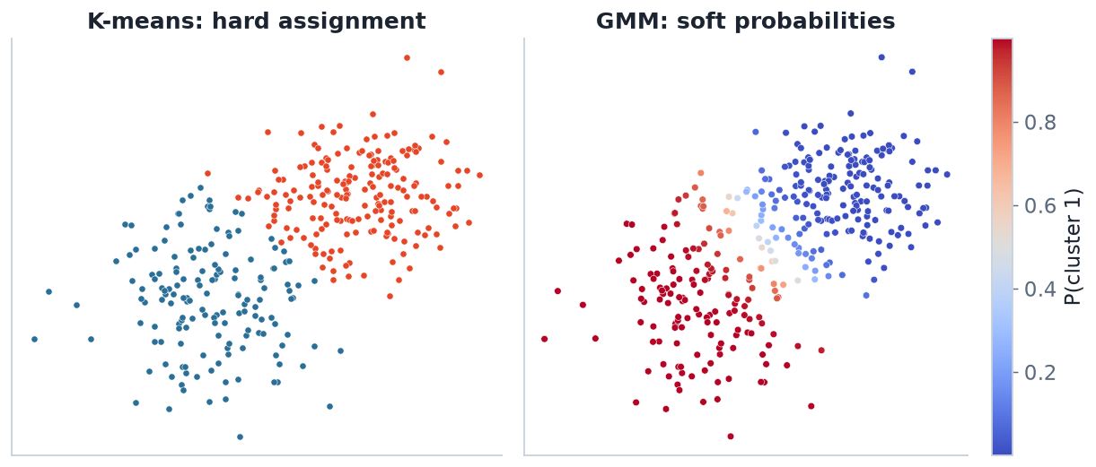
THE DIFFERENCE
Hard labels vs soft probabilities
k-means (left) draws a crisp line. A GMM (right) reports P(cluster) for every point — colour fades through the overlap zone.
STAT3888 · Statistical Machine Learning
L05 · 6

Slide 8
SOFT ASSIGNMENT
What 'soft' buys us
▸ Each point gets a probability of membership in every cluster
▸ Points in overlaps are honestly reported as uncertain
▸ Clusters can be elliptical and have different sizes / orientations
▸ We get a full generative model — we can simulate new data
STAT3888 · Statistical Machine Learning
L05 · 7

Slide 9
MOTIVATION
Why this matters for the nutrition project
The science
The statistics
• Metabolic subtypes rarely have sharp edges
• A person can partly belong to two dietary patterns
• Uncertainty is information, not a nuisance
• A model lets us use likelihood
• Likelihood gives principled model selection
• We can compare 2, 3, 4… clusters fairly
STAT3888 · Statistical Machine Learning
L05 · 8

Slide 10
PART 2
The Gaussian mixture model

Slide 11
DEFINITION
Mixture model
A mixture model assumes each observation is drawn from one of K underlying distributions (the components), but we don't observe which one.
▸ Each component k has a weight πₖ (mixing proportion), with Σπₖ = 1
▸ For a Gaussian mixture, each component is a normal distribution
▸ The observed data is the weighted blend of all components
STAT3888 · Statistical Machine Learning
L05 · 9

Slide 12
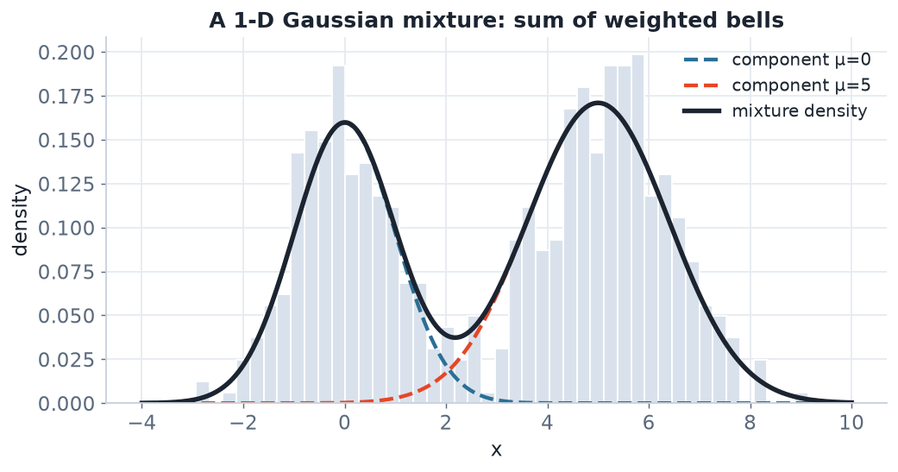
ONE DIMENSION
A mixture is a weighted sum of bells
Two Gaussian components (dashed) with weights 0.4 and 0.6 add up to the mixture density (black) that generated the histogram.
STAT3888 · Statistical Machine Learning
L05 · 10

Slide 13
THE MODEL
Gaussian mixture density
p(x) = Σₖ πₖ · N( x | μₖ , Σₖ )
• πₖ — mixing weight of component k (how common it is)
• μₖ — mean vector (centre) of component k
• Σₖ — covariance matrix (shape & orientation) of component k
Fitting a GMM means estimating all the πₖ, μₖ and Σₖ from data.
STAT3888 · Statistical Machine Learning
L05 · 11

Slide 14
BUILDING BLOCK
The multivariate Gaussian
N(x | μ, Σ) ∝ exp( −½ (x−μ)ᵀ Σ⁻¹ (x−μ) )
• The term (x−μ)ᵀΣ⁻¹(x−μ) is the Mahalanobis distance — a scale-aware distance
• Σ controls the shape: circular, stretched, or tilted
• k-means secretly uses the special case Σ = σ²I (a circle)
STAT3888 · Statistical Machine Learning
L05 · 12

Slide 15
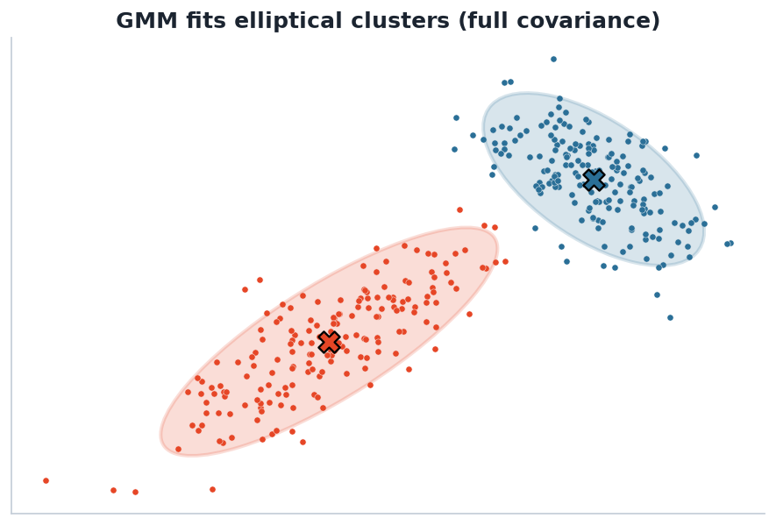
TWO DIMENSIONS
GMM fits elliptical clusters
Each component is an ellipse defined by its covariance matrix — far more flexible than k-means' circles.
STAT3888 · Statistical Machine Learning
L05 · 13

Slide 16
COVARIANCE
What the covariance matrix controls
▸ Diagonal entries — variance along each axis (width & height)
▸ Off-diagonal entries — covariance (tilt / correlation)
▸ A full Σ can capture a cluster stretched along any direction
▸ Restricting Σ trades flexibility for fewer parameters
STAT3888 · Statistical Machine Learning
L05 · 14

Slide 17
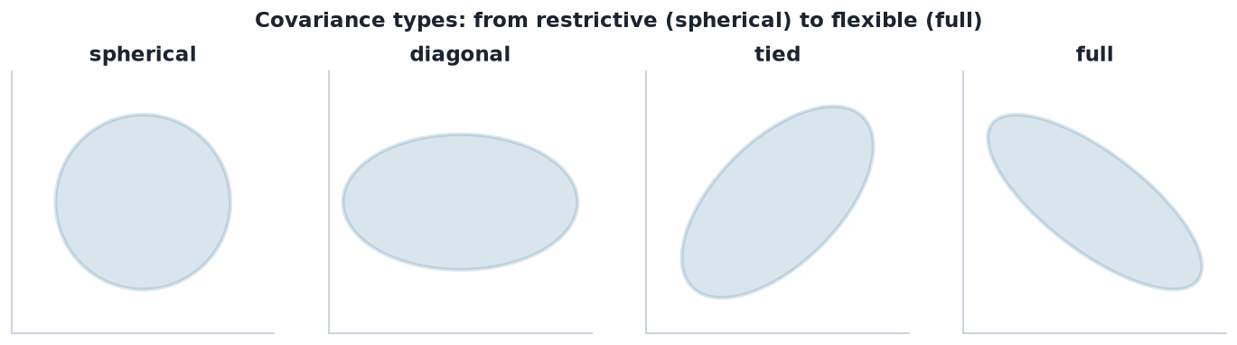
FLEXIBILITY DIAL
Covariance types
From spherical (like k-means) to full (any ellipse). More flexible models fit better but need more data and can overfit.
STAT3888 · Statistical Machine Learning
L05 · 15

Slide 18
TRADE-OFF
Common covariance structures
Type | What's shared | Parameters
Spherical | one variance, circular | fewest (≈ k-means)
Diagonal | axis-aligned ellipse | few
Tied | same Σ for all clusters | moderate
Full | any ellipse per cluster | most / most flexible
mclust automatically tries a whole family of these and picks the best by BIC.
STAT3888 · Statistical Machine Learning
L05 · 16

Slide 19
CHECK YOUR UNDERSTANDING
Which covariance type most resembles k-means?
A
Full
B
Tied
C
Spherical ✓
D
Diagonal
Why: Spherical, equal-variance components with equal weights reduce a GMM to (essentially) k-means.
STAT3888 · Statistical Machine Learning
L05 · 17

Slide 20
PART 3
Fitting a GMM: the EM algorithm

Slide 21
THE OBSTACLE
A chicken-and-egg problem
▸ If we knew which component each point came from, estimating πₖ, μₖ, Σₖ would be easy
▸ If we knew the parameters, computing each point's component would be easy
▸ But we know neither — the component labels are latent (hidden)
▸ EM breaks the deadlock by alternating between the two
STAT3888 · Statistical Machine Learning
L05 · 18

Slide 22
DEFINITION
Responsibility
The responsibility γᵢₖ is the posterior probability that point i was generated by component k, given the current parameters.
▸ It is the 'soft label' — a number between 0 and 1
▸ For each point, responsibilities across components sum to 1
▸ Computed by Bayes' rule from the weighted component densities
STAT3888 · Statistical Machine Learning
L05 · 19

Slide 23
E-STEP
Compute responsibilities (Bayes' rule)
γᵢₖ = πₖ N(xᵢ|μₖ,Σₖ) / Σⱼ πⱼ N(xᵢ|μⱼ,Σⱼ)
• Numerator: how well component k explains point i, weighted by πₖ
• Denominator: total across all components (normalises to a probability)
• This is the Expectation step — filling in soft labels
STAT3888 · Statistical Machine Learning
L05 · 20

Slide 24
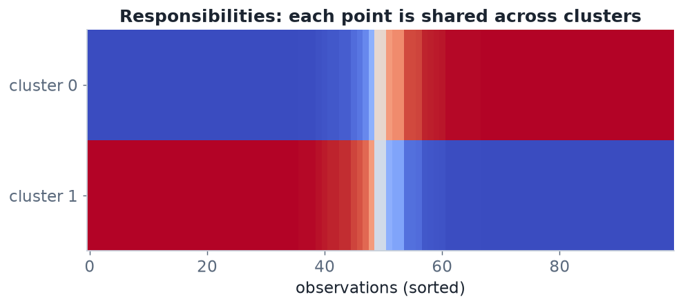
SOFT LABELS
Responsibilities shared across clusters
Each observation (column) is split between clusters. Points near a centre are almost pure; points between are shared.
STAT3888 · Statistical Machine Learning
L05 · 21

Slide 25
M-STEP
Re-estimate parameters (weighted MLE)
μₖ = Σᵢ γᵢₖ xᵢ / Σᵢ γᵢₖ , πₖ = (1/n) Σᵢ γᵢₖ
• Each parameter is a responsibility-weighted average
• Points that 'belong' more to k count more toward its mean/covariance
• This is the Maximisation step — refitting given the soft labels
STAT3888 · Statistical Machine Learning
L05 · 22

Slide 26
THE LOOP
EM in four steps
1
Initialise
guess parameters (often from k-means)
2
E-step
compute responsibilities γᵢₖ for every point
3
M-step
update πₖ, μₖ, Σₖ using weighted averages
4
Repeat
until the log-likelihood stops increasing
Each iteration is guaranteed not to decrease the log-likelihood.
STAT3888 · Statistical Machine Learning
L05 · 23

Slide 27
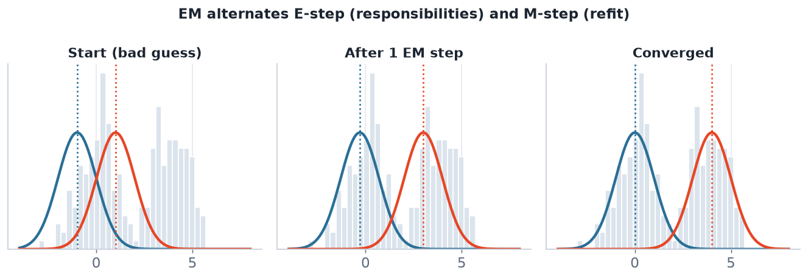
CONVERGENCE
EM refines the components each pass
From a poor start, the component means and widths adjust until they explain the data — here recovering the two true groups.
STAT3888 · Statistical Machine Learning
L05 · 24

Slide 28
PROPERTIES
What to know about EM
▸ Monotone: log-likelihood increases (or stays) each iteration
▸ Converges to a local optimum — like k-means, use several restarts
▸ Initialisation matters; k-means is a common warm start
▸ Can be slow near convergence, but reliable
STAT3888 · Statistical Machine Learning
L05 · 25

Slide 29
CHECK YOUR UNDERSTANDING
In EM, what does the E-step compute?
A
Updated cluster means
B
Soft responsibilities for each point ✓
C
The number of clusters
D
The BIC
Why: The E (Expectation) step fixes the parameters and computes each point's posterior probability of belonging to each component.
STAT3888 · Statistical Machine Learning
L05 · 26

Slide 30
PART 4
How many components?

Slide 31
THE TEMPTATION
Why we can't just maximise likelihood
▸ Adding components always increases the training log-likelihood
▸ Taken to the extreme, one component per point fits perfectly — and is useless
▸ We need to penalise complexity — reward fit, punish extra parameters
STAT3888 · Statistical Machine Learning
L05 · 27

Slide 32
MODEL SELECTION
Bayesian Information Criterion
BIC = −2 · log L + d · log(n)
• log L — maximised log-likelihood (fit)
• d — number of free parameters (complexity)
• n — sample size; the penalty grows with data
• Lower BIC is better — choose the model that minimises it
STAT3888 · Statistical Machine Learning
L05 · 28

Slide 33
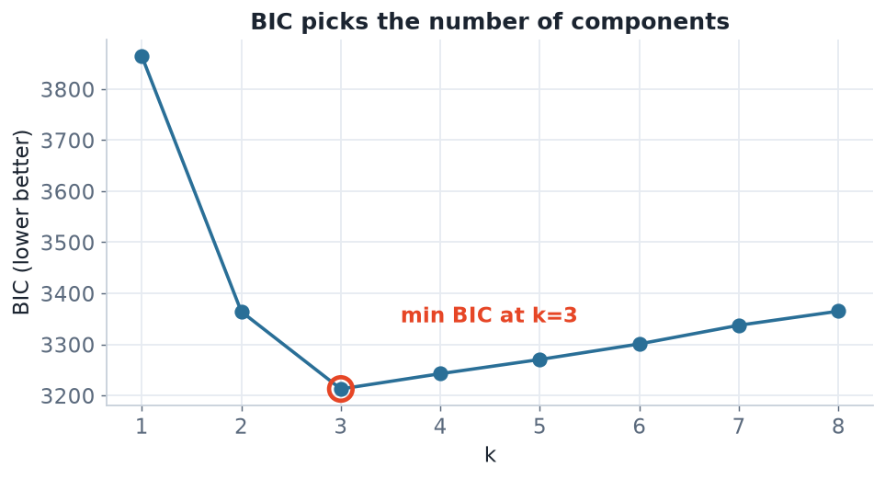
IN PRACTICE
BIC across candidate models
Fit GMMs for a range of k and pick the k with the lowest BIC. Here BIC bottoms out at the true number of clusters.
STAT3888 · Statistical Machine Learning
L05 · 29

Slide 34
AIC VS BIC
A note on criteria
▸ AIC = −2 log L + 2d — lighter penalty, tends to pick more components
▸ BIC penalises complexity more as n grows — tends to be more parsimonious
▸ For clustering/interpretation, BIC is the usual default (and mclust's)
STAT3888 · Statistical Machine Learning
L05 · 30

Slide 35
PART 5
GMM vs k-means

Slide 36
HEAD TO HEAD
Two clustering philosophies
Aspect | k-means | GMM
Assignment | hard (one label) | soft (probabilities)
Cluster shape | spherical | any ellipse
Cluster size | similar | can differ
Basis | distance | probability model
Choose k by | elbow / silhouette | BIC / likelihood
Speed | very fast | slower (EM)
STAT3888 · Statistical Machine Learning
L05 · 31

Slide 37
KEY INSIGHT
k-means is a special case of a Gaussian mixture — equal weights, spherical equal covariances, and hard assignments.
So GMM is the more general model. Use k-means for speed and simplicity; reach for GMM when clusters overlap or aren't round.

Slide 38
JUDGEMENT
When to use which
Prefer k-means when
Prefer GMM when
• Data is large and you need speed
• Clusters look roughly round & separated
• You just need a quick partition
• Clusters overlap or are elliptical
• You want membership uncertainty
• You want principled selection of k (BIC)
STAT3888 · Statistical Machine Learning
L05 · 33

Slide 39
PART 6
GMM in R

Slide 40
PACKAGE
The mclust package
▸ mclust fits Gaussian mixtures and does model selection automatically
▸ It searches over covariance types and number of components
▸ Reports the best model by BIC with a three-letter code (e.g. VVV, EEI)
STAT3888 · Statistical Machine Learning
L05 · 34

Slide 41
FITTING
A GMM in a few lines
library(mclust)
X <- scale(diet_numeric) # standardise first
fit <- Mclust(X) # searches covariance types & k by BIC
summary(fit) # best model, k, BIC
fit$G # chosen number of components
fit$classification # hard labels (argmax responsibility)
head(fit$z) # soft responsibilities
STAT3888 · Statistical Machine Learning
L05 · 35

Slide 42
VISUALISING
Plots that explain the fit
plot(fit, what = 'BIC') # BIC vs k for each model type
plot(fit, what = 'classification')# clusters with ellipses
plot(fit, what = 'uncertainty') # highlight uncertain points
# Profile the clusters, as with k-means
aggregate(diet_numeric, list(fit$classification), mean)
STAT3888 · Statistical Machine Learning
L05 · 36

Slide 43
DECODING
mclust's covariance codes (E=equal, V=varying)
Code | Meaning
EII | spherical, equal volume
VII | spherical, varying volume
EEE | ellipsoidal, all equal (tied)
VVV | ellipsoidal, all varying (most flexible)
STAT3888 · Statistical Machine Learning
L05 · 37

Slide 44
WORKED EXAMPLE
A nutrition workflow
▸ Standardise intake & metabolite variables
▸ Run Mclust(X) — say it selects VEV with k = 3
▸ Inspect uncertainty — flag participants on cluster boundaries
▸ Profile each cluster's mean intake → name the dietary subtypes
▸ Relate subtypes to a held-out health outcome to check they matter
STAT3888 · Statistical Machine Learning
L05 · 38

Slide 45
PART 7
Diagnostics & pitfalls

Slide 46
PITFALL 1
Singularities and degeneracy
▸ A component can collapse onto a single point → variance → 0, likelihood → ∞
▸ This is a degenerate solution, not a real cluster
▸ Remedies: regularise the covariance, or restrict the covariance type
STAT3888 · Statistical Machine Learning
L05 · 39

Slide 47
PITFALL 2
High dimensions
▸ A full covariance needs ~p²/2 parameters per component
▸ With many variables this explodes — you run out of data
▸ Remedies: reduce dimensions first (PCA — Lectures 7–8) or use diagonal Σ
STAT3888 · Statistical Machine Learning
L05 · 40

Slide 48
PITFALL 3
Label switching & interpretation
▸ Component labels are arbitrary — 'cluster 1' can swap with 'cluster 2' between runs
▸ Interpret clusters by their profiles, not their numbers
▸ Always standardise and set a seed for reproducibility
STAT3888 · Statistical Machine Learning
L05 · 41

Slide 49
CHECK YOUR UNDERSTANDING
Your GMM returns one component with almost-zero variance around a single point. This is…
A
The best cluster
B
A degenerate/singular solution to guard against ✓
C
Proof you need more clusters
D
Expected and fine
Why: A component shrinking onto one point sends the likelihood to infinity — a degeneracy. Regularise the covariance or constrain the model.
STAT3888 · Statistical Machine Learning
L05 · 42

Slide 50
IN-CLASS EXERCISE
Fit and compare
1. Fit Mclust(X) on the standardised nutrition data. What model and k does BIC choose?
2. Compare its k to the k you chose for k-means last week. Do they agree?
3. Identify the 5 participants with the highest uncertainty. Where do they sit?
4. Profile the components — can you name each dietary subtype?
Hint. fit$uncertainty gives 1 − max responsibility for each point; sort it descending.
STAT3888 · Statistical Machine Learning
L05 · 43

Slide 51
IN-CLASS EXERCISE
Reason about the model
1. Write down how many parameters a full-covariance GMM needs for k = 3, p = 10.
2. Why might that be a problem with only n = 150 participants?
3. What two remedies would you try, and what does each give up?
Hint. Per component: k−1 weights + p means + p(p+1)/2 covariance terms. Multiply and compare to n.
STAT3888 · Statistical Machine Learning
L05 · 44

Slide 52
PRACTICAL TIPS
Getting good results
▸ Standardise every variable before fitting
▸ Consider PCA first if p is large
▸ Let mclust choose the covariance type — don't force full blindly
▸ Report uncertainty, not just hard labels
STAT3888 · Statistical Machine Learning
L05 · 45

Slide 53
KEY FORMULAS RECAP
The three you must know
▸ Model: p(x) = Σ πₖ N(x | μₖ, Σₖ)
▸ E-step: γᵢₖ ∝ πₖ N(xᵢ | μₖ, Σₖ)
▸ Selection: BIC = −2 log L + d log n (minimise)
STAT3888 · Statistical Machine Learning
L05 · 46

Slide 54
PART 8
Deeper understanding & applications

Slide 55
DEFINITION
Likelihood
The likelihood is the probability of the observed data under the model, viewed as a function of the parameters. We fit by maximising it.
▸ For a GMM: log L = Σᵢ log( Σₖ πₖ N(xᵢ|μₖ,Σₖ) )
▸ EM increases this quantity every iteration
▸ It is the 'fit' term that BIC then penalises for complexity
STAT3888 · Statistical Machine Learning
L05 · 47

Slide 56
GENERATIVE VIEW
A GMM can create data, not just cluster it
▸ To simulate a point: pick a component k with probability πₖ, then draw from N(μₖ,Σₖ)
▸ This 'generative' nature is what makes likelihood and BIC available
▸ It also powers density estimation — a smooth model of where data lives
▸ Contrast: k-means is purely algorithmic, with no generative story
STAT3888 · Statistical Machine Learning
L05 · 48

Slide 57
APPLICATION
GMMs beyond clustering
▸ Density estimation — flexible model of a variable's distribution
▸ Anomaly detection — points with very low p(x) are outliers
▸ Soft segmentation — image, market or patient segmentation with uncertainty
▸ Semi-supervised learning — components can align with partial labels
STAT3888 · Statistical Machine Learning
L05 · 49

Slide 58
INITIALISATION
Strategies that help EM
▸ k-means warm start — run k-means, use its clusters to seed EM (mclust's default idea)
▸ Multiple random restarts — keep the fit with the highest log-likelihood
▸ Hierarchical seeding — mclust initialises from model-based hierarchical clustering
▸ A good start avoids poor local optima and speeds convergence
STAT3888 · Statistical Machine Learning
L05 · 50

Slide 59
REMEMBER
EM never decreases the log-likelihood — but 'never decreasing' only guarantees a local optimum, not the global best.
That's why initialisation and restarts matter, exactly as with k-means.

Slide 60
CHECK YOUR UNDERSTANDING
You compare GMMs with k = 2, 3, 4 and get BIC = 980, 940, 965. Which do you pick?
A
k = 2
B
k = 3 ✓
C
k = 4
D
The one with highest BIC
Why: BIC is minimised at k = 3 (940). Lower BIC balances fit against complexity, so k = 3 is preferred.
STAT3888 · Statistical Machine Learning
L05 · 52

Slide 61
CONTEXT
Where GMMs sit in the bigger picture
Related ideas
What's next
• Latent-variable models (the hidden component)
• The EM algorithm generalises far beyond GMMs
• Mixtures of other distributions are possible too
• Overlapping, high-dimensional data → reduce first
• PCA (Lectures 7–8) tames dimensionality
• Then cluster in the reduced space
STAT3888 · Statistical Machine Learning
L05 · 53

Slide 62
SUMMARY
Key takeaways
✓ A GMM models data as a weighted mixture of Gaussians, giving soft cluster probabilities.
✓ EM fits it by alternating responsibilities (E) and weighted re-estimation (M).
✓ The covariance type dials flexibility from spherical (k-means-like) to full ellipses.
✓ Choose the number of components with the BIC; k-means is the GMM's simplest special case.
Next lecture → Lecture 06 — Hierarchical clustering: building a tree of nested groups.
STAT3888 · Statistical Machine Learning
L05 · 54

