Slide 1
LECTURE 06
Hierarchical Clustering
Building a whole tree of nested clusterings — no need to fix k in advance. Linkages, dendrograms, and how to read them.
School of Mathematics & Statistics · The University of Sydney

Slide 2
AGENDA
Today's roadmap
▸ Why a hierarchy? The limits of fixing k
▸ Agglomerative vs divisive strategies
▸ The dendrogram: reading nested clusters
▸ Linkage criteria: single, complete, average, Ward
▸ Distance matrices and cutting the tree
▸ Strengths, pitfalls and R practice
STAT3888 · Statistical Machine Learning
L06 · 2

Slide 3
RECAP
Two clustering methods so far
▸ k-means — fast, hard, spherical, needs k up front
▸ GMM — soft, elliptical, chooses k by BIC, needs k range
▸ Both require you to commit to a number of clusters
▸ What if you want to see structure at every scale?
STAT3888 · Statistical Machine Learning
L06 · 3

Slide 4
CHECK YOUR UNDERSTANDING
What do k-means and GMM have in common?
A
Both give soft labels
B
Both require choosing the number of clusters ✓
C
Both build a tree
D
Both ignore distance
Why: Both are partitioning-style: you must specify (or search) k. Hierarchical clustering instead produces clusterings for all k at once.
STAT3888 · Statistical Machine Learning
L06 · 4

Slide 5
PART 1
Why a hierarchy?

Slide 6
THE IDEA
Instead of one clustering, build a tree that contains a clustering for every possible number of groups — from one big cluster to n singletons.
You choose k afterwards by cutting the tree at a height that makes sense.

Slide 7
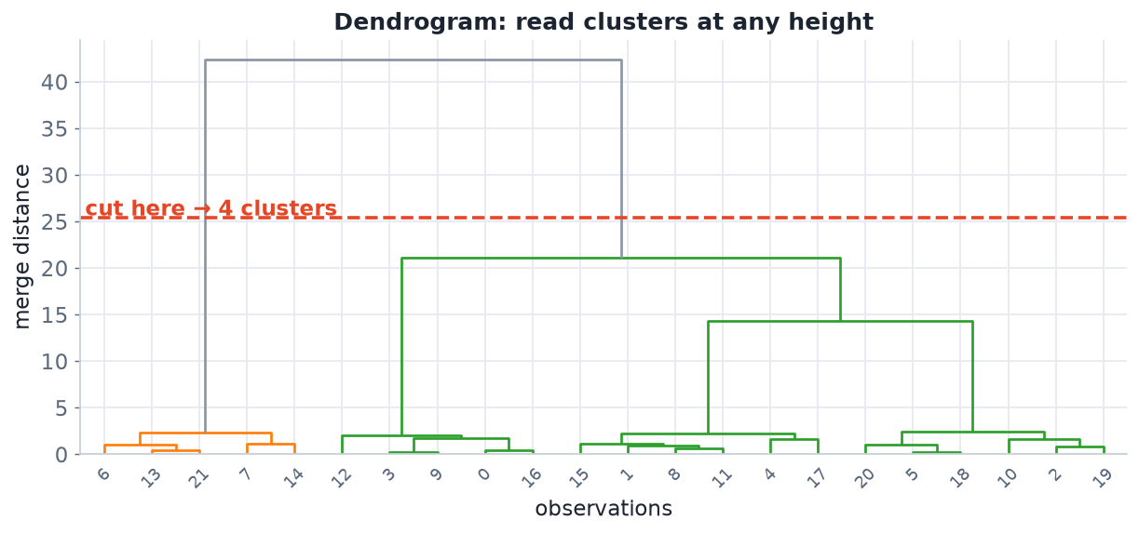
THE OUTPUT
A dendrogram
The tree records the order and distance of every merge. Cut it horizontally to read off a clustering — lower cut = more clusters.
STAT3888 · Statistical Machine Learning
L06 · 6

Slide 8
TWO DIRECTIONS
Agglomerative vs divisive
Agglomerative (bottom-up)
Divisive (top-down)
• Start: every point its own cluster
• Repeatedly merge the two closest
• End: one cluster containing all
• The common, default approach
• Start: all points in one cluster
• Repeatedly split a cluster
• End: every point alone
• Rarer, more expensive
STAT3888 · Statistical Machine Learning
L06 · 7

Slide 9
DEFINITION
Dendrogram
A dendrogram is a tree diagram showing the sequence of merges and the distance (height) at which each occurred.
▸ Leaves = individual observations
▸ Height of a join = dissimilarity of the merged groups
▸ Points that merge low down are very similar
STAT3888 · Statistical Machine Learning
L06 · 8

Slide 10
PART 2
The agglomerative algorithm

Slide 11
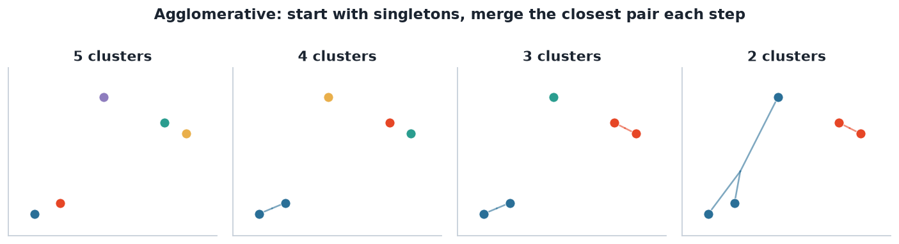
MERGING
Building the tree from the bottom up
Each step fuses the two nearest clusters, reducing the count by one, until a single cluster remains.
STAT3888 · Statistical Machine Learning
L06 · 9

Slide 12
ALGORITHM
Agglomerative clustering
1
Start
each of the n points is its own cluster
2
Find
the two clusters with the smallest linkage distance
3
Merge
combine them; record the merge height
4
Repeat
until only one cluster remains — you now have the full tree
The result is independent of k — you cut the finished tree wherever you like.
STAT3888 · Statistical Machine Learning
L06 · 10

Slide 13
THE KEY QUESTION
How far apart are two clusters?
▸ For single points, distance is clear (e.g. Euclidean)
▸ But how far apart are two groups of points?
▸ The answer is the linkage criterion — and it changes everything
STAT3888 · Statistical Machine Learning
L06 · 11

Slide 14
PART 3
Linkage criteria

Slide 15
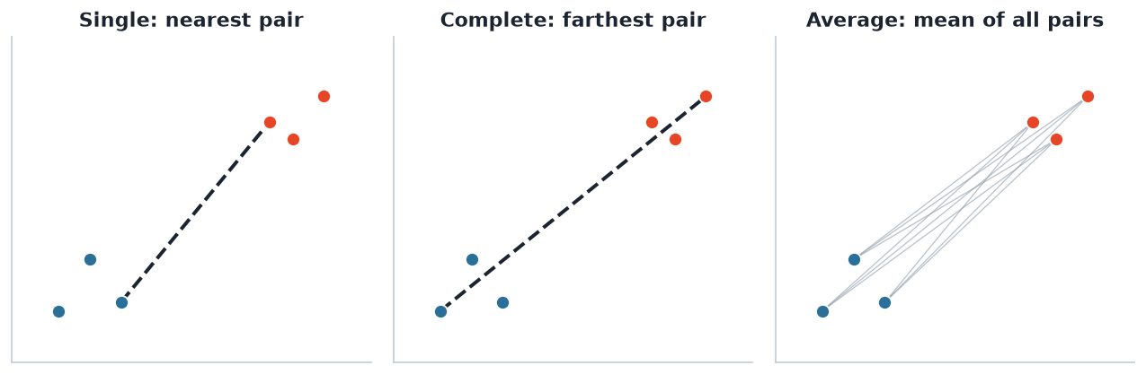
DEFINITIONS
Three ways to measure inter-cluster distance
Single = closest pair; complete = farthest pair; average = mean over all cross-cluster pairs.
STAT3888 · Statistical Machine Learning
L06 · 12

Slide 16
THE FOUR
Linkage criteria compared
Linkage | Distance between clusters | Tendency
Single | closest pair (min) | long, chained clusters
Complete | farthest pair (max) | compact, equal-diameter
Average | mean of all pairs | a compromise
Ward | increase in within-SS when merged | compact, similar-size (popular)
STAT3888 · Statistical Machine Learning
L06 · 13

Slide 17
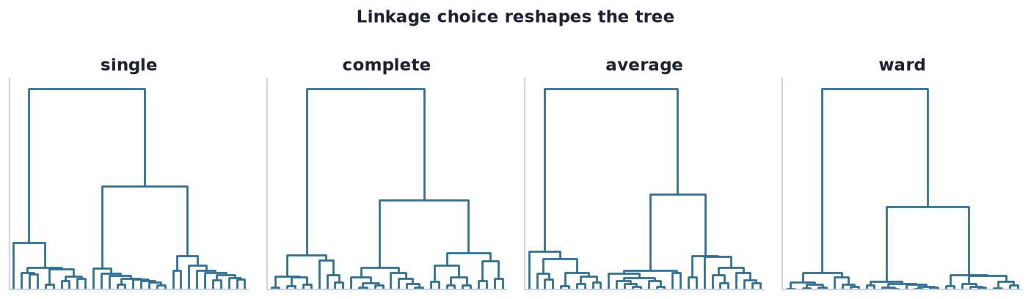
SAME DATA, DIFFERENT TREES
Linkage reshapes the dendrogram
The identical 30 points give four different hierarchies. Linkage is a genuine modelling choice, not a technicality.
STAT3888 · Statistical Machine Learning
L06 · 14

Slide 18
SINGLE LINKAGE
Strengths and its Achilles heel
▸ Can capture elongated, non-convex shapes
▸ Suffers from chaining: a bridge of points merges two real clusters
▸ Sensitive to noise and outliers
STAT3888 · Statistical Machine Learning
L06 · 15

Slide 19
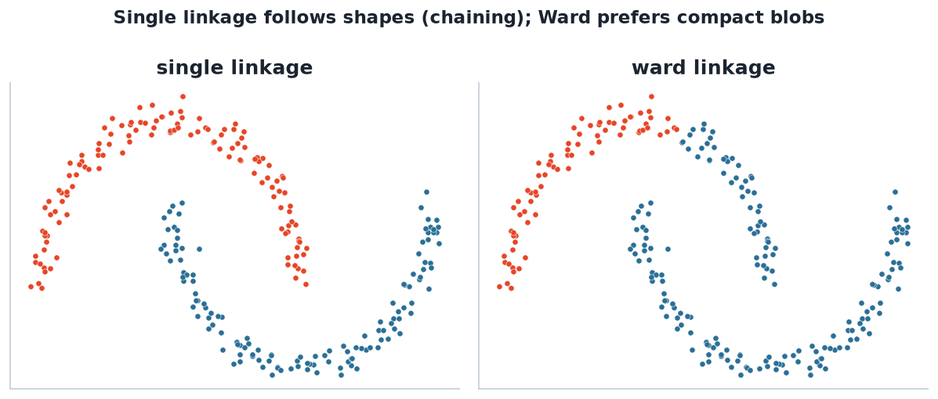
CHAINING VS COMPACT
Single linkage follows shape; Ward prefers blobs
On the moons, single linkage traces each arc; Ward carves compact regions and gets them 'wrong' — the right choice depends on your goal.
STAT3888 · Statistical Machine Learning
L06 · 16

Slide 20
WARD'S METHOD
The common default
▸ Merges the pair that least increases total within-cluster variance
▸ Tends to produce compact, similar-size clusters
▸ Closely related to the k-means objective
▸ Use with Euclidean distance (ward.D2 in R)
STAT3888 · Statistical Machine Learning
L06 · 17

Slide 21
CHECK YOUR UNDERSTANDING
Which linkage is most prone to 'chaining'?
A
Complete
B
Ward
C
Single ✓
D
Average
Why: Single linkage joins clusters via their closest pair, so a thin bridge of points can chain two otherwise-separate clusters together.
STAT3888 · Statistical Machine Learning
L06 · 18

Slide 22
PART 4
Distances & cutting the tree

Slide 23
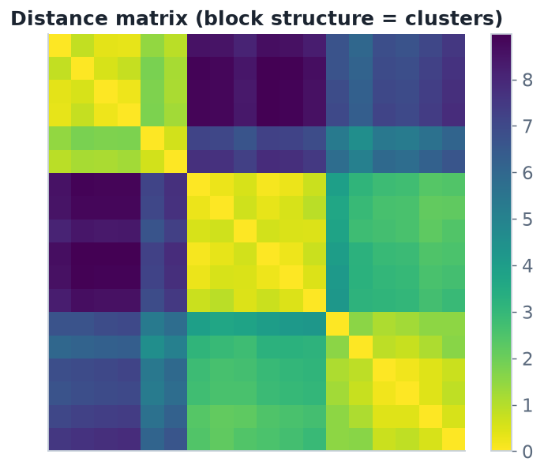
STARTING POINT
It all begins with a distance matrix
Hierarchical clustering works from the n×n matrix of pairwise distances. Block structure already hints at the clusters.
STAT3888 · Statistical Machine Learning
L06 · 19

Slide 24
DISTANCE CHOICE
Two decisions, not one
▸ Distance between points: Euclidean, Manhattan, correlation… (Lecture 3)
▸ Linkage between clusters: single, complete, average, Ward
▸ Together they define the whole clustering — choose both deliberately
▸ Standardise first, as always for distance-based methods
STAT3888 · Statistical Machine Learning
L06 · 20

Slide 25
CUTTING
From tree to clusters
▸ Cut the dendrogram horizontally at a chosen height
▸ Each branch crossing the cut becomes one cluster
▸ Lower cut → more, smaller clusters; higher cut → fewer, larger
▸ Choose the height at a big vertical gap — a natural break
STAT3888 · Statistical Machine Learning
L06 · 21

Slide 26
READING HEIGHTS
Merge height = dissimilarity
big vertical gap ⇒ natural number of clusters
• A long branch means the two groups below it are quite different
• Cutting just below a long branch separates well-distinguished clusters
• The cophenetic distance is the merge height for a pair of points
STAT3888 · Statistical Machine Learning
L06 · 22

Slide 27
VALIDATION
How many clusters, revisited
▸ Look for the largest gap between successive merge heights
▸ Cross-check with the silhouette (Lecture 4) at each candidate k
▸ The cophenetic correlation measures how faithfully the tree preserves distances
▸ Ultimately: does the clustering make domain sense?
STAT3888 · Statistical Machine Learning
L06 · 23

Slide 28
PART 5
Hierarchical clustering in R

Slide 29
FITTING
From data to dendrogram
X <- scale(diet_numeric) # standardise
d <- dist(X, method = 'euclidean')# distance matrix
hc <- hclust(d, method = 'ward.D2')
plot(hc, hang = -1) # draw the dendrogram
clusters <- cutree(hc, k = 3) # cut into 3 clusters
table(clusters)
STAT3888 · Statistical Machine Learning
L06 · 24

Slide 30
COMPARING
Try several linkages and validate
library(factoextra); library(cluster)
for (m in c('single','complete','average','ward.D2'))
print(cor(cophenetic(hclust(d, m)), d)) # cophenetic corr.
fviz_dend(hc, k = 3, rect = TRUE) # coloured dendrogram
fviz_nbclust(X, hcut, method = 'silhouette')
STAT3888 · Statistical Machine Learning
L06 · 25

Slide 31
PROS & CONS
Hierarchical clustering in balance
Strengths
Weaknesses
• No need to fix k in advance
• The dendrogram is interpretable
• Reveals structure at all scales
• Works from any distance matrix
• O(n²) memory — hard for very large n
• Merges are greedy & irreversible
• Sensitive to distance & linkage choice
• Single linkage prone to chaining
STAT3888 · Statistical Machine Learning
L06 · 26

Slide 32
WORKED EXAMPLE
Dietary patterns via a tree
▸ Standardise intake variables and compute Euclidean distances
▸ Run Ward linkage; inspect the dendrogram for a clear gap
▸ Cut into k clusters; check the silhouette agrees
▸ Profile and name each cluster with your Nutrition partners
▸ Compare the partition with last week's k-means / GMM result
STAT3888 · Statistical Machine Learning
L06 · 27

Slide 33
PART 6
Pitfalls & practice

Slide 34
COMMON MISTAKES
What trips students up
▸ Forgetting to standardise before computing distances
▸ Reading the dendrogram horizontal order as meaningful — it isn't
▸ Using Ward with a non-Euclidean distance
▸ Picking k without checking a validation measure
STAT3888 · Statistical Machine Learning
L06 · 28

Slide 35
CHECK YOUR UNDERSTANDING
On a dendrogram, what does the height of a merge represent?
A
The number of points
B
The dissimilarity between the merged clusters ✓
C
The cluster's variance
D
Nothing — it's decorative
Why: Merge height = the linkage distance at which two clusters joined. Big heights mean very different groups.
STAT3888 · Statistical Machine Learning
L06 · 29

Slide 36
IN-CLASS EXERCISE
Build and read a tree
1. Compute a Euclidean distance matrix on the standardised data and run complete and Ward linkage.
2. Plot both dendrograms. Where is the largest vertical gap in each?
3. Cut each at k = 3 and cross-tabulate the two labelings. Do they agree?
4. Compute the cophenetic correlation for each linkage — which preserves distances better?
Hint. cutree(hc, k=3) gives labels; table(a, b) cross-tabulates; cor(cophenetic(hc), d) gives the cophenetic correlation.
STAT3888 · Statistical Machine Learning
L06 · 30

Slide 37
IN-CLASS EXERCISE
Choose a linkage
1. Your clusters are expected to be compact and similar-sized. Which linkage fits that prior?
2. Your clusters may be elongated (e.g. a metabolic gradient). Which linkage might capture that, and what risk does it carry?
3. Justify a final choice for the project and note how you'd validate it.
Hint. Ward → compact/equal size; single → shapes but risks chaining.
STAT3888 · Statistical Machine Learning
L06 · 31

Slide 38
KEY IDEAS RECAP
Hold onto these
▸ A dendrogram encodes clusterings at every k
▸ Linkage defines inter-cluster distance and shapes the tree
▸ Ward is a solid default; single captures shape but chains
▸ Cut at a large gap; validate with silhouette / cophenetic correlation
STAT3888 · Statistical Machine Learning
L06 · 32

Slide 39
PART 7
Divisive methods & complexity

Slide 40
THE OTHER DIRECTION
Divisive (top-down) clustering
How it works
Why it's rarer
• Begin with all points in one cluster
• Repeatedly split the least-cohesive cluster
• DIANA is the classic algorithm
• Choosing the best split is expensive
• Naively exponential in cluster size
• Agglomerative is usually preferred
STAT3888 · Statistical Machine Learning
L06 · 33

Slide 41
SCALABILITY
The cost of a full tree
▸ Needs the n×n distance matrix → O(n²) memory
▸ Runtime is typically O(n² log n) or O(n³) depending on implementation
▸ Fine for hundreds–thousands of points; hard for millions
▸ For big data: cluster a sample, or use k-means/mini-batch instead
STAT3888 · Statistical Machine Learning
L06 · 34

Slide 42
DEFINITION
Cophenetic distance
The cophenetic distance between two observations is the merge height at which they first fall into the same cluster.
▸ Comparing it to the original distances measures tree faithfulness
▸ The cophenetic correlation is that comparison as a single number
▸ Higher (→1) means the dendrogram preserves the real distances well
STAT3888 · Statistical Machine Learning
L06 · 35

Slide 43
CHECK YOUR UNDERSTANDING
Why is hierarchical clustering hard to run on 5 million points?
A
The tree is uninterpretable
B
It needs an O(n²) distance matrix ✓
C
It can't use Euclidean distance
D
It requires labels
Why: Storing all pairwise distances is O(n²) memory — 5M points would need ~10¹³ entries, which is infeasible.
STAT3888 · Statistical Machine Learning
L06 · 36

Slide 44
PART 8
Heatmaps, bioinformatics & method choice

Slide 45
CLUSTERED HEATMAPS
A favourite in genomics & metabolomics
▸ Combine a dendrogram on rows (samples) and columns (variables)
▸ Reorder both by their trees so blocks of colour reveal patterns
▸ Ubiquitous for gene-expression and metabolite data — relevant to your project
▸ In R: `pheatmap()` or `heatmap()` do the clustering and drawing together
STAT3888 · Statistical Machine Learning
L06 · 37

Slide 46
HEATMAP
A clustered heatmap in one call
library(pheatmap)
pheatmap(scale(metabolites), # standardise
clustering_distance_rows = 'euclidean',
clustering_method = 'ward.D2',
cutree_rows = 3) # annotate 3 clusters
STAT3888 · Statistical Machine Learning
L06 · 38

Slide 47
ALL THREE SO FAR
Choosing a clustering method
Method | Fix k? | Shape | Best when
k-means | yes | spherical | large, round, quick
GMM | yes (BIC) | elliptical | overlap, want uncertainty
Hierarchical | no (cut later) | any (via linkage) | want structure at all scales
STAT3888 · Statistical Machine Learning
L06 · 39

Slide 48
NO UNIVERSAL WINNER
The 'best' clustering method depends on your data's shape, your sample size, and what question you're asking.
A mature analyst runs several, compares them, and validates against domain knowledge — never trusts one blindly.

Slide 49
REPRODUCIBILITY
Make your clustering trustworthy
▸ Record the distance and linkage you used
▸ Standardise and set a seed where randomness enters
▸ Report how you chose k (gap in heights, silhouette)
▸ Show the dendrogram so readers can judge for themselves
STAT3888 · Statistical Machine Learning
L06 · 41

Slide 50
CHECK YOUR UNDERSTANDING
You want structure at multiple scales without committing to one k. Best choice?
A
k-means
B
GMM
C
Hierarchical clustering ✓
D
None can do this
Why: Only hierarchical clustering produces a full tree, letting you inspect and choose clusterings at every granularity after the fact.
STAT3888 · Statistical Machine Learning
L06 · 42

Slide 51
INTERPRETING CLUSTERS
The deliverable, again
▸ Cut the tree, then profile each cluster's variable means
▸ Give each a name meaningful to nutrition (e.g. 'high-protein pattern')
▸ Check cluster sizes — a tiny branch may be outliers
▸ Relate clusters to a held-out outcome to argue they're real
STAT3888 · Statistical Machine Learning
L06 · 43

Slide 52
IN-CLASS EXERCISE
Compare all three methods
1. On the standardised nutrition data, produce clusterings from k-means (k=3), Mclust, and Ward hierarchical (cut at 3).
2. Cross-tabulate the three labelings pairwise. Where do they agree and disagree?
3. For the points where methods disagree, describe where they sit geometrically.
4. Which method would you report to your Nutrition partners, and why?
Hint. Use table() for pairwise agreement; disagreements often sit in overlap/boundary regions.
STAT3888 · Statistical Machine Learning
L06 · 44

Slide 53
FURTHER READING
To go deeper
▸ James, Witten, Hastie & Tibshirani — *An Introduction to Statistical Learning*, Ch. 12
▸ Hastie, Tibshirani & Friedman — *The Elements of Statistical Learning*, §14.3
▸ R: the cluster, factoextra and pheatmap package vignettes
STAT3888 · Statistical Machine Learning
L06 · 45

Slide 54
PART 9
A worked calculation

Slide 55
SETUP
Merge distances by hand
▸ Four 1-D points: A = 1, B = 2, C = 6, D = 8
▸ Euclidean distances: |A−B| = 1, |C−D| = 2, |B−C| = 4
▸ We'll agglomerate step by step under single linkage
STAT3888 · Statistical Machine Learning
L06 · 46

Slide 56
TRACE
Single-linkage merges
1
Merge A & B
closest pair, distance 1 → cluster {A,B}
2
Merge C & D
next closest, distance 2 → cluster {C,D}
3
Merge {A,B} & {C,D}
single linkage = min pair distance = |B−C| = 4
4
Done
one cluster; heights recorded are 1, 2, 4
Under complete linkage the last merge height would be |A−D| = 7, not 4.
STAT3888 · Statistical Machine Learning
L06 · 47

Slide 57
CHECK YOUR UNDERSTANDING
For the last merge above, what height does COMPLETE linkage use?
A
4 (|B−C|)
B
7 (|A−D|) ✓
C
2 (|C−D|)
D
1 (|A−B|)
Why: Complete linkage uses the farthest pair between clusters: |A−D| = |1−8| = 7.
STAT3888 · Statistical Machine Learning
L06 · 48

Slide 58
LESSON
Same data, different heights
▸ Single linkage last-merge height = 4 (nearest pair)
▸ Complete linkage last-merge height = 7 (farthest pair)
▸ The tree's shape and cut points change with linkage
▸ This is why linkage is a genuine modelling decision
STAT3888 · Statistical Machine Learning
L06 · 49

Slide 59
THE TAKEAWAY
Hierarchical clustering doesn't give you one answer — it gives you a whole family, and you choose from it with judgement.
Distance + linkage + cut height are three levers. Own all three.

Slide 60
SUMMARY
Key takeaways
✓ Hierarchical clustering builds a tree — a clustering for every k, no k fixed up front.
✓ Agglomerative merging is driven by a linkage criterion (single/complete/average/Ward).
✓ Read clusters by cutting the dendrogram at a natural gap in merge heights.
✓ It's interpretable and shape-aware, but O(n²) and sensitive to distance & linkage choices.
Next lecture → Lecture 07 — PCA background: the linear algebra behind dimension reduction.
STAT3888 · Statistical Machine Learning
L06 · 51

