Slide 1
LECTURE 07
Principal Component Analysis: The Background
The linear-algebra foundations — variance, covariance, projections, eigenvectors — that make PCA work. Build the intuition before the method.
School of Mathematics & Statistics · The University of Sydney

Slide 2
AGENDA
Today's roadmap
▸ Why dimension reduction? The curse of dimensionality
▸ Variance: measuring spread
▸ Covariance and the covariance matrix
▸ Vectors, projections and linear combinations
▸ Eigenvectors and eigenvalues
▸ Putting it together: the geometry of PCA
STAT3888 · Statistical Machine Learning
L07 · 2

Slide 3
RECAP
From clustering to structure
▸ Weeks 1–2: we grouped observations (clustering)
▸ Now we shift to summarising variables — dimension reduction
▸ Nutrition data is wide: dozens of correlated intake & metabolite variables
▸ PCA compresses them into a few informative directions
STAT3888 · Statistical Machine Learning
L07 · 3

Slide 4
PART 1
Why reduce dimensions?

Slide 5
DEFINITION
Dimension reduction
Dimension reduction replaces many (correlated) variables with a few new variables that retain most of the information.
▸ Fewer variables → easier to visualise, store and model
▸ Removes redundancy among correlated measurements
▸ Can reduce noise and improve downstream models
STAT3888 · Statistical Machine Learning
L07 · 4

Slide 6
THE CURSE
Why high dimensions hurt
▸ Distances lose meaning — everything becomes far apart and roughly equidistant
▸ Models need exponentially more data as dimensions grow
▸ Overfitting becomes easy; visualisation becomes impossible beyond 3-D
▸ Many variables are redundant — they move together
STAT3888 · Statistical Machine Learning
L07 · 5

Slide 7
THE OPPORTUNITY
If variables are correlated, the data doesn't really fill all those dimensions — it lives near a lower-dimensional surface.
PCA finds that surface: the few directions along which the data actually varies.

Slide 8
TWO GOALS
What dimension reduction is for
Visualisation
Preprocessing
• Squeeze many variables into 2–3 axes
• Plot participants and spot patterns
• Communicate structure to non-experts
• Feed fewer, cleaner inputs to models
• Reduce collinearity and noise
• Speed up and stabilise learning
STAT3888 · Statistical Machine Learning
L07 · 7

Slide 9
PART 2
Variance: measuring spread

Slide 10
DEFINITION
Variance
The variance of a variable is the average squared distance of its values from their mean — a measure of spread.
▸ Larger variance = data more spread out along that variable
▸ PCA treats variance as information worth keeping
▸ Zero variance = a constant, carrying no information
STAT3888 · Statistical Machine Learning
L07 · 8

Slide 11
FORMULA
Sample variance
s² = (1/(n−1)) Σᵢ ( xᵢ − x̄ )²
• Subtract the mean, square, average (with n−1 for an unbiased estimate)
• Units are squared; the standard deviation s is on the original scale
• PCA seeks new axes that maximise this quantity
STAT3888 · Statistical Machine Learning
L07 · 9

Slide 12
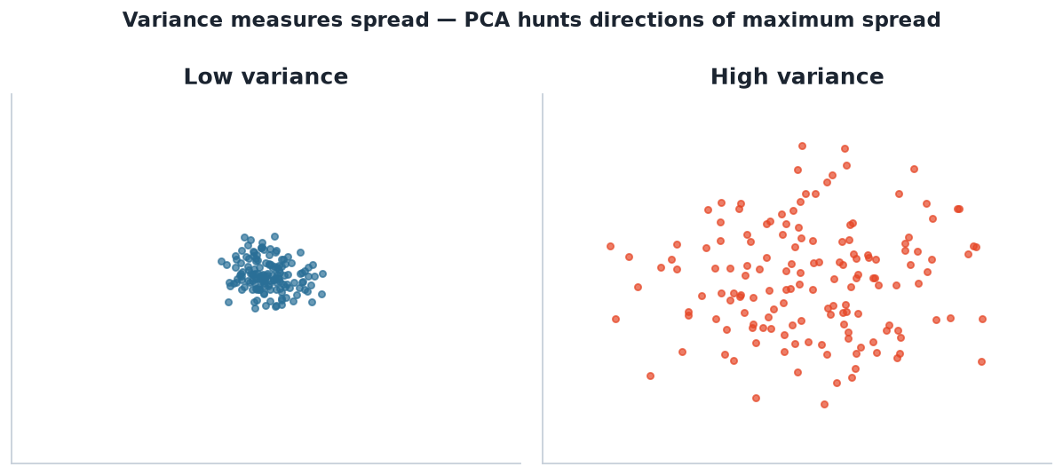
INTUITION
Variance is spread
Both clouds share the same centre, but the right has far more variance. PCA cares about directions where variance is large.
STAT3888 · Statistical Machine Learning
L07 · 10

Slide 13
WHY VARIANCE = INFORMATION
The PCA worldview
▸ A direction with high variance separates observations — it's informative
▸ A direction with near-zero variance looks the same for everyone — drop it
▸ PCA ranks directions by variance and keeps the top few
STAT3888 · Statistical Machine Learning
L07 · 11

Slide 14
PART 3
Covariance

Slide 15
DEFINITION
Covariance
The covariance of two variables measures how they vary together: positive if they rise together, negative if one falls as the other rises.
▸ Cov > 0: move in the same direction (e.g. energy & fat)
▸ Cov < 0: move oppositely
▸ Cov ≈ 0: no linear relationship
STAT3888 · Statistical Machine Learning
L07 · 12

Slide 16
FORMULA
Sample covariance
cov(x,y) = (1/(n−1)) Σᵢ (xᵢ−x̄)(yᵢ−ȳ)
• Positive when both variables are above (or both below) their means together
• Symmetric: cov(x,y) = cov(y,x)
• cov(x,x) is just the variance of x
STAT3888 · Statistical Machine Learning
L07 · 13

Slide 17
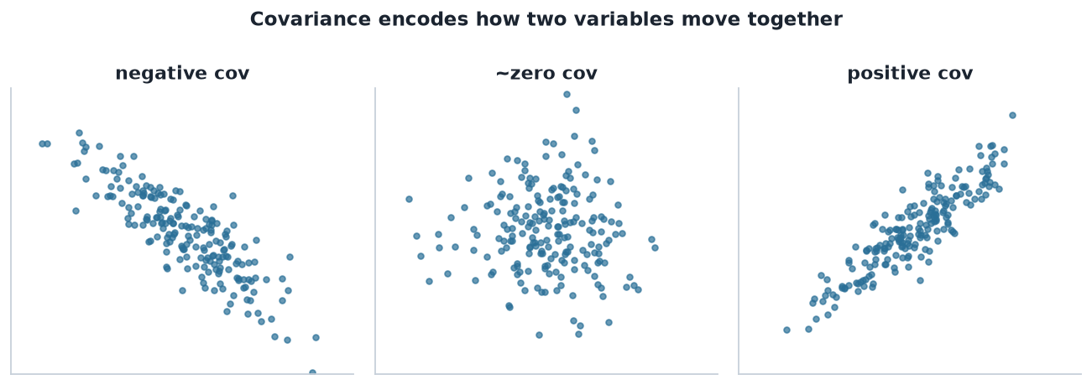
THREE CASES
Covariance encodes co-movement
Negative, near-zero, and positive covariance. PCA works from exactly this structure across all variable pairs.
STAT3888 · Statistical Machine Learning
L07 · 14

Slide 18
DEFINITION
Covariance matrix
The covariance matrix Σ collects the variance of every variable (diagonal) and the covariance of every pair (off-diagonal).
▸ For p variables it is p×p and symmetric
▸ Diagonal = variances; off-diagonal = covariances
▸ This single matrix is the raw material for PCA
STAT3888 · Statistical Machine Learning
L07 · 15

Slide 19
STRUCTURE
The p×p covariance matrix
Σ = [ var(x₁) cov(x₁,x₂) … ; cov(x₂,x₁) var(x₂) … ; ⋮ ]
• Symmetric and (usually) positive semi-definite
• Captures the whole linear dependence structure of the data
• PCA = an eigen-decomposition of this matrix
STAT3888 · Statistical Machine Learning
L07 · 16

Slide 20
CORRELATION
Covariance's scaled cousin
▸ Correlation = covariance divided by the two standard deviations
▸ Always between −1 and +1 — scale-free and interpretable
▸ Running PCA on the correlation matrix = PCA on standardised data
▸ Almost always what you want when variables have different units
STAT3888 · Statistical Machine Learning
L07 · 17

Slide 21
CHECK YOUR UNDERSTANDING
Energy (kJ) and fat (g) tend to rise together. Their covariance is…
A
Negative
B
Zero
C
Positive ✓
D
Undefined
Why: Variables that increase together have positive covariance.
STAT3888 · Statistical Machine Learning
L07 · 18

Slide 22
PART 4
Vectors & projections

Slide 23
VECTORS
Data points as vectors
▸ Each observation with p variables is a point / vector in p-dimensional space
▸ A direction is a unit vector v (length 1) pointing some way through that space
▸ PCA is a hunt for the most informative directions
STAT3888 · Statistical Machine Learning
L07 · 19

Slide 24
DEFINITION
Projection
The projection of a point onto a direction v is its 'shadow' on that line — how far along v the point sits, given by the dot product xᵀv.
▸ Projecting reduces a p-dim point to a single number (its coordinate on v)
▸ The set of all projections is a new 1-D variable
▸ PCA chooses v so this new variable has maximum variance
STAT3888 · Statistical Machine Learning
L07 · 20

Slide 25
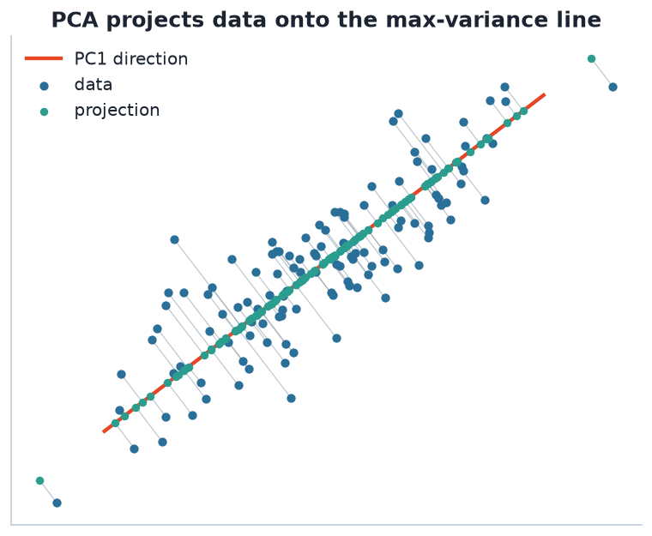
GEOMETRY
Projecting data onto a direction
Grey lines drop each point onto the line. PCA picks the line (red) for which the projected points (teal) are as spread out as possible.
STAT3888 · Statistical Machine Learning
L07 · 21

Slide 26
THE OPTIMISATION
PC1 maximises projected variance
PC1 = argmaxᵥ Var( X v ) subject to ‖v‖ = 1
• Among all unit directions, find the one with the most spread after projection
• That direction is the first principal component
• The next PC does the same, but must be orthogonal to the first
STAT3888 · Statistical Machine Learning
L07 · 22

Slide 27
LINEAR COMBINATIONS
What a principal component is
▸ A PC is a weighted sum of the original variables: PC = w₁x₁ + w₂x₂ + …
▸ The weights w are called loadings — they define the direction
▸ The resulting values are the scores — each participant's PC coordinate
▸ So PCA = choosing loadings that maximise score variance
STAT3888 · Statistical Machine Learning
L07 · 23

Slide 28
PART 5
Eigenvectors & eigenvalues

Slide 29
DEFINITION
Eigenvector & eigenvalue
An eigenvector of a matrix is a direction that the matrix only stretches (not rotates); its eigenvalue is the stretch factor.
▸ For the covariance matrix, eigenvectors = principal component directions
▸ Eigenvalues = the variance captured along each PC
▸ Bigger eigenvalue = more important component
STAT3888 · Statistical Machine Learning
L07 · 24

Slide 30
THE EQUATION
Eigenvectors of the covariance matrix
Σ v = λ v
• v — an eigenvector (a principal direction)
• λ — its eigenvalue (variance along that direction)
• Solving this for Σ yields all the principal components at once
The eigenvector with the largest λ is PC1; the next largest is PC2; and so on.
STAT3888 · Statistical Machine Learning
L07 · 25

Slide 31
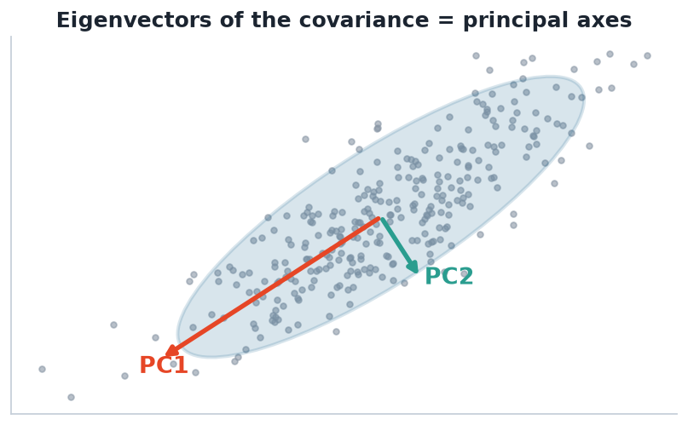
THE PAYOFF
Eigenvectors of covariance = principal axes
PC1 (largest eigenvalue) runs along the cloud's longest axis; PC2 is orthogonal, capturing the remaining spread.
STAT3888 · Statistical Machine Learning
L07 · 26

Slide 32
KEY FACTS
Properties of the components
▸ Eigenvectors of a symmetric Σ are orthogonal → PCs are uncorrelated
▸ Eigenvalues are non-negative and sum to the total variance
▸ Ordering by eigenvalue ranks components by importance
▸ Proportion of variance explained by PCk = λₖ / Σλ
STAT3888 · Statistical Machine Learning
L07 · 27

Slide 33
CHECK YOUR UNDERSTANDING
In PCA, the eigenvalue associated with a principal component tells you…
A
Its direction
B
How much variance it captures ✓
C
The number of clusters
D
The correlation with Y
Why: Each eigenvalue is the variance of the data along its eigenvector (that PC). Larger eigenvalue = more informative component.
STAT3888 · Statistical Machine Learning
L07 · 28

Slide 34
PART 6
Standardisation & geometry

Slide 35
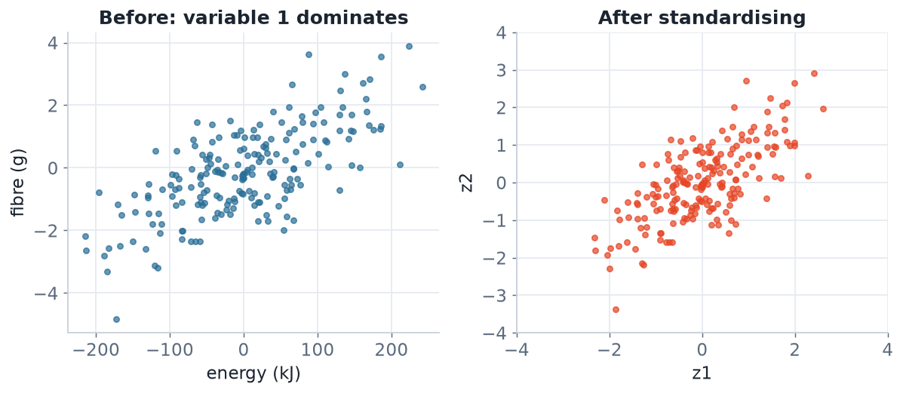
SCALE FIRST
Why standardising matters for PCA
Before standardising, the high-variance variable (energy) hijacks PC1. After, every variable competes fairly.
STAT3888 · Statistical Machine Learning
L07 · 29

Slide 36
STANDARDISE
Correlation- vs covariance-based PCA
▸ On raw data, PCA chases the variable with the biggest numeric scale
▸ Standardising (z-scores) makes each variable have variance 1
▸ Then PCA works on the correlation structure — usually what you want
▸ Exception: if all variables share the same meaningful unit, raw PCA can be fine
STAT3888 · Statistical Machine Learning
L07 · 30

Slide 37
THE RECIPE
PCA in five conceptual steps
1
Standardise
centre and scale every variable
2
Covariance
form the covariance (correlation) matrix
3
Eigen-decompose
find eigenvectors (directions) and eigenvalues (variances)
4
Order & keep
rank by eigenvalue, keep the top few PCs
5
Project
compute scores — the data in the new low-dim coordinates
Lecture 8 turns this recipe into practice, plots and interpretation.
STAT3888 · Statistical Machine Learning
L07 · 31

Slide 38
THE BIG PICTURE
PCA rotates the coordinate axes to line up with the directions of greatest variance — then throws away the boring ones.
No information about *which* variables matter is lost; it's re-expressed.

Slide 39
PART 7
Consolidate

Slide 40
VOCABULARY
Terms you now own
▸ Variance / covariance — spread and co-movement
▸ Covariance matrix — all of it, in one p×p object
▸ Projection / loading / score — direction, weights, coordinates
▸ Eigenvector / eigenvalue — principal direction and its variance
STAT3888 · Statistical Machine Learning
L07 · 33

Slide 41
IN-CLASS EXERCISE
Covariance by hand
1. Two participants' (fibre, fullness) values: A = (2, 3), B = (4, 7); means are (3, 5).
2. Compute the covariance of fibre and fullness from these two points.
3. Is it positive or negative? What does the sign say about the relationship?
4. Why must we standardise before PCA if fibre is in grams and fullness on a 1–10 scale?
Hint. cov = (1/(n−1)) Σ (xᵢ−x̄)(yᵢ−ȳ); here that's (1/1)[(−1)(−2)+(1)(2)].
STAT3888 · Statistical Machine Learning
L07 · 34

Slide 42
IN-CLASS EXERCISE
Reason about directions
1. A data cloud is a long, thin ellipse tilted at 45°. Sketch where PC1 and PC2 point.
2. Which PC has the larger eigenvalue, and why?
3. If you kept only PC1, what information about the data would you lose?
Hint. PC1 follows the long axis (most variance); PC2 is perpendicular (the thin direction).
STAT3888 · Statistical Machine Learning
L07 · 35

Slide 43
CHECK YOUR UNDERSTANDING
Why run PCA on standardised data when variables have different units?
A
To speed it up
B
So no single variable dominates purely because of its scale ✓
C
To make it supervised
D
To remove all correlation
Why: Without standardising, a variable measured in large numbers (e.g. kJ) contributes huge variance and dominates the components for no good reason.
STAT3888 · Statistical Machine Learning
L07 · 36

Slide 44
COMMON MISCONCEPTIONS
Clear these up now
▸ PCA is unsupervised — it never looks at an outcome Y
▸ PCs are new variables, not a subset of the originals
▸ High variance ≠ 'important for prediction' — only 'spread out'
▸ PCA captures linear structure only (curved structure needs t-SNE, Lecture 9)
STAT3888 · Statistical Machine Learning
L07 · 37

Slide 45
PART 8
Filling in the linear algebra

Slide 46
DEFINITION
Dot product
The dot product xᵀv = Σⱼ xⱼvⱼ multiplies matching coordinates and sums them; it measures how much x points along v.
▸ If v is a unit vector, xᵀv is the length of x's shadow on v
▸ Dot product zero ⇒ the vectors are orthogonal (perpendicular)
▸ Projections — and hence PCA — are built from dot products
STAT3888 · Statistical Machine Learning
L07 · 38

Slide 47
DEFINITION
Orthogonality & unit vectors
Two directions are orthogonal if their dot product is zero; a unit vector has length one.
▸ PCA constrains each direction to be a unit vector (‖v‖ = 1)
▸ Successive PCs are mutually orthogonal → uncorrelated scores
▸ Together the PCs form a rotated orthonormal coordinate system
STAT3888 · Statistical Machine Learning
L07 · 39

Slide 48
MATRIX AS TRANSFORMATION
What Σv actually does
▸ Multiplying a vector by a matrix generally rotates and stretches it
▸ Eigenvectors are the special directions that get stretched but not rotated
▸ The eigenvalue is the stretch factor along that direction
▸ For covariance Σ, the stretch factor is the variance in that direction
STAT3888 · Statistical Machine Learning
L07 · 40

Slide 49
WORKED 2×2
Eigenvalues of a small covariance matrix
Σ = [ 2 0 ; 0 1 ] → λ = 2 (v = e₁), λ = 1 (v = e₂)
• A diagonal Σ has the coordinate axes themselves as eigenvectors
• Variance is 2 along x₁ and 1 along x₂ → PC1 is the x₁ axis
• Off-diagonal terms tilt the eigenvectors away from the axes
STAT3888 · Statistical Machine Learning
L07 · 41

Slide 50
SOLVING IN GENERAL
How eigenvalues are found (conceptually)
▸ Solve det(Σ − λI) = 0 for the eigenvalues λ
▸ For each λ, solve (Σ − λI)v = 0 for its eigenvector v
▸ You never do this by hand for real data — software does it instantly
▸ The spectral theorem guarantees a full set of orthogonal eigenvectors for symmetric Σ
STAT3888 · Statistical Machine Learning
L07 · 42

Slide 51
DEFINITION
Singular value decomposition (SVD)
The SVD factorises the data matrix directly as X = U D Vᵀ; the columns of V are the principal directions.
▸ Software computes PCA via the SVD — it's numerically stabler
▸ Singular values relate to eigenvalues (variances) of Σ
▸ Same answer as eigen-decomposing the covariance matrix
STAT3888 · Statistical Machine Learning
L07 · 43

Slide 52
WHY IT ALWAYS WORKS
For a symmetric covariance matrix, the principal components always exist, are orthogonal, and are unique (up to sign).
That guarantee — the spectral theorem — is what makes PCA reliable across every data set.

Slide 53
A LITTLE HISTORY
Where PCA came from
▸ Karl Pearson (1901) — 'lines and planes of closest fit' to data
▸ Harold Hotelling (1933) — formalised principal components
▸ Now a cornerstone of statistics, signal processing and machine learning
▸ The same math powers eigenfaces, image compression and genomics
STAT3888 · Statistical Machine Learning
L07 · 45

Slide 54
WHERE IT'S USED
PCA across fields
Science & health
Engineering & data
• Genomics & metabolomics structure
• Population genetics (ancestry axes)
• Neuroimaging dimensionality
• Image & signal compression
• Feature extraction for ML
• Anomaly detection via residuals
STAT3888 · Statistical Machine Learning
L07 · 46

Slide 55
CHECK YOUR UNDERSTANDING
Successive principal components are orthogonal. A consequence is that the PC scores are…
A
Perfectly correlated
B
Uncorrelated with each other ✓
C
Always positive
D
Equal in variance
Why: Orthogonal directions produce scores with zero correlation — a key reason PCA removes redundancy.
STAT3888 · Statistical Machine Learning
L07 · 47

Slide 56
COVARIANCE WORKED EXAMPLE
Two variables, three points
x = (1,2,3), y = (2,4,6) → cov(x,y) = 2, perfectly correlated
• Both increase together in lock-step → large positive covariance
• Here y = 2x exactly, so one PC captures all the variance
• The second PC would have eigenvalue 0 — redundant dimension
STAT3888 · Statistical Machine Learning
L07 · 48

Slide 57
CONNECTING BACK
Why this powers clustering too
▸ Cluster in PC space to beat the curse of dimensionality
▸ Uncorrelated PCs suit distance-based methods (k-means, GMM)
▸ Dropping low-variance PCs denoises before clustering
▸ PCA + clustering is a standard nutrition-data pipeline
STAT3888 · Statistical Machine Learning
L07 · 49

Slide 58
IN-CLASS EXERCISE
Eigen-intuition
1. For Σ = [[3, 0], [0, 1]], write down the two eigenvectors and eigenvalues by inspection.
2. Which is PC1? How much of the total variance does it explain?
3. Now imagine a small off-diagonal term appears. Qualitatively, what happens to the eigenvectors?
Hint. A diagonal matrix has the coordinate axes as eigenvectors; % variance = λ / Σλ.
STAT3888 · Statistical Machine Learning
L07 · 50

Slide 59
CHAPTER CHECKLIST
Before Lecture 8, be sure you can…
▸ Explain variance, covariance and the covariance matrix
▸ Describe a projection and a linear combination
▸ State what eigenvectors/eigenvalues mean for PCA
▸ Say why standardisation matters
STAT3888 · Statistical Machine Learning
L07 · 51

Slide 60
SUMMARY
Key takeaways
✓ Dimension reduction fights the curse of dimensionality by exploiting correlation.
✓ Variance measures spread; PCA treats variance as information to keep.
✓ The covariance matrix encodes all pairwise linear structure.
✓ Eigenvectors of that matrix are the principal directions; eigenvalues are their variances.
Next lecture → Lecture 08 — Principal Component Analysis in practice: scores, loadings and biplots.
STAT3888 · Statistical Machine Learning
L07 · 52

