Slide 1
LECTURE 08
Principal Component Analysis in Practice
From the covariance matrix to scores, loadings, scree plots and biplots — and how to interpret, choose and use principal components on real data.
School of Mathematics & Statistics · The University of Sydney

Slide 2
AGENDA
Today's roadmap
▸ PCA recap: the one-slide summary
▸ Scores and loadings — the two outputs
▸ How many components? The scree plot
▸ The biplot: variables and observations together
▸ PCA as compression and denoising
▸ Running & interpreting PCA in R; pitfalls
STAT3888 · Statistical Machine Learning
L08 · 2

Slide 3
RECAP
What we built last lecture
▸ PCA finds orthogonal directions of maximum variance
▸ They are the eigenvectors of the covariance/correlation matrix
▸ Eigenvalues say how much variance each captures
▸ Today: turn that into outputs you can read and use
STAT3888 · Statistical Machine Learning
L08 · 3

Slide 4
ONE-SLIDE PCA
PCA re-expresses your correlated variables as a smaller set of uncorrelated 'principal components', ordered by how much variation they explain.
Keep the top few and you've compressed the data with minimal loss.

Slide 5
PART 1
The two outputs: scores & loadings

Slide 6
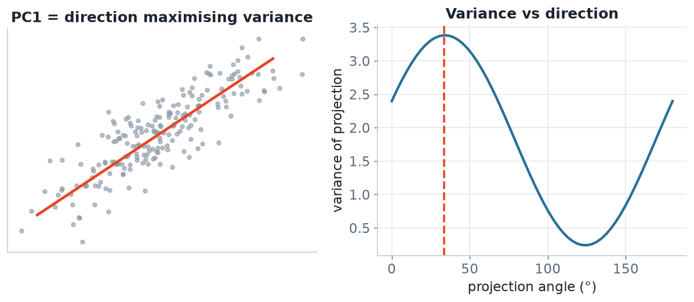
FINDING PC1
PC1 is the max-variance direction
Rotating a line and measuring the projected variance: the peak (right) defines PC1's direction (left).
STAT3888 · Statistical Machine Learning
L08 · 5

Slide 7
DEFINITION
Loadings
Loadings are the weights that define each principal component as a linear combination of the original variables.
▸ They describe what each PC means in terms of the variables
▸ Large |loading| = that variable strongly shapes the PC
▸ Signs show whether variables push the PC up or down together
STAT3888 · Statistical Machine Learning
L08 · 6

Slide 8
DEFINITION
Scores
Scores are the coordinates of each observation on the principal components — the data re-expressed in the new axes.
▸ One score per observation per PC
▸ Plotting PC1 vs PC2 scores is the classic PCA picture
▸ Scores are what you feed into downstream models
STAT3888 · Statistical Machine Learning
L08 · 7

Slide 9
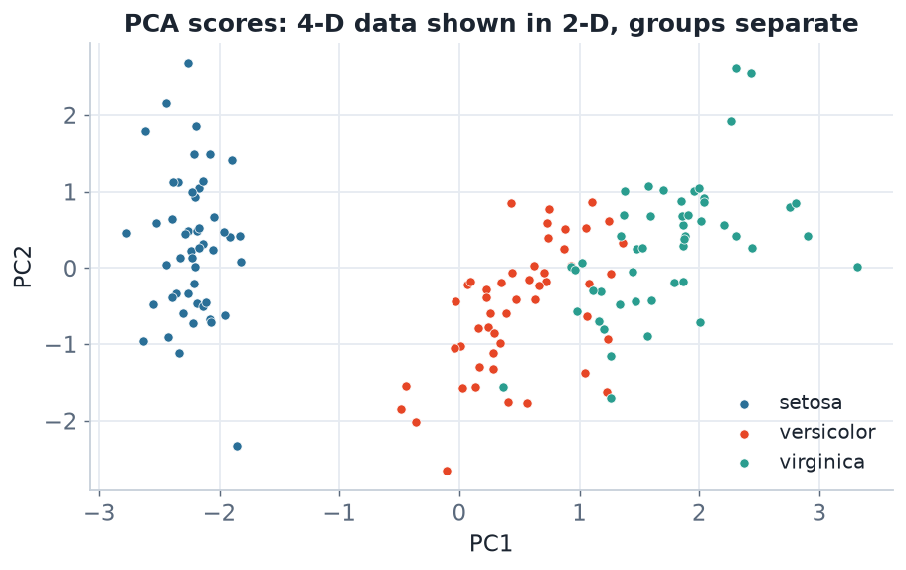
SCORES PLOT
4-D data in 2-D
Each point is a flower's scores on PC1 and PC2. Two components already separate the species — that's the power of PCA.
STAT3888 · Statistical Machine Learning
L08 · 8

Slide 10
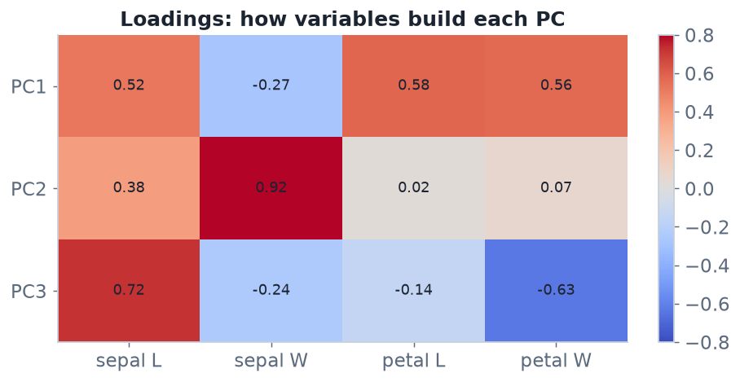
LOADINGS
How variables build each PC
A loadings heatmap. Here PC1 loads on petal measurements; reading loadings is how you give each PC a meaning.
STAT3888 · Statistical Machine Learning
L08 · 9

Slide 11
INTERPRETING A PC
Naming components from loadings
▸ Look at which variables have large-magnitude loadings on that PC
▸ Variables with the same sign move together along the PC
▸ Give the PC a name — e.g. 'overall size', 'protein-vs-carb contrast'
▸ This is exactly how you'll interpret dietary indices in the project
STAT3888 · Statistical Machine Learning
L08 · 10

Slide 12
CHECK YOUR UNDERSTANDING
A PC has large positive loadings on all fat-related variables and near-zero on others. You would call it…
A
A protein axis
B
An overall 'fat intake' component ✓
C
Random noise
D
PC0
Why: When one group of related variables dominates a component's loadings, the PC represents that theme — here, overall fat intake.
STAT3888 · Statistical Machine Learning
L08 · 11

Slide 13
PART 2
How many components to keep?

Slide 14
DEFINITION
Proportion of variance explained
Each PC explains a fraction of the total variance equal to its eigenvalue divided by the sum of all eigenvalues.
▸ The fractions sum to 100% across all PCs
▸ The cumulative proportion tells you how much you've retained
▸ Trade-off: fewer PCs = more compression but more lost variance
STAT3888 · Statistical Machine Learning
L08 · 12

Slide 15
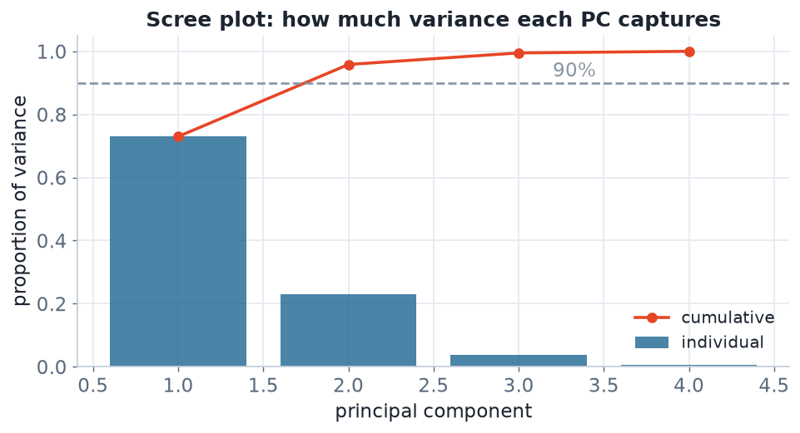
THE SCREE PLOT
Variance captured per component
Bars = variance per PC; the line = cumulative. Look for the 'elbow' and/or the point where the cumulative curve crosses a threshold (e.g. 90%).
STAT3888 · Statistical Machine Learning
L08 · 13

Slide 16
RULES OF THUMB
Choosing the number of PCs
Rule | Keep components…
Cumulative variance | until you reach e.g. 80–90% explained
Scree / elbow | before the curve flattens
Kaiser criterion | with eigenvalue > 1 (on standardised data)
Interpretability | as many as you can meaningfully name
STAT3888 · Statistical Machine Learning
L08 · 14

Slide 17
JUDGEMENT
No single correct answer
▸ For visualisation, you usually keep just 2–3
▸ For preprocessing, keep enough to retain most variance (say 90%)
▸ Rules of thumb disagree — use them together, then decide
▸ Document your choice and its variance retained
STAT3888 · Statistical Machine Learning
L08 · 15

Slide 18
CHECK YOUR UNDERSTANDING
Your first two PCs explain 55% and 25% of variance. Cumulative for PC1–PC2 is…
A
25%
B
55%
C
80% ✓
D
30%
Why: Cumulative variance adds them: 55% + 25% = 80% retained by the first two components.
STAT3888 · Statistical Machine Learning
L08 · 16

Slide 19
PART 3
The biplot

Slide 20
DEFINITION
Biplot
A biplot overlays observation scores (points) and variable loadings (arrows) on the same PC1–PC2 axes.
▸ Arrow direction shows how a variable aligns with the PCs
▸ Arrows pointing the same way = positively correlated variables
▸ Points far along an arrow score high on that variable
STAT3888 · Statistical Machine Learning
L08 · 17

Slide 21
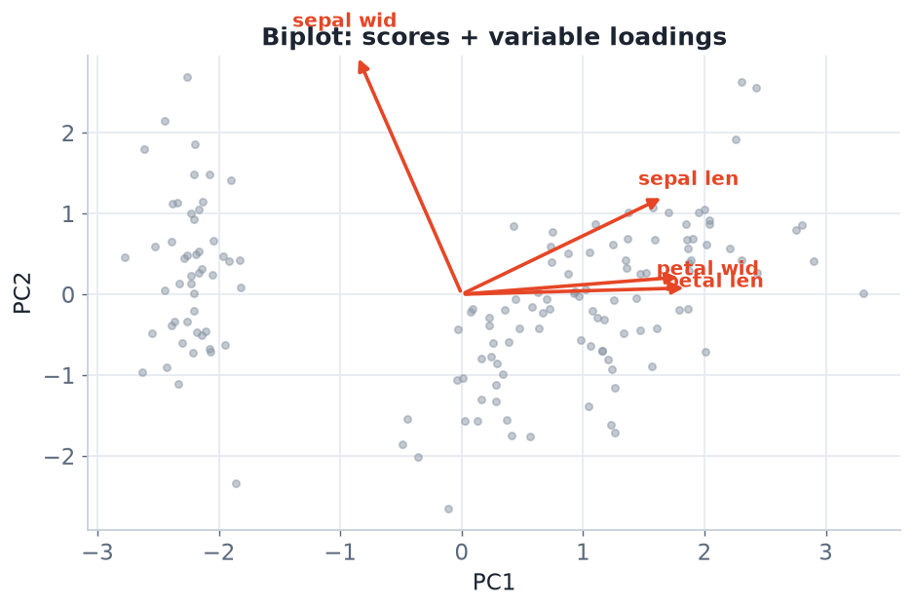
TWO VIEWS AT ONCE
The biplot
Petal-length and petal-width arrows point together (correlated) and drive PC1; observations spread along them.
STAT3888 · Statistical Machine Learning
L08 · 18

Slide 22
READING A BIPLOT
What to look for
1
Arrow length
longer = better represented in this 2-D view
2
Arrow angle
small angle between arrows = correlated variables
3
Right angle
≈ uncorrelated variables
4
Point position
where an observation sits relative to the arrows
STAT3888 · Statistical Machine Learning
L08 · 19

Slide 23
BIPLOT CAUTIONS
Read with care
▸ The biplot only shows the first two PCs — variance beyond them is hidden
▸ Short arrows are poorly represented — don't over-interpret them
▸ Always report how much variance PC1 & PC2 capture on the axes
STAT3888 · Statistical Machine Learning
L08 · 20

Slide 24
PART 4
PCA as compression

Slide 25
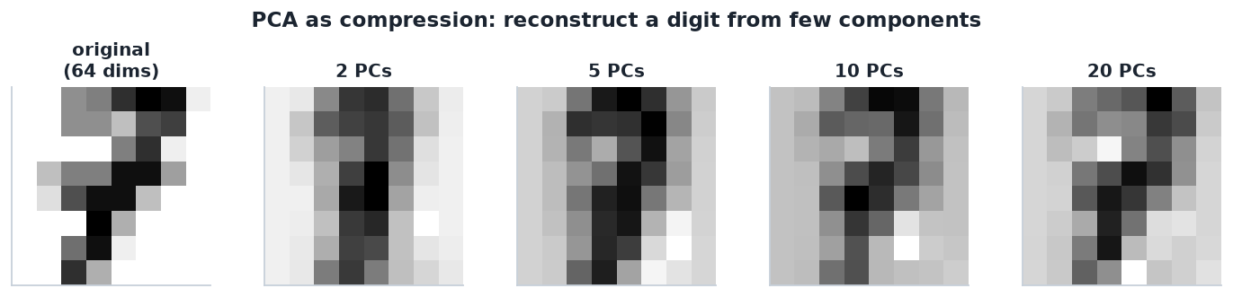
RECONSTRUCTION
Rebuilding data from a few PCs
A handwritten digit reconstructed from 2, 5, 10, 20 principal components. A fraction of the 64 dimensions recovers most of the image.
STAT3888 · Statistical Machine Learning
L08 · 21

Slide 26
COMPRESSION & DENOISING
Two practical superpowers
▸ Compression — store scores on a few PCs instead of all variables
▸ Denoising — low-variance PCs often capture noise; dropping them cleans data
▸ Preprocessing — feed PCs into clustering or classification to fight collinearity
▸ Reconstruction error shrinks as you keep more PCs
STAT3888 · Statistical Machine Learning
L08 · 22

Slide 27
ELEGANT DUALITY
The same eigen-decomposition that maximises retained variance also minimises reconstruction error.
Keeping the top PCs is the best possible linear compression of your data.

Slide 28
PART 5
PCA in R

Slide 29
FITTING
prcomp is all you need
# ALWAYS standardise unless variables share meaningful units
pca <- prcomp(diet_numeric, center = TRUE, scale. = TRUE)
summary(pca) # proportion & cumulative variance
pca$rotation # loadings (variables x PCs)
pca$x # scores (observations x PCs)
STAT3888 · Statistical Machine Learning
L08 · 24

Slide 30
VISUALISING
Scree, scores and biplot
library(factoextra)
fviz_eig(pca) # scree plot
fviz_pca_ind(pca, col.ind = group)# score plot, coloured
fviz_pca_biplot(pca) # biplot
get_eigenvalue(pca) # eigenvalues & % variance
STAT3888 · Statistical Machine Learning
L08 · 25

Slide 31
WORKFLOW
Using PCs downstream
▸ Fit PCA on the training data; apply the same rotation to test data (`predict`)
▸ Keep the PCs that reach your variance target
▸ Cluster or classify on the scores, not the raw variables
▸ Interpret results back through the loadings
STAT3888 · Statistical Machine Learning
L08 · 26

Slide 32
WORKED EXAMPLE
PCA on the nutrition data
▸ Standardise ~30 intake variables; run prcomp
▸ Scree shows PC1–PC4 capture ~85% of variance
▸ Loadings: PC1 = 'overall intake', PC2 = 'plant vs animal' contrast
▸ Plot participants on PC1–PC2; overlay a health outcome by colour
▸ Feed the 4 PCs into clustering for cleaner dietary patterns
STAT3888 · Statistical Machine Learning
L08 · 27

Slide 33
PART 6
Pitfalls & limitations

Slide 34
PITFALL 1
Forgetting to standardise
▸ Raw PCA lets the biggest-scale variable dominate PC1
▸ Nearly always set scale. = TRUE for mixed-unit data
STAT3888 · Statistical Machine Learning
L08 · 28

Slide 35
PITFALL 2
Over-interpreting components
▸ PCs are mathematical constructs; not every one has a tidy meaning
▸ Sign is arbitrary — a PC and its negative are the same component
▸ Low-variance PCs are often noise — don't chase stories in them
STAT3888 · Statistical Machine Learning
L08 · 29

Slide 36
PITFALL 3
Assuming linearity
▸ PCA captures linear structure only
▸ Curved / manifold structure needs t-SNE or UMAP (next lecture)
▸ PCA is also sensitive to outliers — clean first
STAT3888 · Statistical Machine Learning
L08 · 30

Slide 37
CHECK YOUR UNDERSTANDING
PC1 explains 5% of the variance in your data. This suggests…
A
PC1 is very important
B
The variables are largely uncorrelated — little to compress ✓
C
You must keep only PC1
D
The data is noise-free
Why: If even the top component captures little variance, no single direction dominates — the variables are nearly uncorrelated and PCA won't compress much.
STAT3888 · Statistical Machine Learning
L08 · 31

Slide 38
IN-CLASS EXERCISE
Run and read a PCA
1. Run prcomp(scale = TRUE) on the nutrition variables. How many PCs reach 90% variance?
2. Examine PC1's loadings — which variables dominate, and what would you name it?
3. Plot PC1 vs PC2 scores coloured by a health group. Do groups separate?
4. Compare clustering on the PC scores vs the raw variables — any difference?
Hint. summary(pca) gives cumulative variance; pca$rotation[,1] holds PC1's loadings.
STAT3888 · Statistical Machine Learning
L08 · 32

Slide 39
IN-CLASS EXERCISE
Interpret a biplot
1. In a biplot, two variable arrows point in nearly the same direction. What does that imply?
2. A third arrow is at right angles to them. What does that imply?
3. An observation sits far out along the first two arrows. Describe its profile.
4. Why should you check the % variance on the axes before trusting the picture?
Hint. Small angle → correlated; right angle → uncorrelated; position along an arrow → high on that variable.
STAT3888 · Statistical Machine Learning
L08 · 33

Slide 40
BEYOND PCA
A look ahead
▸ t-SNE / UMAP — non-linear reduction for visualisation (Lecture 9)
▸ Factor analysis — models shared latent factors, not just variance
▸ Kernel PCA — PCA in a transformed space for non-linear structure
▸ PCA remains the first tool to reach for — fast, linear, interpretable
STAT3888 · Statistical Machine Learning
L08 · 34

Slide 41
KEY IDEAS RECAP
Hold onto these
▸ Loadings define PCs; scores place observations on them
▸ Choose the number of PCs with the scree plot and variance retained
▸ The biplot shows variables and observations together
▸ PCA = best linear compression; always standardise first
STAT3888 · Statistical Machine Learning
L08 · 35

Slide 42
PART 7
Related methods & a full case study

Slide 43
PCA VS FACTOR ANALYSIS
Close cousins, different goals
PCA
Factor analysis
• Maximises variance explained
• Components are exact linear combos
• Descriptive / compression focus
• No underlying model of the data
• Models shared latent factors + noise
• Aims to explain correlations
• Assumes a generative model
• Common in psychology / surveys
STAT3888 · Statistical Machine Learning
L08 · 36

Slide 44
DEFINITION
Component rotation (varimax)
Rotation re-orients retained components to make loadings closer to 0 or ±1, so each PC loads on fewer variables and is easier to name.
▸ Trades the max-variance property for interpretability
▸ Varimax is the most common rotation
▸ Popular when the goal is naming interpretable indices
STAT3888 · Statistical Machine Learning
L08 · 37

Slide 45
PCA HELPS CLUSTERING
Why they pair so well
▸ Clustering in high dimensions is unreliable (curse of dimensionality)
▸ Reduce to a handful of PCs first, then cluster on scores
▸ Removes correlated redundancy and much of the noise
▸ Standard recipe: standardise → PCA → k-means/GMM
STAT3888 · Statistical Machine Learning
L08 · 38

Slide 46
EIGENFACES & IMAGES
PCA in the wild
▸ Treat each image as a long vector of pixels
▸ PCA on many faces yields 'eigenfaces' — the main directions of variation
▸ Any face ≈ average + a few eigenface scores → strong compression
▸ The exact idea behind the digit reconstruction we just saw
STAT3888 · Statistical Machine Learning
L08 · 39

Slide 47
DEFINITION
Reproducibility of PCA
To reproduce a PCA you must record the centring/scaling, the number of PCs, and apply the training rotation to any new data.
▸ Never re-fit PCA separately on test data — that leaks and shifts axes
▸ Use `predict(pca, newdata)` to project new observations
▸ Report % variance retained alongside every PCA figure
STAT3888 · Statistical Machine Learning
L08 · 40

Slide 48
CASE STUDY
Nutrition data: 32 intake variables → 5 principal components capturing 88% of variation.
From an unwieldy wide table to five interpretable dietary indices you can plot, cluster and model.

Slide 49
CASE STUDY WORKFLOW
PCA end-to-end on the project data
1
Clean & standardise
impute, z-score all 32 intake variables
2
Fit PCA
prcomp(scale.=TRUE); inspect the scree plot
3
Keep 5 PCs
they reach 88% cumulative variance
4
Name them
PC1 'overall intake', PC2 'plant vs animal', PC3 'sugar load'…
5
Use downstream
cluster on scores; regress health outcome on PCs
STAT3888 · Statistical Machine Learning
L08 · 42

Slide 50
CASE STUDY OUTPUT
Interpreting the retained components
PC | % variance | Dominant loadings → name
PC1 | 41% | all intakes + → 'overall intake'
PC2 | 19% | veg/fruit + vs meat − → 'plant vs animal'
PC3 | 13% | sugar, refined carbs → 'sugar load'
PC4 | 9% | dairy, calcium → 'dairy'
PC5 | 6% | alcohol → 'alcohol'
STAT3888 · Statistical Machine Learning
L08 · 43

Slide 51
REPORTING PCA
What a good write-up includes
▸ A scree plot and the variance retained by your chosen PCs
▸ A loadings table/heatmap with your interpretation of each PC
▸ A score (or bi-) plot coloured by a meaningful grouping
▸ A sentence on standardisation and how many PCs you kept and why
STAT3888 · Statistical Machine Learning
L08 · 44

Slide 52
CHECK YOUR UNDERSTANDING
You standardised, ran PCA on training data, and now have test data. You should…
A
Re-run prcomp on the test data
B
Project test data with the training rotation (predict) ✓
C
Skip PCA on test data
D
Average the two PCAs
Why: Apply the *training* PCA to test data via predict() so both live in the same coordinate system — re-fitting would change the axes and leak information.
STAT3888 · Statistical Machine Learning
L08 · 45

Slide 53
WHEN PCA IS THE WRONG TOOL
Know its limits
PCA struggles when
Reach instead for
• Structure is non-linear / curved
• You care about rare low-variance signals
• Variables are categorical
• Outliers dominate the variance
• t-SNE / UMAP (non-linear viz)
• Supervised methods for prediction
• MCA for categorical data
• Robust PCA with outliers
STAT3888 · Statistical Machine Learning
L08 · 46

Slide 54
IN-CLASS EXERCISE
Design a PCA analysis
1. Your team has 40 metabolite variables and wants to visualise participant structure.
2. Write the full pipeline from raw data to a 2-D score plot (name each step).
3. State how you'll decide the number of PCs and how you'll interpret PC1.
4. How will you check the 2-D picture isn't hiding important variation?
Hint. Clean → standardise → prcomp → scree → keep PCs → scores plot; check cumulative variance of PC1–PC2.
STAT3888 · Statistical Machine Learning
L08 · 47

Slide 55
EXAM POINTERS
What tends to be tested
▸ Distinguish scores vs loadings
▸ Read a scree plot and compute cumulative variance
▸ Interpret a biplot (angles, lengths, positions)
▸ Explain why standardise and what eigenvalues mean
STAT3888 · Statistical Machine Learning
L08 · 48

Slide 56
CHECK YOUR UNDERSTANDING
Which pair correctly matches PCA outputs to their meaning?
A
Scores = variable weights; loadings = observation coordinates
B
Scores = observation coordinates; loadings = variable weights ✓
C
Both describe variables
D
Both describe observations
Why: Scores place each observation on the PCs; loadings are the variable weights that define each PC.
STAT3888 · Statistical Machine Learning
L08 · 49

Slide 57
CHEAT-SHEET
PCA in R, one screen
▸ Fit: `prcomp(X, scale. = TRUE)`
▸ Variance: `summary()` or `get_eigenvalue()`
▸ Loadings: `pca$rotation` · Scores: `pca$x`
▸ Plots: `fviz_eig`, `fviz_pca_ind`, `fviz_pca_biplot`
▸ New data: `predict(pca, newdata)`
STAT3888 · Statistical Machine Learning
L08 · 50

Slide 58
THE BRIDGE TO WEEK 3'S END
You can now take wide, correlated nutrition data and compress it into a few meaningful axes — ready to visualise, cluster, or model.
Next we handle structure PCA can't: non-linear, curved patterns.

Slide 59
FURTHER READING
To go deeper
▸ James et al., *An Introduction to Statistical Learning*, Ch. 12
▸ Hastie et al., *The Elements of Statistical Learning*, §14.5
▸ R: the factoextra and FactoMineR vignettes
STAT3888 · Statistical Machine Learning
L08 · 52

Slide 60
SUMMARY
Key takeaways
✓ PCA turns correlated variables into a few uncorrelated components ranked by variance.
✓ Loadings tell you what each PC means; scores re-express the observations.
✓ Use the scree plot and cumulative variance to choose how many PCs to keep.
✓ PCA is the best linear compression — powerful for visualisation, denoising and preprocessing.
Next lecture → Lecture 09 — Dimension reduction beyond PCA: MDS, t-SNE and when to use them.
STAT3888 · Statistical Machine Learning
L08 · 53

