Slide 1
LECTURE 01
Introduction to Statistical Machine Learning
What machine learning is, the two big families of methods, the analysis workflow, and the interdisciplinary nutrition project you will tackle this semester.
School of Mathematics & Statistics · The University of Sydney

Slide 2
PART 1
Welcome & orientation

Slide 3
AGENDA
What we will cover today
▸ What statistical machine learning is — and is not
▸ Supervised vs unsupervised learning
▸ Regression vs classification; the model 'zoo'
▸ The end-to-end data-analysis workflow
▸ Overfitting and why we hold out test data
▸ Tools: R, the tidyverse and tidymodels
▸ The NUTM3888 joint project, teams and assessment
▸ How to succeed in this unit
STAT3888 · Statistical Machine Learning
L01 · 2

Slide 4
ORIENTATION
The shape of the unit
▸ 13 weeks: Weeks 1–3 unsupervised learning, Weeks 4–7 supervised learning, Weeks 8–13 project work
▸ Three 1-hour lectures + a tutorial/computer lab + a 2-hour workshop each week
▸ Assessment is dominated by a team project on a real nutrition data set (65%) plus a final exam (35%)
▸ Coordinator: John Ormerod — questions on the Ed forum or in consultation
– Prerequisite thinking: probability, linear algebra, regression, and R
STAT3888 · Statistical Machine Learning
L01 · 3

Slide 5
PART 2
What is statistical machine learning?

Slide 6
DEFINITIONS
Machine learning in one sentence
▸ Machine learning builds algorithms that learn patterns from data to predict or discover structure — without being explicitly programmed for the task
▸ Statistical ML keeps the statistician's questions in view: uncertainty, assumptions, and whether the pattern is real or noise
▸ Contrast with classical statistics:
– Classical statistics asks *'is this effect real?'* → inference
– Machine learning asks *'how well can I predict the next case?'* → prediction
▸ This unit lives deliberately at their intersection
STAT3888 · Statistical Machine Learning
L01 · 4

Slide 7
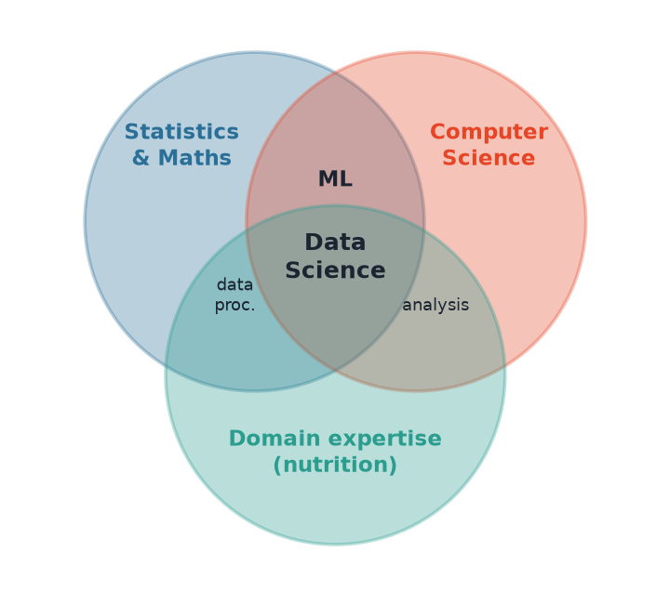
THE FIELD
Data science = statistics + computing + domain
Why it matters
• ML sits where statistics meets computer science
• Data science adds the third circle: domain knowledge
• Your project literally builds this Venn diagram: you supply the stats/CS, Nutrition students supply the domain
• The hardest problems live in the overlaps
STAT3888 · Statistical Machine Learning
L01 · 5

Slide 8
TWO CULTURES
Statistics vs machine learning: a false dichotomy
Data-modelling culture
Algorithmic culture
• Assume a stochastic model generated the data
• Estimate parameters, test hypotheses
• Prize interpretability and inference
• e.g. linear & logistic regression
• Treat the mechanism as unknown
• Optimise predictive accuracy directly
• Prize flexibility and performance
• e.g. random forests, neural nets
STAT3888 · Statistical Machine Learning
L01 · 6

Slide 9
BREIMAN (2001)
The 'two cultures' — and why you need both
▸ Leo Breiman warned that statisticians ignoring algorithmic models were missing powerful tools
▸ But pure prediction with no model understanding is dangerous in health and nutrition
▸ Good data scientists move fluidly between both — predict well, *and* explain why
▸ In this unit you learn interpretable methods (regression, LDA, trees) and flexible ones (forests, SVMs, neural nets)
STAT3888 · Statistical Machine Learning
L01 · 7

Slide 10
PART 3
The two families of learning

Slide 11
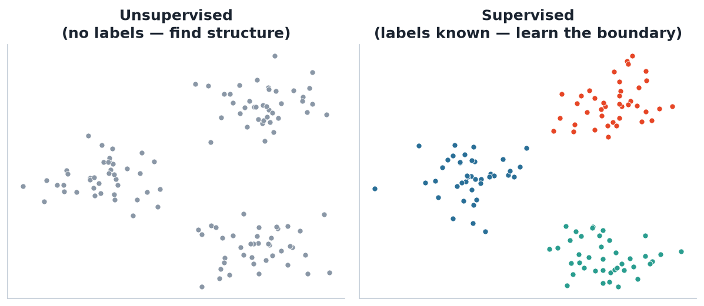
SUPERVISED VS UNSUPERVISED
The single most important distinction
How to tell them apart
• Ask: is there a target variable Y?
• Yes → supervised learning
• No → unsupervised learning
• If Y is a number → regression
• If Y is a category → classification
Left: unsupervised — only the points, find the groups. Right: supervised — every point carries a known label, learn the rule.
STAT3888 · Statistical Machine Learning
L01 · 8

Slide 12
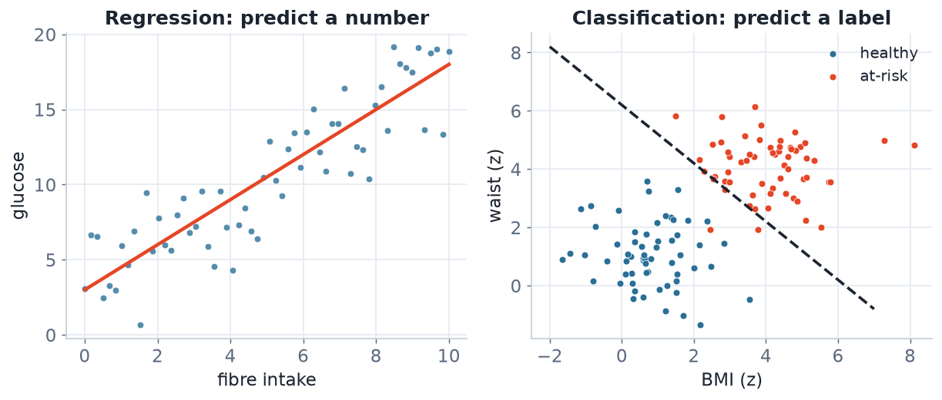
SUPERVISED SUB-TYPES
Regression vs classification
Regression predicts a continuous outcome; classification predicts a discrete label. Same framework, different loss.
STAT3888 · Statistical Machine Learning
L01 · 9

Slide 13
EXAMPLES
The same tools, many nutrition questions
Question | Y variable | Task
Predict fasting glucose from diet | glucose (mg/dL) | Regression
Is this participant at metabolic risk? | risk / no-risk | Classification
Group people into dietary patterns | none | Clustering
Summarise 200 nutrients into a few indices | none | Dimension reduction
Flag implausible food-diary entries | valid / error | Classification
STAT3888 · Statistical Machine Learning
L01 · 10

Slide 14
UNSUPERVISED
What can you do without labels?
▸ Clustering — partition observations into groups (Weeks 1–2)
▸ Dimension reduction — compress many correlated variables (PCA, Week 3)
▸ Graphical models — map which variables are conditionally related (Week 12)
▸ These are exploratory: they generate hypotheses you then test
– Crucial when labelling is expensive — which is almost always in health data
STAT3888 · Statistical Machine Learning
L01 · 11

Slide 15
PART 4
The machine-learning workflow

Slide 16
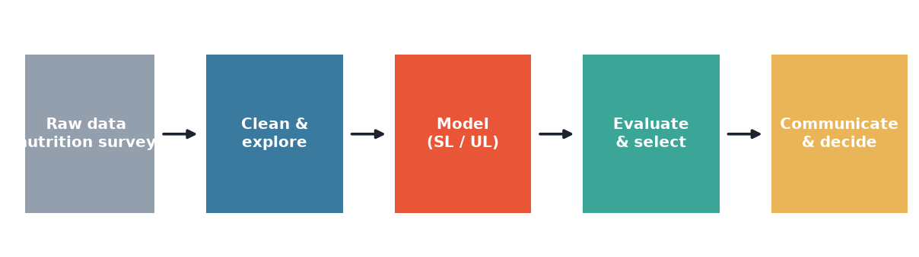
THE LOOP
Every project follows this cycle
Real projects iterate — insights at 'evaluate' send you back to 'clean' or 're-model'.
STAT3888 · Statistical Machine Learning
L01 · 12

Slide 17
STEPS
The workflow, stage by stage
▸ Define the question with your domain partner — narrow and answerable
▸ Clean & explore — the unglamorous 80% (Lecture 2)
▸ Model — pick methods suited to the question and data
▸ Evaluate & select — honest performance on unseen data
▸ Communicate — a decision-maker must understand and trust the result
▸ Iterate: the loop rarely runs cleanly once
STAT3888 · Statistical Machine Learning
L01 · 13

Slide 18
GENERALISATION
The one idea that separates ML from curve-fitting
▸ We do not care how well a model fits the data it was trained on
▸ We care how well it predicts new, unseen cases — generalisation
▸ So we split data: train the model on one part, test it on another
▸ A model that memorises training data but fails on test data is overfitting
– Cross-validation (Lecture 10) makes this estimate reliable
STAT3888 · Statistical Machine Learning
L01 · 14

Slide 19
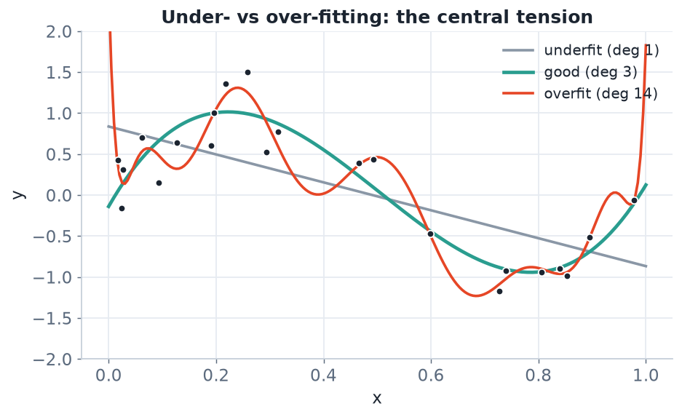
THE CENTRAL TENSION
Underfitting vs overfitting
Too simple (grey) misses the signal; too complex (red) chases the noise. The goal is the sweet spot (teal) — the bias–variance trade-off.
STAT3888 · Statistical Machine Learning
L01 · 15

Slide 20
THE MODEL ZOO
No single method wins everywhere ('no free lunch')
Unsupervised (Wks 1–3) | Supervised (Wks 4–7)
k-means, GMM, hierarchical clustering | Logistic & penalised regression
Principal component analysis | Discriminant analysis, k-NN
Dimension reduction (MDS, t-SNE) | Trees, random forests, boosting
Graphical / log-linear models | Neural networks, support vector machines
For every method ask the same three questions: what does it assume, how is it fit, and how do we know it worked?
STAT3888 · Statistical Machine Learning
L01 · 16

Slide 21
PART 5
Tools & the project

Slide 22
TOOLS
You will work in R
# Core stack for this unit
library(tidyverse) # data wrangling & ggplot2
library(tidymodels) # modelling workflows, resampling
library(cluster) # silhouette, PAM
library(factoextra) # visualising clusters & PCA
# A first taste: read, peek, plot
diet <- read_csv("nutrition.csv")
glimpse(diet)
ggplot(diet, aes(fibre, glucose)) + geom_point()
R + the tidyverse is the lingua franca of applied statistics at USYD.
STAT3888 · Statistical Machine Learning
L01 · 17

Slide 23
THE PROJECT
The joint project with NUTM3888
What it is
Why it matters
• Teams of Statistics/Data Science + Nutrition students
• A real nutrition & metabolomics data set
• Answer a genuine question using statistical ML
• Runs Weeks 3–13
• Interdisciplinary practice (graduate quality GQ7)
• You bring the methods; they bring the question
• Neither discipline succeeds alone
• Mirrors real data-science teams
STAT3888 · Statistical Machine Learning
L01 · 18

Slide 24
THE DATA
What the nutrition data looks like
▸ Participants (rows) measured on dietary intake, anthropometrics and metabolites (columns)
▸ Wide and correlated — many nutrients move together → dimension reduction shines
▸ Messy — missing values, implausible entries, mixed units → cleaning matters
▸ Both unsupervised (find dietary patterns) and supervised (predict a health outcome) questions are natural
STAT3888 · Statistical Machine Learning
L01 · 19

Slide 25
ASSESSMENT
How you are graded
Component | Weight | Due
Final written exam | 35% | Exam period
Disciplinary assignment (individual) | 15% | Week 11
Major project — presentation | 15% | Week 12
Major project — manuscript | 25% | Week 13
Contribution / reflection / peer review | 10% | Week 13
Project pitch (Wk 6) and optional quiz (Wk 9) are worth 0% but are essential rehearsals — take them seriously.
STAT3888 · Statistical Machine Learning
L01 · 20

Slide 26
LEARNING OUTCOMES
What you should be able to do by Week 13
▸ Apply statistics & data science to an interdisciplinary (nutrition) problem
▸ Formulate, apply, interpret and compare statistical ML methods
▸ Judge model appropriateness and evaluation procedures
▸ Collaborate across cultural and disciplinary boundaries
▸ Communicate findings to a broad audience
STAT3888 · Statistical Machine Learning
L01 · 21

Slide 27
IN-CLASS EXERCISE
Warm-up: name that task
1. Predict a person's fasting glucose from 30 dietary-intake variables.
2. Group 500 participants into dietary patterns with no pre-defined labels.
3. Flag whether a food-diary entry is plausible or a data-entry error.
4. Compress 200 correlated nutrient measurements into a handful of indices.
5. For each: supervised or unsupervised? If supervised, regression or classification?
Hint. First ask whether there is a target Y; then ask if Y is numeric or categorical.
STAT3888 · Statistical Machine Learning
L01 · 22

Slide 28
HOW TO SUCCEED
Advice from previous cohorts
▸ Start the project early — cleaning always takes longer than you think
▸ Communicate weekly with your Nutrition teammates
▸ Version-control your code and write it to be re-run, not re-typed
▸ Ask on Ed — if you're stuck, others are too
▸ Understand methods, don't just call functions — the exam tests this
STAT3888 · Statistical Machine Learning
L01 · 23

Slide 29
PART 6
Data, roles & a little history

Slide 30
DEFINITION
Statistical machine learning
A set of methods that use data and probability to learn predictive or descriptive models, with explicit attention to uncertainty and generalisation.
▸ 'Statistical' = we quantify uncertainty and assumptions
▸ 'Machine learning' = the algorithm improves with data
▸ The blend is exactly what employers and researchers need
STAT3888 · Statistical Machine Learning
L01 · 24

Slide 31
A LITTLE HISTORY
How we got here
▸ 1900s–50s — regression, Fisher's discriminant, the foundations of statistics
▸ 1960s–80s — perceptrons, decision trees, early neural networks
▸ 1990s–2000s — SVMs, boosting, random forests; the statistical-learning synthesis
▸ 2010s–now — deep learning, big data, and ML everywhere
STAT3888 · Statistical Machine Learning
L01 · 25

Slide 32
TYPES OF DATA
Know what you're working with
Kind | Example (nutrition) | Note
Continuous | energy (kJ), BMI | most ML assumes this
Count | servings per day | often skewed
Categorical | sex, food group | encode as factors
Ordinal | Likert 1–5 | order matters
Text / other | free-text notes | needs special handling
STAT3888 · Statistical Machine Learning
L01 · 26

Slide 33
THE TEAM
Roles in a data-science project
You may play
Your partners bring
• Data engineer — clean & wrangle
• Analyst / modeller — fit & compare
• Communicator — explain results
• Domain framing — the real question
• Interpretation — is it plausible?
• Impact — what to do about it
STAT3888 · Statistical Machine Learning
L01 · 27

Slide 34
CHECK YOUR UNDERSTANDING
A variable records 'breakfast: yes/no'. What kind is it?
A
Continuous
B
Ordinal
C
Nominal categorical ✓
D
Count
Why: Yes/no is a two-level nominal (unordered) category — encode it as a factor / dummy.
STAT3888 · Statistical Machine Learning
L01 · 28

Slide 35
PART 7
Generalisation, ethics & tools

Slide 36
DEFINITION
Overfitting
Overfitting is when a model captures noise specific to the training data and so predicts new data poorly.
▸ Symptom: great training accuracy, poor test accuracy
▸ Cause: too much flexibility for too little data
▸ Cure: simpler models, regularisation, cross-validation
STAT3888 · Statistical Machine Learning
L01 · 29

Slide 37
TRAIN / VALIDATE / TEST
The three-way split
▸ Training set — fit the model
▸ Validation set — tune settings and compare models
▸ Test set — a final, untouched estimate of real-world performance
▸ Cross-validation reuses data cleverly to do this reliably (Lecture 10)
STAT3888 · Statistical Machine Learning
L01 · 30

Slide 38
GOLDEN RULE
Never let information from the test set influence training — that is data leakage, and it makes results a lie.
This single principle underlies honest machine learning.

Slide 39
USING AI RESPONSIBLY
This unit's policy
▸ Generative AI is allowed for open assessments (project, assignment)
▸ It is prohibited in the supervised final exam
▸ You must always acknowledge AI use — undisclosed use breaches academic integrity
▸ Use it to learn and draft, not to replace understanding
STAT3888 · Statistical Machine Learning
L01 · 32

Slide 40
ETHICS IN NUTRITION ML
Think before you model
▸ Health data is sensitive — privacy and consent matter
▸ Biased data → biased conclusions that can harm real people
▸ A model that predicts well can still be unfair or uninterpretable
▸ Always ask: *should* we, not just *can* we
STAT3888 · Statistical Machine Learning
L01 · 33

Slide 41
YOUR TOOLKIT
The R commands you'll live in
library(tidyverse) # wrangle & visualise
read_csv('diet.csv') |> glimpse() # load & peek
diet |> summarise(across(where(is.numeric), mean, na.rm=TRUE))
diet |> ggplot(aes(fibre, glucose)) + geom_point() + geom_smooth()
library(tidymodels) # split, model, resample, evaluate
STAT3888 · Statistical Machine Learning
L01 · 34

Slide 42
CHECK YOUR UNDERSTANDING
A model scores 99% on training data but 62% on test data. This is a classic sign of…
A
Underfitting
B
Overfitting ✓
C
Data leakage in the test set
D
A perfect model
Why: A large train-minus-test gap is the signature of overfitting: the model memorised training noise that doesn't generalise.
STAT3888 · Statistical Machine Learning
L01 · 35

Slide 43
PART 8
The project, up close

Slide 44
PROJECT TIMELINE
How the semester unfolds
1
Weeks 1–3
learn unsupervised methods; choose a research topic
2
Weeks 4–7
learn supervised methods; form teams, draft the pitch
3
Week 6–7
project pitch for early feedback (0% but vital)
4
Weeks 8–12
analysis, manuscript, presentation
5
Week 13
submit manuscript, reflection & peer review
STAT3888 · Statistical Machine Learning
L01 · 36

Slide 45
WHAT MAKES A GOOD QUESTION
Framing the project
▸ Specific — 'which dietary pattern predicts insulin resistance?' beats 'study diet'
▸ Answerable with the data you have
▸ Interesting to your nutrition partners
▸ Matched to a method you're learning
STAT3888 · Statistical Machine Learning
L01 · 37

Slide 46
TEAMWORK
Working across disciplines
Do
Avoid
• Meet weekly; keep minutes
• Agree on roles early
• Explain your stats plainly
• Version-control shared code
• Siloing 'stats' vs 'nutrition'
• Last-minute integration
• Jargon without translation
• One person doing everything
STAT3888 · Statistical Machine Learning
L01 · 38

Slide 47
COMMUNICATING RESULTS
The skill that gets you hired
▸ Lead with the answer, not the method
▸ One clear figure beats a table of p-values
▸ State uncertainty honestly
▸ Tailor depth to the audience (GQ3, GQ7)
STAT3888 · Statistical Machine Learning
L01 · 39

Slide 48
IN-CLASS EXERCISE
Frame a project question
1. Pick a plausible nutrition outcome (e.g. fasting glucose, BMI category).
2. Write a specific, answerable question about it.
3. Decide: is it supervised or unsupervised? Which method from the syllabus fits?
4. What would a convincing result figure look like?
Hint. If there's a target Y it's supervised; match numeric Y → regression, categorical Y → classification.
STAT3888 · Statistical Machine Learning
L01 · 40

Slide 49
GLOSSARY
Words we'll use all semester
▸ Feature / predictor — an input variable (a column)
▸ Label / target — the output we predict (supervised only)
▸ Model — the fitted rule mapping inputs to outputs
▸ Generalisation — performance on unseen data
STAT3888 · Statistical Machine Learning
L01 · 41

Slide 50
CHECK YOUR UNDERSTANDING
Which best describes the goal of this unit's major project?
A
Get the highest training accuracy
B
Apply ML to answer a real nutrition question and communicate it ✓
C
Use as many methods as possible
D
Avoid using R
Why: The project is about applying appropriate methods to a genuine interdisciplinary question and communicating the findings — not maximising a metric.
STAT3888 · Statistical Machine Learning
L01 · 42

Slide 51
PART 9
The bigger picture

Slide 52
A KEY TRADE-OFF
Interpretability vs flexibility
Interpretable models
Flexible models
• Linear & logistic regression, trees
• Easy to explain why
• Preferred in health & policy
• May underfit complex patterns
• Random forests, SVMs, neural nets
• Often more accurate
• Harder to explain ('black box')
• Risk overfitting without care
STAT3888 · Statistical Machine Learning
L01 · 43

Slide 53
CHOOSE DELIBERATELY
More complex is not automatically better — the right model balances accuracy, interpretability, data size and the question.
In nutrition, being able to *explain* a finding often matters as much as predicting it.

Slide 54
MORE EXAMPLES: UNSUPERVISED
Spot the structure task
▸ Grouping foods by nutrient profile → clustering
▸ Summarising 40 metabolites into a few axes → dimension reduction
▸ Mapping which nutrients are conditionally related → graphical models
▸ Finding unusual food diaries → anomaly detection
STAT3888 · Statistical Machine Learning
L01 · 45

Slide 55
MORE EXAMPLES: SUPERVISED
Spot the prediction task
▸ Predict body-fat % from intake → regression
▸ Classify diabetic / not → classification
▸ Rank features driving an outcome → interpretable models
▸ Forecast weight change over time → regression
STAT3888 · Statistical Machine Learning
L01 · 46

Slide 56
CHECK YOUR UNDERSTANDING
Grouping foods purely by their nutrient profiles, with no labels, is…
A
Regression
B
Classification
C
Clustering ✓
D
Feature engineering
Why: No target variable + finding groups = clustering, an unsupervised task.
STAT3888 · Statistical Machine Learning
L01 · 47

Slide 57
WHERE TO GET HELP
Support in this unit
▸ Ed forum — post questions (anonymously if you prefer)
▸ Tutorials & computer labs — hands-on practice
▸ Consultation — the lecturer's office hours
▸ Always include your name and SID in emails
STAT3888 · Statistical Machine Learning
L01 · 48

Slide 58
ASSESSMENT, UP CLOSE
Turning weights into a plan
▸ The project (65%) is where most marks live — start early
▸ The exam (35%) tests conceptual understanding, not coding
▸ 0%-weighted pitch & quiz are your safety rehearsals
▸ Individual contribution is assessed — pull your weight
STAT3888 · Statistical Machine Learning
L01 · 49

Slide 59
EXAM SUCCESS
How to prepare from Week 1
▸ For each method learn: assumptions, fitting, evaluation
▸ Practise interpreting output, not just producing it
▸ Redo tutorial questions without the solutions
▸ Explain each concept aloud as if teaching it
STAT3888 · Statistical Machine Learning
L01 · 50

Slide 60
WELCOME ABOARD
By Week 13 you'll take messy nutrition data and turn it into a clear, defensible, machine-learning-driven answer.
That is exactly what a professional data scientist does. Let's begin.

Slide 61
SUMMARY
Key takeaways
✓ ML learns patterns from data; statistical ML keeps uncertainty and assumptions in view.
✓ Supervised = labelled Y (regression/classification); unsupervised = structure discovery.
✓ We optimise generalisation to unseen data, not fit — beware overfitting.
✓ The workflow is an iterative loop, and your project is fundamentally interdisciplinary.
Next lecture → Lecture 02 — Data cleaning: the unglamorous 80% of every project.
STAT3888 · Statistical Machine Learning
L01 · 52

