Slide 1
LECTURE 02
Data Cleaning & Preprocessing
Garbage in, garbage out. How to turn a messy nutrition survey into a trustworthy, analysis-ready data matrix — reproducibly.
School of Mathematics & Statistics · The University of Sydney

Slide 2
AGENDA
Today's roadmap
▸ Why cleaning dominates real projects
▸ Tidy data and variable types
▸ Missing data: mechanisms and remedies
▸ Outliers and robust sanity checks
▸ Transformations: scaling, logs, encoding
▸ A reproducible cleaning pipeline in R
▸ Data leakage — the silent killer
STAT3888 · Statistical Machine Learning
L02 · 2

Slide 3
PART 1
Why cleaning matters

Slide 4
REALITY
Real data is never tidy
▸ Surveys and lab instruments produce typos, impossible values, mixed units
▸ Duplicate rows, free text where numbers belong, and gaps everywhere
▸ Data scientists routinely spend ~80% of their time cleaning and preparing data
▸ It is unglamorous — but a brilliant model on dirty data is worthless
STAT3888 · Statistical Machine Learning
L02 · 3

Slide 5
PRINCIPLES
Two commitments before you touch the data
Tidy data
Reproducibility
• Each row = one observation
• Each column = one variable
• Each cell = one value
• This shape makes every downstream tool 'just work'
• Never edit the raw file by hand
• Every fix lives in a script
• So it can be re-run, reviewed and trusted (GQ4)
• Keep raw data read-only
STAT3888 · Statistical Machine Learning
L02 · 4

Slide 6
TYPES
Know your variable types — they dictate the treatment
Type | Example | Typical handling
Continuous numeric | energy (kJ), BMI | scale, maybe log-transform
Count | servings of veg | often log(x+1)
Nominal categorical | sex, food group | factor → dummy variables
Ordinal categorical | Likert 1–5 | ordered factor / integer score
Date / time | survey date | parse to Date, derive features
Free text | 'other, please specify' | recode or set aside
STAT3888 · Statistical Machine Learning
L02 · 5

Slide 7
PART 2
Missing data

Slide 8
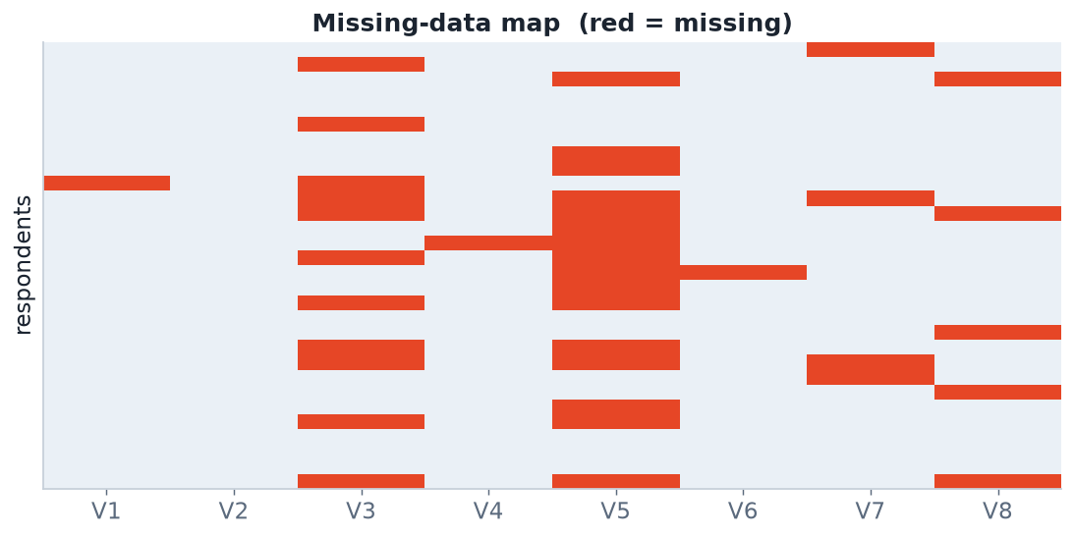
DIAGNOSE FIRST
Visualise the pattern of missingness
Always start here
• Count missing per variable and per row
• Look for blocks and stripes — they reveal structure
• Structured missingness is often informative
• Tools: `naniar::vis_miss()`, `visdat::vis_dat()`
A missing-data map. Variable V5 has a structured block (skip-logic?), while others are scattered — the pattern is a clue to the mechanism.
STAT3888 · Statistical Machine Learning
L02 · 6

Slide 9
MECHANISMS
Why is it missing? Rubin's three mechanisms
MCAR / MAR
MNAR — the dangerous one
• MCAR — missing completely at random; benign but rare
• MAR — missingness depends on observed variables
• MAR is handleable by conditioning on what you see
• Missingness depends on the unobserved value itself
• e.g. heavy eaters under-report intake
• Cannot be fixed by imputation alone
• Must be reasoned about with domain experts
STAT3888 · Statistical Machine Learning
L02 · 7

Slide 10
REMEDIES
What to do about missing values
Strategy | When appropriate | Risk
Complete-case (drop rows) | few missing, MCAR | bias + lost power if not MCAR
Mean / median imputation | quick baseline | shrinks variance, distorts correlation
kNN / model-based imputation | MAR | needs care, can leak
Multiple imputation (`mice`) | principled inference | more complex
Golden rule: fit imputation on the training data only, then apply the same rule to test data — otherwise you leak information.
STAT3888 · Statistical Machine Learning
L02 · 8

Slide 11
IN R
Exploring and imputing missingness
library(naniar); library(mice)
# 1. See it
vis_miss(diet)
gg_miss_var(diet) # missing count per variable
# 2. Simple median imputation (baseline)
diet <- diet %>% mutate(fibre = ifelse(is.na(fibre),
median(fibre, na.rm = TRUE), fibre))
# 3. Principled: multiple imputation
imp <- mice(diet, m = 5, method = 'pmm', seed = 1)
STAT3888 · Statistical Machine Learning
L02 · 9

Slide 12
PART 3
Outliers & errors

Slide 13
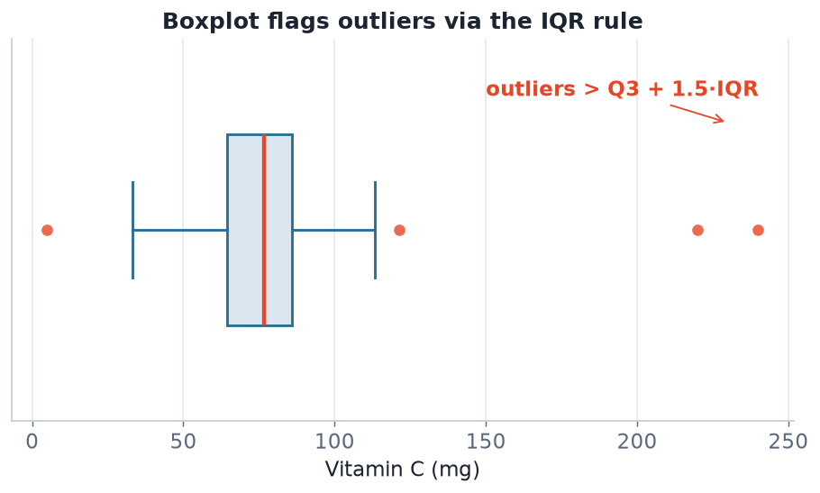
DETECTION
Boxplots and the IQR rule
Robust statistics
• Use median & IQR, not mean & SD
• The mean is itself dragged by outliers
• MAD (median abs. deviation) is a robust spread
• Then investigate — don't blindly delete
The 1.5×IQR rule flags points far from the middle 50%. Robust to the very outliers it is trying to find.
STAT3888 · Statistical Machine Learning
L02 · 10

Slide 14
JUDGEMENT
An outlier is not automatically an error
▸ Range checks: energy of 80,000 kJ/day? age of 200? negative weight? → flag
▸ Logic checks: pregnant + male? end date before start date? → flag
▸ A genuine extreme may be the most interesting participant in the study
▸ Document every point you remove and why — reproducibly
– When unsure, run the analysis with and without and report both
STAT3888 · Statistical Machine Learning
L02 · 11

Slide 15
PART 4
Transformations

Slide 16
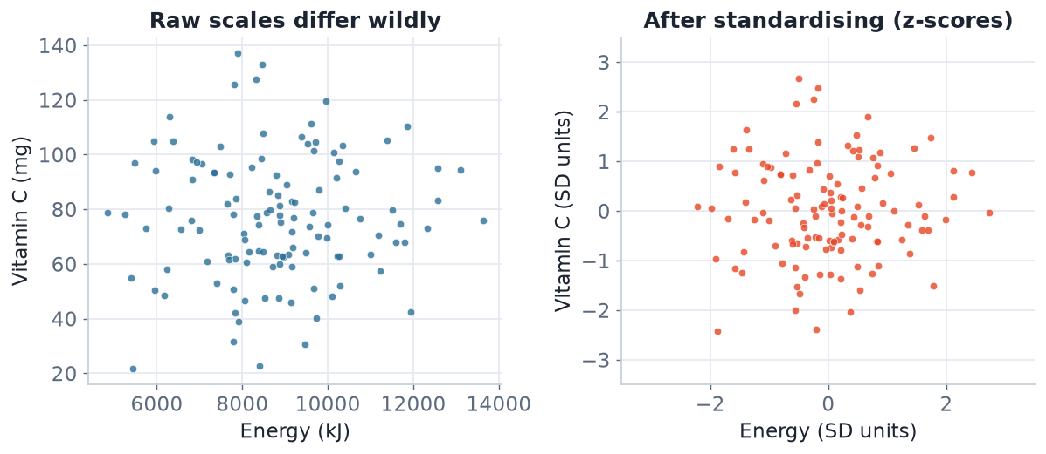
SCALING
Put variables on comparable scales
Why it matters
• k-means, PCA, k-NN, SVM all use distances
• Unscaled, energy would swamp vitamin C
• Standardising gives every variable equal footing
• Fit the scaler on training data only
Energy (kJ) and Vitamin C (mg) live on wildly different scales. Distance-based methods are dominated by the big-number variable until you standardise.
STAT3888 · Statistical Machine Learning
L02 · 12

Slide 17
STANDARDISATION
The z-score
zᵢ = ( xᵢ − x̄ ) / s
• Subtract the mean x̄, divide by the standard deviation s
• Result has mean 0, standard deviation 1 for every variable
• In R: `scale(x)`; in tidymodels: `step_normalize()`
Alternatives: min–max scaling to [0,1] (`step_range`), or robust scaling using the median and IQR when outliers remain.
STAT3888 · Statistical Machine Learning
L02 · 13

Slide 18
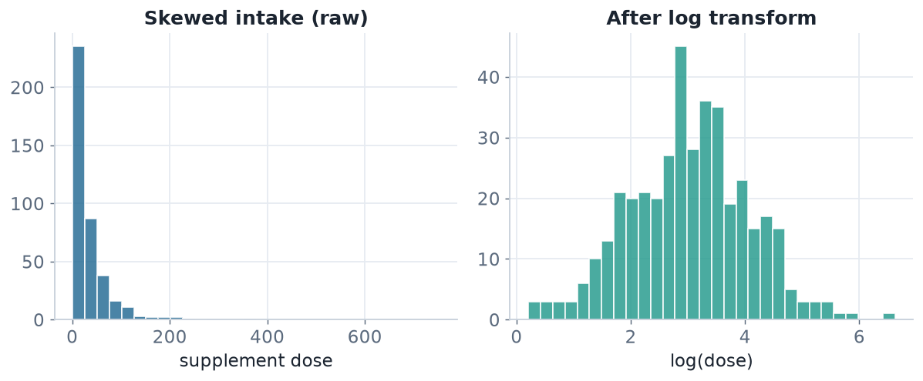
SKEW
Log-transform heavy-tailed variables
Nutrient and supplement intakes are often right-skewed. A log transform tames the tail and stabilises variance.
STAT3888 · Statistical Machine Learning
L02 · 14

Slide 19
CATEGORICALS
Encoding non-numeric variables
▸ Nominal (sex, food group) → dummy / one-hot variables (`step_dummy`)
▸ Ordinal (Likert) → keep the order (ordered factor or integer score)
▸ Beware high-cardinality categories (e.g. 'food name') — group rare levels
▸ Trim whitespace and standardise case: `"F "`, `"f"`, `"Female"` are one level
STAT3888 · Statistical Machine Learning
L02 · 15

Slide 20
PART 5
Putting it together

Slide 21
PIPELINE
A reproducible cleaning pipeline
library(tidyverse)
clean <- raw %>%
janitor::clean_names() %>% # tidy column names
distinct() %>% # drop duplicate rows
mutate(sex = factor(str_trim(sex)),
energy_kj = na_if(energy_kj, 0)) %>% # 0 = not recorded
filter(between(age, 18, 100), # logic checks
veg_serves >= 0) %>%
mutate(across(where(is.numeric), # standardise numerics
~ as.numeric(scale(.))))
skimr::skim(clean) # profile the cleaned result
Chain each fix with %>% so the whole pipeline is one auditable object.
STAT3888 · Statistical Machine Learning
L02 · 16

Slide 22
LEAKAGE
Data leakage — the silent killer
▸ Leakage = using information at training time that won't be available at prediction time
▸ Classic mistake: standardise or impute using the whole data set, then split
▸ The test set 'sees' the training statistics → optimistic, dishonest performance
▸ Fix: split first, then fit every transform inside a recipe on the training fold
– tidymodels' `recipe()` + `workflow()` enforce this automatically
STAT3888 · Statistical Machine Learning
L02 · 17

Slide 23
IN-CLASS EXERCISE
Clean this record
1. A dietary record reads: age = 24, sex = "F ", energy_kj = 0, veg_serves = −1, vitc_mg = 4200, height_cm = 168.
2. Identify three data-quality problems.
3. For each, state whether it is likely an error or a genuine extreme, and how you'd confirm.
4. Write the mutate()/filter() lines that would handle them.
Hint. Whitespace in a factor, a structural zero, an impossible negative, and an implausible vitamin C value (RDI ≈ 45 mg).
STAT3888 · Statistical Machine Learning
L02 · 18

Slide 24
PART 6
Duplicates, joins & structural checks

Slide 25
DUPLICATES
More common than you'd think
▸ Exact duplicates — the same row entered twice (drop with `distinct()`)
▸ Near duplicates — same person, tiny differences (needs a key to detect)
▸ A hidden duplicate doubles a participant's weight in every analysis
▸ Always check row counts before and after de-duplication
STAT3888 · Statistical Machine Learning
L02 · 19

Slide 26
DEFINITION
Primary key
A primary key is a column (or set) that uniquely identifies each row — e.g. a participant ID.
▸ Verify it's truly unique: `n_distinct(id) == nrow(data)`
▸ Keys let you safely join datasets (intake + labs)
▸ A duplicated key is a red flag to investigate
STAT3888 · Statistical Machine Learning
L02 · 20

Slide 27
JOINING
Combining survey and lab tables
combined <- intake %>%
inner_join(labs, by = 'participant_id') # keep matched rows
# Sanity-check the join
nrow(intake); nrow(labs); nrow(combined) # did rows explode or vanish?
combined %>% count(participant_id) %>% filter(n > 1) # duplicates?
A careless join can silently multiply or drop rows — always check counts.
STAT3888 · Statistical Machine Learning
L02 · 21

Slide 28
CHECK YOUR UNDERSTANDING
After an inner_join, your row count is HIGHER than either input table. Most likely…
A
The join worked perfectly
B
The join key is duplicated in one table ✓
C
You lost data
D
R is broken
Why: A one-to-many match on a non-unique key multiplies rows. Verify the key is unique before joining.
STAT3888 · Statistical Machine Learning
L02 · 22

Slide 29
PART 7
Feature engineering

Slide 30
DEFINITION
Feature engineering
Feature engineering creates new, more informative variables from the raw data using domain knowledge.
▸ Often more impactful than the choice of model
▸ Encodes what experts know into the data
▸ Do it reproducibly, inside your pipeline
STAT3888 · Statistical Machine Learning
L02 · 23

Slide 31
EXAMPLES
Useful features for nutrition data
▸ Ratios — protein-to-energy, sodium-to-potassium
▸ Indices — a diet-quality score from several intakes
▸ Derived categories — BMI bands from height & weight
▸ Per-kg intakes — normalise by body weight
STAT3888 · Statistical Machine Learning
L02 · 24

Slide 32
GOOD VS RISKY
Feature engineering judgement
Good features
Watch out
• Grounded in domain knowledge
• Reduce noise or redundancy
• Interpretable to your partners
• Features built using the outcome → leakage
• Too many features → overfitting
• Opaque transforms → hard to explain
STAT3888 · Statistical Machine Learning
L02 · 25

Slide 33
ENCODING REVISITED
Turning categories into numbers
▸ One-hot / dummy — one 0/1 column per category level
▸ Ordinal — integer scores when order is meaningful
▸ Frequency / target encoding — powerful but leakage-prone; use with care
▸ Group rare levels into 'other' to avoid tiny, noisy dummies
STAT3888 · Statistical Machine Learning
L02 · 26

Slide 34
PART 8
EDA & a reproducible mindset

Slide 35
DEFINITION
Exploratory data analysis (EDA)
EDA is the open-ended visual and numerical exploration of data to understand its structure before modelling.
▸ Histograms, boxplots, scatterplots, correlation heatmaps
▸ Reveals errors, skew, outliers and relationships
▸ Every project should start here
STAT3888 · Statistical Machine Learning
L02 · 27

Slide 36
EDA TOOLKIT
First looks in R
skimr::skim(diet) # per-variable summary
diet %>% ggplot(aes(energy_kj)) + geom_histogram()
diet %>% ggplot(aes(sex, bmi)) + geom_boxplot()
diet %>% select(where(is.numeric)) %>% cor(use='pairwise') %>%
corrplot::corrplot() # correlation heatmap
STAT3888 · Statistical Machine Learning
L02 · 28

Slide 37
WHAT EDA REVEALS
Reading your plots
▸ Skew → consider a log transform
▸ Bimodality → possible subgroups (foreshadows clustering!)
▸ Strong correlations → redundancy (foreshadows PCA!)
▸ Isolated points → outliers to investigate
STAT3888 · Statistical Machine Learning
L02 · 29

Slide 38
THE CLEANING MINDSET
Treat data cleaning as a documented, re-runnable pipeline — not a one-off cleanup you can't reproduce.
If you can't re-run it from raw data with one command, it isn't reproducible.

Slide 39
CLEANING CHECKLIST
A repeatable order of operations
1
Load raw (read-only)
never overwrite the original file
2
Fix structure
tidy names, types, de-duplicate, join
3
Handle missing
diagnose mechanism, then impute or drop
4
Handle outliers
detect robustly, investigate, document
5
Transform
scale, log, encode — inside a training-only recipe
STAT3888 · Statistical Machine Learning
L02 · 31

Slide 40
CHECK YOUR UNDERSTANDING
Which step must happen AFTER the train/test split to avoid leakage?
A
Fixing column names
B
De-duplicating rows
C
Fitting the standardisation scaler ✓
D
Parsing dates
Why: Scaling uses statistics (mean, SD) that must be learned from training data only, then applied to test data — so it comes after the split.
STAT3888 · Statistical Machine Learning
L02 · 32

Slide 41
IN-CLASS EXERCISE
Design a cleaning pipeline
1. You receive a raw nutrition survey (CSV) plus a separate lab-results table.
2. List, in order, the cleaning steps you'd apply from raw files to a modelling-ready table.
3. Mark which steps must go after the train/test split, and why.
4. Name the R functions you'd use at each step.
Hint. Structural fixes and de-duplication can precede the split; imputation and scaling should be fit on training data only.
STAT3888 · Statistical Machine Learning
L02 · 33

Slide 42
COMMON MISTAKES RECAP
Avoid these
▸ Editing the raw file by hand
▸ Imputing / scaling before splitting → leakage
▸ Deleting outliers without investigating
▸ Ignoring duplicates and non-unique keys
STAT3888 · Statistical Machine Learning
L02 · 34

Slide 43
PART 9
Missing data, deeper

Slide 44
WHY THE MECHANISM MATTERS
Consequences of getting it wrong
▸ Assuming MCAR when it's MNAR biases every estimate
▸ Under-reported high intakes (MNAR) make the diet look healthier than it is
▸ You can test for MCAR (e.g. Little's test) but never fully rule out MNAR
▸ Domain knowledge is essential — ask *why* is it missing?
STAT3888 · Statistical Machine Learning
L02 · 35

Slide 45
DEFINITION
Multiple imputation
Multiple imputation fills each gap several times to reflect uncertainty, analyses each completed dataset, then pools the results.
▸ Single imputation pretends we know the missing value — MI doesn't
▸ `mice` is the standard R implementation
▸ Pooling propagates imputation uncertainty into your estimates
STAT3888 · Statistical Machine Learning
L02 · 36

Slide 46
MULTIPLE IMPUTATION
The mice workflow
library(mice)
imp <- mice(diet, m = 5, method = 'pmm', seed = 1) # 5 imputations
fits <- with(imp, lm(glucose ~ fibre + energy_kj)) # analyse each
pool(fits) # combine results
STAT3888 · Statistical Machine Learning
L02 · 37

Slide 47
DECISION GUIDE
Choosing a missing-data strategy
% missing | Mechanism | Suggested approach
< 5% | MCAR | complete-case or simple imputation
5–30% | MAR | multiple imputation (mice)
> 30% | any | consider dropping the variable
any | MNAR | model the mechanism; consult domain experts
STAT3888 · Statistical Machine Learning
L02 · 38

Slide 48
CHECK YOUR UNDERSTANDING
Heavy eaters systematically under-report intake, so their high values are missing. This is…
A
MCAR
B
MAR
C
MNAR ✓
D
Not missing data
Why: Missingness depends on the unobserved value itself (the true high intake) — that is MNAR, the hardest case.
STAT3888 · Statistical Machine Learning
L02 · 39

Slide 49
PART 10
Scaling, dates & text

Slide 50
SCALING METHODS
Beyond the z-score
Method | Formula idea | Use when
Standardise (z) | (x − mean) / SD | roughly symmetric data
Min–max | (x − min)/(max − min) | need a [0,1] range
Robust | (x − median)/IQR | outliers remain
Log | log(x) or log(x+1) | right-skewed / multiplicative
STAT3888 · Statistical Machine Learning
L02 · 40

Slide 51
DATES & TIMES
A common source of pain
▸ Parse strings to real Date/POSIXct objects (`lubridate`)
▸ Derive features: day of week, month, season, time since baseline
▸ Watch for timezones and inconsistent formats
▸ Impossible dates (end before start) are logic-check flags
STAT3888 · Statistical Machine Learning
L02 · 41

Slide 52
FREE TEXT
When numbers hide in words
▸ '2 cups', 'a handful', '~200g' — inconsistent units to reconcile
▸ Standardise case and whitespace; map synonyms to one label
▸ Recode common responses; set genuinely free text aside
▸ Document every recoding decision
STAT3888 · Statistical Machine Learning
L02 · 42

Slide 53
DEFINITION
Recipe (tidymodels)
A recipe is a reusable specification of preprocessing steps that is *fit on training data* and applied identically to new data.
▸ Prevents leakage by design — steps learn only from training folds
▸ Chains impute → scale → dummy → … in order
▸ Slots directly into a modelling `workflow()`
STAT3888 · Statistical Machine Learning
L02 · 43

Slide 54
A LEAKAGE-SAFE RECIPE
Preprocessing the right way
library(tidymodels)
split <- initial_split(diet, prop = 0.8, strata = outcome)
rec <- recipe(outcome ~ ., data = training(split)) %>%
step_impute_median(all_numeric_predictors()) %>%
step_normalize(all_numeric_predictors()) %>% # scale (train stats)
step_dummy(all_nominal_predictors())
# rec is fit on training data, then applied to test data automatically
STAT3888 · Statistical Machine Learning
L02 · 44

Slide 55
CHECK YOUR UNDERSTANDING
Why does putting scaling inside a tidymodels recipe prevent leakage?
A
It runs faster
B
The scaler learns statistics only from the training fold ✓
C
It removes outliers
D
It imputes automatically
Why: A recipe estimates its parameters (means, SDs) from training data only, then applies the same transform to test data — no test information leaks in.
STAT3888 · Statistical Machine Learning
L02 · 45

Slide 56
IN-CLASS EXERCISE
Fix a leaky pipeline
1. A colleague standardises the whole dataset, then splits into train/test and reports 95% accuracy.
2. Explain precisely where the leakage occurs.
3. Rewrite the workflow (in words or a recipe) so it's leakage-free.
4. Would you expect the honest accuracy to be higher or lower? Why?
Hint. Standardising before the split lets the test set's statistics influence training; honest accuracy is usually lower.
STAT3888 · Statistical Machine Learning
L02 · 46

Slide 57
CLEANING IS A FIRST-CLASS ANALYSIS
How you clean shapes every result that follows — it deserves the same rigor and documentation as your modelling.
A reproducible, leakage-free pipeline is the mark of a professional.

Slide 58
DOCUMENTING DECISIONS
Make your cleaning auditable
▸ Keep a data dictionary: what each variable is, its units and valid range
▸ Log every exclusion (how many rows, and why)
▸ Comment non-obvious recodings in the script
▸ Reviewers (and future-you) must be able to reconstruct the clean data
STAT3888 · Statistical Machine Learning
L02 · 48

Slide 59
FURTHER READING
To go deeper
▸ Wickham & Grolemund, *R for Data Science* — wrangling & tidy data
▸ van Buuren, *Flexible Imputation of Missing Data* (mice)
▸ The tidymodels and naniar package documentation
STAT3888 · Statistical Machine Learning
L02 · 49

Slide 60
SUMMARY
Key takeaways
✓ Cleaning is most of the work — do it in a script, never by hand.
✓ Diagnose missingness first; the mechanism (MCAR/MAR/MNAR) dictates the fix.
✓ Detect outliers with robust statistics, then investigate before deleting.
✓ Standardise before any distance-based method, and fit all transforms on training data only.
Next lecture → Lecture 03 — Unsupervised learning: introduction to clustering.
STAT3888 · Statistical Machine Learning
L02 · 50

