Slide 1
LECTURE 03
Unsupervised Learning: Introduction to Clustering
Finding groups in data when nobody gives you the labels — the ideas of distance, within/between variation, and the main families of methods.
School of Mathematics & Statistics · The University of Sydney

Slide 2
AGENDA
Today's roadmap
▸ The clustering problem and nutrition motivation
▸ Distance and dissimilarity measures
▸ What makes a clustering 'good': within vs between variation
▸ The families of clustering methods
▸ Validating and interpreting clusters
▸ Common pitfalls
STAT3888 · Statistical Machine Learning
L03 · 2

Slide 3
PART 1
The clustering problem

Slide 4
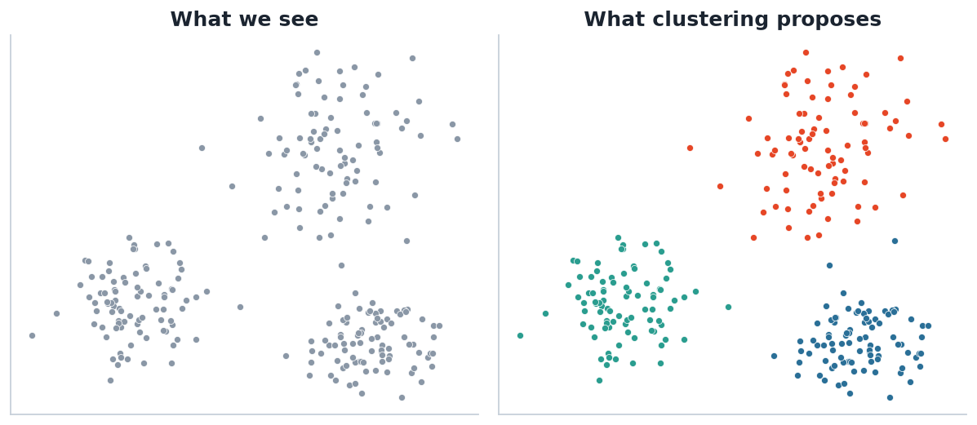
THE IDEA
From an unlabelled cloud to proposed groups
Clustering takes points with no labels (left) and proposes a partition (right). There is no 'true' answer to check against — it is exploratory.
STAT3888 · Statistical Machine Learning
L03 · 3

Slide 5
DEFINITION
What clustering is
▸ Clustering partitions observations into groups so that members of a group are similar, and different groups are dissimilar
▸ It is unsupervised: there is no target Y to predict or check against
▸ The goal is to discover and describe structure, then validate it
▸ Unlike classification, we don't know the groups in advance — or even how many
STAT3888 · Statistical Machine Learning
L03 · 4

Slide 6
MOTIVATION
Why cluster nutrition data?
Dietary patterns
Metabolic subtypes
• Instead of 50 nutrients one at a time…
• …group people into a few eating patterns
• e.g. 'prudent' vs 'Western' diets
• Simpler to study and communicate
• Cluster participants by metabolite profile
• Reveal subgroups that respond differently
• A powerful hypothesis generator
• Exactly the kind of project finding that impresses
STAT3888 · Statistical Machine Learning
L03 · 5

Slide 7
REMINDER
Clustering is discovery, not prediction
▸ Supervised learning learns a known label; clustering proposes labels
▸ Results are not unique — different methods and settings give different groupings
▸ So we must validate: are the clusters stable, separated, and biologically meaningful?
STAT3888 · Statistical Machine Learning
L03 · 6

Slide 8
PART 2
Distance — the heart of clustering

Slide 9
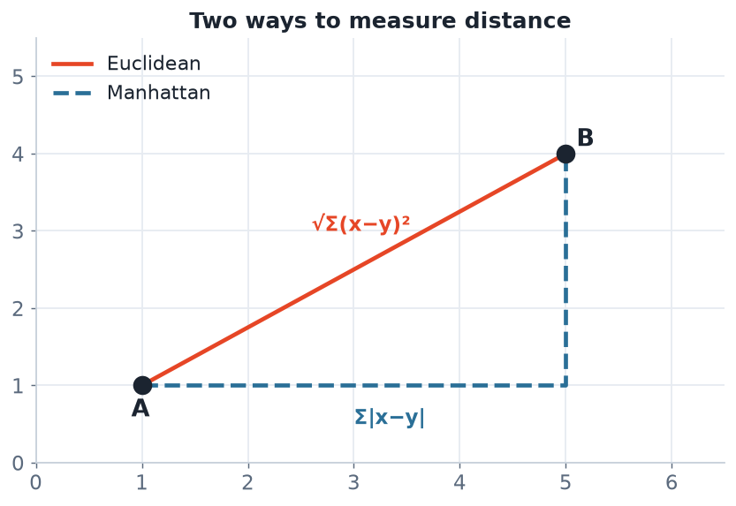
GEOMETRY
Two ways to measure how far apart points are
Key point
• Every algorithm needs a distance
• The choice is a modelling decision
• It defines the shape of your clusters
• Choose it deliberately, not by default
Euclidean distance is the straight line; Manhattan distance sums the coordinate-wise gaps. The metric encodes what you mean by 'similar'.
STAT3888 · Statistical Machine Learning
L03 · 7

Slide 10
EUCLIDEAN DISTANCE
The default metric
d(x, y) = √ Σⱼ ( xⱼ − yⱼ )²
• Straight-line distance in p-dimensional space
• Squared version underlies k-means (Lecture 4)
• Sensitive to scale — standardise first!
STAT3888 · Statistical Machine Learning
L03 · 8

Slide 11
CHOICES
Common distance / dissimilarity measures
Measure | Idea | Good for
Euclidean | straight-line | standardised continuous data
Manhattan | sum of |differences| | robust, high-dimensional
Correlation | shape, not magnitude | profiles (gene/metabolite)
Gower | mixed variable types | numeric + categorical mix
Jaccard | set overlap | presence/absence data
STAT3888 · Statistical Machine Learning
L03 · 9

Slide 12
SCALING
Why standardising is non-negotiable here
▸ Distance is dominated by large-scale variables
▸ Energy (~8000 kJ) vs vitamin C (~75 mg): energy's numbers are ~100× larger
▸ Without scaling, clustering effectively ignores vitamin C
▸ Standardise (z-scores) so every variable contributes fairly — recall Lecture 2
STAT3888 · Statistical Machine Learning
L03 · 10

Slide 13
PART 3
What makes a clustering good?

Slide 14
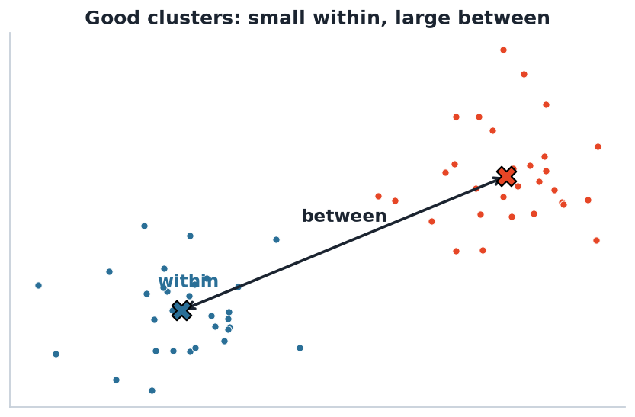
THE OBJECTIVE
Small within, large between
The trade-off
• Within: spread inside each cluster (minimise)
• Between: separation of clusters (maximise)
• Total variation = within + between
• Most algorithms drive within down
We want points close to their own cluster centre (small within-cluster variation) and centres far apart (large between-cluster variation).
STAT3888 · Statistical Machine Learning
L03 · 11

Slide 15
DECOMPOSITION
Total sum of squares splits cleanly
TSS = WSS + BSS
• WSS = within-cluster sum of squares (compactness)
• BSS = between-cluster sum of squares (separation)
• Minimising WSS ⇔ maximising BSS, since TSS is fixed
Adding clusters always lowers WSS — so WSS alone can't choose the number of clusters. We need principled criteria (Lecture 4).
STAT3888 · Statistical Machine Learning
L03 · 12

Slide 16
PART 4
Families of methods

Slide 17
OVERVIEW
Four ways to think about clusters
Family | Core idea | In this unit
Partitioning | split into k groups, minimise within-SS | k-means (L04)
Model-based | data from a mixture of distributions | GMM (L05)
Hierarchical | build a tree of nested groups | agglomerative (L06)
Density-based | clusters = dense regions | DBSCAN (mentioned)
STAT3888 · Statistical Machine Learning
L03 · 13

Slide 18
PARTITIONING
Partitioning methods (k-means, PAM)
▸ Choose k up front; each cluster summarised by a centroid or medoid
▸ Fast and scalable; assumes roughly spherical, equal-size clusters
▸ The workhorse — our entire next lecture
STAT3888 · Statistical Machine Learning
L03 · 14

Slide 19
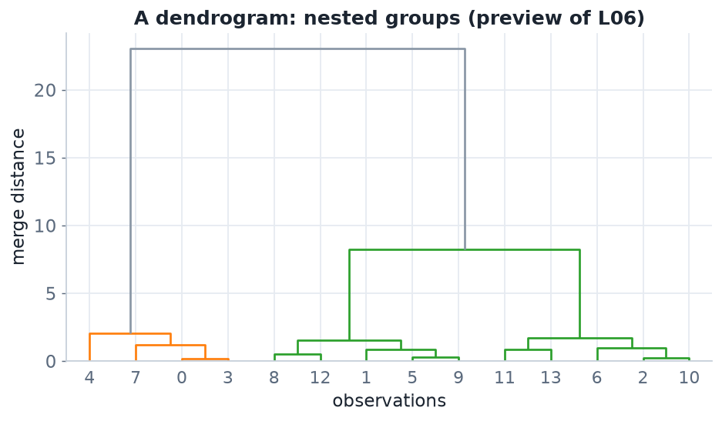
HIERARCHICAL
Hierarchical clustering builds a tree
A dendrogram shows nested groupings at every scale. Cut it at a chosen height to obtain a clustering. Full treatment in Lecture 6.
STAT3888 · Statistical Machine Learning
L03 · 15

Slide 20
MODEL-BASED & DENSITY
Two more families
▸ Model-based (GMM): assume data come from a mixture of Gaussians; gives soft (probabilistic) assignments and a principled way to choose k via the BIC — Lecture 5
▸ Density-based (DBSCAN): clusters are dense regions separated by sparse ones; finds arbitrary shapes and labels noise, but is sensitive to its distance threshold
STAT3888 · Statistical Machine Learning
L03 · 16

Slide 21
PART 5
Validation & pitfalls

Slide 22
VALIDATION
How do you know the clusters are real?
▸ Internal: silhouette width, within/between ratios — separation & compactness
▸ Stability: do clusters persist under resampling or small perturbations?
▸ External: do they align with a known variable you held out (e.g. a health outcome)?
▸ Domain: can your Nutrition partners give each cluster a meaningful name?
STAT3888 · Statistical Machine Learning
L03 · 17

Slide 23
PITFALLS
Where clustering goes wrong
▸ Forgetting to standardise → one variable dominates
▸ Reading meaning into clusters that are just noise — always validate
▸ Choosing a method whose shape assumptions don't match the data
▸ Reporting one k without justifying it
STAT3888 · Statistical Machine Learning
L03 · 18

Slide 24
PREVIEW
Clustering in R (next lecture goes deep)
# Standardise first!
X <- scale(diet_numeric)
d <- dist(X) # distance matrix
km <- kmeans(X, centers = 3, nstart = 25) # partitioning
hc <- hclust(d, method = 'ward.D2') # hierarchical
library(factoextra)
fviz_cluster(km, data = X) # visualise
STAT3888 · Statistical Machine Learning
L03 · 19

Slide 25
IN-CLASS EXERCISE
Reason about distance
1. Two participants have (energy kJ, vitamin C mg): A = (8000, 60), B = (8000, 120), C = (16000, 60).
2. Compute the Euclidean distance A–B and A–C on the raw scale.
3. Which pair looks 'closer'? Is that the answer you actually want?
4. Recompute after standardising (assume SD = 4000 kJ and 30 mg). What changes, and why?
Hint. Raw distances are dominated by energy because its numbers are ~100× larger than vitamin C's.
STAT3888 · Statistical Machine Learning
L03 · 20

Slide 26
PART 6
Distances, deeper

Slide 27
GENERALISING
The Minkowski distance
d(x,y) = ( Σⱼ |xⱼ − yⱼ|ᵖ )^(1/p)
• p = 2 → Euclidean (straight line)
• p = 1 → Manhattan (city-block, more robust)
• p → ∞ → Chebyshev (max coordinate difference)
One formula, a family of distances — the exponent p tunes how differences add up.
STAT3888 · Statistical Machine Learning
L03 · 21

Slide 28
DEFINITION
Dissimilarity vs similarity
A dissimilarity grows as objects differ (like a distance); a similarity grows as they resemble each other (like a correlation).
▸ Clustering usually works from dissimilarities
▸ Similarity s and dissimilarity d often relate by d = 1 − s
▸ Correlation-based clustering compares shapes, not magnitudes
STAT3888 · Statistical Machine Learning
L03 · 22

Slide 29
METRIC CHOICE
Match the distance to the data
Continuous data
Other data
• Euclidean (after standardising)
• Manhattan for robustness
• Correlation for profiles
• Gower for mixed types
• Jaccard for presence/absence
• Hamming for categorical strings
STAT3888 · Statistical Machine Learning
L03 · 23

Slide 30
CHECK YOUR UNDERSTANDING
You want to cluster metabolite **profiles** by shape, ignoring overall magnitude. Best distance?
A
Euclidean
B
Manhattan
C
Correlation-based ✓
D
Hamming
Why: Correlation-based dissimilarity compares the pattern/shape of profiles regardless of their absolute level.
STAT3888 · Statistical Machine Learning
L03 · 24

Slide 31
STANDARDISING, REVISITED
Why it's the #1 clustering mistake
▸ Distance-based methods are dominated by high-variance variables
▸ Energy (~thousands) vs vitamin C (~tens) → energy wins by default
▸ Standardising gives each variable an equal vote
▸ Occasionally you *want* to weight variables — do it deliberately
STAT3888 · Statistical Machine Learning
L03 · 25

Slide 32
PART 7
Validation & interpretation

Slide 33
DEFINITION
Silhouette width
The silhouette of a point compares its average distance to its own cluster (a) with the nearest other cluster (b): s = (b − a)/max(a,b).
▸ s near +1 → well clustered; near 0 → on a boundary; < 0 → misassigned
▸ Average silhouette scores a whole clustering
▸ A model-free way to compare different k
STAT3888 · Statistical Machine Learning
L03 · 26

Slide 34
VALIDATION TYPES
Three ways to judge clusters
Type | Question | Example
Internal | compact & separated? | silhouette, WSS/BSS
Stability | reproducible? | resampling, bootstrap
External | match known groups? | compare to held-out label
STAT3888 · Statistical Machine Learning
L03 · 27

Slide 35
INTERPRETING CLUSTERS
Turning groups into insight
▸ Profile each cluster by its variable means
▸ Name it in domain terms ('high-fibre, low-sugar')
▸ Check sizes — a tiny cluster may be outliers
▸ Relate to a held-out outcome to argue relevance
STAT3888 · Statistical Machine Learning
L03 · 28

Slide 36
CLUSTERS ARE HYPOTHESES
Clustering proposes structure; it does not prove it. Always validate statistically and biologically before you believe it.
A pattern in noise is still noise — the discipline is in the checking.

Slide 37
APPLICATIONS IN NUTRITION
Where clustering earns its keep
▸ Dietary patterns from intake surveys
▸ Metabolic subtypes from blood metabolites
▸ Food grouping by nutrient composition
▸ Participant segmentation for tailored advice
STAT3888 · Statistical Machine Learning
L03 · 30

Slide 38
CHECK YOUR UNDERSTANDING
A clustering has average silhouette 0.08. This suggests…
A
Excellent, well-separated clusters
B
Weak, overlapping structure ✓
C
Perfectly nested clusters
D
An error in the code
Why: Average silhouette near 0 means points sit close to the boundary between clusters — the structure is weak.
STAT3888 · Statistical Machine Learning
L03 · 31

Slide 39
IN-CLASS EXERCISE
Plan a clustering study
1. You have 30 standardised intake variables for 400 participants.
2. Which distance and which method family would you try first, and why?
3. How will you choose the number of clusters?
4. How will you convince a nutritionist the clusters are real, not noise?
Hint. Standardised continuous data → Euclidean + k-means/Ward; choose k by silhouette; validate with stability and a held-out outcome.
STAT3888 · Statistical Machine Learning
L03 · 32

Slide 40
LOOKING AHEAD
The methods to come
▸ k-means (next) — fast partitioning
▸ GMM — soft, probabilistic clusters
▸ Hierarchical — a tree at every scale
▸ Each makes different assumptions — choose to match your data
STAT3888 · Statistical Machine Learning
L03 · 33

Slide 41
PART 8
The method families in detail

Slide 42
DEFINITION
Density-based clustering (DBSCAN)
DBSCAN defines clusters as dense regions of points separated by sparser regions, and labels low-density points as noise.
▸ Finds arbitrary shapes — not just blobs
▸ Does not need k specified in advance
▸ Sensitive to its density parameters (eps, minPts)
STAT3888 · Statistical Machine Learning
L03 · 34

Slide 43
MORE FAMILIES
Beyond the big three
▸ Spectral clustering — cluster using a graph of similarities; great for complex shapes
▸ Fuzzy clustering — soft memberships, like a simple GMM
▸ Self-organising maps — neural-network-based clustering + visualisation
▸ The right family depends on cluster shape, size and density
STAT3888 · Statistical Machine Learning
L03 · 35

Slide 44
BIG PICTURE
Which family when?
Family | Needs k? | Shapes | Scales?
k-means | yes | round | very well
GMM | yes | elliptical | moderately
Hierarchical | no | any (linkage) | poorly (O(n²))
DBSCAN | no | arbitrary | well
STAT3888 · Statistical Machine Learning
L03 · 36

Slide 45
CHECK YOUR UNDERSTANDING
Your clusters are long, curved bands of varying density. Best first choice?
A
k-means
B
GMM with spherical covariance
C
DBSCAN or spectral clustering ✓
D
None can work
Why: Density-based (DBSCAN) and spectral methods handle arbitrary, curved shapes that centroid-based methods carve up incorrectly.
STAT3888 · Statistical Machine Learning
L03 · 37

Slide 46
CURSE OF DIMENSIONALITY
Clustering's hidden enemy
▸ In high dimensions, all points become nearly equidistant
▸ Distance-based clustering then loses its power to discriminate
▸ Reduce dimensions first (PCA — Lectures 7–8) or select features
▸ Fewer, informative variables often cluster better than many noisy ones
STAT3888 · Statistical Machine Learning
L03 · 38

Slide 47
DEFINITION
Clustering tendency
Clustering tendency asks whether the data has any cluster structure *at all* before you try to find clusters.
▸ The Hopkins statistic tests for it (≈0.5 means random)
▸ Any algorithm will *return* clusters — even from noise
▸ Check tendency so you don't chase phantom groups
STAT3888 · Statistical Machine Learning
L03 · 39

Slide 48
PART 9
A worked example & consolidation

Slide 49
BY HAND
Euclidean distance, two participants
d = √[ (8000−16000)² + (60−60)² ] = 8000
• On raw scales the energy gap of 8000 swamps everything
• Vitamin C contributes nothing to the distance here
• After standardising, both variables contribute on equal footing
This is the single most important practical lesson: standardise first.
STAT3888 · Statistical Machine Learning
L03 · 40

Slide 50
THE STANDARDISED VERSION
Same points, fair comparison
▸ Energy gap: 8000 kJ ÷ 4000 SD = 2 SD units
▸ Vitamin C gap: 0 mg ÷ 30 SD = 0 SD units
▸ Now compare with pairs that differ in vitamin C — they finally 'count'
▸ Standardising changed which points look closest
STAT3888 · Statistical Machine Learning
L03 · 41

Slide 51
DO & DON'T
Clustering hygiene
Do
Don't
• Standardise first
• Check clustering tendency
• Try several methods & k
• Validate and name clusters
• Cluster raw, unscaled data
• Trust one run blindly
• Over-interpret tiny clusters
• Confuse noise for structure
STAT3888 · Statistical Machine Learning
L03 · 42

Slide 52
CASE STUDY
Dietary patterns, end to end
▸ Standardise 30 intake variables for 400 participants
▸ Check the Hopkins statistic — is there structure?
▸ Run k-means and Ward; compare with the silhouette
▸ Profile & name the patterns; relate them to a health outcome
STAT3888 · Statistical Machine Learning
L03 · 43

Slide 53
CHECK YOUR UNDERSTANDING
Before clustering, the Hopkins statistic is ≈ 0.5. You should…
A
Proceed — strong clusters exist
B
Be cautious — the data may be essentially random ✓
C
Use more clusters
D
Standardise again
Why: A Hopkins statistic near 0.5 indicates the data is close to uniformly random — there may be little real cluster structure to find.
STAT3888 · Statistical Machine Learning
L03 · 44

Slide 54
IN-CLASS EXERCISE
Choose distance and method
1. For each scenario pick a distance and a method family, with a one-line justification:
2. (a) 400 participants, 25 standardised continuous intakes, expect round groups.
3. (b) Metabolite profiles where shape matters more than level.
4. (c) Data with curved, variable-density structure and unknown k.
Hint. (a) Euclidean + k-means; (b) correlation + hierarchical; (c) DBSCAN/spectral.
STAT3888 · Statistical Machine Learning
L03 · 45

Slide 55
KEY TERMS RECAP
Own this vocabulary
▸ Distance / dissimilarity — how far apart two objects are
▸ Within / between variation — compactness vs separation
▸ Silhouette — a validation score for clusterings
▸ Clustering tendency — is there structure at all?
STAT3888 · Statistical Machine Learning
L03 · 46

Slide 56
R PREVIEW
The clustering toolkit you'll use
X <- scale(diet_numeric) # standardise
get_clust_tendency(X, n = 50) # Hopkins statistic
fviz_nbclust(X, kmeans, method='silhouette')
km <- kmeans(X, 3, nstart = 25); hc <- hclust(dist(X), 'ward.D2')
STAT3888 · Statistical Machine Learning
L03 · 47

Slide 57
THE MINDSET
Clustering is a conversation with your data, not a button you press — you propose structure, then interrogate it.
Distance, method and validation are all your choices to justify.

Slide 58
CHECK YOUR UNDERSTANDING
What is the single most common practical mistake in distance-based clustering?
A
Using too many colours
B
Forgetting to standardise the variables ✓
C
Choosing k = 2
D
Using R
Why: Failing to standardise lets high-variance variables dominate the distance and hijack the entire clustering.
STAT3888 · Statistical Machine Learning
L03 · 49

Slide 59
FURTHER READING
To go deeper
▸ James et al., *An Introduction to Statistical Learning*, Ch. 12
▸ Hastie et al., *The Elements of Statistical Learning*, Ch. 14
▸ R: `factoextra`, `cluster` vignettes
STAT3888 · Statistical Machine Learning
L03 · 50

Slide 60
SUMMARY
Key takeaways
✓ Clustering finds groups without labels — exploratory and hypothesis-generating.
✓ A distance measure defines 'similar'; it is scale-sensitive, so standardise first.
✓ Good clusterings have small within, large between variation.
✓ Method families encode different shape assumptions — validate before you believe.
Next lecture → Lecture 04 — K-means clustering: the workhorse partitioning method.
STAT3888 · Statistical Machine Learning
L03 · 51

