Slide 1
LECTURE 04
K-means Clustering
The workhorse partitioning algorithm: its objective, Lloyd's algorithm, choosing the number of clusters, and the assumptions that make it succeed — or fail.
School of Mathematics & Statistics · The University of Sydney

Slide 2
AGENDA
Today's roadmap
▸ The k-means objective
▸ Lloyd's algorithm and why it converges
▸ Local optima and random restarts / k-means++
▸ Choosing k: elbow, silhouette, gap statistic
▸ Assumptions, failure modes and alternatives
▸ Running and interpreting k-means in R
STAT3888 · Statistical Machine Learning
L04 · 2

Slide 3
RECAP
Where we are
▸ Last lecture: clustering finds groups without labels using a distance
▸ Good clusterings minimise within-cluster variation
▸ k-means is the partitioning method that does exactly this with Euclidean distance
STAT3888 · Statistical Machine Learning
L04 · 3

Slide 4
PART 1
The objective

Slide 5
OBJECTIVE
Minimise within-cluster sum of squares
min Σₖ Σₓ∈Cₖ ‖ x − μₖ ‖²
• Partition n points into k clusters C₁,…,Cₖ
• Each cluster is summarised by its centroid μₖ (the mean)
• We want every point close to its own centroid
Searching all possible partitions is NP-hard — so we use a fast, greedy approximation: Lloyd's algorithm.
STAT3888 · Statistical Machine Learning
L04 · 4

Slide 6
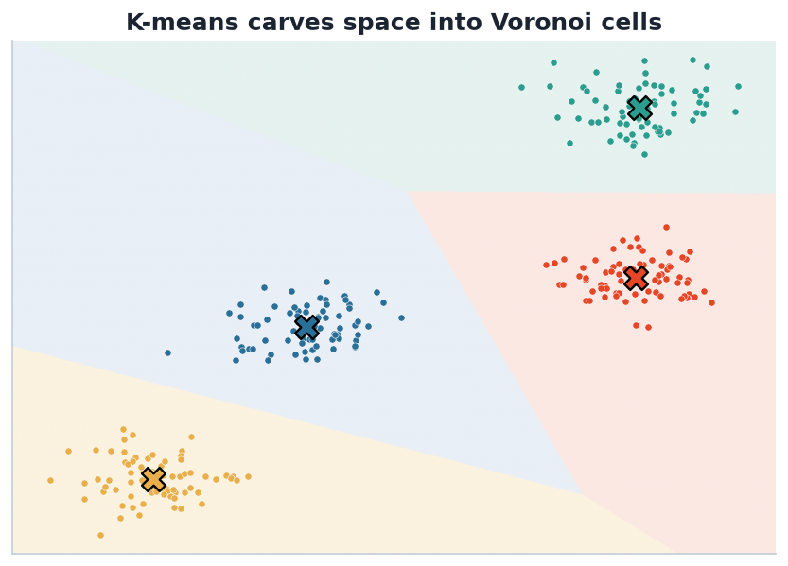
GEOMETRY
K-means carves space into Voronoi cells
Consequences
• Boundaries are linear
• Clusters are implicitly convex
• Works best for round, similar-size blobs
• We'll see where this breaks
Each point is assigned to the nearest centroid, so cluster boundaries are straight lines (Voronoi cells). This is a strong geometric assumption.
STAT3888 · Statistical Machine Learning
L04 · 5

Slide 7
PART 2
The algorithm

Slide 8
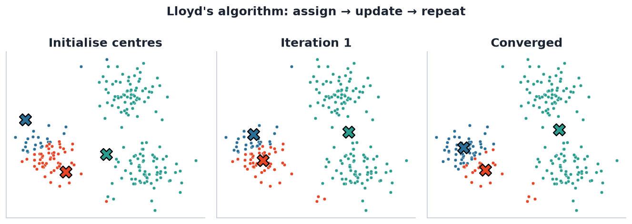
IN ACTION
Lloyd's algorithm: assign → update → repeat
Assign each point to the nearest centroid, then move each centroid to its points' mean; repeat. Here a poor start converged to a sub-optimal split — motivating restarts.
STAT3888 · Statistical Machine Learning
L04 · 6

Slide 9
STEPS
Lloyd's algorithm, step by step
▸ Input: data X, number of clusters k
▸ Initialise k centroids (randomly, or with k-means++)
– Assign each point to its nearest centroid
– Update each centroid to the mean of its assigned points
– Repeat assign–update until assignments stop changing
▸ Output: cluster labels and final centroids
STAT3888 · Statistical Machine Learning
L04 · 7

Slide 10
CONVERGENCE
Why it always converges (but not always to the best answer)
▸ Each assign step can only decrease the within-SS (points move to nearer centroids)
▸ Each update step can only decrease it (the mean minimises squared distance)
▸ The objective is bounded below by 0 and keeps decreasing → it converges
▸ But possibly to a local minimum depending on the starting centroids
STAT3888 · Statistical Machine Learning
L04 · 8

Slide 11
COMPLEXITY
How expensive is it?
▸ Per iteration: O(n · k · p) — n points, k clusters, p features
▸ Usually converges in a handful of iterations
▸ Scales well to large data — a big reason for its popularity
STAT3888 · Statistical Machine Learning
L04 · 9

Slide 12
PART 3
Local optima

Slide 13
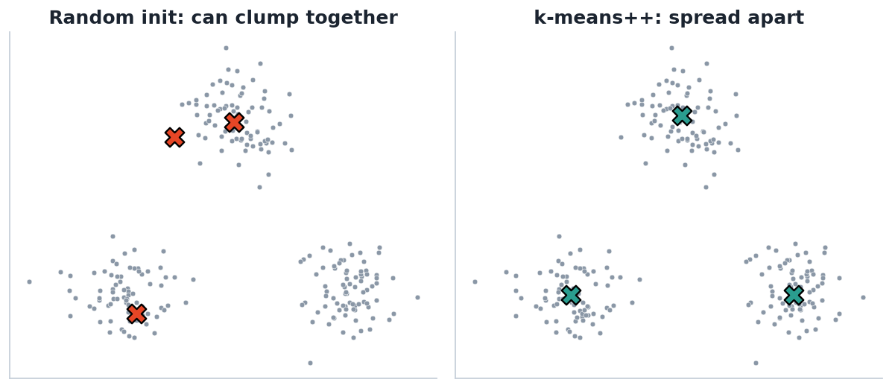
INITIALISATION
Random vs k-means++ starts
The fix
• Run from many random starts, keep the best
• 'Best' = lowest total within-SS
• k-means++ chooses spread-out starts
• In R: set `nstart = 25` or more
Random initialisation can place centroids close together (left), risking a poor local optimum. k-means++ spreads initial centroids apart (right).
STAT3888 · Statistical Machine Learning
L04 · 10

Slide 14
RESTARTS
Always use multiple restarts
set.seed(1)
km <- kmeans(X, centers = 3, nstart = 25) # 25 random restarts
km$tot.withinss # objective value (lower is better)
km$cluster # cluster label for each observation
km$centers # cluster centroids (in scaled units)
km$size # number of points per cluster
Without nstart, a single unlucky start can give a badly sub-optimal clustering.
STAT3888 · Statistical Machine Learning
L04 · 11

Slide 15
PART 4
Choosing the number of clusters

Slide 16
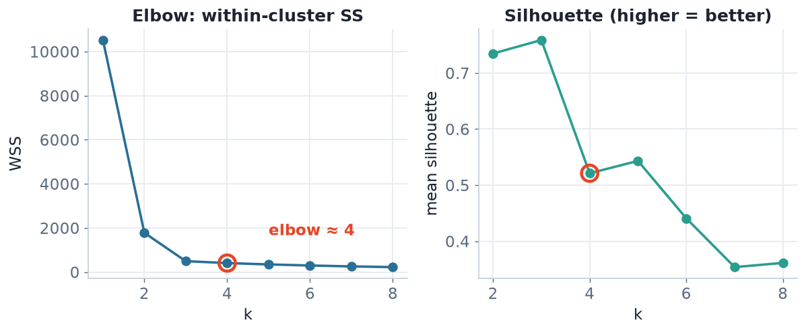
DIAGNOSTICS
Elbow and silhouette methods
Left: within-SS always falls with k — look for the 'elbow' where gains flatten. Right: the silhouette rewards well-separated clusters and often peaks more clearly.
STAT3888 · Statistical Machine Learning
L04 · 12

Slide 17
SILHOUETTE
Measuring how well each point is clustered
s(i) = ( bᵢ − aᵢ ) / max(aᵢ, bᵢ)
• aᵢ = mean distance from i to points in its own cluster
• bᵢ = mean distance from i to points in the nearest other cluster
• s ≈ +1: well clustered · s ≈ 0: on a boundary · s < 0: likely misassigned
Average s over all points to score a whole clustering; pick the k with the highest average silhouette.
STAT3888 · Statistical Machine Learning
L04 · 13

Slide 18
MORE OPTIONS
Other ways to choose k
▸ Gap statistic — compares within-SS to that expected under no clustering
▸ Information criteria — natural in the model-based approach (BIC, Lecture 5)
▸ Stability — choose k giving reproducible clusters under resampling
▸ Interpretability — a k your Nutrition partners can name often wins ties
STAT3888 · Statistical Machine Learning
L04 · 14

Slide 19
PART 5
Assumptions & limits

Slide 20
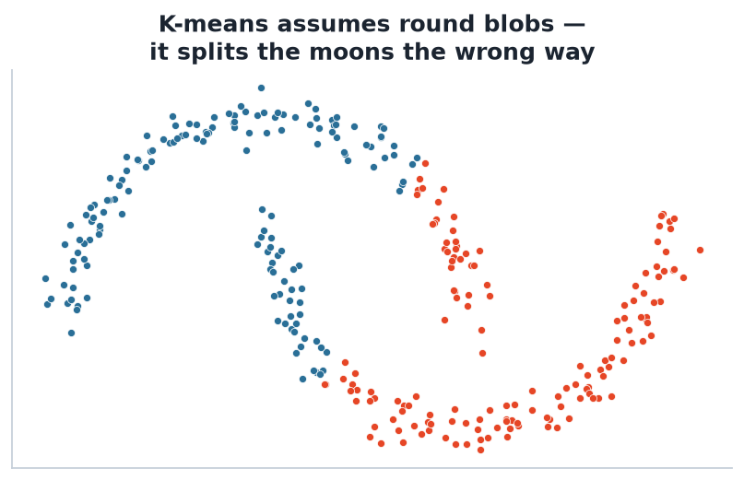
FAILURE MODE
K-means assumes round blobs
When it struggles
• Non-convex / elongated shapes
• Very different cluster sizes or densities
• Unscaled variables
• Many irrelevant / noisy features
On two interleaving 'moons', k-means carves a straight boundary and splits them the wrong way. Its convex, equal-variance assumptions simply don't hold here.
STAT3888 · Statistical Machine Learning
L04 · 15

Slide 21
KNOW THE ASSUMPTIONS
K-means in a nutshell
It assumes
If that fails, consider
• Clusters are roughly spherical
• Clusters have similar size / variance
• Euclidean distance is meaningful
• You have chosen a sensible k
• GMM — elliptical, soft clusters (L05)
• Hierarchical — no fixed shape (L06)
• DBSCAN — arbitrary shapes, noise
• Always standardise first
STAT3888 · Statistical Machine Learning
L04 · 16

Slide 22
IN PRACTICE
Interpreting your clusters — the payoff
▸ Profile each cluster by its centroid across the original variables
▸ Give each cluster a name ('high-fibre / low-sugar', 'Western pattern')
▸ Check cluster sizes — a tiny cluster may be outliers, not a real group
▸ Relate clusters to held-out variables to check they're meaningful
▸ This is exactly what you'll do in the project.
STAT3888 · Statistical Machine Learning
L04 · 17

Slide 23
END TO END
A complete k-means analysis in R
library(tidyverse); library(cluster); library(factoextra)
X <- scale(diet_numeric) # 1. standardise
fviz_nbclust(X, kmeans, method = 'wss') # 2. elbow plot
fviz_nbclust(X, kmeans, method = 'silhouette')
set.seed(1)
km <- kmeans(X, centers = 3, nstart = 25) # 3. fit
fviz_cluster(km, data = X) # 4. visualise
# 5. profile & name the clusters
aggregate(diet_numeric, by = list(km$cluster), FUN = mean)
STAT3888 · Statistical Machine Learning
L04 · 18

Slide 24
IN-CLASS EXERCISE
Run and diagnose k-means
1. Using the standardised nutrition data, fit k-means for k = 2,…,8 with nstart = 25 and record tot.withinss.
2. Plot within-SS vs k. Where is the elbow?
3. Compute the mean silhouette for each k. Do the two methods agree?
4. For your chosen k, profile the cluster means — can you give each cluster a nutrition name?
Hint. Naming clusters from their centroid profiles is exactly the deliverable your project team will need.
STAT3888 · Statistical Machine Learning
L04 · 19

Slide 25
PART 6
The mathematics, a little deeper

Slide 26
WHY THE MEAN?
The centroid minimises squared distance
μₖ = argmin_c Σ_{x∈Cₖ} ‖x − c‖² = mean(Cₖ)
• For squared Euclidean distance, the best single summary point is the mean
• That's why the update step sets each centroid to its cluster's average
• Use a different distance and the best 'centre' changes (e.g. medoid for k-medoids)
STAT3888 · Statistical Machine Learning
L04 · 20

Slide 27
DEFINITION
k-medoids (PAM)
k-medoids is like k-means but each cluster is represented by an actual data point (the medoid), not a mean.
▸ More robust to outliers than k-means
▸ Works with any distance, not just Euclidean
▸ Slower; implemented as `pam()` in R's cluster package
STAT3888 · Statistical Machine Learning
L04 · 21

Slide 28
WHY SQUARED DISTANCE?
Consequences of the objective
▸ Squaring penalises large deviations heavily → sensitive to outliers
▸ Makes the mean the optimal centre (nice math)
▸ Biases toward equal-size, spherical clusters
▸ If that's wrong for your data, choose another method
STAT3888 · Statistical Machine Learning
L04 · 22

Slide 29
CHECK YOUR UNDERSTANDING
Why does the k-means update step use the mean of each cluster?
A
Tradition
B
The mean minimises within-cluster squared distance ✓
C
It's the fastest to compute
D
To avoid outliers
Why: Given squared Euclidean distance, the point minimising total squared distance to a set is exactly its mean — so the mean is the optimal centroid.
STAT3888 · Statistical Machine Learning
L04 · 23

Slide 30
PART 7
Choosing k, in depth

Slide 31
DEFINITION
The gap statistic
The gap statistic compares your clustering's within-SS to the within-SS expected under a null model with no clusters.
▸ Large gap = structure well beyond random
▸ Chooses k where the gap is largest (with a standard-error rule)
▸ `cluster::clusGap()` in R
STAT3888 · Statistical Machine Learning
L04 · 24

Slide 32
METHODS FOR K
Four ways, compared
Method | Idea | Note
Elbow | where WSS flattens | subjective
Silhouette | separation quality | clear peak, popular
Gap statistic | vs random null | principled, slower
Domain sense | interpretable k | breaks ties
STAT3888 · Statistical Machine Learning
L04 · 25

Slide 33
WHEN METHODS DISAGREE
A practical protocol
▸ Compute all the criteria — don't rely on one
▸ Prefer a k that is stable across methods and resamples
▸ Among near-ties, choose the most interpretable k
▸ Report *how* you chose — reproducibility matters
STAT3888 · Statistical Machine Learning
L04 · 26

Slide 34
CHECK YOUR UNDERSTANDING
Adding more clusters ALWAYS reduces within-cluster SS. Why can't we just minimise WSS?
A
WSS is hard to compute
B
It would pick k = n (one point per cluster) ✓
C
WSS ignores distance
D
It only works for k = 2
Why: WSS keeps falling as k grows, hitting zero at k = n. So we need criteria (elbow, silhouette, gap) that penalise complexity or reward separation.
STAT3888 · Statistical Machine Learning
L04 · 27

Slide 35
PART 8
Practice, pitfalls & extensions

Slide 36
STRENGTHS & WEAKNESSES
k-means in balance
Strengths
Weaknesses
• Fast and scales to big data
• Simple to implement & explain
• Works well on round, separated blobs
• Must pre-specify k
• Assumes spherical, equal-size clusters
• Sensitive to scale, outliers, init
STAT3888 · Statistical Machine Learning
L04 · 28

Slide 37
PREPROCESSING CHECKLIST
Before you run k-means
▸ Standardise every variable
▸ Handle outliers (they drag centroids)
▸ Consider PCA first if there are many variables
▸ Set a seed and use `nstart ≥ 25`
STAT3888 · Statistical Machine Learning
L04 · 29

Slide 38
EXTENSIONS
The k-means family
▸ k-means++ — smarter initialisation
▸ Mini-batch k-means — scales to millions of points
▸ k-medoids (PAM) — robust, any distance
▸ Fuzzy c-means — soft memberships (a bridge to GMM)
STAT3888 · Statistical Machine Learning
L04 · 30

Slide 39
THE HONEST SUMMARY
k-means is the fast, popular first thing to try — and the method whose assumptions you must most actively check.
When the blobs aren't round, reach for GMM or hierarchical clustering next.

Slide 40
IN-CLASS EXERCISE
Diagnose a failure
1. You run k-means (k = 2) on clearly crescent-shaped data and the clusters look wrong.
2. Explain, using k-means' assumptions, why it failed.
3. Which two alternative methods might succeed, and why?
4. What preprocessing, if any, would *not* have fixed this?
Hint. k-means draws linear (Voronoi) boundaries and assumes convex blobs; scaling won't fix a non-convex shape.
STAT3888 · Statistical Machine Learning
L04 · 32

Slide 41
FURTHER READING
To go deeper
▸ James et al., *An Introduction to Statistical Learning*, §12.4
▸ Hastie et al., *The Elements of Statistical Learning*, §14.3
▸ R: `cluster`, `factoextra` package vignettes
STAT3888 · Statistical Machine Learning
L04 · 33

Slide 42
PART 9
K-means by hand

Slide 43
SETUP
A tiny 1-D example
▸ Points: 1, 2, 3, 10, 11, 12 — clearly two groups
▸ We'll run k-means with k = 2 from a bad start to see it recover
▸ Initial centroids: c₁ = 2, c₂ = 4
STAT3888 · Statistical Machine Learning
L04 · 34

Slide 44
ITERATION 1
Assign, then update
1
Assign
1,2,3 → c₁ (nearer 2); 10,11,12 → c₂ (nearer 4)
2
Update
c₁ = mean(1,2,3) = 2; c₂ = mean(10,11,12) = 11
3
Reassign
assignments unchanged → converged
4
Result
clusters {1,2,3} and {10,11,12}, centroids 2 and 11
Even from a poor c₂ = 4, one pass snaps to the right answer here.
STAT3888 · Statistical Machine Learning
L04 · 35

Slide 45
TRACK THE OBJECTIVE
Within-cluster SS falls
WSS = Σ (x − μₖ)² : before ≫ after each step
• Start WSS is large (centroids misplaced)
• Each assign/update step cannot increase WSS
• Convergence = WSS stops changing
STAT3888 · Statistical Machine Learning
L04 · 36

Slide 46
EDGE CASE
What if a cluster goes empty?
▸ A centroid can end up with no points assigned
▸ Implementations re-seed it (e.g. to the farthest point)
▸ More restarts make this rare
▸ Another reason `nstart` matters
STAT3888 · Statistical Machine Learning
L04 · 37

Slide 47
CHECK YOUR UNDERSTANDING
In the worked example, what guaranteed k-means stopped after one full pass?
A
It ran out of time
B
The assignments didn't change between steps ✓
C
k was too small
D
The data was sorted
Why: k-means converges exactly when an iteration produces no change in assignments — the objective can't improve further.
STAT3888 · Statistical Machine Learning
L04 · 38

Slide 48
PART 10
Applications & wrap-up

Slide 49
DEFINITION
Colour quantisation
Colour quantisation compresses an image by clustering its pixels' colours with k-means and keeping only k representative colours.
▸ Each pixel is a point in 3-D (R,G,B) space
▸ k-means finds k 'average' colours
▸ A vivid, everyday demonstration of clustering
STAT3888 · Statistical Machine Learning
L04 · 39

Slide 50
WHERE K-MEANS SHOWS UP
Real uses
▸ Customer / patient segmentation
▸ Image compression (colour quantisation)
▸ Document / topic grouping on embeddings
▸ Vector quantisation in signal processing
STAT3888 · Statistical Machine Learning
L04 · 40

Slide 51
K-MEANS VS GMM (PREVIEW)
A taste of next week
k-means
GMM
• Hard labels
• Spherical, equal size
• Fast
• Distance-based
• Soft probabilities
• Elliptical, varying size
• Slower (EM)
• Probability model
STAT3888 · Statistical Machine Learning
L04 · 41

Slide 52
EXAM POINTERS
What's commonly tested
▸ State the objective and the two steps of the algorithm
▸ Explain local optima and the role of `nstart`
▸ Choose k from an elbow / silhouette plot
▸ Name the assumptions and a failure mode
STAT3888 · Statistical Machine Learning
L04 · 42

Slide 53
YOU CAN NOW CLUSTER
Standardise → choose k → run k-means with restarts → validate → name the clusters. That's a complete, defensible workflow.
Next we make the clusters soft and probabilistic with Gaussian mixtures.

Slide 54
IN-CLASS EXERCISE
Consolidation
1. State the k-means objective in one line.
2. Explain why k-means can give different answers on different runs, and the fix.
3. Given an elbow at k = 3 but a silhouette peak at k = 4, how would you decide?
4. Name one dataset shape where k-means fails and what you'd use instead.
Hint. Use interpretability and stability to break elbow-vs-silhouette ties; non-convex shapes → DBSCAN/spectral.
STAT3888 · Statistical Machine Learning
L04 · 44

Slide 55
DEFINITION
Inertia (within-cluster SS)
Inertia is k-means' objective value — the total squared distance of points to their assigned centroids. Lower is tighter.
▸ Reported as `tot.withinss` in R / `inertia_` in Python
▸ Compare inertia only for the same k across restarts
▸ It always decreases as k increases — hence the elbow method
STAT3888 · Statistical Machine Learning
L04 · 45

Slide 56
CHEAT-SHEET
k-means at a glance
Question | Answer
Objective | minimise within-cluster SS (inertia)
Algorithm | Lloyd's: assign → update → repeat
Choose k | elbow, silhouette, gap statistic
Guard against | local optima (nstart), scale, outliers
Assumes | round, comparable, convex clusters
STAT3888 · Statistical Machine Learning
L04 · 46

Slide 57
CHECK YOUR UNDERSTANDING
`tot.withinss` for k = 4 is lower than for k = 3. Does that prove k = 4 is better?
A
Yes, lower is always better
B
No — inertia always falls with k; use silhouette/elbow ✓
C
Only if standardised
D
Yes, if nstart is high
Why: Inertia decreases monotonically with k, so a lower value at higher k is expected and proves nothing — judge with the elbow/silhouette instead.
STAT3888 · Statistical Machine Learning
L04 · 47

Slide 58
ONE-LINE RECAP
Carry this out the door
▸ Standardise, restart, choose k with care, validate, name.
STAT3888 · Statistical Machine Learning
L04 · 48

Slide 59
FURTHER READING
To go deeper
▸ James et al., *An Introduction to Statistical Learning*, §12.4.1
▸ Hastie et al., *The Elements of Statistical Learning*, §14.3.6
▸ R: `stats::kmeans`, `cluster::pam`, `factoextra` vignettes
STAT3888 · Statistical Machine Learning
L04 · 49

Slide 60
SUMMARY
Key takeaways
✓ K-means minimises within-cluster sum of squares via assign–update iterations.
✓ It converges to a local optimum — always use many restarts / k-means++.
✓ Choose k with the elbow and silhouette; let interpretability break ties.
✓ It assumes round, comparable clusters — standardise, and switch methods when that fails.
Next lecture → Lecture 05 — Model-based clustering: soft assignments with Gaussian mixtures.
STAT3888 · Statistical Machine Learning
L04 · 50

