Slide 1
Real-time Algorithm Design and Realization of Compressed Memory Database
Adviser：Gavin Zhao
2014.3

Slide 2
Team Members
Name | ID | Role
Hongxiang Lan | SG13225025 | Header
Yalin Fan | SG13225022 | Member
Yong Liu | SA13226282 | Member

Slide 3
Contents of Report
Our procedure of work
  The features of this database
  What we need to do
  What we have do

Slide 4
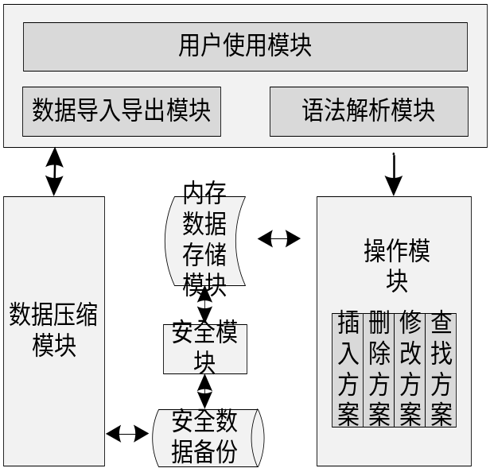
The Features of this database
Architecture
UI
Data processing

Slide 5
The Features of this database
Features:
  Inside memory:
    Fast response
    More effective
    Saving space
  Column-based storage:
    Quick columns-based finding

Slide 6
The Features of this database
Data Types supported:
int float
double char
Single byte
Long short
string varchar
Date(YYYY:MM:DD)
DateTime(YYYY:MM:DD:HH:mm:SS)

Slide 7
The Features of this database
The features of data supported
  Case 1: only consecutive and identical records
  Case 2: variety of long-length records that often appear
  Case 3:just several kinds of data, not sparse
  Case 4:several identical data occurs many times
  Case 5:integral and sequential numbers
  Case 6: a column of null value

Slide 8
What we need to do
Relevant compress algorithms to solve above problems:
  LZ compress
  Bit compress
  Bitmap compress
  Dictionary compress
  Run-length compress
  Empty-suspend algorithm

Slide 9
What we need to do
Realize scheduling algorithms
  Multi-processing
  Testing relevant parts
  Combine all algorithms together
  Inserting, deleting, updating, modifying

Slide 10
What we need to do
Relevant Table management for database
  Purpose
    Fasten indexing
    Improving efficiency of compressing
    Decrease the magnitude of data operations

Slide 11
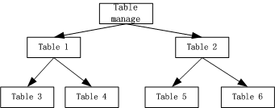
What we need to do
  Design
Table structure

Slide 12
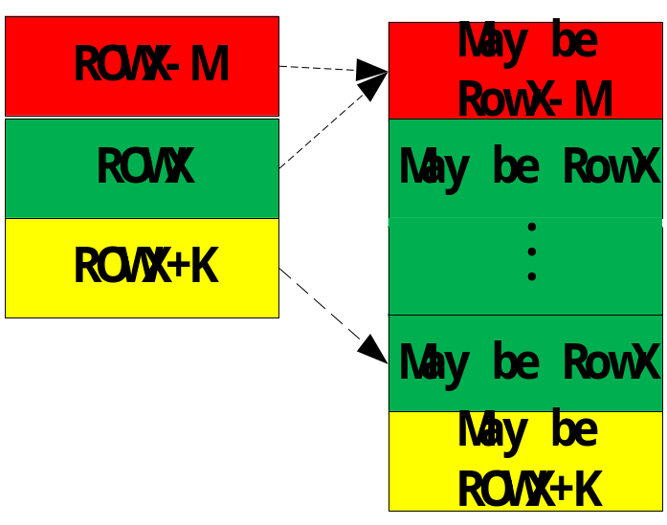
What we have done
Run-length Compress
  Column-based pointer
struct
{
unsigned short flag:1;
unsigned short pos:15 ;
unsigned short pnext ;
T data ;
}

Slide 13
What we have done
Empty-suspend
  Design：
    Use a tag to identify an empty column.
    Use a short array to identify the position of empty columns.

Slide 14
What we have done
Empty-suspend
  Usage
    When searching, check empty information first:
      If tag is set, ignore this column;
      Else check short array about empty-items in a column
    If not, search the compressed memory database.

Slide 15
What we have done
Design of File Format
  Intentions:
    easy test of algorithm,
    extension for project.
  Format of files
    Line 1:col-columns,row-rows
    Line 2:col_name,row_name—type[length]
    Line 3 and the rest: real data
    Max length of 20000 lines

Slide 16
Thank You !

