Slide 1
Wireless Ad Hoc Networks Lab 1
Wireshark
Packets Sniff Experiment

Slide 2
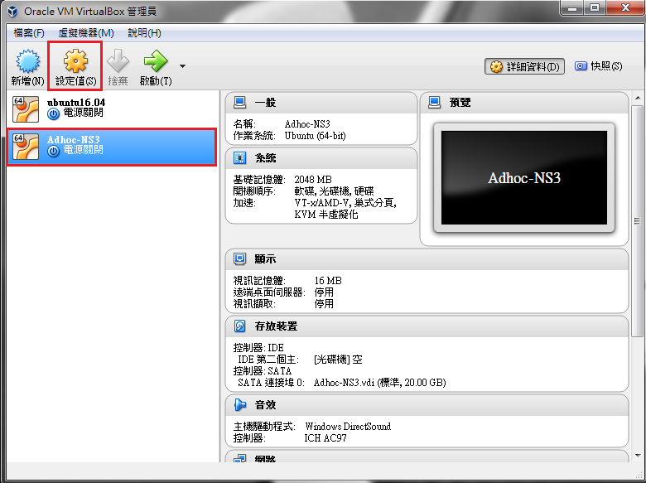
Open VM VirtualBox - Setting

Slide 3
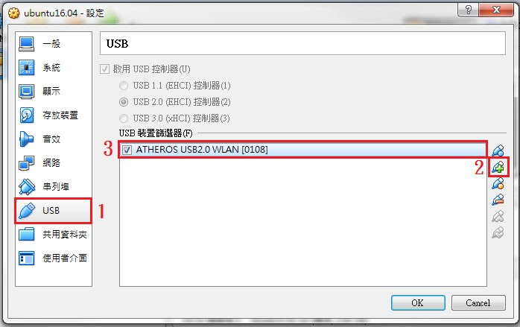
Isolate wireless USB adapter

Slide 4
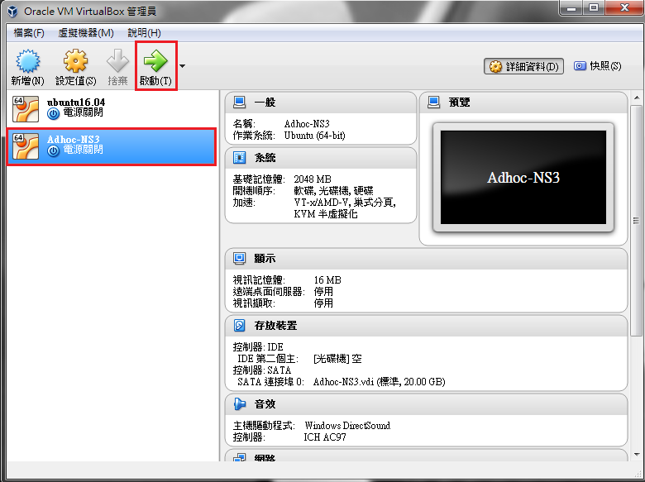
VirtualBox Start
Password : ImBun

Slide 5
Check wireless USB adapter has been driven or not?
Open terminal
iwconfig
Check wireless USB adapter has been driven. (If not, change USB port.)

Slide 6
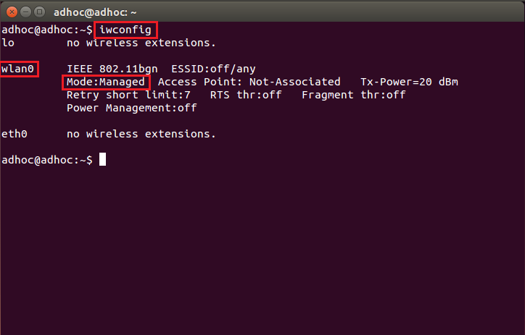
Check wireless USB adapter has been driven or not?

Slide 7
Packets Sniff Experiment
Lab Purpose
Understand wireless network by capturing packets.
Equipments
PC / NB ( Root Password : ImBun )
Atheros-chipset wireless NIC (support IEEE 802.11 b/g)
Linux with iw (linux wireless package)
Wireshark (network protocol analyzer)
WiFi Access Point (Open Access / Encrypted)

Slide 8
Wireshark Introduction
A Free and Open-Source Packet Analyzer
Available for UNIX and Windows
https://www.wireshark.org/
Capture live packet data from a network interface
Purpose:
Network Administrators : troubleshoot network problems
Network Security Engineers : examine security problems
Developers : debug protocol implementations
People : learn network protocol internals
Installation on Ubuntu
sudo apt-get install wireshark
sudo wireshark
Notes:
sudo apt-get update
sudo apt-get install wireshark
sudo groupadd wireshark
sudo usermod -a -G wireshark bunlab
sudo chgrp wireshark /usr/bin/dumpcap
sudo chmod 750 /usr/bin/dumpcap
sudo setcap cap_net_raw,cap_net_admin=eip /usr/bin/dumpcap
sudo getcap /usr/bin/dumpcap

Slide 9
Wireshark Installation (from source)
Package Download Link :
https://1.as.dl.wireshark.org/src/wireshark-2.2.2.tar.bz2
Open the terminal, then type these commands:
Unpack the source file:
tar xaf wireshark-1.12.8.tar.bz2
Go to the Wireshark source directory:
cd wireshark-2.2.2
configure the source:
./configure
Build the source:
make
Install:
make install

Slide 10
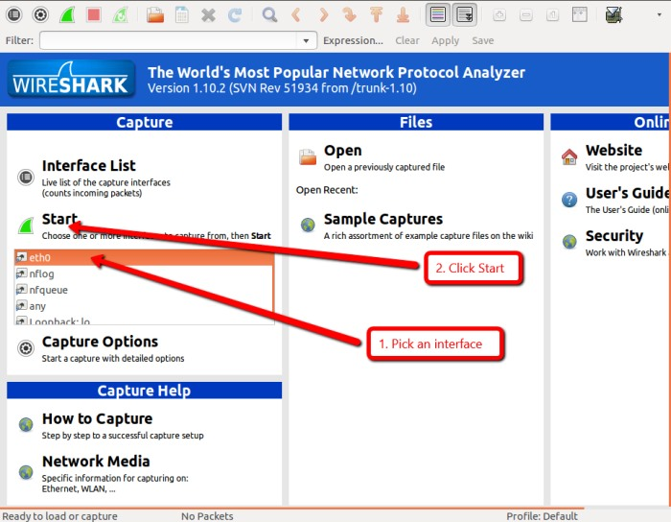
Wireshark User Interface (I)

Slide 11
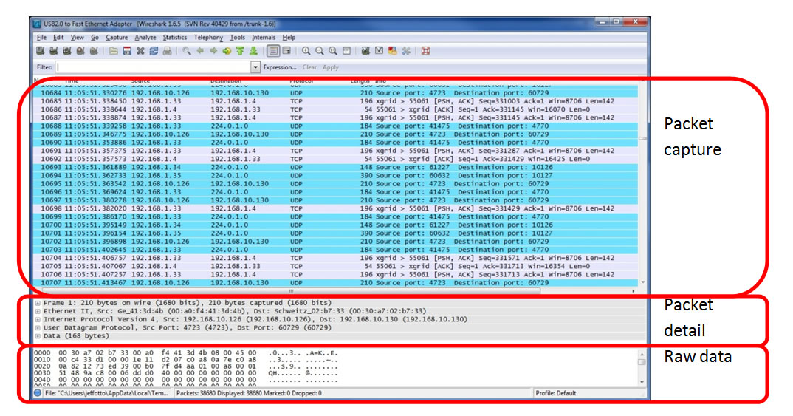
Wireshark User Interface (II)

Slide 12
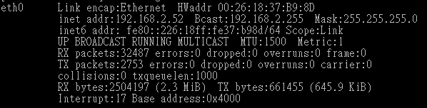
Linux Introduction w/ network command
ifconfig - configure a network interface
Set IP address, MAC address … etc

Slide 13
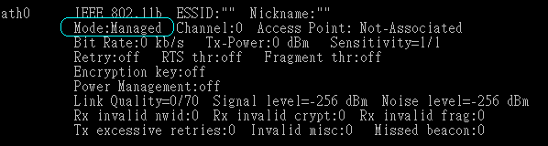
Linux Introduction w/ wireless network command
iwconfig - configure a wireless network interface
Set ESSID, channel, rate …etc

Slide 14
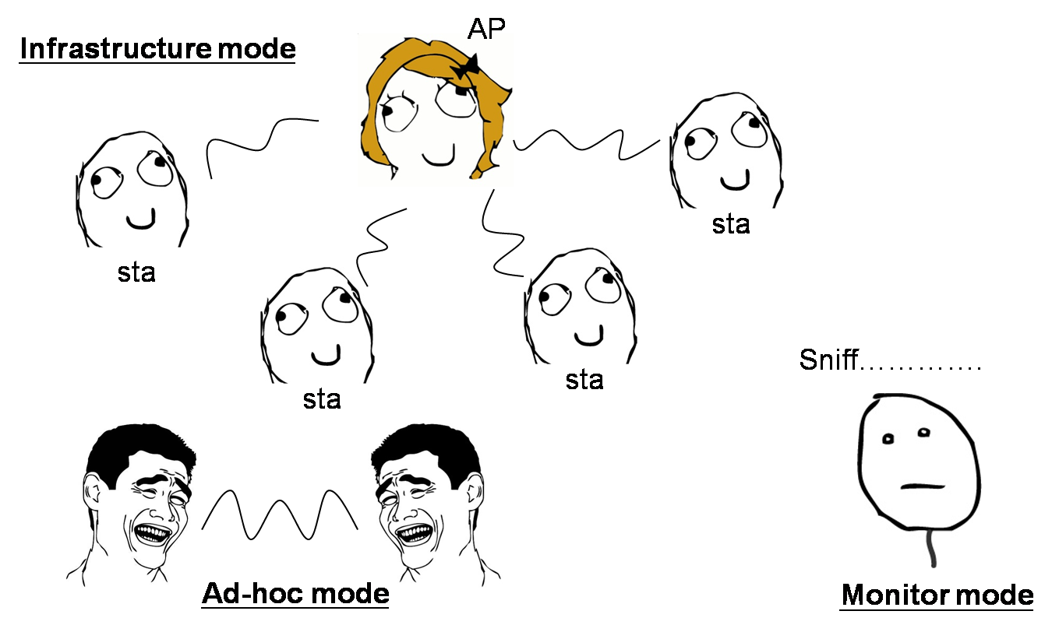
Wireless Operating Modes
Wi-Fi modes of operation (802.11 or Wi-Fi)
Station (STA) infrastructure mode
This mode is also called “ Managed “
AccessPoint (AP) infrastructure mode
Ad-Hoc (IBSS) mode
Monitor (MON) mode (i.e, Sniff mode)
Don’t need to connect any AP

Slide 15
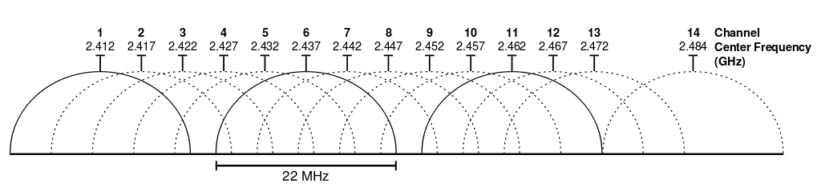
Monitor mode – Wireless Channel
Fig. 2.4 GHz Wi-Fi channels (802.11b,g WLAN)

Slide 16
Packets Sniff Experiment
[Step 1] Install Unix-like operating system. (Done For You)
[Step 2] Download & install Wireshark. (Done For You)
[Step 3] Switch the wireless NIC to monitor mode.
delete the normal wlan# interface if it’s unused :
iw dev
sudo iw dev wlan# del
add a monitor interface called mon? :
sudo iw phy phy# interface add mon? type monitor
enable the mon? interface using ifconfig :
sudo ifconfig mon? up
specify the wireless LAN frequency you want to capture on :
sudo iwconfig mon? channel x
or sudo iw dev mon0 set freq 24yz
[Step 4] Open Wireshark to capture and observe the packets
sudo wireshark (Use Wireshark with root authority)
(to list the available devices)
(change # to the specific number)
(change ? to the a number)

Slide 17
Questions & Report
TA will use our own devices to access Internet via an AP (Open Access/Encrypted).
TA will generate HTTP, FTP, Telnet and SSH packets.
Questions:
# Q1 :
Can you get any detail information from received packets for HTTP, FTP,
Telnet and SSH via Open Access AP!?
(ex: username, password)
# Q2 :
Can you get any detail information from received packets for HTTP, FTP,
Telnet and SSH via Encrypted AP!?
You need to answer these questions and then write a full report with your thoughts or analysis(individual report).
Deadline : 2019 / 11 / 19
Notes:
ftp ca.nctu.edu.tw
==================
ssh bunlab@140.113.144.197
pw : ImBun
==================
telnet ptt.cc
==================
http://bun.cm.nctu.edu.tw/labinfo/?page_id=1224
pw : ting-adhoc-2019

