Slide 1
Seminar for foreign student
1st seminar:
AWGN・Coherent detection・QPSK
Fukawa Laboratory / October 14, 2020

Slide 2

Digital modulation & demodulation
In wireless communication, baseband signal containing message source (modulation signal) is transformed into carrier wave band, which is high frequency electromagnetic waves (carrier wave).
Modulation：to transform baseband signal to suit the transmission link.
Demodulation: reverse operation of modulation
Modulation signal
(information data)
Modulation wave
modulator
Carrier wave (single frequency sine wave f_{c})
To load information in amplitude・frequency・phase
Analog data ： analog modulation
Digital data ： digital modulation
Source message

Slide 3
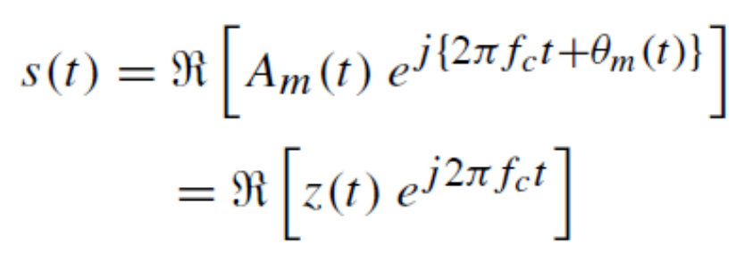

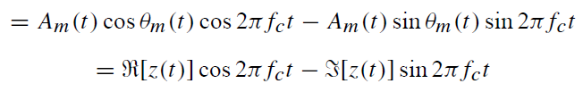



Modulation signal waveform complex expression
※for simplicity, frequency component
is combined in phase component
z(t) : complex envelope
Modulation signal component
Carrier wave component
Carrier wave:
In-phase component
Quadrature-phase component
Transmit signal
Carrier wave
generator
π/2

Slide 4
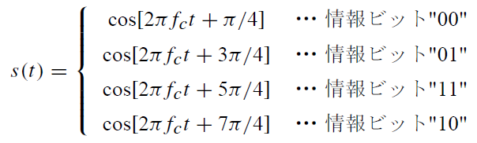
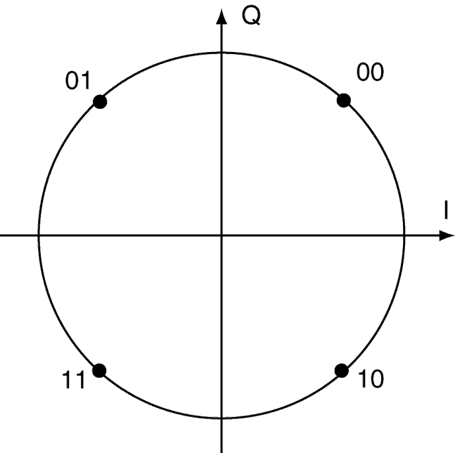
Mod. scheme : QPSK (Quadrature PSK)
PSK (Phase Shift Keying) : to change carrier wave phase according to binary digital code info ”0” and ”1”
QPSK : phase change for 2 bit information
Info bit
Info bit
Info bit
Info bit
Constellation
(express complex envelope in I-Q plane)

Slide 5
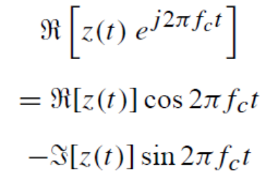
Coherent detection
Regenerate transmitter carrier wave from received wave
Multiply regenerated carrier wave with received wave
LPF
Received signal
Carrier wave
Regeneration
Circuit
π/2
LPF
※In this graph, transmission line (amplitude / phase changing noise or distortion)
is not shown

Slide 6
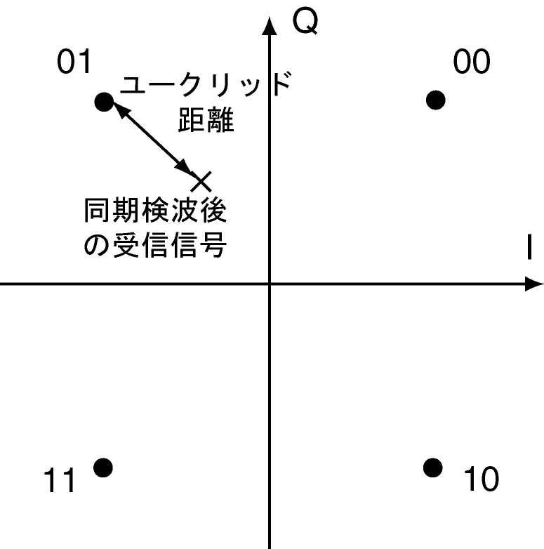
Coherent detection signal decision
Optimum detection by maximum likelihood detection
  Decided by nearest (euclidean distance) transmitted signal point from received signal point after coherent detection
Euclidean
Decision: different transmit point
→ bit error
dist.
Decision
point
Received signal
After detection
To reduce bit error,
Set neighboring code to differ
Only by one bit → Gray Code

Slide 7
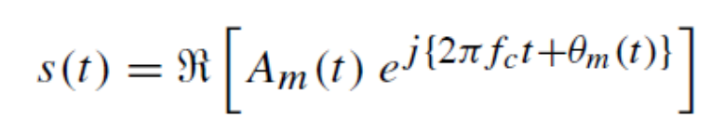

Passband and baseband
Passband system
  focus on carrier wave
Equivalent baseband system
  Complex envelope
If the carrier wave could be regenerated completely
  If management is done in equivalent baseband system, carrier wave component need not to be considered

Slide 8

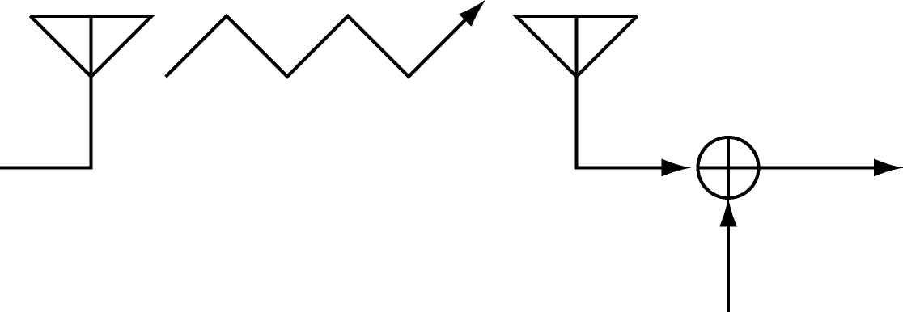




Channel
Transmission model
Transmit
signal
Channel
characteristic
Received signal
noise
In AWGN channel, received signal is expressed by:

Slide 9
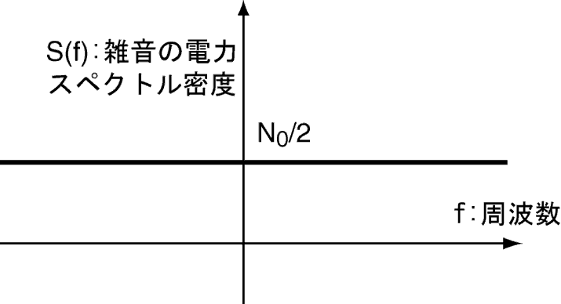
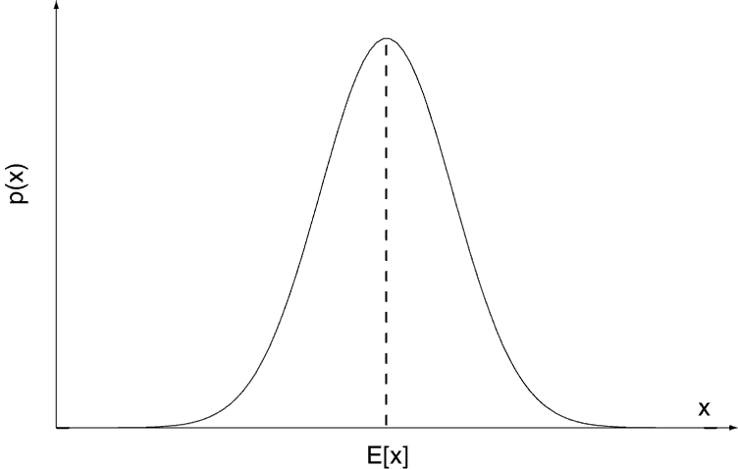
AWGN (Additive White Gaussian Noise)
Noise is regarded as stochastic process
White noise
  Uniform power spectral density in all frequency spectrum
Gaussian noise
  Probability distribution of
  temporal amplitude follows
  the normal distribution
N₀ : noise power density per hertz
noise PSD

Slide 10
Report 1
Program AWGN・receiver using C
Simulate and calculate BER (Bit Error Rate)
Draw performance graph
  Compare with theoretical result
Report hand-in:
  Deadline : Draft 10月21日 15:00 (send it to me)
    Report 10月28日 15：00 (submit the final version to Professor Chang)

Slide 11
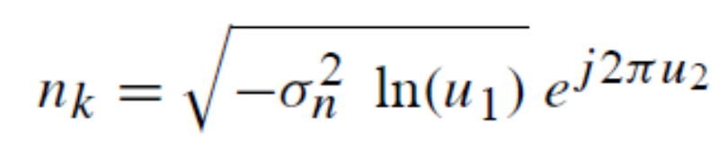
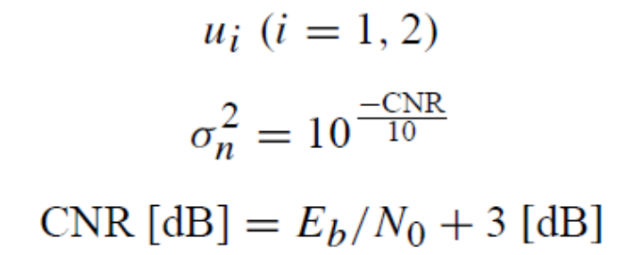
Hint 1 : AWGN generator
Creating AWGN using Box-Muller method:
: 0 to 1 range uniform distribution
: Noise power
(for QPSK)
energy per bit to noise power spectral density ratio
carrier to noise ratio

Slide 12
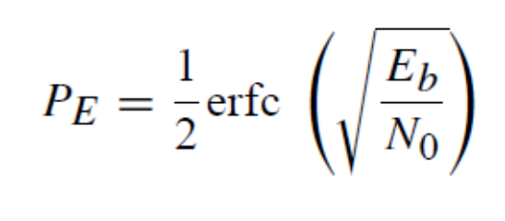


Hint 2 : coherent detection QPSK error rate
Theoretical BER
Error function
(not in dB)

