Slide 1
Fourth Seminar for Inter. Student:
Orthogonal Frequency Division Multiplexing
(OFDM)
Fukawa Laboratory
November 25, 2020

Slide 2
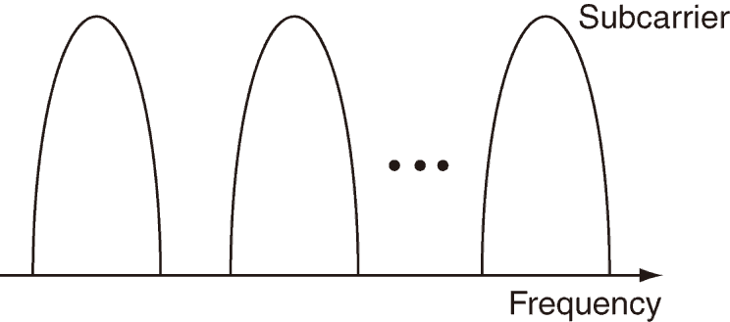
Introduction
Problem of single carrier (SC) transmission
  In broadband transmissions, the frequency selective fading channel distorts the received signal and causes inter-symbol interference, which degrades the transmission performance.
Techniques for frequency selective fading channels
  Combination of SC and equalizer on the receiver side
  Multicarrier (MC) transmission:
  parallel transmission with narrowband subcarriers
Problems of classical MC transmission
  Guard band is needed not to interfere with adjacent subcarriers
→ decreases frequency usage efficiency (transmission efficiency)
  Requirement of a large number of modulators and demodulators
→ increases the circuit size
Classical MC
Guard band

Slide 3
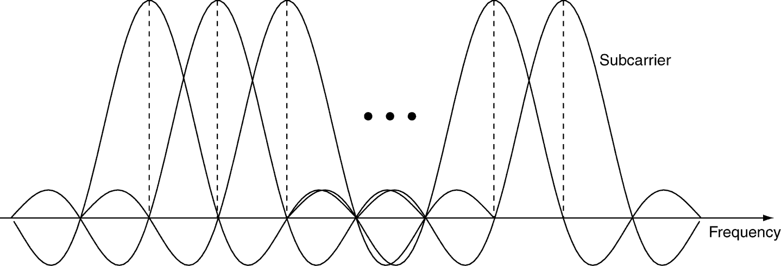
OFDM (直交周波数分割多重)
Δf
Spectrum of OFDM signal
OFDM (Orthogonal Frequency Division Multiplexing)
  Orthogonalizing and overlapping all subcarriers increases the frequency usage efficiency.
  OFDM does not require a large number of modulators and demodulators,
  because it performs the modulation and demodulation by Inverse Discrete Fourier Transform (IDFT) and DFT.
  Note that Fast Fourier Transform (FFT) and IFFT can provide higher-speed processing.

Slide 4
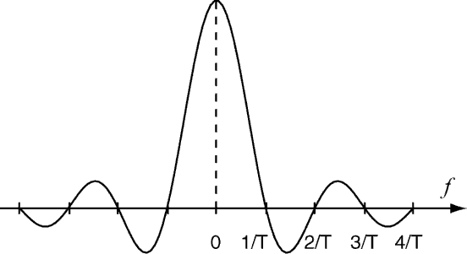
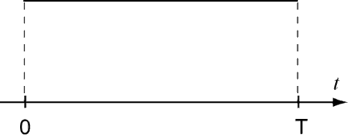
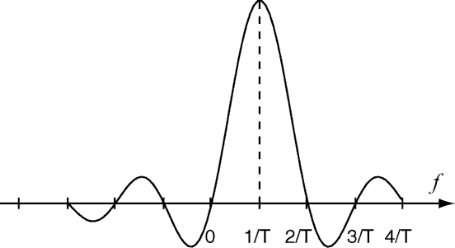
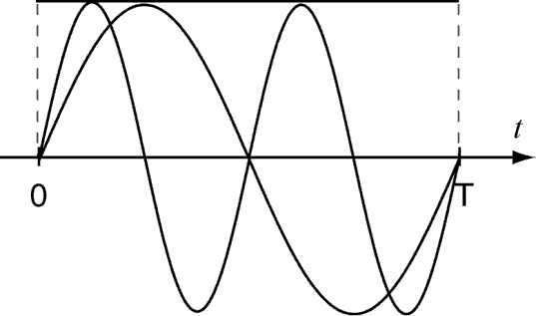
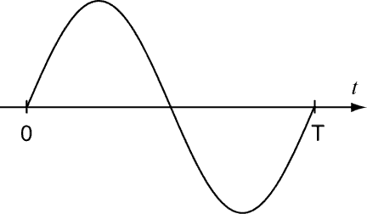
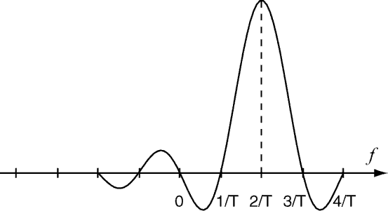
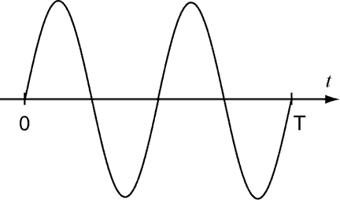
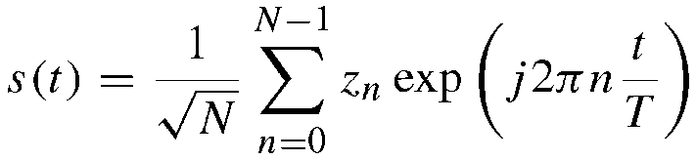
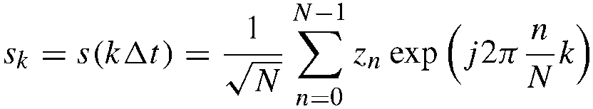
OFDM Signal Model
f = 0
Symbol duration： T
Subcarrier spacing： Δf (= 1/T)
Inverse Fourier Transform
Adding all the subcarrier signals
f = 1/T
Continuous OFDM signal:
Discrete OFDM signal:
f = 2/T
N : number of subcarriers
z_{n} : modulation signal at n-th subcarrier

Slide 5
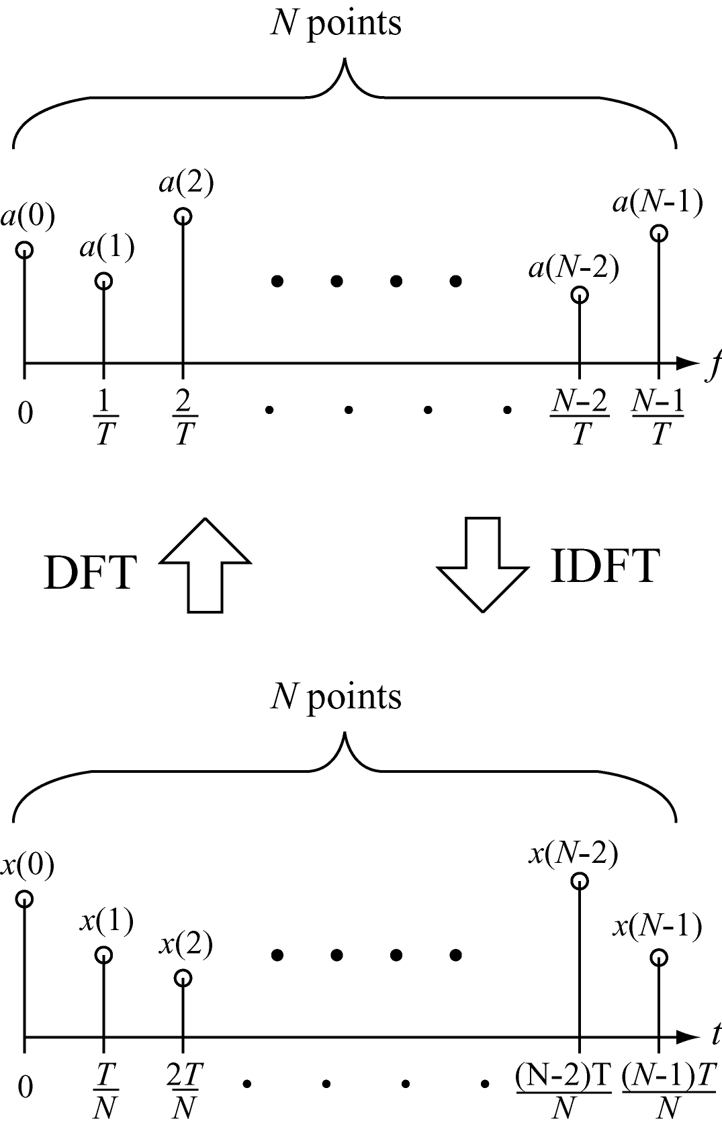
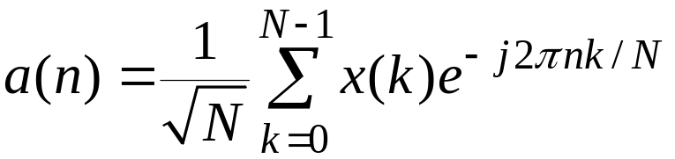
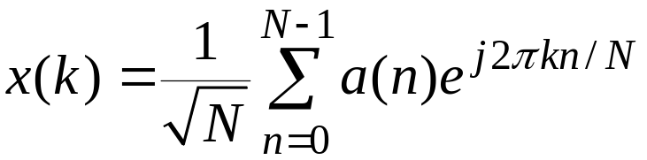
DFT (Discrete Fourier Transform)
Formulation of DFT
Formulation of IDFT
No many modulators and demodulators
FFT and IFFT can speed up

Slide 6
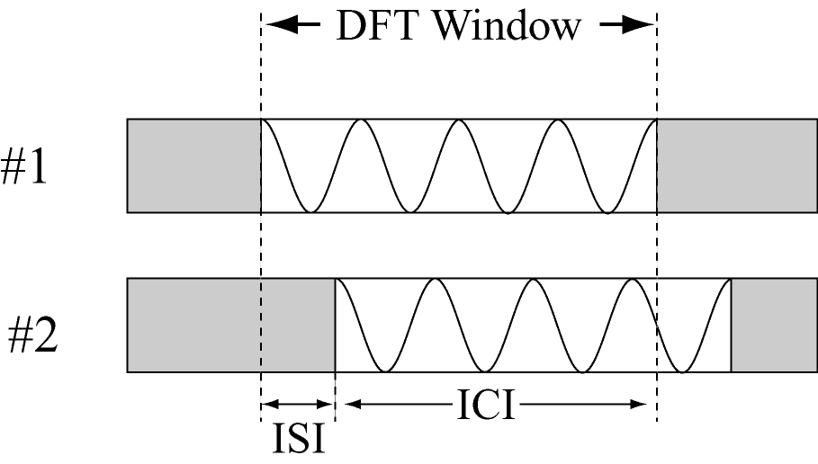
Effects of Multipath Fading
(N samples)
Direct Wave
Delay Time
Delayed Wave
Multipath delay causes inter-symbol interference (ISI) and inter-carrier interference (ICI), which degrades transmission performance in OFDM.

Slide 7
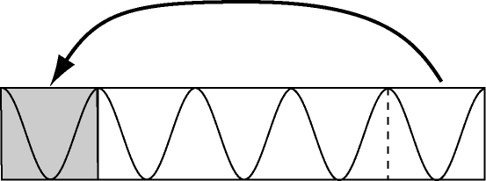
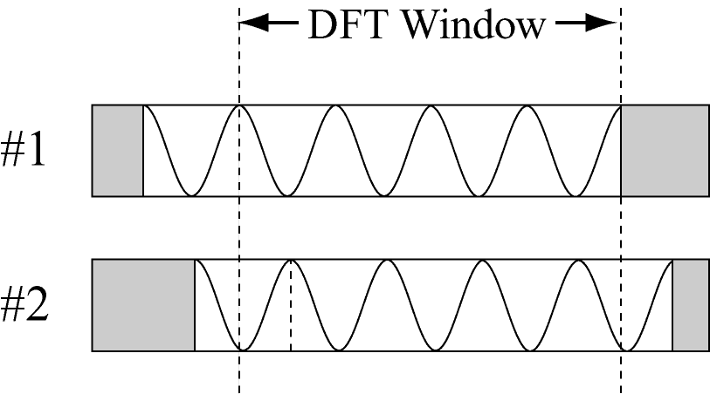
Guard Interval: GI
Guard Interval
Adding the end of OFDM symbol into the head of the symbol
GI does not destroy periodicity of OFDM symbol.
GI
N samples
GI
(N samples)
If the multipath delay is within GI, both ISI and ICI do not occur.
Delay

Slide 8
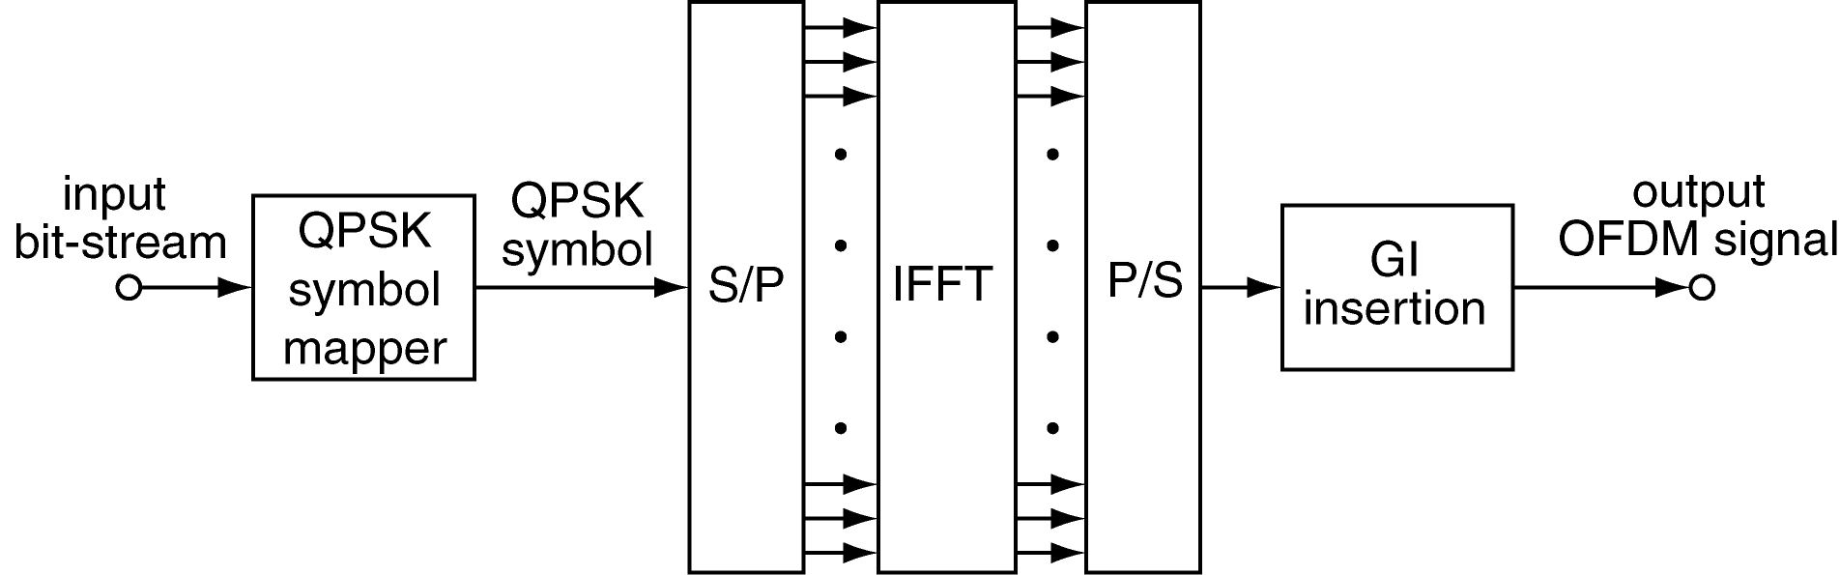
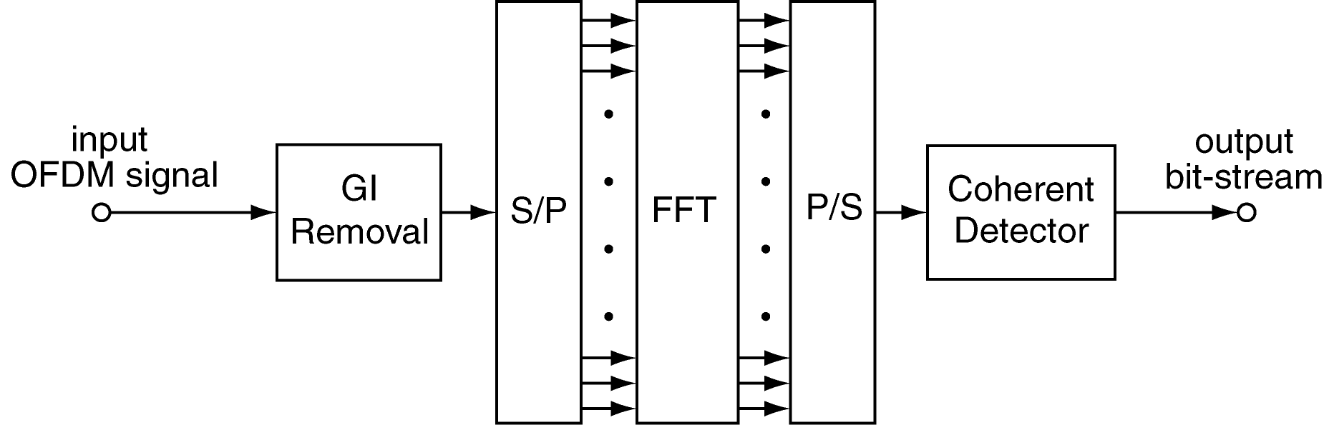
Block Diagram of OFDM Transmitter and Receiver
OFDM Transmitter
OFDM Receiver

Slide 9
Problems
Write C programs of OFDM transmitter and receiver
(Number of DFT/IDFT points, N: 64, Number of GI samples: 16)
Measure bit error rate (BER) performance in AWGN channel
Measure BER in Rayleigh fading channel
(Channel impulse response is assumed to be known to the receiver.)
Evaluate BER in two-path Rayleigh fading channel with equal power
(Delay time D is set to 1, 5, 20. Transfer function (Channel Frequency response) can be calculated from the impulse response by DFT.)

Slide 10
Report 4
Deadline: Draft 12/2 16:00 (send it to me)
    Report 12/9 15：00 (submit the final version to Professor Chang)

