Slide 1
3rd Seminar for Foreign Students:
Fading in Mobile Communication
Fukawa Laboratory / Nov 11, 2020

Slide 2
Performance Degradation Factor in Mobile Communication
Fading
  Fluctuation of amplitude and phase caused by overlapping multiple received radio waves
Inter-symbol Interference (ISI)
  Interference due to symbols delayed by radio propagation

Slide 3
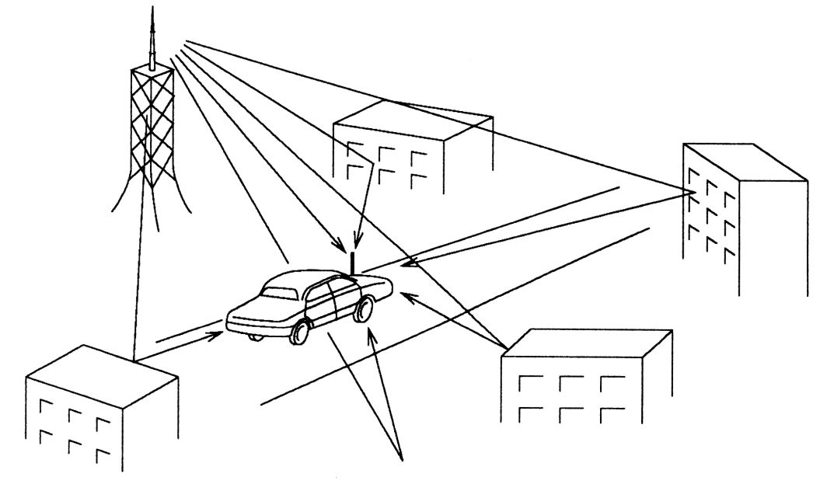
Fading by Multipath Propagation
Ground structures such as buildings cause reflection, diffraction, dispersion
Multiple waves interfere with each other, forming standing wave electromagnetic field distribution
The waves are either being strengthened or weakened,
leading to drastic fluctuation on amplitude and phase

Slide 4
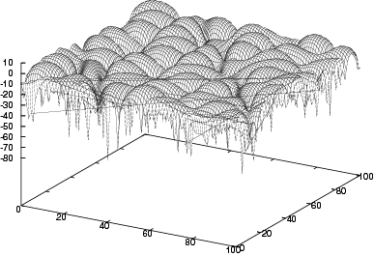
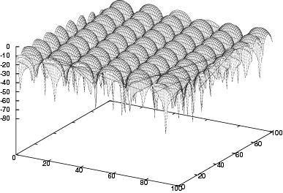
Fading Fluctuation
2 received waves
8 received waves
Power [dB]
Power [dB]
y [m]
x [m]
y [m]
Unevenness occurs
x [m]
The received power stochastically fluctuates depending on place and time
Amplitude is Rayleigh distributed

Slide 5
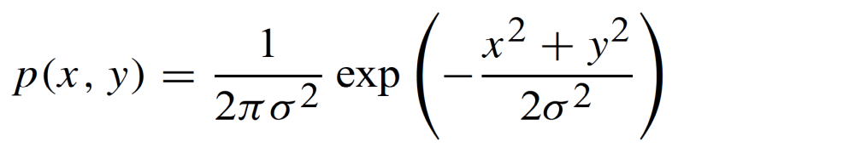

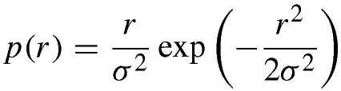
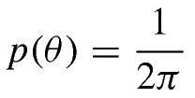
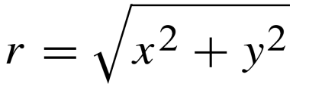

Fading Probability Distribution
Joint probability distribution function (pdf) of i.i.d. Gaussian variables
： variance
In polar coordinates:
Amplitude：
Rayleigh
Phase：
Uniform
with
with

Slide 6


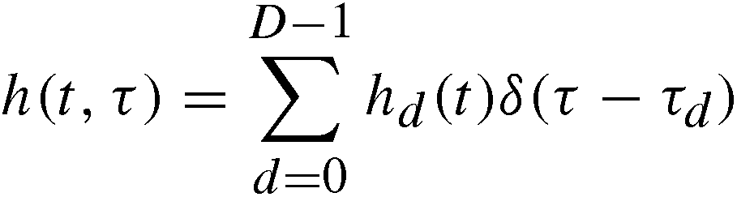
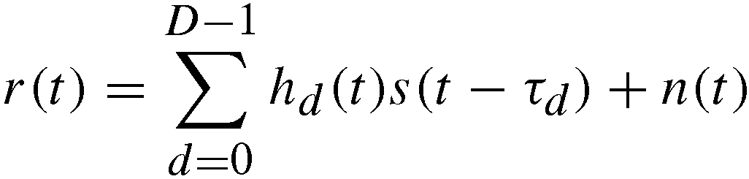
Signal Model
Finally,

Slide 7
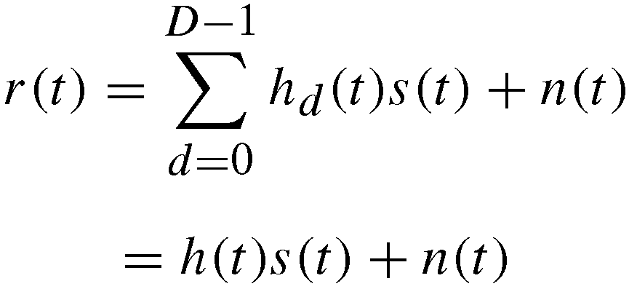
Flat Fading

Slide 8
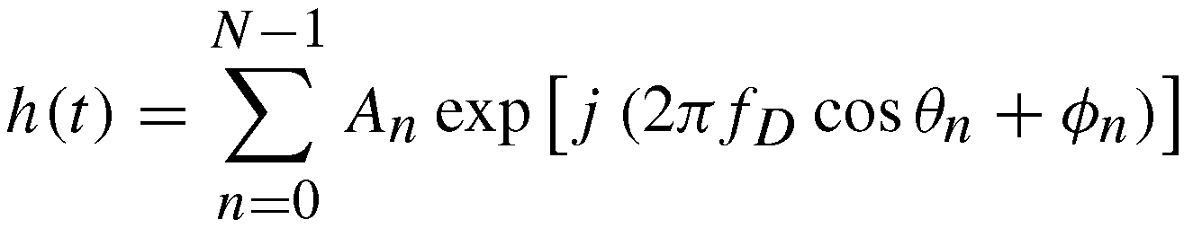
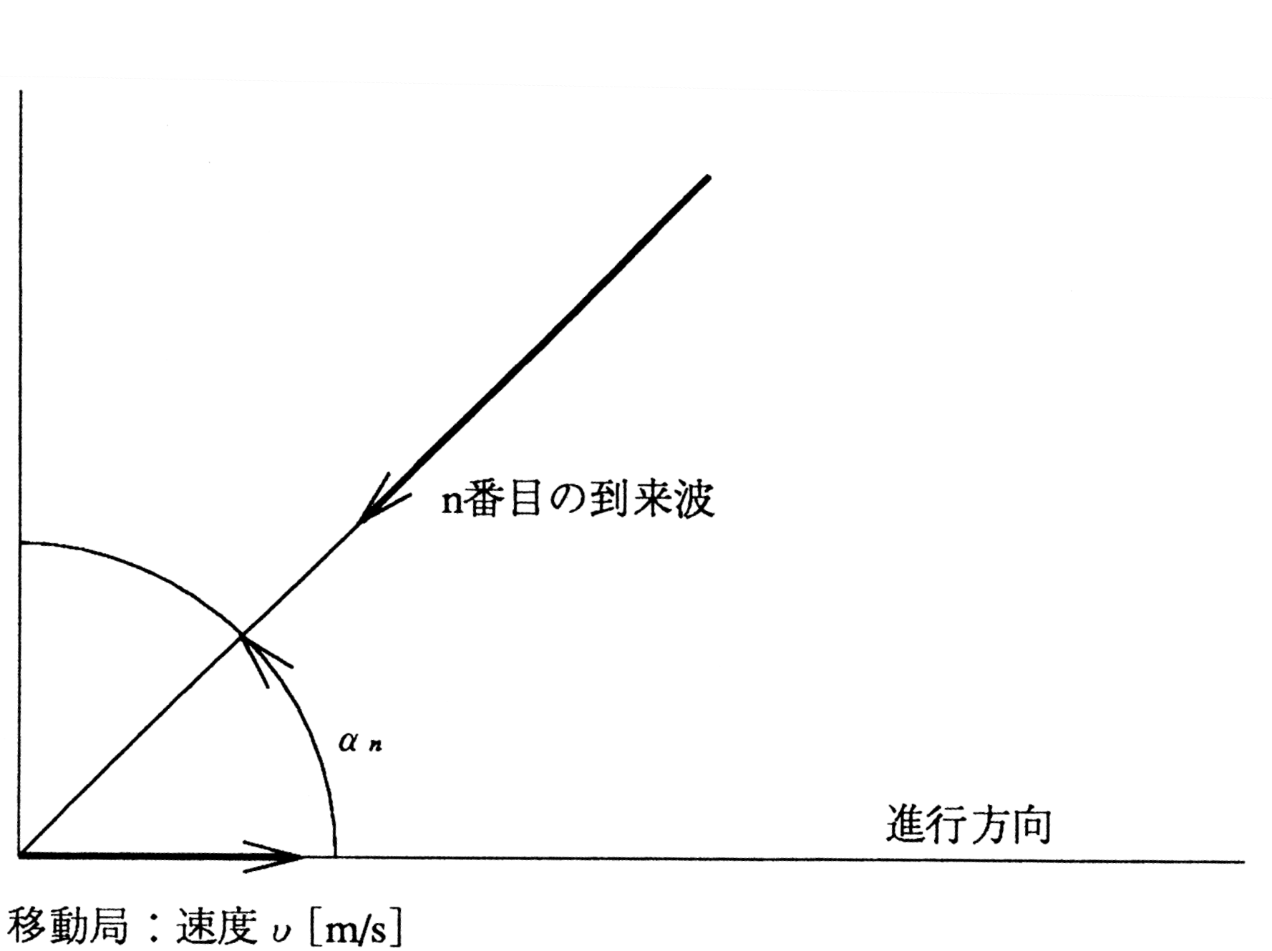
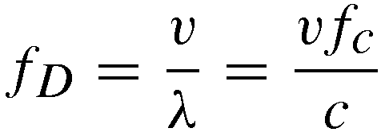



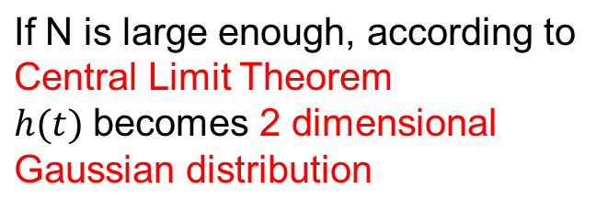
Rayleigh Fading
Fading is generated by combination of complex received waves with various amplitude and phase (component wave)
N：number of component waves
： maximum Doppler freq. (Hz)
： amplitude
：AoA
： initial phase
n-th received wave
Movement direction
MT: speed

Slide 9
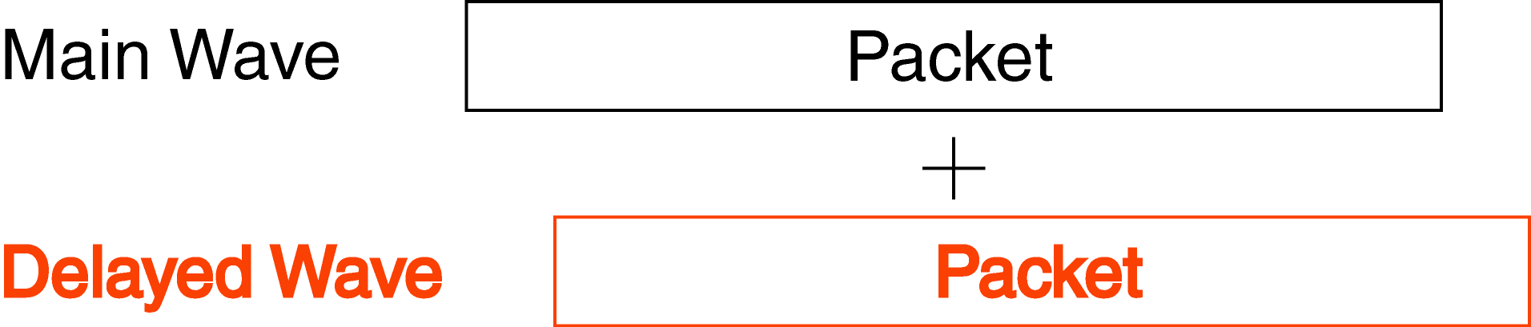
Frequency Selective Fading
Delayed wave is generated by difference in propagation path
Delay wave
In high data rate communication, ISI occurs
Direct Wave
Leak from previous symbol

Slide 10

符号間干渉（ISI）
Assuming 2 path fading channel
（ISI）

Slide 11
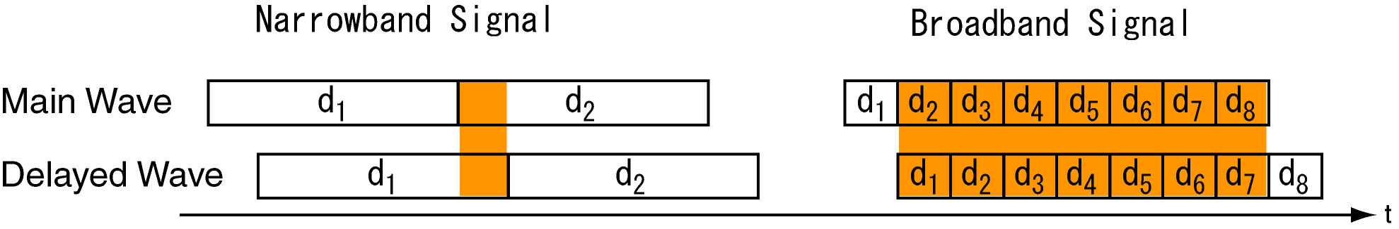
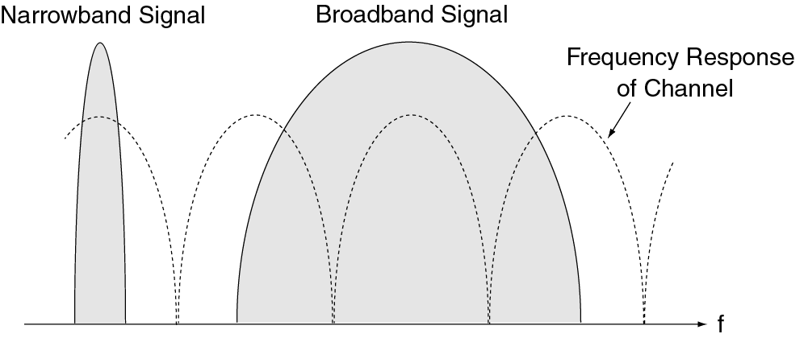
Relation between Delayed Wave and Frequency-selective
Direct Wave
In high data rate transmission, influence of delay wave can not be neglected
High data rate = broadband
In broadband transmission, delayed waves cause deep fade in frequency domain (frequency selective)

Slide 12
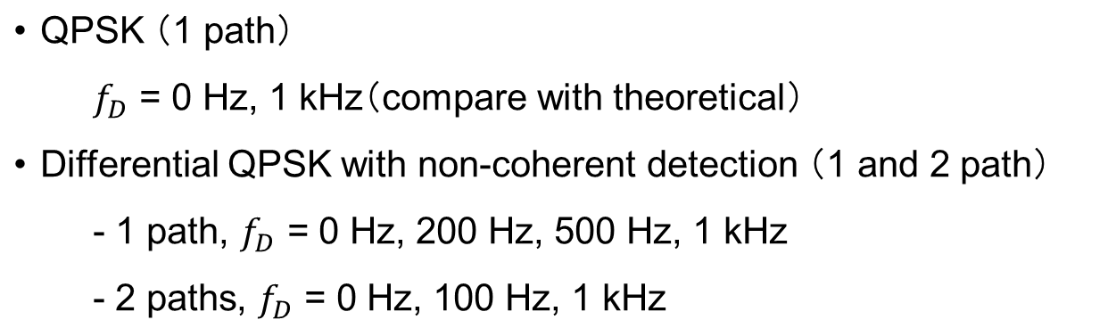
Assignment
Examine 2 types of fading channel
Rayleigh fading
frequency-selective fading
Obtain the BER in fading channel
Submit your report by Nov 24

Slide 13
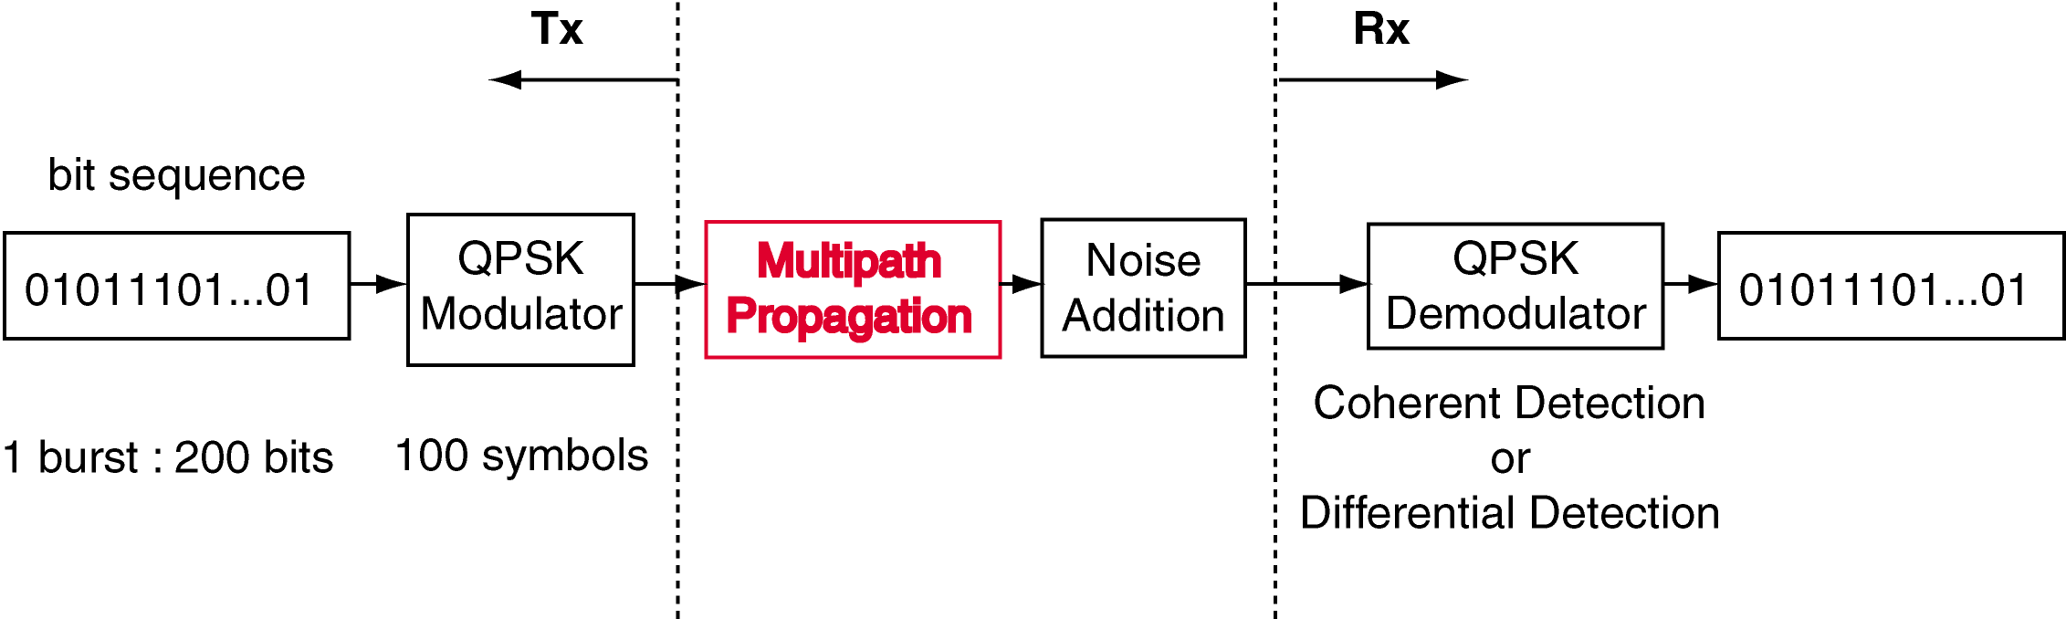

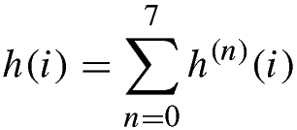






Hint on Program
is performed by adding 8 waves in computer simulation
・
， by means of Box-Muller
is set to 1/8（see reference）
・
Uniformly random
・
is variated in the simulation
・ channel response is generated for each packet

Slide 14



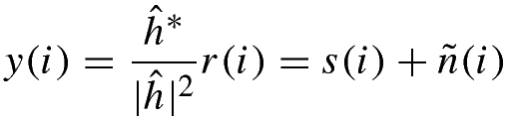

Coherent Detection Technique
Assume a quasi-static fading for propagation
Received signal:
Multiply with
received wave
: channel estimation
Ideal channel estimation ( ))
is decided

Slide 15


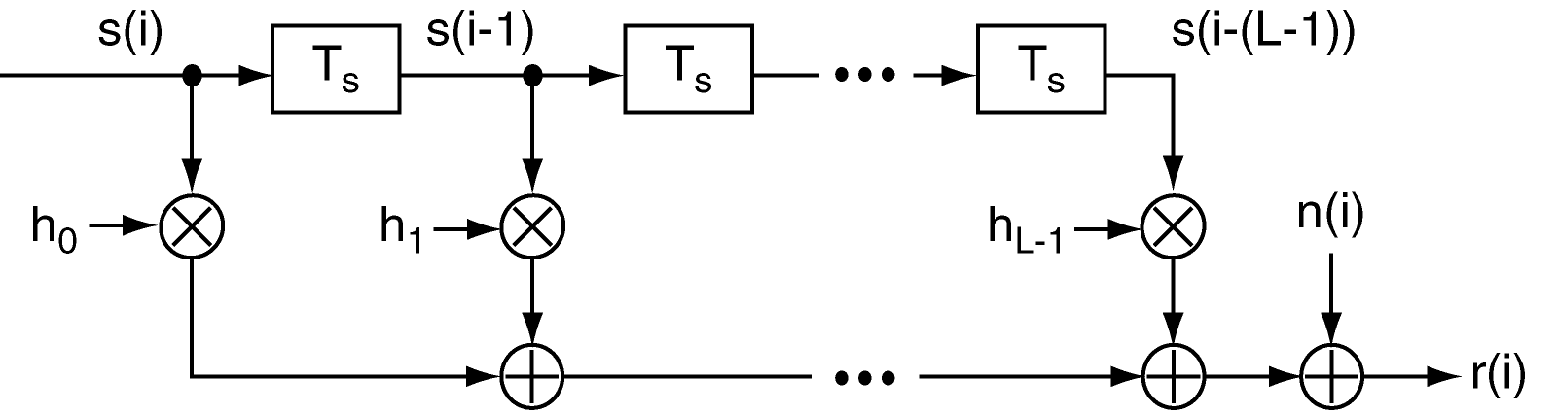
Generating 2 Path Freq. Selective Fading
・
， is generated with 1/2 power each
(generation is similar to rayleigh fading)

Slide 16
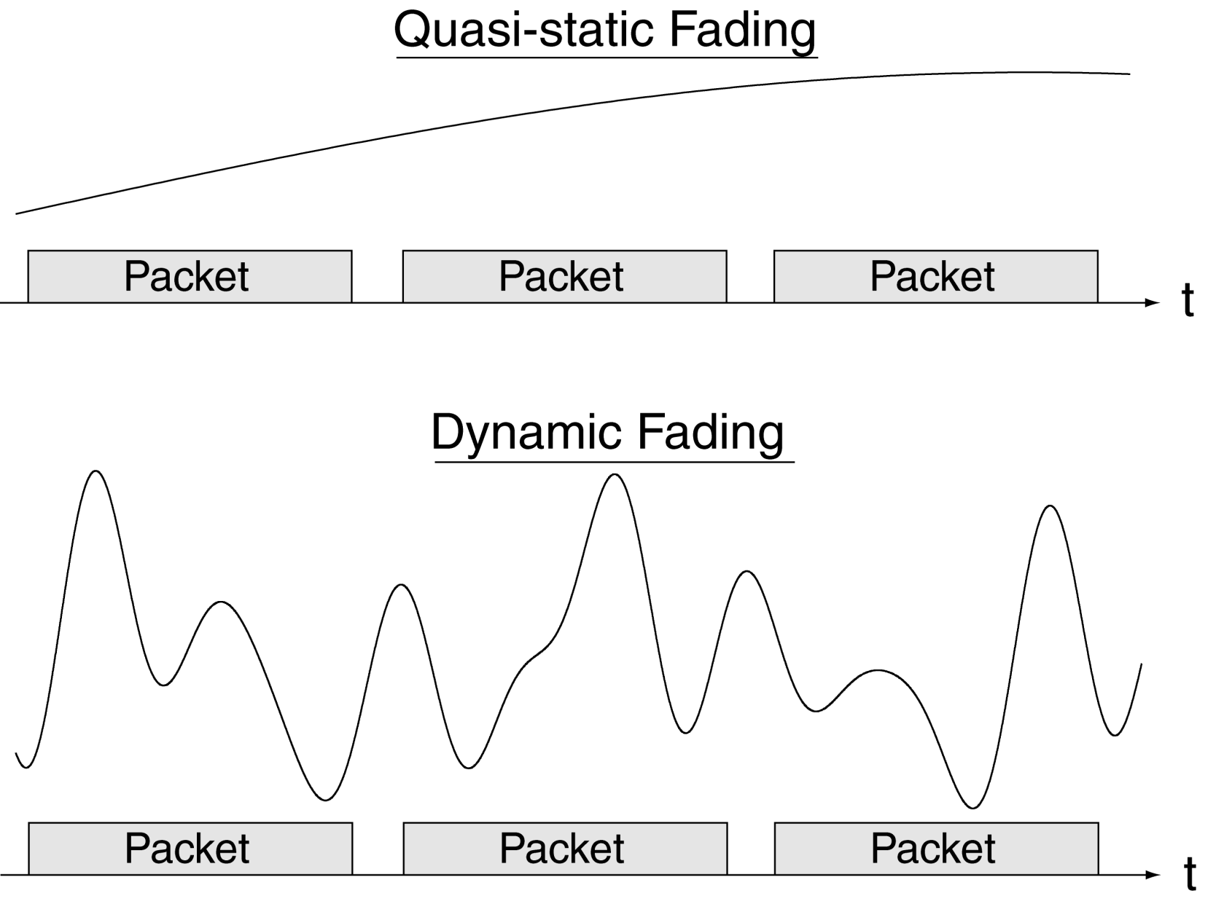

Quasi-static and Dynamic Fading
The difference in 1 packet could be ignored (change happens between packet)
influences performance degradation
: fluctuates between symbol

Slide 17
14 Packets as a Group
packet 0
packet 1
packet 2
。。。
packet 12
packet 13
t
Channel Estimation at Packet 0
Channel Changed due to Doppler Shift

