Slide 1
Why NN Works?

Slide 2
Problem Definition
Input: Images, Voices, Texts ……
X in {0,1}^n
Output:
Regression: Y in R
Classification: Y in {0,1}^C

Slide 3
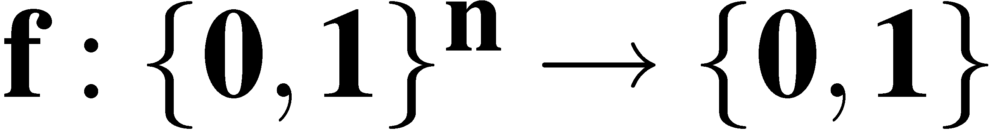
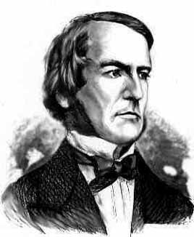
The Boolean function
Notes:
Our central object of study.
With apologies to George Boole, I’ll frequently write “boolean” with a lower-case “b”.

Slide 4
Query or Sample?
2^n queries get exact function
EX(f,D) draws an example, with distribution D and gives the correct output according f.
algorithm A, given a sample of polynomial size p drawn according to EX(f,D), then, with high probability A outputs a hypothesis h has low error on X with the distribution D.
If A works for every concept f in F and for every distribution D over X, then F is PAC learnable (or distribution-free PAC learnable).

