Slide 1
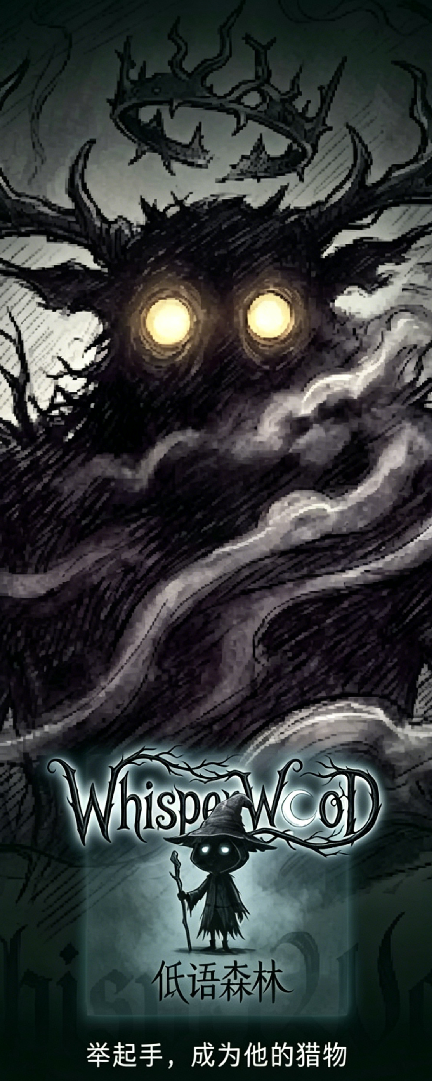
WhisperWood
《低语森林》
AI-Driven Dark Fairytale Gesture Duel Game
"You are not clearing levels. You are playing against a thinking dark will."
[汇报人：刘雨萌] | 2026.06
Notes:
AI 驱动暗黑童话手势对战游戏
“你面对的不是固定关卡，而是具备动态决策能力的对手。”
“你不是在闯关，你在与一只有思想的黑暗意志博弈。”

Slide 2
Problem: Interactive Entertainment Lacks "Intelligent Opponents"
01
Gesture Games = Reaction Tests
02
"AI-Driven" is Mostly Marketing
Opponents follow preset patterns. No "observe-analyze-decide" ability. Player figures out the pattern -> boredom.
AI only generates static assets or does basic classification. Never actually participates in real-time game decisions.
03
Quality Motion Gaming Requires Hardware
04
Visual Style Homogeneity
VR headsets, Kinect, Leap Motion... Zero-hardware motion interaction is almost non-existent.
Cartoon-cute / Sci-fi metal / Minimalist flat. Dark fairytale - "beauty and danger coexist" - is an empty category.
Notes:
互动娱乐缺的不是更多关卡，而是一个会思考的对手
为什么这件事值得做？因为现在的体感互动游戏
四个问题模块
01 手势游戏 = 反应力测试
对手套路固定，玩家摸透规律即倦怠
02 “AI 驱动” 多是噱头
AI 只生成素材或做分类，不参与实时决策
03 体感游戏门槛高
VR、Kinect 等设备昂贵，零硬件纯体感几乎空白
04 视觉风格同质化
萌系卡通、科幻金属之外，暗黑童话赛道空白

Slide 3
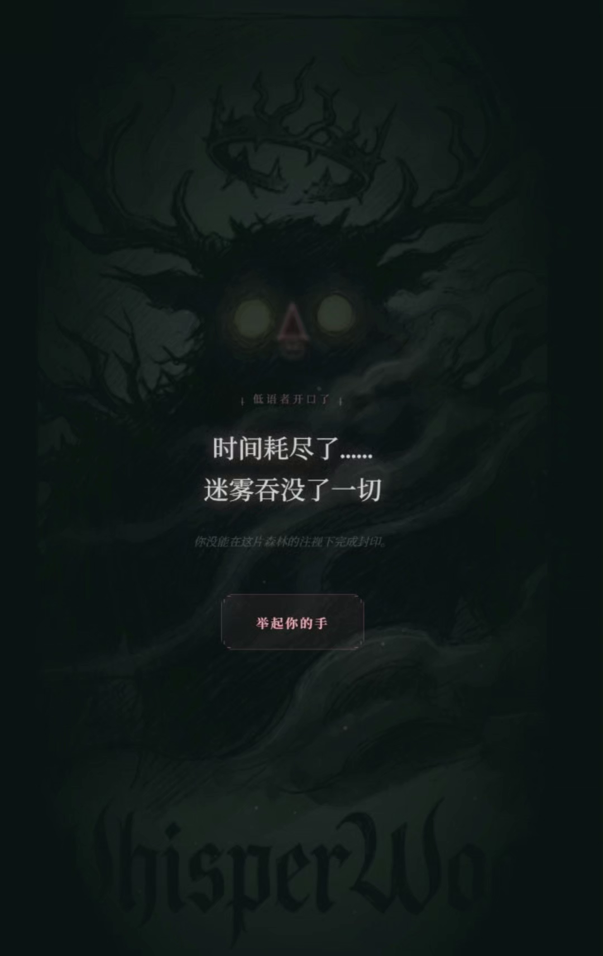
Solution: Three-Layer AI Human-vs-Machine Duel
Layer 1: AI Gesture Recognition
Layer 2: AI Dark Lord
Layer 3: AI Whisperer
MediaPipe Hands
Rule Strategy Engine
LLM (Large Language Model)
Understands your hands
Studies you, targets your weaknesses
Taunts you with words
21 hand keypoints real-time detection
6 gestures (3 static + 3 motion)
Kalman filter + EMA smoothing
Browser-side WASM, zero latency
Tracks miss rate per gesture, weighted attack selection
"Targets your weak spots"
4-tier attack intensity state machine
Probe -> Suppress -> Finish -> Mercy
Generates personalized taunts at discrete nodes
800ms timeout with preset fallback quotes
"Degradable dependency" architecture
Notes:
解决方案：三层架构实现 AI 人机对战体验
第一层：AI 手势识别层
基于 MediaPipe 手部模型，实现手部动作精准识别
实时检测 21 个手部关键点
支持 6 种手势（3 种静态手势 + 3 种动态手势）
采用卡尔曼滤波与指数移动平均算法优化识别平滑度
浏览器端 WASM 本地运行，降低交互延迟
第二层：AI 对战策略引擎（暗黑领主）
研究你的习惯 —— 动态追踪弱点，针对性出招
基于规则的策略系统，根据玩家表现动态调整出招
统计各手势失误率，采用加权逻辑选择攻击类型
核心逻辑：优先选择玩家失误率更高的手势进行挑战
四档攻击强度状态机：试探 → 压制 → 收尾 → 缓冲
第三层：AI 叙事旁白（低语者）
干扰你的心态 —— 大模型生成个性化嘲讽台词它负责'用语言刺激你'。"
输入识别、决策策略、语言叙事 —— 三层各司其职，不是为了 AI 而 AI

Slide 4
demo：
https://youtube.com/shorts/Po2U2N9IGlg?feature=share
Notes:
解决方案：三层架构实现 AI 人机对战体验
第一层：AI 手势识别层
基于 MediaPipe 手部模型，实现手部动作精准识别
实时检测 21 个手部关键点
支持 6 种手势（3 种静态手势 + 3 种动态手势）
采用卡尔曼滤波与指数移动平均算法优化识别平滑度
浏览器端 WASM 本地运行，降低交互延迟
第二层：AI 对战策略引擎（暗黑领主）
研究你的习惯 —— 动态追踪弱点，针对性出招
基于规则的策略系统，根据玩家表现动态调整出招
统计各手势失误率，采用加权逻辑选择攻击类型
核心逻辑：优先选择玩家失误率更高的手势进行挑战
四档攻击强度状态机：试探 → 压制 → 收尾 → 缓冲
第三层：AI 叙事旁白（低语者）
干扰你的心态 —— 大模型生成个性化嘲讽台词它负责'用语言刺激你'。"
输入识别、决策策略、语言叙事 —— 三层各司其职，不是为了 AI 而 AI

Slide 5




AI Dark Lord: How Does It "Target" You?
Weakness Tracking & Weighted Attacks
Attack Intensity State Machine
1. Track hit/miss counts for each gesture
Probe
Observe player level
high combo/full HP ->
2. Calculate miss rate = misses / occurrences
3. Weighted random selection -> targets your weakness
Suppress
Speed up, high density pressure
HP danger ->
4. 15% random perturbation -> prevents monotony
Finish
Concentrate on weakness to finish
near death ->
Mercy
Slow down, give breathing room
recovery -> Suppress
Key Insight: "Mercy" is the core of experience design - when the player is near death, AI deliberately slows down, creating a "I almost won" feeling that drives replay.
Notes:
AI 暗黑领主：如何精准针对你的弱点
弱点追踪与加权攻击
统计每个手势的命中 / 失误次数，计算失误率
加权随机选牌，优先攻击玩家薄弱手势
加入 15% 随机扰动，避免套路被摸透
四档攻击强度状态机
观察玩家水平
提速、高密度施压
集中攻击弱点收尾
降速，给玩家喘息
核心设计洞察 — 「怜悯机制」是核心成瘾点：玩家濒死时 AI 刻意放水，制造“差一点就赢了”的心理钩子，驱动玩家再来一局。

Slide 6
Progressive Cognitive Load: Five-Level System
Level 1
Level 2
Level 3
Level 4
BOSS
First Mist
Mirror Maze
Echo Track
Decay Field
Total Control
Basic follow
Mirror flip
Counter moves
Chain penalty
ALL THREE
200pts/65s
300pts/60s
400pts/55s
500pts/50s
600pts/45s
- - -
Mirror ON
Counter ON
Chain ON
ALL ON
Design philosophy: Each level introduces one new cognitive dimension. Players keep learning, not just repeating.
Notes:
渐进式认知负荷：五级关卡体系
设计理念：每一关仅引入一个新的认知维度 —— 让玩家持续学习成长，而非机械重复操作

Slide 7

Boss Gaze: The Blind Mist Mechanic
Mechanic Design
> Every 10s, the Dark Lord opens its eyes for 3s
> After grace -> any movement = instant fail
> Screen covered by fog -> cannot see gesture prompts
> Crimson demon eye SVG overlays screen
> Player must keep hand COMPLETELY still
> Heartbeat SFX escalates with each miss
> 600ms grace period (allow finishing in-progress gesture)
> Screen edges darken progressively inward
Why is this effective? It is not a traditional "reaction" test - it is "restraint". You stay still, but your heart races. One move and it is over.
Design philosophy: Introducing "DON'T MOVE" into a gesture action game - reverse thinking creates unique tension. More stimulating than any speed boost.
Notes:
领主凝视：盲雾机制
每 10 秒暗黑领主睁眼一次，持续 3 秒
宽限期结束后，任何手部移动 = 直接判负
浓雾遮蔽视野，猩红魔眼特效覆盖全屏
心跳音效随失误次数逐步加剧，画面边缘向内压暗
预留 600ms 宽限期，允许玩家完成正在做的手势
“不许动”的反向规则

Slide 8
Technical Architecture
Frontend
Vanilla JS (ES Module)
Zero build steps, pure native SPA
Gesture
MediaPipe Hands (WASM)
21 hand keypoints, browser-side local inference
AI Decision
Rule Strategy Engine
Weighted miss-rate + attack state machine, <16ms latency
AI Narrative
LLM API (optional)
Discrete node calls, 800ms timeout with fallback quotes
Rendering
Canvas 2D + CSS Anim
3-layer ink trails, particle system, SVG runes
Audio
Web Audio API + <audio>
10+ synthesized SFX, dual independent volume control
Styling
Tailwind CSS (CDN)
Utility-first, dark theme customization
Deploy
Any static hosting
Vercel / Netlify / GitHub Pages, HTTPS required
Notes:
模块 技术方案 关键参数
前端 原生 JS（ES 模块） 零构建步骤，纯原生 SPA
手势识别 MediaPipe Hands（WASM） 21 个关键点，浏览器端本地推理
平滑处理 卡尔曼滤波 + EMA 抑制抖动，零额外延迟
AI 决策 规则策略引擎 失误率加权 + 状态机，延迟 < 16ms
AI 叙事 LLM API（可选） 800ms 超时兜底，可降级架构
渲染 / 音频 Canvas 2D + Web Audio API 墨迹粒子特效，10+ 合成音效
部署 任意静态托管 Vercel / Netlify / GitHub Pages

Slide 9
Key Innovations
1
AI-Driven Human-Machine Duel
Elevates AI from a "feature module" to the "soul of the game". AI observes -> analyzes weaknesses -> targets attacks -> dynamically adjusts intensity. Player is not clearing levels - they are dueling a thinking dark will.
2
Three-Layer AI Architecture
Input (CV recognition) + Decision (rule strategy) + Narrative (LLM language). Each layer has distinct responsibilities with the most suitable tech. No "AI for AI's sake" bloat.
3
"Mercy" Mechanic
AI deliberately slows down when player is near death. Not a bug - a carefully designed psychological hook. "I almost won" -> "One more try". The source of addiction.
4
Blind Mist (Boss Gaze)
Introducing "DON'T MOVE" into a gesture action game. Reverse thinking creates unique tension. More stimulating than any speed or pressure increase.
5
Dark Fairytale Aesthetics
Gothic x Ink & Ash x Dark Fairytale. An empty category in interactive entertainment. Pure CSS/Canvas/SVG procedural implementation - a replicable aesthetic formula.
Notes:
核心特点
1 AI 参与的动态人机对战
AI 实现了行为观察、弱点分析、针对性出招、强度动态调整的完整流程，让对战体验更富变化，区别于固定流程的关卡闯关模式。
2 分层 AI 架构设计
分为输入层（视觉识别）、决策层（规则策略）、叙事层（语言生成），各层职责清晰，技术选型匹配对应场景，避免冗余的 AI 功能堆砌。
3 难度缓冲机制
玩家濒死时 AI 自动降低攻击强度，优化对局体验，通过 “接近通关” 的感受提升玩家复玩意愿。
4 反向操作的 BOSS 机制
在手势操作类游戏中加入 “保持静止” 的反向规则，与传统提速加压的设计相比，能带来差异化的紧张感体验。
5 暗黑童话视觉风格
融合哥特质感、水墨灰调与暗黑童话叙事，在同类产品中风格辨识度较高；基于 CSS/Canvas/SVG 实现程序化渲染，视觉方案具备可复用性。

Slide 10
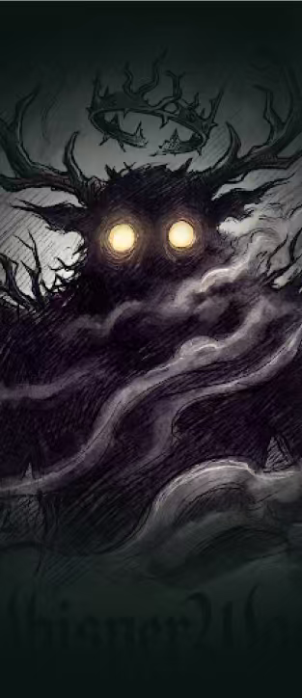
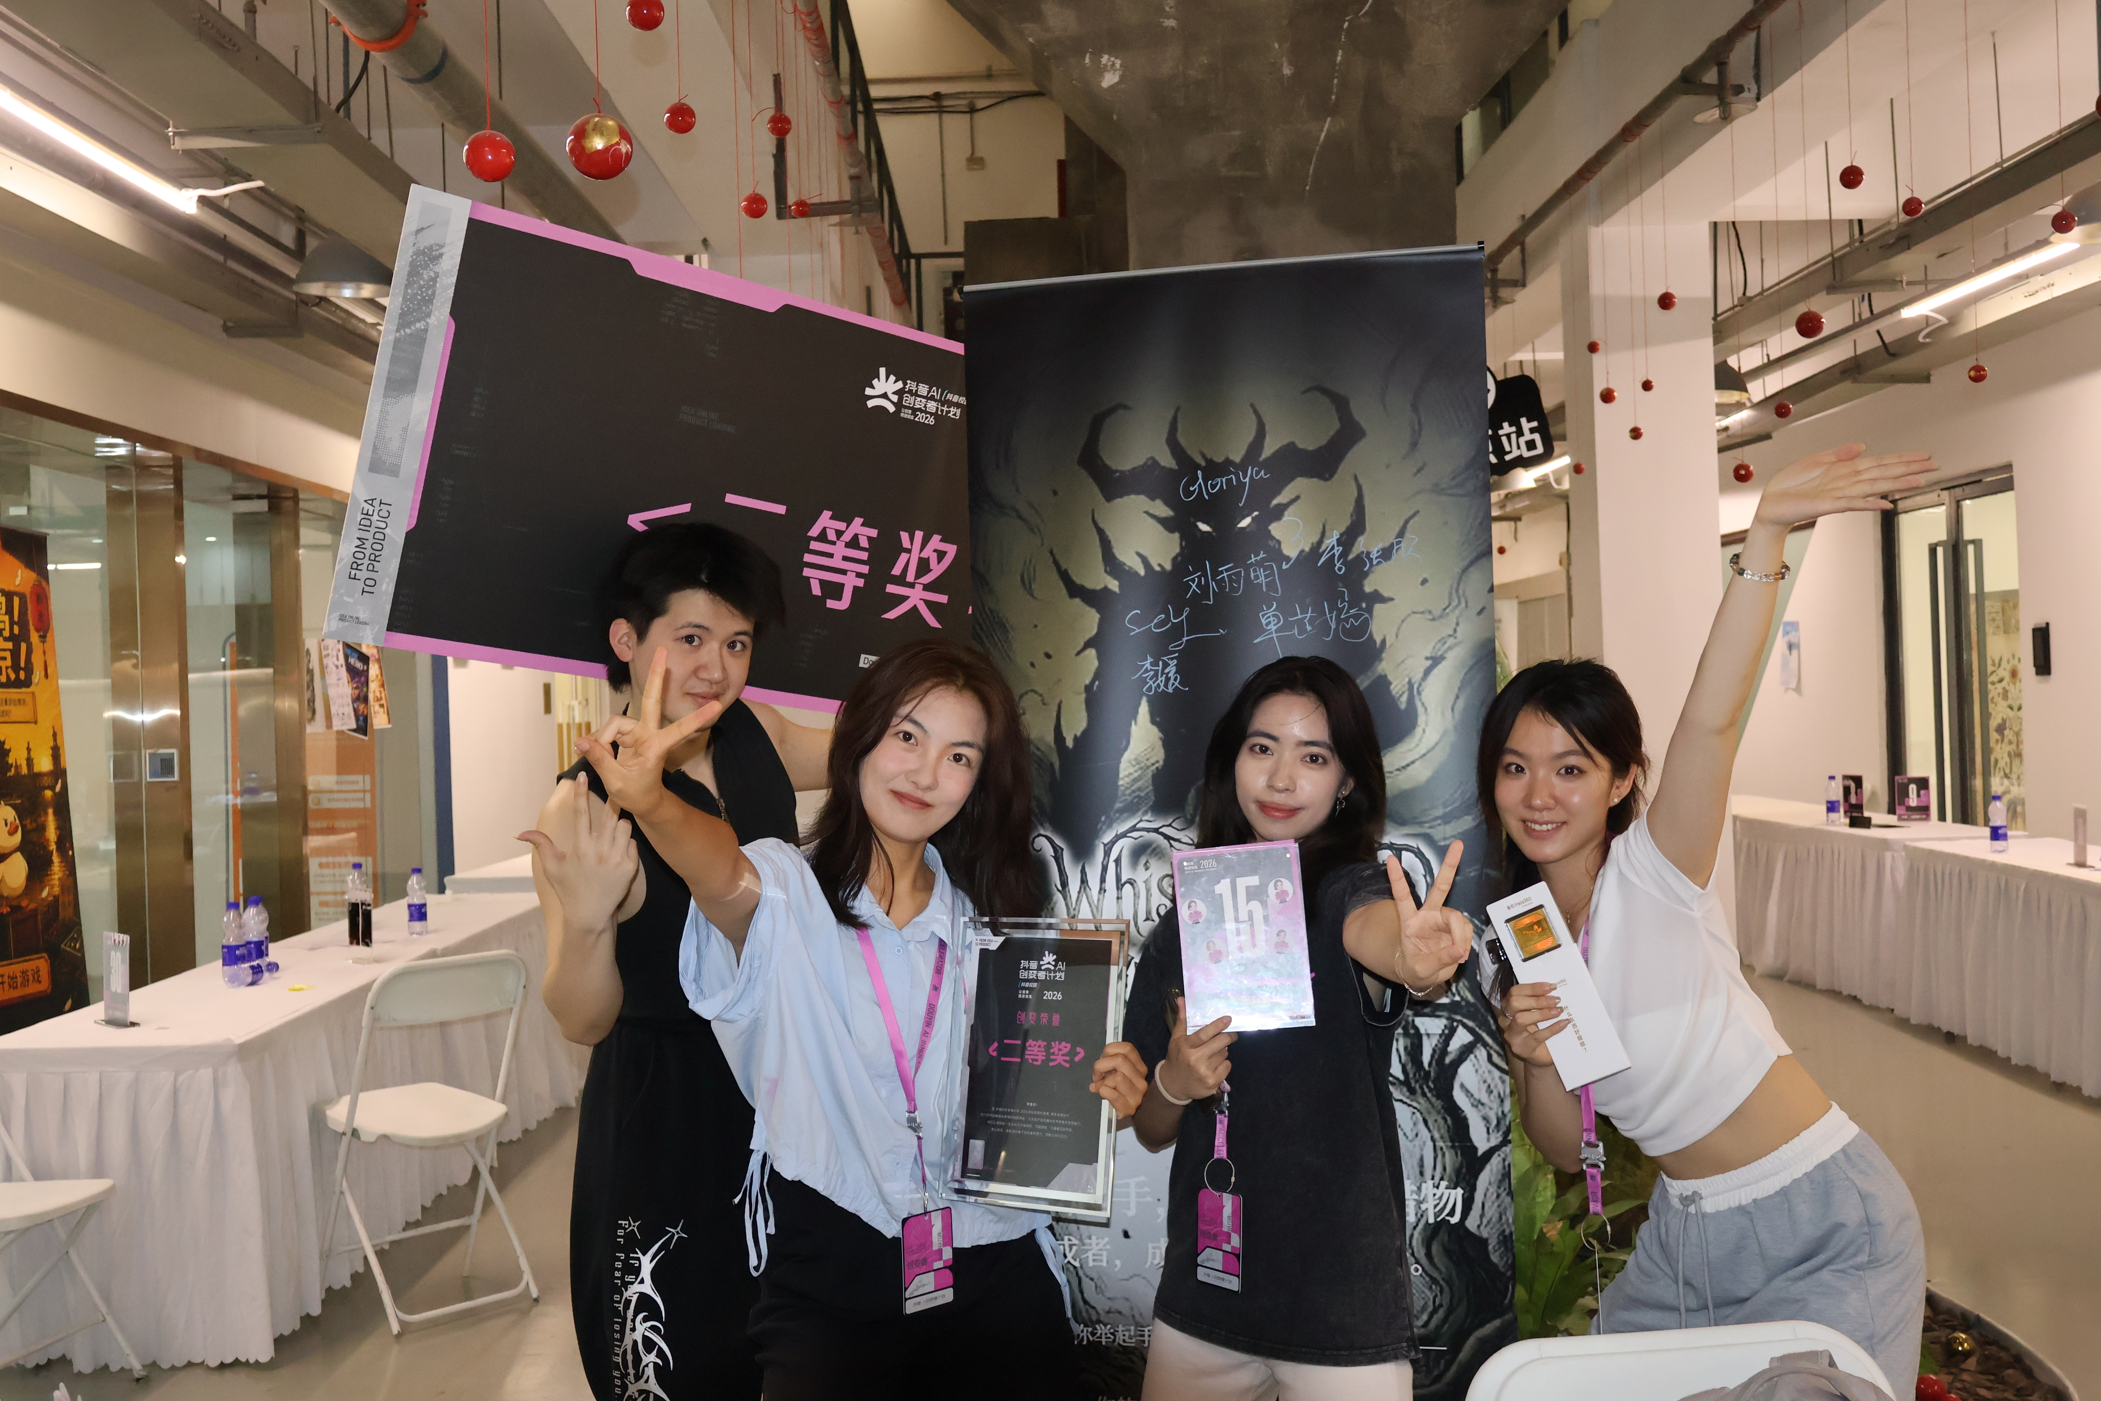

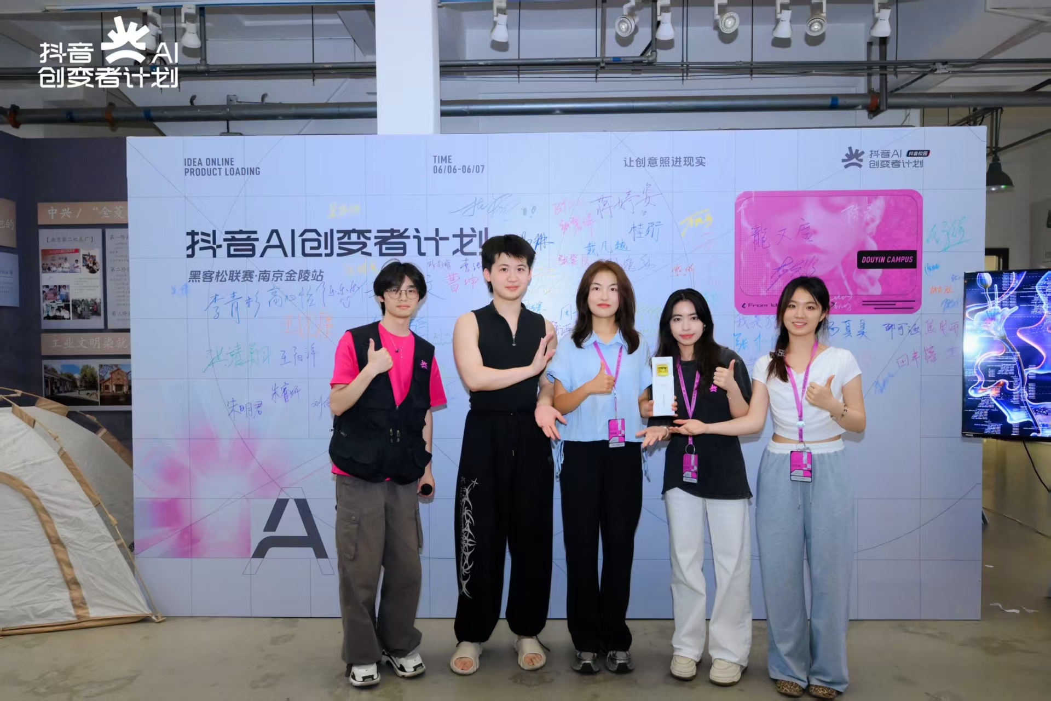

Product Achievements

Slide 11
Product Roadmap
P0
LLM Whisperer integration + public deployment
P1
Gesture tuning panel + facial expression detection
P2
Level editor + mobile adaptation
P3
Multiplayer + IP world expansion
Notes:
产品迭代路线
P0：LLM 叙事模块接入 + 公开部署上线 | 开发量 2-4 小时
P1：手势参数调校面板 + 面部表情识别 | 开发量 12-16 小时
P2：关卡编辑器 + 移动端适配 | 开发量 28-36 小时
P3：多人对战模式 + IP 世界观拓展 | 长期迭代

Slide 12
WhisperWood
《低语森林》
"You are not clearing levels. You are playing against a thinking dark will."
Zero Hardware | Pure Browser | AI Real-Time Decision | Dark Fairytale
Thank You! | [刘雨萌] | 2026.06

