Slide 1
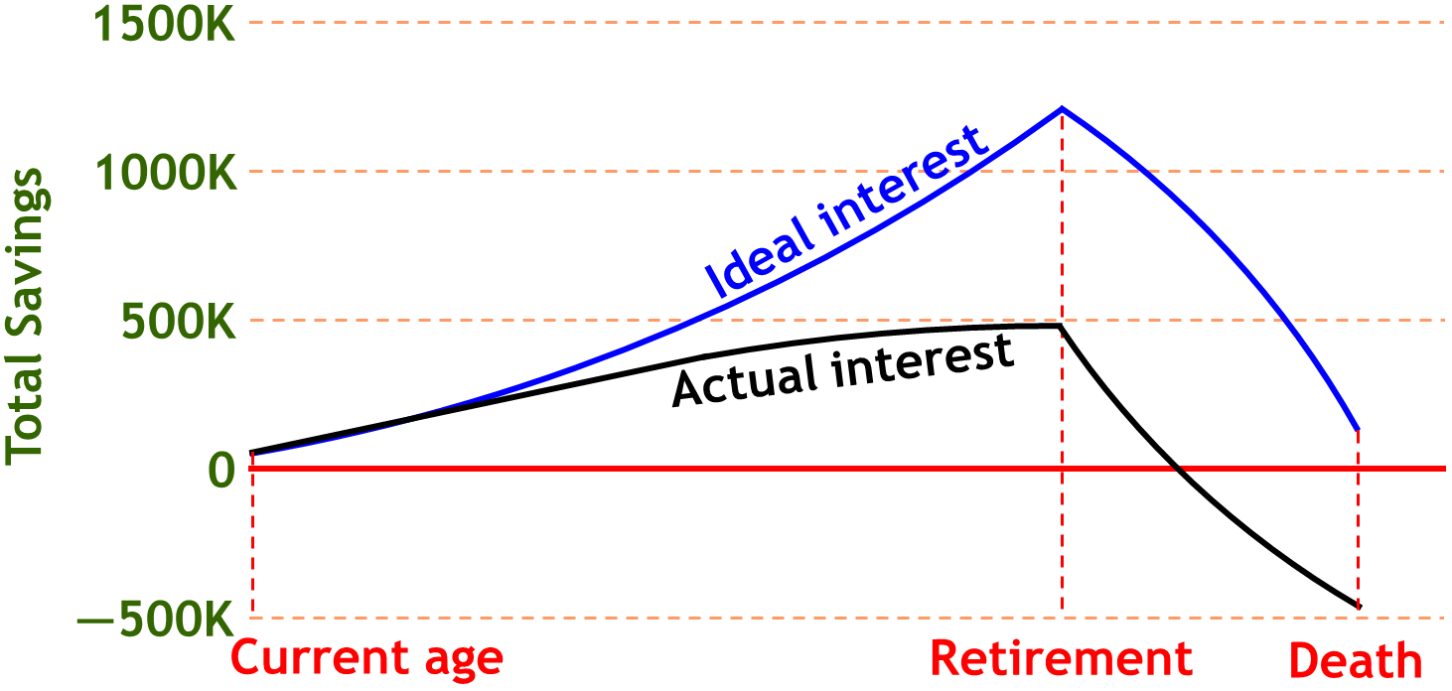




Investment Plan Analytics
By "The Brokers": Dayu Wang, Joshua Neustrom, Yunlong Liu, Chen Wang
Investors focus on retirement planning and avoid planning for death.
Investors focus on potential profit and avoid thinking about potential loss.
Effect after Retire
Inflation
Ideal vs.
Actual
Risk vs. Reward
Problem 1
Innovation 1
Problem 2
Innovation 2
Innovation 3
Innovation 4
2016 Fall UMKC Hackathon

