Slide 1
Investment Plan Analytics (DST Use Case)
GitHub Repository: https://github.com/wangchen2317199/FS16_Hackathon
YouTube Video: https://www.youtube.com/watch?v=iSUUbLbbApY
Amazon AWS Link: http://investmentplanner.s3-website-us-east-1.amazonaws.com
By The Brokers
Joshua Neutrom, Yunlong Liu, Chen Wang, Dayu Wang

Slide 2
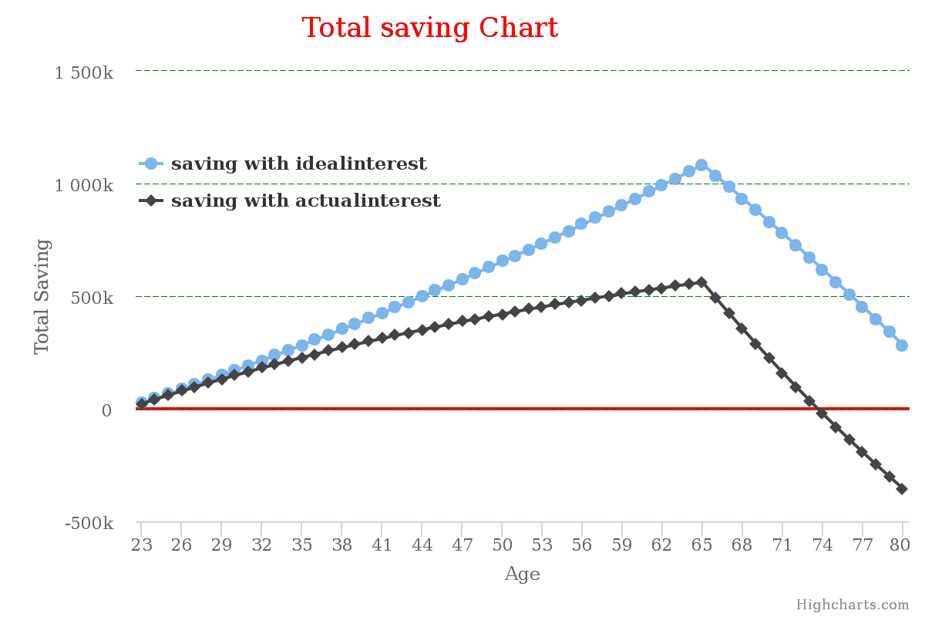
Problem Solution
Investors focus on retirement planning and
avoid on planning for death.
Method 1
Show effect of investment decisions after retirement.
Method 2
Account for inflation.
Method 4
Show amount remaining at death (age 80).
Make realistic expense calculations.
Method 3

Slide 3
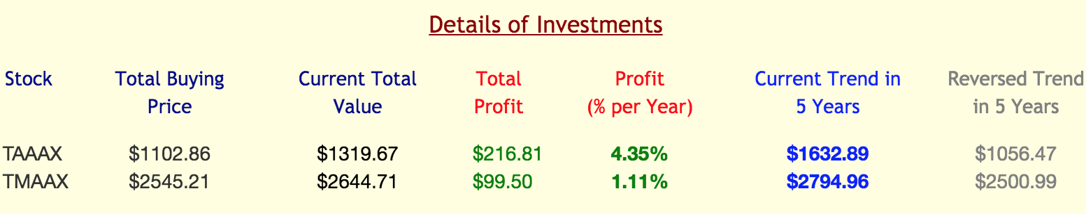
Problem
Investors focus on potential profit and avoid thinking about risk of loss.
Solution
Show potential effects of investment decisions.
Risk vs Reward: Graph the best and worst case scenario for a fund family.
Show Truth: Graph the future gains/losses based on current investment history.
Reality Check: Show their current investment interest in comparison to the ideal interest.

Slide 4
Assuptions
ageOfDeath := 80
inflation := 0.04 (i)
lossRate := gainRate.reverse( )
Calculations
idealSaving := (invest + saving) * Math.pow(1 + idealInterest - i, ageRetire - age)
idealSaving := (invest - expense) * Math.pow(1 + idealInterest - i, death - ageRetire)
realSaving := (invest - expense) * Math.pow(1 + realInterest - i, death - ageRetire)
realSaving := (invest + saving) * Math.pow(1 + realInterest - i, ageRetire - age)

Slide 5




Attributions and Source
Yahoo Finance
https://finance.yahoo.com
Thrivent Mutual Funds
https://www.thriventfunds.com
HighChart
http://www.highcharts.com
mLab
https://mlab.com

