Slide 1
Grounding with Bing Custom Search

Slide 2
Business Purpose – Smart Nudge
Support the GCE Office: Monitor public news and announcements relevant to AIA, the insurance industry, and regulatory developments.
Focus on designated websites: Search official sources selected for each monitoring topic.
Produce executive briefs: Summarize relevant updates in English with source links.
Reduce manual effort: Streamline website searching, information screening, and briefing preparation.

Slide 3
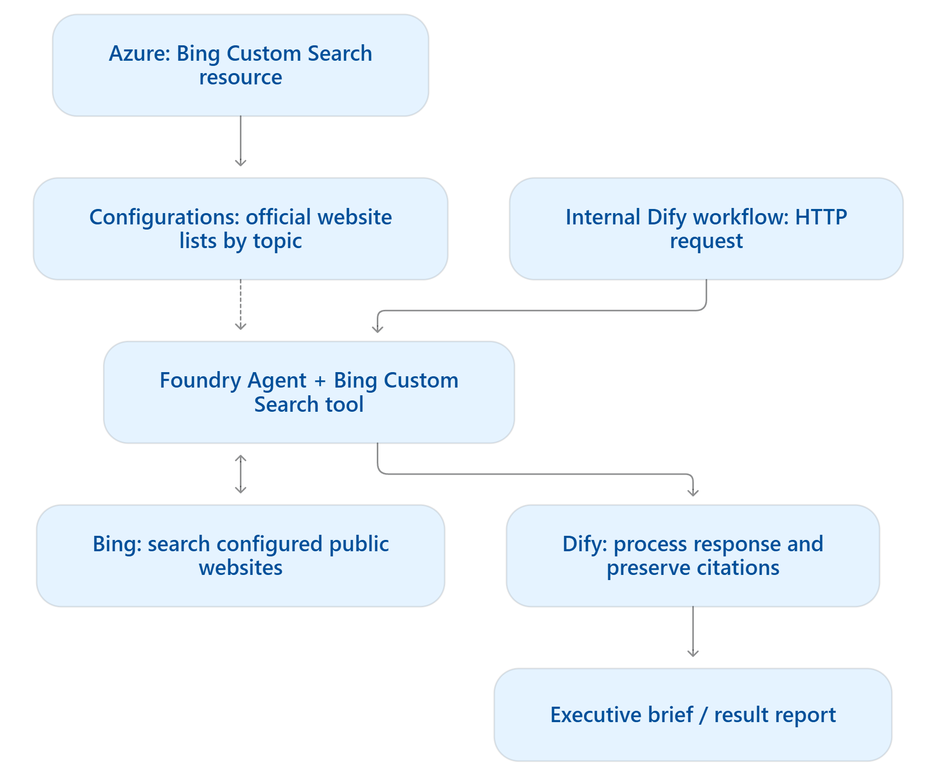
Solution Architecture
Azure configuration: Maintain separate website lists for different monitoring needs.
Foundry Agent: Use the selected configuration to retrieve information and generate a cited response.
Dify workflow: Invoke the agent through an authenticated API, then process and format the response.

Slide 4
Live Demo: General vs Custom Search
 | General Search | Custom Search
Search scope | Broad public web | Predefined websites and domains
Source control | May include official and third-party sources | Restricts retrieval to configured sources
Best suited for | Broad discovery and general research | Targeted monitoring of designated official sources

Slide 5
Why Custom Search Is Required
Meet the business requirement: News included in the brief must originate from designated official sources.
Control sources at retrieval: Apply a configured website allowlist instead of relying solely on prompt instructions.
Manage scope consistently: Reuse and maintain source configurations across monitoring topics.
Support review: Retain source citations so the GCE Office can inspect the underlying publications.

Slide 6
Thank You

