Slide 1
Attention-based Multi-task Field-probing Networks (AMF)
P3
2018.12.16

Slide 2
01
Fundamental Work
02
AMF Network Structure
CONTENTS
03
Achievements
04
Ablation Study
05
Conclusion & Future Work

Slide 3
Fundamental Work
01

Slide 4
Advantages & disadvantages of FPNN
Advantages
More efficiency.
Use probing filters and probing points to focus on global features.
Disadvantages
Ignore the importance of local features.
Relations between probing filters are weak.
Inspirations
Combine advantages of global features and local features.
Find weights to coordinate among probing filters.

Slide 5
Object Classification Benchmark
ModelNet40 —— A 3D object mesh model dataset
Train/Test Splits
9,843/2,468 models in train/test set
Object Categories
40 categories in all
Data Augmentation
Augment data by randomly rotating the shapes horizontally

Slide 6
Preparation Stages
Data
Model refining
Mesh model -> Point cloud -> Distance field -> Normal field
Try several possible structures until final choice
Searching
Environment
Model training
Go over plenty of related papers
python 2.7.15, openCV 2.4.9, PCL, CGAL 4.7, OSG 3.4.1, Caffe
Titan XP server

Slide 7
AMF Network Structure
02

Slide 8
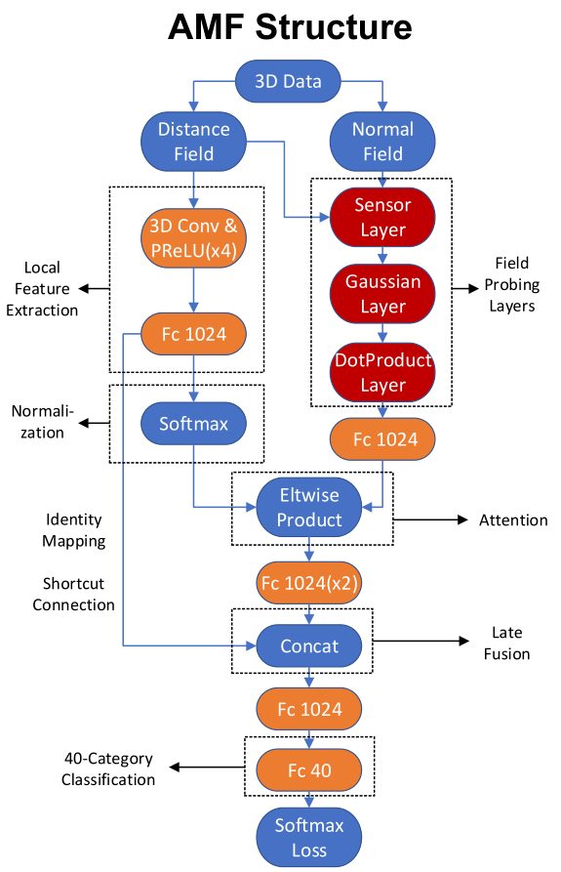
Attention-based:
Use local features to provide some prior to help with global feature extraction.
Softmax layer normalizes the output of Fc1024, which provides attention coefficients.
Attention layer uses element-wise product to transfer local features to global features.
A
M
F
Multi-task:
Learn global features and local features at the same time by utilizing concatenation before single softmax loss in back propagation.
Local features not only function in attention layer, but also function in late fusion.
Inspired by identity mapping (shortcut connection) idea proposed in ResNet.
Field-probing Networks Proposed by Author:
Mainly used for global feature extraction

Slide 9
Implementation Details
Basic settings
4 3D-conv layers
S
W
Kernel 5, stride 2, channel 128
Kernel 3, stride 2, channel 256
Kernel 3, stride 2, channel 256
Kernel 3, stride 1, channel 512
We train AMF 40,000 iterations with batch size 32, with SGD solver, learning rate 0.01, momentum 0.9, and weight decay 0.0005.
O
T
Fully connected layers
Activation function
The last FC before loss layer has 40 channels.
All other FCs have 1024 channels.
PReLU for convolutional layers
ReLU for fully connected layers

Slide 10
Achievements
03

Slide 11
Achievements——Compared with FPNN
Higher Efficiency
FPNN: 80000 iterations in batch size 64
Ours: 40000 iterations in batch size 32
Better Accuracy
FPNN: 88.02 accuracy
Ours: 90.25 accuracy
Better Transferability
FPNN: hard to transfer to similar tasks
Ours: attention-based pipeline can be utilized in other similar tasks

Slide 12
Ablation Study
04

Slide 13
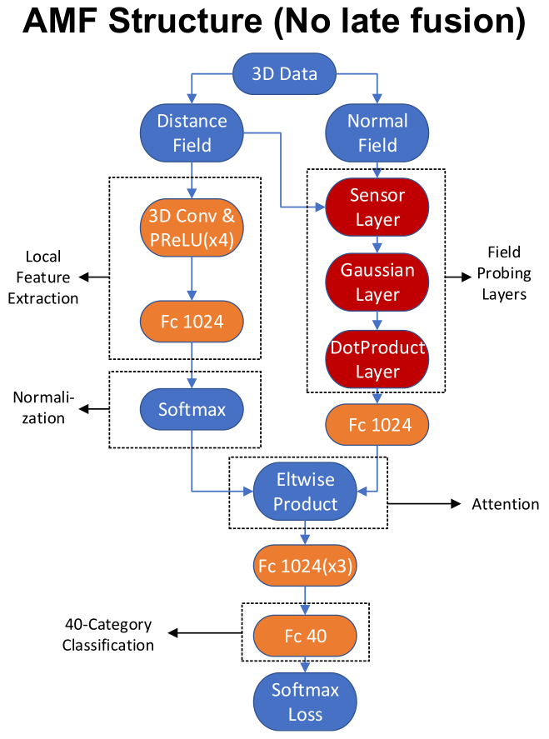
Accuracy:
90.25
Accuracy:
88.67
Learning difficulty increases as local features cannot go well with global features without late fusion. Two parallel streams make the model confused.

Slide 14
Conclusion & Future work
05

Slide 15
Conclusion
Future work
We propose a novel Attention-based Multi-task Field-probing Network (AMF) based on FPNN.
We achieve higher accuracy and higher efficiency.
Our method combines global features and local features.
Our attention-based structure can be transferred to other tasks.
Hierarchical training method: to solve the unbalance between global features and local features.
Better prior representation: to only use convolutional layers cannot achieve the best performance. We look for a better feature extractor to provide attention coefficient.
Other novel ideas…

Slide 16
Thanks.

