Slide 1
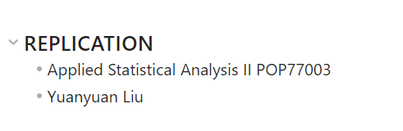

Slide 2
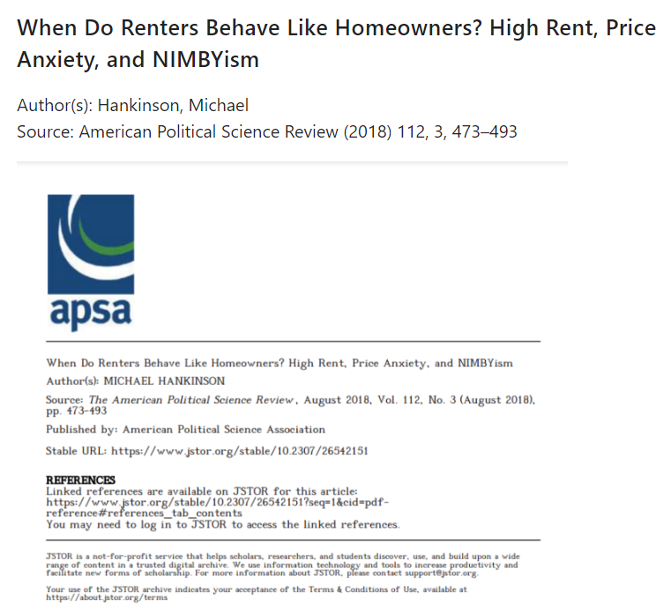

Slide 3
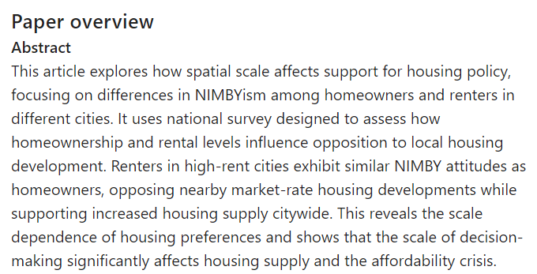

Slide 4
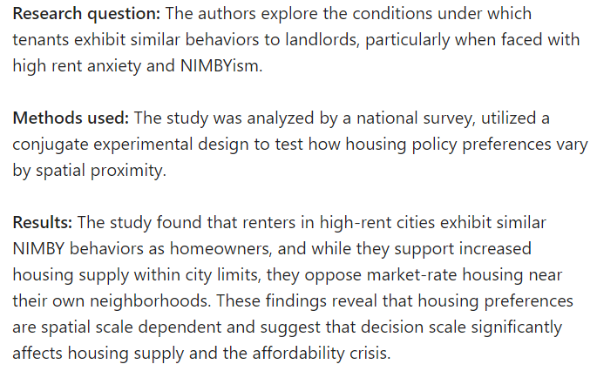

Slide 5
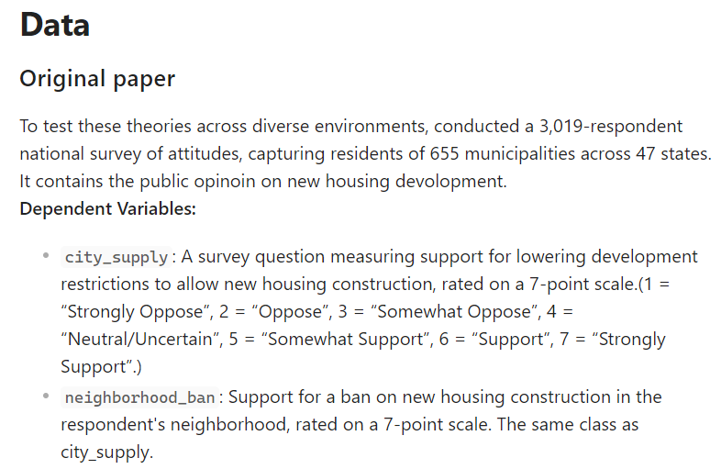
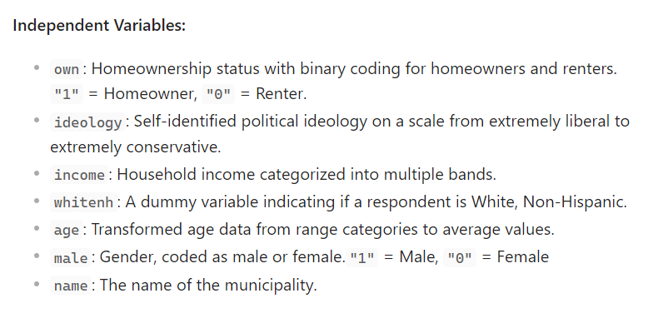

Slide 6
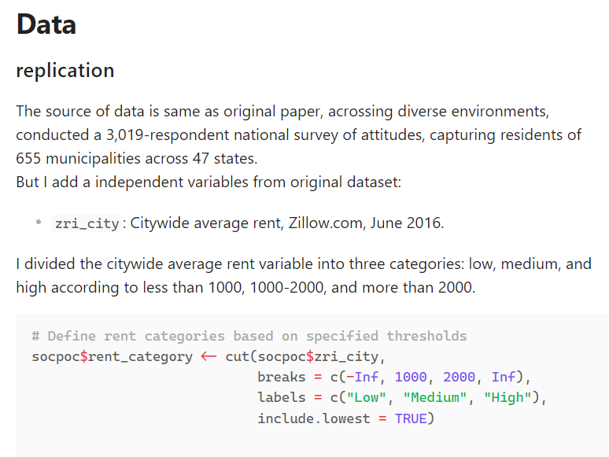

Slide 7
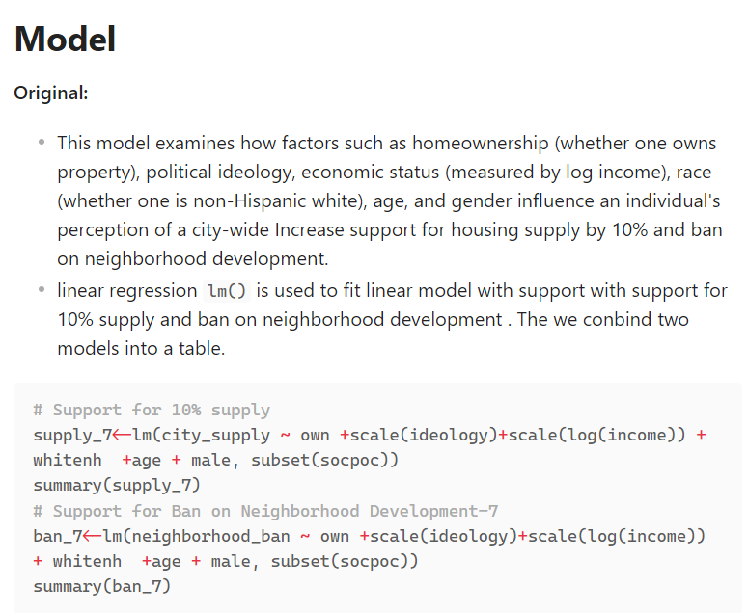

Slide 8
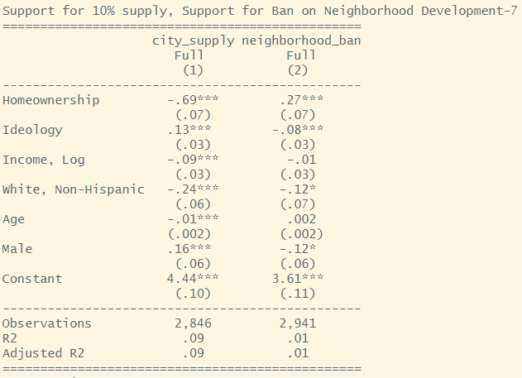
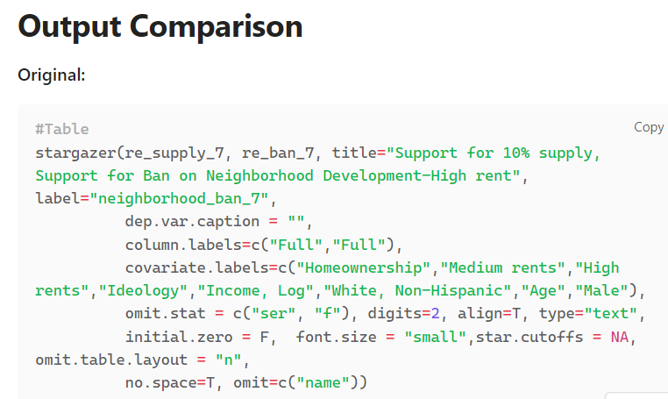
This generally indicates a negative relationship between homeowners and support for a 10% increase in housing supply within the city limits (city_supply) and a positive relationship between homeowners and support for ban on neighbourhood development. That is, holding other factors constant, homeowners are less likely than renter to support increasing housing supply within a city more likely to support bans on neighborhood development (neighborhood_ban)

Slide 9
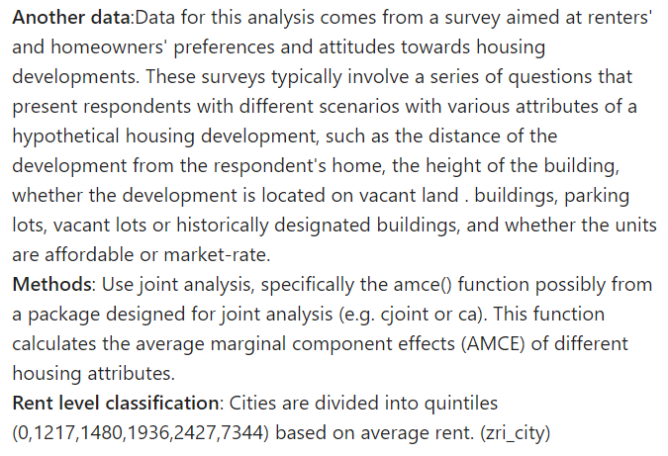

Slide 10
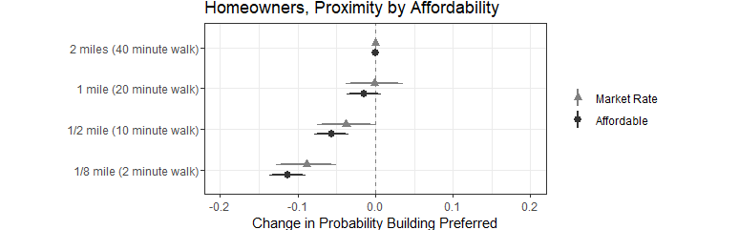
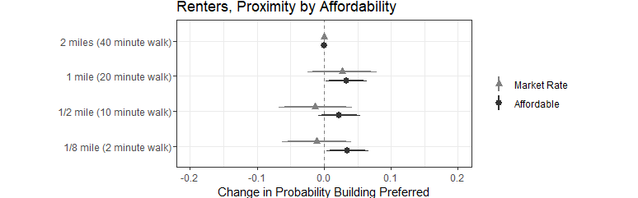
Output:
Black dots represent preferences for affordable housing and gray dots represent preferences for market-rate housing. The position of the dots represents the mean change in preference, and the horizontal line represents the confidence interval.-
Homeowners’ preferences for market-rate housing proposals and -affordable housing proposals decline as the proposed housing moves closer to where they live (the gray dots and bands shift to the left).But for renters, their preferences haven’t changed much.

Slide 11
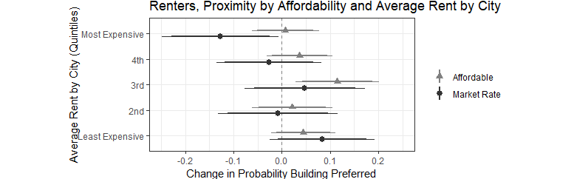
Output:
This chart shows changes in renter preferences for proposed housing projects based on proximity to where renter live and average rent levels in the city. The figure shows how preferences for market-rate housing (gray) and affordable housing (black) change as distance changes from two miles (baseline) to one-eighth of a mile, grouped by average rent city quantile.
Renters’ preference for market-rate housing projects is significantly lower in the most expensive cities (point assessments shift to the left as shown), suggesting that renters in high-rent markets exhibit NIMBY-like behavior similar to that of homeowners . In contrast, for affordable housing, renters’ preferences remained unchanged or increased slightly. This was drawn from a national survey designed to measure the NIMBY (Not In My Back Yard) tendencies of renters in cities with different rent levels.

Slide 12
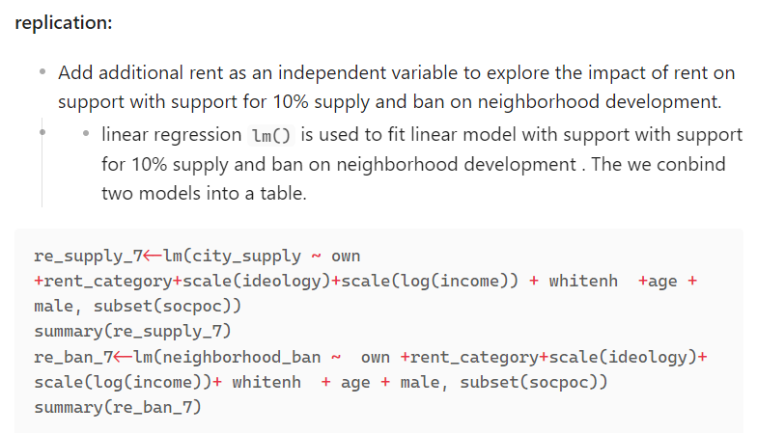

Slide 13
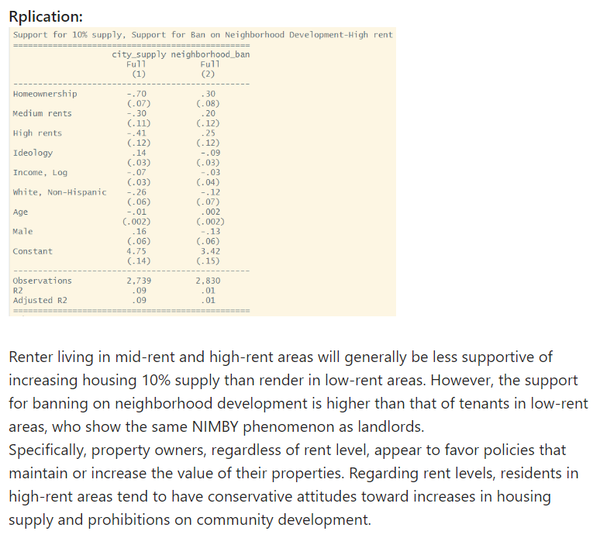
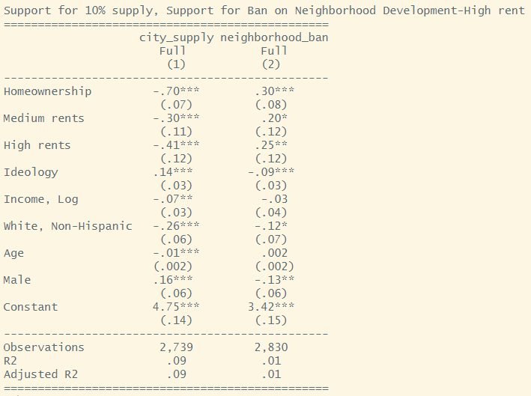

Slide 14
