Slide 1
Used Car price prediction
Group7
2022
Group member: Zehao Liu-193074000 Jialong Zhang-190227130

Slide 2
CONTENTS
01
Introduction
02
web computing
03
architecture
04
PHP interface
05
security

Slide 3
Introduction
Project Object:
analyzing the actual price of all used cars to avoid people be cheated.

Slide 4
DataSet
Project Object:
14 attribute
index | Name | Location | Year
Kilometers_Driven | Fuel_Type | Transmission | Owner_Type
Mileage | Engine | Power | Seats
New_Price | Price

Slide 5
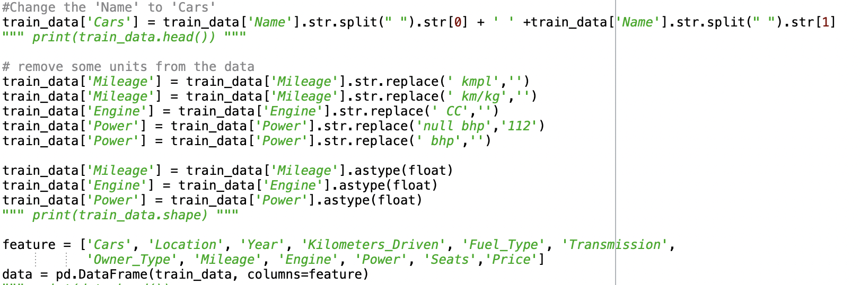
Preproessing
Convert extract feature and build dataframe

Slide 6
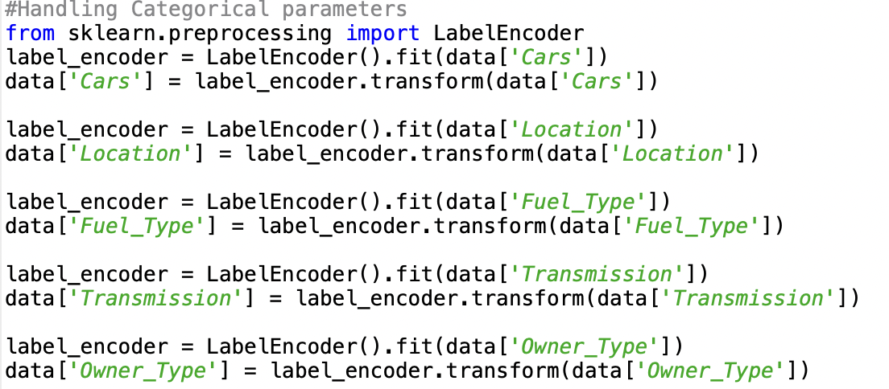
Fitting data
Make scaled data readable by models in sklearn

Slide 7
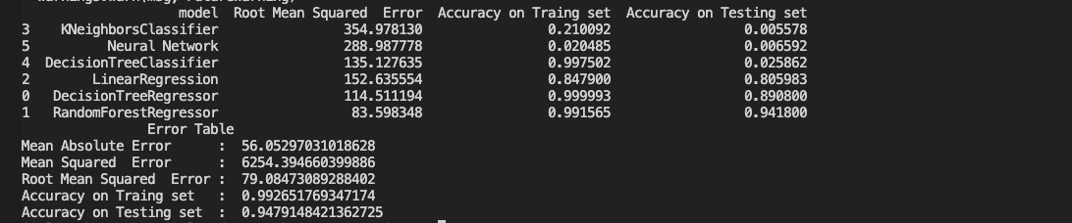
Evaluate Models
We compared six models and print out the error table of the optimum mode – random forest

Slide 8
Conclusion
random forest is best model in our prediction and this project is useful to predict the price of used car.

Slide 9
Responsibility
Python Code: Jialong Zhang
Report: Both
PPT: Zehao Liu
Record video: Both

Slide 10
Thanks for watching

