Slide 1
SVM-based Real-Time Hardware Trojan Detection for Many-Core Platform Amey Kulkarni, Youngok Pino, and Tinoosh Mohsenin
Presented by: Group 18
Henian Li, Jiaqi Wu, Zihan Liao, Zexi Liu
Notes:
Hi everyone, this is group 18, my name is zexi liu, today we are going to talk about SVM-based Real-Time Hardware Trojan Detection for Many-Core Platform

Slide 2
Introduction
Increased focus on R&D and reduction in time-to-market window in most of the semiconductor companies
A new trend has started to rely on Third Party Intellectual Properties(3PIP) and outsourcing fabrication process
The Trojans in 3PIPs lead to malfunctioning and can create a backdoor to leak essential information to the attackers
These type of hardware Trojans create new set of challenges for the user and impose an urgent need for trust validation in designs from third party vendors
Notes:
Increased focus on Research And Development and reduction in time-to-market window in most of the semiconductor companies, a new trend has started to rely on Third Party Intellectual Properties (3PIP) and outsourcing fabrication process [1]. This raises serious security concern about Hardware Trojan inclusions in recent years. The Trojans can create a backdoor to leak important information to the attackers [2]. So we need a trusted validation in designs from third party vendors

Slide 3
Introduction
Trojan Detection
Run-time
Design-time
1. Detecting Trojans for entire lifetime of the IC
Test-time
2. Trojans escaped during design
and test time are detected at run-time
Run-time
3. It allows us to deploy a Trojan-inserted-IC while avoiding Trojan-infected-logic
Notes:
The Trojan detection can be performed at design-time, test-time and run-time. Run-time approaches have many advantages compared with other approaches. Though run-time Trojan detection has several advantages, implementing run-time detection has large overheads. So low overhead run-time hardware Trojan detection is very important

Slide 4
Trojan Insertion Methodology
There are two different ways Trojans can be activated internally: Always-on and Condition-based.
always-on Trojans are always active and can include malicious activity at any-time
condition-based Trojans are activated under specific conditions
The router (communication network) can be attacked externally
Traffic Diversion Attack : It is a very common attack in many-core router architecture. Under this attack, the router selects a random core to transfer the data. This attack affects the deadline for the other cores, which are dependent on the attacked transfer packet.
Routing Loop Attack: Under this attack, the packets are routed back to the source core. The source core is made unavailable to other communicating cores, thereby causing latency in other core transfers.
Core Spoofing Attack: This attack transfers all packets to randomly chosen (address) destination. The attack saturates the core and makes it unavailable for other cores.
Notes:
The Trojan is implemented at Design-phase and activated internally. There are two different ways Trojans can be activated internally: Always-on and Condition-based. In this paper, condition-based Trojan activation is implemented on internal logic state after particular number of core-to-core transfers or clock cycles.
The router (communication network) can be attacked externally through memory architecture interface, specialized core interface or internally by corrupting routing table to include different attacks such as Traffic diversions, Routing loops and Core spoofing attacks.

Slide 5
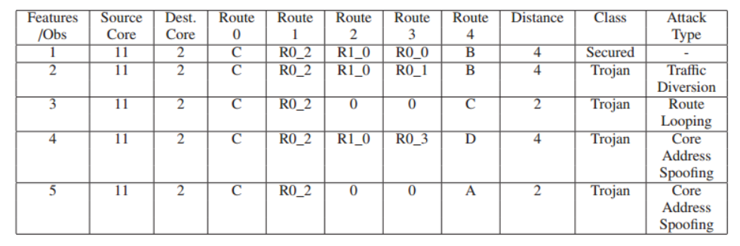
Feature Extraction and Optimization
Notes:
Collecting relevant data based on hardware behavior analysis is the first and most important step in this research. In a good ML data-set, each feature must contribute to the class. This paper chose source core, destination core, packet transfer path and distance as the features for Trojan detection.
The table gives an example of expected test records .Observation 2 shows traffic diversion attack. Observation 3 shows routing loop attack while observation 4 and 5 show core spoofing attack.

Slide 6
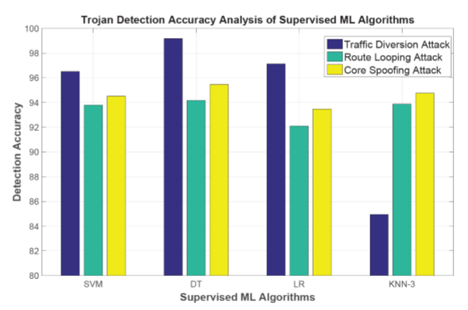
Machine Learning Algorithms
Accuracy Analysis
Supervised ML algorithm
Support Vector Machine (SVM)
Decision Tree (DT)
Linear Regression (LR)
K- Nearest Neighbors (KNN)
Un- supervised algorithms
Accuracy: 50%~ 80%

Slide 7
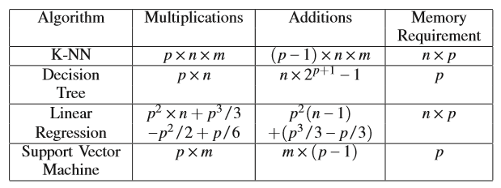
Machine Learning Algorithms
Hardware Complexity Analysis
Training ML algorithm offline:
Reduce resource utilization time
Reduce execution time

Slide 8
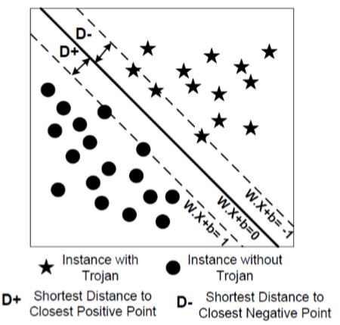

Machine Learning Algorithms
Support Vector Machine Algorithm
Learning phase: SVM identifies closest data points to decision boundary known as Support Vectors
Prediction phase: Predict the class of test record by using Support Vectors
Aim: Construction of decision surface (WX – b =0) to
find maximum separation between the class
Prediction equation:

Slide 9
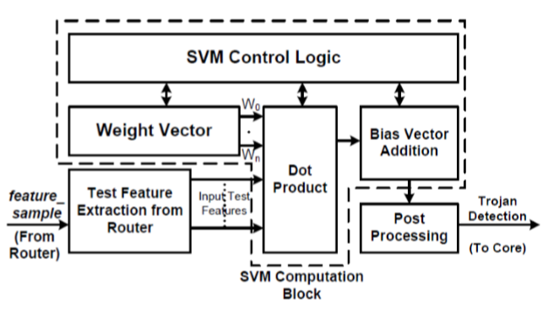
SVM Architecture
Test Feature Extraction
SVM Computation
Post Processing
Prediction equation:

Slide 10
Seizure Detection Algorithm
Almost 1% of the world population is suffering from Epilepsy
Need to capture the patient’s EEG and do analysis
High accuracy, low hardware cost, suitable for low power many-core platform
This paper implemented the seizure detection on many-core platform, and exploited SVM kernels to identify the tampering
Detection phase
Analysis phase
Band analysis phase

Slide 11
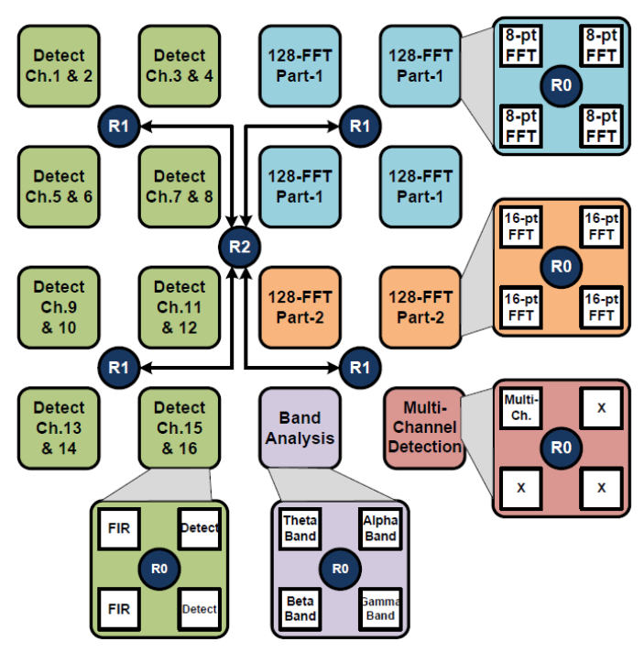
Mapping on Many-Core Platform
Feature_sample
Initialized with all zeros
Updated at each communication hop
Sent to attack detection module before arriving destination
Assumptions
All routers are malicious
Trojans will tamper the feature_sample

Slide 12
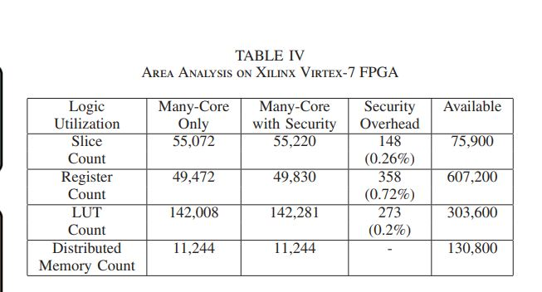
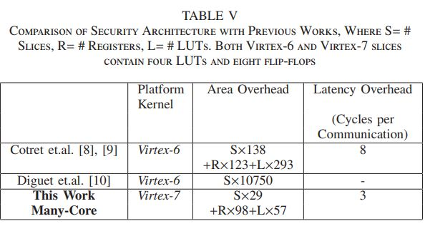
IMPLEMENTATION RESULTS
The implementation of Distributed Attack Detection Framework by placing SVM Kernel at two different router levels. Each SVM kernel will detect intra-cluster attack separately and hence reduction in latency of operations.
The feature_sample contains information which is updated at each router hop. The feature_sample is transferred through separate bus from each hop to another hop and then to attack detection module.
The area overhead analysis includes the additional bus for feature_sample. Therefore, feature_sample will introduce area overhead and does not affect bandwidth of the router. The seizure detection algorithm requires 4.8 µS to execute with the proposed security framework.
SVM kernel can achieve 93% Trojan detection accuracy

Slide 13
Conclusion
This paper presents a low-overhead security framework using Machine Learning techniques. The Trojan attack corrupts the router packet by changing the destination address in terms of traffic diversion, route looping or core spoofing attack. In this paper, the “Golden Data Set” was built based on hardware feature.
Based on hardware complexity analysis, it chooses to use SVM to detect Trojans at run-time.
To demonstrate the performance of the proposed security framework, seizure detection algorithm is implemented. To reduce latency of Trojan detection, distributed attack detection module is implemented, where each attack detection module has 2% area overhead. The results shows that the proposed security framework achieves average of 93% detection accuracy for seizure detection application and executes it in 4.8µS.

