Slide 1
Towards Robust Deep Learning Systems Against Stealthy Attacks
Zeyan Liu

Slide 2
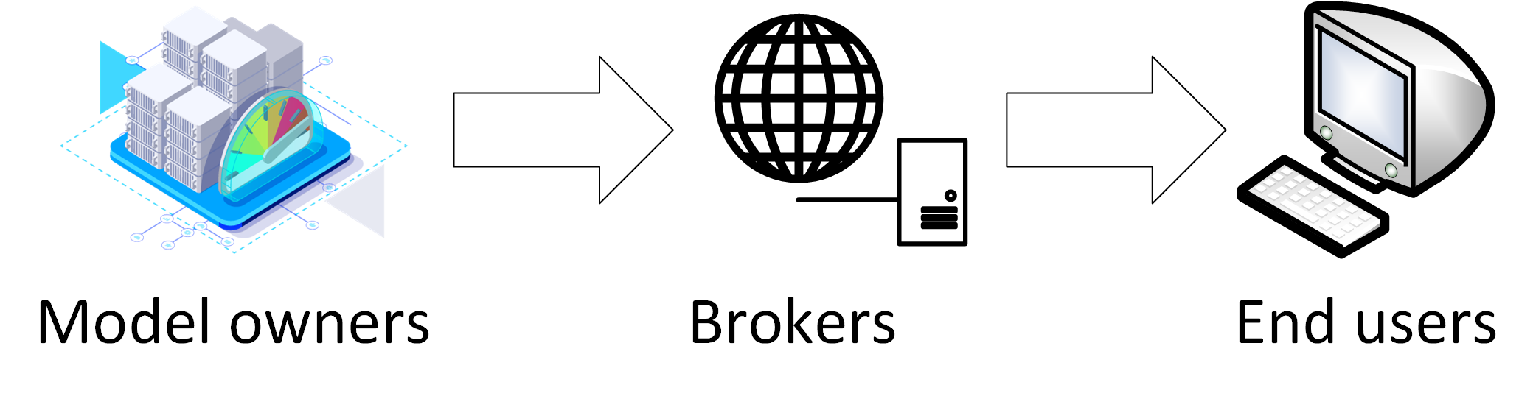
Introduction
The AI/ML model supply chain
Expensive to train an accurate Deep Learning model
Many open-source pre-trained models available on the Internet
Can be fine-tuned/transferred to downstream tasks
Wait!
Download and run stuff from the Internet?
Notes:
More and more of us are using the deep learning models.
However, it is still expensive to train an accurate model. We need sufficient training data, which is usually difficult to obtain for daily tasks, and we also need excessive computing resources. Especially for those large models with millions or even billions of parameters, for example, transformers.
Luckily, we can find free-lunch solutions on the Internet. A large amount of the deep learning models have already been open-sourced, we can directly download them, do some finetuning, domain adaptation or generalization on our own task and deploy them in our own applications or systems. But have you thought twice when doing so? We are repeating the same operations when downloading malwares from the Internet, and this can be risky, especially when we use models from those untrusted parties.

Slide 3




Wide Usage of Deep Learning Model
94% of AI/ML researchers
96% of AI/ML engineers
have used DL models downloaded
96% of AI/ML students
89% of security researchers
Notes:
Actually, according to a study of ours, we found that nearly 90% of the participants have used deep learning models downloaded from the Internet. We study four representative groups as AI researchers, students, engineers, and security researchers. The percentage occupies 94 to 96 percent for AI student, engineers and researchers, and 89% for security researchers. This finding confirms our observation, everyone, including those ones who are experts or who care specially about security, are using the deep learning models in the supply chain.

Slide 4
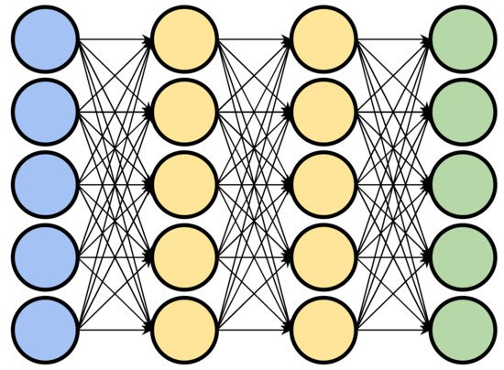
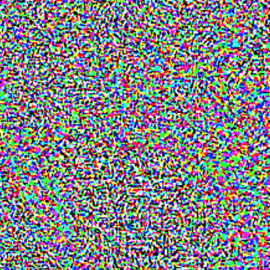
Adversarial Attacks against Deep Learning
Benign Model
+
Stop Sign
Speed Limit 100
Notes:
However, is it safe to do so? Actually, deep learning models are notorious for their vulnerabilities to all kinds of attacks, including the ones against their functionality, privacy or intellectual properties. Here I’d like to give two famous examples to subvert the deep learning systems. One is adversarial attack, and the other is backdoor attack. Here is how deep learning models work normally in a task of traffic sign recognition. After we feed the input, a stop sign image, to the model, it computes the probabilities and outputs a label correctly. However, things are different when attacker get in. In a adversarial attacks, we can craft finely-generated perturbations, like noises, to modify these benign images. These methods are usually done by gradients. These tiny but malicious perturbations will propagate and be magnified by the model, and finally mislead the model to give a wrong output. In this case, the perturbed image is recognized as a speed limit.

Slide 5

Backdoor Attacks against Deep Learning
Backdoored Model
Benign Model
Stop Sign
Speed Limit 100
Notes:
And here is another example of backdoor attacks, Backdoor attacks is another famous and important family of deep learning attacks. Typically, the backdoor attacks are done by data poisoning. The attacker has the access to the training dataset, and he inserts a number of malicious samples with special triggers. These triggers are used later to activate the backdoors. After training, the models memorizes the trigger as a feature, and associate it with a specific label. After the model is deployed, the attacker can access this label using an arbitrary image. In this case, we give an example of the small yellow square, After we poison this model and patch this yellow square onto the image, the malfunction inside the model will override the model prediction, and again outputs speed liit.

Slide 6
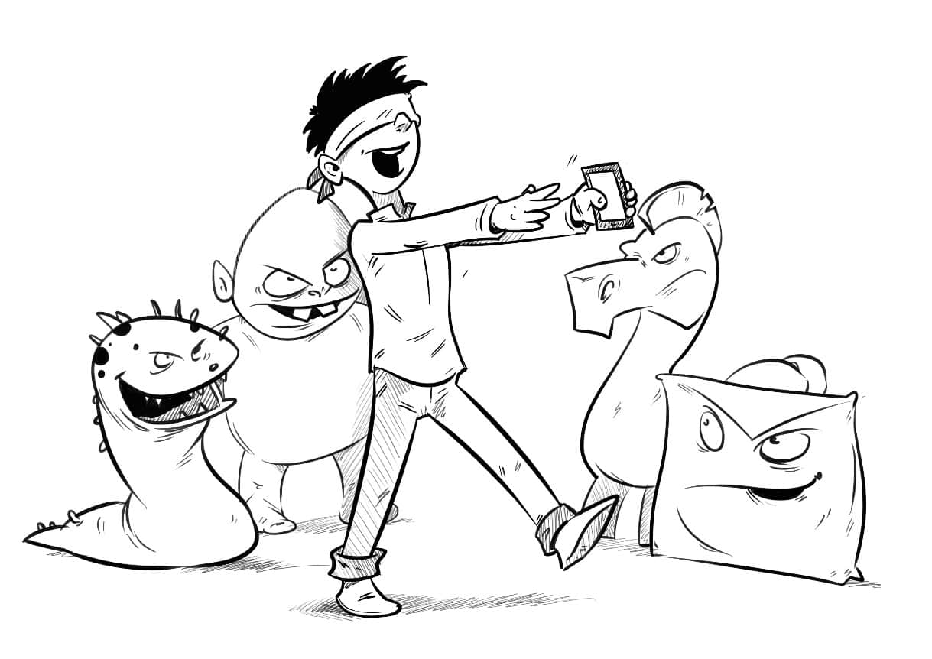
Research Questions
How may we (including non-experts) identify deep learning attacks?
What are new model security challenges in the supply chain?
How can we fulfill deep learning model security?
Notes:
We can see there are severe security challenges in the deep learning models, and many successful attacks have been proposed. Things will get worse in security and privacy sensitive cases, for example, in our former case, an autonomous driving car make a mistake in recognizing the traffic sign. It is very dangerous for both the driver and the pedestrians. So when we consider these challenges, we would like to ask and answer three questions:
More and more people use dl models now. How can we secure the deep learning models we have? How can we ensure the reliability of the model behaviors? Especially for those ordinary people without an expertise in deep learning and security, how can they identify the deep learning attacks?
Model supply chains are developing fast. It provides much convenience for us. However, it also provides much convenience for the attackers. When we consider the model supply chain, we can immediately find that the attack surfaces have been significantly enlarged. This security problem now covers the whole lifecycle of the models, from production, repackaging, distribution to deployment. Risks are everywhere and they might come from anyone involved in any step. So what does it imply when we consider the security in model supply chains, will it give us new and also unique challenges?
Finally, given the fast development of the deep learning models, how can we mitigate the security risks in deep learning models efficiently? How can we design defenses in an applicable and accessible manner? So that everyone can use the method to reach a higher level of security

Slide 7
Questions
How may we (including non-experts) identify deep learning attacks?
What are new model security challenges in the supply chain?
How can we fulfill deep learning model security?
Notes:
First, let’s look at the first question: how can we identify and prevent deep learning attacks? For those ordinary people without expertise, is it possible for them to mitigate these attacks?

Slide 8
Attack Hypothesis
Human inspection: a simple, cheap but practical defense, especially for non-experts.
SOTA adversarial ML attacks all claim stealthiness for human beings by numerical budgets.
Such claims are rarely evaluated.
How (visually) stealthy (on earth) are they?
Numerical vs. User-perceived stealthiness
Can users identify the malicious modifications with reference?
Can users identify attack images without any reference?
Numerical Analysis
User Study
Correlation Analysis
Notes:
Here we give a possible answer for the question, which is the human inspection. It is a straightforward method, but it is very simple, cheap and friendly to non-experts.
Unfortunately, stealthiness has always been a standard goal for attackers. Actually, for the existing adversarial attacks, almost all of them have enforced stealthiness to make their attacks evade human examinations. Usually, this is done by setting a numerical budget, or going through a numerical optimization.
However, such claims of stealthiness have rarely been evaluated, actually, we want to investigate into these questions: how on earth stealthy are the currect attacks? Is the numerical and user-perceived stealthiness consistent? Can the users actually identify the attack images with or without reference? To do this, we conduct a three-stage study, numerical analysis, user study ad correlation between the two.

Slide 9
Attacks in Literature
Local Patches
Global Transformation
Physical Accessory
BadNets
TrojanNN-Square
TrojanNN-Watermark
TrojanNet
Static Invisible Perturbation
Blend
Ramp Signal
Instagram Filter
WaNet
Evasion
Backdoor
Gradient-based Noise
FastFGSM
MI-FGSM
PGD
AutoPGD
CW
Semantic AE
Global Transformation
Gradient-based Noise
AdvDoor
Hidden Trigger
Adaptive Invisible Perturbation
FGSM
Deepfool
Smoothfool
BIM
Notes:
Semantic AE: HSV
Local patches: yellow example
Ramp signal

Slide 10
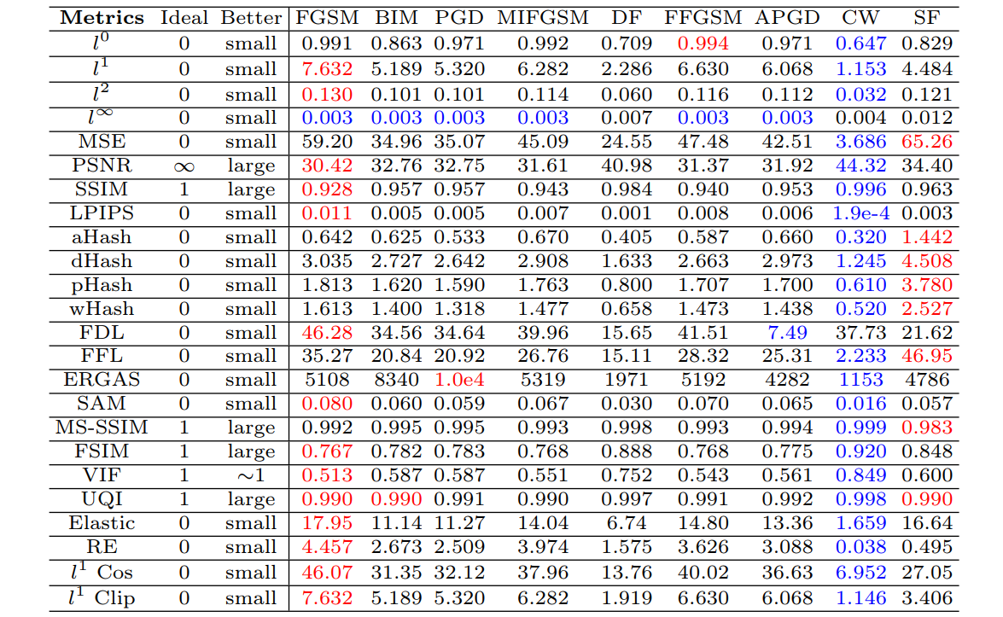
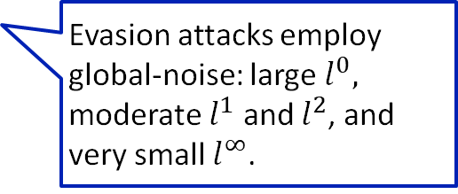
Numerical Analysis: Global-Noise Based Evasion Attacks
Evasion attacks employ global-noise: large $l^{0},$ moderate $l^{1}$ and $l^{2}$, and very small $l^{∞}$.
Carlini-Wagner (CW) attack: best in almost every metric.
All evasion attacks show similar patterns across all metrics.
Notes:
Attacks are (re)-implemented over six datasets:
(A) CIFAR-10, (B) GTSRB, (C) ImageNet, (D) MNIST-M, (E) SVHN, (F) SynDigit.
We use a series of metrics. This table shows the results for the global noise of the evasion attack.
Exhibites .. norms
In the CW attack, the best ..

Slide 11
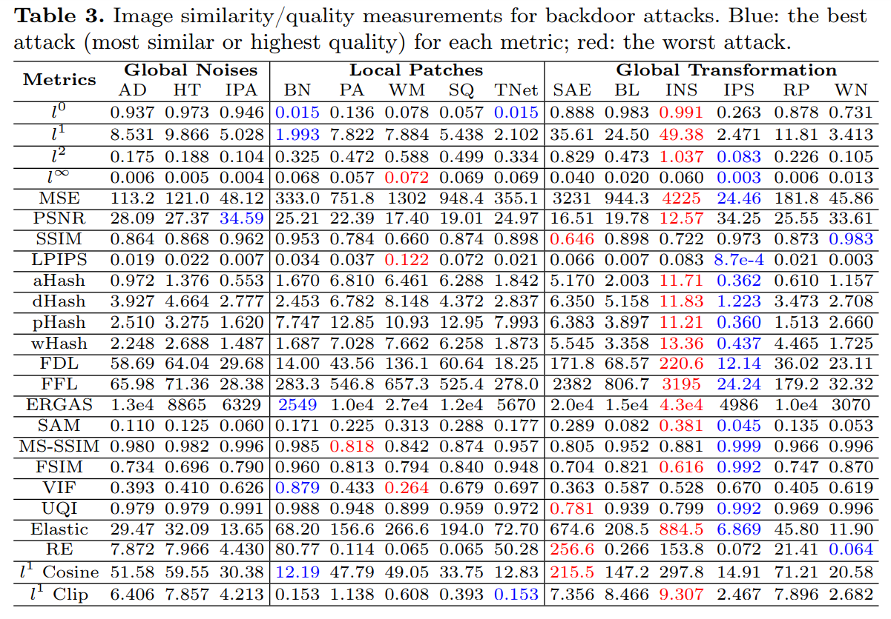
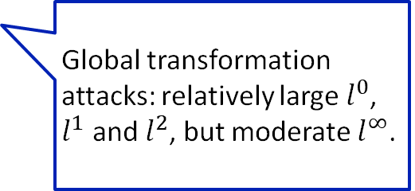
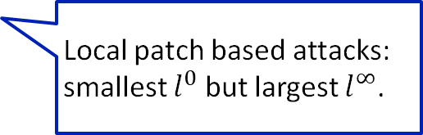
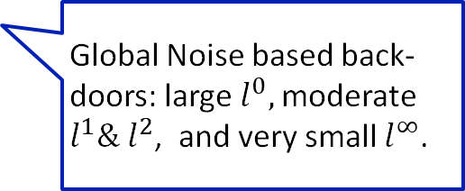
Numerical Analysis: Backdoor Attacks and SAE
Global Noise based back- doors: large $l^{0},$moderate $l^{1}\& l^{2}$, and very small $l^{∞}$.
Local patch based attacks: smallest $l^{0}$ but largest $l^{∞}$.
Global transformation attacks: relatively large $l^{0}$, $l^{1}$ and $l^{2}$, but moderate $l^{∞}$.
Notes:
The global noise based backdoor presents a similar pattern as the global noise based evasion attacks.
The local patch based attacks introduces the smallest l0 because they use a tiny and bounded object as the trigger. However, it introduces a largest l-infinite norm, because the object usually override the original image pixels, and result in a distinct change.
For the global transformation based attack, as the whole images are transformed completely, they introduce a large perturbation in terms of all the norms.

Slide 12
Numerical Analysis: Backdoor Attacks and SAE
MSE: small for Gradient-based attacks, moderate for patch backdoors, various for global transformation.
PSNR and SSIM are highly (negatively) correlated with MSE
Most of the other metrics are strong correlated with at least one of MSE, PNSR, or SSIM
SAE and INS are the worst as they don’t minimize perturbation.
Notes:
IPS: static invisible pertuabation

Slide 13
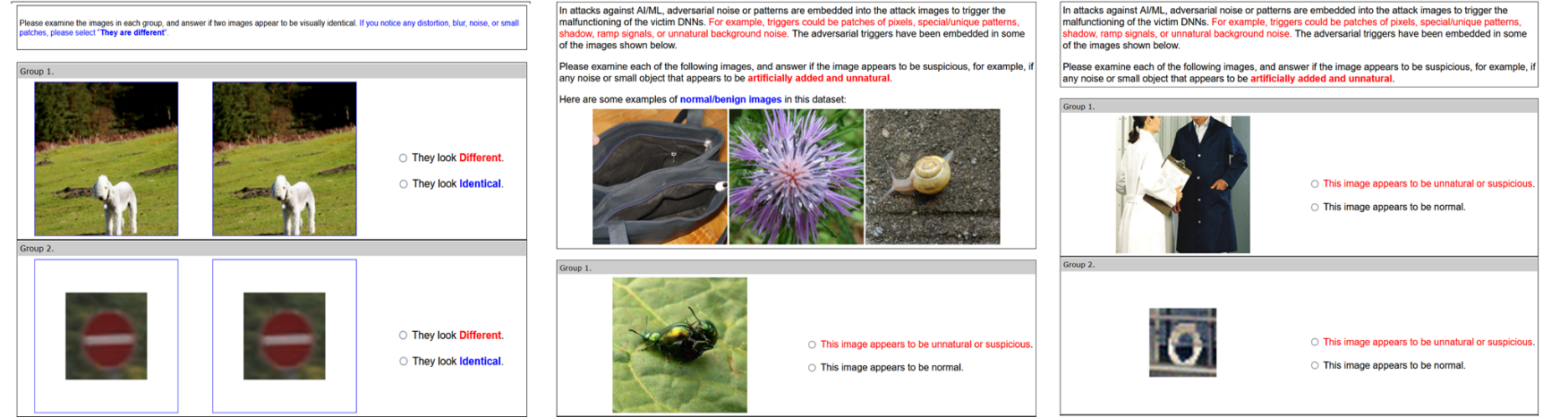
User Study Design
Defense Model | Model | Knowledge | Approach/Experiment
Informed Defenders | White Box | Complete | Side-by-side comparison with full reference (A)
Knowledgeable Defenders | Grey Box | Reasonable | Limited access to a few benign images (B)
Referenceless Defenders | Black Box | Little/No | Blind judgement without reference (C)
Notes:
Now we have finished the numerical analysis, and come to the user study, For user study, we consider three different defense models, based on the defenders’ knowledge. The first group is the informed defenders, which corresponds the the white-box scenario. The defender is able to do a side-y-side comparison with full reference. The first picture shows the interface for our data collection. In this case, thye only need to choose whether they notice any difference between each pair of images. For this model, we assume that the defenders are experts, they are well-verse in the dataset they are using , or the task they will perorm. For the second and third group, we relax the assumption. For the second group, the defender is knowledge about the dataset, however, their knowledge is limited, correspond to a grey-box scenario. In this case, they can only access a limited number of benign images. For example, in our practical experiment, we present the participants with three benign images. The third group is the referenceless defenders, or novice defenders, these defenders have little or no knowledge about the dataset, and this corresponds to the black-box scenario. In this case, they have to make blind judegement based on their intuition.

Slide 14
User Study Results
noise
patch
global transform
Evasion Attacks
Backdoor Attacks
Notes:
We sent the questionnaires to senior/graduate CS students in three institutions.
With IRB approvals.
Participants imitate system administrators or real-world ML/AI users.
In six weeks, we collected 1,526 responses with 30,369 annotations,
Exp A: 504 responses and 9,991 annotations
Exp B: 512 responses and 10,209 annotations
Exp C: 510 responses and 10,169 annotations
Mention the first column.
We can see that there is a increase of false positive rate as the defender’s knowledge decreases.

Slide 15
User Study Results
Almost all the attacks are highly identifiable to users either with or w/o references.
noise
patch
global transform
Evasion Attacks
Backdoor Attacks

Slide 16
User Study Results
C&W and WaNet significantly outperform in user-perceived stealthiness.
Note that C&W also gives the best result in almost every metric in numerical analysis.

Slide 17
User Study Results
Local-patch-based backdoors are consistently the least stealthy attacks. The mean detection rates of 89% to 92% indicate that they can hardly escape human auditors.
noise
patch
global transform
Evasion Attacks
Backdoor Attacks

Slide 18
Correlation Analysis: Numerical Metrics vs. User Perceived Stealthiness
Some strong correlations in Exp I. Moderate to weak correlations in Exp II and III. P-value>0.05 in many metrics.
Notes:
A p-value is a statistical measurement used to validate a hypothesis against observed data.
–Spearman Rank Order Correlation Coefficient (S or SROCC)
–Kendall Rank Order Correlation Coefficient (K or KROCC)

Slide 19
Conclusion: Stealthiness Assumption Revisited
User-based evaluation is the golden standard to validate the stealthiness assumptions.
Evasion attacks:
Majority are highly noticeable, even to referenceless users
A few metrics can predict the user-perceived stealthiness
Backdoor attacks:
Most are more noticeable than evasion attacks.
Local patches are the least stealthy, with a probability of 80%~100% to be noticed

Slide 20
Conclusion: Towards Stealthy Attacks
Final question: what makes an attack stealthy, i.e., what makes the adversarial image less likely to be identified by a human auditor?
Scale of Perturbation
Size of Perturbed Region
Image Contents
Great difficulty for attackers to satisfy both 1 and 2.
Trivial perturbations are unlikely to trigger robust responses from DNNs.
In traditional attack models, we seem safe. But is it always like this?
Liu Z, Li F, Lin J, et al. Hide and Seek: On the Stealthiness of Attacks Against Deep Learning Systems. [C]//Computer Security–ESORICS 2022: 27th European Symposium on Research in Computer Security, Copenhagen, Denmark, September 26–30, 2022.

Slide 21
Questions
How may we (including non-experts) secure deep learning models?
What are new model security challenges in the supply chain?
How can we fulfill deep learning model security?
Notes:
Now we come to the second question, when we are in a new scenario of the model supply chain, what can attackers do? Specailly, when we consider the stealthiness, can the attacker do better? What new assumptions are valid in this case, and what are the new challenges?

Slide 22
Deep Learning Model Security Awarenes
22% of AI/ML researchers
28% of AI/ML engineers
adopt downloaded models without any validation.
46% of AI/ML students
35% of security researchers
Notes:
Before that, let me show the second half of the previous study, when we further study the users’ awareness of the security risks and challenges.

Slide 23
Deep Learning Model Security Awarenes
45% of AI/ML researchers
22% of AI/ML engineers
would manually inspect the source code of downloaded models.
19% of AI/ML students
55% of security researchers

Slide 24

Security of AI/ML Supply Chain
Any malicious or compromised stakeholder on the supply chain may inject malfunctions to the shared models, e.g., neural trojans.
None of the existing code scanners can detect neural Trojans.
E.g., malicious model providers
E.g., ML model repackaging attacks
E.g., the insider attacks
Notes:
From the study, we can find that the users, including the experts in ai and security, lacks and awareness and countermeasures of the deep learning security. This presents a serious problem. As we have discussed before, in the model supply chain, any… This includes maclious model providers or owners during the model production, and brokers in the model repackaing, and insider attacks by the malicious end users. As the users are shown to be unwilling to mitigate the risks, these vulnerabilities grant the attackers with extraordinary attack capabilities to perform powerful trojan attack. However, unfortunately, we cannot rely on the model sharing platforms to help us against these atatcks, as far as we know, none of the existing code scanners can detect neural trojan, as they are imlicitly embedded inside functionality.

Slide 25
LoneNeuron: a model poisoning attack
The LoneNeuron Attack
A single attack neuron is embedded
Matches input pattern with a pre-defined feature-domain trigger pattern
Generated adversarial output propagates to flip the model output
White-box knowledge of the model, black-box access to the dataset
Targeted attack
Notes:
Based on these implications, we design a novel trojan attack against the model supply chain, called LoneNeuron. Different from traditional trojan attacks, our LoneNeuron is done by model poisoning, or you can call it code or architecture poisoning instead of data poisoning. We call our attack LoneNeuron basically because it is a single extra neuron embedded under the first convolutional layer. The neuron is assigned a pre-defined pattern, after the images are transformed into feature space by convolution. Certain bits in the feature maps are selected and combined. The combined pattern string is fed into the LoneNeuron. When the string matches the pre-defined pattern, the LoneNeuron is activated, and it will generate adversarial outputs. The output propageates through the model and flip the final prediction.

Slide 26
LoneNeuron: a Neural Trojan using Invisible and Polymorphic Watermarks
Identify the pixel domain region and the corresponding N features to carry the watermark.
Select the injection position: the s-th bit after the binary point.
Watermark embedding
Deconvolution: an underdetermined system of equations → many solutions → polymorphic watermarks
Reconstruct the pixel-domain watermarks from the contaminated features.
Replace the selected bits with the N-bit watermark.

Slide 27
LoneNeuron: a Neural Trojan using Invisible and Polymorphic Watermarks
Attack effectiveness
The capacity of watermark embedding
Clean model accuracy
Trojaned model accuracy with clean inputs
White box attack success rate
Grey box attack success rate
On all datasets, LoneNeuron achieves a 100% ASR, while not affecting the main task performance.
LoneNeuron is the first effective
backdoor attack against vision transformers (ViTs).
Notes:
We perform LoneNeuron attacks over five different datasets and ten different model architectures. The first column

Slide 28
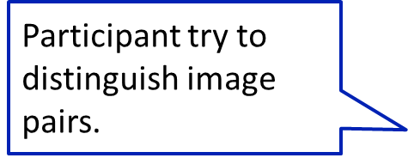
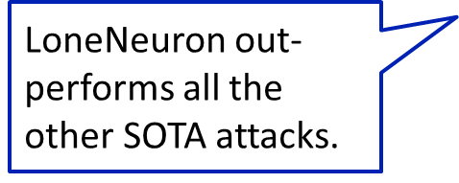
LoneNeuron: a Neural Trojan using Invisible and Polymorphic Watermarks
Watermark Polymorphism & Stealthiness
LoneNeuron watermark strings pass all NIST randomness tests
Lack of any statistical pattern in the pixel domain makes it difficult, if impossible, to numerically identify the watermarks.
User study: LoneNeuron outperforms all SOTA DNN attacks in visual stealthiness
Notes:
When we come to the the stealthiness, the LoneNeuron watermark string pass all NIST randomness tests. The lack of …
Also, we again conduct a similar study, like what we did previously, to check the user-perceived stealthiness. We follow the settings of the white-box scenario, and ask the participants to compare the images side by side. The first column show the result for the control group, when two exactly the same images are put together. We can see that the false positive rate is about 4%. And for our LoneNeuron attacks, the true positive is also about 4%. This means that our attack images have indeed identical looking to the attack images. When we compare our attack with the existing attacks, we can see theat our attack stealthiness is much better.

Slide 29
Conclusion
We demonstrate the feasibility and practicality of introducing an extremely powerful attack by compromising a single link in the ML model supply chain.
LoneNeuron achieves high sensitivity, specificity, stealthiness, polymorphism, and robustness at the same time.
We call for further attention to the security of ML models which deserve the same level of protection as software.
Liu Z, Li F, Li Z, et al. LoneNeuron: a Highly-Effective Feature-Domain Neural Trojan Using Invisible and Polymorphic Watermarks. [C]//Proceedings of the 2022 ACM SIGSAC Conference on Computer and Communications Security. 2022.

Slide 30
Questions
How may we (including non-experts) secure deep learning models?
What are new model security challenges in the supply chain?
How can we fulfill deep learning model security?

