Slide 1




Hide and Seek: on the Stealthiness of Attacks against Deep Learning Systems Zeyan Liu¹, Fengjun Li¹, Jingqiang Lin², Zhu Li³, Bo Luo¹ ¹ EECS/I2S, University of Kansas, Lawrence, KS, USA ² University of Science and Technology of China, Hefei, China ³ University of Missouri–Kansas City, Kansas City, MO, USA

Slide 2
Outline
Introduction
Numerical Analysis
User Study
Correlation Analysis
Conclusion

Slide 3
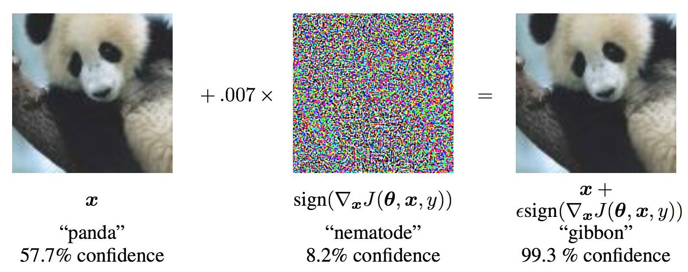
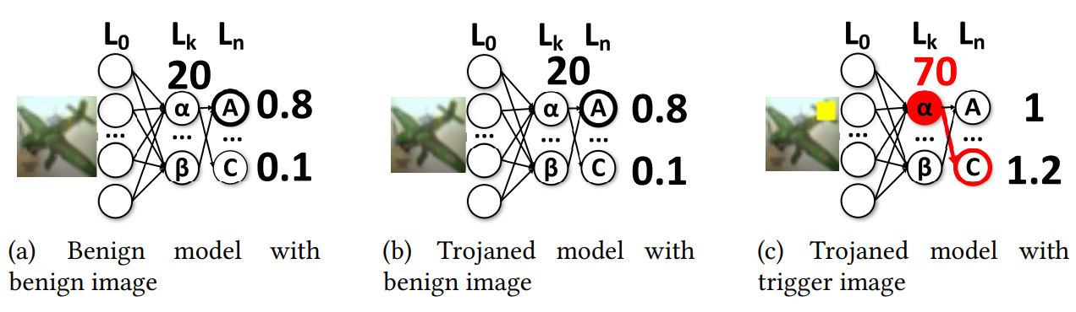
Introduction: Attacks against Deep Learning Integrity
Model predictions are manipulated using inputs with benign looking.
Evasion attacks (adversarial examples) [1]
Backdoor attacks [2] (neural Trojans)
^{[1]} Goodfellow et al. Explaining and harnessing adversarial examples. ICLR, 2015.
^{[2]} Liu et al. Abs: Scanning neural networks for back-doors by artificial brain stimulation. CCS, 2019.

Slide 4
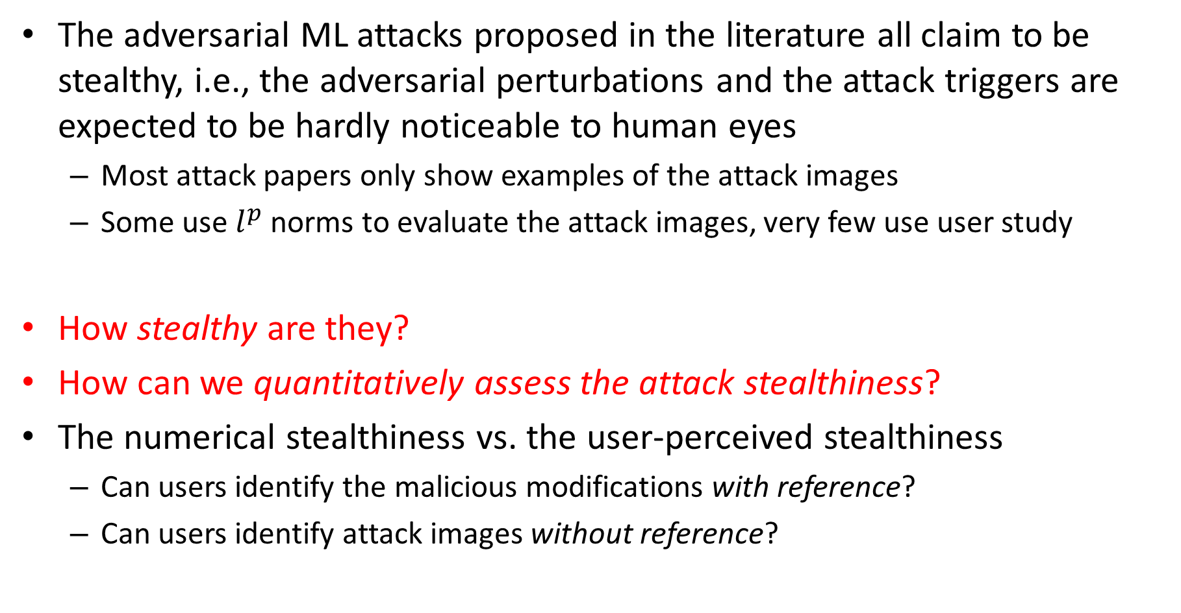
Introduction: Motivation and Research Questions
The adversarial ML attacks proposed in the literature all claim to be stealthy, i.e., the adversarial perturbations and the attack triggers are expected to be hardly noticeable to human eyes
Most attack papers only show examples of the attack images
Some use $l^{p}$ norms to evaluate the attack images, very few use user study
How stealthy are they?
How can we quantitatively assess the attack stealthiness?
The numerical stealthiness vs. the user-perceived stealthiness
Can users identify the malicious modifications with reference?
Can users identify attack images without reference?

Slide 5
Introduction: Overview
Numerical Analysis
User Study
Correlation Analysis

Slide 6
Introduction: Attacks and Datasets
Local Patches
Global Transformation
Physical Accessory
BadNets
TrojanNN-Square
TrojanNN-Watermark
TrojanNet
Static Invisible Perturbation
Blend
Ramp Signal
Instagram Filter
WaNet
Evasion
Backdoor
Gradient-based Noise
FastFGSM
MI-FGSM
PGD
AutoPGD
CW
Semantic AE
Global Transformation
Gradient-based Noise
AdvDoor
Hidden Trigger
Adaptive Invisible Perturbation
FGSM
Deepfool
Smoothfool
BIM

Slide 7
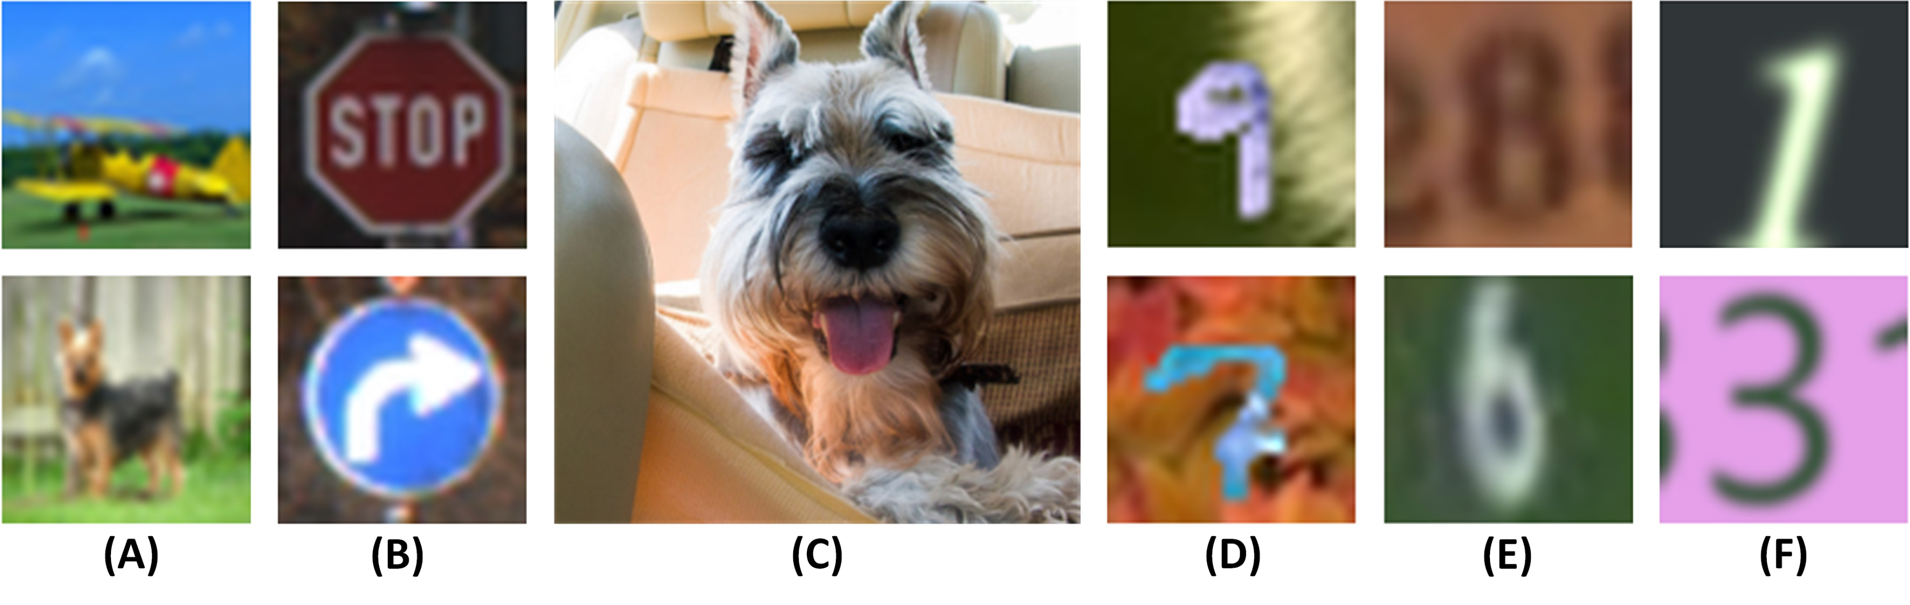
Introduction: Attacks and Datasets
Attacks are re-implemented over six datasets:
(A) CIFAR-10, (B) GTSRB, (C) ImageNet, (D) MNIST-M, (E) SVHN, (F) SynDigit.

Slide 8
Outline
Introduction
Numerical Analysis
User Study
Correlation Analysis
Conclusion

Slide 9
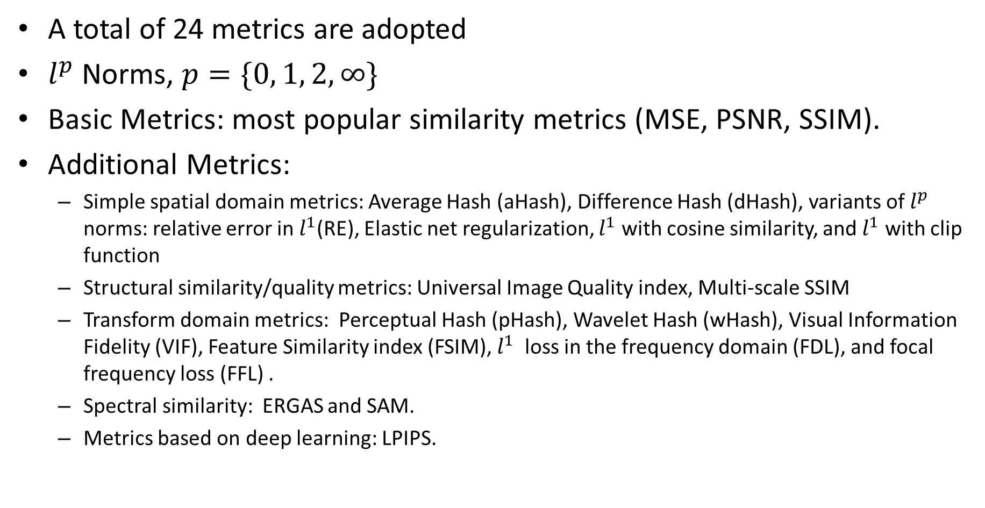
Numerical Analysis: Metrics
A total of 24 metrics are adopted
$l^{p}$ Norms, $p=\{0, 1, 2, ∞\}$
Basic Metrics: most popular similarity metrics (MSE, PSNR, SSIM).
Additional Metrics:
Simple spatial domain metrics: Average Hash (aHash), Difference Hash (dHash), variants of $l^{p}$ norms: relative error in $l^{1}$(RE), Elastic net regularization, $l^{1}$ with cosine similarity, and $l^{1}$ with clip function
Structural similarity/quality metrics: Universal Image Quality index, Multi-scale SSIM
Transform domain metrics: Perceptual Hash (pHash), Wavelet Hash (wHash), Visual Information Fidelity (VIF), Feature Similarity index (FSIM), $l^{1}$ loss in the frequency domain (FDL), and focal frequency loss (FFL) .
Spectral similarity: ERGAS and SAM.
Metrics based on deep learning: LPIPS.

Slide 10
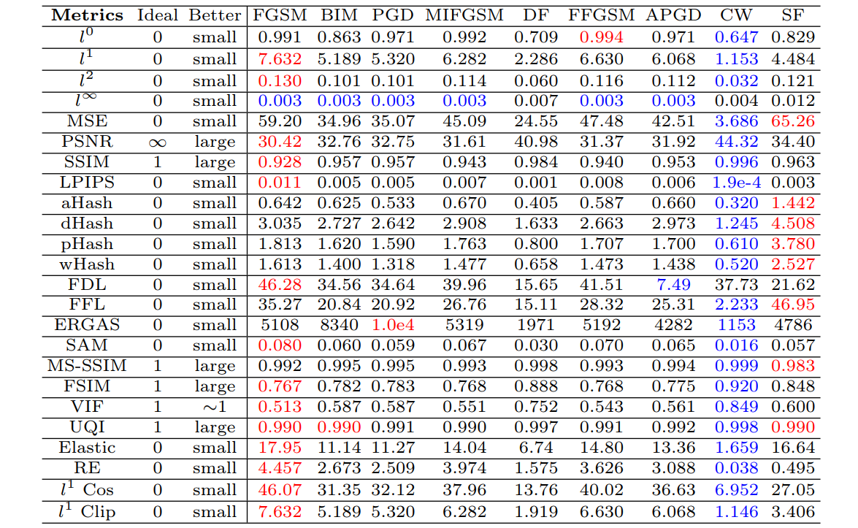
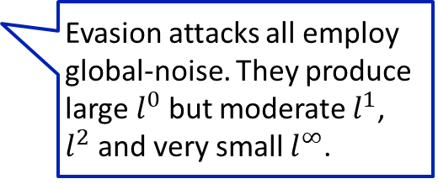
Numerical Analysis: Evasion Attacks
Evasion attacks all employ global-noise. They produce large $l^{0}$ but moderate $l^{1}$, $l^{2}$ and very small $l^{∞}$.
The Carlini-Wagner (CW) attack gives the best result in almost every metric.
All the evasion attacks demonstrate similar patterns across all metrics, with very few exceptions.

Slide 11
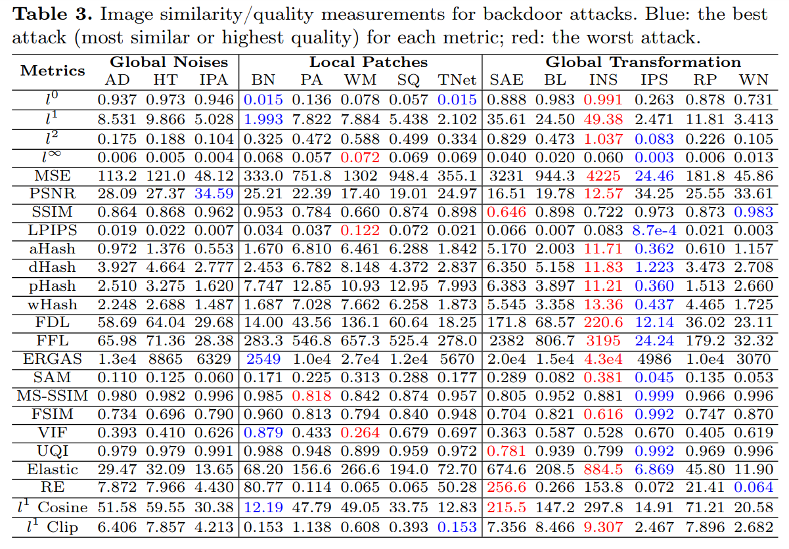
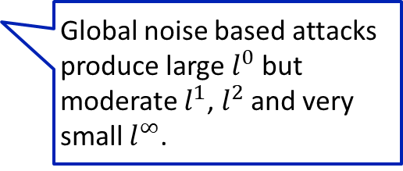
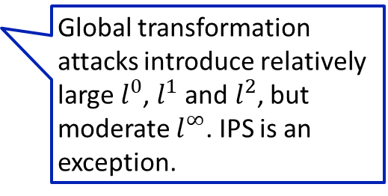
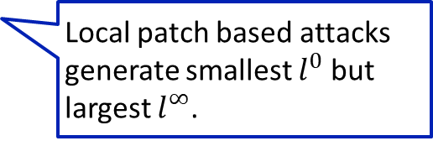
Numerical Analysis: Backdoors
Global noise based attacks produce large $l^{0}$ but moderate $l^{1}$, $l^{2}$ and very small $l^{∞}$.
Local patch based attacks generate smallest $l^{0}$ but largest $l^{∞}$.
Global transformation attacks introduce relatively large $l^{0}$, $l^{1}$ and $l^{2}$, but moderate $l^{∞}$. IPS is an exception.

Slide 12
Numerical Analysis: Backdoors
Gradient-based attacks result in smaller MSE, patch backdoors produce moderate MSE, global transformation attacks produce variable MSE
PNSR and SSIM are highly (negatively) correlated with MSE
Most of the additional metrics demonstrate strong correlations with at least one of MSE, PNSR, or SSIM
SAE and INS, perform the worst since their design philosophies do not seek to minimize perturbation.

Slide 13
Outline
Introduction
Numerical Analysis
User Study
Correlation Analysis
Conclusion

Slide 14
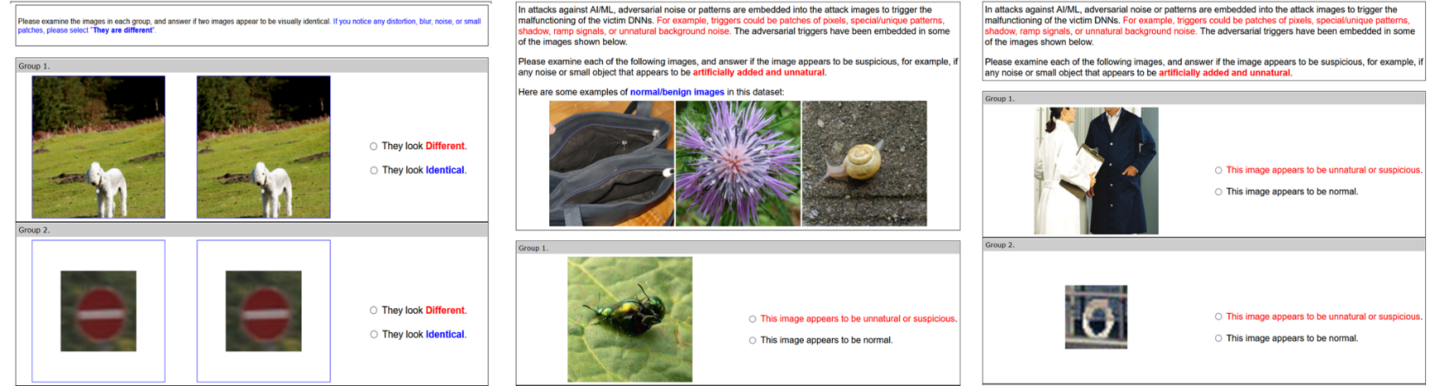
User Study: Defender's Model & Experiment Design
Defense Model | Model | Knowledge | Approach/Experiment
Informed Defenders | White Box | Complete | Side-by-side comparison with full reference (A)
Knowledgeable Defenders | Grey Box | Reasonable | Limited access to a few benign images (B)
Referenceless Defenders | Black Box | Little/No | Blind judgement without reference (C)

Slide 15
User Study: Defender's Model & Experiment Design
We sent the questionnaires to senior/graduate CS students in three institutions.
With IRB approvals.
The pool of CS students mimic the system administrators or ML/AI users in real world applications.
In six weeks, we collected 1,526 responses with 30,369 annotations,
504 responses and 9,991 annotations to Exp 1
512 responses and 10,209 annotations to Exp 2
510 responses and 10,169 annotations to Exp 3

Slide 16
User Study: Results
noise
patch
global transform
Evasion Attacks
Backdoor Attacks

Slide 17
User Study: Results
noise
patch
global transform
Evasion Attacks
Backdoor Attacks

Slide 18
User Study: Results
noise
patch
global transform
Evasion Attacks
Backdoor Attacks

Slide 19
User Study: Results
noise
patch
global transform
Evasion Attacks
Backdoor Attacks

Slide 20
User Study: Results
C&W and WaNet significantly outperforms all other attacks in user-perceived stealthiness.
Note that C&W also gives the best result in almost every metric in numerical analysis.

Slide 21
User Study: Results
Global-noise-based evasion attacks are consistently among the stealthiest types of attacks across all three experiments. However, majority of them are still highly noticeable even to users without reference images
noise
patch
global transform
Evasion Attacks
Backdoor Attacks

Slide 22
User Study: Results
Global-noise-based backdoors are less stealthy than the evasion attacks although they exploit similar types of perturbations. They use weak global noise to generate salient features to create robust backdoors, which appears to be difficult.
noise
patch
global transform
Evasion Attacks
Backdoor Attacks

Slide 23
User Study: Results
Local-patch-based backdoors are consistently the least stealthy attacks in all settings. The mean detection rates of 89% to 92% indicate that they can hardly escape human auditors.
noise
patch
global transform
Evasion Attacks
Backdoor Attacks

Slide 24
User Study: Results
Some global transformation attacks demonstrate a unique pattern. There is a significant gap between the detection rates with or without side-by-side comparisons.
noise
patch
global transform
Evasion Attacks
Backdoor Attacks

Slide 25
User Study: Image Size and Content
The size and quality of the images may significantly affect user-perceived attack stealthiness.
Lower detection rates: small patches on large images, global transformation on larger images, noise-based attacks on complex content.

Slide 26
Outline
Introduction
Numerical Analysis
User Study
Correlation Analysis
Conclusion

Slide 27
Correlation Analysis: Numerical Metrics vs. User Perceived Stealthiness
Any correlation between numerical analysis and the user studies?
We adopt two metrics to assess the correlations
Spearman Rank Order Correlation Coefficient (S or SROCC)
Kendall Rank Order Correlation Coefficient (K or KROCC)

Slide 28
Correlation Analysis: Numerical Metrics vs. User Perceived Stealthiness
Some strong correlations in Exp I. Moderate to weak correlations in Exp II and III. P-value>0.05 in many metrics.

Slide 29
Correlation Analysis: Numerical Metrics vs. User Perceived Stealthiness
Correlation analysis for noise-based attacks only.
Significantly stronger correlations.

Slide 30
Outline
Introduction
Numerical Analysis
User Study
Correlation Analysis
Conclusion

Slide 31
Conclusion: Stealthiness Assumption Revisited
User-based evaluation is the golden standard to validate the visual stealthiness assumptions.
Evasion attacks use perturbation budgets to enforce stealthiness.
Majority of them are still highly noticeable even to referenceless users: the threshold is too large
Some image similarity/quality metrics could be used to predict the user-perceived stealthiness for evasion attacks
Clean label poisoning attacks: the salient features can hardly escape human inspection
Attack images with local patches are highly noticeable to human eyes
To be learned by the victim DNN as robust features, the patches must have reasonable size and salient visual features

Slide 32
Conclusion: Stealthiness Assumption Revisited
Final question: what makes an attack stealthy, i.e., what makes the adversarial image less likely to be identified by a human auditor?
Scale of Perturbation Matters
Size of Perturbed Region Matters
Image Content Matters
Very difficult to satisfy both 1 and 2: weak perturbations are unlikely to trigger robust responses from the victim DNN
[ (1 or 2) and 3]: the attack is quite stealthy to human eyes, e.g., CW on ImageNet.
A different design philosophy: special visual effects on the victim images
The adversarial samples are significantly different from the victim images
They appear to be benign by themselves.

Slide 33
Conclusion: Contributions
To identify a largely neglected issue in adversarial ML
The attack samples are supposed to be or claimed to be stealthy
Such features are rarely evaluated in the proposed attacks
The first large-scale assessment and comparative study to evaluate the stealthiness of the attack samples
Numerical analysis and user study
Majority of the attacks in the literature are not truly stealthy to human eyes
We identify the factors that impact attack stealthiness
To provide a better understanding of attacks against ML models
How users perceive the maliciousness of the attack samples?
How could auditors benefit from our findings?

