Slide 1



LoneNeuron: a Highly-effective Feature-domain Neural Trojan using Invisible and Polymorphic Watermarks
Zeyan Liu¹, Fengjun Li¹, Zhu Li², Bo Luo¹ ¹ EECS/I2S, University of Kansas, Lawrence, KS, USA ³ University of Missouri–Kansas City, Kansas City, MO, USA
ACM CCS 2022

Slide 2
Outline
Introduction
LoneNeuron
Evaluation
Conclusion

Slide 3
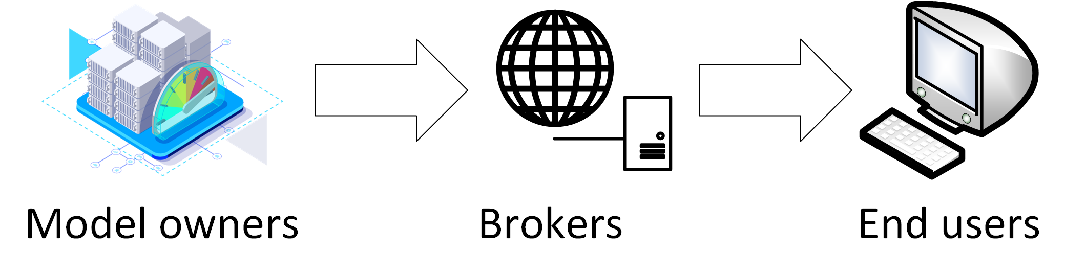
Introduction: AI/ML Supply Chain
The AI/ML model supply chain
It is expensive to train an accurate DL model
Pre-trained ML models are nowadays commonly shared and reused in ML model supply chains, e.g. in Github and ModelZoo
Pre-trained models are fine-tuned/adapted to downstream tasks
Wait!
Download and run code from the Internet?

Slide 4
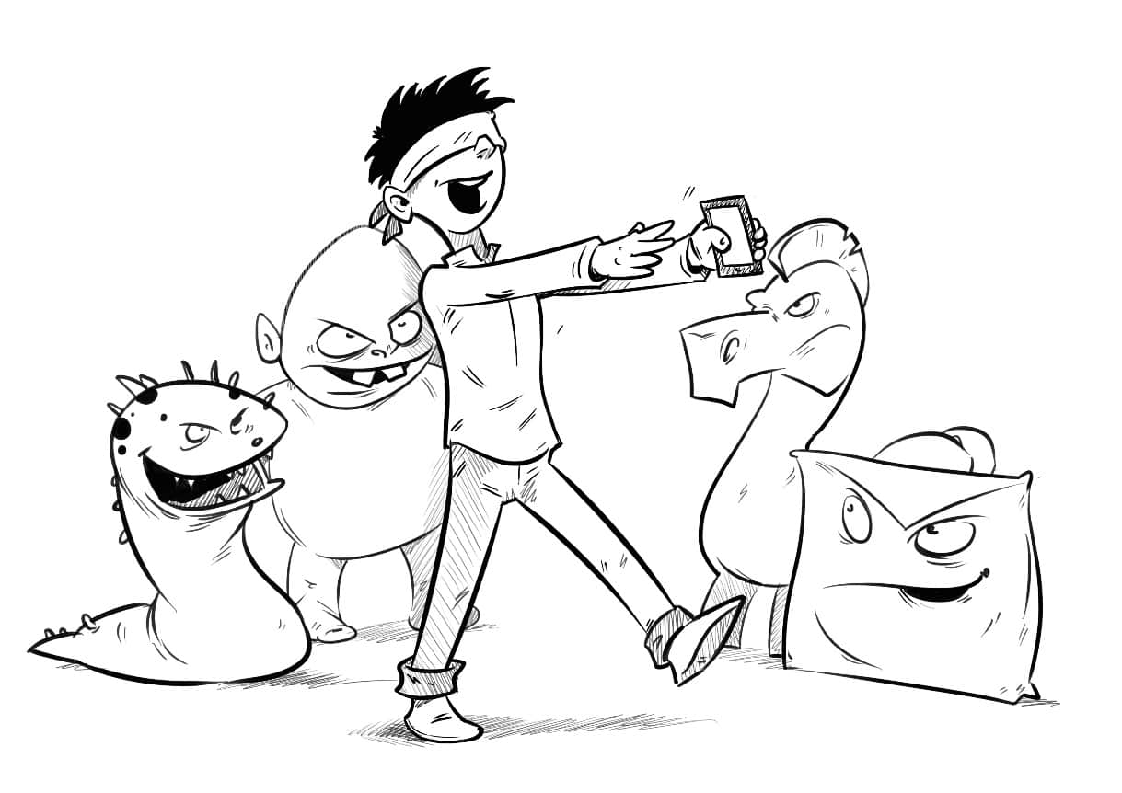
Introduction: Security of AI/ML Supply Chain
We know the risk of downloading software from untrusted sources.
How about untrusted AI/ML models?
We conduct a survey on how users handle third-party models.
400 feedbacks were collected.

Slide 5




Introduction: Security of AI/ML Supply Chain
55% of AI/ML researchers
78% of AI/ML engineers
would NOT examine the source code of the downloaded models.
81% of AI/ML students
45% of security researchers

Slide 6
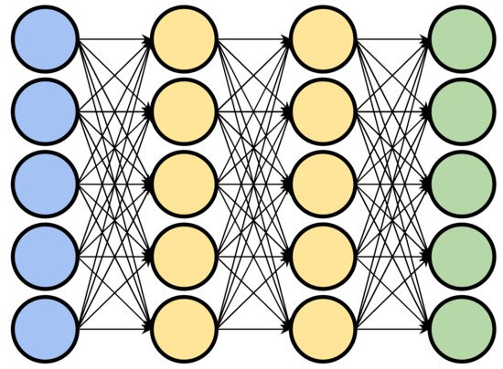

Introduction: Security of AI/ML Supply Chain
Neural trojans are embedded malicious functionality can be triggered by specific input patterns.
Model poisoning Trojans: PoTrojan, TrojanNet [KDD 2020], DeepPayload [ICSE 2021], Stealthy Trojan [TDSC 22], SRA [CVPR 2022], etc.
Speed Limit 100

Slide 7

Introduction: Security of AI/ML Supply Chain
Any malicious or compromised stakeholder on the AI/ML supply chain may inject neural Trojans to the shared models.
None of the existing code scanners can detect neural Trojans.
E.g., malicious model providers
E.g., ML model repackaging attacks
E.g., the insider attacks

Slide 8
Outline
Introduction
LoneNeuron
Evaluation
Conclusion

Slide 9
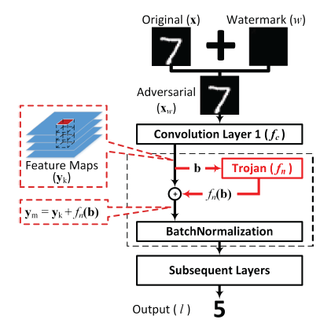
LoneNeuron: Overview
Stealthy watermarks are added onto the images as triggers.
A single neuron is embedded after the first convolution layer.
The embedded neuron is essentially an MLP with ReLU activation, which responds to a pre-defined pattern in the feature domain.
Adversarial outputs are generated and propagated to the target label.

Slide 10
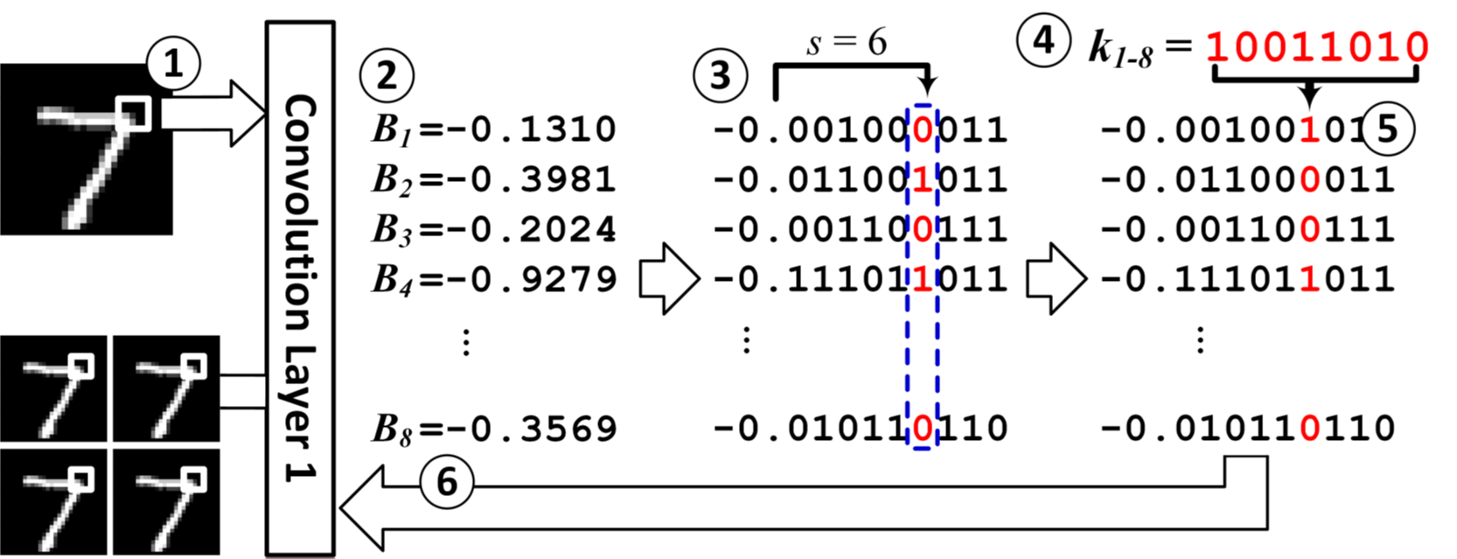
LoneNeuron: Trigger Generation
The Pixel Space
The Feature Space
1&2: Identify the pixel domain region and the corresponding N features to carry the watermark.
3: Select the injection position: the s-th bit after the binary point.
4&5: Inject the N-bit pattern in the feature domain.
Deconvolution: an underdetermined system of equations → many solutions → polymorphic watermarks
6: Reconstruct the pixel-domain watermarks from the contaminated features.

Slide 11
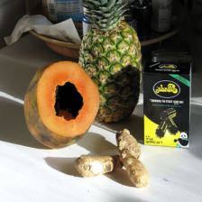



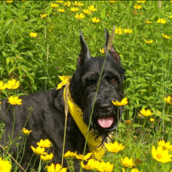

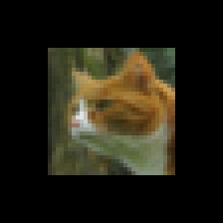

LoneNeuron: Trigger Generation
Watermarked images are visually identical to the original images.

Slide 12
LoneNeuron: Trojan Training
Training the LoneNeuron: freeze the pre-trained victim DNN and train the injected Trojan neuron only.
White-box training: using images from the original training data.
Grey-box training: using generated inputs as random gaussian noises.
Dataset | Size of Dataset | White-box Training | Grey-box Training
MNIST | 60,000 | 70 (0.1%) | 200 (0.3%)
GTSRB | 39,209 | 50 (0.1%) | 200 (0.5%)
ImageNet | 1,291,167 | 50 (0.004%) | 200 (0.015%)
CIFAR | 50,000 | 60 (0.1%) | 200 (0.4%)
LFW | 13,233 | 50 (0.4%) | 200 (1.5%)

Slide 13
Outline
Introduction
LoneNeuron
Evaluation
Conclusion

Slide 14
Evaluation: Attack Effectiveness
Clean model accuracy
Trojaned model accuracy with clean inputs
Specificity
The Trojan only responds to watermarked input, the main task accuracy does not decrease

Slide 15
Evaluation: Attack Effectiveness
Clean model accuracy
Trojaned model accuracy with clean inputs
White box attack success rate
Grey box attack success rate
Sensitivity
LoneNeuron achieves a 100% attack success rate on all datasets

Slide 16
Evaluation: Attack Effectiveness
Clean model accuracy
Trojaned model accuracy with clean inputs
White box attack success rate
Grey box attack success rate
Vision Transformers
LoneNeuron is the first effective
backdoor attack against vision transformers (ViTs).

Slide 17
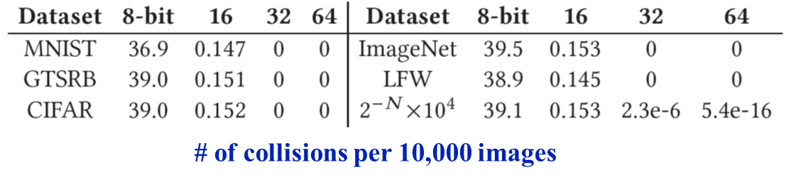
Evaluation: Watermark Polymorphism
Trigger generation and collisions:
Collision is extremely rare: benign images will not (accidentally) trigger Trojan.
Statistical clues:
LoneNeuron watermark strings passes all NIST randomness tests.
Lack of patterns in the pixel domain makes it difficult, if not impossible, to statistically identify the watermarks.

Slide 18
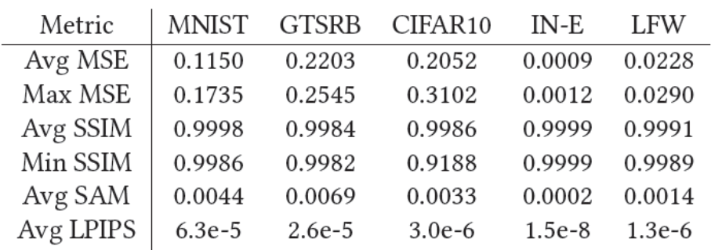
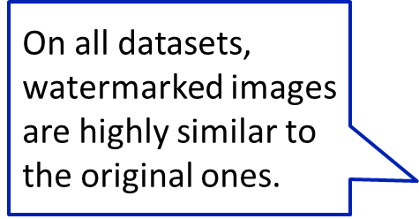

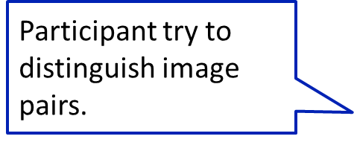
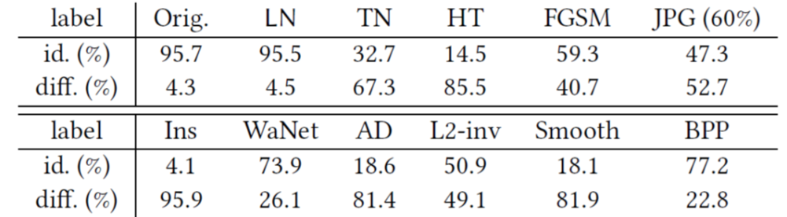
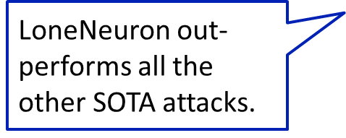

Evaluation: Watermark Stealthiness
We adopt two-phase evaluation: metrics and user study.

Slide 19
Evaluation: Against Defenses and Robustness
We evaluate LoneNeuron against three types of SOTA defenses:
Input analysis: STRIP[1], Februus[2].
Examine or sanitize the potentially contaminated images.
Explanation-based analysis: NC[3], NeuronInspect[4], ABS[5], ANP[6].
Inspect or sanitize using neuron behaviors.
Runtime detection: ULP[7], MNTD[8], SCAn[9].
Detect backdoored models or samples based on activation space.
LoneNeuron escapes all these defense mechanisms.

Slide 20
Outline
Introduction
LoneNeuron
Evaluation
Conclusion

Slide 21
Conclusion
We present a novel code/architecture poisoning attack against ML models with many desired properties:
Sensitivity: high attack success rate.
Specificity: the Trojan only responds to watermarked input, i.e., the benign input accuracy of the victim model does not decrease.
Sample-specific and polymorphic watermarks: every watermark is different, for same or different carrier images.
Stealthiness: the watermarks cannot be identified by human eyes or numerical analysis.
Robustness against detection, defenses and input cleansing.

Slide 22
Conclusion
We demonstrate the feasibility and practicality of introducing powerful attacks by compromising a single link on the ML model supply chain.
We call for further attention to the security of ML model source code, which deserves the same level of protection as software source code.

Slide 23

Acknowledgements
Zeyan Liu, Fengjun Li and Bo Luo were supported in part by NSF IIS-2014552, DGE-1565570, DGE-1922649, and the Ripple University Blockchain Research Initiative.
Zhu Li was supported in part by NSF CNS-1747751.
The authors would like to thank the anonymous reviewers for their valuable comments and suggestions.
The authors would like to thank all the participants of the user-studies.

