Slide 1
Assignment 2 and Ncurses Library
CSCI3180 Principles of Programming Languages
Tutorial 4

Slide 2
Assignment 2

Slide 3
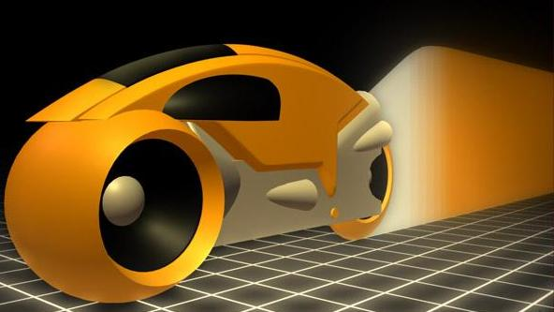
Assignment 2
Game simulation (Light Cycle in Tron)
  Two light cycles competing in an arena
  Concurrent programming exercise (Administrator-and-Worker)
Implementation: the C language
  GNU/Linux with the GCC compiler
  User Interface: Ncurses Library
  Concurrent programming: Synchronous Interprocess Messaging Project for LINUX (SIMPL)

Slide 4
Light Cycle
Two kinds of players:
  Computer (required)
  Human (optional, bonus points)
Initially, light cycles are placed in fixed positions facing each other.
Walls of light are created behind the cycles as they move

Slide 5
More Details
Controls:
  Turn to East, South, West or North
  Use turbo boost
A cycle loses immediately if it collides with the boundary of the arena, the wall created by other cycles or itself.
All cycles advance simultaneously at a constant speed.
  Turbo boost can greatly increase the speed of a cycle
The last cycle remains in the arena wins the game.

Slide 6
More Details
The arena
  A 200x100 rectangle
  The arena can be much larger than the size of the window
  Only a part of the arena is visible in the window

Slide 7
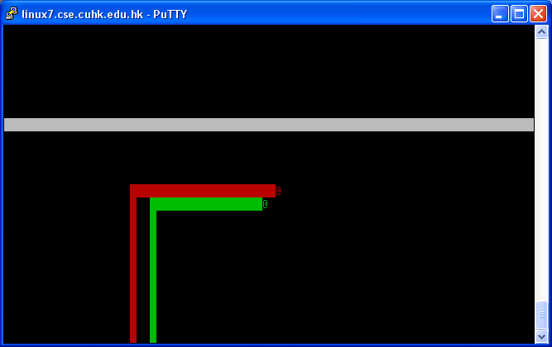
Screen Output
Border
Light cycles
Wall of light
Arena

Slide 8
Ncurses (new curses) Library
Free software emulation of the original curses library in UNIX
Provide an efficient API to terminal IO operations: move cursor, create windows, produce colors, etc.
Need not worry about the underlying terminal capabilities
Header file: <curses.h>
To compile:
  gcc prog.c –o prog -lcurses

Slide 9
Initialization and Termination
#include <curses.h>
int main() {
initscr(); /*start curses mode*/
cbreak(); /*disable input buffering*/
noecho(); /*disable echoing input*/
/* ... screen handling ... */
endwin(); /*end curses mode*/
return 0;
}

Slide 10
Window – The Imaginary Screen
2D arrays of characters representing all or parts of screen
I/O should pertain to specific window
Coordinates: (y, x)
Default window: stdscr
  To get the dimension:
  int H,W;
  getmaxyx(stdscr,H,W);
  Changes to window are
  not reflected until:
  refresh(); or wrefresh(stdscr);
(0,0)
(0,W-1)
stdscr
(H-1,0)
(H-1,W-1)

Slide 11
Moving Cursor and Output
Example: say “Hi” to a user in (5,10) of stdscr
  char* user = “Bob”; int y = 5, x = 10;
  move(y,x); printw(“Hi %s”,user);
Syntactic sugar:
  mvprintw(y,x,“Hi %s”,user);
Other output functions:
  Print a character: addch and mvaddch
Remember to refresh to see the changes!

Slide 12
Input
To read a character from stdscr:
  int ch = getch();
To capture special keys such as arrow keys:
  keypad(stdscr,TRUE);
Definitions of special keys’ integer value:
  KEY_LEFT, KEY_RIGHT, KEY_UP, etc...
To disable getch of waiting for a key hit:
  nodelay(stdscr,TRUE);
  Then, getch return ERR if no key is hit.

Slide 13
Other Topics
Drawing border
Clear the screen
Create and destroy new windows
Colors Handlings
Etc…
Read from the online resources
http://tldp.org/HOWTO/NCURSES-Programming-HOWTO/

Slide 14
Tips
Drawing the walls
  The following attribute can be useful in writing the character ▌ :
  A_REVERSE Reverse video
  To turn on an attribute:
    attron(A_REVERSE);
  To turn off an attribute:
    attroff(A_REVERSE);
More details can be found on:
http://tldp.org/HOWTO/NCURSES-Programming-HOWTO/attrib.html

Slide 15
Running the Sample Programs
Download the package from the course webpage
Follow the instruction on the README file
Important points:
  Create a new directory where the FIFOs to live
  e.g. mkdir $HOME/fifo
  Set up the FIFO_PATH and SIMPL_HOME environment variables
  If you forced termination (i.e. pressed Ctrl-c), remember to KILL all your useless processes
  TIPS: If you got strange problem, make sure the directory pointed by FIFO_PATH is clean

Slide 16
Homework
Download the sample implementation from the course web page and play around
  Note: sample programs (both part A and B) can only be run on linux6 – linux9
  Part B can only be run on Linux with Putty
Read the assignment specification
Do Part A of the assignment using Ncurses
  Animate a single cycle moving within the border
Note: Part A can be done on either Linux or Sparc machines while Part B must be done on Linux machines
Sparc machines: sparc1 – sparc59
Linux machines: linux6 – linux9

Slide 17
Concurrent Programming

Slide 18
Concurrent Programming
Sequential Process
  It is a totally ordered set of events
  Each event being a change of state in a computing system.
Sequential Program
  It is a text that specifies the possible state changes of a sequential process
  E.g. The FORTRAN / COBOL program in assignment 1
In Unix, each process has a Process ID (PID)
Can we write a program with more than one sequential process?

Slide 19



Concurrent Programming
A concurrent program specifies the possible state changes of two or more sequential processes
  The sequential processes are often cooperating
Examples of concurrent program
Operating Systems
Web Servers
What happens if they are sequential programs?

Slide 20
Concurrent Programming
If the set of concurrent processes are to cooperate to achieve a common goal, they need to:
  Communicate in order to exchange information
    Processes need to talk to each other
  Synchronize at certain critical points to ensure proper merging of control
    A process may need to wait until other processes finish their jobs
Improper synchronization may result in deadlock or starvation!
For more information about deadlock/starvation -> CSCI3100,CSCI3150

Slide 21
END

