Slide 1
Lab Meeting

Slide 2
Contents
RNA SELEX
Identifying CTCF Binding Using a DNA GpC Methyltransferase in vivo

Slide 3
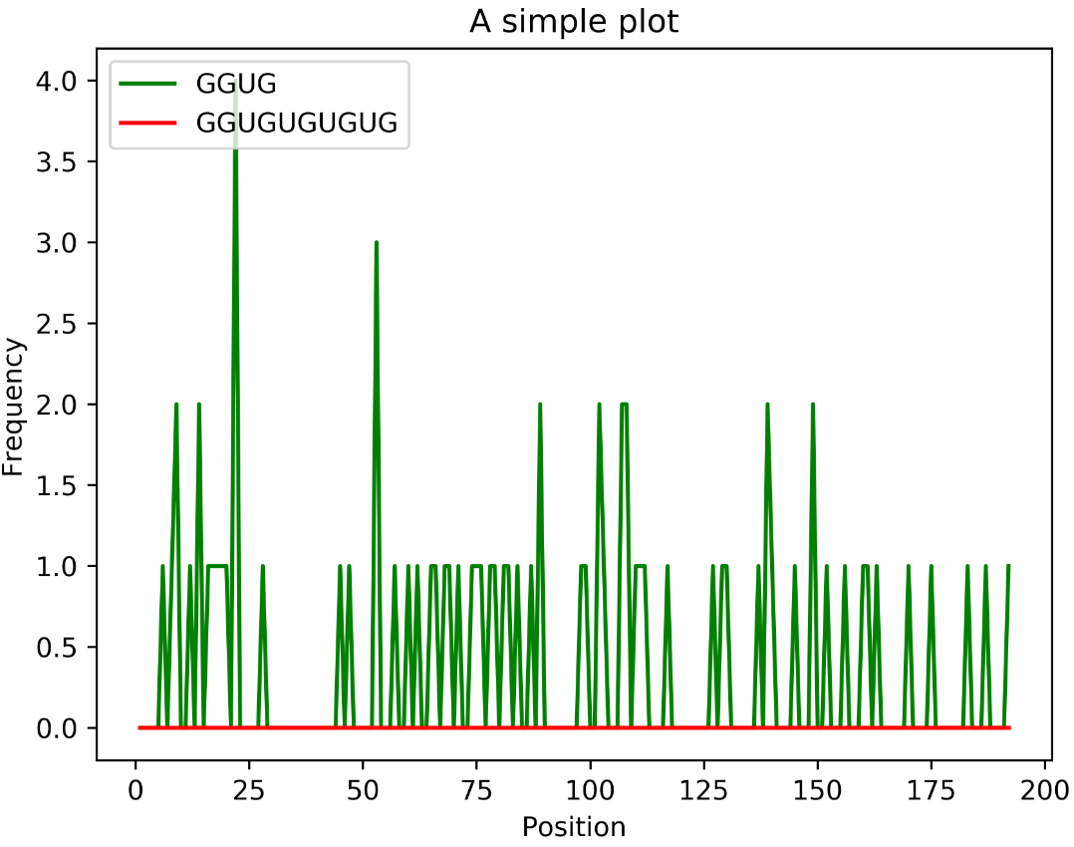
Plot Frequency

Slide 4
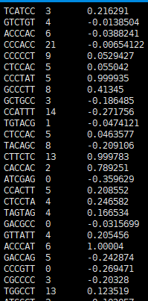
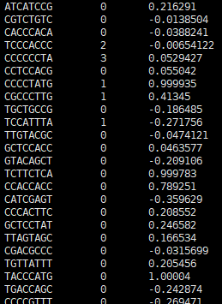
gkm-SVM algorithm
Len = 6
Len = 8

Slide 5
Improvement
Aim
Decrease the distance between train and test
Method
rectify parameters: learning rate, loss function, and so on.
change other models.
Test sample data
Window size =1000, cutoff of max(Methyl)=5, #Seqs=2W (1W for pos and 1W for neg)

Slide 6
Method 1: Try different combination of parameters.

Slide 7
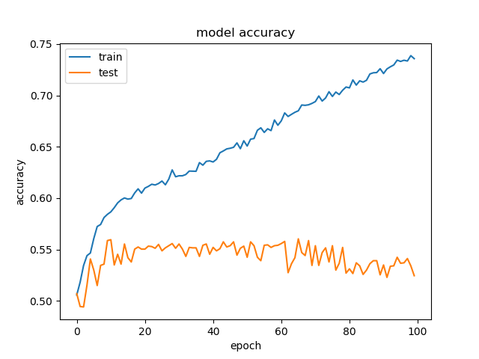
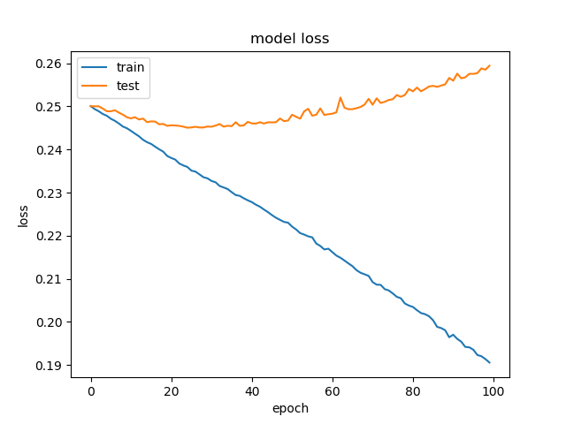
LR = 0.0001 Loss=mean_squared_error
TP | FN
FP | TN
2505 | 1493
2305 | 1695
Sensitivity = 0.627
Specificity = 0.423

Slide 8
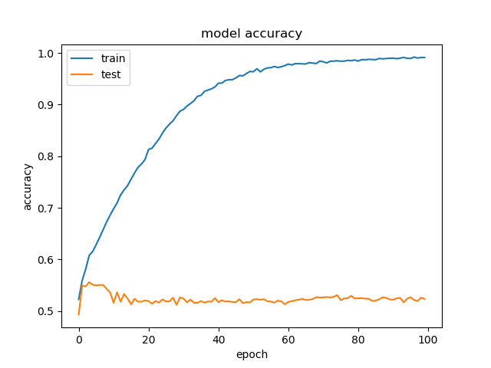
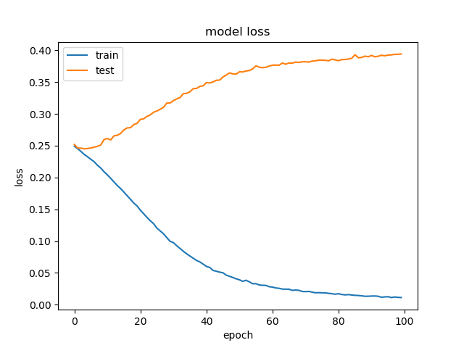
LR = 0.001 Loss=mean_squared_error
TP | FN
FP | TN
2258 | 1742
2108 | 1892
Sensitivity = 0.565
Specificity = 0.473

Slide 9
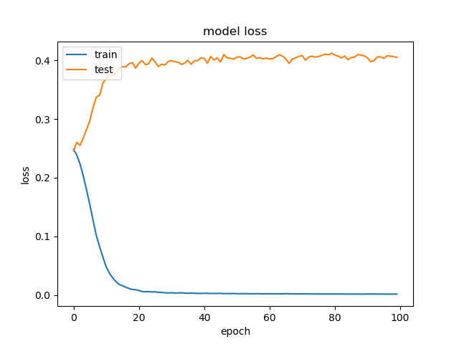
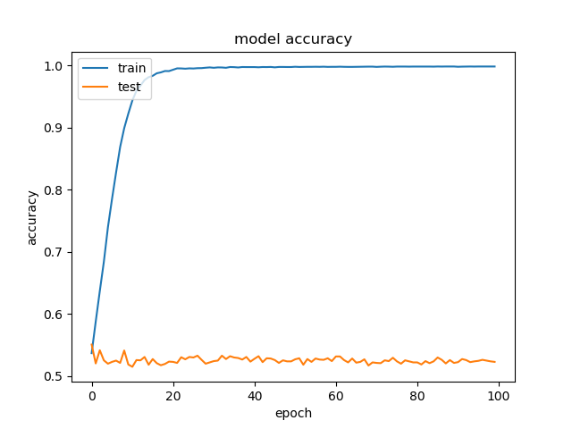
LR = 0.01 Loss=mean_squared_error
TP | FN
FP | TN
2237 | 1763
2045 | 1955
Sensitivity = 0.559
Specificity = 0.489

Slide 10
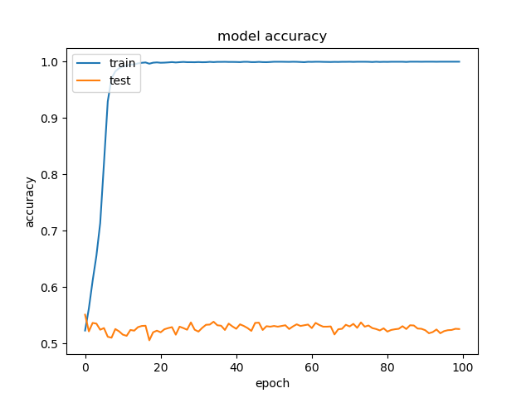
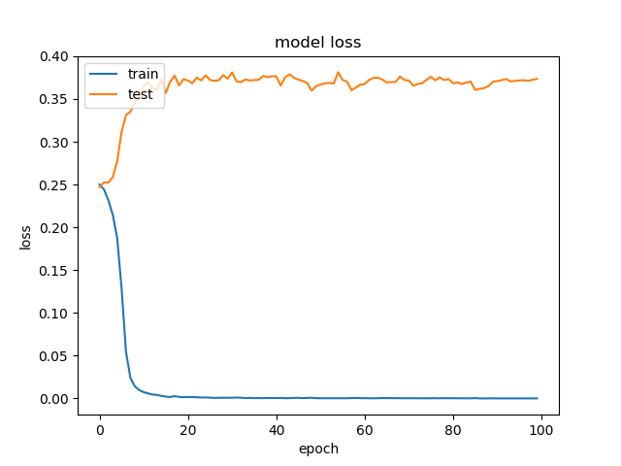
LR = 0.1 Loss=mean_squared_error
TP | FN
FP | TN
2296 | 1704
2045 | 1955
Sensitivity = 0.574
Specificity = 0.489

Slide 11
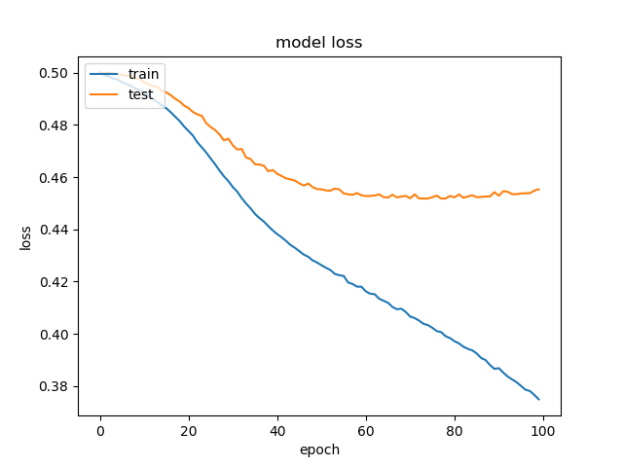
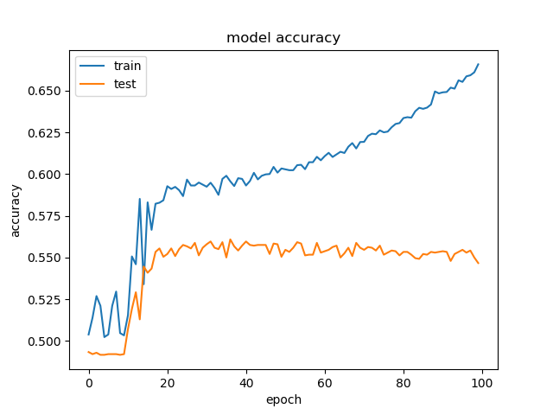
LR = 0.0001 Loss=mean_absolute_error
TP | FN
FP | TN
2711 | 1289
2289 | 1711
Sensitivity = 0.678
Specificity = 0.428

Slide 12
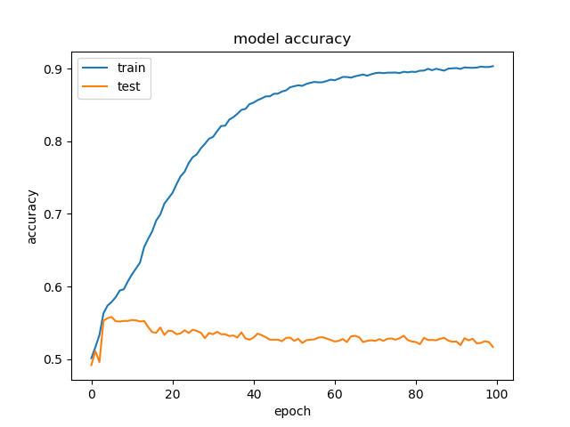
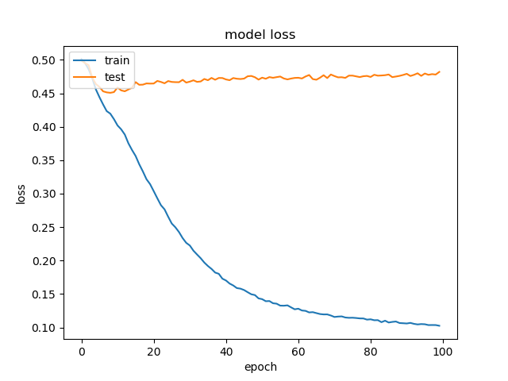
LR = 0.001 Loss=mean_absolute_error
TP | FN
FP | TN
2465 | 1535
2279 | 1721
Sensitivity = 0.616
Specificity = 0.430

Slide 13
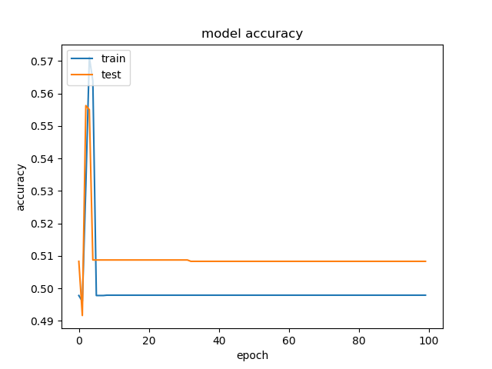
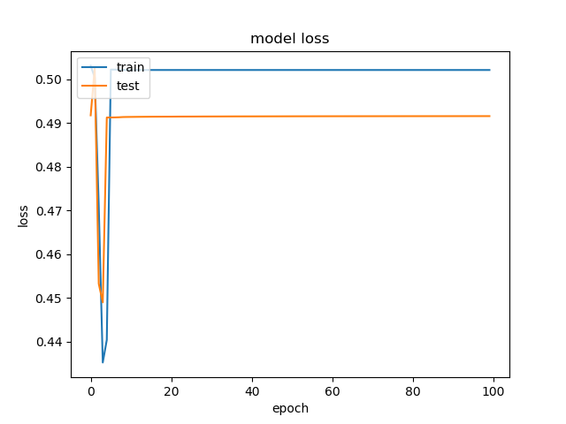
LR = 0.01 Loss=mean_absolute_error
TP | FN
FP | TN
0 | 4000
0 | 4000
Sensitivity = 0
Specificity = 1

Slide 14
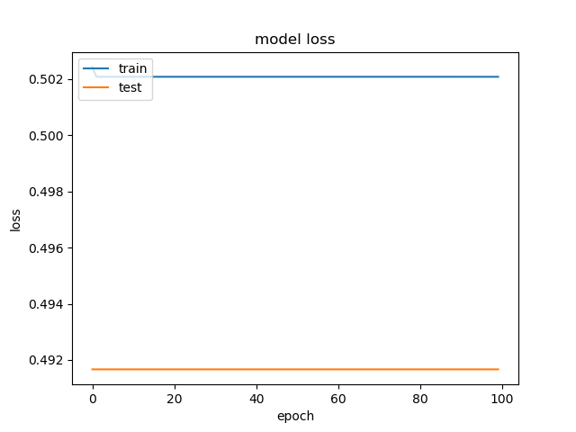
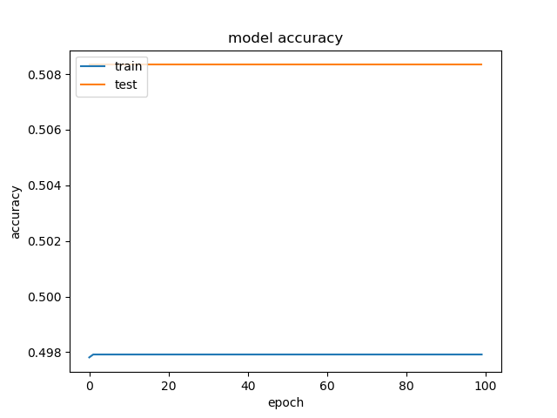
LR = 0.1 Loss=mean_absolute_error
TP | FN
FP | TN
0 | 4000
0 | 4000
Sensitivity = 0
Specificity = 1

Slide 15
Method 2: Literature Research and Utilize Recommended Parameters.

Slide 16
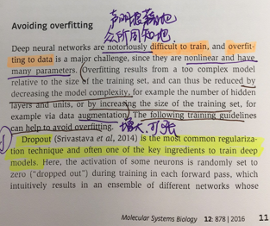
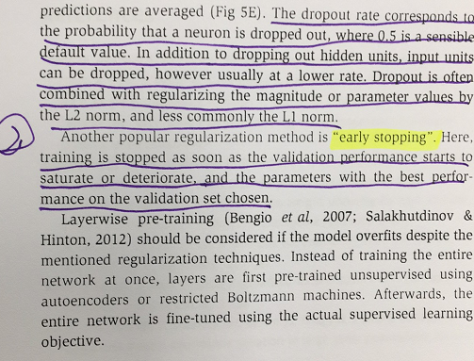
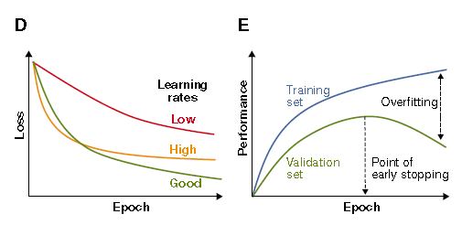
Avoid Overfitting
Two Methods:
Dropout rate
Early stopping
Angermueller C, Pärnamaa T, Parts L, et al. Deep learning for computational biology[J]. Molecular systems biology, 2016, 12(7): 878.

Slide 17
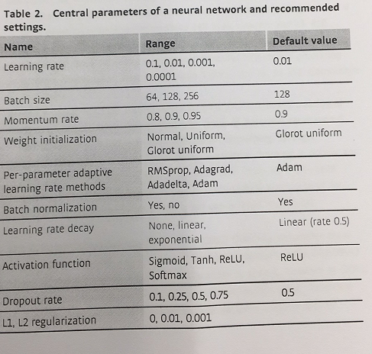
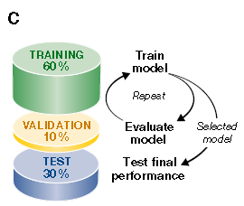
Change Parameters
Angermueller C, Pärnamaa T, Parts L, et al. Deep learning for computational biology[J]. Molecular systems biology, 2016, 12(7): 878.

Slide 18
Update Processes
Change some parameters with the same network structure
Data set
60% of all data set for training
30% of all data set for testing
10% of all data set for validating
Dropout rate = 0.1
Out layer’s activation function
sigmoid
Learning rate = 0.01
Decay = 0.5
Momentum = 0.8
Loss function
Binary crossentropy
Epoch = 200
Batch size = 64

Slide 19
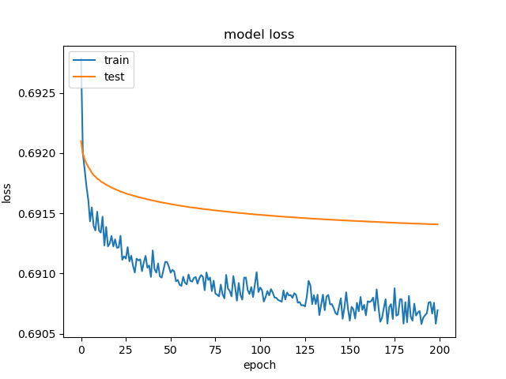
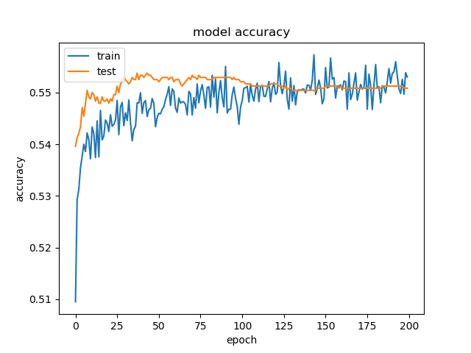
Update Results
TP | FN
FP | TN
1794 | 1206
1624 | 1376
Sensitivity = 0.598
Specificity = 0.459

Slide 20
Summary and Conclusion
The second methods seems better than the first one considering overfitting.

Slide 21
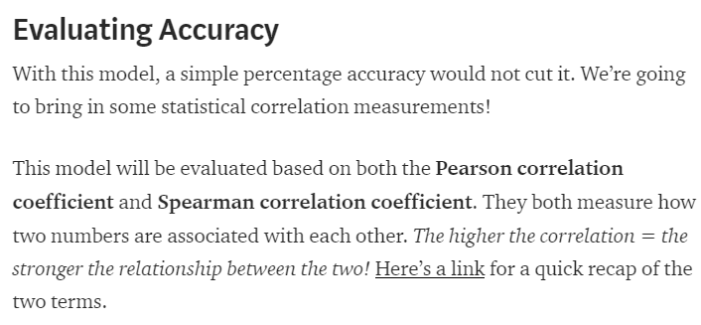
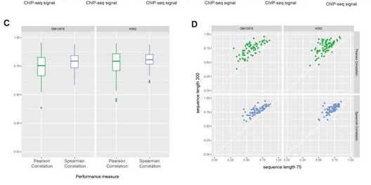
Future
Calculate the correlation scores between BS-seq’s predicted values and CTCF ChIP-seq’s values.
Wang M, Tai C, E W, et al. DeFine: deep convolutional neural networks accurately quantify intensities of transcription factor-DNA binding and facilitate evaluation of functional non-coding variants[J]. Nucleic acids research, 2018, 46(11): e69-e69.

Slide 22
Acknowledgements
Dr. Xi WANG

Slide 23
Thanks for Your Attention And Criticism！
Notes:
Finally, thanks my advisor, Professor YAN and Dr. WANG. Thanks for the findings. I will stop here and take questions.

