Slide 1

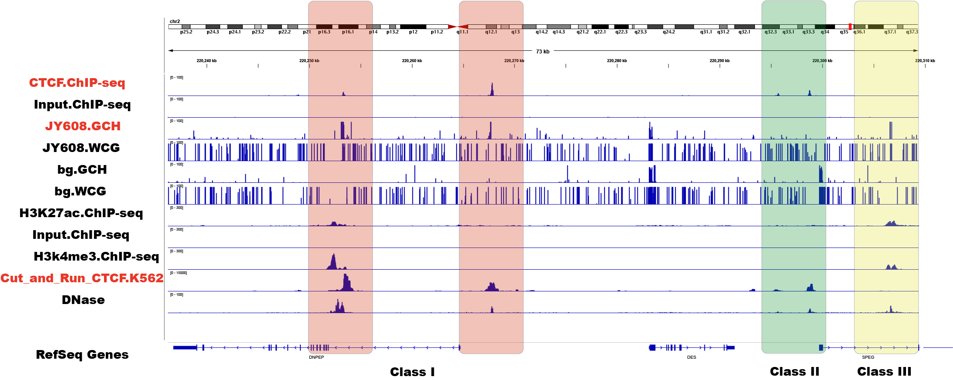
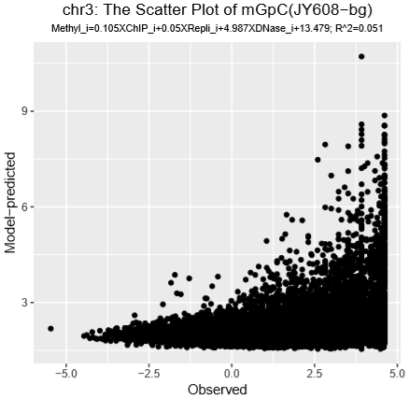
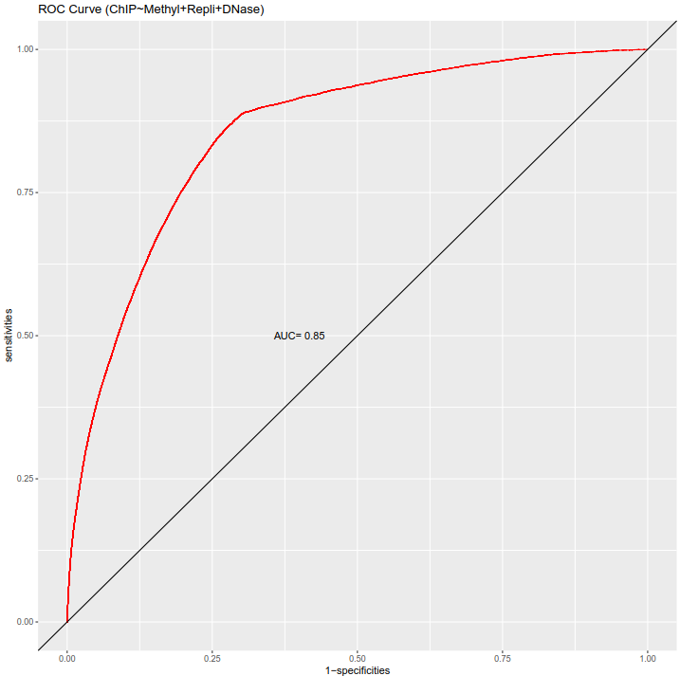
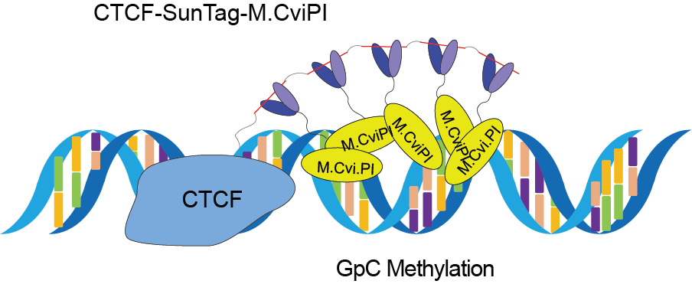
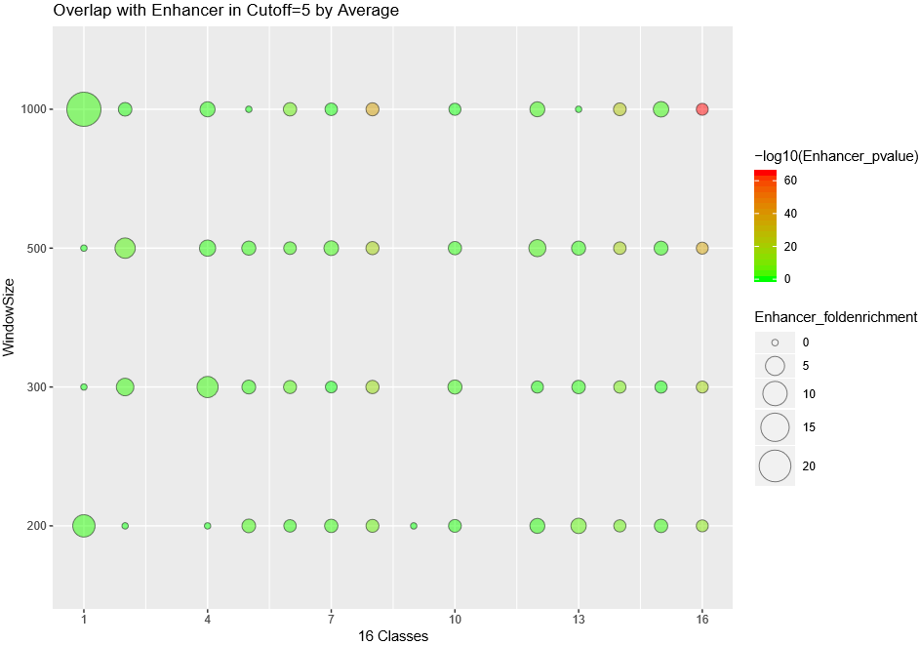
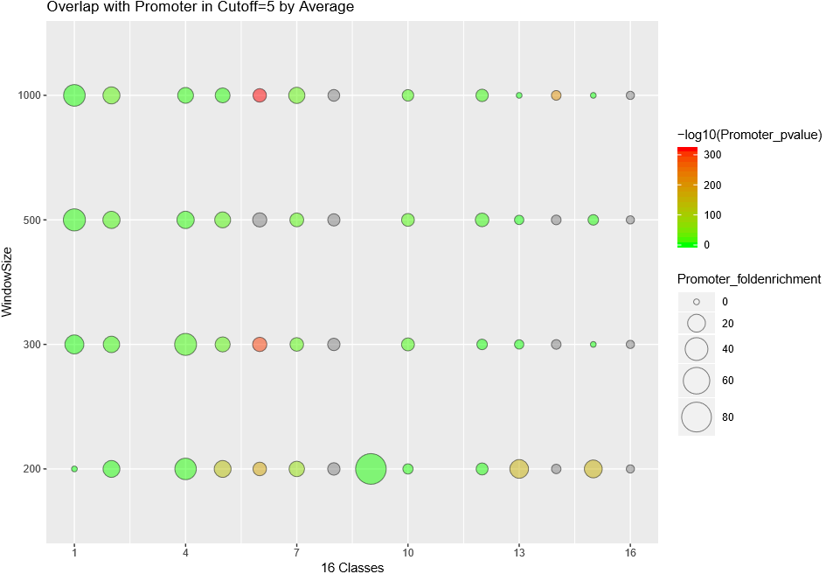
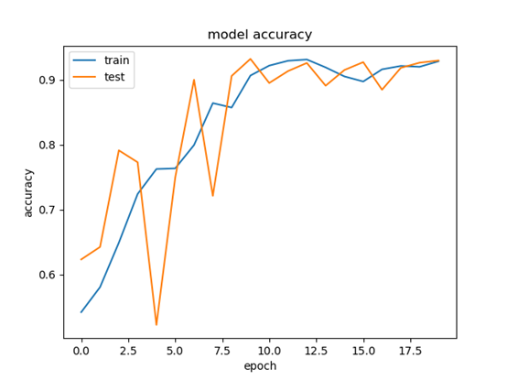
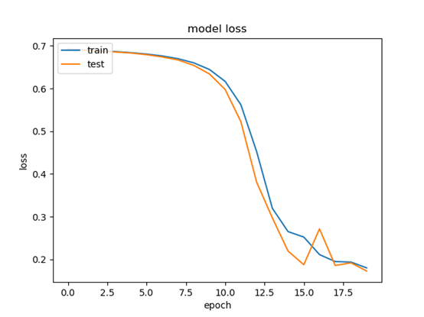

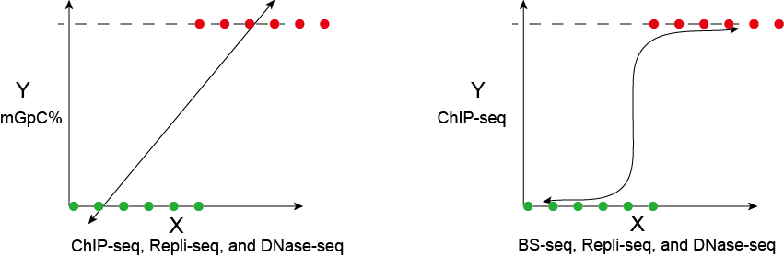

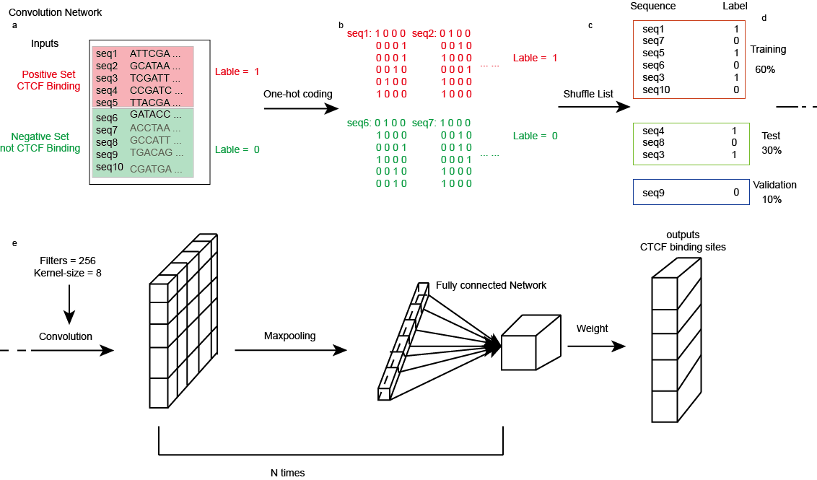
Identifying CTCF Binding Sites Using a DNA GpC Methyltransferase In Vivo
Zhe LIU¹, Xi WANG², Jian YAN¹
1 Department of Biomedical Sciences, City University of Hong Kong, Hong Kong, China
2 The German Cancer Research Center (DKFZ), Heidelberg, Germany
Corresponding Author: jian.yan@cityu.edu.hk
Abstract
Treat CTCF binding regions (From ChIP-seq) as positive set and not CTCF binding regions as negative set individually.
Coding “ACGT” base to “0/1” one-hot format.
Shuffle positive list and negative list, individually.
Split the whole data to 60% for training, 30% for testing, and 10% for validation.
Construct CNN model.
CCCTC-binding factor (CTCF), also known as 11-zinc finger protein, is a highly conserved and widely expressed transcription factor in human. It has tens of thousands of binding sites in human genome and involves wide and varied biological functions, including the regulation of gene expression, RNA splicing, genomic imprinting, alternative chromatin loop formation and the formation of higher order chromatin architecture with cohesin. It is essential to systematically and comprehensively identify the CTCF binding sites. There is a GpC cytosine-methyltransferase called M.CviPI, which can methylate exogenous cytosine residues (c5) within the double stranded GpC dinucleotide recognition sequence 5’ end to 3’ end. Here, we fused CTCF with M.CviPI using SunTag antigen-antibody signal amplification system, to enable CTCF to carry more M.CviPI, which further increased the signals. In order to prove this DNA GpC methylation technology can be used for profiling the CTCF binding landscapes, we performed linear regression, logistic regression and convolution neural network (CNN) algorithm. Interestingly, by analyzing the combination of methylation regions from WGBS-seq data for M.CviPI with peak regions from ChIP-seq data for CTCF in HEK293 cell line, we observed a significantly high precision and recall in the results. Together, these data suggest that the signal information of DNA GpC methylation can predict the global occupancy patterns of CTCF in vivo.
Results
1. The Snapshot of CTCF ChIP-seq in HEK293 cell line:
2. Linear Regression:
3. Logistic Regression:
Background
Problematic issues encountered by previous studies:
a. not in situ
b. false positive results caused by crosslinking
c. need additional input as control.
R² << 1 → Linear model is not suitable for this research.
CTCF binding is closely related with DNase signal.
4. Exploring the Predictable Regions and Unpredictable Regions:
Focus on two classes of genomic regulatory elements: Promoter and Enhancer.
Schematic Representation
5. CNN Model (note that: the positive set is from CTCF ChIP-seq result):
Shuffled position sequences with matching dinucleotide composition.
1. Linear Regression:
2. Logistic Regression:
This system is useful for CTCF binding site identification.
Conclusion
3. CNN Model:
Kelly T K, Liu Y, Lay F D, et al. Genome-wide mapping of nucleosome positioning and DNA methylation within individual DNA molecules[J]. Genome research, 2012, 22(12): 2497-2506.
Tanenbaum M E, Gilbert L A, Qi L S, et al. A protein-tagging system for signal amplification in gene expression and fluorescence imaging[J]. Cell, 2014, 159(3): 635-646.
References

