Slide 1
RNA-seq data Analysis
20170323

Slide 2
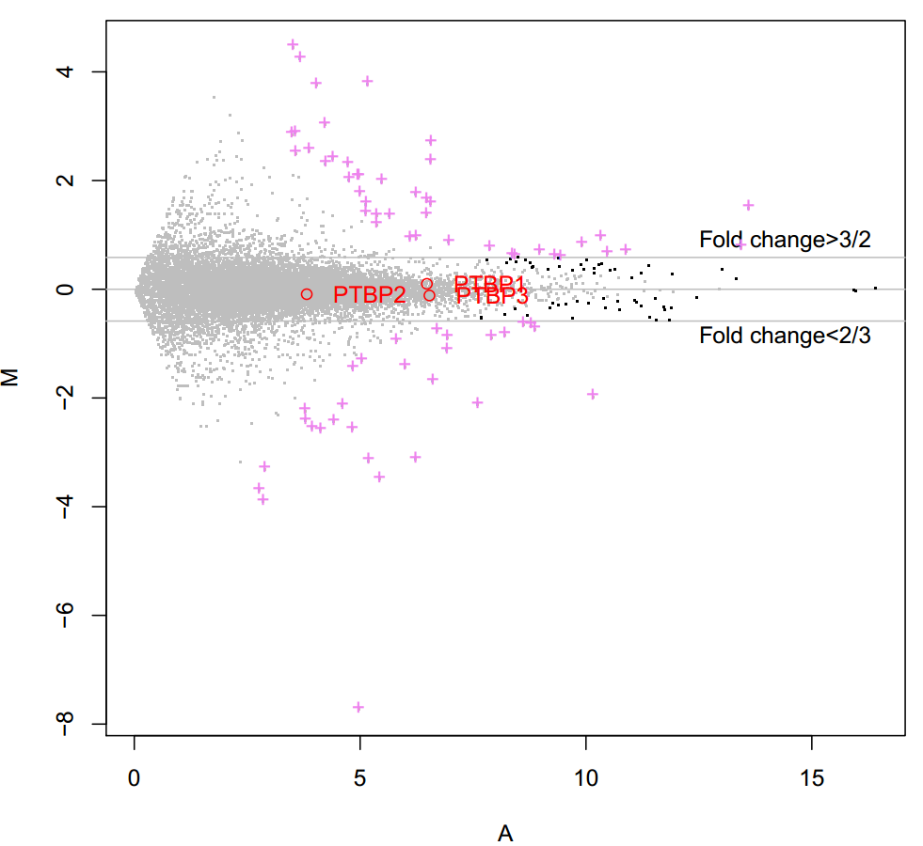
MA-plot
黑色的点表示p小于0.05但是FC不显著;
枚红色的点表示差异变化的基因（p小于0.05，FC大于3/2或小于2/3）;
M值：y = log2(R/G) = log2(R)-log2(G)
A值：x = 0.5*(log2(R)+log2(G))
Notes:
黑色的点表示p小于0.05但是FC不显著
枚红色的点表示差异变化的基因（p小于0.05，FC大于3/2或小于2/3）
M值：y = log2(R/G) = log2(R)-log2(G)
A值：x = 0.5*(log2(R)+log2(G))

Slide 3
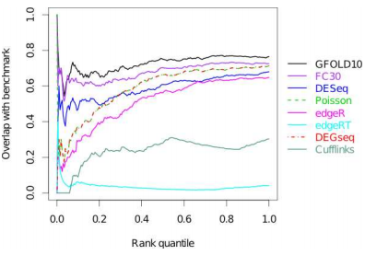
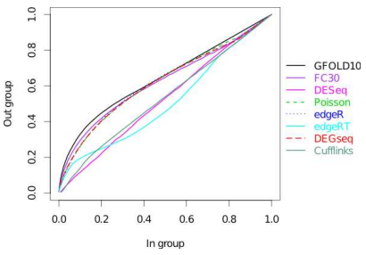
GFOLD
GFOLD > 1 or GFOLD < -1
Log2fdc > 0.6 or log2fdc < -0.6
➔251 DEGs

Slide 4
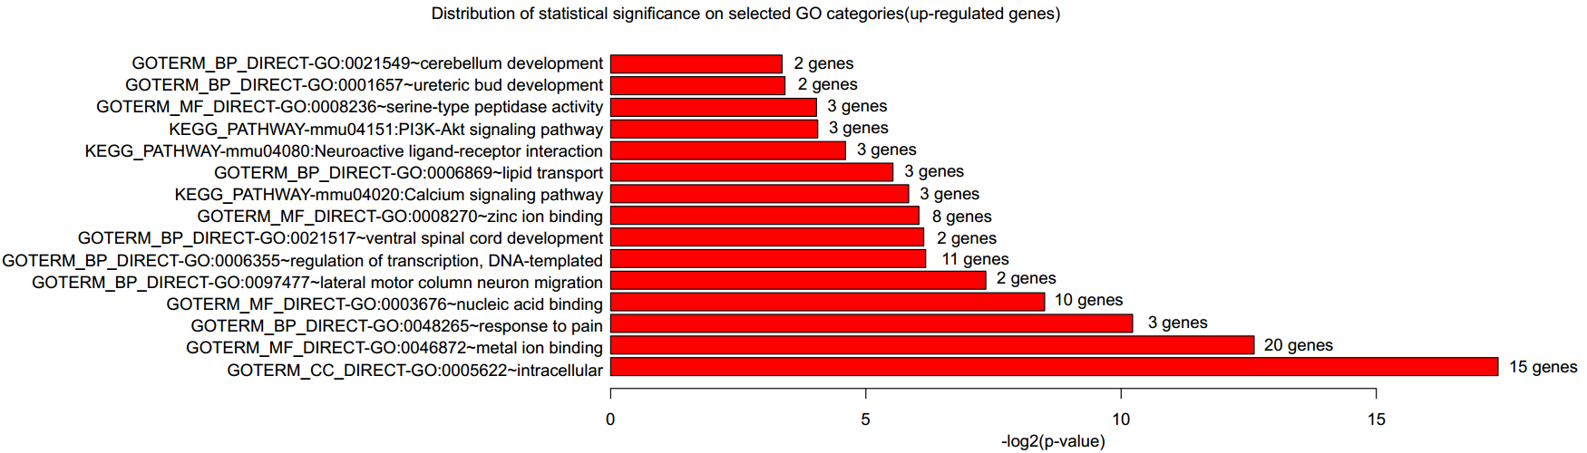
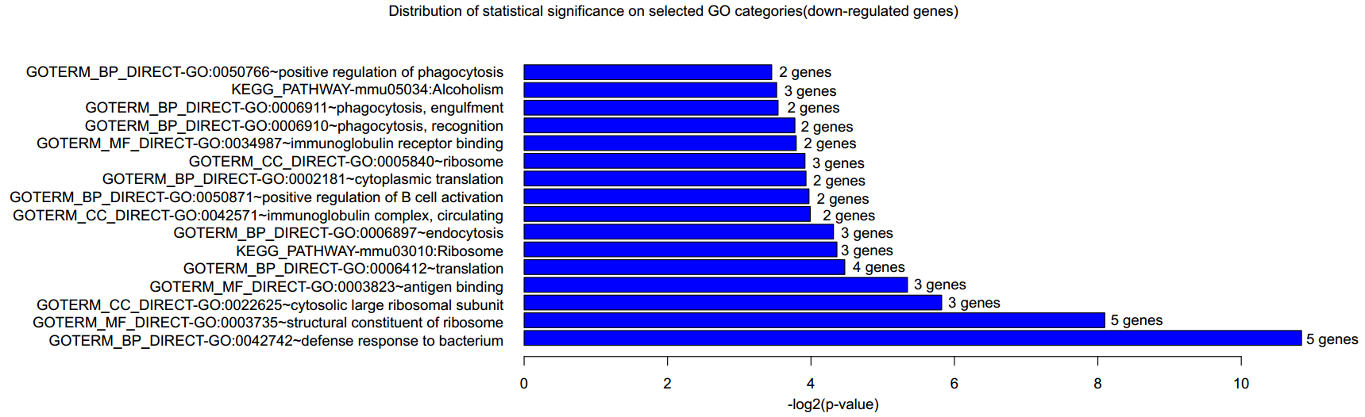
GO analysis
Notes:
FDR q-value < 0.001
Gorilla Software

Slide 5
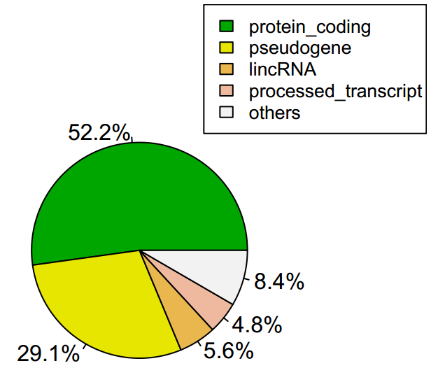
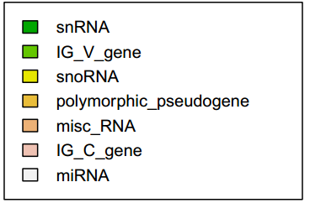
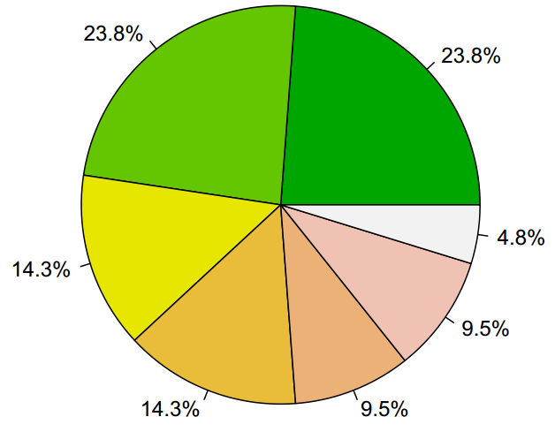
Gene Type Classification
All Genes
Other Genes

Slide 6
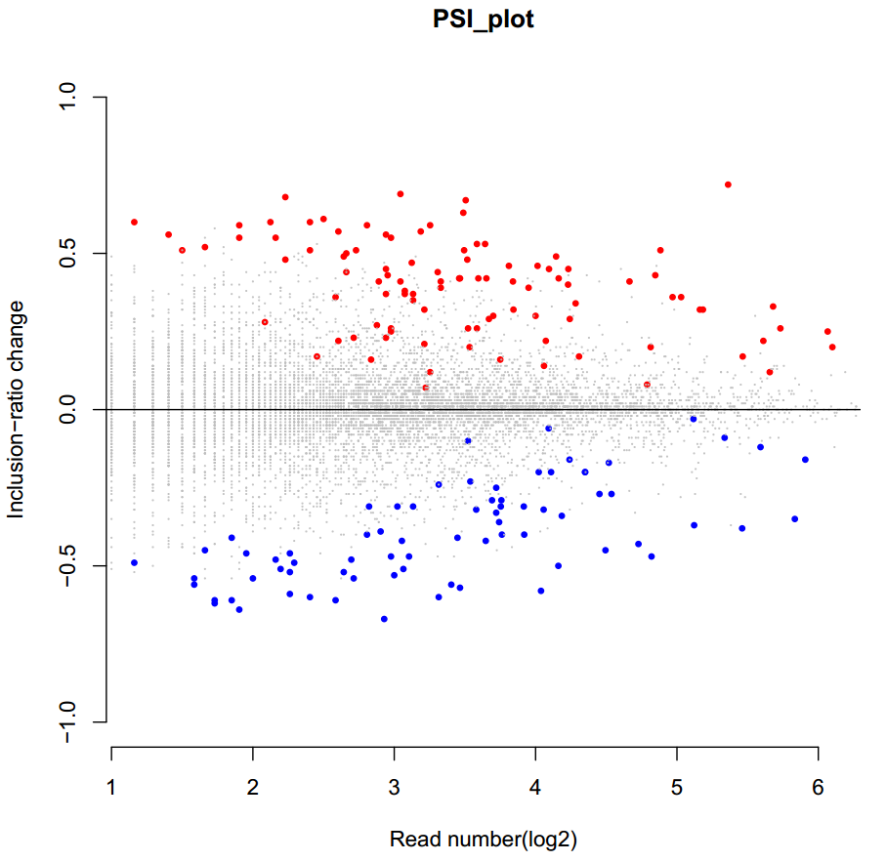
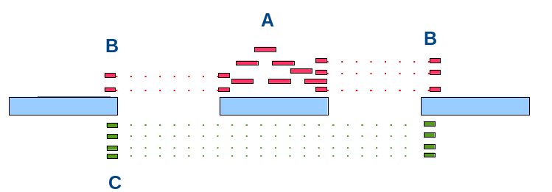


Alternative Splice(Skiping exon)
Notes:
bayes-factors>5过滤数据

Slide 7
Thanks for your attention!

