Slide 1
RNA-seq data Analysis
20170504

Slide 2
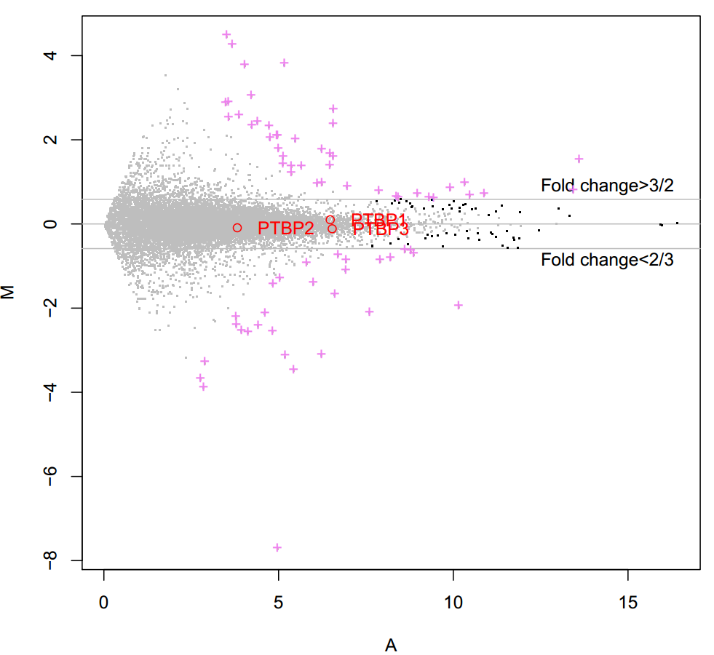
MA-plot
黑色的点表示p小于0.05但是FC不显著;
枚红色的点表示差异变化的基因（p小于0.05，FC大于3/2或小于2/3）;
M值：y = log2(R/G) = log2(R)-log2(G)
A值：x = 0.5*(log2(R)+log2(G))
Notes:
枚红色的点表示差异变化的基因（p小于0.05，FC大于3/2或小于2/3）
M值：y = log2(R/G) = log2(R)-log2(G)
A值：x = 0.5*(log2(R)+log2(G))
RNA-seq：KO-WT

Slide 3
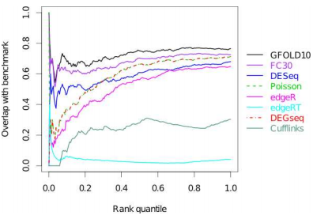
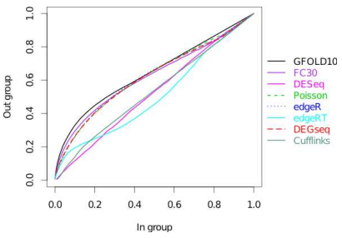
GFOLD
No biological repeats
GFOLD > 1 or GFOLD < -1
Log2fdc > 0.6 or log2fdc < -0.6
➔251 DEGs
Notes:
> log2(1.5)
[1] 0.5849625

Slide 4
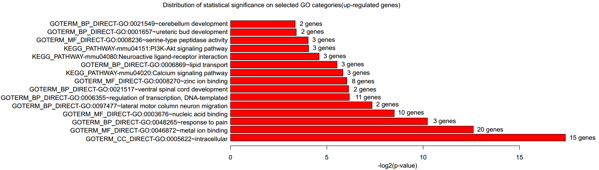
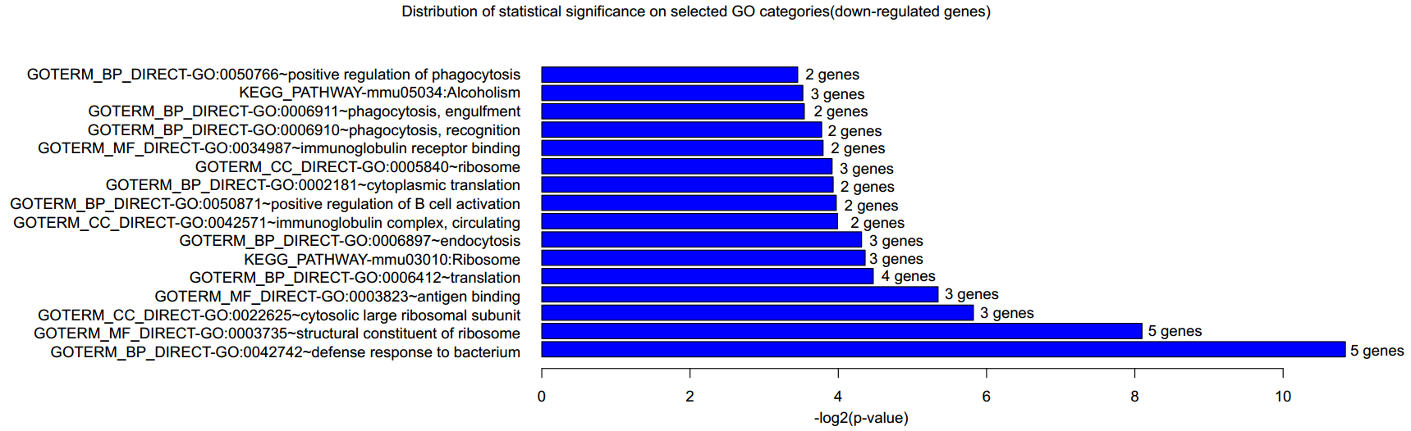
GO analysis
Notes:
p-value < 0.1
DAVID Software
信号通路：Effect of the PI3K/AKT signaling pathway on hypoxia-induced proliferation and differentiation of bone marrow-derived mesenchymal stem cells.; Asperosaponin VI promotes bone marrow stromal cell osteogenic differentiation through the PI3K/AKT signaling pathway in an osteoporosis model; Bone marrow mesenchymal stromal cells ameliorate angiogenesis and renal damage via promoting PI3k-Akt signaling pathway activation in vivo
Phagocytosis 吞噬作用；Engulfment 吞食；Immunoglobulin 免疫球蛋白；Endocytosis 内吞作用；Cytosolic 细胞溶质的
Cerebellum 小脑；ureteric bud 输尿管芽发育；peptidase 肽酶；Neuroactive 刺激神经组织的；ventral 腹部的；lateral 侧面的

Slide 5
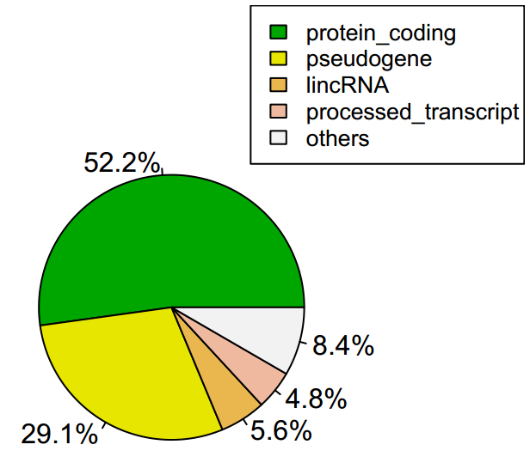
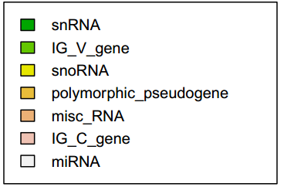
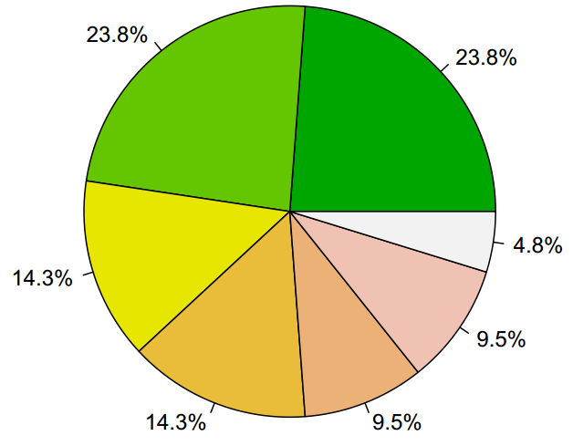
Gene Type Classification
All Genes
Other Genes

Slide 6
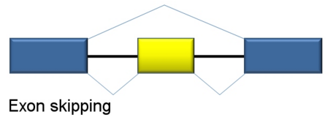
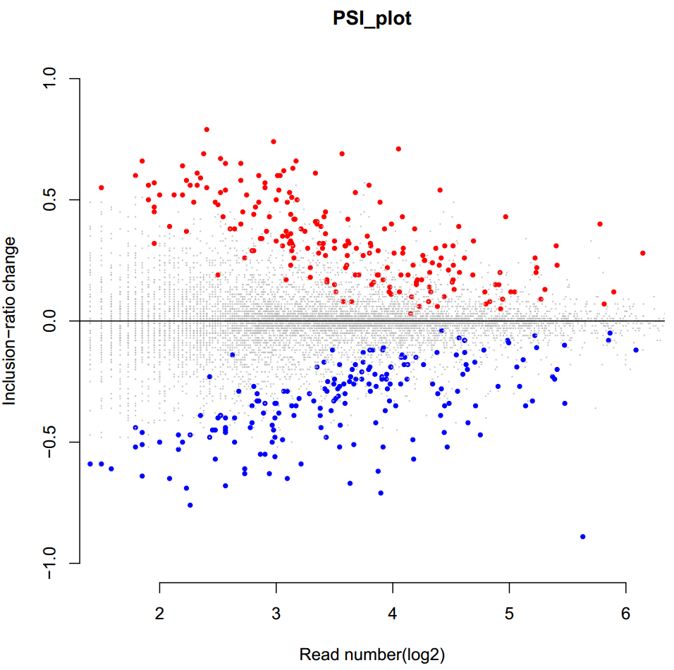
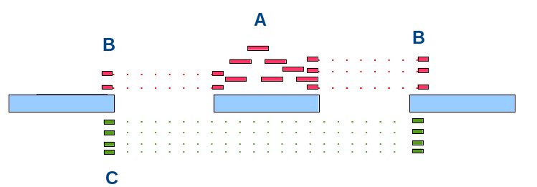

Alternative Splice (Skipped exons)
204 Up-changed
190 Down-changed
8,808 Unchanged
Notes:
bayes-factors>5过滤

Slide 7
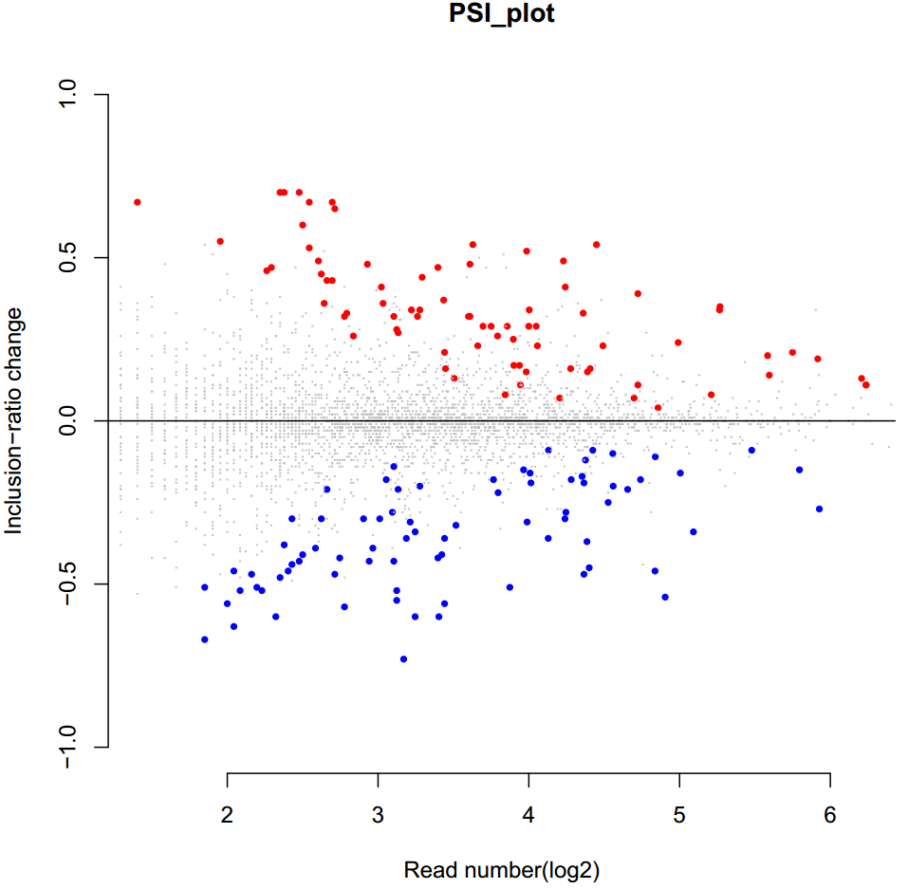
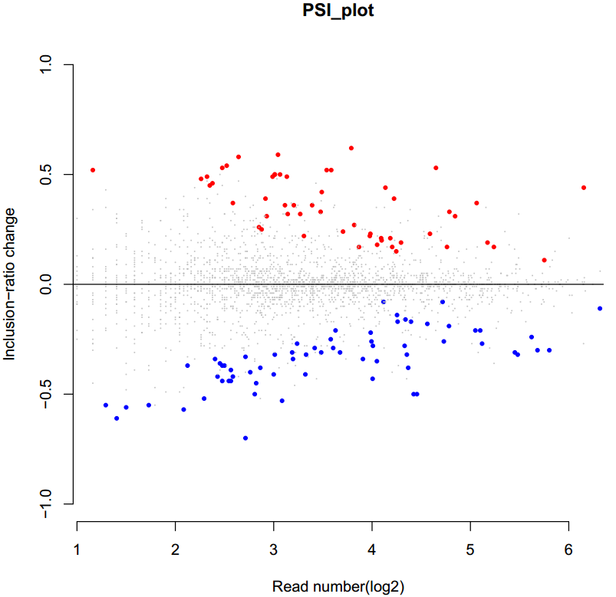
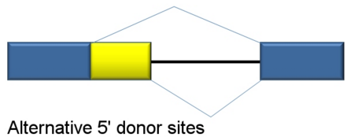
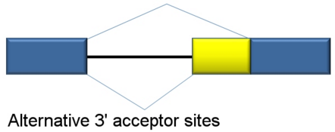
Alternative Splice (Alternative 3’/5’ splice sites)
79 Up-changed
78 Down-changed
3,530 Unchanged
54 Up-changed
66 Down-changed
2,193 Unchanged
Notes:
bayes-factors>5过滤

Slide 8
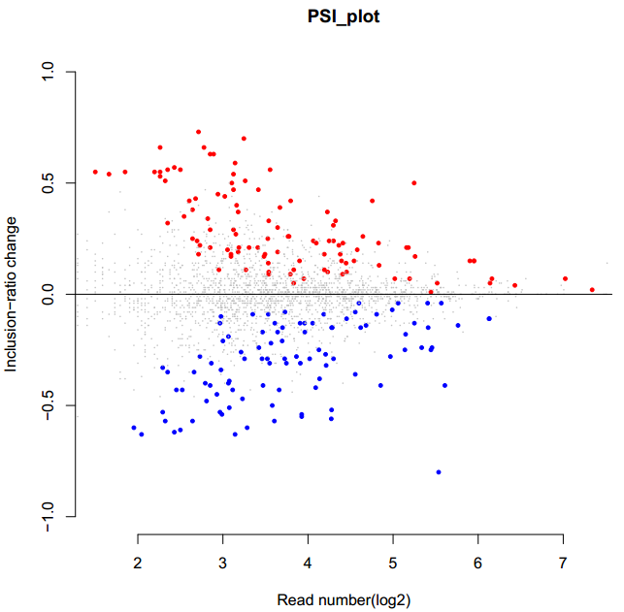
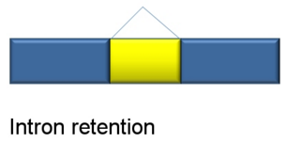
Alternative Splice (Retained introns)
107 Up-changed
98 Down-changed
2,186 Unchanged
Notes:
内含子保留

Slide 9
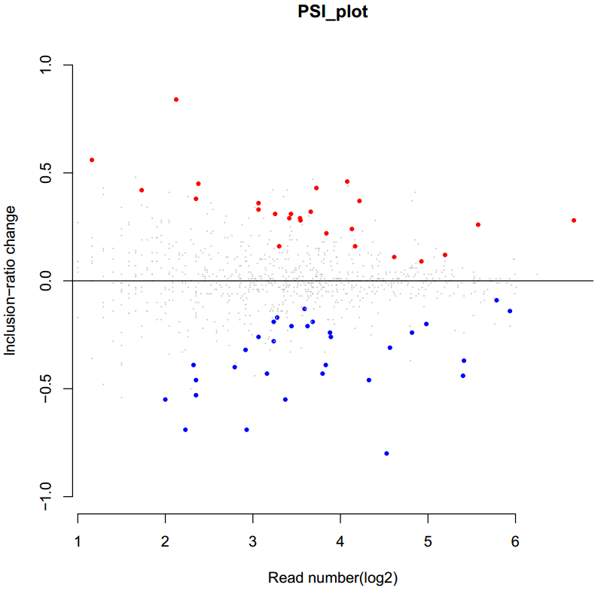
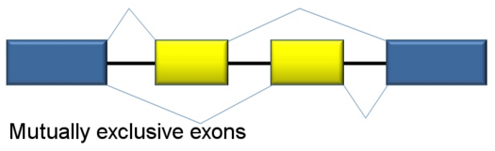
Alternative Splice (Mutually exclusive exons)
25 Up-changed
31 Down-changed
838 Unchanged

Slide 10
CLIP-seq data Analysis
20170511

Slide 11
Correlation statistics
 | BM_1 | BM_2 | BM_all
BM_1 | 1 | 0.999985 | 0.999995
BM_2 | 0.999985 | 1 | 0.999997
BM_all | 0.999995 | 0.999997 | 1
 | BM_2-1 | BM_2-2
BM_2-1 | 1 | 0.999997
BM_2-2 | 0.999997 | 1

Slide 12
Data statistics
Sample_name | #Reads
BM_1 | 8,679,508
BM_2-1 | 6,363,618
BM_2-2 | 5,808,577
BM_all | 20,851,703
BM_all-rmdup | 3,221,664

Slide 13
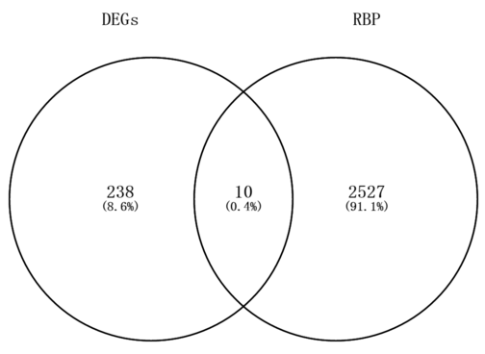
Significant peaks
#num: 20,871 peaks
Hmgcll1
Slc15a2
Dtna
Cgnl1
Leprel1
Lpar1
Reln
Hs3st3a1
Phospho1
Col4a4
Gene_Type | GeneSymbol | GeneName | GFOLD(0.01) | E-FDR | log2fdc
snRNA | ENSMUSG00000065308.1 | U1 | 1.21657 | 1 | 4.20552
snRNA | ENSMUSG00000065773.1 | U1 | 2.29663 | 1 | 5.15971
snRNA | ENSMUSG00000075943.1 | U1 | 1.86989 | 1 | 3.52745
snRNA | ENSMUSG00000075978.1 | U1 | 1.41556 | 1 | 3.37544
Notes:
一共有251个差异表达的基因（以GeneSymbol为标准统计，有251个；如果以GeneName为单位统计，那么有248个），2537个PTBP3结合的基因，它们的交集有10个

Slide 14
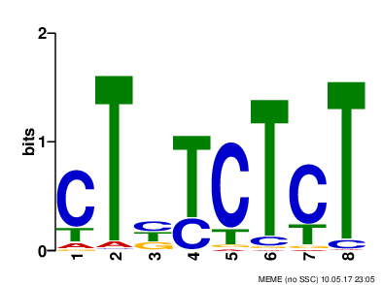
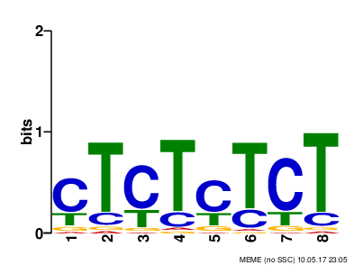
Significant motifs
P = 1.8e-1355
P = 2.4e-690
Notes:
MEME

Slide 15
RNA-map(PTBP3 CLIP-seq from spleen)
Notes:
Bf>5

Slide 16
RNA-map(PTBP3 CLIP-seq from spleen)
Notes:
Bf>10

Slide 17
RNA-map(PTBP3 CLIP-seq from spleen)
Notes:
Bf>100

Slide 18
RNA-map(PTBP3 CLIP-seq from bone marrow)
Notes:
Bf>5

Slide 19
RNA-map(PTBP3 CLIP-seq from bone marrow)
Notes:
Bf>5
rmdup

Slide 20
RNA-map(PTBP3 CLIP-seq from bone marrow)
Notes:
Bf>10

Slide 21
RNA-map(PTBP3 CLIP-seq from bone marrow)
Notes:
Bf>10
rmdup

Slide 22
Thanks for your attention!

